Slide 1
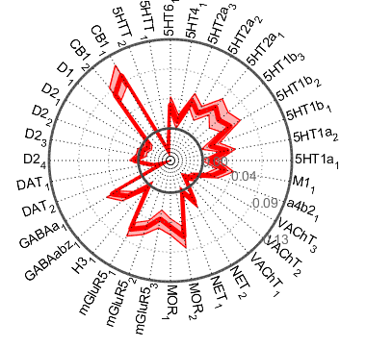
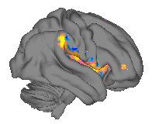
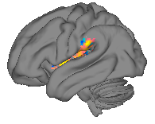
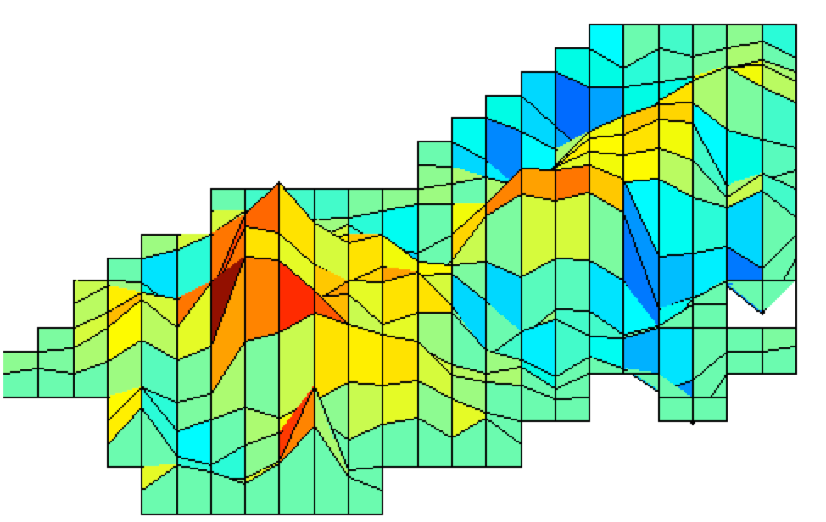
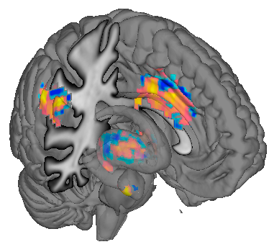
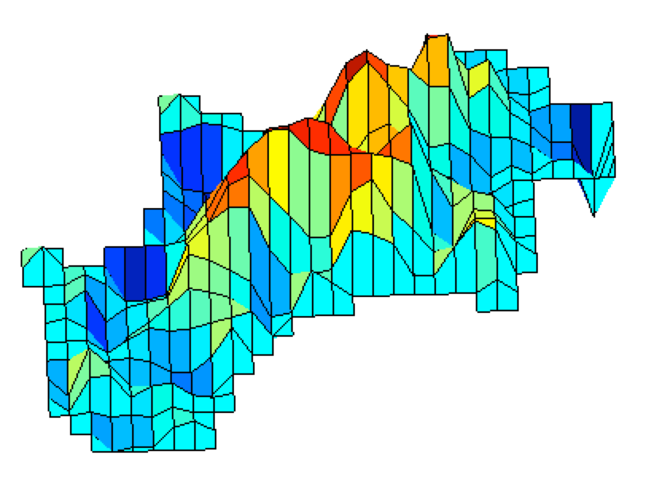
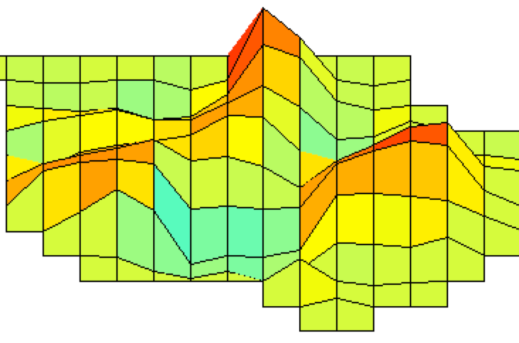
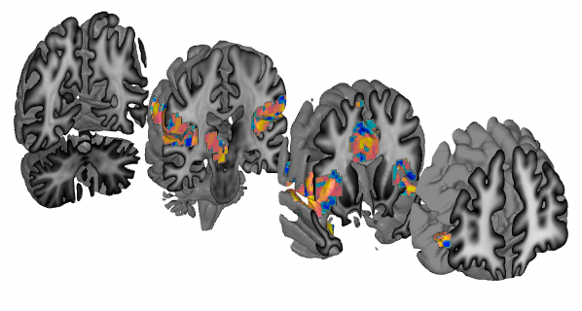
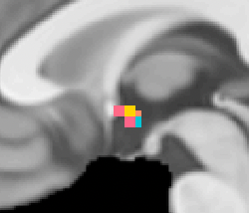
Multiple systems-level measures (neuromarkers)
Neurologic Pain Signature
TPJ
am-insula, dp-insula
SII
md-thalamus
vl-thalamus
Anterior midcingulate (aMCC)
bl-amygdala
hypothalamus
STN, VTA, RN, ZI
a-PFC
Cannabinoid: CB1
Serotonin: 5HT
Acetylcholine: α4β2, M1, VAChT
Norepinephrine: NET
Opioid: MOR
Glutamate: mGluR5
Histamine: H3
GABA: GABAa, GABAbZ
Dopamine: D1, D2, D3, DAT
Wager et al. 2013, NEJM
npspos
Notes:
Canlab_help_examples Github repo
NPS_SIIPS_surface_figures_2025.mlx
New_NPS_SIIPS_surface_figures.m
% NPS Pos
[imgs, names] = load_image_set('npsplus');
obj = get_wh_image(imgs, 2);
show_surfaces(obj)
create_figure('wedges');
%stats = image_similarity_plot(obj, 'cosine_similarity', 'bucknerlab_wholebrain', 'plotstyle', 'polar');
stats = image_similarity_plot(obj, 'cosine_similarity', 'bucknerlab_wholebrain', 'colors', {[1 .7 0] [.3 0 .7]}, 'bicolor');
create_figure('neurotransmitters')
stats = image_similarity_plot(obj, 'cosine_similarity', 'mapset', 'receptorbinding', 'colors', {[1 .7 0] [.3 0 .7]}, 'bicolor', 'plotstyle', 'polar', 'dofixrange', [-0.5 0.5]);
% Table
atl = load_atlas('canlab2024');
[region_obj, results_table] = table(obj, 'subdivide', 'atlas_obj', atl);
pag = region_obj(strcmp({region_obj.shorttitle}, 'BStem_PAG'))
thal = region_obj(contains({region_obj.shorttitle}, 'Thal'))
%%
% [imgs, names] = load_image_set('siips');
% obj = get_wh_image(imgs, 1);
obj = fmri_data(which('nonnoc_v11_4_subcluster_maps_fdr05_pattern_wttest.nii'))
show_surfaces(obj)
create_figure('wedges');
%stats = image_similarity_plot(obj, 'cosine_similarity', 'bucknerlab_wholebrain', 'plotstyle', 'polar');
stats = image_similarity_plot(obj, 'cosine_similarity', 'bucknerlab_wholebrain', 'colors', {[1 .7 0] [.3 0 .7]}, 'bicolor');
create_figure('neurotransmitters')
stats = image_similarity_plot(obj, 'cosine_similarity', 'mapset', 'receptorbinding', 'colors', {[1 .7 0] [.3 0 .7]}, 'bicolor', 'plotstyle', 'polar', 'dofixrange', [-0.5 0.5]);
atl = load_atlas('canlab2024');
[region_obj, results_table] = table(obj, 'subdivide', 'atlas_obj', atl);
pag = region_obj(strcmp({region_obj.shorttitle}, 'BStem_PAG'))
hy = region_obj(contains({region_obj.shorttitle}, 'hypothalamus'))
%%
function show_surfaces(obj)
d = descriptives(obj);
cmaprange = [d.prctile_vals(d.prctiles == 5) d.prctile_vals(d.prctiles == 95)]; % 5 and 95%
create_figure('surf');
h = surface(obj, 'cmaprange', cmaprange);
f = create_figure('slabs');
h = surface(obj, 'cmaprange', cmaprange, 'coronal_slabs_4');
% Make axes invisible
hh = findobj(gcf, 'Type', 'Axes');
set(hh, 'Visible', 'off')
% remove colorbars
hh = findobj(gcf, 'Type', 'Colorbar')
set(hh, 'Visible', 'off')
f = create_figure('4surf');
h = surface(obj, 'cmaprange', cmaprange, 'foursurfaces_hcp');
% remove colorbars
hh = findobj(gcf, 'Type', 'Colorbar')
set(hh, 'Visible', 'off')
end

Slide 2
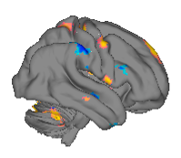
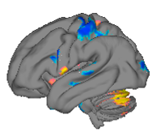
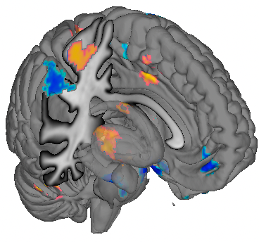
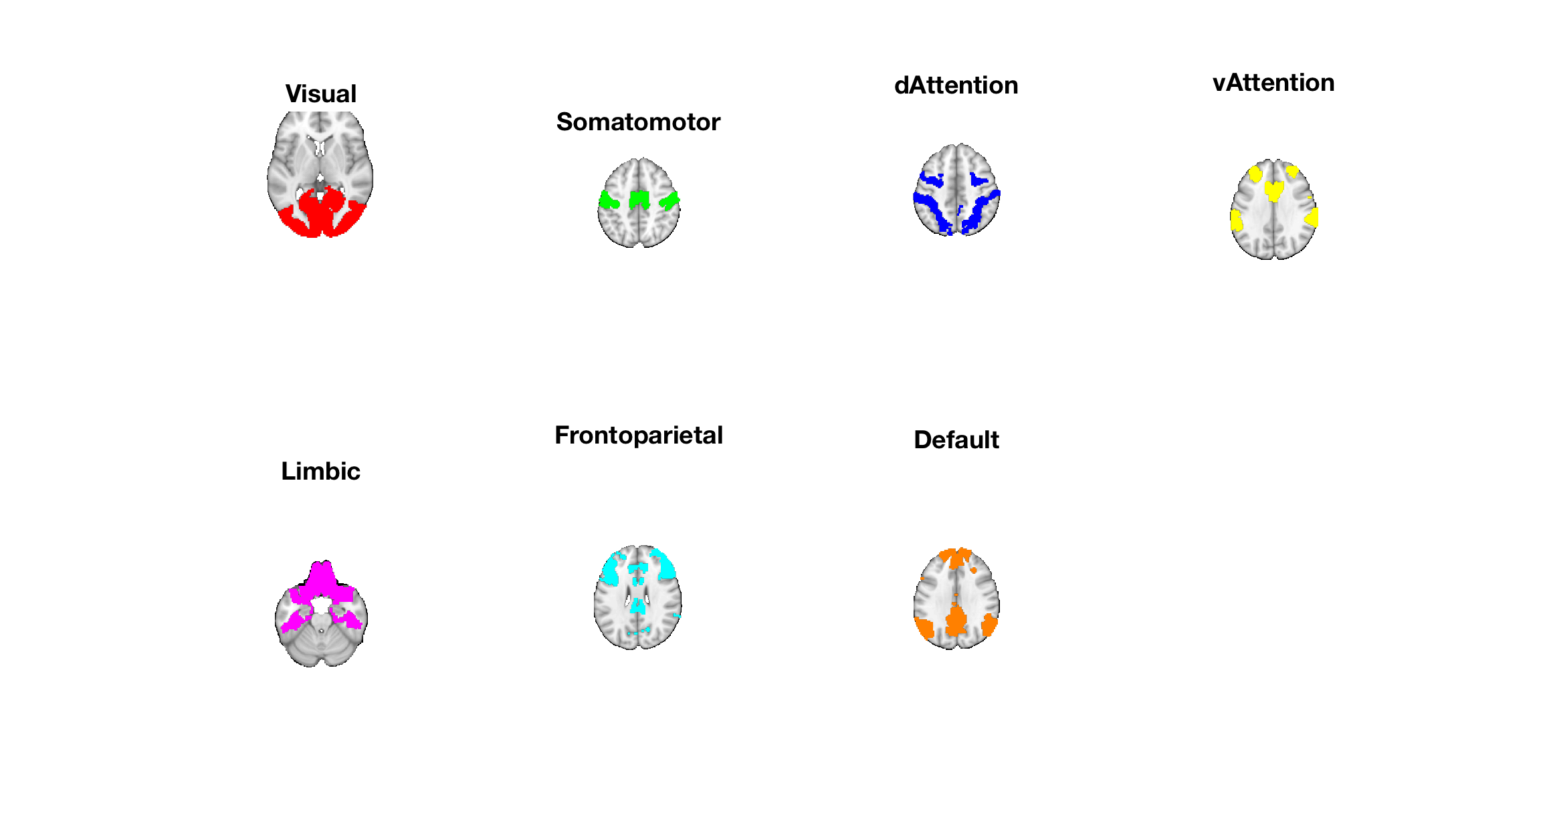
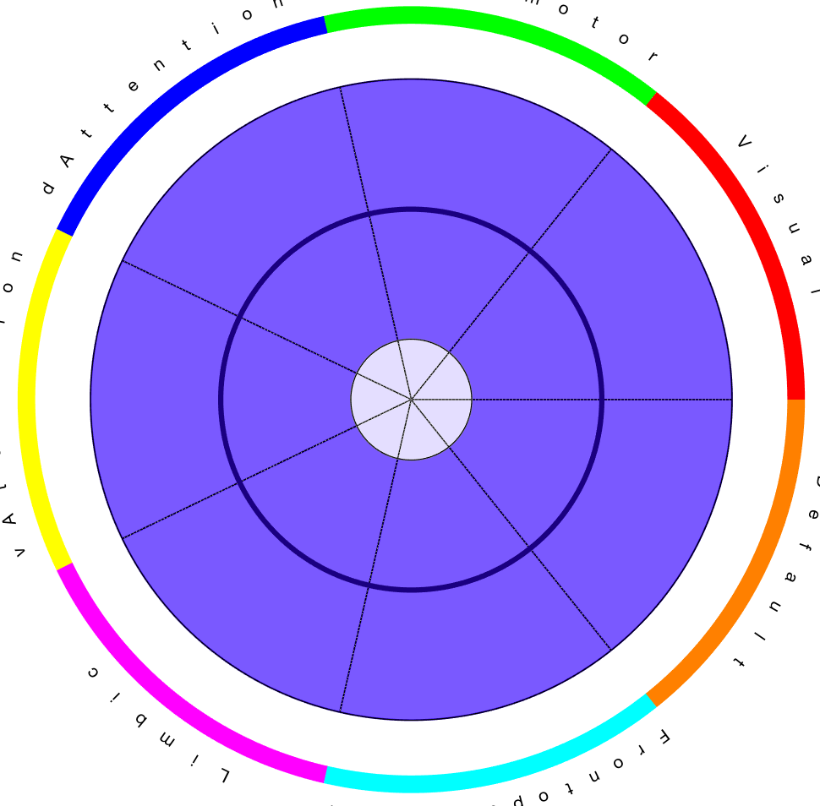
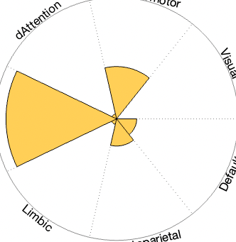
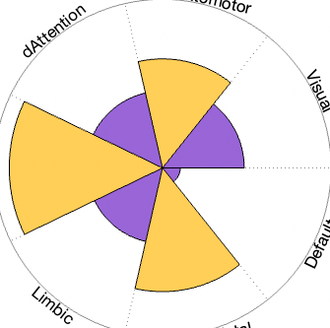
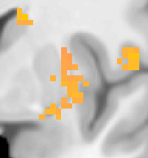
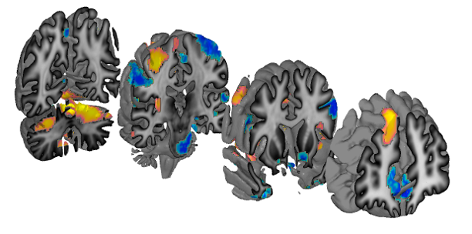
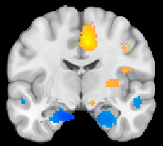
Multiple systems-level measures (neuromarkers)
Neurologic Pain Signature
Stimulus Intensity-Independent Pain Signature
dmPFC
S1
M1
A dynamic process
Geuter
NPS
SIIPS
- Multiple systems
da-insula
dAttn
dAttn
SMN
SMN
pMCC
vAttn
CBLM
vAttn
Vis
p-striatum
claustrum
Vis
Limbic
Limbic
vmPFC
FPN
DMN
FPN
DMN
hipp
npspos
pons
TP
nAC
SIIPS-1, FDR q < 0.05
Wager et al. 2013, NEJM
Notes:
obj = fmri_data(which('nonnoc_v11_4_subcluster_maps_fdr05_pattern_wttest.nii'))
show_surfaces(obj)
create_figure('wedges');
%stats = image_similarity_plot(obj, 'cosine_similarity', 'bucknerlab_wholebrain', 'plotstyle', 'polar');
stats = image_similarity_plot(obj, 'cosine_similarity', 'bucknerlab_wholebrain', 'colors', {[1 .7 0] [.3 0 .7]}, 'bicolor');
create_figure('neurotransmitters')
stats = image_similarity_plot(obj, 'cosine_similarity', 'mapset', 'receptorbinding', 'colors', {[1 .7 0] [.3 0 .7]}, 'bicolor', 'plotstyle', 'polar', 'dofixrange', [-0.5 0.5]);
atl = load_atlas('canlab2024');
[region_obj, results_table] = table(obj, 'subdivide', 'atlas_obj', atl);
pag = region_obj(strcmp({region_obj.shorttitle}, 'BStem_PAG'))
hy = region_obj(contains({region_obj.shorttitle}, 'hypothalamus'))

Slide 3
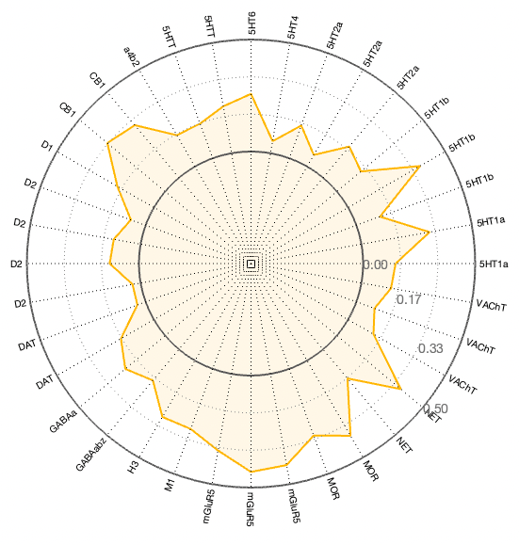
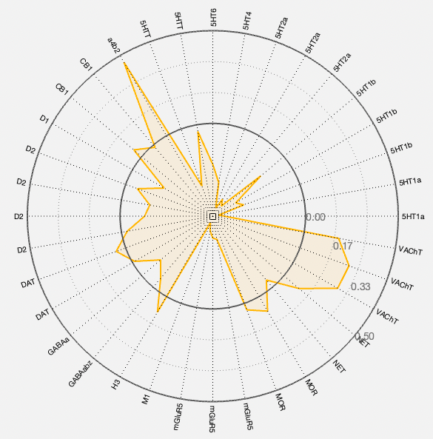
NPS and SIIPS: Different neurochemical profiles

