Slide 1
Code maps
repodir on Github = '/projects/joas2631/Repositories/OLP4CBP';

Slide 2
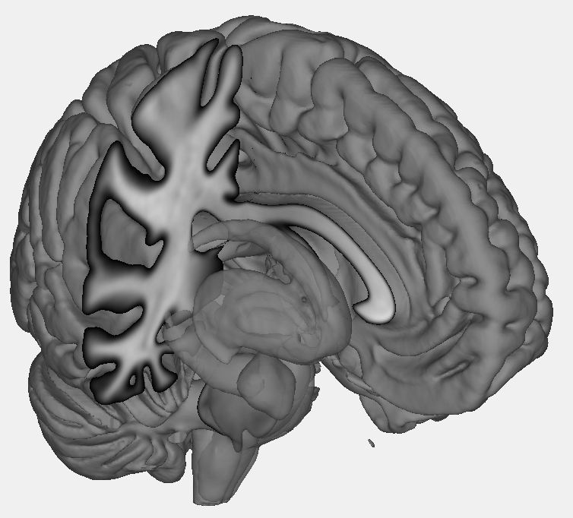
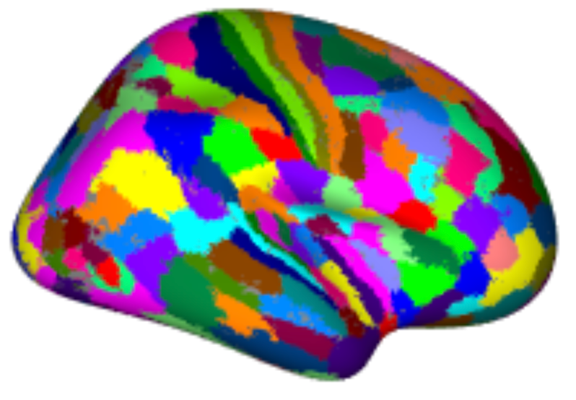
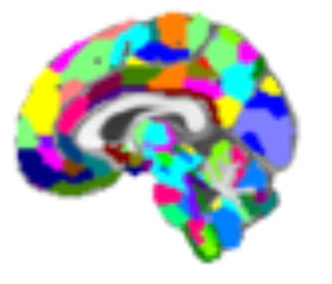
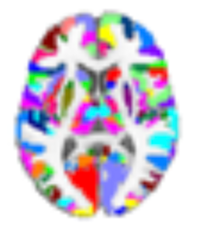
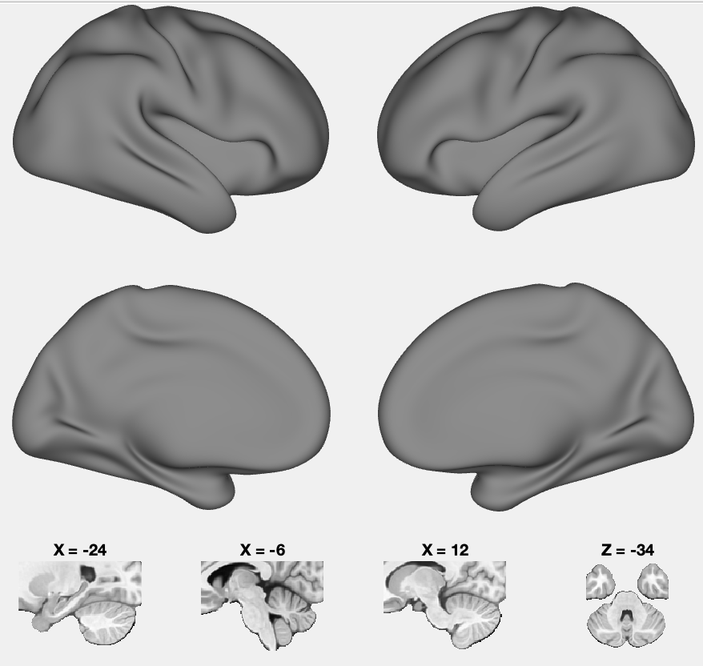
CANlab tools: Surface rendering
This code map shows some of the internal functions and organization
Functions are designed for multiple entry points, allowing flexibility
Use:
Optional inputs control the flow through the system, including keywords that create surfaces
Many options are passed through to lower-level functions
Graphics objects in Matlab return handles that can be used to manipulate objects
Call object methods by passing in an object. E.g., for Image_vector.surface, pass in an fmri_data or other child of the image_vector class
Object types:
fmri_data
statistic_image
atlas
Object types:
fmri_data
statistic_image
Object types:
atlas
Use:
Use canlab_results_fmridisplay to create a ”scene” with multiple surfaces/montages. The fmridisplay object (e.g., “o2” in code help”) contains handles to surfaces that can be passed to other functions, e.g., addblobs( ) or surface( ).
Image_vector.surface
Image_vector.montage
atlas.montage
region.surface
region.montage
canlab_results_fmridisplay
handles
handles
addbrain
fmridisplay
Object types:
fmridisplay
Image_vector.
render_on_surface
fmridisplay.addblobs
render_blobs
fmridisplay.montage
fmridisplay.surface
Legend
handles
addbrain
Custom scripts
Object types:
fmridisplay
Canlab Core functions
handles
Key variables
Files

Slide 3
Effect size estimation pathway
Estimate unbiased ‘brain decoding’ effect sizes for a set of contrasts
Use:
Evaluate/benchmark a dataset or analysis pathway using two-alternative-forced-choice SVM classification to decode conditions from brain activity in new individual participants
specif_contrasts
brainomics_build_design_matrix.m
specif_model
onsets2fmridesign
X
Image data:
preprocessed_fMRI_bold.nii.gz
brainomics_1st_level_analysis
brainomics_reload_objects
condition_data_objects
Brainomics_condition_objects.mat
Legend
HTML Report Generation
brainomics_publish_svm_effect_size
Custom scripts
X
brainnomics_run_paired_SVM.m
canlab_run_paired_SVM
brainomics_reload_objects
Canlab Core functions
Key variables
brainnomics_run_paired_SVM.m
EFFECT_SIZES_SVM.mat
Analysis performance metrics:
SVM classification effect size (d)
Files
HTML Report saved in results/

Slide 4
Preprocessing/denoising for connectivity
Takes in preprocessed BIDS-format images from fMRIprep and saves .mat files with a brainpathway_multisubject object cleaned data
Loop through Ps
Atlas: canlab2018_2mm
Image data:
denoise_image_sponpain
4-D.nii.gz files for each P.
create_brainpathways_objects_with_sponpain_tabl.m
resample_space
datadir = '/pl/active/ics/data/projects/wagerlab/labdata/data/OLP4CBP/Imaging/preprocessed/fmriprep';
bs.add_subject
bs (brainpathway_multisubject object)
b.voxel_dat = dat_rs.dat
Custom info hard-coded
ndummies = 15;
TR = .46;
smoothing_kernel = 6;
fl_dir = '/pl/active/ics/data/projects/wagerlab/labdata/projects/OLP4CBP/first_level'; % to find spon pain task model
preprocdir = '/pl/active/ics/data/projects/wagerlab/labdata/data/OLP4CBP/Imaging/preprocessed/fmriprep/'; % to find fmriprep confounds file
get_subject_metadata_from_fnames
Custom info
brainpathway_data_gsr_censoring_pipeline_nosmoothing.mat
bs
fmri_data
dat
Single-P 4D dataset
Legend
onsets2fmridesign
model_reg
Task regressors (covariates here,
Special for this sponpain task)
make_nuisance_covs_from_fmriprep_output3
Custom scripts
'*task-sponpain*confounds*.tsv'
dat.covariates
Spike/motion/global nuisance
covariates added to data
Canlab Core functions
GSR flag
preprocess(dat, 'smooth’…)
dat
Single-P fMRI data obj with covs
Key variables
smoothing flag
Files
canlab_connectivity_preproc(dat, 'bpf', [.01 .1]…)
Band-pass and remove covs in one step
***individual subject 4-D cleaned data files with covs).mat
dat

Slide 5
SVM node-level graph metric pipeline
publish_predict_SVM_on_brainpathway_graph_properties
HDI_results_0.4.mat
Series of models with different samples and outcomes
Set up sample and variables
predict_SVM_on_brainpathway_graph_prop_model1
predict_SVM_on_brainpathway_graph_prop_model2
predict_SVM_on_brainpathway_graph_prop_model3
… etc ...
brainpathways object (bs)
predict_SVM_on_brainpathway_graph_prop_plugin1...2…3
6 node-wise graph metrics stored in bs
Extracted with Sporns BCT toolbox
Tested one at a time as predictor set:
k
1. 10-fold CV prediction
xval_SVM
2. CV prediction with case-wise normalized observations (X)
'community'
'core_w'
'degree'
'betweenness_bin'
'clustercoef_bin'
'local_efficiency_bin'
HTML reports for each model
3. CV prediction with optimized hyperparameters
predict_SVM_on_brainpathway_graph_prop_model1_...
… etc. …
cSVM_summary_table
Legend
cSVM_stats
Custom scripts
cSVM_model1_stats.mat
Canlab Core functions
cSVM_model2_stats.mat
Key variables
…etc…
Files
OLP Github functions

Slide 6
SVM pipeline
fmri_data.predict() is an interactive tool which runs several algorithms (SVM, SVR, lass—PCR, elastic net) with multiple options.
Xval_SVM_pipeline is more suited towards pipelines that test various aspects in a sequence.
Atlas: canlab2018_2mm
xval_SVM
Image data:
K-fold xval
Nested xval
Bootstrapping
Permutation
4-D.nii.gz files for each P.
fmri_data
Activation features
Within/between error, single-interval/forced-choice
Best hyperparameters
Model weights with P-values
Test for bias
Overall model P-values
k
Network loadings
Neurosynth sim
Necessary and sufficient networks
Model discrim validity
Atlas: canlab2018_2mm
brainpathway_multisubject
xval_SVM
Viz features
Image data:
Pairwise connectivity features
4-D.nii.gz files for each P.
Graph metric features
Needed improvements in predict:
Add Matlab algos, replace Spider as default
Blocked holdout sets
Feature selection in nested cross-val
Return model object
Within/between error/accuracy
Legend
Other needed improvements
Harmonize codes for within/between error
Harmonize codes for xval train/test selection
Harmonize codes for blocked bootstrapping
Create module for testing nuisance cov relationships - mvmediation
Create module (?) for series of interpretation tests: Networks, structure coeffs, neurosynth
Output metric for model stability: ICC
Custom scripts
Needed improvements in xval_SVM:
update to handle only between-person error case
Return training-set model weights, for application to new observations.
Feature selection in nested cross-val
Permutation
Either expand to include SVR for regression, or create new SVR fcn
Return model object instead of structure
Test for confounds, global signal relationships
Test structure coeffs?
Canlab Core functions
Key variables
Files

Slide 7
make_nuisance_covs_from_fmriprep_output3
% 1) spikes for framewise displacement > .25mm. Note that Head Motion Parameter Estimates (HMPs) are filtered
% according to Power 2019 and back-computed to ~2 seconds back, vs. 1 frame back
% 2) spikes for DVARS z-score > 3
% 3) spikes for the n volumes following the volumes identified in #1 and #2 above. n = spike_additional_vols
% about 2 sec worth is recommended.
% 4) 24 motion covs (based on unfiltered HMPs): HMPs, diff(HMPs), squared HMPs, squared diffs
% 5) fmriprep global CSF
% 6) fmriprep global Global Signal (not always used in CANlab)
Current choices:
n = 4 frames following spikes removed
GSR = yes
Smoothing = no

Slide 8
Extras / Template

