Slide 1
HRF
HRF matrix
modelSaturation
getSmoothing
canonical_autocorrelation, getV
spm_hrf
convmtx
Nonlinearity model
Smoothing matrix
ACF matrix
Design matrix
Model matrix
Efficiency
Onset times
efficiency
calcEfficiency
getPredictors
efficiency,
onsets2efficiency
onsets2delta
onsets2delta
Delta function
xpower
Cond function
designvector2model
Power
spm_efficiency
SPM design
Deconvolution design matrix
GA2 paramvec
tor_make_deconv_mtx3
Plots
plotDesign
rt2delta
Onset times
and RTs
xpower.m
Attention
Language, etc.
Input: Heat
Input: Task instructions

Slide 2
Genetic Algorithm Toolbox for fMRI - Partial Function Flowchart
HRF
HRF matrix
modelSaturation
getSmoothing
canonical_autocorrelation, getV
spm_hrf
convmtx
Nonlinearity model
Smoothing matrix
ACF matrix
Design matrix
Model matrix
Efficiency
Onset times
efficiency
calcEfficiency
getPredictors
efficiency,
onsets2efficiency
onsets2delta
onsets2delta
Delta function
xpower
Cond function
designvector2model
Power
xzpower
spm_efficiency
SPM design
Deconvolution design matrix
GA2 paramvec
tor_make_deconv_mtx3
rt2delta
Onset times
and RTs

Slide 3
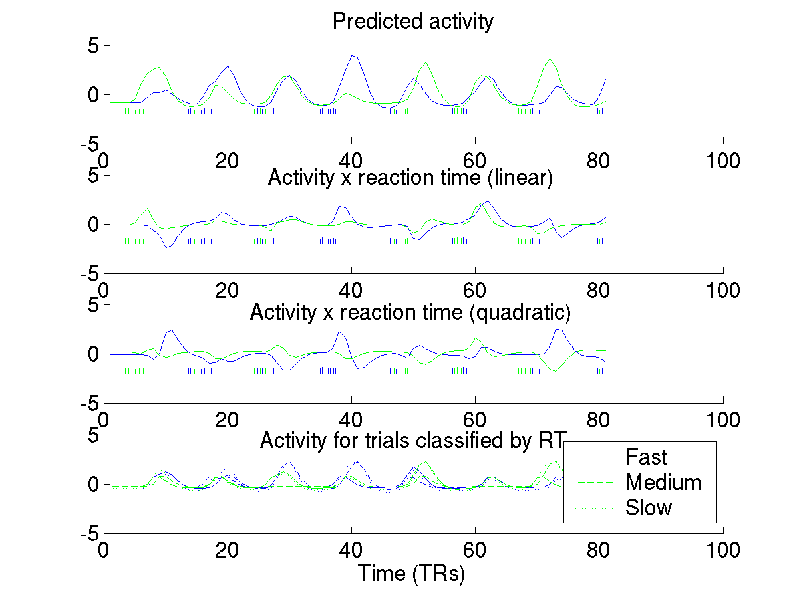
Adding reaction time effects to the design matrix

Slide 4
Building designs
Onset times
getPredictors
onsets2delta
Delta function
Cond function
getPredictorsOddEven
designvector2model

