Slide 1
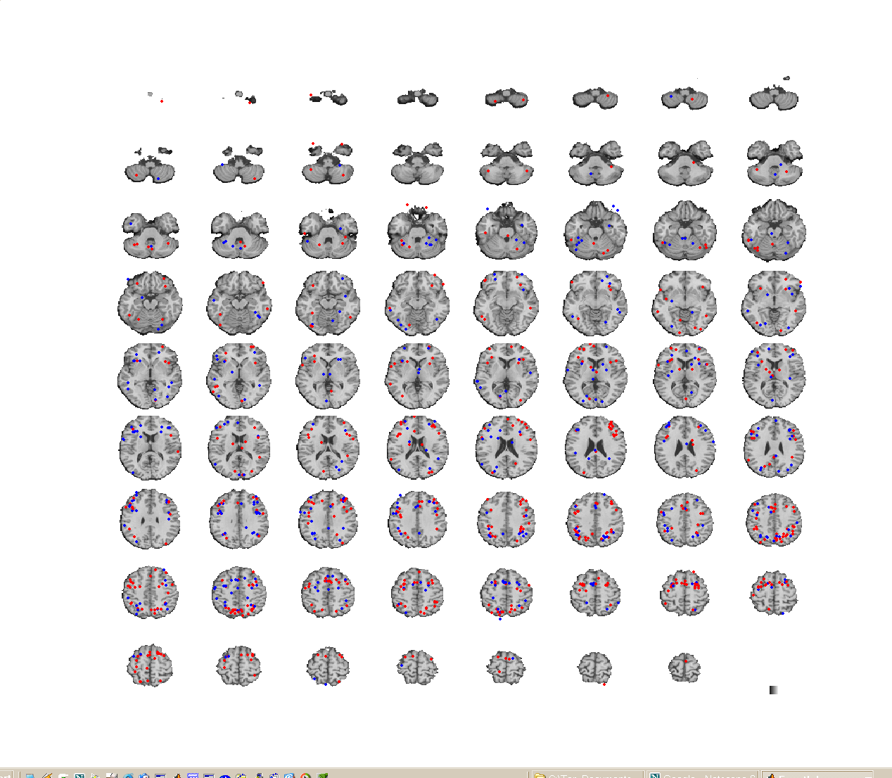
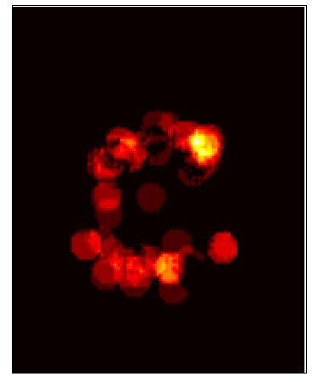
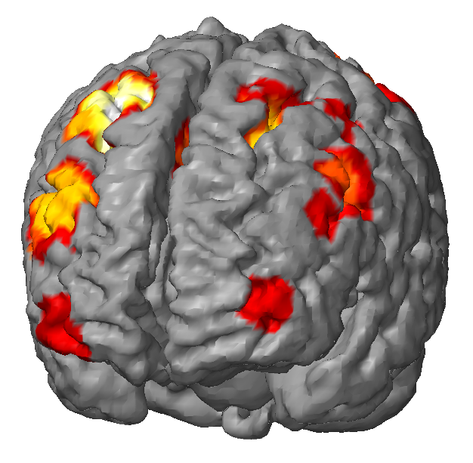
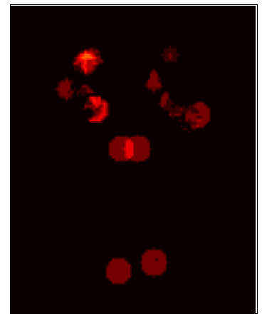
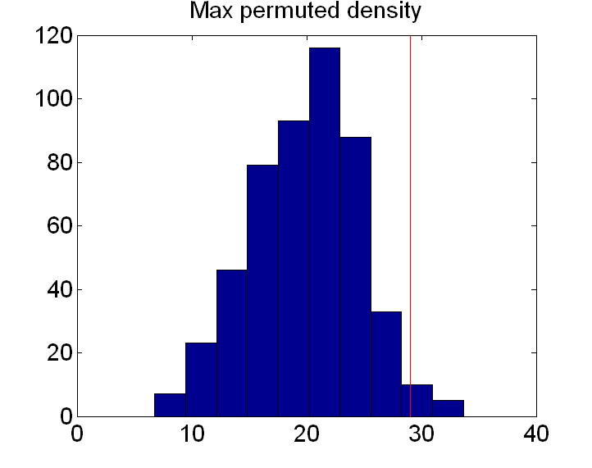
Density analysis methods
k
(Stor + Exec)
- Stor
Permuted
locations

Slide 2
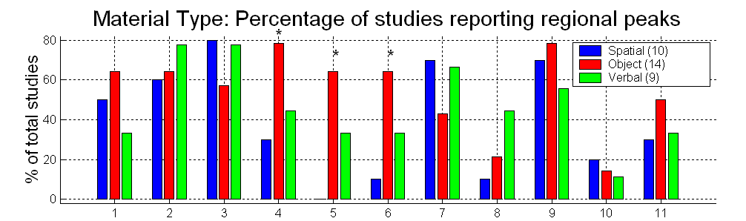
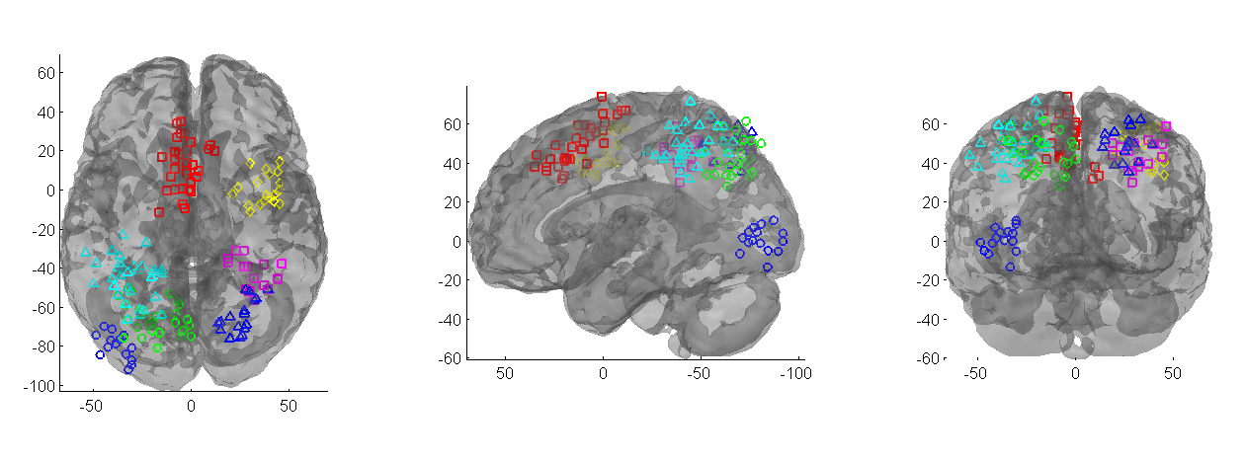
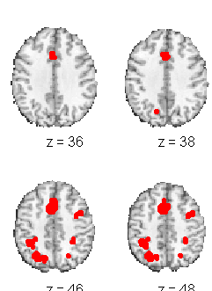
Meta-analysis flowchart
Monte Carlo overlap between sets of clusters
database2clusters
Excel database
cluster_overlap_npm
read_database
cluster_chi2
Chi-square analysis
Variables in workspace
Clusters
With meta- analysis peaks
density_choose_radius
Multiple correspondence analysis
db_cluster_burt_table
tor_mca
Choice of radius (r)
Density img
cluster_manova
Manova
density_pdf
db_cluster_table
make_figure_into_orthviews.m
density_diff_pdf
dbcluster_glass_plot
i_density,i_density_pdf
cluster_surf
Thresholded density img
Clusters
mask2clusters
montage_clusters
plot_dens_results
Hypothesis testing on cluster solution:
fuzzy_conf_cluster.m
density_image

Slide 3
Meta-analysis flowchart c (finding studies that have activated around a specified point)
Monte Carlo overlap between sets of clusters
cluster_overlap_npm
cluster_chi2
Chi-square analysis
meta_analysis_master_file.mat
meta_analysis_table
Multiple correspondence analysis
cl = database_point_probe
dbcluster_point_table(cl)
db_cluster_burt_table
tor_mca
Clusters with meta-peaks
And table
cluster_manova
Manova
db_cluster_table
make_figure_into_orthviews.m
dbcluster_glass_plot
cluster_surf
montage_clusters
Hypothesis testing on cluster solution:
fuzzy_conf_cluster.m

Slide 4
Meta-analysis flowchart d (whole brain contrast)
dbcontrast2density
Get_contrast_indicator
Create new images for each contrast,
Or load info about existing images from mat file
dbcluster2indic
Count frequencies, make indicator
Matrix for task conditions
threshold_pa_overall
Monte carlo test that gives uncorrected p-values for p(a), thresholded using FDR; returns clusters
Can input test field for p(a|task) as well as overall
Whole_brain_ptask_givena
For whole brain, makes maps of task-specificity given activation in each region
p_task_given_activation
Estimates and inference on information provided about the task

Slide 5
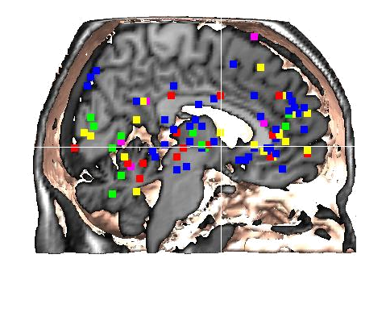

Slide 6
Density regions are useful for…
Consensus ROIs for future studies
Defining ROIs for meta-analysis
  Testing for selectivity and spatial gradients across task types
Comparing locations of regions across domains
Directly comparing similarities of tasks

