Slide 1
Simulations for optimizing STOP-SIGNAL task for abcd
Tor Wager, 8/31/2016

Slide 2
Sim 1: Parameters (these defaults are embedded in generate_stop_signal_design.m)
% Fixed Design Parameters
% ----------------------------------
event1duration = 1; % duration of cue
trialtypes = 2; % stop, go
trialspertype = [150 30]; % for one run; 300 go, 60 stop total
% All ISI times in sec.
isidistribution = 'exponential'; % 'exponential' or 'geometric’
ISImin = .700; % Constraints: Psychological (can subjects process cue) and statistical (longer = less BOLD nonlinearity, which is difficult to model).
ISImean = 1.1; % For 'exponential' only. Includes ISImin. There is an optimal empirical value -- longer is better for deconvolution/FIR, but we also need to fit within total scan time constraints.
ISIstep = .1; % For 'geometric' only. There is an optimal empirical value -- longer is better for deconvolution/FIR, but we also need to fit within total scan time constraints.
ISImax = 2; % Truncate to avoid VERY long ISIs
allow_repeats = [1 0]; % Repeats ok for each trial type? 1=go=yes, 2=stop=no
% Assumptions about TR and scanning params
% Used in plotting and design construction: Will downsample to TR
TR = 2;

Slide 3
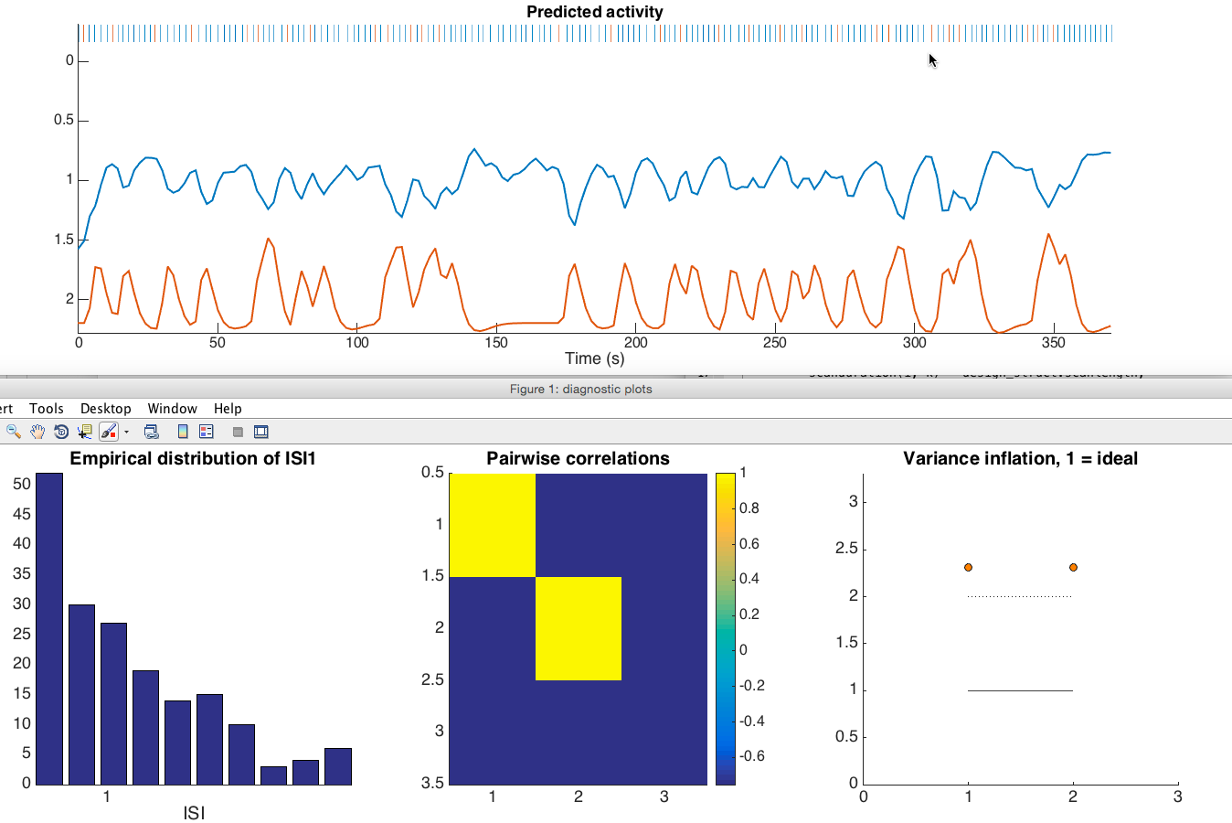
Sample random design
VIFs of 2 = moderate problems, per run
VIFs of 5 = severe problems
This is for standard HRF; deconvolution will be worse
Go (blue) and Stop (red) are negatively correlated.
This is due to the rapid design. Stop – Go should be efficient.
Stop as a function of performance (correct, error) should be OK

Slide 4
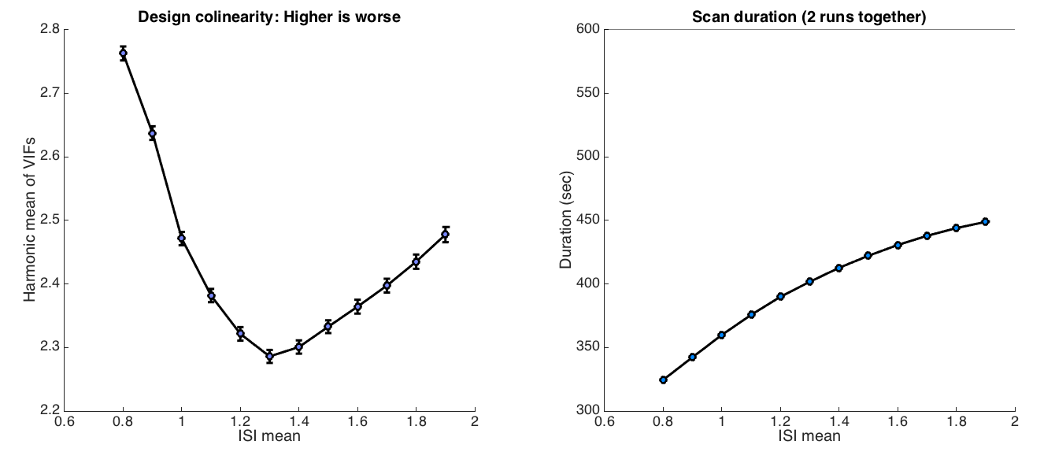
Simulation 1: Effects of mean ISI
If we can use a mean ISI of 1.1 sec, that will improve the ability to estimate responses to both Go and Stop trials. This will add about 25 sec to the run length, but may be worth it if we can afford to do that.
Scan duration (1 run)
Previous choice, 0.9 sec
Better overall, 1.1 sec
1.1 sec adds about 20 sec to the run length

Slide 5
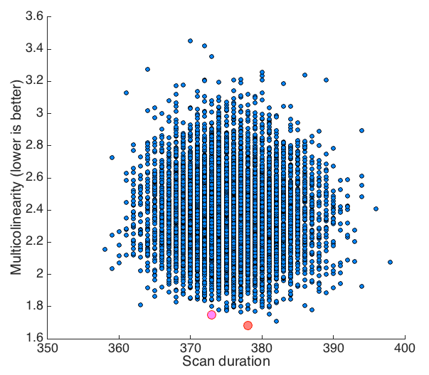
Sim 2: Optimizing realized design
10,000 designs plotted by scan duration and quality (y-axis, lower is better). Quality is harmonic mean of VIF. Best design is in red, and best design under 375 secs (1 runs) is in pink.

Slide 6
Sample designs: Best of 10,000
Event1 onset | Trial type | ISI1 | Event1Dur
0 | 1 | 1.1223 | 1
2.1223 | 1 | 0.73 | 1
3.8524 | 2 | 1.2261 | 1
6.0784 | 1 | 1.1715 | 1
8.2499 | 1 | 0.8407 | 1
10.0907 | 1 | 0.8432 | 1
11.9339 | 2 | 0.8907 | 1
13.8246 | 1 | 0.8162 | 1
15.6408 | 1 | 0.7364 | 1
Time (sec) | 1 = GO
 | 2 = STOP
- It takes about 1 min of computer time to search 10,000 designs currently
- Lists can be saved in this format and imported into E-Prime to generate custom onsets for different versions

