Slide 1
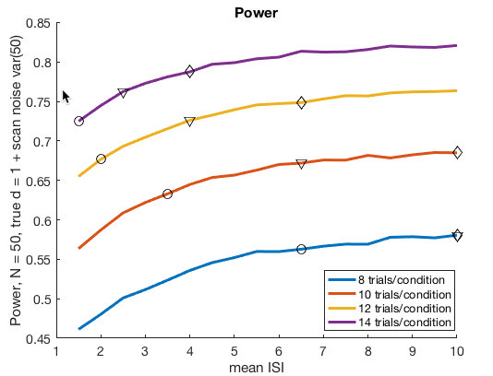
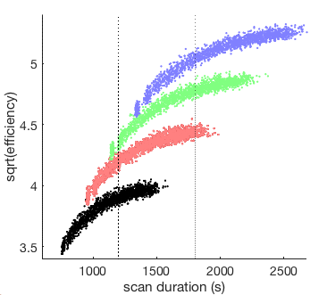
Trial design
25 min task, 4 sec mean ISI, 12 trials x 6 trial types = 72 trials
2 runs x 12.5 min / run with 36 trials, 6 per cell with 2 (body site) x 3 (stim type) cells
Or 3 runs x 8:20 each, each with 12 trials x 2 body sites in one modality.
Notes:
Wager_PainDesign_sim1.m
Github: FMRI_simulations repo, design_optimization/Wager_Pain_Design1
Uses generate_jittered_er_design_pain_plus_rating
Efficiency2power (alpha version!!!)
Reference effects:
% reference effects hard-coded in efficiency2power:
% b_mean = 1; % true effect
% var_g = 1; % group variance; individual differences
% s2 = 50; % scan-to-scan noise variance
% N = 50; % sample size
% alpha = 0.001; % alpha value

Slide 2
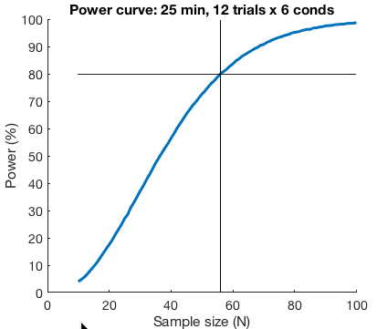
Power curve
Notes:
Wager_PainDesign_sim1.m
Github: FMRI_simulations repo, design_optimization/Wager_Pain_Design1

