Slide 1
Simulations for optimizing mid task for abcd
Tor Wager, 12/18/15

Slide 2
Sim 1: Parameters (these defaults are embedded in generate_jittered_er_design.m)
% Fixed Design Parameters
% ----------------------------------
% we want to get 10 trials/condition in 5 mins -
% so, 20 trials/condition total across 2 5-min runs
event1duration = 2; % duration of cue
event2duration = 2; % duration of feedback
trialtypes = 5; % neutral, 2 levels of loss, 2 levels of gain
trialspertype = 20;
ISI2isconstant = 1; % ITI is constant (as opposed to jittered).
ISI2constantvalue = 0; % in seconds, used only if ISI2isconstant
% All ISI times in sec.
isidistribution = 'exponential'; % 'exponential' or 'geometric'
ISImin = 1.5; % Constraints: Psychological (can subjects process cue) and statistical (longer = less BOLD nonlinearity, which is difficult to model).
ISImean = 2; % For 'exponential' only. Includes ISImin. There is an optimal empirical value -- longer is better for deconvolution/FIR, but we also need to fit within total scan time constraints.
ISImax = 6; % Truncate to avoid VERY long ISIs
% Assumptions about TR and scanning params
% Used in plotting and design construction: Will downsample to TR
TR = 2;

Slide 3
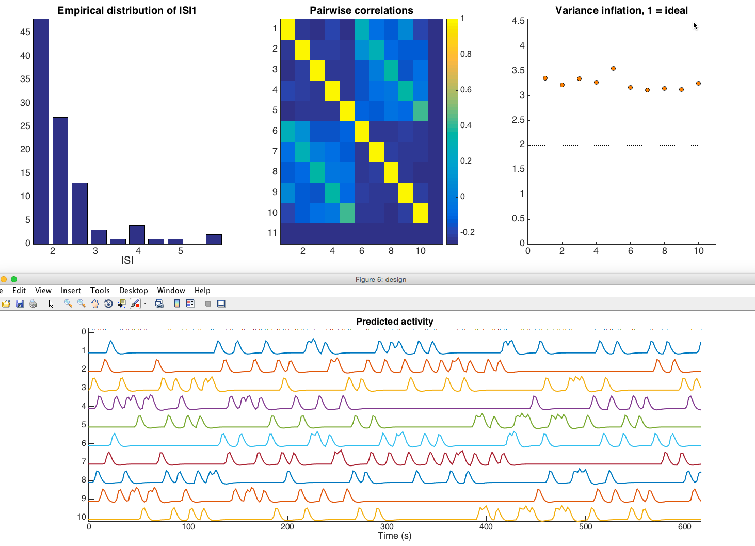
Sample design
VIFs of 2 = moderate problems, per run
VIFs of 5 = severe problems
This is for standard HRF; deconvolution will be worse
Cue
Feedback
Cue
Feedback

Slide 4
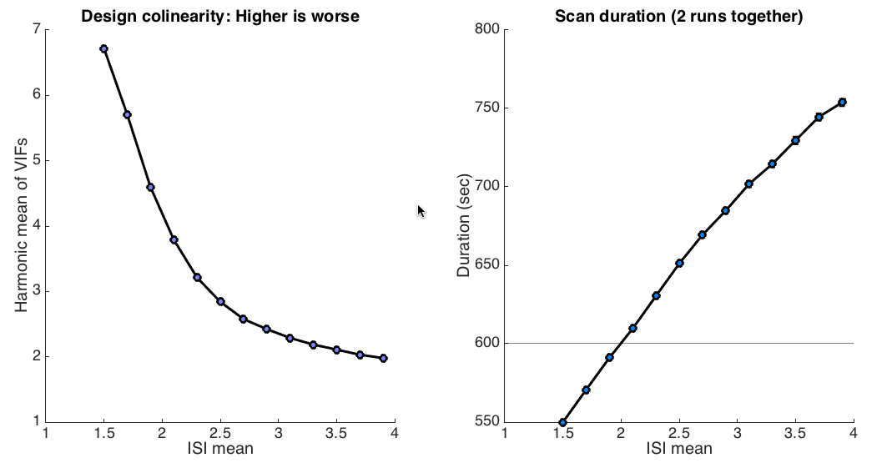
Simulation 1: Effects of mean ISI
A design of 600 sec total (across two 5-min runs) is on the steep part of the colinearity curve. Even 30 secs per run longer would help a lot, and 1 min extra per run would help a whole lot.

Slide 5
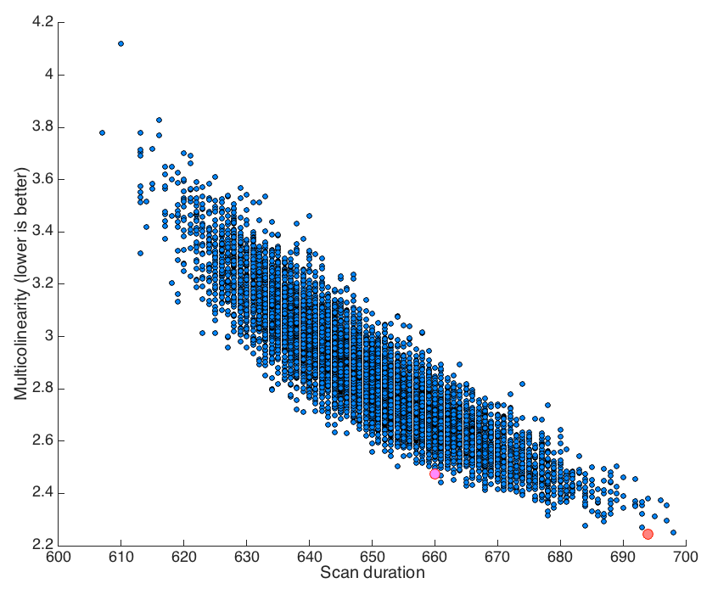
Sim 2: Optimizing realized design
10,000 designs plotted by scan duration and quality (y-axis, lower is better). Quality is harmonic mean of VIF. Best design is in red, and best design under 660 secs total (2 runs) is in pink.

Slide 6
Sample designs: Best of 10,000
Event1 onset | Event2 onset | Trial type | ISI1 | ITI | Event1Dur | Event2Dur
0 | 4.9269 | 1 | 2.9269 | 0 | 2 | 2
6.9269 | 11.0609 | 5 | 2.1341 | 0 | 2 | 2
13.0609 | 16.5928 | 4 | 1.5319 | 0 | 2 | 2
18.5928 | 23.9464 | 5 | 3.3536 | 0 | 2 | 2
25.9464 | 33.6026 | 2 | 5.6562 | 0 | 2 | 2
35.6026 | 39.499 | 5 | 1.8964 | 0 | 2 | 2
41.499 | 47.2726 | 2 | 3.7735 | 0 | 2 | 2
49.2726 | 55.7174 | 1 | 4.4449 | 0 | 2 | 2
57.7174 | 61.7915 | 3 | 2.0741 | 0 | 2 | 2
63.7915 | 67.6898 | 4 | 1.8983 | 0 | 2 | 2
69.6898 | 75.8086 | 3 | 4.1188 | 0 | 2 | 2
77.8086 | 81.3784 | 4 | 1.5699 | 0 | 2 | 2
83.3784 | 87.3158 | 4 | 1.9374 | 0 | 2 | 2
89.3158 | 93.7707 | 1 | 2.4549 | 0 | 2 | 2
95.7707 | 101.1699 | 2 | 3.3992 | 0 | 2 | 2
103.1699 | 107.3039 | 3 | 2.1341 | 0 | 2 | 2
109.3039 | 113.0123 | 2 | 1.7083 | 0 | 2 | 2
- It takes about 3 min of computer time to search 10,000 designs currently
- Lists can be saved in this format and imported into E-Prime to generate custom onsets for different versions

