Slide 1
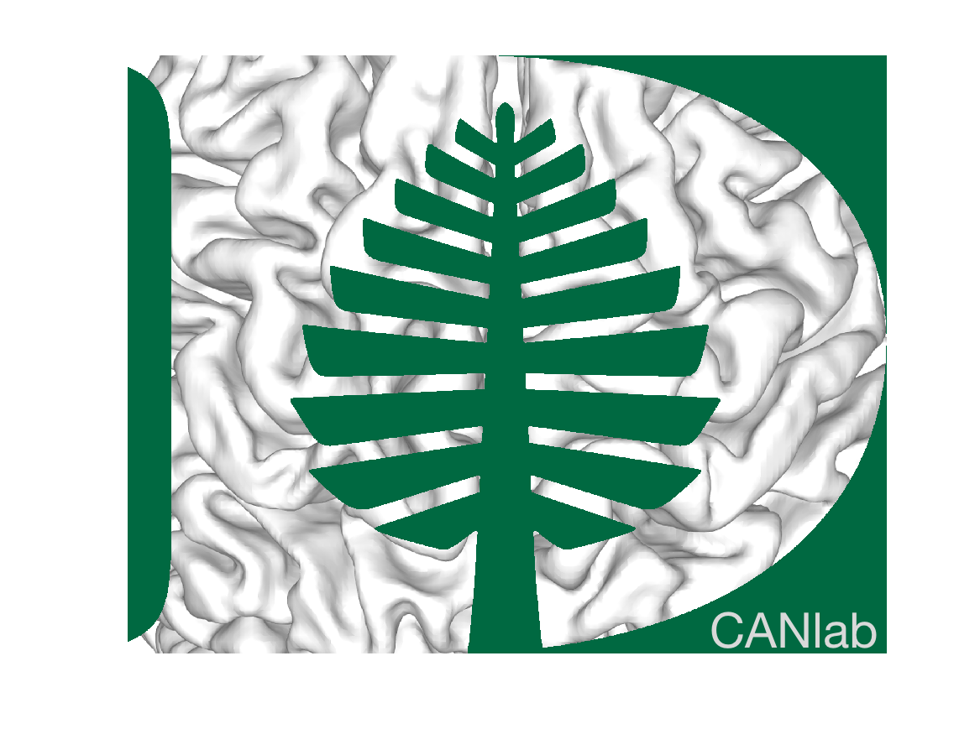

2026 Neurosynth topics vector embedding
Tor D. Wager
Department of Psychological and Brain Sciences
Dartmouth College
Notes:
If you’re like me, you want to make the world a better place. I want to understand pain and emotional distress, and design interventions that will help.
I believe many of you share the same goal – to help patients with depression, anxiety, substance use problems recover and live healthy lives.
But the space of possible interventions is vast… and if we don’t know why symptoms arise, it’s unclear how to treat them. Consider the Ebers Papyrus…

Slide 2
Workflow
neurosynth_data_obj.mat -> write text files with topics in topic_terms_csv/
Use codex to extract embeddings with codex_embedding_instructions.txt
Save topic_embeddings_text-embedding-3-large.csv / .mat
Analyze/visualize with topic_embedding_similarity_analysis.m
Plots sorted matrix based on dendrogram/hierarchical clustering
Plots brain similarity

Slide 3
Embedding model
- Model name: text-embedding-3-large
- Provider/API: OpenAI Embeddings API
- Use in this workflow: text embeddings for each topic-term document
- Output dimensionality in this run: 3072
- Documents embedded: 50
CSV shape: 3073 rows by 50 columns
That corresponds to 3072 embedding dimensions plus 1 header row, across 50 documents
Header order starts with 0_Sensory_Stimulation, 2_Substance_Abuse, 4_Trauma_Stress, 5_Cognitive_Impairment,
6_Object_Recognition

Slide 4
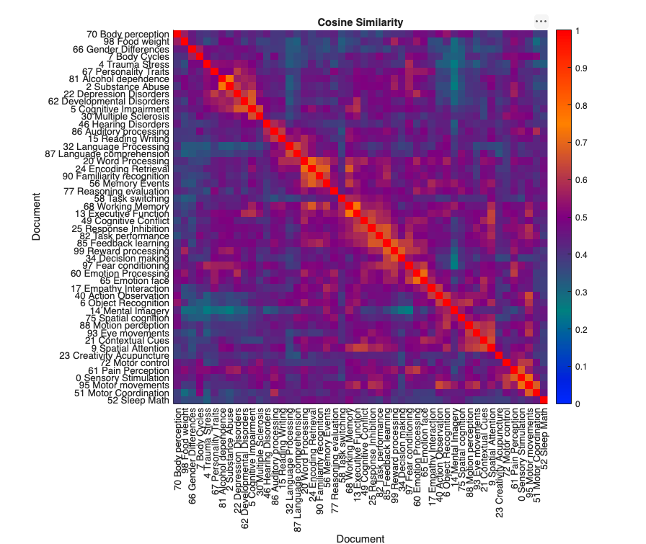
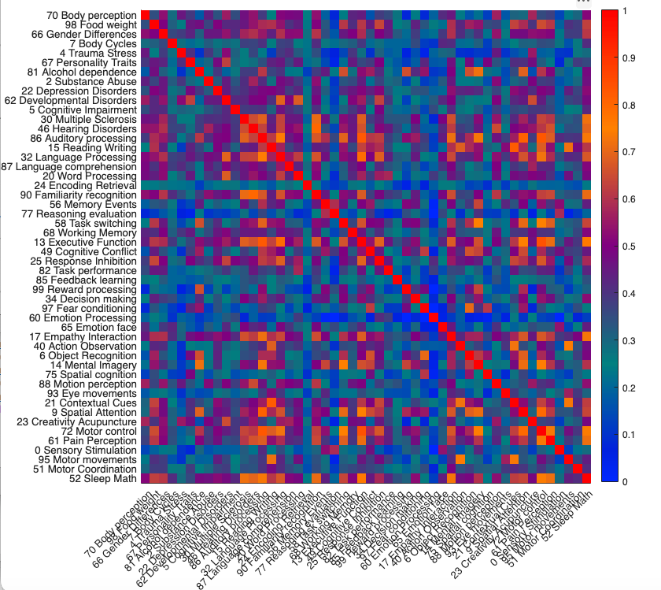
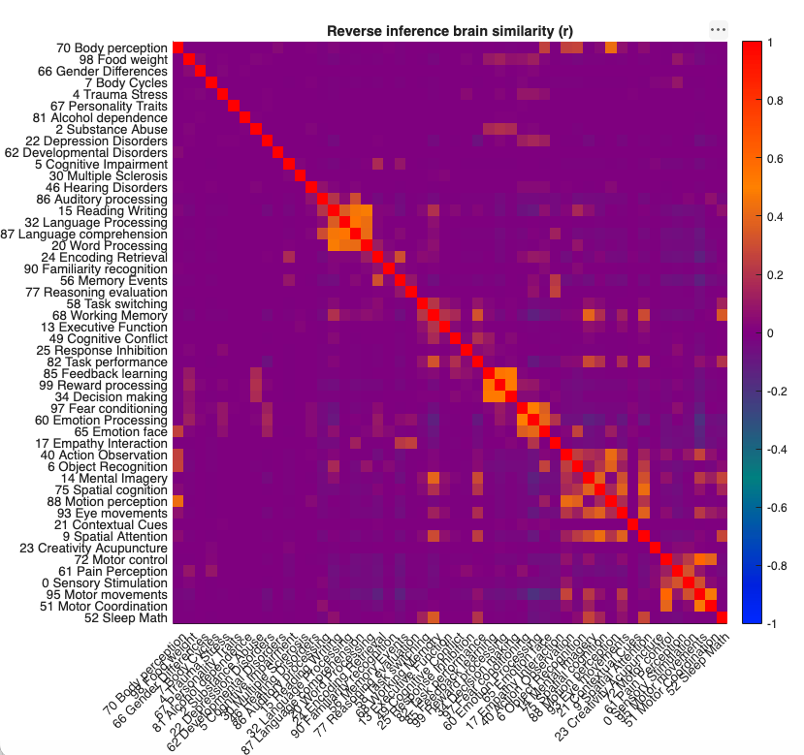
Brain pattern similarity
Forward inference (same topic order)
Semantic similarity
text-embedding-3-large
Reverse inference (same topic order)

Slide 5
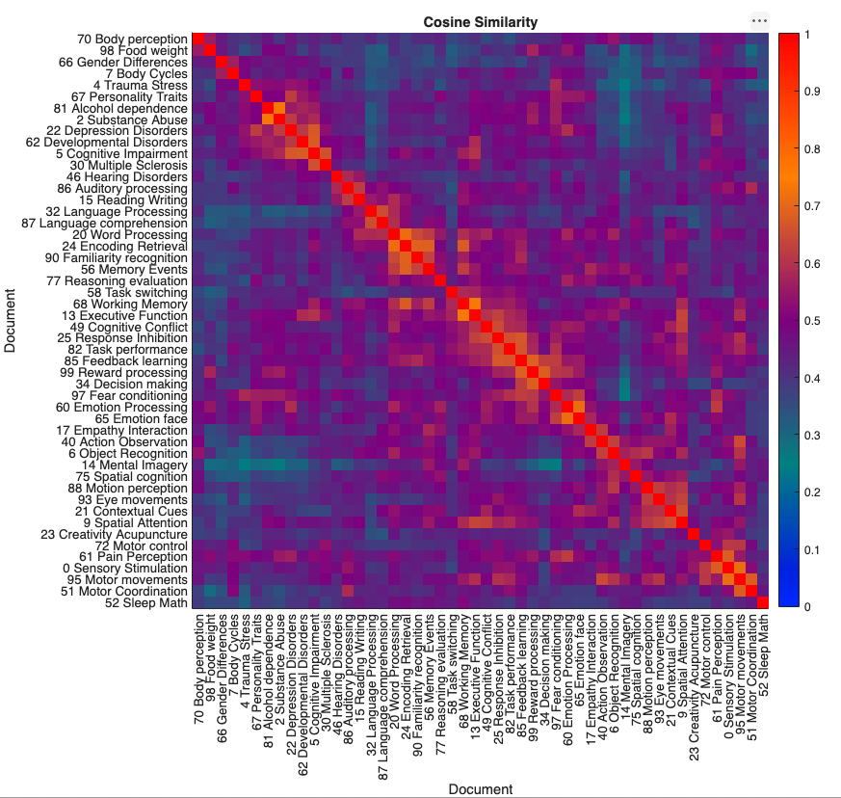
Semantic similarity
text-embedding-3-large

Slide 6
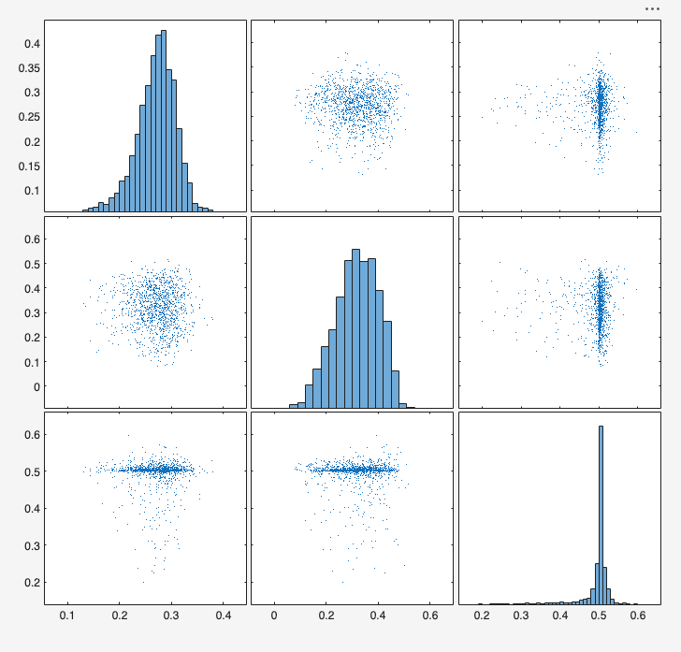
Semantic similarity does not correlate with brain similarity
semantic
forward
reverse
Correlation matrix
1.0000 -0.0515 0.0153
-0.0515 1.0000 -0.0080
0.0153 -0.0080 1.0000
Note: did not do brain cosine sim

Slide 7
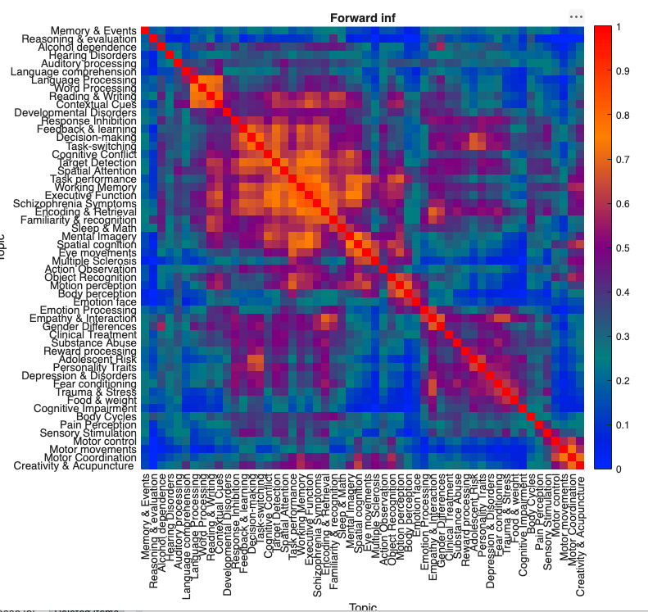
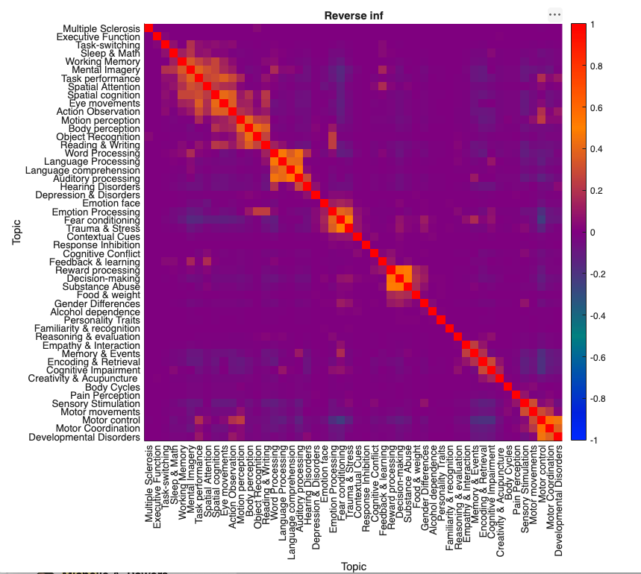
Brain topic similarity shows meaningful structure for both forward and reverse inference maps

