Slide 1
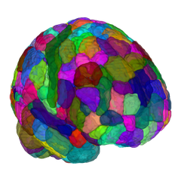
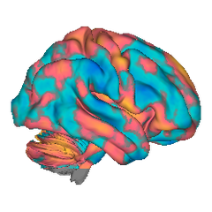
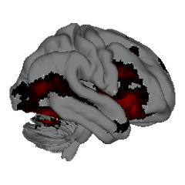
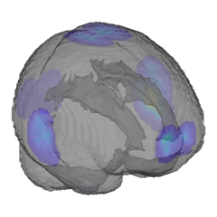
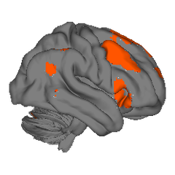
Neuroimaging Pattern Masks
A CANlab open library of brain signatures, atlases & meta-analytic maps
Atlases & Parcellations
33 labeled atlases & networks
CANlab · Glasser · Schaefer · Tian
Multivariate Signatures
Meta-Analysis Maps
29 predictive brain patterns
23 consensus map sets
NPS · SIIPS1 · PINES · VPS · FEPS
Emotion · Working memory · Placebo
Neurosynth Maps
NPM
Individual Study Maps
100 topics + MKDA term maps
Per-study effect maps
Automated large-scale meta-analysis
Bayes-factor evidence maps
OPEN LIBRARY
Spatial Basis Functions
Templates
5 gradient / ICA map sets
MNI reference brains
Cortical gradients · ICAs · transcriptomic
T1 templates · cerebellum · transforms
github.com/canlab/Neuroimaging_Pattern_Masks

Slide 2
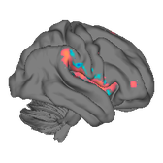
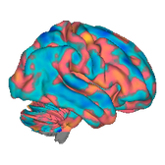
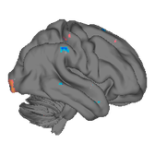
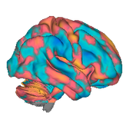
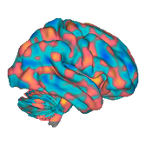
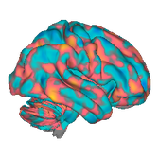
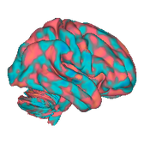
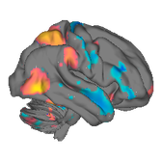
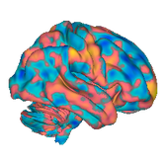
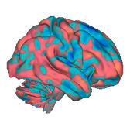
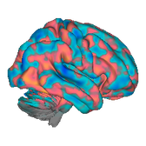
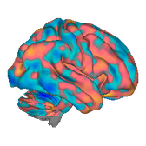
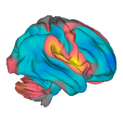
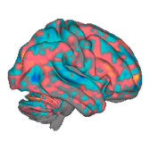
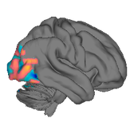
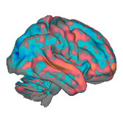
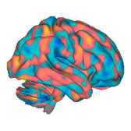
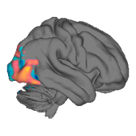
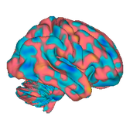
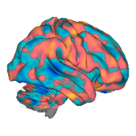
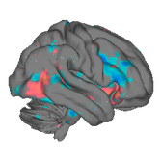
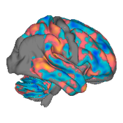
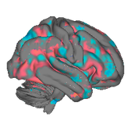
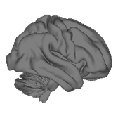
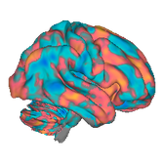
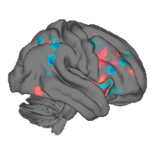
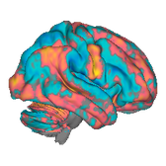
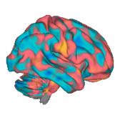
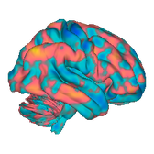
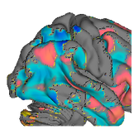
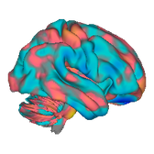
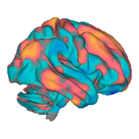
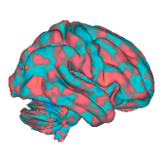
Multivariate Signature Patterns
29 studies · 36 pre-trained neuromarkers, grouped by what they predict
SIGNATURES
Pain
Aversive / Negative affect
Appetitive / Reward
10 signatures
9 signatures
7 signatures
NOCICEPTIVE SYSTEMS
THREAT
Threat conditioning (ImEx)
REWARD & CRAVING
NPS - Neurologic Pain
Signature
Reddan · 2018
Brain Reward Signature (BRS)
Wager · 2013
on request
Speer · 2023
SIIPS1 - cerebral pain
Subjective fear (VIFS)
Craving — drug & food (NCS)
Woo · 2017
Zhou · 2021
Koban · 2022
Multiaversive (MPA2)
Sexual-image classifier (BASIC)
Facial expression of pain
Čeko · 2021
van 't Hof · 2021
Picard · 2024
(FEPS)
NEGATIVE EMOTION
Reward decision value
Somatovisceral pain
Negative affect (PINES)
Coll · 2022
Van Oudenhove · 2020
Chang · 2015
Empathic care
Pain mediation (cPDM)
Negative emotions (BPLS)
Ashar · 2017
Geuter · 2020
Kragel · 2015
POSITIVE EMOTION
VICARIOUS / OBSERVED
Negative emotion schemas
Positive emotions (BPLS)
Vicarious pain (VPS)
Kragel · 2019
Kragel · 2015
Krishnan · 2016
SOCIAL COGNITION
Positive emotion schemas
General vicarious pain
Empathic distress
Kragel · 2019
Zhou · 2020
Ashar · 2017
MODULATION & VALUE
Interpersonal guilt
Cognitive & Social
Placebo analgesia
Yu · 2019
4 signatures
Wager · 2011
Romantic rejection (dpSP)
ATTENTION & CONTROL
Pain × cognitive control
Woo · 2015
Sustained attention (saCPM)
Silvestrini · 2020
Rosenberg · 2017
Pain decision value
Clinical
Cognitive control (Stroop)
Coll · 2022
3 signatures
Silvestrini · 2020
PATIENT & CHRONIC-PAIN MARKERS
MFC generalizability
Physiology
Fibromyalgia — pain &
Kragel · 2018
3 signatures
multisensory
SOCIAL COGNITION
López-Solà · 2017
Mentalizing — self / other
AUTONOMIC RESPONSES
Chronic back pain (S1)
Açıl · 2026
Skin conductance (SCL)
Lee · 2019
Eisenbarth · 2016
Fear of neck movement
Heart rate
(PiFoneM)
Eisenbarth · 2016
Murillo · 2026
Skin-conductance + pain
Matthewson · 2019

Slide 3
Old versions

Slide 5
Multivariate Signature Patterns
29 published neuromarkers, grouped by what they predict · first author & year below each
Signature taxonomy
5 domains · 10 sub-branches
Pain
Aversive / Negative affect
Appetitive / Reward
Cognitive & Social
Clinical
10 signatures
9 signatures
3 signatures
6 signatures
3 signatures
NOCICEPTIVE SYSTEMS
PHYSIOLOGY
REWARD & CRAVING
ATTENTION & CONTROL
PATIENT & CHRONIC-PAIN MARKERS
Neurologic Pain Signature
Autonomic — skin conductance
Brain Reward Signature (BRS)
Sustained attention (saCPM)
Fibromyalgia — pain & multisensory
Wager · 2013
on request
Eisenbarth · 2016
Speer · 2023
Rosenberg · 2017
López-Solà · 2017
SIIPS1 — beyond nociception
Autonomic — heart rate
Craving — drug & food (NCS)
MFC generalizability
Chronic back pain (S1)
Woo · 2017
Eisenbarth · 2016
Koban · 2022
Kragel · 2018
Lee · 2019
Facial expression of pain (FEPS)
Skin-conductance + pain
Sexual-image classifier (BASIC)
Fear of neck movement (PiFoneM)
Picard · 2024
Matthewson · 2019
van 't Hof · 2021
SOCIAL COGNITION
Murillo · 2026
Somatovisceral pain
Mentalizing — self / other
Van Oudenhove · 2020
THREAT
Açıl · 2026
Pain mediation (cPDM)
Threat conditioning (ImEx)
Empathic care & distress
Geuter · 2020
Reddan · 2018
Ashar · 2017
VICARIOUS / OBSERVED
Subjective fear (VIFS)
Interpersonal guilt
Zhou · 2021
Yu · 2019
Vicarious pain (VPS)
Multiaversive (MPA2)
Romantic rejection (dpSP)
Krishnan · 2016
Čeko · 2021
Woo · 2015
General vicarious pain
Zhou · 2020
EMOTION
MODULATION & VALUE
Negative affect (PINES)
Chang · 2015
Placebo analgesia
Emotion categories (BPLS)
Wager · 2011
Kragel · 2015
Pain × cognitive control
Emotion schemas — 20 types
Silvestrini · 2020
Kragel · 2019
Pain decision value
Coll · 2022
Some folders contribute signatures to more than one branch. · CANlab · github.com/canlab/Neuroimaging_Pattern_Masks

Slide 6
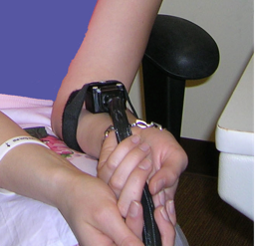


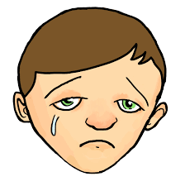

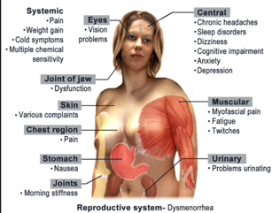
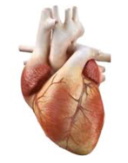


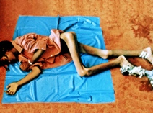
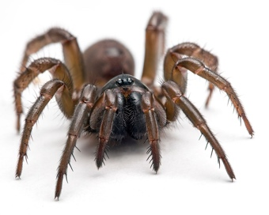
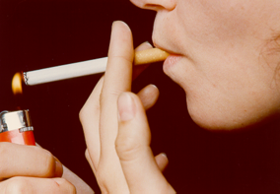
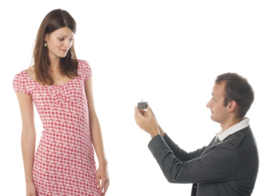

Neuromarkers for pain and affect: Different brain patterns for different experiences (and contexts)
Different!
Max: r = 0.22
except ’general aversive’
Evoked somatic pain
Vicarious pain
Threat CS+
Emotion categories
fibromyalgia
Stress-evoked
Skin conductance
Heat & Pressure-pain specific
Heart rate
Sexual images
Empathic distress
Empathic care
General
Negative affect
Food & Drug craving
‘fear’ images
$
Reward
Social Rejection
Threat CS+
Placebo
References: https://sites.dartmouth.edu/canlab/publications/
Notes:
Max correlation = 0.2

