Slide 1
Neurosynth topics v5
Visualizations
Tor Wager

Slide 2
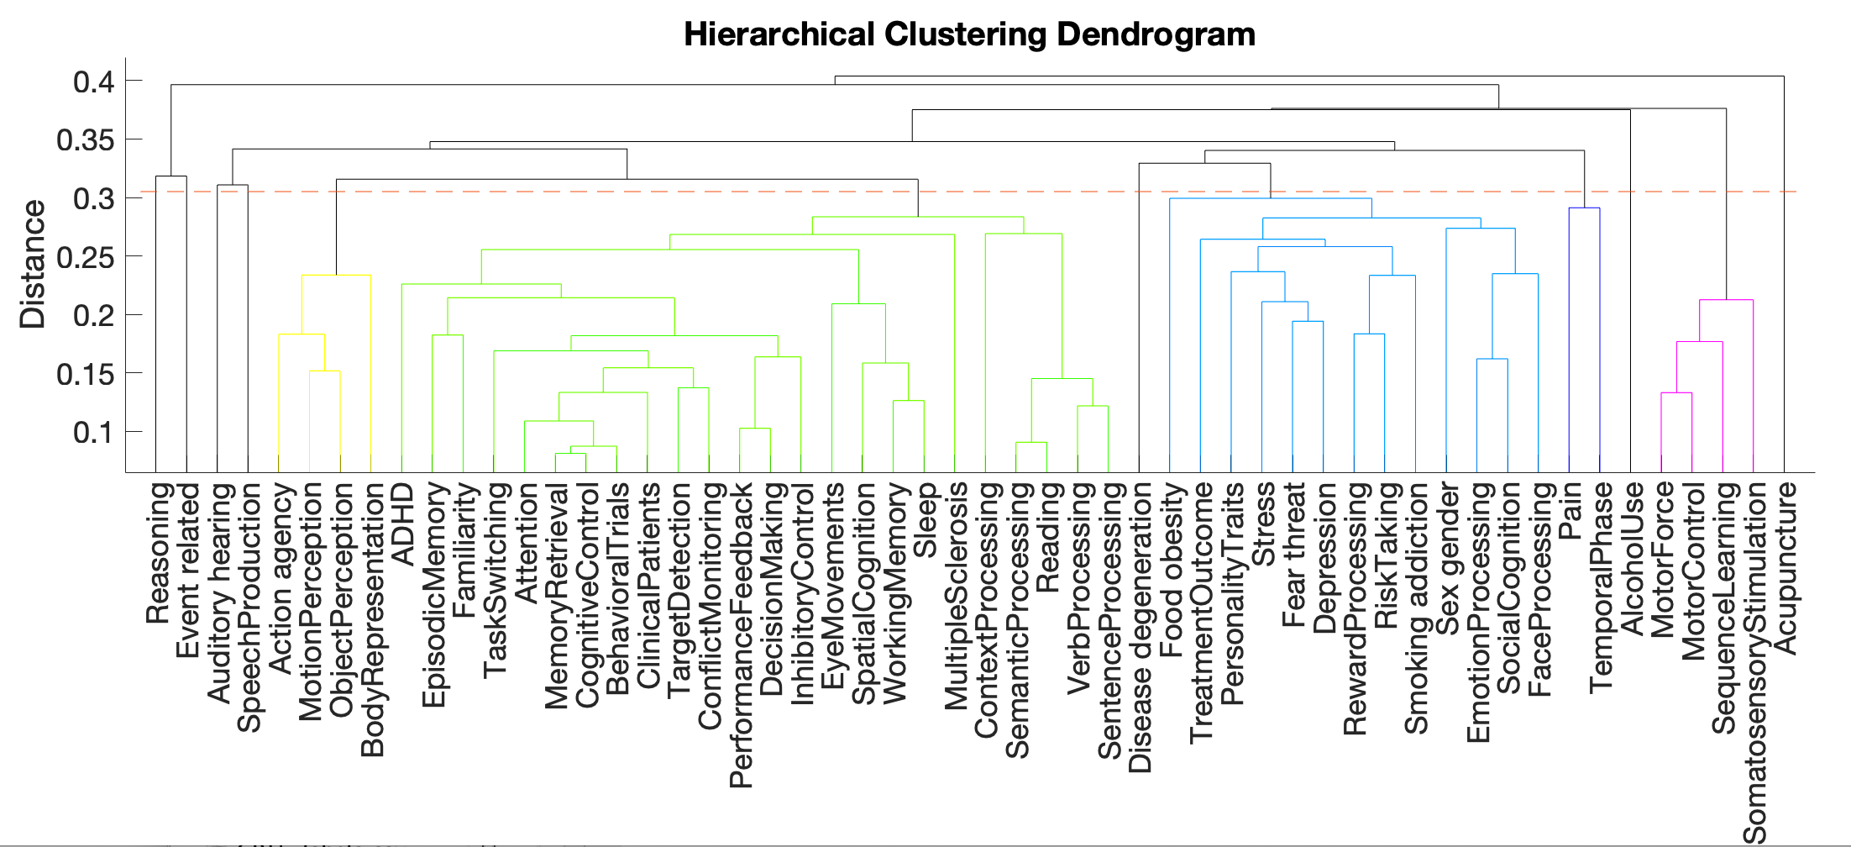
Forward inference topics

Slide 3
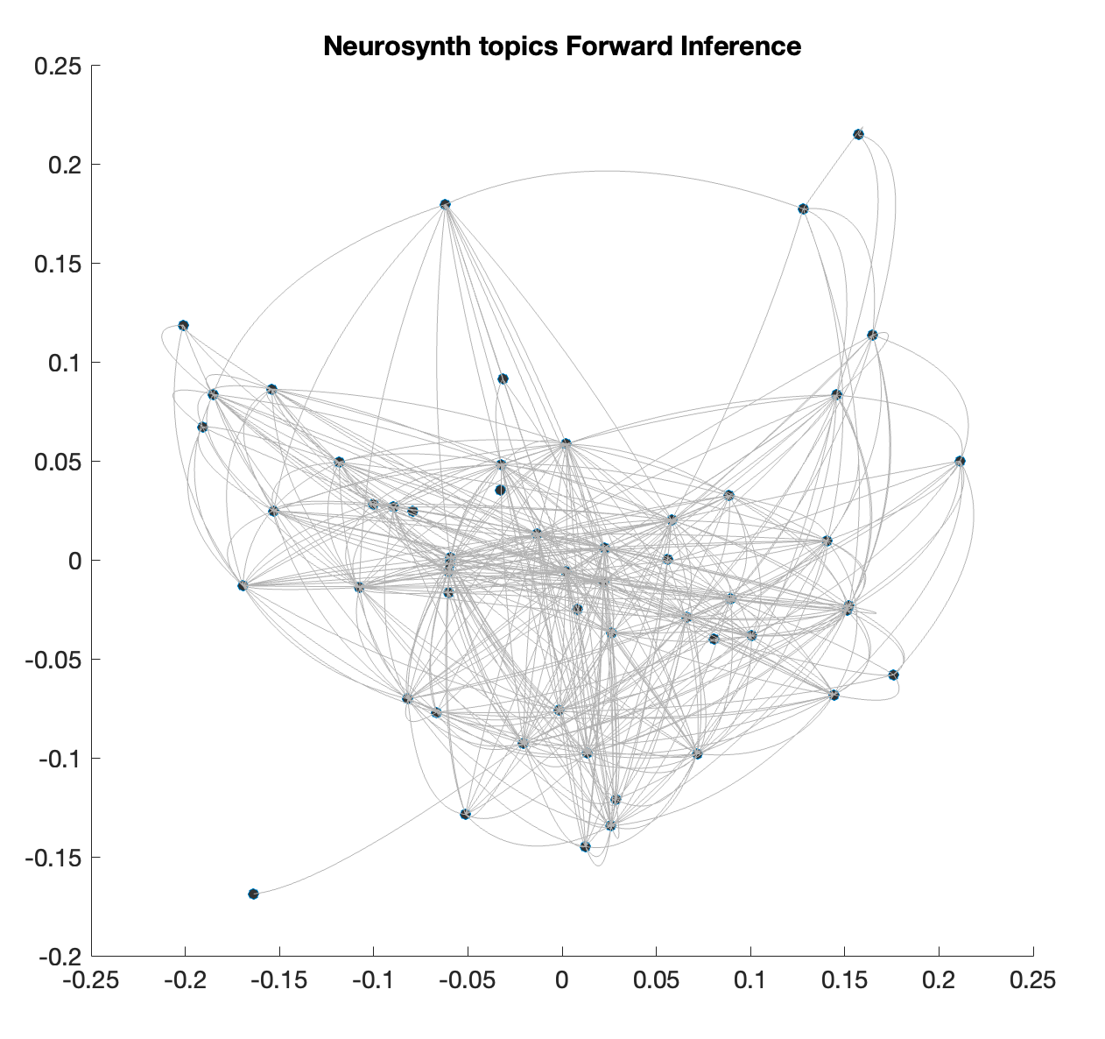
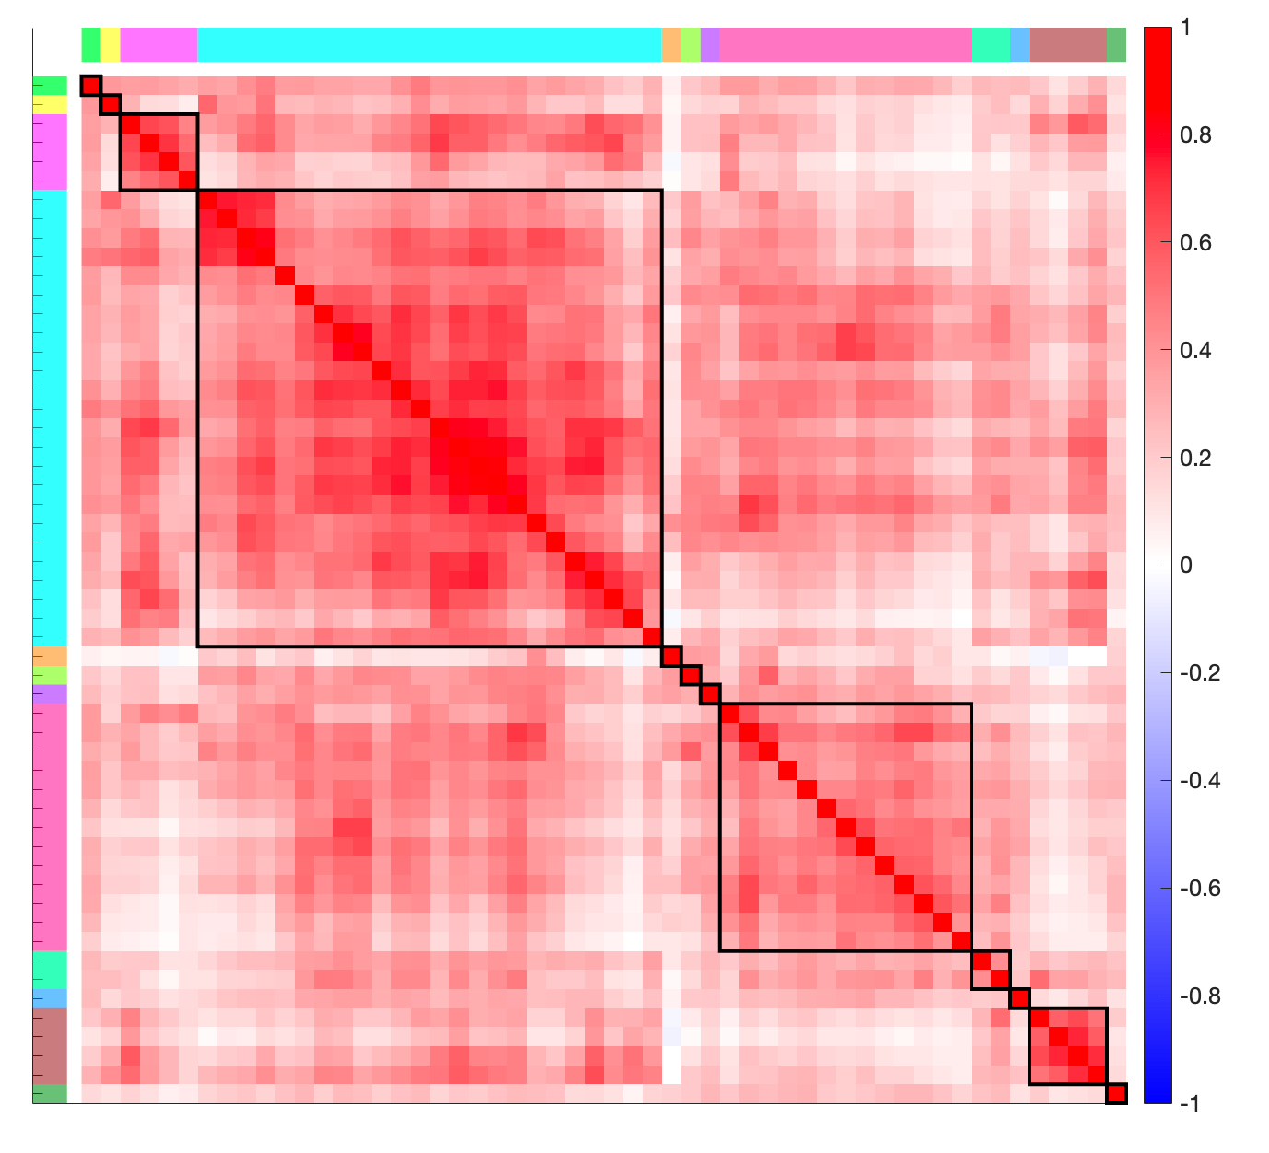
Forward inference topics

Slide 4
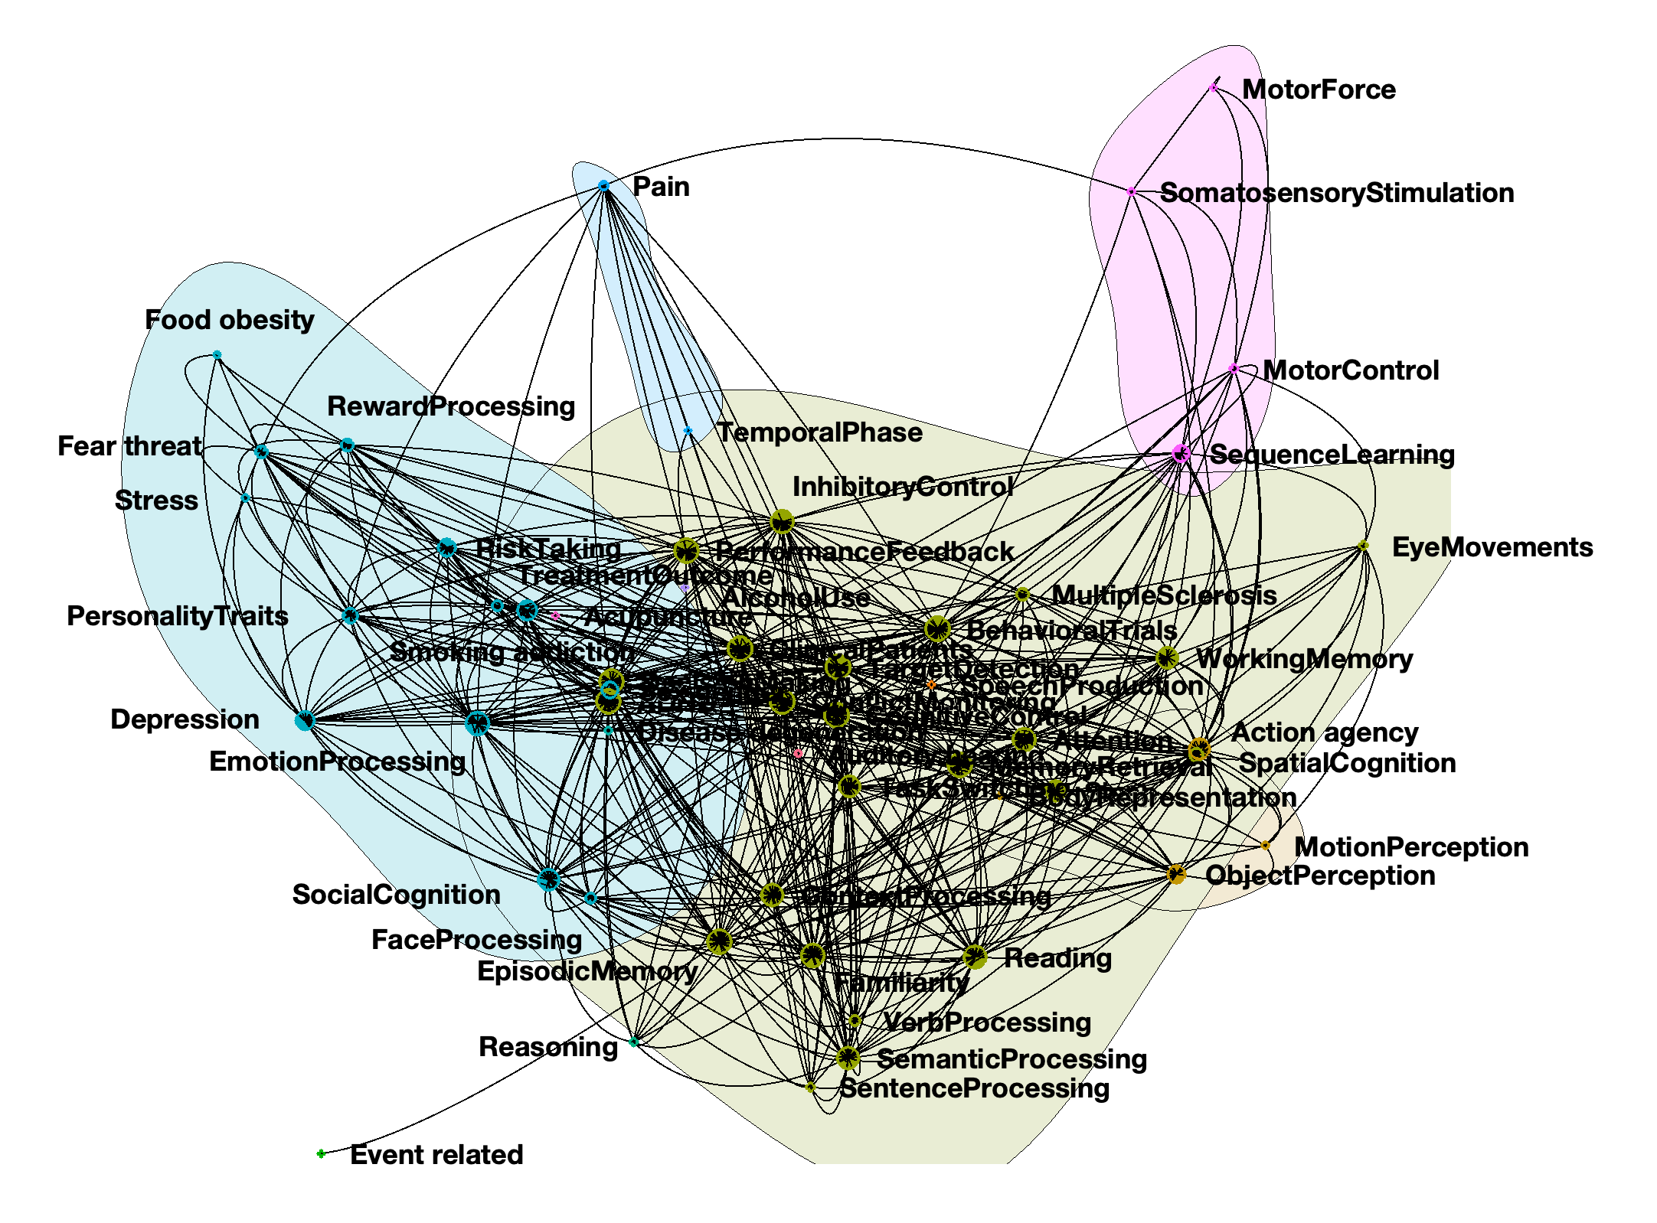
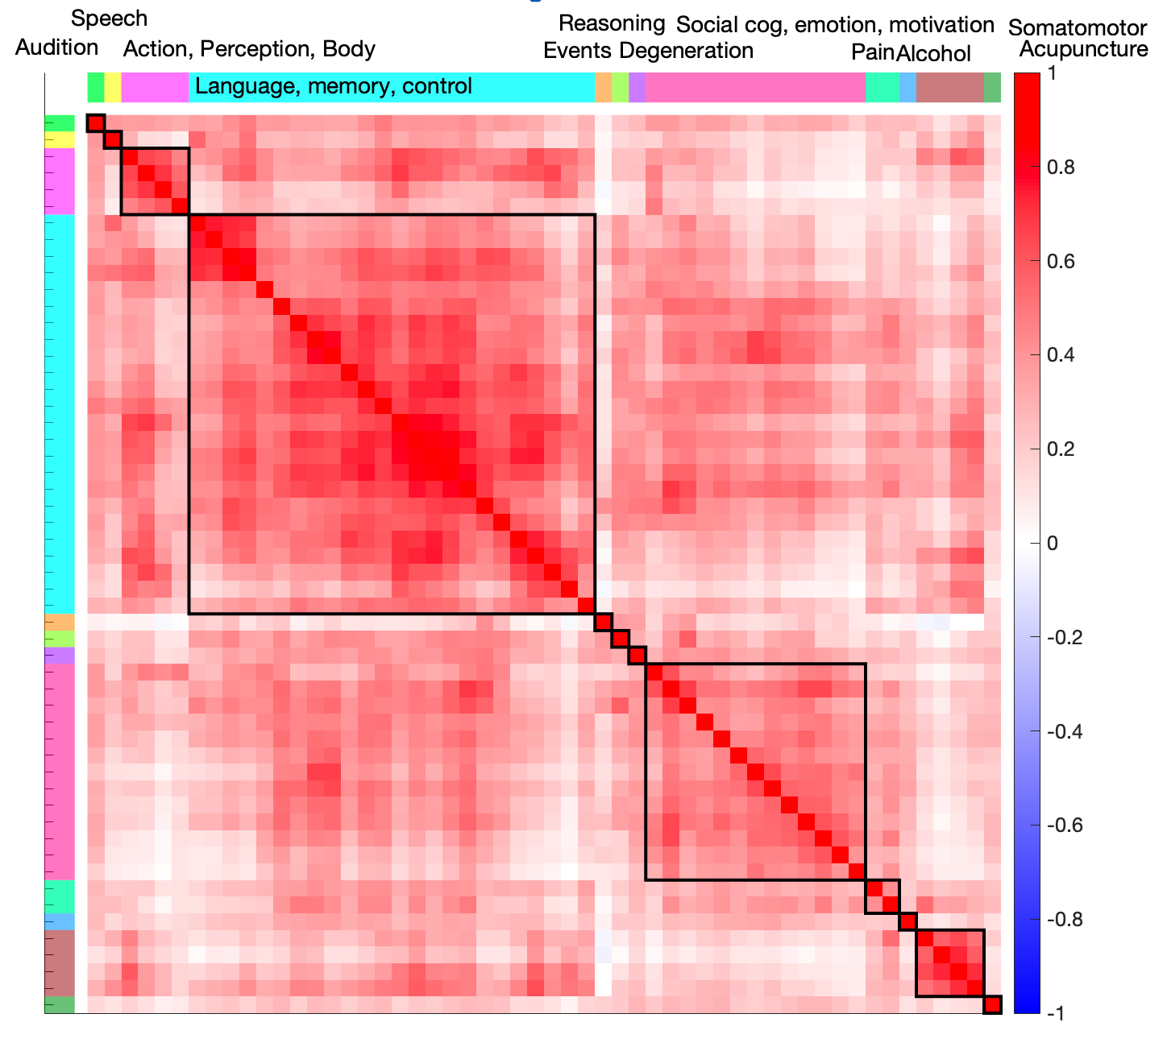
Forward inference topics

Slide 5
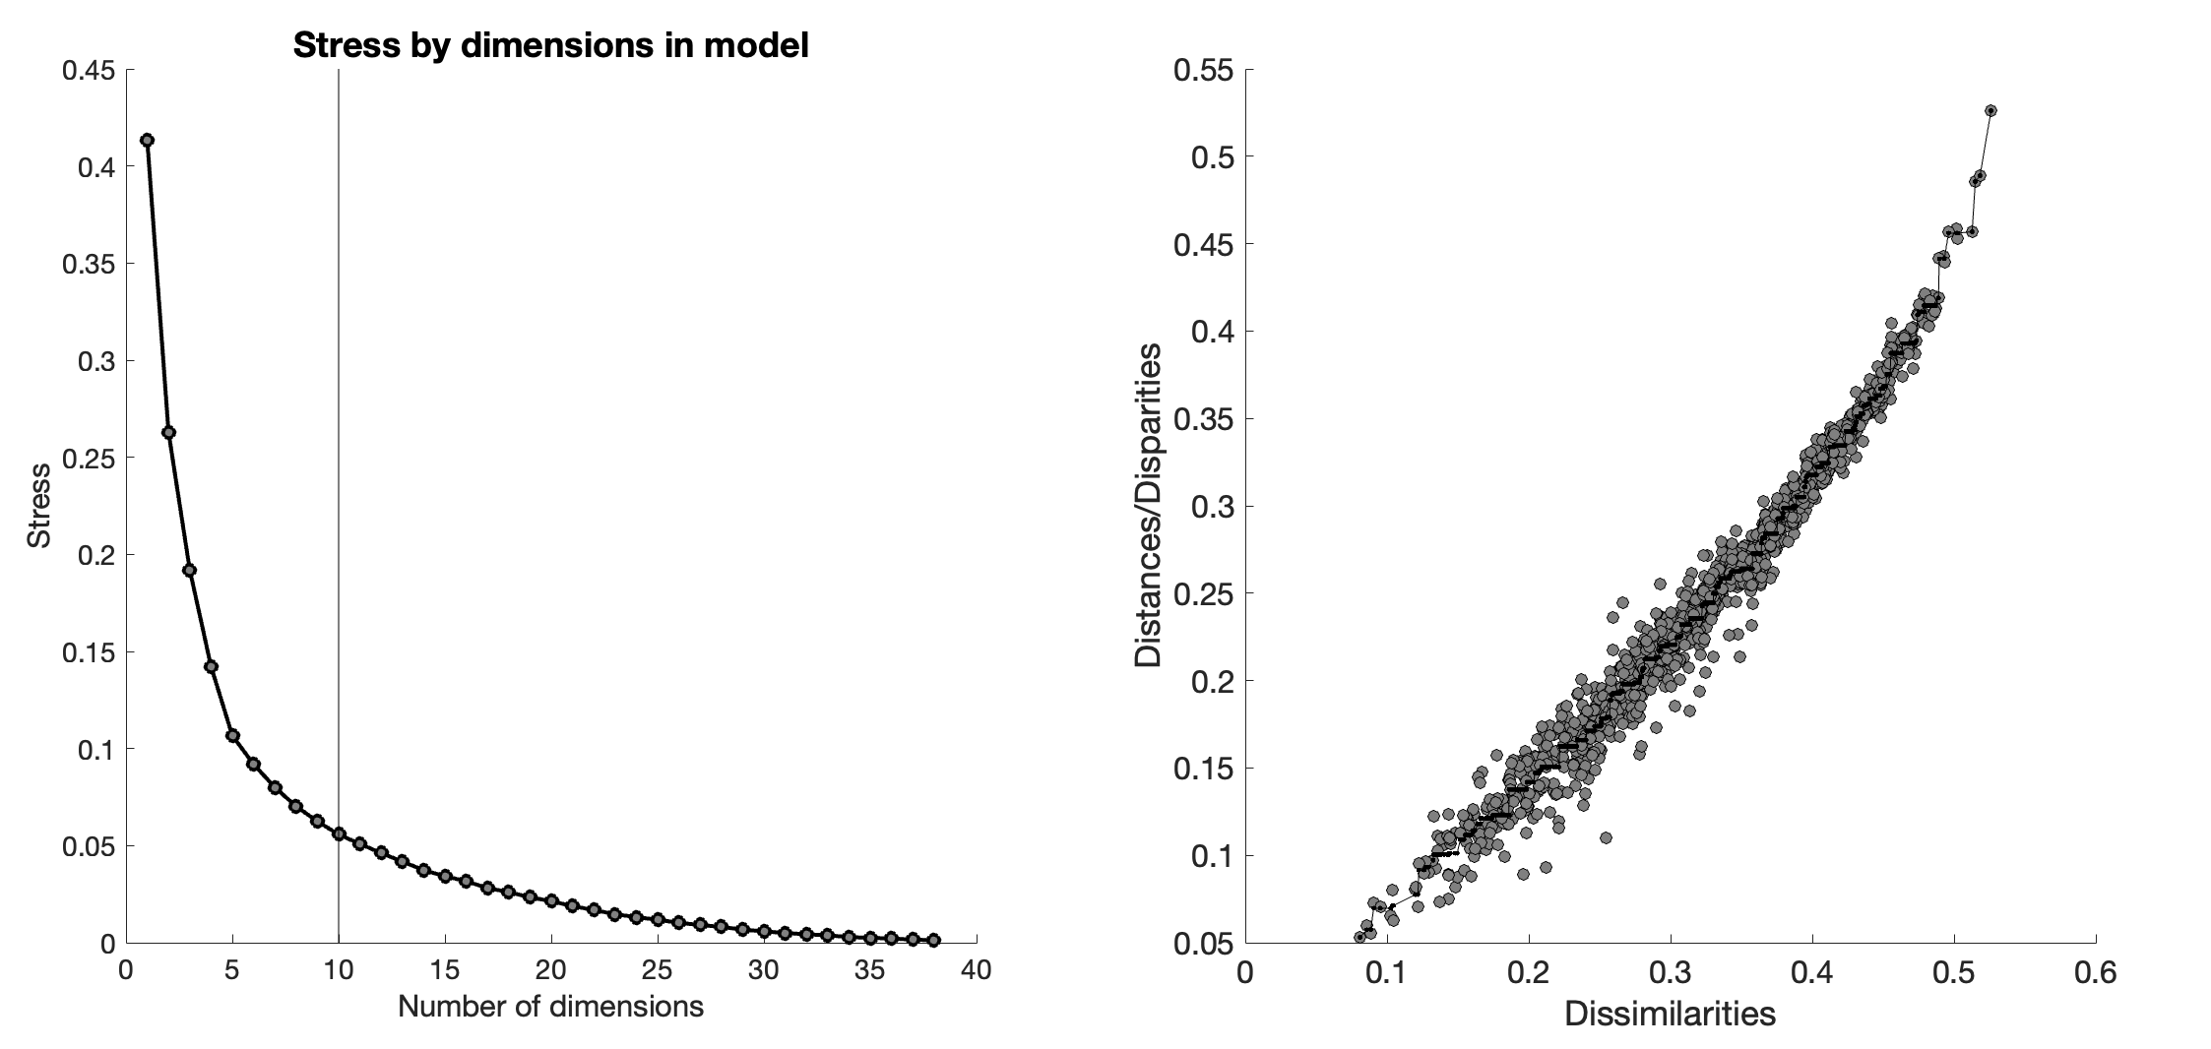
Forward inference topics
10 dims, 12 clusters chosen

