Slide 1
BMRK5 study description
Jessica Andrews-Hanna
Hedwig Eisenbarth
Elizabeth Reynolds-Losin
Tor Wager

Slide 2
Study Overview
Pre-scanner tasks
  Word fluency task (Jess)
  Word association task (Jess)
  Thoughts task (Jess)
  training sessions for pain/sound task and n-back (Liz/Hedwig)
In-Scanner Tasks
  resting state with thoughts questions afterwards (Jess)
  Pain & Sound Task (Liz)
  Distraction + Emotional Movies Tasks (Hedwig)
Post-Scanner Tasks
  rating of the emotional movie clips continuously (Hedwig)
  Word judgment task (Jess)

Slide 3
Questionnaire measures
ASSIST (drug use/abuse)
BDI (depression)
BFI (personality, five factors)
BHPQ (history of pain)
CSQ (coping strategies)
EOD (discrimination experience)
ERQ (emotion regulation)
FFMQ (mindfulness)
FOP (fear of pain)
Illness Beliefs
IPI (mind wandering)
KRS (reactivity)
LEC (life events)
MASQA (anxious arousal)
MEIM (ethnicity identity)
Pain Beliefs
PANAS (trait mood)
PCS (pain cathastrophizing)
PPI (psychopathy)
PSWQ (worry)
RRS (rumination)
STRAIN (loss life events)
WQ (worry)

Slide 4
Sample description
General population sample, recruitment via:
  Community Twin Sample and Family Sample from the IBG CU Boulder (n=44)
  flyer and craigslist in the Denver metro area (n=30)
demographics (participants with existing fMRI data):
  36m 38f
  15 AA, 30 white, 29 hispanic (any race)

Slide 5
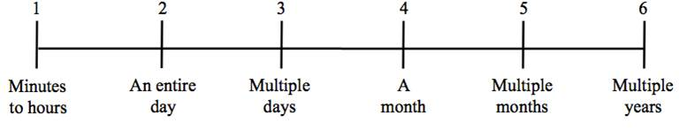
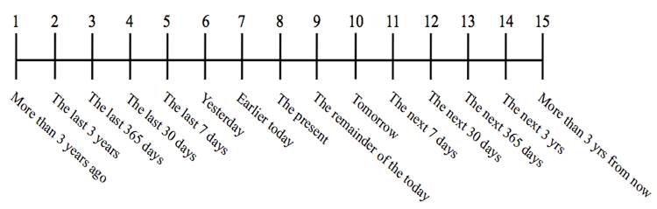
Autobiographical Thought Sampling Task
Participants are video-recorded while…
recalling 6 frequently-occurring thoughts
rating each thought on a variety of content variables
My emotions pertaining to this thought are POSITIVE.
My emotions pertaining to this thought are NEGATIVE.
When this thought occurs, it is hard for me to stop thinking about it.
This thought contributes to my sense of self-identity.
This thought involves, or concerns, other people.
I experience this thought with clear and vivid mental imagery.
This thought concerns a topic that pertains to …
This thought concerns a topic that pertains to …
verbally describing the nature of each thought for 45 seconds

Slide 6
Self-Report Ratings: Relationships with Mental Health Traits
Depression Composite = BDI-II, Ruminative Response Scale, PANAS-Negative
r = 0.44; p = 0.0001
rob p = 0.000065***
r = -0.41; p = 0.003
rob p = 0.00024***
r = 0.11; p = 0.35
rob p = 0.58
r = 0.30; p = 0.01
rob p = 0.009**
Notes:
Plot pos & neg mood in same graph (2 axes)

Slide 7
Semantic Association Task
Failure
Arousal
Pain
Valence
21 abstract concepts (seed words) drawn from ANEW database
Shame
Worry
Alone
For each seed word, participants given 3s to generate each of 10 consecutive associations
Jealousy
Crisis
Noise
Want
Teach
After fMRI session, participants rate all 21 seed concepts on valence, arousal, and value/ personal importance
Breath
Advice
Beginning
Memory
Future
Trip
Father
Heart
Spouse
Beautiful
Win
0
1
2
3
4
5
6
7
8
9
Most Negative/
Least Arousal
Most Positive/
Most Arousal
Notes:
Affective norms for english words
Sad, mother

Slide 8

Semantic Free Association Task
Subject 2
Example of autobiographical thought for this participant:
“I will be experiencing a lay off here shortly. Not knowing when is stressful but okay because I know a general time frame in which I will be laid off…”
FAILURE
dissapointment
wrongful
hateful
Subject 1
letdown
FAILURE
lose
tomorrow
disappointment
work
parents
work
children
layoff
happiness
layoff
flying
failure
sailing
water
fishing
eating

Slide 9
LIWC Text Analysis: Relationships with Mental Health Traits
r = 0.32; p = 0.007
rob p = 0.007**
r = 0.05; p = 0.068
rob p = 0.57
r = 0.26; p = 0.03
rob p = 0.01*
r = 0.34; p = 0.12
rob p = 0.02*
Notes:
Plot pos & neg mood in same graph (2 axes)

Slide 10
Resting State Paradigm
single resting state run (7 min)
- ultra-fast fMRI sequence (tr = 460ms)
Participants subsequently answer questions about the content of their thoughts

Slide 11
Planned analyses
Examine relationships between mental health traits, spontaneous thoughts,
free associations, and measures of functional network connectivity
→ machine learning prediction
→ graph analysis
→ dynamic functional connectivity
→ focus on valence, association strength, variability in thought content
→ assess relationships with responses to physical pain and
emotional movies

Slide 12


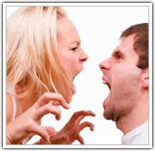
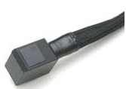

Pain Sound Task Overview
Noxious Heat
Noxious Sound
Negative Sound
Modality Specificity
Pain Specificity

Slide 13
Pain Sound Task: Condition Details
Intensity | Intermediate Pain | Long Pain | Offset Analgesia
Low | 47°C, 8 sec. | 47°C, 11 sec. | 47°C, 11 sec.
Medium | 48°C, 8 sec. | 48°C, 11 sec. | 48°C, 11 sec.
High | 49°C, 8 sec. | 49°C, 11 sec. | 49°C, 11 sec.
Intensity | Unpleasant Sounds: Nails on a Chalkboard | IADS Negative Sounds: Sickness,Disasters, Crying or Attacks
Low | 30 Db | 6/9
Medium | 60 Db | 7/9
High | 90 Db | 8/9

Slide 14
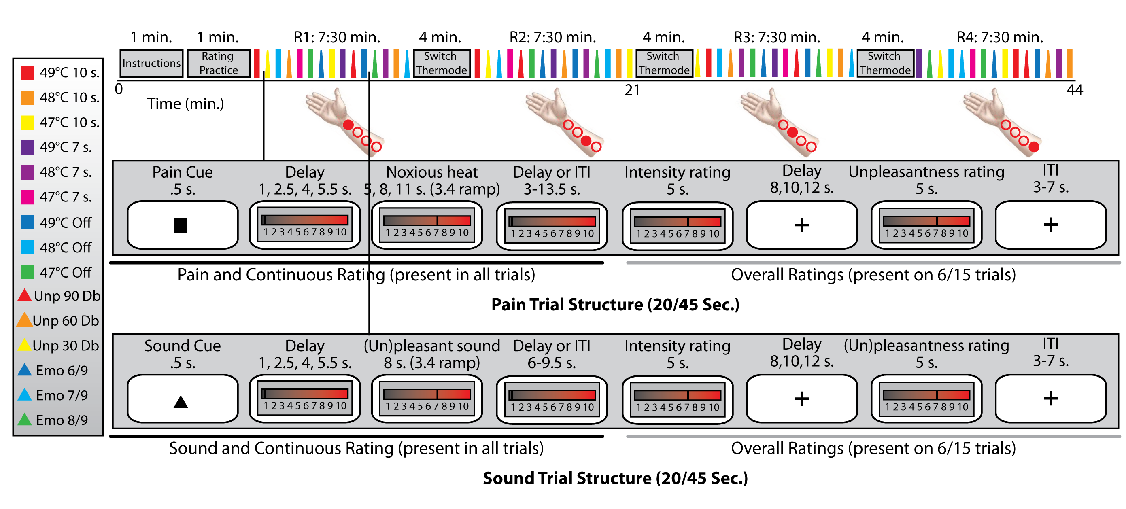
Pain Sound Task Structure

Slide 15
Pain Sound Task Written Description
The purpose of the pain-sound task was to allow for the identification of neural correlates of different aspects of the pain experience including pain duration, pain modality, and pain specificity. The task consisted of three main conditions: painful heat delivered to the inner forearm, acoustically aversive shrill sounds, and emotionally negative sound clips (e.g., domestic violence). Heat stimuli were delivered with three different temporal profiles: 8 sec. constant temperature,11 sec. constant temperature, and 11 sec. with temperature spike. Each of these types of stimuli were delivered at three different intensity levels in each of four runs.

Slide 16
Pain Modulation Tasks (1)
Neg movie with 12 pain trials, 4 during and pre/post
between-subject condition
1
2
3
4
Pos movie with 12 pain trials, 4 during and pre/post
neg. mood
movies
pos. mood
pos. mood
movies
neg. mood
n-back
movies
stress
stress
movies
n-back
“Movie only” task: 3 films, 6 min total, 2 min/movie. Rating of pos vs. neg.
After scanning: continuous + intensity in each emotion category after each

Slide 17
Pain Modulation Tasks (2)
modulation 1:
stress/positive movie
or nback/negative movie
movies
modulation 2:
stress/positive movie
or nback/negative movie
7min
18min
7min
modu-lator
pre
post
pain stimuli:
Each block, 4 pre/4 during/4 post
48°, on the foot,
1 skin site for 1 task
2min
2min
2min
48°C
48°C
48°C
48°C
1-4s 1.5s 7.5s 1.5s 17-22s 1.5s 7.5s 1.5s 17-22s 1.5s 7.5s 1.5s 17-22s 1.5s 7.5s 1.5s 17-22s
BOLD, SCR, pulse, pupil size

Slide 18
Emotional Movies Task:
In scanner part
movies
loss
disgust
anger
disgust
anger
loss
disgust
anger
loss
2min 2min 2min 2min 2min 2min 2min 2min 2min
How negative or positive do you feel right now?
negative ---- neutral ---- positive (VAS scale)
movie order fully randomized
movie clip name | content | category
Clip_256_2min.avi | documentary about african albinos | loss
Chemical_Warfare_2min.avi | documentary about Syrian chemical attack | loss
Spiderbite2.avi | spider bite abscess extraction | disgust
Clip_156_1.avi | Jack ass clip, wasabi snooters | disgust
Clip_336.avi | report about an unjustified police attack | anger
Clip_371_2min.avi | documentary about LA street kids gang | anger

Slide 19
Emotional Movie Task:
Post scanner Task
participants watched the movies again and rated the clips continuously while watching
“How negative or positive did you feel when you saw this the first time?”
negative -------- neutral --------- positive
after each clip rate for actual emotions:
angry | suspicious | sad
pleased | engaged | aroused
anxious | sceptical | embarrassed
nervous | disgusted | happy

Slide 20
Written description of the Emotional Movies Task
We are presenting six videos with a duration of about 2 min each from the three categories anger (report about juvenile street gangs in LA, report about an assault of an innocent person by police officers), loss (report about chemical attack in Syria, report about albino Africans who are murdered to sell their body parts) and physical disgust (extraction of a spider bite abscess of a person, Jack ass show on inhaling a wasabi-soy sauce mix into the nose). The six videos were selected based on previous ratings and in part shortened to 2min duration. Each video was presented once. The three categories loss, physical disgust and anger were chosen as they are all from the negative emotion spectrum and these different categories might have common processes but could maybe also be differentiated based on neurobiological response.
In addition to brain imaging (with 3T scanner), heart rate (HR), skin conductance (SCR) and pupil dilation response (PR) will be collected throughout the scanning procedure. Resting state scans will be collected before the movies will be presented. DNA will be collected from all consenting participants.
After each video, participants rate their actual mood on a visual analog scale (VAS) from very negative through neutral to very positive. After the scanner session, participants will see the movies again and be asked to rate them continuously during the presentation for the mood (VAS from very negative through neutral to very positive) they are actually provoking from moment to moment. Participants will be asked to refer to what they felt when they first saw the movie in the scanner. In addition, participants rate the movies overall on several emotion categories. During watching the movies outside of the scanner, participants’ faces got recorded via video camera, in order to evaluate their emotional facial expressions.
The goal is to compare the different emotional categories on the different levels, behaviorally, psycho-physiologically and in terms of functional brain activity as well as to link the different response-levels to each other.
Participants also fill in a number of questionnaires, such as Mood and Anxiety Questionnaire (MASQ), Emotion Regulation Questionnaire (ERQ), Kohn Reactivity Scale (KRS), Interpersonal Reactivity Index (IRI), Life Events Questionnaire.

Slide 21
Future plans regarding the emotional movies tasks
apply the 5 emotion maps from the meta analysis to the BMRK5 data
train new predictive algorithms for negative affect overall and for the different types of negative affect (loss, disgust and anger)
test prediction of emotional facial expressions by different pattern

