Slide 1
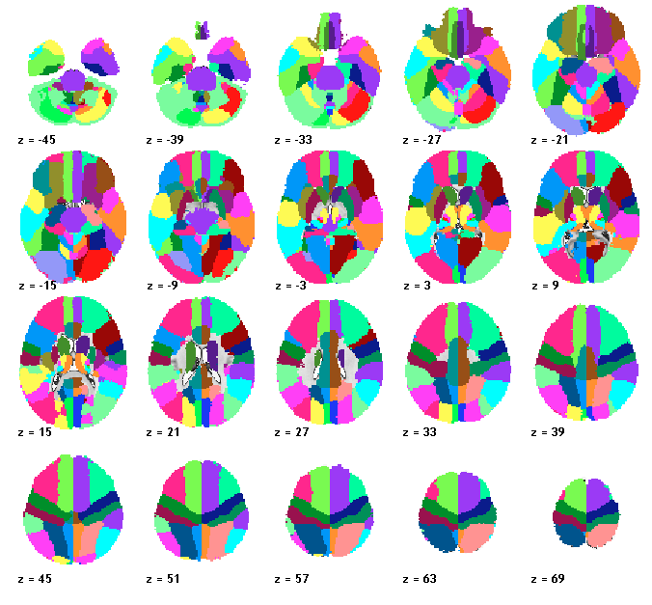
Atlas
Data is in: …matlab_code_canlab/Atlas_Localization_Tools/atlas_labels_combined.img

Slide 2
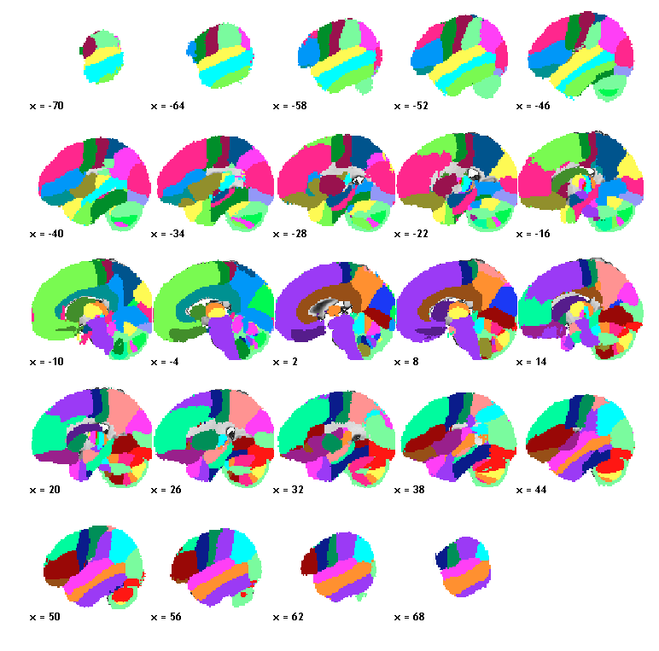
Atlas

Slide 3
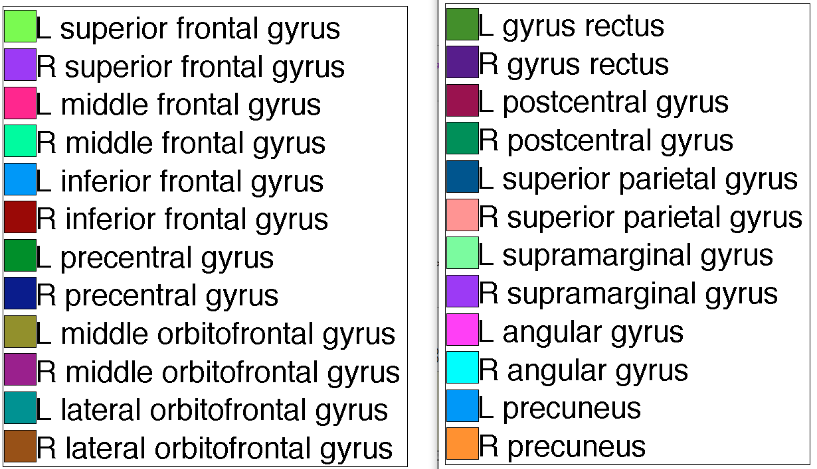
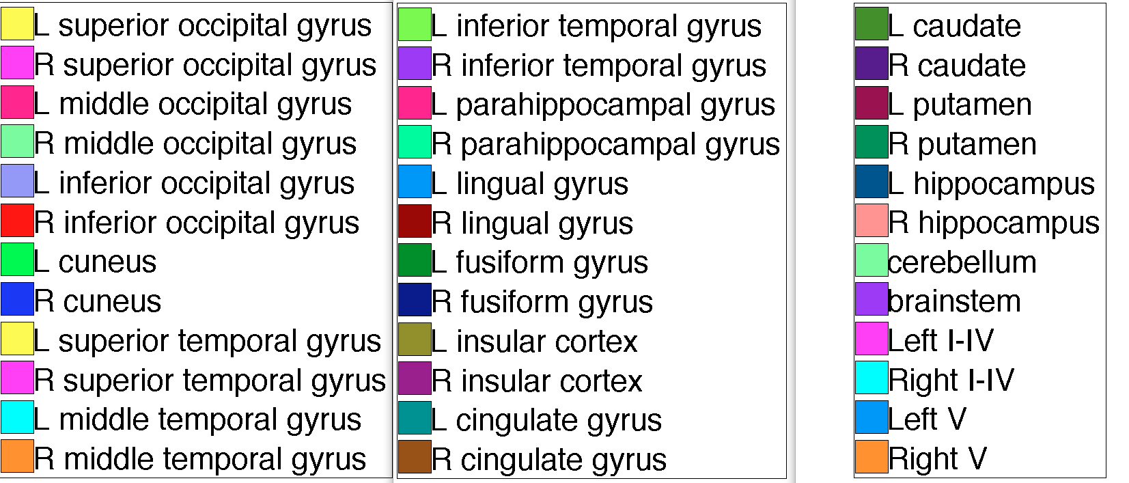
Atlas

Slide 4
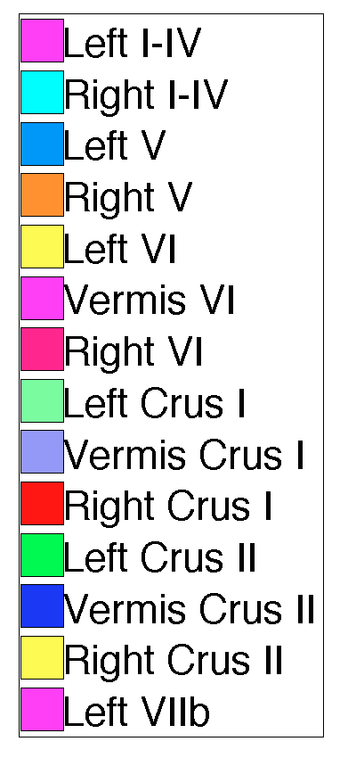
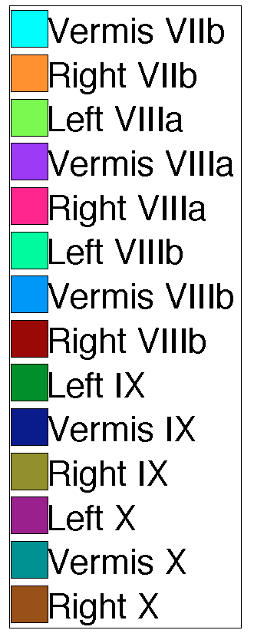
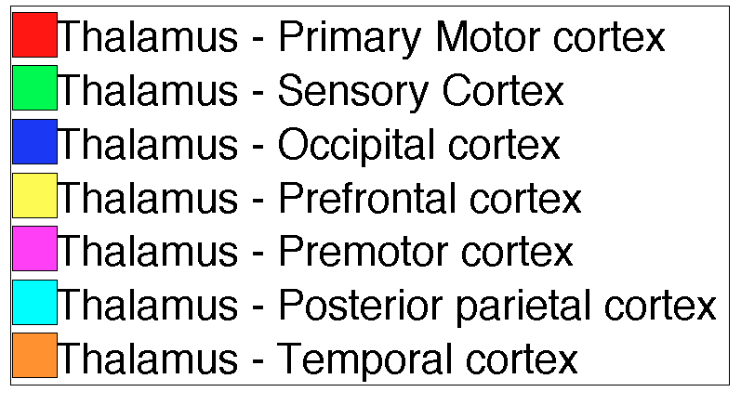
Atlas
Cerebellum
Thalamus

Slide 5
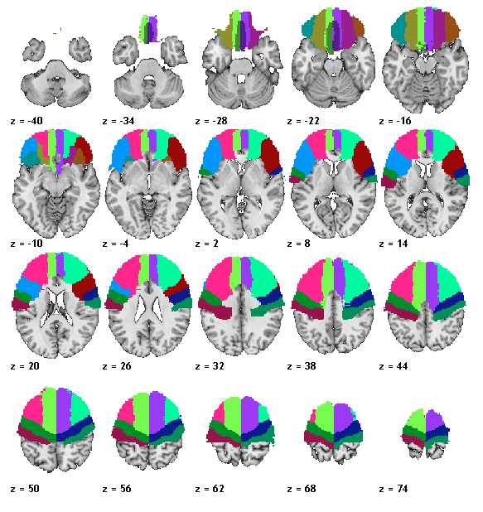
Frontal

Slide 6
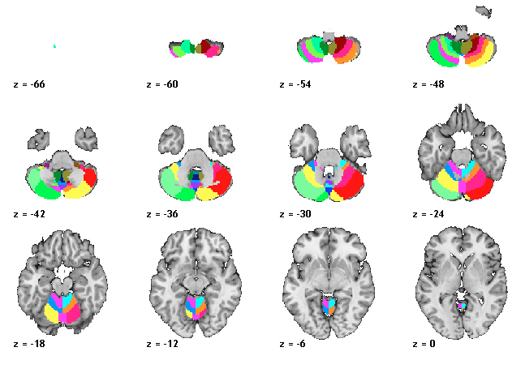
Cerebellum

Slide 7
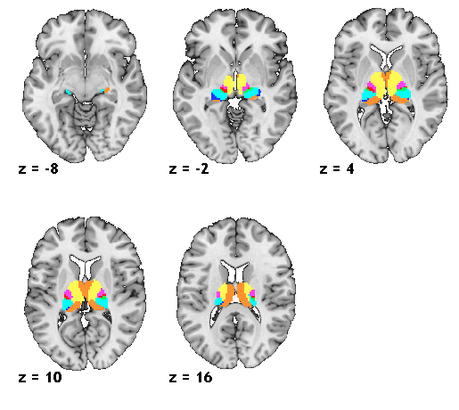
Thalamus
Thalamus

Slide 8
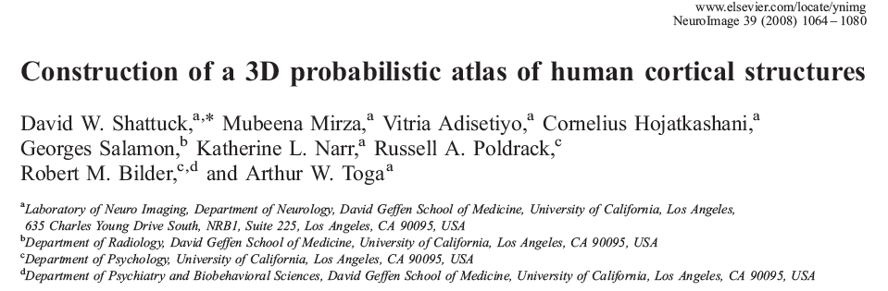
References for image
Cortex/brainstem
Cerebellum
Diedrichsen, J., Balster, J.H., Flavell, J., Cussans, E., Ramnani, N. (2009). A probabilistic MR atlas of the human cerebellum. Neuroimage.
Thalamus
H. Johansen-Berg, T.E.J. Behrens,E.L. Sillery, O. Ciccarelli, C.A.M. Wheeler-Kingshott, A.J. Thompson, S.M. Smith and P.M. Matthews.
Functional Anatomical validation and individual variation of diffusion tractography-based segmentation of the human thalamus.
Cerebral Cortex: 2005 Jan;15(1):31-9

