Slide 1

Introduction to Data Mining
Yücel SAYGIN
ysaygin@sabanciuniv.edu
http://people.sabanciuniv.edu/~ysaygin/

Slide 2
A Brief History
Historically, we had operational databases, ex: for accounts, customers, personnel of a bank
Data collection is now very easy and storage is very cheap
Enterprises are in a data collection frenzy hoping that they can use that later on
Data warehouses:
  Integrating historical data from multiple sources
  For high level decision making
Data Mining

Slide 3
Overview of Data Mining
Why do we need data mining?
  Data collection is easy, and huge amounts of data is collected everyday into flat files, databases and data warehouses
  We have lots of data but this data needs to be turned into knowledge
  Data mining technology tries to extract useful knowledge from huge collections of data

Slide 4
Overview of Data Mining
Data mining definition: Extraction of interesting information from large data sources
The extracted information should be
  Implicit
  Non-trivial
  Previously unknown
  and potentially useful
Query processing, simple statistics are not data mining
Databases + Statistics + Machine Learning = Data Mining

Slide 5
Overview of Data Mining
Data mining applications
  Market basket analysis
  CRM (loyalty detection, churn detection)
  Fraud detection
  Stream mining
  Web mining
  Mining of bioinformatics data

Slide 6
Overview of Data Mining
Retail market, as a case study:
  What type of data is collected?
  What type of knowledge do we need about customers?
  Is it useful to know the customer buying patterns?
  Is it useful to segment the customers?

Slide 7
Overview of Data Mining
Advertisement of a product: A case study
  Send all the customers a brochure
  Or send a targeted list of customers a brochure
  Sending a smaller targeted list aims to guarantee a high percentage of response, cutting the mailing cost

Slide 8
Overview of Data Mining
What complicates things in data mining?
  Incomplete and noisy data
  Complex data types
  Heterogeneous data sources
  Size of data (need to have distributed, parallel scalable algorithms)

Slide 9
Data Mining Models
Patterns (Associations, sequences, temporal sequences)
Clusters (Descriptive)
Predictive models (Classification)

Slide 10
Associations (As an example of patterns)
Remember the case study of retail market, and market basket analysis
Remember the type of data collected
Associations are among the most popular patterns that can be extracted from transactional data.
We will explain the properties of associations and how they could be extracted from large collections of transactions efficiently based on the slide of the book : “Data Mining Concepts and Techniques” by Jiawei Han and Micheline Kamber.

Slide 11
What Is Association Mining?
Association rule mining:
  Finding frequent patterns, associations, correlations, or causal structures among sets of items or objects in transaction databases, relational databases, and other information repositories.
Applications:
  Basket data analysis, cross-marketing, catalog design, clustering, classification, etc.
Examples.
  Rule form: “Body → Ηead [support, confidence]”.
  buys(x, “diapers”) → buys(x, “beers”) [0.5%, 60%]
  major(x, “CS”) ^ takes(x, “DB”) → grade(x, “A”) [1%, 75%]

Slide 12
Association Rule: Basic Concepts
Given:
  (1) database of transactions,
  (2) each transaction is a list of items (purchased by a customer in a visit)
Find: all rules that correlate the presence of one set of items with that of another set of items
  E.g., 98% of people who purchase tires and auto accessories also get automotive services done
Applications
  * ⇒ Maintenance Agreement (What the store should do to boost Maintenance Agreement sales)
  Home Electronics ⇒ * (What other products should the store stocks up?)
  Attached mailing in direct marketing
  Detecting “ping-pong”ing of patients, faulty “collisions”

Slide 13
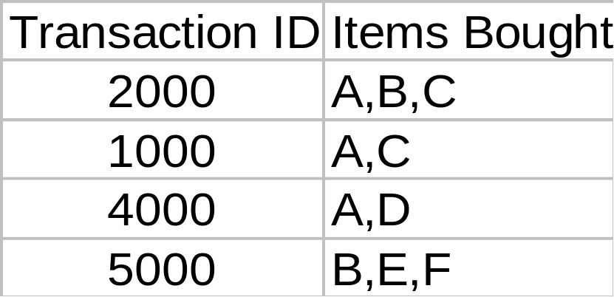
Rule Measures: Support and Confidence
Customer
buys both
Customer
buys diaper
Find all the rules X & Y ⇒ Z with minimum confidence and support
  support, s, probability that a transaction contains {X & Y & Z}
  confidence, c, conditional probability that a transaction having {X & Y} also contains Z
Customer
buys beer
Let minimum support 50%, and minimum confidence 50%, we have
  A ⇒ C (50%, 66.6%)
  C ⇒ A (50%, 100%)

Slide 14
Association Rule Mining: A Road Map
Boolean vs. quantitative associations (Based on the types of values handled)
  buys(x, “SQLServer”) ^ buys(x, “DMBook”) → buys(x, “DBMiner”) [0.2%, 60%]
  age(x, “30..39”) ^ income(x, “42..48K”) → buys(x, “PC”) [1%, 75%]
Single dimension vs. multiple dimensional associations (see ex. Above)
Single level vs. multiple-level analysis
  What brands of beers are associated with what brands of diapers?
Various extensions
  Correlation, causality analysis
    Association does not necessarily imply correlation or causality
  Maxpatterns and closed itemsets
  Constraints enforced E.g., small sales (sum < 100) trigger big buys (sum > 1,000)?

Slide 15
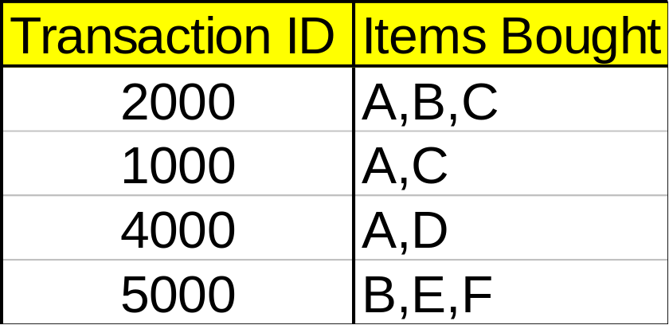
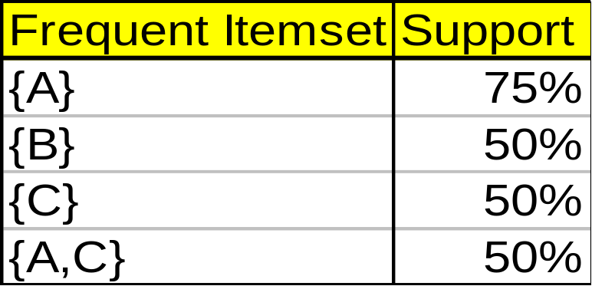
Mining Association Rules—An Example
Min. support 50%
Min. confidence 50%
For rule A ⇒ C:
  support = support({A C}) = 50%
  confidence = support({A C})/support({A}) = 66.6%
The Apriori principle: (Agrawal and Srikant)
  Any subset of a frequent itemset must be frequent

Slide 16
Mining Frequent Itemsets: the Key Step
Find the frequent itemsets: the sets of items that have minimum support
  A subset of a frequent itemset must also be a frequent itemset
    i.e., if {A B} is a frequent itemset, both {A} and {B} should be a frequent itemset
  Iteratively find frequent itemsets with cardinality from 1 to k (k-itemset)
Use the frequent itemsets to generate association rules.

Slide 17
The Apriori Algorithm
Join Step: C_{k} is generated by joining L_{k-1}with itself
Prune Step: Any (k-1)-itemset that is not frequent cannot be a subset of a frequent k-itemset
Pseudo-code:
    C_{k}: Candidate itemset of size k
    L_{k} : frequent itemset of size k
    L₁ = {frequent items};
    for (k = 1; L_{k} !=∅; k++) do begin
    C_{k+1} = candidates generated from L_{k};
    for each transaction t in database do
      increment the count of all candidates in C_{k+1} that are contained in t
    L_{k+1} = candidates in C_{k+1} with min_support
    end
    return ∪_{k} L_{k};

Slide 18
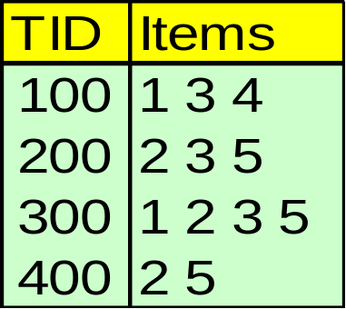
The Apriori Algorithm — Example
Database D
Find frequent sets of items with support 40% or more

Slide 19
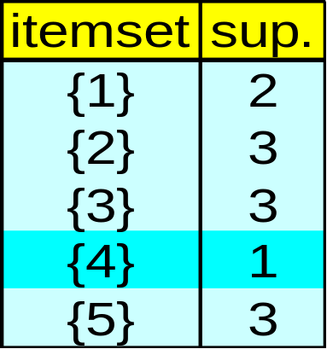
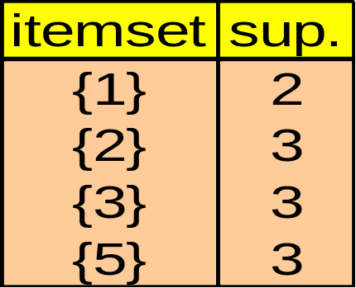
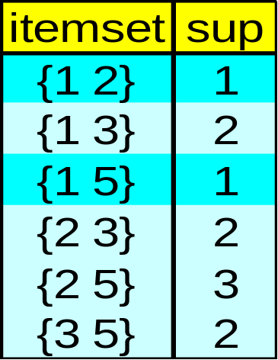
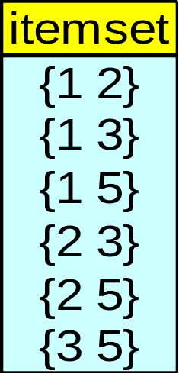

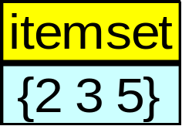
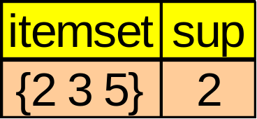
The Apriori Algorithm — Example
Database D
L₁
C₁
Scan D
C₂
C₂
L₂
Scan D
C₃
Scan D
L₃

Slide 20
How to Generate Candidates?
Suppose the items in L_{k-1} are listed in an order
Step 1: self-joining L_{k-1}
  insert into C_{k}
  select p.item₁, p.item₂, …, p.item_{k-1}, q.item_{k-1}
  from L_{k-1} p, L_{k-1} q
  where p.item₁=q.item₁, …, p.item_{k-2}=q.item_{k-2}, p.item_{k-1} < q.item_{k-1}
Step 2: pruning
  forall itemsets c in C_{k} do
    forall (k-1)-subsets s of c do
      if (s is not in L_{k-1}) then delete c from C_{k}

Slide 21
Example of Generating Candidates
L₃={abc, abd, acd, ace, bcd}
Self-joining: L₃*L₃
  abcd from abc and abd
  acde from acd and ace
Pruning:
  acde is removed because ade is not in L₃
C₄={abcd}

Slide 22
How to Count Supports of Candidates?
Why counting supports of candidates is a problem?
  The total number of candidates can be very huge
  One transaction may contain many candidates
Method:
  Candidate itemsets are stored in a hash-tree
  Leaf node of hash-tree contains a list of itemsets and counts
  Interior node contains a hash table
  Subset function: finds all the candidates contained in a transaction

Slide 23
How to Generate Candidates?
Assume that you have a relational database for storing customer transactions
Design simple queries for counting the frequent itemsets
Design a little system with database interaction for mining associations

Slide 24
Methods to Improve Apriori’s Efficiency
Hash-based itemset counting: A k-itemset whose corresponding hashing bucket count is below the threshold cannot be frequent
Transaction reduction: A transaction that does not contain any frequent k-itemset is useless in subsequent scans
Partitioning: Any itemset that is potentially frequent in DB must be frequent in at least one of the partitions of DB
Sampling: mining on a subset of given data, lower support threshold + a method to determine the completeness
Dynamic itemset counting: add new candidate itemsets only when all of their subsets are estimated to be frequent

Slide 25
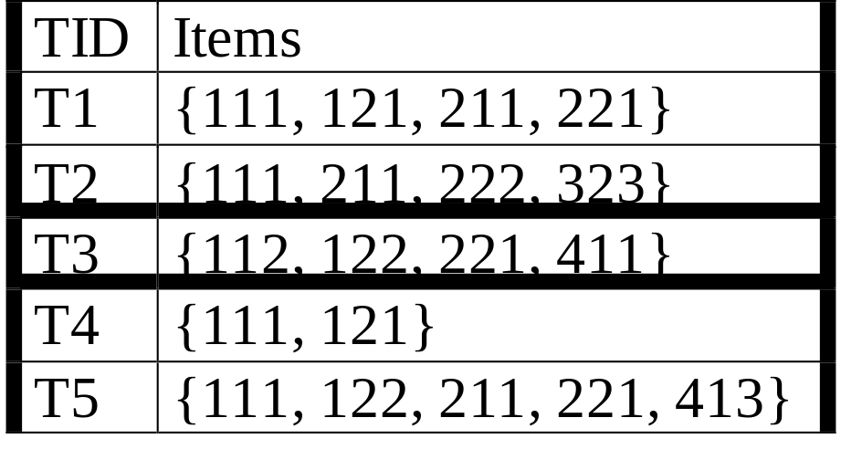
Multiple-Level Association Rules
Food
Items often form hierarchy.
Items at the lower level are expected to have lower support.
Rules regarding itemsets at
appropriate levels could be quite useful.
Transaction database can be encoded based on dimensions and levels
We can explore shared multi-level mining
milk
bread
skim
2%
wheat
white
Fraser
Sunset

Slide 26
Classification
Is an example of predictive modelling
The basic idea is to build a model using past data to predict the class of a new data sample.
Lets remember the case of targeted mailing of brochures.
IF we can work on a small well selected sample to profile the future customers who will respond to the mail ad, then we can save the mailing costs.
The following slides are based on the slides of the book “Data Mining Concepts and Techniques” by Jiawei Han and Micheline Kamber.

Slide 27
Classification—A Two-Step Process
Model construction: describing a set of predetermined classes
  Each tuple/sample is assumed to belong to a predefined class, as determined by the class label attribute
  The set of tuples used for model construction is training set
  The model is represented as classification rules, decision trees, or mathematical formulae
Model usage: for classifying future or unknown objects
  Estimate accuracy of the model
    The known label of test sample is compared with the classified result from the model
    Accuracy rate is the percentage of test set samples that are correctly classified by the model
    Test set is independent of training set, otherwise over-fitting will occur
  If the accuracy is acceptable, use the model to classify data tuples whose class labels are not known

Slide 28
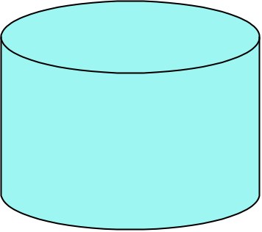
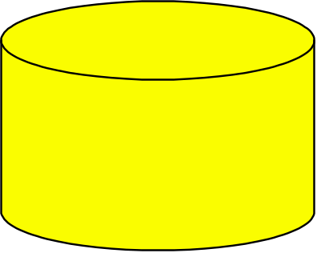
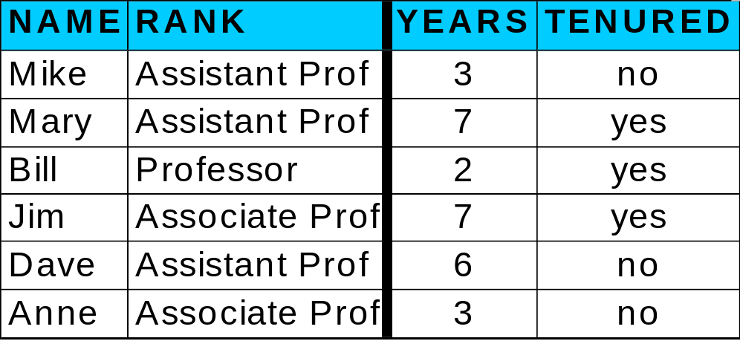
Classification Process (1): Model Construction
Classification
Algorithms
Training
Data
Classifier
(Model)
IF rank = ‘professor’
OR years > 6
THEN tenured = ‘yes’

Slide 29
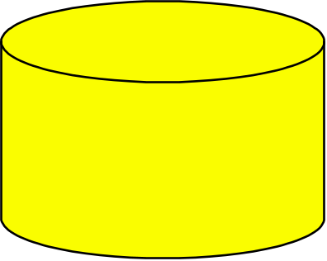
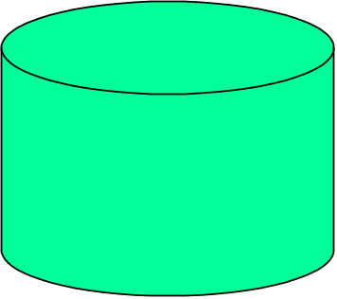
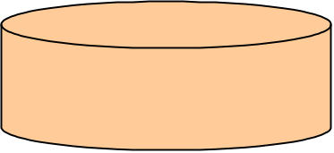
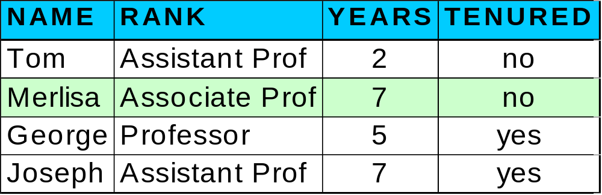

Classification Process (2): Use the Model in Prediction
Classifier
Testing
Data
Unseen Data
(Jeff, Professor, 4)
Tenured?

Slide 30
Supervised vs. Unsupervised Learning
Supervised learning (classification)
  Supervision: The training data (observations, measurements, etc.) are accompanied by labels indicating the class of the observations
  New data is classified based on the training set
Unsupervised learning (clustering)
  The class labels of training data is unknown
  Given a set of measurements, observations, etc. with the aim of establishing the existence of classes or clusters in the data

Slide 31
Issues regarding classification and prediction (1): Data Preparation
Data cleaning
  Pre-process data in order to reduce noise and handle missing values
Relevance analysis (feature selection)
  Remove the irrelevant or redundant attributes
Data transformation
  Generalize and/or normalize data

Slide 32
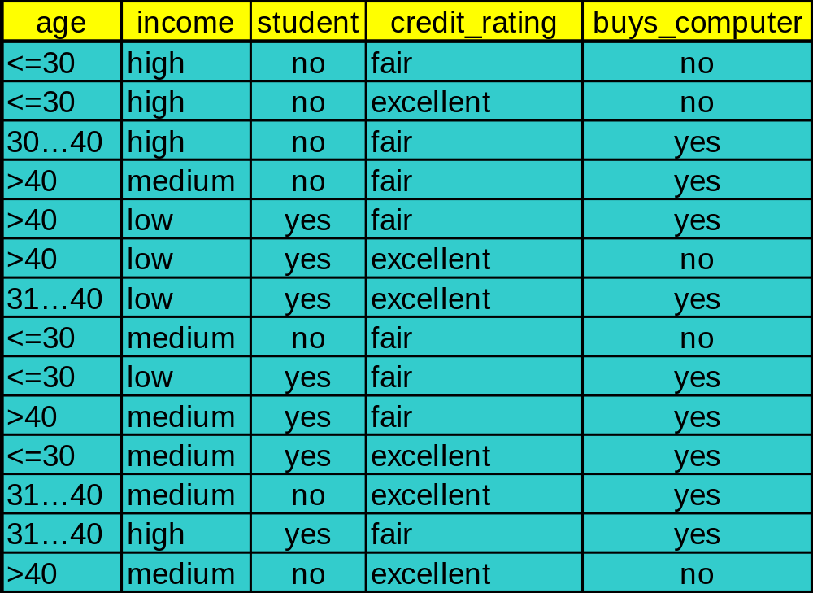
Training Dataset
This follows an example from Quinlan’s ID3

Slide 33
Output: A Decision Tree for “buys_computer”
age?
<=30
overcast
>40
30..40
student?
yes
credit rating?
no
yes
excellent
fair
no
yes
no
yes

Slide 34
Algorithm for Decision Tree Induction
Basic algorithm (a greedy algorithm)
  Tree is constructed in a top-down recursive divide-and-conquer manner
  At start, all the training examples are at the root
  Attributes are categorical (if continuous-valued, they are discretized in advance)
  Examples are partitioned recursively based on selected attributes
  Test attributes are selected on the basis of a heuristic or statistical measure (e.g., information gain)
Conditions for stopping partitioning
  All samples for a given node belong to the same class
  There are no remaining attributes for further partitioning – majority voting is employed for classifying the leaf
  There are no samples left

Slide 35
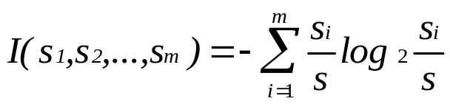
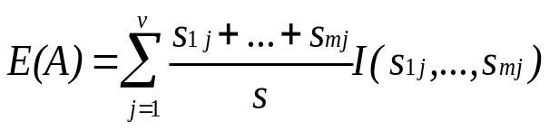

Attribute Selection Measure - Information Gain (ID3/C4.5)
Select the attribute with the highest information gain
S contains s_{i} tuples of class C_{i} for i = {1, …, m}
information measures info required to classify any arbitrary tuple
entropy of attribute A with values {a₁,a₂,…,a_{v}}
information gained by branching on attribute A

Slide 36
Attribute Selection by Information Gain Computation
Class P: buys_computer = “yes”
Class N: buys_computer = “no”
I(p, n) = I(9, 5) =0.940

Slide 37
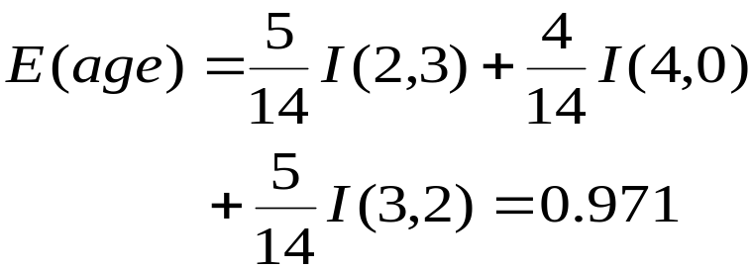
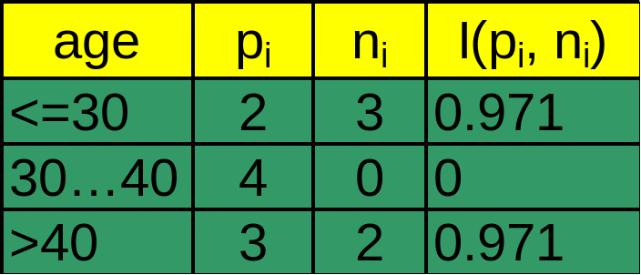
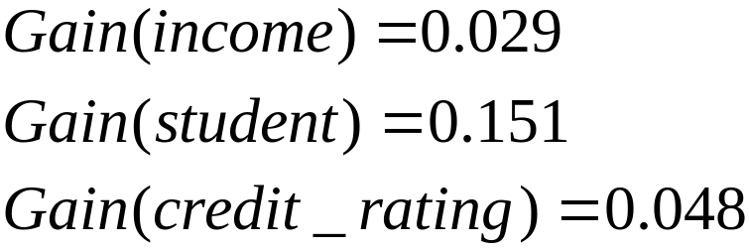
Attribute Selection by Information Gain Computation
Class P: buys_computer = “yes”
Class N: buys_computer = “no”
I(p, n) = I(9, 5) =0.940
Compute the entropy for age:
Hence
Similarly

Slide 38
Other Attribute Selection Measures
Gini index (CART, IBM IntelligentMiner)
  All attributes are assumed to be continuous-valued
  Assume there exist several possible split values for each attribute
  May need other tools, such as clustering, to get the possible split values
  Can be modified for categorical attributes

Slide 39
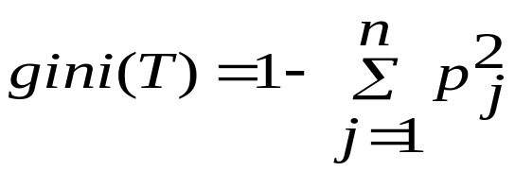
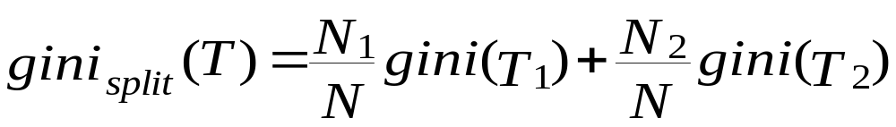
Gini Index (IBM IntelligentMiner)
If a data set T contains examples from n classes, gini index, gini(T) is defined as
where p_{j} is the relative frequency of class j in T.
If a data set T is split into two subsets T₁ and T₂ with sizes N₁ and N₂ respectively, the gini index of the split data contains examples from n classes, the gini index gini(T) is defined as
The attribute provides the smallest gini_{split}(T) is chosen to split the node (need to enumerate all possible splitting points for each attribute).

Slide 40
Extracting Classification Rules from Trees
Represent the knowledge in the form of IF-THEN rules
One rule is created for each path from the root to a leaf
Each attribute-value pair along a path forms a conjunction
The leaf node holds the class prediction
Rules are easier for humans to understand
Example
  IF age = “<=30” AND student = “no” THEN buys_computer = “no”
  IF age = “<=30” AND student = “yes” THEN buys_computer = “yes”
  IF age = “31…40” THEN buys_computer = “yes”
  IF age = “>40” AND credit_rating = “excellent” THEN buys_computer = “yes”
  IF age = “<=30” AND credit_rating = “fair” THEN buys_computer = “no”
September 15, 2004

Slide 41
Avoid Overfitting in Classification
The generated tree may overfit the training data
  Too many branches, some may reflect anomalies due to noise or outliers
  Result is in poor accuracy for unseen samples
Two approaches to avoid overfitting
  Prepruning: Halt tree construction early—do not split a node if this would result in the goodness measure falling below a threshold
    Difficult to choose an appropriate threshold
  Postpruning: Remove branches from a “fully grown” tree—get a sequence of progressively pruned trees
    Use a set of data different from the training data to decide which is the “best pruned tree”
September 15, 2004

Slide 42
Approaches to Determine the Final Tree Size
Separate training (2/3) and testing (1/3) sets
Use cross validation, e.g., 10-fold cross validation
Use all the data for training
  but apply a statistical test (e.g., chi-square) to estimate whether expanding or pruning a node may improve the entire distribution
September 15, 2004

Slide 43
Bayesian Classification: Why?
Probabilistic learning: Calculate explicit probabilities for hypothesis, among the most practical approaches to certain types of learning problems
Incremental: Each training example can incrementally increase/decrease the probability that a hypothesis is correct. Prior knowledge can be combined with observed data.
Probabilistic prediction: Predict multiple hypotheses, weighted by their probabilities
Standard: Even when Bayesian methods are computationally intractable, they can provide a standard of optimal decision making against which other methods can be measured
September 15, 2004

Slide 44
Bayesian Theorem: Basics
Let X be a data sample whose class label is unknown
Let H be a hypothesis that X belongs to class C
For classification problems, determine P(H/X): the probability that the hypothesis holds given the observed data sample X
P(H): prior probability of hypothesis H (i.e. the initial probability before we observe any data, reflects the background knowledge)
P(X): probability that sample data is observed
P(X|H) : probability of observing the sample X, given that the hypothesis holds
September 15, 2004

Slide 45
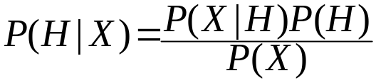
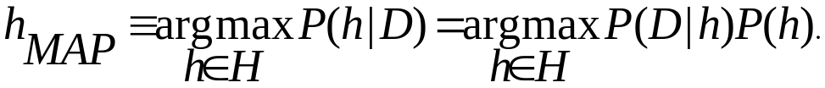
Bayesian Theorem
Given training data X, posteriori probability of a hypothesis H, P(H|X) follows the Bayes theorem
Informally, this can be written as
  posterior =likelihood x prior / evidence
MAP (maximum posteriori) hypothesis
Practical difficulty: require initial knowledge of many probabilities, significant computational cost
September 15, 2004

Slide 46
Naïve Bayesian Classifier
Each data sample X is represented as a vector {x₁, x₂, …, x_{n}}
There are m classes C₁, C₂, …, C_{m}
Given unknown data sample X, the classifier will predict that X belongs to class C_{i}, iff
  P(C_{i}|X) > P (C_{j}|X) where 1 ≤ j ≤ m , I ≠ J
  By Bayes theorem, P(C_{i}|X)= P(X|C_{i})P(C_{i})/ P(X)
September 15, 2004

Slide 47
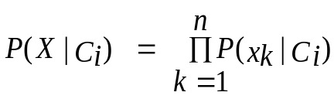
Naïve Bayes Classifier
A simplified assumption: attributes are conditionally independent:
The product of occurrence of say 2 elements x₁ and x₂, given the current class is C, is the product of the probabilities of each element taken separately, given the same class P([y₁,y₂],C) = P(y₁,C) * P(y₂,C)
No dependence relation between attributes
Greatly reduces the computation cost, only count the class distribution.
Once the probability P(X|C_{i}) is known, assign X to the class with maximum P(X|C_{i})*P(C_{i})
September 15, 2004

Slide 48
Training dataset
Class:
C1:buys_computer=
‘yes’
C2:buys_computer=
‘no’
Data sample
X =(age<=30,
Income=medium,
Student=yes
Credit_rating=
Fair)
September 15, 2004

Slide 49
Naïve Bayesian Classifier: Example
Compute P(X/Ci) for each class
P(age=“<30” | buys_computer=“yes”) = 2/9=0.222
P(age=“<30” | buys_computer=“no”) = 3/5 =0.6
P(income=“medium” | buys_computer=“yes”)= 4/9 =0.444
P(income=“medium” | buys_computer=“no”) = 2/5 = 0.4
P(student=“yes” | buys_computer=“yes)= 6/9 =0.667
P(student=“yes” | buys_computer=“no”)= 1/5=0.2
P(credit_rating=“fair” | buys_computer=“yes”)=6/9=0.667
P(credit_rating=“fair” | buys_computer=“no”)=2/5=0.4
X=(age<=30 ,income =medium, student=yes,credit_rating=fair)
P(X|Ci) : P(X|buys_computer=“yes”)= 0.222 x 0.444 x 0.667 x 0.0.667 =0.044
P(X|buys_computer=“no”)= 0.6 x 0.4 x 0.2 x 0.4 =0.019
P(X|Ci)*P(Ci ) : P(X|buys_computer=“yes”) * P(buys_computer=“yes”)=0.028
P(X|buys_computer=“no”) * P(buys_computer=“no”)=0.007
X belongs to class “buys_computer=yes”
September 15, 2004

Slide 50
Naïve Bayesian Classifier: Comments
Advantages :
  Easy to implement
  Good results obtained in most of the cases
Disadvantages
  Assumption: class conditional independence , therefore loss of accuracy
  Practically, dependencies exist among variables
  E.g., hospitals : patients: Profile : age, family history etc
  Symptoms : fever, cough etc , Disease : lung cancer, diabetes etc , Dependencies among these cannot be modeled by Naïve Bayesian Classifier, use a Bayesian network
How to deal with these dependencies?
  Bayesian Belief Networks
September 15, 2004

Slide 51
k-NN Classifier:
Learning by analogy,
Each sample is a point in n-dimensional space
Given an unknown sample u,
  search for the k nearest samples
  Closeness can be defined in Euclidean space
  Assign the most common class to u.
Instance based, (Lazy) learning while decision trees are eager
K-NN requires the whole sample space for classification therefore indexing is needed for efficient search.
September 15, 2004

Slide 52
Case-based reasoning
Similar to K-NN,
When a new case arrives, and identical case is searched
If not, most similar case is searched
Depending on the representation, different search techniques are needed, for example graph/subgraph search
September 15, 2004

Slide 53
Genetic Algorithms
Incorporate ideas from natural evolution
Rules are represented as a sequence of bits
  IF A1 and NOT A2 THEN C2 : 1 0 0
  Initially generate a sequence of random rules
  Choose the fittest rules
  Create offspring by using genetic operations such as
    crossover (by swapping substrings from pairs of rules)
    and mutation (inverting randomly selected bits)
September 15, 2004

Slide 54
Data Mining Tools
WEKA (Univ of Waikato, NZ)
Open source implementation of data mining algorithms
Implemented in Java
Nice API
Link : Google WEKA, first entry

Slide 55
Benchmarks
Important for testing the performance of various algorithms against various datasets
UCI Machine Learning Repository is a very good data source
Try a data sample from there and see how you can apply the classification algorithms

Slide 56
Clustering
A descriptive data mining method
Groups a given dataset into smaller clusters, where the data inside the clusters are similar to each other while the data belonging to different clusters are dissimilar
Similar to classification in a sense but this time we do not know the labels of clusters. Therefore it is an unsupervised method.
Lets go back to the retail market example. How can we segment our customers with respect to their profiles and shopping behaviour.
The following slides are based on the slides of the book “Data Mining Concepts and Techniques” by Jiawei Han and Micheline Kamber.

Slide 57
What Is Good Clustering?
A good clustering method will produce high quality clusters with
  high intra-class similarity
  low inter-class similarity
The quality of a clustering result depends on both the similarity measure used by the method and its implementation.
The quality of a clustering method is also measured by its ability to discover some or all of the hidden patterns.

Slide 58
Requirements of Clustering in Data Mining
Scalability
Ability to deal with different types of attributes
Discovery of clusters with arbitrary shape
Able to deal with noise and outliers
Insensitive to order of input records
High dimensionality
Interpretability and usability

Slide 59
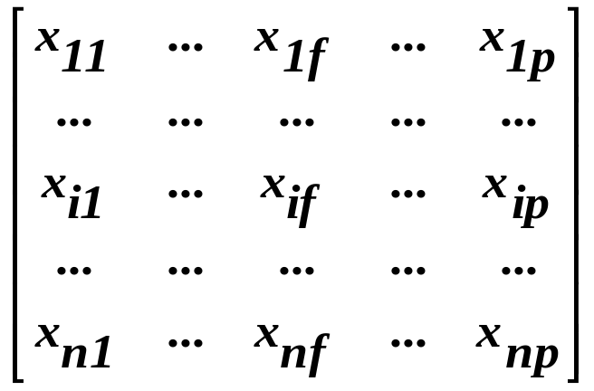

Data Structures
Data matrix
Dissimilarity matrix

Slide 60
Measure the Quality of Clustering
Dissimilarity/Similarity metric: Similarity is expressed in terms of a distance function, which is typically metric: d(i, j)
There is a separate “quality” function that measures the “goodness” of a cluster.
The definitions of distance functions are usually very different for interval-scaled, boolean, categorical, ordinal and ratio variables.
Weights should be associated with different variables based on applications and data semantics.
It is hard to define “similar enough” or “good enough”
  the answer is typically highly subjective.
September 15, 2004

Slide 61
Type of data in clustering analysis
Interval-scaled variables:
Binary variables:
Nominal, ordinal, and ratio variables:
Variables of mixed types:
September 15, 2004

Slide 62


Interval-scaled variables
Standardize data
  Calculate the mean absolute deviation:
  where
  Calculate the standardized measurement (z-score)
Using mean absolute deviation is more robust than using standard deviation

Slide 63


Similarity and Dissimilarity Between Objects
Distances are normally used to measure the similarity or dissimilarity between two data objects
Some popular ones include: Minkowski distance:
  where i = (x_{i1}, x_{i2}, …, x_{ip}) and j = (x_{j1}, x_{j2}, …, x_{jp}) are two p-dimensional data objects, and q is a positive integer
If q = 1, d is Manhattan distance

Slide 64

Similarity and Dissimilarity Between Objects (Cont.)
If q = 2, d is Euclidean distance:
  Properties
    d(i,j) ≥ 0
    d(i,i) = 0
    d(i,j) = d(j,i)
    d(i,j) ≤ d(i,k) + d(k,j)
Also one can use weighted distance.

Slide 65



Binary Variables
A contingency table for binary data
Simple matching coefficient (invariant, if the binary variable is symmetric):
Jaccard coefficient (noninvariant if the binary variable is asymmetric):
Object j
Object i

Slide 66
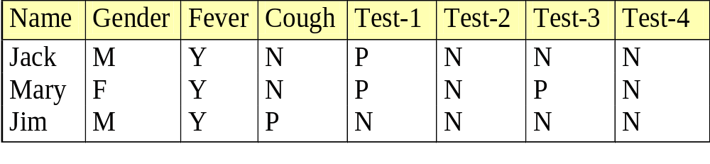

Dissimilarity between Binary Variables
Example
  gender is a symmetric attribute
  the remaining attributes are asymmetric binary
  let the values Y and P be set to 1, and the value N be set to 0

Slide 67

Nominal Variables
A generalization of the binary variable in that it can take more than 2 states, e.g., red, yellow, blue, green
Method 1: Simple matching
  m: # of matches, p: total # of variables
Method 2: use a large number of binary variables
  creating a new binary variable for each of the M nominal states

Slide 68


Ordinal Variables
An ordinal variable can be discrete or continuous
order is important, e.g., rank
Can be treated like interval-scaled
  replacing x_{if} by their rank
  map the range of each variable onto [0, 1] by replacing i-th object in the f-th variable by
  compute the dissimilarity using methods for interval-scaled variables

Slide 69

Similarity and Dissimilarity Between Objects (Cont.)
If q = 2, d is Euclidean distance:
  Properties
    d(i,j) ≥ 0
    d(i,i) = 0
    d(i,j) = d(j,i)
    d(i,j) ≤ d(i,k) + d(k,j)
Also, one can use weighted distance, parametric
September 15, 2004

Slide 70
Ratio-Scaled Variables
Ratio-scaled variable: a positive measurement on a nonlinear scale, approximately at exponential scale, such as Ae^{Bt} or Ae^{-Bt}
Methods:
  treat them like interval-scaled variables — not a good choice! (why?)
  apply logarithmic transformation
y_{if} = log(x_{if})
  treat them as continuous ordinal data treat their rank as interval-scaled.
September 15, 2004

Slide 71
Major Clustering Approaches
Partitioning algorithms: Construct various partitions and then evaluate them by some criterion
Hierarchcal algorithms: Create a hierarchical decomposition of the set of data (or objects) using some criterion
Density-based: based on connectivity and density functions
September 15, 2004

Slide 72
Partitioning Algorithms: Basic Concept
Partitioning method: Construct a partition of a database D of n objects into a set of k clusters
Given a k, find a partition of k clusters that optimizes the chosen partitioning criterion
  Global optimal: exhaustively enumerate all partitions
  Heuristic methods: k-means and k-medoids algorithms
  k-means (MacQueen’67): Each cluster is represented by the center of the cluster
  k-medoids or PAM (Partition around medoids) (Kaufman & Rousseeuw’87): Each cluster is represented by one of the objects in the cluster
September 15, 2004

Slide 73
The K-Means Clustering Method
Given k, the k-means algorithm is implemented in four steps:
  Partition objects into k nonempty subsets
  Compute seed points as the centroids of the clusters of the current partition (the centroid is the center, i.e., mean point, of the cluster)
  Assign each object to the cluster with the nearest seed point
  Go back to Step 2, stop when no more new assignment
September 15, 2004

Slide 74
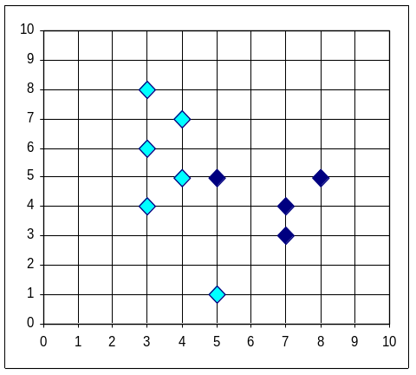


The K-Means Clustering Method
Example
10
10
9
9
8
8
7
7
6
6
5
5
4
Assign each objects to most similar center
Update the cluster means
4
3
3
2
2
1
1
0
0
0
1
2
3
4
5
6
7
8
9
10
0
1
2
3
4
5
6
7
8
9
10
reassign
reassign
K=2
Arbitrarily choose K object as initial cluster center
Update the cluster means
September 15, 2004

Slide 75
Comments on the K-Means Method
Strength: Relatively efficient: O(tkn), where n is # objects, k is # clusters, and t is # iterations. Normally, k, t << n.
    Comparing: PAM: O(k(n-k)² ), CLARA: O(ks² + k(n-k))
Comment: Often terminates at a local optimum. The global optimum may be found using techniques such as: deterministic annealing and genetic algorithms
Weakness
  Applicable only when mean is defined, then what about categorical data?
  Need to specify k, the number of clusters, in advance
  Unable to handle noisy data and outliers
  Not suitable to discover clusters with non-convex shapes
September 15, 2004

