Slide 1
The Relational Model
These slides are based on the slides of your text book.
Notes:
1
The slides for this text are organized into chapters. This lecture covers Chapter 3.
Chapter 1: Introduction to Database Systems
Chapter 2: The Entity-Relationship Model
Chapter 3: The Relational Model
Chapter 4 (Part A): Relational Algebra
Chapter 4 (Part B): Relational Calculus
Chapter 5: SQL: Queries, Programming, Triggers
Chapter 6: Query-by-Example (QBE)
Chapter 7: Storing Data: Disks and Files
Chapter 8: File Organizations and Indexing
Chapter 9: Tree-Structured Indexing
Chapter 10: Hash-Based Indexing
Chapter 11: External Sorting
Chapter 12 (Part A): Evaluation of Relational Operators
Chapter 12 (Part B): Evaluation of Relational Operators: Other Techniques
Chapter 13: Introduction to Query Optimization
Chapter 14: A Typical Relational Optimizer
Chapter 15: Schema Refinement and Normal Forms
Chapter 16 (Part A): Physical Database Design
Chapter 16 (Part B): Database Tuning
Chapter 17: Security
Chapter 18: Transaction Management Overview
Chapter 19: Concurrency Control
Chapter 20: Crash Recovery
Chapter 21: Parallel and Distributed Databases
Chapter 22: Internet Databases
Chapter 23: Decision Support
Chapter 24: Data Mining
Chapter 25: Object-Database Systems
Chapter 26: Spatial Data Management
Chapter 27: Deductive Databases
Chapter 28: Additional Topics

Slide 2
Why Study the Relational Model?
By “Codd”, 1970
Implementation: IBM’s, System R, by Chamberlain et. al.
SEQUEL
Most widely used model.
  Vendors: IBM, Informix, Microsoft, Oracle, Sybase, etc.
Recent competitor: object-oriented model
  ObjectStore, Versant, Ontos
  A synthesis: object-relational model
    Informix Universal Server, UniSQL, O2, Oracle, DB2
Notes:
2

Slide 3
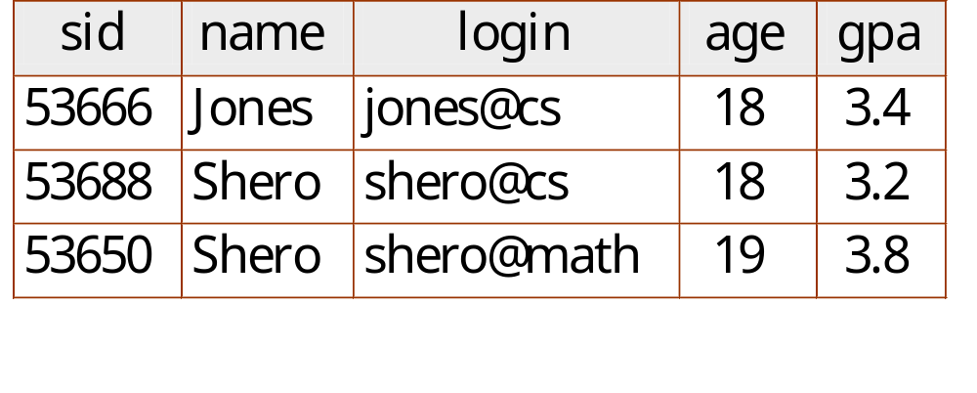
Relational Database: Definitions
Relational database: a set of relations
Notes:
3

Slide 4
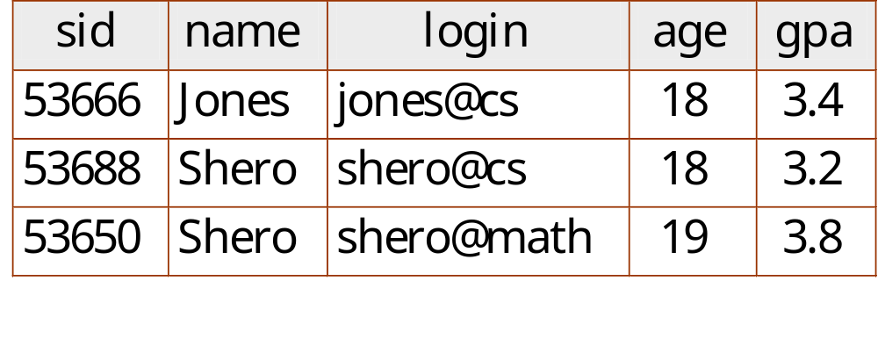
Relational Database: Definitions
Relation: made up of 2 parts:
  Instance : a table, with rows and columns.
  #Rows = cardinality, #fields = degree / arity.
  Schema : specifies name of relation, plus name and type of each column.
    E.G. Students(sid: string, name: string, login: string, age: integer, gpa: real).
Notes:
3

Slide 5
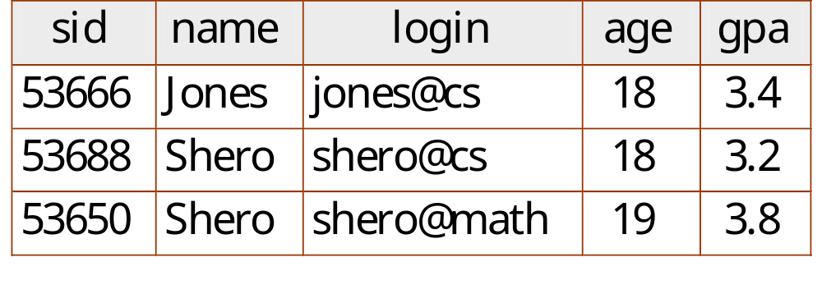
Relational Database: Definitions
You can think of a relation as a set of rows or tuples (i.e., all rows are distinct).
Notes:
3

Slide 6
Relational Query Languages
A major strength of the relational model: supports simple, powerful querying of data.
Queries can be written intuitively, and the DBMS is responsible for efficient evaluation.
Notes:
9

Slide 7
The SQL Query Language
Developed by IBM (system R) in the 1970s
Need for a standard since it is used by many vendors
Standards:
  SQL-86
  SQL-89 (minor revision)
  SQL-92 (major revision, current standard)
  SQL-99 (major extensions)

Slide 8
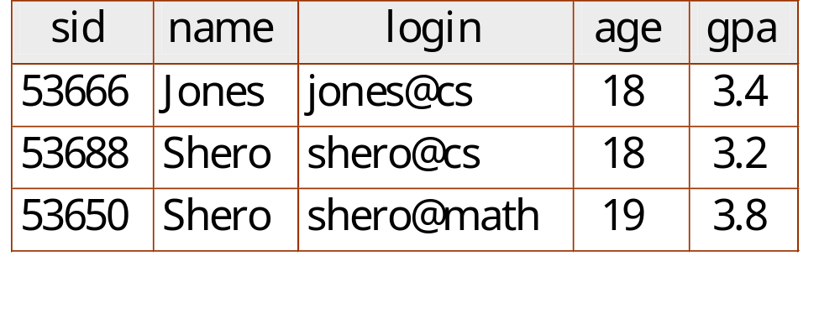
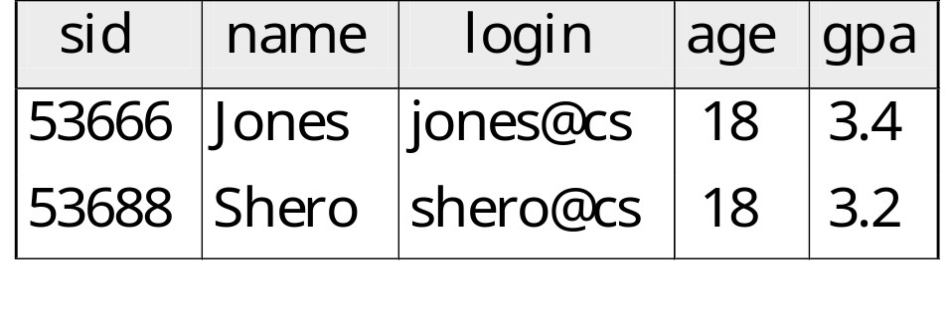
The SQL Query Language
Find all students
with age 18
SELECT *
FROM Students S
WHERE S.age=18

Slide 9

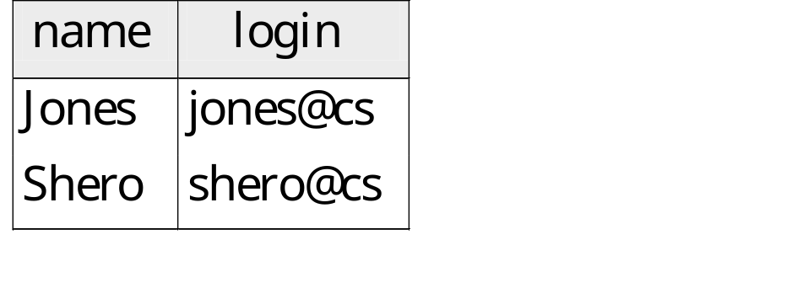
The SQL Query Language
Names and logins of
all students
with age 18
SELECT S.name, S.login
FROM Students S
WHERE S.age=18

Slide 10
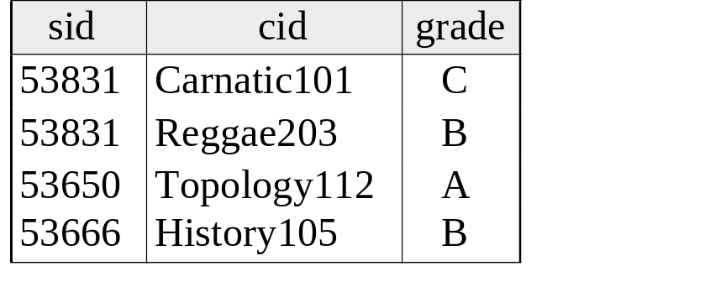
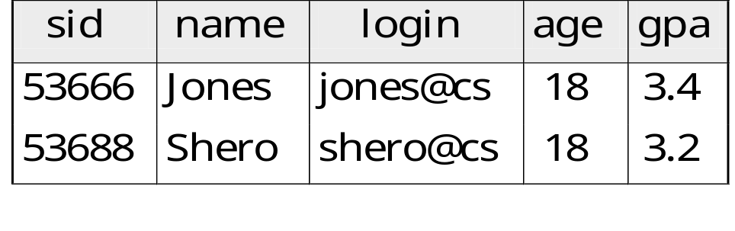
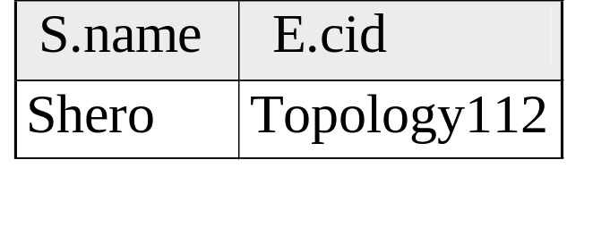
Querying Multiple Relations
Enrolled
Students
Names and cids of
Students who had an A
From the cid they are
enrolled
SELECT S.name, E.cid
FROM Students S, Enrolled E
WHERE S.sid=E.sid AND E.grade=“A”

Slide 11
Creating Relations in SQL
CREATE TABLE Students
(sid: CHAR(20),
name: CHAR(20),
login: CHAR(10),
age: INTEGER,
gpa: REAL)
Creates the Students relation. Observe that the type (domain) of each field is specified, and enforced by the DBMS whenever tuples are added or modified.
Notes:
15

Slide 12
Creating Relations in SQL
As another example, the Enrolled table holds information about courses that students take.
CREATE TABLE Enrolled
(sid: CHAR(20),
cid: CHAR(20),
grade: CHAR(2))
Notes:
15

Slide 13
Destroying and Altering Relations
DROP TABLE Students
Destroys the relation Students. The schema information and the tuples are deleted.
Notes:
16

Slide 14
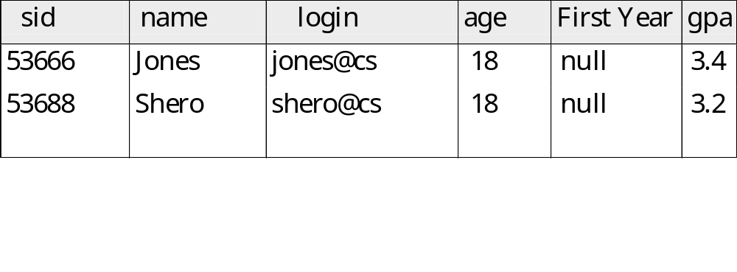
Destroying and Altering Relations
ALTER TABLE Students
ADD COLUMN firstYear: integer
The schema of Students is altered by adding a new field; every tuple in the current instance is extended with a null value in the new field.
Notes:
16

Slide 15
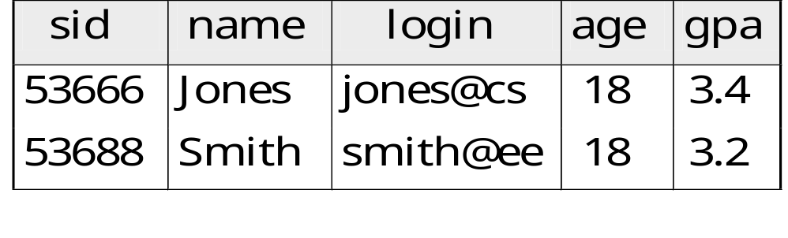
Adding and Deleting Tuples
Can insert a single tuple using
INSERT INTO Students (sid, name, login, age, gpa)
VALUES (53688, ‘Smith’, ‘smith@ee’, 18, 3.2)
Notes:
10

Slide 16
Adding and Deleting Tuples
Can delete all tuples satisfying some condition (e.g., name = Shero):
DELETE
FROM Students S
WHERE S.name = ‘Shero’
Powerful variants of these commands are available; more later!
Notes:
10

Slide 17
Integrity Constraints (ICs)
IC: condition that must be true for any instance of the database; e.g., domain constraints.
  ICs are specified when schema is defined.
  ICs are checked when relations are modified.
A legal instance of a relation is one that satisfies all specified ICs.
  DBMS should not allow illegal instances.
If the DBMS checks ICs, stored data is more faithful to real-world meaning.
  Avoids data entry errors, too!
Notes:
5

Slide 18
Primary Key Constraints
A set of fields is a key for a relation if :
  1. No two distinct tuples can have same values in all key fields, and
  2. This is not true for any subset of the key.
  Part 2 false? A superkey.
  If there’s >1 key for a relation, one of the keys is chosen (by DBA) to be the primary key.
E.g., sid is a key for Students. (What about name?) The set {sid, gpa} is a superkey.
Notes:
6

Slide 19
Primary and Candidate Keys in SQL
“For a given student and course, there is a single grade.”
CREATE TABLE Enrolled
(sid CHAR(20)
cid CHAR(20),
grade CHAR(2),
PRIMARY KEY (sid,cid) )
Notes:
6

Slide 20
Primary and Candidate Keys in SQL
Possibly many candidate keys (specified using UNIQUE), one of which is chosen as the primary key.
CREATE TABLE Enrolled
(sid CHAR(20)
cid CHAR(20),
grade CHAR(2),
PRIMARY KEY (sid),
UNIQUE (cid, grade) )
“Students can take only one course, and receive a single grade for that course; further, no two students in a course receive the same grade.”
Used carelessly, an IC can prevent the storage of database instances that arise in practice!
Notes:
6

Slide 21
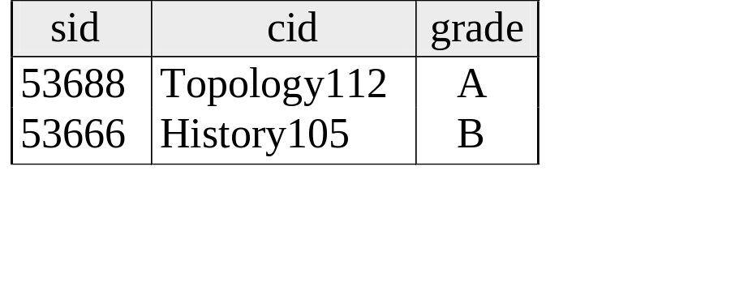
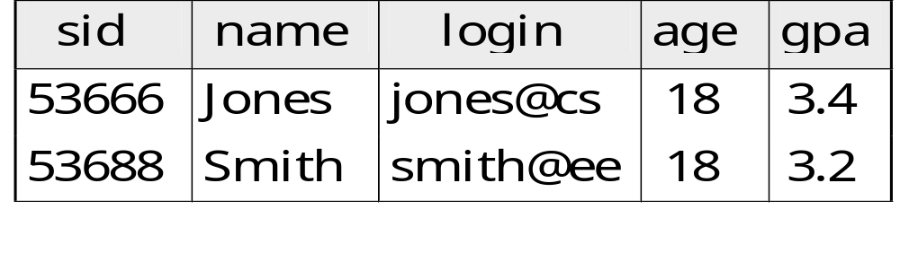
Foreign Keys, Referential Integrity
Foreign key : Set of fields in one relation that is used to `refer’ to a tuple in another relation. (Must correspond to primary key of the second relation.) Like a `logical pointer’.
E.g. sid is a foreign key referring to Students:
Notes:
7

Slide 22
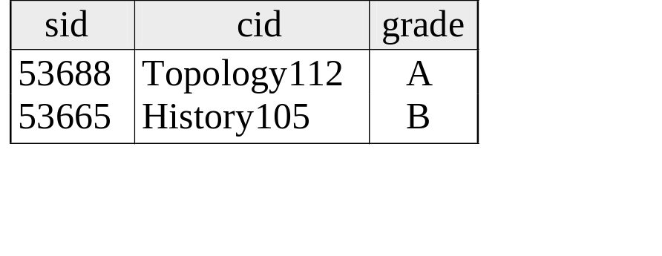
Foreign Keys, Referential Integrity
  If all foreign key constraints are enforced, referential integrity is achieved, i.e., no dangling references.
  Can you name a data model w/o referential integrity?
    Links in HTML!
Notes:
7

Slide 23
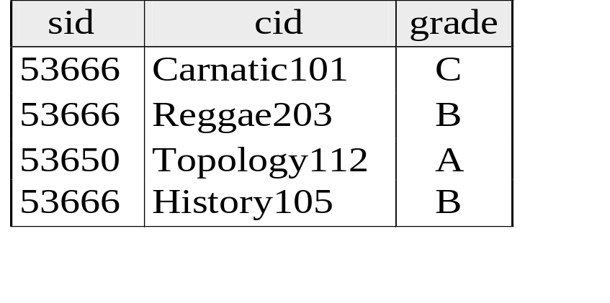
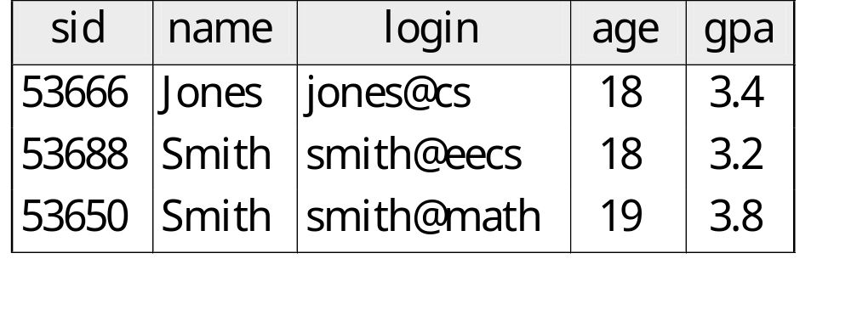
Foreign Keys in SQL
Only students listed in the Students relation should be allowed to enroll for courses.
CREATE TABLE Enrolled
(sid CHAR(20), cid CHAR(20), grade CHAR(2),
PRIMARY KEY (sid,cid),
FOREIGN KEY (sid) REFERENCES Students )
Enrolled
Students
Notes:
7

Slide 24
Enforcing Referential Integrity
Consider Students and Enrolled; sid in Enrolled is a foreign key that references Students.
What should be done if an Enrolled tuple with a non-existent student id is inserted?
Reject it!
Notes:
13

Slide 25
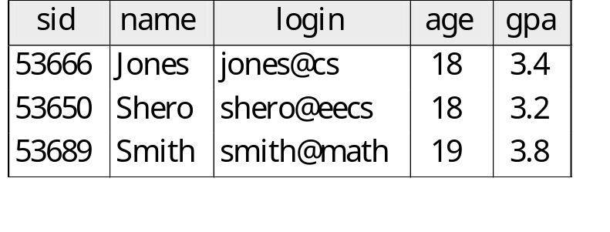
Enforcing Referential Integrity
What should be done if a Students tuple (say 53650) is deleted?
Also delete all Enrolled tuples that refer to it.
Disallow deletion of a Students tuple that is referred to.
Set sid in Enrolled tuples that refer to it to a default sid.
(In SQL, also: Set sid in Enrolled tuples that refer to it to a special value null, denoting `unknown’ or `inapplicable’.)
Similar if primary key of Students tuple is updated.
Notes:
13

Slide 26
Enforcing Referential Integrity
What should be done if primary key of Students tuple is updated.
Notes:
13

Slide 27
Referential Integrity in SQL/92
SQL/92 supports all 4 options on deletes and updates.
  Default is NO ACTION (delete/update is rejected)
  CASCADE (also delete all tuples that refer to deleted tuple)
  SET NULL / SET DEFAULT (sets foreign key value of referencing tuple)
CREATE TABLE Enrolled
(sid CHAR(20),
cid CHAR(20),
grade CHAR(2),
PRIMARY KEY (sid,cid),
FOREIGN KEY (sid)
REFERENCES Students
ON DELETE CASCADE
ON UPDATE SET DEFAULT )
Notes:
14

Slide 28
Where do ICs Come From?
ICs are based upon the semantics of the real-world enterprise that is being described in the database relations.
We can check a database instance to see if an IC is violated, but we can NEVER infer that an IC is true by looking at an instance.
  An IC is a statement about all possible instances!
  From example, we know name is not a key, but the assertion that sid is a key is given to us.
Key and foreign key ICs are the most common; more general ICs supported too.

Slide 29
Views
A view is just a relation, but we store a definition, rather than a set of tuples.
CREATE VIEW YoungActiveStudents (name, grade)
AS SELECT S.name, E.grade
FROM Students S, Enrolled E
WHERE S.sid = E.sid and S.age<21
Views can be dropped using the DROP VIEW command.
Notes:
18

Slide 30
ViewsContd.
Restrict data access and/or simplify data access
  Views can be used to present necessary information (or a summary), while hiding details in underlying relation(s).
  Given YoungStudents, but not Students or Enrolled, we can find students s who have are enrolled, but not the cid’s of the courses they are enrolled in.
Notes:
22

