Slide 1
LECTURE 3:
Relational Algebra
THESE SLIDES ARE BASED ON YOUR TEXT BOOK

Slide 2
Query Languages
For manipulation and retrieval of stored data
Relational model supports simple yet powerful query languages
Query languages are not as complex as programming languages
They are specialized for data manipulation and retrieval

Slide 3
Relational Algebra
It is a mathematical query language
Forms the basis of the SQL query language
Relational Calculus is another mathematical query language but it is declarative rather than operational
We will concentrate on relational algebra in this course

Slide 4
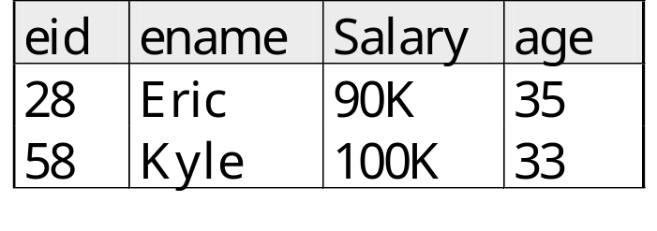
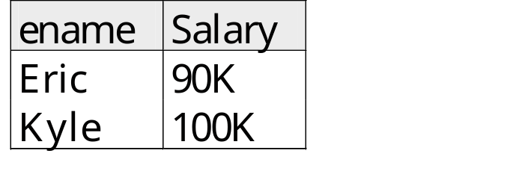
Basics of Querying
A query is applied to relation instances, and the result of a query is also a relation instance.

Slide 5

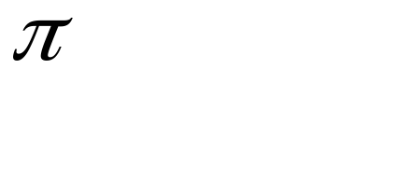
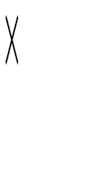


Relational Algebra Operations
Basic operations:
  Selection ( ) Selects a subset of rows from relation.
  Projection ( ) Deletes unwanted columns from relation.
  Cross-product ( ) Combines two relations.
  Set-difference ( ) Tuples in relation 1, but not in relation 2.
  Union ( ) Tuples in relation 1 and in relation 2.

Slide 6
Relational Algebra
Additional operations:
  Intersection,
  Join
  division,
  Renaming
Each operation returns a relation therefore operations can be composed

Slide 7
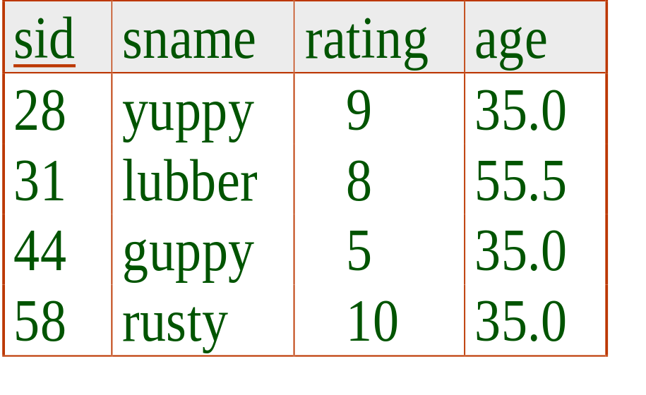
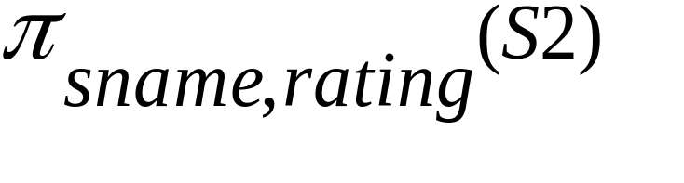
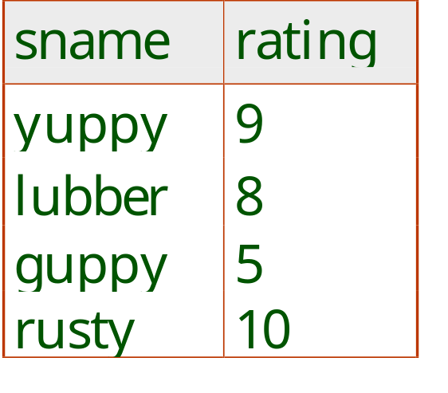
S2
Projection
Input is a single relation instance
Deletes attributes that are not in projection list.
Schema of result contains exactly the fields in the projection list, with the same names that they had in the input relation.
Projection operator has to eliminate duplicates (Why??)
  Note: real systems typically don’t do duplicate elimination unless the user explicitly asks for it. (Why not?)

Slide 8
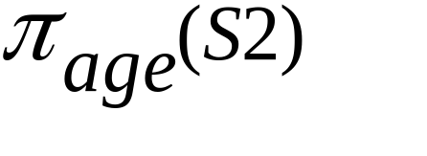
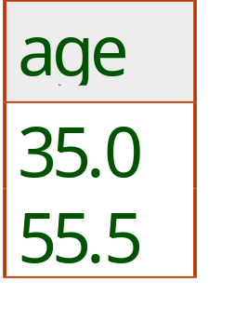
S2
Projection
Input is a single relation instance
Deletes attributes that are not in projection list.
Schema of result contains exactly the fields in the projection list, with the same names that they had in the input relation.
Projection operator has to eliminate duplicates (Why??)
  Note: real systems typically don’t do duplicate elimination unless the user explicitly asks for it. (Why not?)

Slide 9
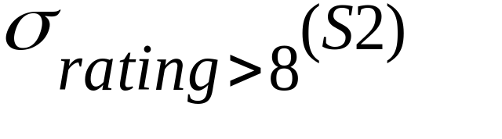
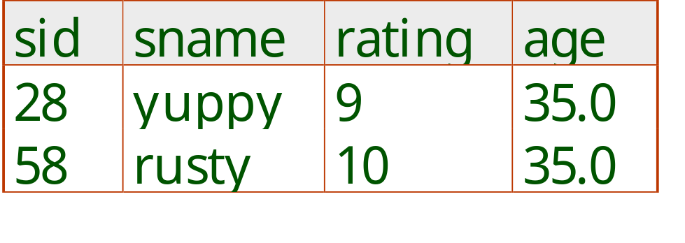
S2
Selection
Input is a single relation instance
Selects rows that satisfy selection condition.
No duplicates in result! (Why?)
Schema of result identical to schema of input relation.

Slide 10
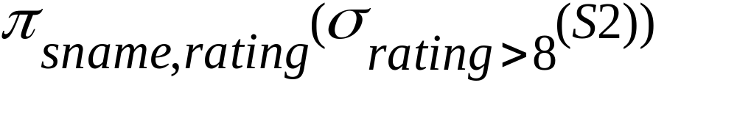
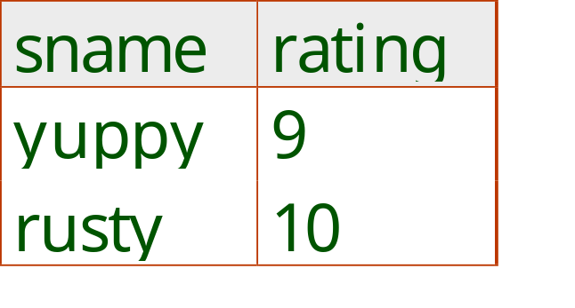
S2
Selection
Input is a single relation instance
Selects rows that satisfy selection condition.
No duplicates in result! (Why?)
Schema of result identical to schema of input relation.
Result relation can be the input for another relational algebra operation!

Slide 11
Union, Intersection, Set-Difference
All of these operations take two input relations, which must be union-compatible:
  Same number of fields.
  `Corresponding’ fields have the same type.
What is the schema of result?

Slide 12
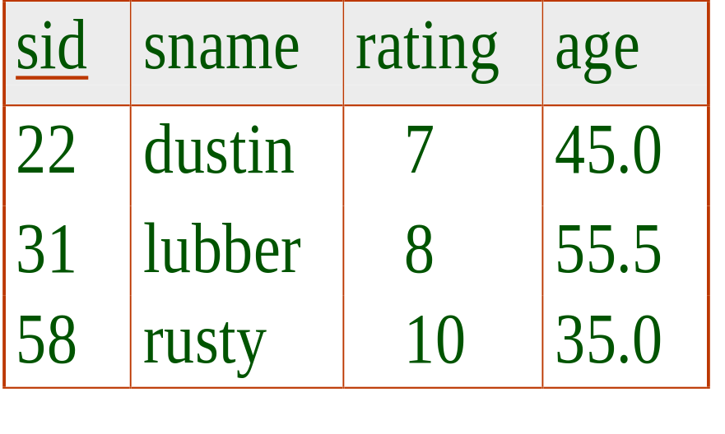
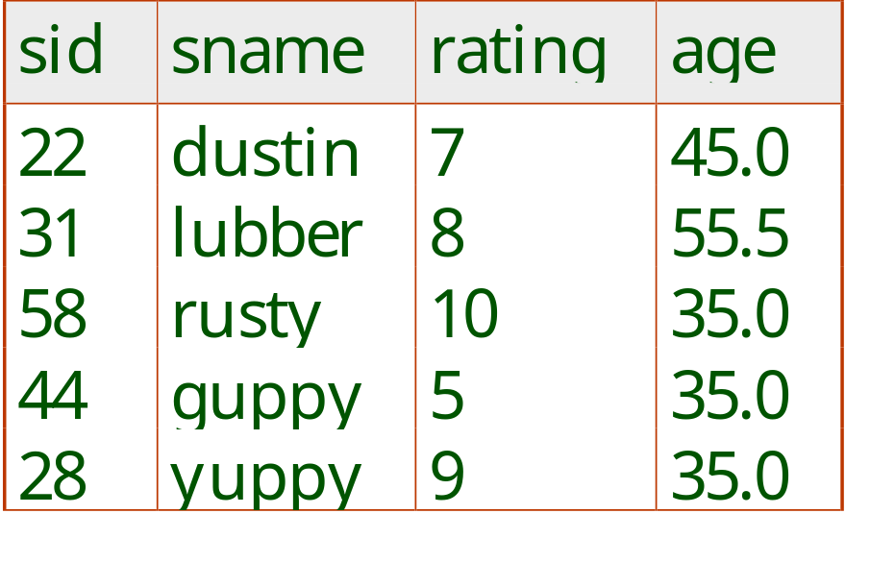
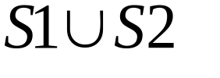
Union
S1
S2

Slide 13
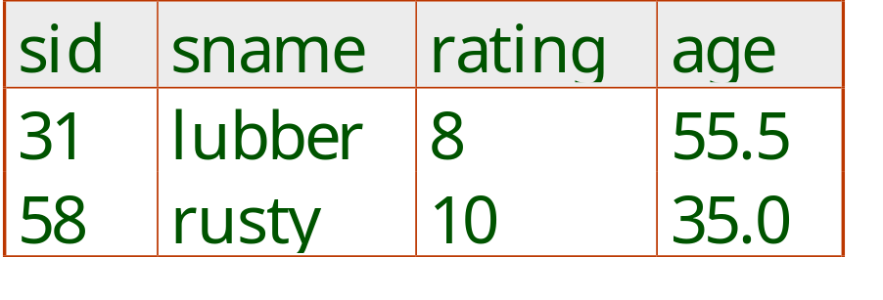
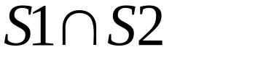
Intersection
S1
S2

Slide 14
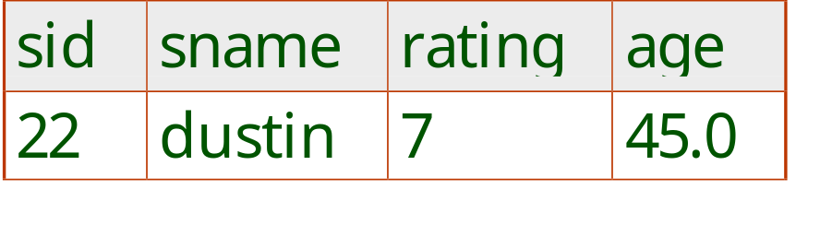

Intersection
S1
S2

Slide 15
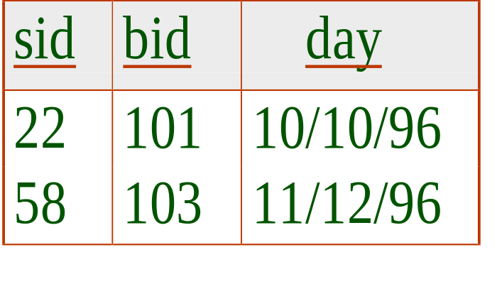
Cross-Product
S1 X R1
Each row of S1 is paired with each row of R1.
Result schema has one field per field of S1 and R1, with field names `inherited’ if possible.
S1
R1

Slide 16
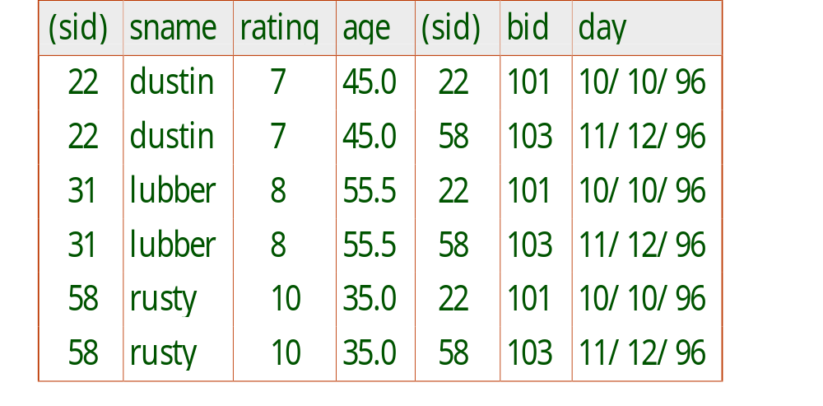
Cross-Product
R1
S1
S1 X R1

Slide 17
Cross-Product
R1
S1
S1 X R1

Slide 18
Cross-Product
R1
S1
S1 X R1

Slide 19
Cross-Product
R1
S1
S1 X R1

Slide 20
Cross-Product
R1
S1
S1 X R1

Slide 21
Cross-Product
R1
S1
S1 X R1

Slide 22
Cross-Product
R1
S1
S1 X R1

Slide 23
Cross-Product
R1
S1
S1 X R1

Slide 24
  Both S1 and R1 have a field called sid. Which may cause a conflict when referring to columns
S1 X R1

Slide 25
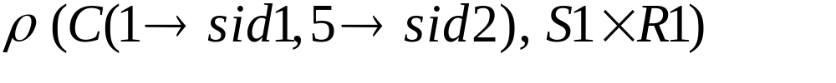
Renaming Operator
Takes a relation schema and gives a new name
to the schema and the columns
1 2 3 4 5 6 7
S1 X R1
C
sid1
sid2

Slide 26
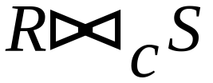
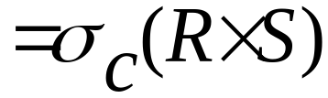
Joins
Condition Join :
Result schema same as that of cross-product.
Fewer tuples than cross-product, might be able to compute more efficiently
Sometimes called a theta-join.

Slide 27
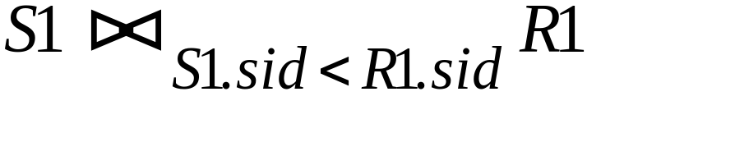
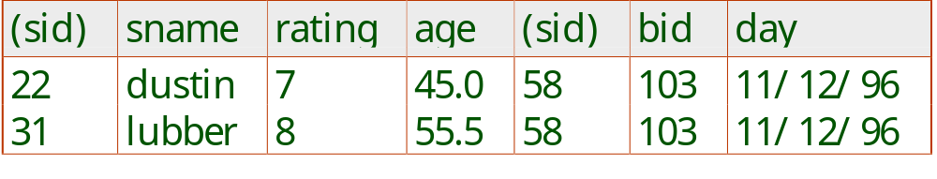
Joins
S1
R1

Slide 28
S1
R1
S1 X R1

Slide 29
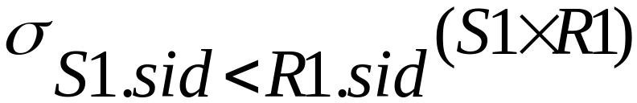
S1
R1

Slide 30
S1
R1

Slide 31
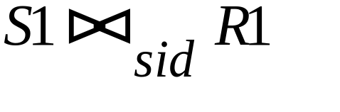
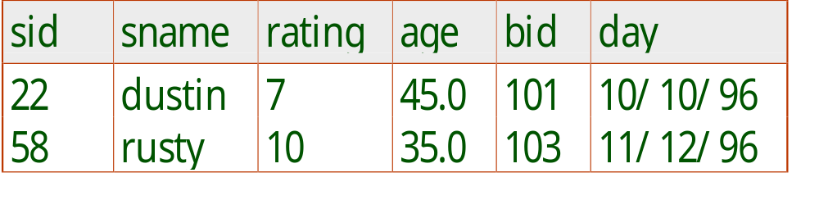
Equi-Join: A special case of condition join where the condition c contains only equalities.
S1
R1

Slide 32
Equi-Join: A special case of condition join where the condition c contains only equalities.
S1
R1

Slide 33
Equi-Join: A special case of condition join where the condition c contains only equalities.
S1
R1

Slide 34
Equi-Join: A special case of condition join where the condition c contains only equalities.
S1
R1

Slide 35
Joins
Equi-Join: A special case of condition join where the condition c contains only equalities.
Result schema similar to cross-product, but only one copy of fields for which equality is specified.
Natural Join: Equijoin on all common fields.

Slide 36
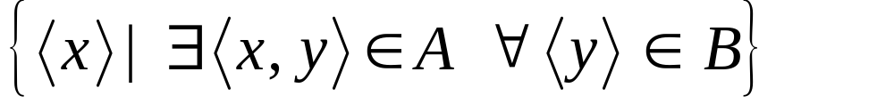
Division
Not supported as a primitive operator, but useful for expressing queries like: Find sailors who have reserved all boats.
Let A have 2 fields, x and y; B have only field y:
  A/B =
  i.e., A/B contains all x tuples (sailors) such that for every y tuple (boat) in B, there is an xy tuple in A.
  Or: If the set of y values (boats) associated with an x value (sailor) in A contains all y values in B, the x value is in A/B.
In general, x and y can be any lists of fields; y is the list of fields in B, and x U y is the list of fields of A.

Slide 37
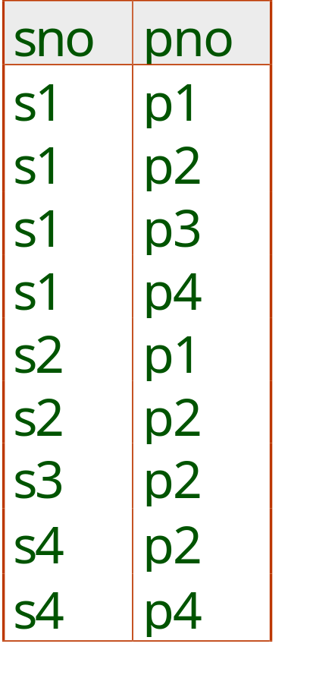
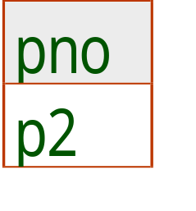
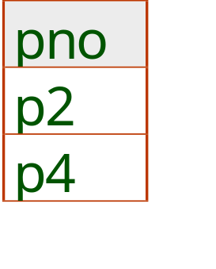
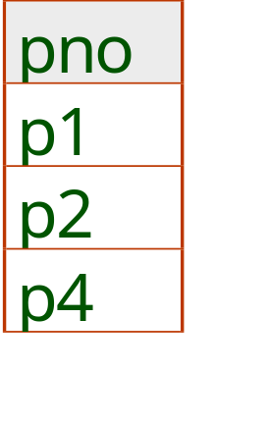
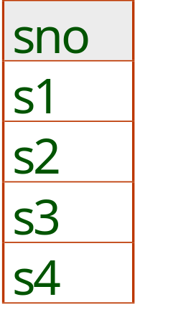
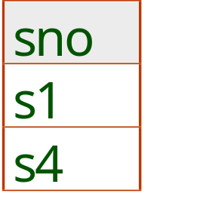
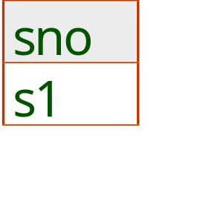
Examples of Division A/B
B1
B2
B3
A
A/B1
A/B2
A/B3

Slide 38
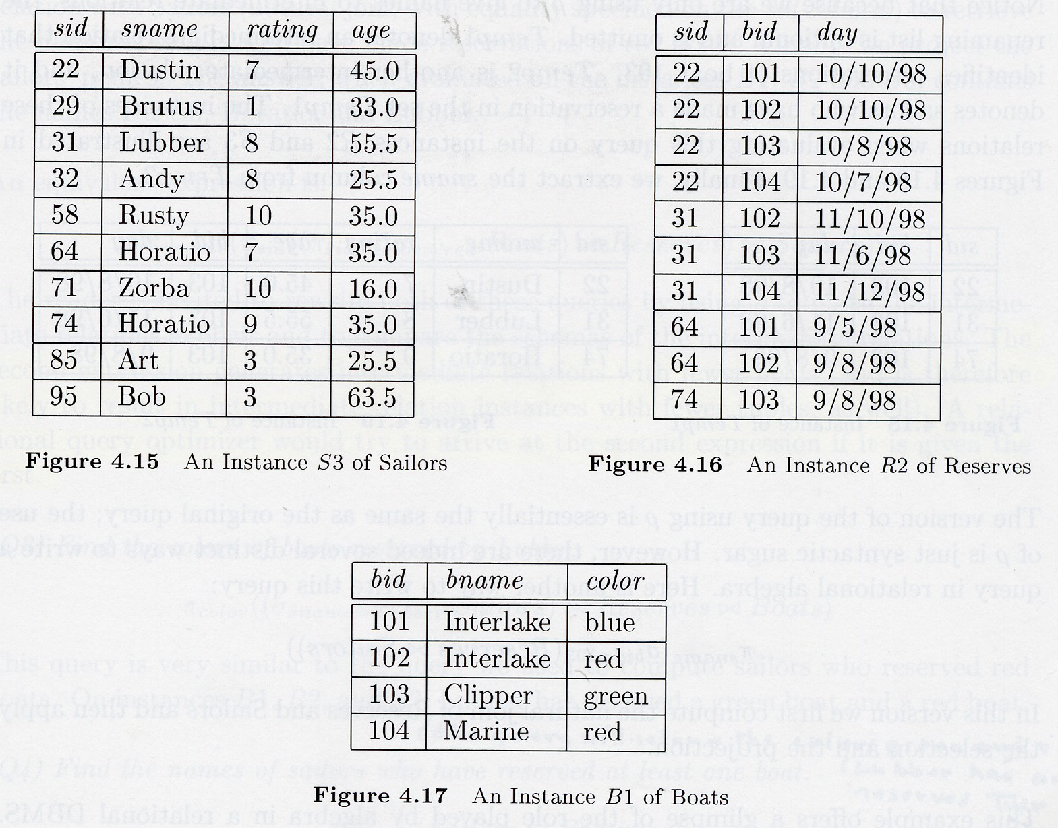

Slide 39
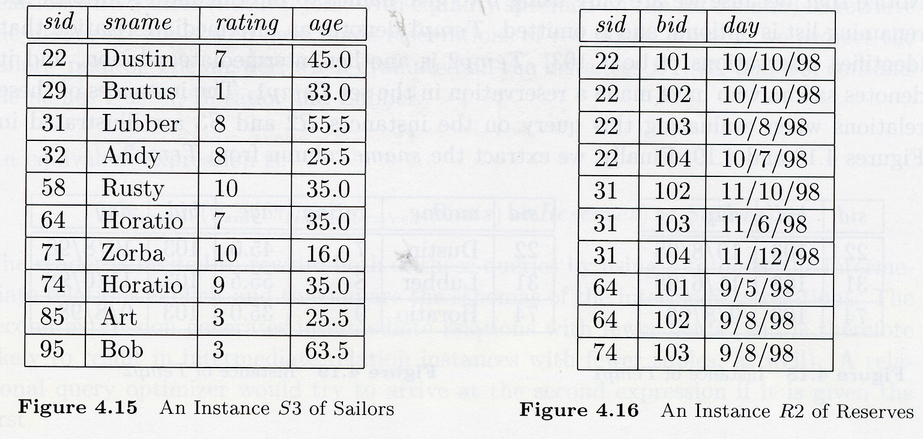
Find names of sailors who’ve reserved boat #103

Slide 40
Find names of sailors who’ve reserved boat #103

Slide 41
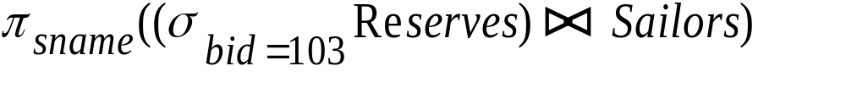
Find names of sailors who’ve reserved boat #103
Solution 1:

Slide 42
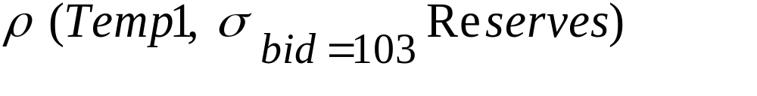
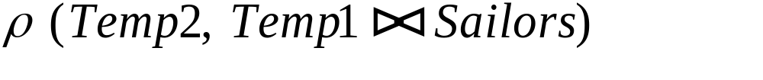
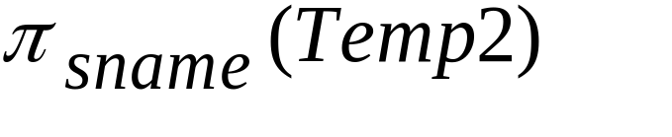
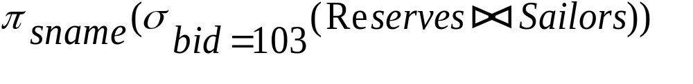
Find names of sailors who’ve reserved boat #103
Solution 1:
Solution 2:
Solution 3:

Slide 43
Find names of sailors who’ve reserved a red boat

Slide 44
Find names of sailors who’ve reserved a red boat
Information about boat color only available in Boats; so need an extra join:
A more efficient solution:
A query optimizer can find this given the first solution!

Slide 45
Find sailors who’ve reserved a red or a green boat
Can identify all red or green boats, then find sailors who’ve reserved one of these boats:
Can also define Tempboats using union! (How?)

Slide 46
Find sailors who’ve reserved a red and a green boat
SOLUTION is simple….
just take the query in the previous slide
replace the “or” sign with an “and” sign!
But there is a problem with this solution!

Slide 47
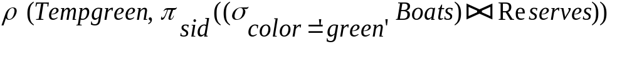
Find sailors who’ve reserved a red and a green boat.
HOW ABOUT THIS ANSWER?

Slide 48
Find sailors who’ve reserved a red and a green boat.
HOW ABOUT THIS ONE?

Slide 49
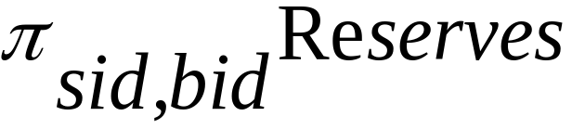
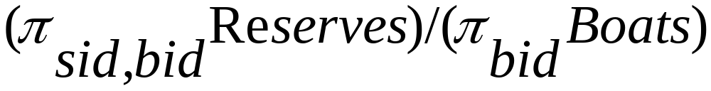
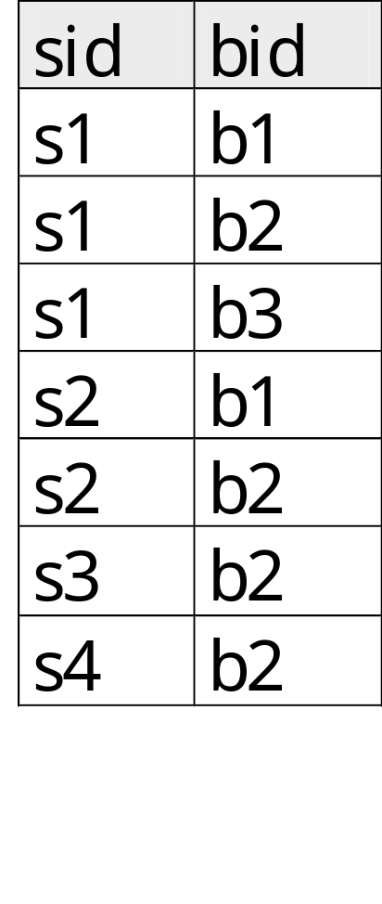
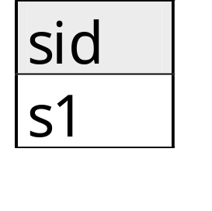
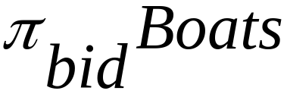

Find the names of sailors who’ve reserved all boats

Slide 50


Find the names of sailors who’ve reserved all boats
Uses division; schemas of the input relations to / must be carefully chosen:
To find sailors who’ve reserved all ‘Interlake’ boats:
.....

Slide 51
Example
EMPLOYEE(NAME, SSN, BDATE, ADDRESS, SALARY)
DEPARTMENT(DNAME, DNUMBER, MGRSSN)
(MGRSSN references SSN in EMPLOYEE table)
WORKSIN(ESSN, DNUMBER, HOURS)
(DNUMBER references DNUMBER in DEPARTMENT table)
(ESSN reference SSN in EMPLOYEE table)
Write the relational algebra expressions for the following queries:
1) List the names of employees whose salary is greater than 30000
2) List the names of employees who work in “shoes” department
3) List the names of employees who work in all departments

