Slide 1
LECTURE 4: SQL
THESE SLIDES ARE BASED ON YOUR TEXT BOOK

Slide 2
SQL
A standard for querying relational data
Basic query structure
DISTINCT is an optional keyword indicating that duplicates should be eliminated. (Otherwise duplicate elimination is not done)
SELECT [DISTINCT] attribute-list
FROM relation-list
WHERE condition

Slide 3

SQL
A standard for querying relational data
Basic query structure
Comparisons (Attr op const or Attr1 op Attr2, where op is one of ) combined using AND, OR and NOT.
SELECT [DISTINCT] attribute-list
FROM relation-list
WHERE condition

Slide 4
Conceptual Evaluation Strategy
Semantics of an SQL query defined in terms of the following conceptual evaluation strategy:
  Compute the cross-product of relation-list.
  Discard resulting tuples if they do not satisfy the conditions.
  Display attributes that are in attribute-list.
  If DISTINCT is specified, eliminate duplicate rows.
This strategy is probably the least efficient way to compute a query! An optimizer will find more efficient strategies to compute the same answers.

Slide 5
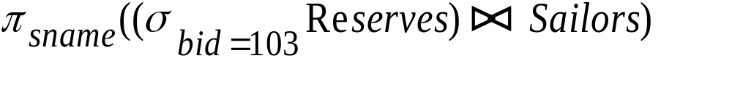
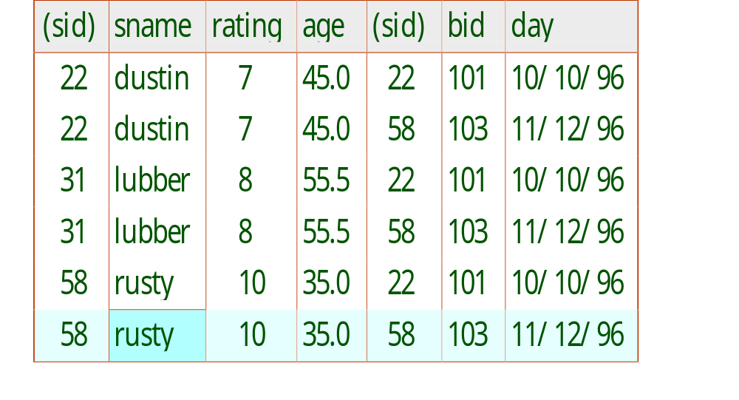
Example of Conceptual Evaluation
SELECT sname
FROM Sailors, Reserves
WHERE Sailors.sid=Reserves.sid AND bid=103
Query: Find names of sailors who
Reserved boat number 103

Slide 6
Range Variables
Query: Find names of sailors who
Reserved boat number 103
SELECT sname
FROM Sailors, Reserves
WHERE Sailors.sid=Reserves.sid AND bid=103
Range variables are necessary when joining a table with itself !!!
SELECT S.sname
FROM Sailors S, Reserves R
WHERE S.sid=R.sid AND bid=103

Slide 7
Expressions and Strings
SELECT S.age, age1=S.age-5, 2*S.age AS age2
FROM Sailors S
WHERE S.sname LIKE ‘B_%B’
Illustrates use of arithmetic expressions and string pattern matching: Find triples (of ages of sailors and two fields defined by expressions) for sailors whose names begin and end with B and contain at least three characters.
AS and = are two ways to name fields in result.
LIKE is used for string matching. `_’ stands for any one character and `%’ stands for 0 or more arbitrary characters.

Slide 8
Find names of sailors who’ve reserved a red or a green boat
SELECT R.sid
FROM Boats B, Reserves R
WHERE R.bid=B.bid
AND (B.color=‘red’ OR B.color=‘green’)
SELECT R.sid
FROM Boats B, Reserves R
WHERE R.bid=B.bid
AND B.color=‘red’
UNION
SELECT R.sid
FROM Boats B, Reserves R
WHERE R.bid=B.bid
AND B.color=‘green’
UNION: Can be used to compute the union of any two union-compatible sets of tuples (which are themselves the result of SQL queries).

Slide 9
SELECT R.sid
FROM Boats B, Reserves R
WHERE R.bid=B.bid
AND B.color=‘red’
EXCEPT
SELECT R.sid
FROM Boats B, Reserves R
WHERE R.bid=B.bid
AND B.color=‘green’
EXCEPT : Used to compute the set difference of two union-compatible sets of tuples
What do we get if we replace UNION with EXCEPT in the previous SQL query?

Slide 10
Find sid’s of sailors who’ve reserved a red and a green boat
SELECT R.sid
FROM Boats B1, Reserves R1,
Boats B2, Reserves R2
WHERE R1.sid = R2.sid AND
R1.bid=B1.bid AND R2.bid=B2.bid
AND (B1.color=‘red’ AND B2.color=‘green’)
INTERSECT: Can be used to compute the intersection of any two union-compatible sets of tuples.
Included in the SQL/92 standard, but some systems don’t support it.
Contrast symmetry of the UNION and INTERSECT queries with how much the other versions differ.
SELECT R.sid
FROM Boats B, Reserves R
WHERE R.bid=B.bid
AND B.color=‘red’
INTERSECT
SELECT r.sid
FROM Boats B, Reserves R
WHERE R.bid=B.bid
AND B.color=‘green’

Slide 11
Nested Queries
Find names of sailors who’ve reserved boat #103:
SELECT S.sname
FROM Sailors S
WHERE S.sid IN (SELECT R.sid
FROM Reserves R
WHERE R.bid=103)
WHERE clause can itself contain an SQL query! (As well as FROM and HAVING clauses which we will see later on.)
To understand semantics of nested queries, think of a nested loops evaluation: For each Sailors tuple, check the qualification by computing the subquery.
  For (i=1…10) do {
  x=x+1;
    For (j=1…5) do {
    y=y+1;
    }
  }

Slide 12
Nested Queries
Find names of sailors who did not reserve boat #103:
SELECT S.sname
FROM Sailors S
WHERE S.sid NOT IN (SELECT R.sid
FROM Reserves R
WHERE R.bid=103)

Slide 13
Nested Queries with Correlation
Find names of sailors who’ve reserved boat #103:
We can use EXISTS operator which is another set comparison operator, like IN.
SELECT S.sname
FROM Sailors S
WHERE EXISTS (SELECT *
FROM Reserves R
WHERE R.bid=103 AND S.sid=R.sid)

Slide 14
Nested Queries with Correlation
Find names of sailors who reserved a boat at most once
UNIQUE construct can be used.
UNIQUE checks for duplicate tuples. Returns TRUE if the corresponding set does not contain duplicates.
SELECT S.sname
FROM Sailors S
WHERE UNIQUE ( SELECT R.bid
FROM Reserves R
WHERE S.sid=R.sid)

Slide 15

More on Set-Comparison Operators
We’ve already seen IN, EXISTS and UNIQUE. Can also use NOT IN, NOT EXISTS and NOT UNIQUE.
Also available: op ANY, op ALL
Find sailors whose rating is greater than that of some sailor called Horatio:
SELECT *
FROM Sailors S
WHERE S.rating > ANY (SELECT S2.rating
FROM Sailors S2
WHERE S2.sname=‘Horatio’)

Slide 16
Rewriting INTERSECT Queries Using IN
Find names of sailors who’ve reserved both a red and a green boat:
SELECT S.name
FROM Sailors S, Boats B, Reserves R
WHERE S.sid=R.sid AND R.bid=B.bid AND B.color=‘red’
AND S.sid IN (SELECT S2.sid
FROM Sailors S2, Boats B2, Reserves R2
WHERE S2.sid=R2.sid AND R2.bid=B2.bid
AND B2.color=‘green’)

Slide 17
How would you rewrite queries with EXCEPT construct?
EXCEPT queries can be re-written using NOT IN.

Slide 18
Division in SQL
Find sailors who’ve reserved all boats.
SELECT S.sname
FROM Sailors S
WHERE NOT EXISTS
((SELECT B.bid
FROM Boats B)
EXCEPT
(SELECT R.bid
FROM Reserves R
WHERE R.sid = S.sid))
THINK ABOUT HOW YOU CAN WRITE THE RELATIONAL
ALGEBRA VERSION WITHOUT USING THE DIVISION OPERATOR

Slide 19
Division in SQL
Find sailors who’ve reserved all boats.
How can we do it without EXCEPT?
SELECT S.sname
FROM Sailors S
WHERE NOT EXISTS (SELECT B.bid
FROM Boats B
WHERE NOT EXISTS (SELECT R.bid
FROM Reserves R
WHERE R.bid=B.bid
AND R.sid=S.sid))

Slide 20
JOINS (SQL 2003 std, source: wikipedia)
Employee Table
Department Table
LastName | DepartmentID
Rafferty | 31
Jones | 33
Steinberg | 33
Robinson | 34
Smith | 34
Jasper | 36
DepartmentID | DepartmentName
31 | Sales
33 | Engineering
34 | Clerical
35 | Marketing

Slide 21
Inner Joins
SELECT *
FROM employee INNER JOIN department
ON employee.DepartmentID = department.DepartmentID
SELECT *
FROM employee, department
WHERE employee.DepartmentID = department.DepartmentID

Slide 22
Inner Joins
Employee.LastName | Employee.DepartmentID | Department.DepartmentName | Department.DepartmentID
Smith | 34 | Clerical | 34
Jones | 33 | Engineering | 33
Robinson | 34 | Clerical | 34
Steinberg | 33 | Engineering | 33
Rafferty | 31 | Sales | 31

Slide 23
Joins
SELECT *
FROM employee NATURAL JOIN department
Employee.LastName | DepartmentID | Department.DepartmentName
Smith | 34 | Clerical
Jones | 33 | Engineering
Robinson | 34 | Clerical
Steinberg | 33 | Engineering
Rafferty | 31 | Sales

Slide 24
Joins
SELECT *
FROM employee CROSS JOIN department
SELECT *
FROM employee, department;

Slide 25
Joins
SELECT *
FROM employee LEFT OUTER JOIN department
ON department.DepartmentID = employee.DepartmentID
Employee. LastName | Employee. DepartmentID | Department. DepartmentName | Department. DepartmentID
Jones | 33 | Engineering | 33
Rafferty | 31 | Sales | 31
Robinson | 34 | Clerical | 34
Smith | 34 | Clerical | 34
Jasper | 36 | NULL | NULL
Steinberg | 33 | Engineering | 33

Slide 26
Joins
SELECT *
FROM employee FULL OUTER JOIN department
ON employee.DepartmentID = department.DepartmentID
Some DBMSs do not support FULL OUTER JOIN!
Can you implement FULL OUTER JOIN WITH LEFT and
RIGHT OUTER JOINS?

Slide 27
Aggregate Operators
Significant extension of relational algebra.
They are used to write statistical queries
Mainly used for reporting such as
  the total sales in 2004,
  average, max, min income of employees
  Total number of employees hired/fired in 2004
COUNT (*)
COUNT ( [DISTINCT] A)
SUM ( [DISTINCT] A)
AVG ( [DISTINCT] A)
MAX (A)
MIN (A)

Slide 28
Aggregate Operators
COUNT (*)
COUNT ( [DISTINCT] A)
SUM ( [DISTINCT] A)
AVG ( [DISTINCT] A)
MAX (A)
MIN (A)
Total number of sailors in the club?
SELECT COUNT (*)
FROM Sailors S

Slide 29
Aggregate Operators
COUNT (*)
COUNT ( [DISTINCT] A)
SUM ( [DISTINCT] A)
AVG ( [DISTINCT] A)
MAX (A)
MIN (A)
Average age of sailors in the club
Whose rating is 10?
SELECT AVG (S.age)
FROM Sailors S
WHERE S.rating=10

Slide 30
Aggregate Operators
COUNT (*)
COUNT ( [DISTINCT] A)
SUM ( [DISTINCT] A)
AVG ( [DISTINCT] A)
MAX (A)
MIN (A)
Average distinct ages of sailors in the club
Whose rating is 10?
SELECT AVG ( DISTINCT S.age)
FROM Sailors S
WHERE S.rating=10

Slide 31
COUNT (*)
COUNT ( [DISTINCT] A)
SUM ( [DISTINCT] A)
AVG ( [DISTINCT] A)
MAX (A)
MIN (A)
Aggregate Operators
Names of sailors whose rating is equal to the maximum rating in the club.
SELECT S.sname
FROM Sailors S
WHERE S.rating= (SELECT MAX(S2.rating)
FROM Sailors S2)

Slide 32
COUNT (*)
COUNT ( [DISTINCT] A)
SUM ( [DISTINCT] A)
AVG ( [DISTINCT] A)
MAX (A)
MIN (A)
Aggregate Operators
Number of sailors whose rating is equal to the maximum rating in the club.
SELECT COUNT(S.sid)
FROM Sailors S
WHERE S.rating= (SELECT MAX(S2.rating)
FROM Sailors S2)

Slide 33
COUNT (*)
COUNT ( [DISTINCT] A)
SUM ( [DISTINCT] A)
AVG ( [DISTINCT] A)
MAX (A)
MIN (A)
Aggregate Operators
How many different ratings are there in the club?
SELECT COUNT (S.rating)
FROM Sailors S
Above query is not correct. Think why!
SELECT COUNT (DISTINCT S.rating)
FROM Sailors S

Slide 34
Find name and age of the oldest sailor(s)
SELECT S.sname, MAX (S.age)
FROM Sailors S
This query is illegal! (We’ll see why a bit later, when we discuss GROUP BY.)

Slide 35
Find name and age of the oldest sailor(s)
This query is correct and it is allowed in the SQL/92 standard, but is not supported in some systems.
SELECT S.sname, S.age
FROM Sailors S
WHERE S.age =
(SELECT MAX (S2.age)
FROM Sailors S2)

Slide 36
Find name and age of the oldest sailor(s)
This query is valid for all systems .
SELECT S.sname, S.age
FROM Sailors S
WHERE (SELECT MAX (S2.age)
FROM Sailors S2)
= S.age

Slide 37
GROUP BY and HAVING
So far, we’ve applied aggregate operators to all (qualifying) tuples. Sometimes, we want to apply them to each of several groups of tuples.
Consider: Find the age of the youngest sailor for each rating level.
  In general, we don’t know how many rating levels exist, and what the rating values for these levels are!
  Suppose we know that rating values go from 1 to 10; we can write 10 queries that look like this (!):
SELECT MIN (S.age)
FROM Sailors S
WHERE S.rating = i
For i = 1, 2, ... , 10:

Slide 38
Queries With GROUP BY and HAVING
SELECT [DISTINCT] target-list
FROM relation-list
WHERE qualification
GROUP BY grouping-list
HAVING group-qualification
The target-list contains (i) attribute names (ii) terms with aggregate operations (e.g., MIN (S.age)).
  The attribute list (i) must be a subset of grouping-list. Intuitively, each answer tuple corresponds to a group, and these attributes must have a single value per group. (A group is a set of tuples that have the same value for all attributes in grouping-list.)

Slide 39
Conceptual Evaluation
The cross-product of relation-list is computed, tuples that fail qualification are discarded, `unnecessary’ fields are deleted, and the remaining tuples are partitioned into groups by the value of attributes in grouping-list.
The group-qualification is then applied to eliminate some groups. Expressions in group-qualification must have a single value per group!
  In effect, an attribute in group-qualification that is not an argument of an aggregate op also appears in grouping-list.
One answer tuple is generated per qualifying group.

Slide 40
SELECT [DISTINCT] target-list
FROM relation-list
WHERE qualification
GROUP BY grouping-list
HAVING group-qualification
Conceptual Evaluation
SELECT target-list
FROM relation-list
WHERE qualification
HAVING group-qualification
GROUP BY grouping-list
gr1
gr2
RESULT
gr3
gr4
gr5

Slide 41
SELECT S.rating
FROM Sailors S
WHERE S.age >= 18
GROUP BY S.rating
HAVING COUNT (*) > 1
Conceptual Evaluation
SELECT S.rating
FROM Sailors S
WHERE S.age >= 18
Age = 20
Age = 25
HAVING COUNT (*) > 1
GROUP BY S.rating
Age = 19
gr1
Rating=1
Age=70
Rating=1
Rating = 4
Age = 60
Rating =2
Rating =3
gr2
Rating=2
Age = 40
Rating=2
Rating=2
Rating=3
RESULT
Age = 33
Rating=5
Rating=3
Rating=1
gr3
Rating=3
Rating = 1
Age = 32
Rating=4
Rating = 2
Rating=3
Rating=3
Rating = 3
Rating=4
Rating = 4
Age = 18
Rating=1
Rating=4
gr4
Rating=4
Age = 22
Rating=4
Age = 39
gr5
Rating=5

Slide 42

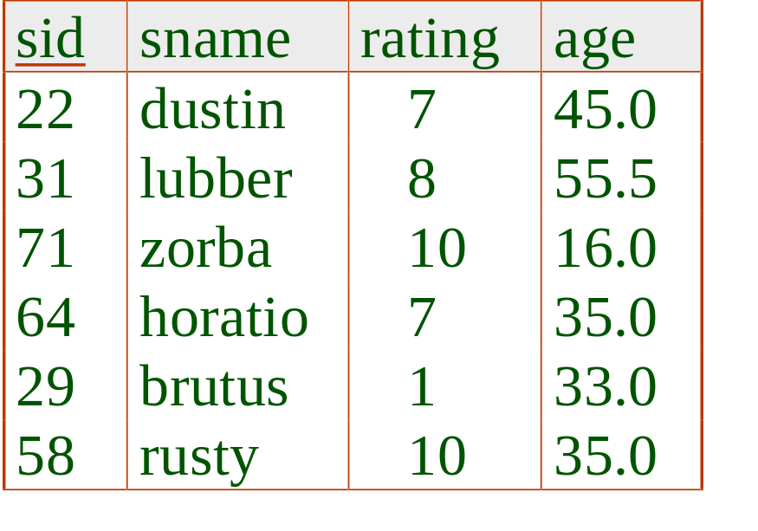
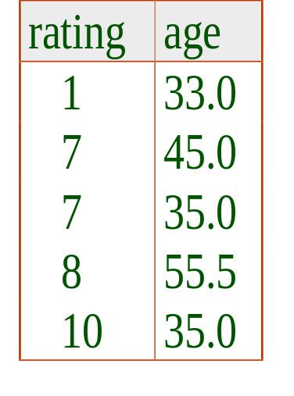
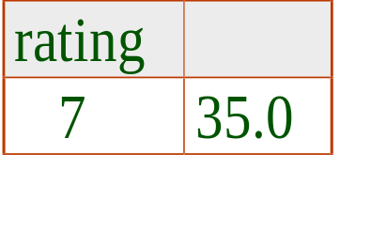
Find the age of the youngest sailor with age 18, for each rating with at least 2 such sailors
SELECT S.rating, MIN (S.age)
FROM Sailors S
WHERE S.age >= 18
GROUP BY S.rating
HAVING COUNT (*) > 1
Only S.rating and S.age are mentioned in the SELECT, GROUP BY or HAVING clauses;
2nd column of result is unnamed. (Use AS to name it.)
Answer relation

Slide 43
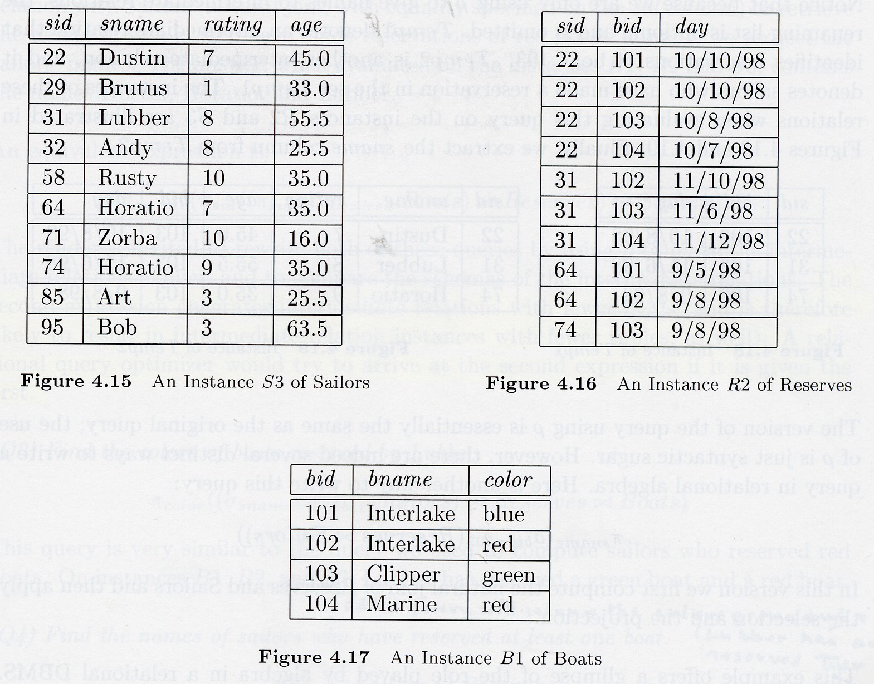
For each red boat, find the number of reservations for this boat

Slide 44
For each red boat, find the number of reservations for this boat
SELECT B.bid, COUNT (*) AS scount
FROM Boats B, Reserves R
WHERE R.bid=B.bid AND B.color=‘red’
GROUP BY B.bid
What do we get if we remove B.color=‘red’ from the WHERE clause and add a HAVING clause with this condition?
SELECT B.bid, COUNT (*) AS scount
FROM Boats B, Reserves R
WHERE R.bid=B.bid
GROUP BY B.bid
HAVING B.color=‘red’

Slide 45
Find the age of the youngest sailor with age > 18, for each rating with at least 2 sailors (of any age)
The following query:
SELECT S.rating, MIN (S.age)
FROM Sailors S
WHERE S.age > 18
GROUP BY S.rating
HAVING COUNT (*) > 1
Is not exactly right!

Slide 46
Find the age of the youngest sailor with age > 18, for each rating with at least 2 sailors (of any age)
SELECT S.rating, MIN (S.age)
FROM Sailors S
WHERE S.age > 18
GROUP BY S.rating
HAVING 1 < (SELECT COUNT (*)
FROM Sailors S2
WHERE S.rating=S2.rating)
Shows HAVING clause can also contain a subquery.

Slide 47
Find those ratings for which the average age is the minimum over all ratings
Aggregate operations cannot be nested! WRONG:
SELECT S.rating
FROM Sailors S
WHERE S.age = (SELECT MIN (AVG (S2.age)) FROM Sailors S2)
Correct solution (in SQL/92):
SELECT Temp.rating, Temp.avgage
FROM (SELECT S.rating, AVG (S.age) AS avgage
FROM Sailors S
GROUP BY S.rating) AS Temp
WHERE Temp.avgage = (SELECT MIN (Temp.avgage)
FROM Temp)

Slide 48
Null Values
Field values in a tuple are sometimes unknown (e.g., a rating has not been assigned) or inapplicable (e.g., no spouse’s name).
  SQL provides a special value null for such situations.
The presence of null complicates many issues. E.g.:
  Special operators needed to check if value is/is not null.
  Is rating>8 true or false when rating is equal to null? What about AND, OR and NOT connectives?
  We need a 3-valued logic (true, false and unknown).
  Meaning of constructs must be defined carefully. (e.g., WHERE clause eliminates rows that don’t evaluate to true.)
  New operators (in particular, outer joins) possible/needed.

Slide 49
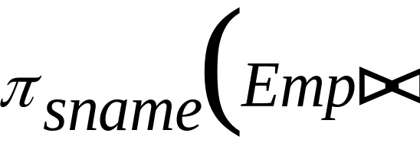
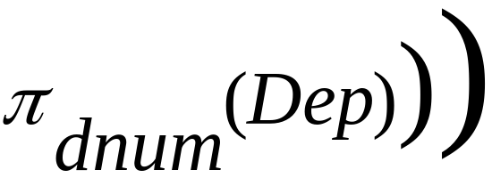
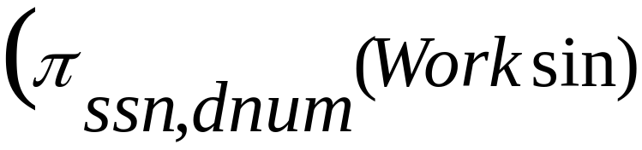

EMP(NAME, SSN, BDATE, ADDRESS, SALARY)
DEP(DNAME, DNUM, MGRSSN)
(MGRSSN references SSN in EMP table)
WORKSIN(SSN, DNUM, HOURS)
(DNUM references DNUM in DEP table)
(SSN reference SSN in EMP table)
Write the relational algebra expressions for the following queries:
List the names of employees who work in all departments

Slide 50
EMPLOYEE(NAME, SSN, BDATE, ADDRESS, SALARY, SUPERSSN, DNO)
DEPARTMENT(DNAME, DNUMBER, MGRSSN, MGRSTARTDATE)
DEPT_LOCATIONS(DNUMBER, DLOCATION)
PROJECT(PNAME, PNUMBER, PLOCATION, DNUM)
WORKSON(ESSN, PNO, HOURS)
DEPENDENT(ESSN, DEPENDENT_NAME, SEX, BDATE, RELATIONSHIP)
Q11: List the names of managers with at least one dependent
SELECT EMPLOYEE.NAME
FROM EMPLOYEE, DEPARTMENT
WHERE DEPARTMENT.MGRSSN = EMPLOYEE.SSN AND
EMPLOYEE.SSN IN
(SELECT DISTINCT ESSN
FROM DEPENDENT)

Slide 51
EMPLOYEE(NAME, SSN, BDATE, ADDRESS, SALARY, SUPERSSN, DNO)
DEPARTMENT(DNAME, DNUMBER, MGRSSN, MGRSTARTDATE)
DEPT_LOCATIONS(DNUMBER, DLOCATION)
PROJECT(PNAME, PNUMBER, PLOCATION, DNUM)
WORKSON(ESSN, PNO, HOURS)
DEPENDENT(ESSN, DEPENDENT_NAME, SEX, BDATE, RELATIONSHIP)
Q12: List the names of employees who do not work on a project controlled by
department no 5.
SELECT NAME
FROM EMPLOYEE
WHERE SSN NOT IN (SELECT WORKSON.ESSN
FROM WORKSON, PROJECT
WHERE WORKSON.PNO = PROJECT.PNUMBER
AND PROJECT.DNUM = 5)

Slide 52
EMPLOYEE(NAME, SSN, BDATE, ADDRESS, SALARY, SUPERSSN, DNO)
DEPARTMENT(DNAME, DNUMBER, MGRSSN, MGRSTARTDATE)
DEPT_LOCATIONS(DNUMBER, DLOCATION)
PROJECT(PNAME, PNUMBER, PLOCATION, DNUM)
WORKSON(ESSN, PNO, HOURS)
DEPENDENT(ESSN, DEPENDENT_NAME, SEX, BDATE, RELATIONSHIP)
Q13: List the names of employees who do not work on all projects controlled by
department no 5.
SELECT E.NAME
FROM WORKSON W, EMPLOYEE E
WHERE E.SSN = W.ESSN
AND EXISTS ((SELECT P.PNUMBER
FROM PROJECT P
WHERE P.DNUM = 5)
EXCEPT (SELECT W1.PNO
FROM WORKSON W1
WHERE W1.ESSN = W.ESSN))
ORACLE DOES NOT SUPPORT EXCEPT!!!

Slide 53
EMPLOYEE(NAME, SSN, BDATE, ADDRESS, SALARY, SUPERSSN, DNO)
DEPARTMENT(DNAME, DNUMBER, MGRSSN, MGRSTARTDATE)
DEPT_LOCATIONS(DNUMBER, DLOCATION)
PROJECT(PNAME, PNUMBER, PLOCATION, DNUM)
WORKSON(ESSN, PNO, HOURS)
DEPENDENT(ESSN, DEPENDENT_NAME, SEX, BDATE, RELATIONSHIP)
Q13: List the names of employees who do not work on all projects controlled by
department no 5.
SELECT E.NAME
FROM WORKSON W, EMPLOYEE E
WHERE E.SSN = W.ESSN
AND EXISTS (SELECT P.PNUMBER
FROM PROJECT P
WHERE P.DNUM = 5
AND NOT EXISTS (SELECT W1.ESSN
FROM WORKSON W1
WHERE W1.ESSN = W.ESSN
AND W1.PNO = P.PNUMBER))

Slide 54
EMPLOYEE(NAME, SSN, BDATE, ADDRESS, SALARY, SUPERSSN, DNO)
DEPARTMENT(DNAME, DNUMBER, MGRSSN, MGRSTARTDATE)
DEPT_LOCATIONS(DNUMBER, DLOCATION)
PROJECT(PNAME, PNUMBER, PLOCATION, DNUM)
WORKSON(ESSN, PNO, HOURS)
DEPENDENT(ESSN, DEPENDENT_NAME, SEX, BDATE, RELATIONSHIP)
Q14: List the names of employees who do not have supervisors
(IS NULL checks for null values!)
SELECT NAME
FROM EMPLOYEE
WHERE SUPERSSN IS NULL

Slide 55
EMPLOYEE(NAME, SSN, BDATE, ADDRESS, SALARY, SUPERSSN, DNO)
DEPARTMENT(DNAME, DNUMBER, MGRSSN, MGRSTARTDATE)
DEPT_LOCATIONS(DNUMBER, DLOCATION)
PROJECT(PNAME, PNUMBER, PLOCATION, DNUM)
WORKSON(ESSN, PNO, HOURS)
DEPENDENT(ESSN, DEPENDENT_NAME, SEX, BDATE, RELATIONSHIP)
Q15: Find the SUM of the salaries of all employees, the max salary,
min salary and average salary.
SELECT SUM(SALARY) AS SALARY_SUM, MAX(SALARY) AS MAX_SALARY,
MIN(SALARY) AS MIN_SALARY, AVG(SALARY) AS AVERAGE_SALARY
FROM EMPLOYEE

Slide 56
EMPLOYEE(NAME, SSN, BDATE, ADDRESS, SALARY, SUPERSSN, DNO)
DEPARTMENT(DNAME, DNUMBER, MGRSSN, MGRSTARTDATE)
DEPT_LOCATIONS(DNUMBER, DLOCATION)
PROJECT(PNAME, PNUMBER, PLOCATION, DNUM)
WORKSON(ESSN, PNO, HOURS)
DEPENDENT(ESSN, DEPENDENT_NAME, SEX, BDATE, RELATIONSHIP)
Q16: Find the SUM of the salaries of all employees, the max salary,
min salary and average salary for research department.
SELECT SUM(SALARY) AS SALARY_SUM, MAX(SALARY) AS MAX_SALARY,
MIN(SALARY) AS MIN_SALARY, AVG(SALARY) AS AVERAGE_SALARY
FROM EMPLOYEE, DEPARTMENT
WHERE EMPLOYEE.DNO = DEPARTMENT.DNUMBER
AND DEPARTMENT.DNAME = 'RESEARCH'

Slide 57
EMPLOYEE(NAME, SSN, BDATE, ADDRESS, SALARY, SUPERSSN, DNO)
DEPARTMENT(DNAME, DNUMBER, MGRSSN, MGRSTARTDATE)
DEPT_LOCATIONS(DNUMBER, DLOCATION)
PROJECT(PNAME, PNUMBER, PLOCATION, DNUM)
WORKSON(ESSN, PNO, HOURS)
DEPENDENT(ESSN, DEPENDENT_NAME, SEX, BDATE, RELATIONSHIP)
Q17: Find the number of employees in research department.
SELECT COUNT(*) AS EMPLOYEE_COUNT
FROM EMPLOYEE, DEPARTMENT
WHERE EMPLOYEE.DNO = DEPARTMENT.DNUMBER
AND DEPARTMENT.DNAME = 'RESEARCH'

Slide 58
EMPLOYEE(NAME, SSN, BDATE, ADDRESS, SALARY, SUPERSSN, DNO)
DEPARTMENT(DNAME, DNUMBER, MGRSSN, MGRSTARTDATE)
DEPT_LOCATIONS(DNUMBER, DLOCATION)
PROJECT(PNAME, PNUMBER, PLOCATION, DNUM)
WORKSON(ESSN, PNO, HOURS)
DEPENDENT(ESSN, DEPENDENT_NAME, SEX, BDATE, RELATIONSHIP)
Q18: Find the number of distinct salary values for Employees.
SELECT COUNT(DISTINCT SALARY)
FROM EMPLOYEE

Slide 59
EMPLOYEE(NAME, SSN, BDATE, ADDRESS, SALARY, SUPERSSN, DNO)
DEPARTMENT(DNAME, DNUMBER, MGRSSN, MGRSTARTDATE)
DEPT_LOCATIONS(DNUMBER, DLOCATION)
PROJECT(PNAME, PNUMBER, PLOCATION, DNUM)
WORKSON(ESSN, PNO, HOURS)
DEPENDENT(ESSN, DEPENDENT_NAME, SEX, BDATE, RELATIONSHIP)
Q19: Display the names of the employees who do not practice birth control
(more than 5 children).
SELECT NAME
FROM EMPLOYEE
WHERE SSN IN (SELECT ESSN
FROM DEPENDENT
WHERE RELATIONSHIP = 'Child'
GROUP BY ESSN
HAVING COUNT(*) > 5)

Slide 60
EMPLOYEE(NAME, SSN, BDATE, ADDRESS, SALARY, SUPERSSN, DNO)
DEPARTMENT(DNAME, DNUMBER, MGRSSN, MGRSTARTDATE)
DEPT_LOCATIONS(DNUMBER, DLOCATION)
PROJECT(PNAME, PNUMBER, PLOCATION, DNUM)
WORKSON(ESSN, PNO, HOURS)
DEPENDENT(ESSN, DEPENDENT_NAME, SEX, BDATE, RELATIONSHIP)
Q20: For each department, retrieve the department number, number of employees
in that department and the average salary.
SELECT DNO, COUNT(*) AS EMPLOYEE_COUNT, AVG(SALARY) AS AVERAGE_SALARY
FROM EMPLOYEE
GROUP BY DNO

Slide 61
EMPLOYEE(NAME, SSN, BDATE, ADDRESS, SALARY, SUPERSSN, DNO)
DEPARTMENT(DNAME, DNUMBER, MGRSSN, MGRSTARTDATE)
DEPT_LOCATIONS(DNUMBER, DLOCATION)
PROJECT(PNAME, PNUMBER, PLOCATION, DNUM)
WORKSON(ESSN, PNO, HOURS)
DEPENDENT(ESSN, DEPENDENT_NAME, SEX, BDATE, RELATIONSHIP)
Q21: For each project, retrieve the project number, the project name, and the number
of employees who work for that project.
SELECT PROJECT.PNAME, PROJECT.PNUMBER, COUNT(*) AS EMPLOYEE_COUNT
FROM PROJECT, WORKSON
WHERE WORKSON.PNO = PROJECT.PNUMBER
GROUP BY PROJECT.PNUMBER
DO YOU SEE ANYTHING WRONG WITH THIS QUERY?

Slide 62
EMPLOYEE(NAME, SSN, BDATE, ADDRESS, SALARY, SUPERSSN, DNO)
DEPARTMENT(DNAME, DNUMBER, MGRSSN, MGRSTARTDATE)
DEPT_LOCATIONS(DNUMBER, DLOCATION)
PROJECT(PNAME, PNUMBER, PLOCATION, DNUM)
WORKSON(ESSN, PNO, HOURS)
DEPENDENT(ESSN, DEPENDENT_NAME, SEX, BDATE, RELATIONSHIP)
Q21: For each project, retrieve the project number, the project name, and the number
of employees who work for that project.
SELECT PROJECT.PNAME, PROJECT.PNUMBER, COUNT(*) AS EMPLOYEE_COUNT
FROM PROJECT, WORKSON
WHERE WORKSON.PNO = PROJECT.PNUMBER
GROUP BY PROJECT.PNUMBER, PROJECT.PNAME

Slide 63
EMPLOYEE(NAME, SSN, BDATE, ADDRESS, SALARY, SUPERSSN, DNO)
DEPARTMENT(DNAME, DNUMBER, MGRSSN, MGRSTARTDATE)
DEPT_LOCATIONS(DNUMBER, DLOCATION)
PROJECT(PNAME, PNUMBER, PLOCATION, DNUM)
WORKSON(ESSN, PNO, HOURS)
DEPENDENT(ESSN, DEPENDENT_NAME, SEX, BDATE, RELATIONSHIP)
Q22: For each project on which more than two employees work,
retrieve the project number, the project name, and the number
of employees who work on the project.
SELECT PROJECT.PNAME, PROJECT.PNUMBER, COUNT(*) AS EMPLOYEE_COUNT
FROM PROJECT, WORKSON
WHERE WORKSON.PNO = PROJECT.PNUMBER
GROUP BY PROJECT.PNUMBER, PROJECT.PNAME
HAVING COUNT(*) > 2

Slide 64
EMPLOYEE(NAME, SSN, BDATE, ADDRESS, SALARY, SUPERSSN, DNO)
DEPARTMENT(DNAME, DNUMBER, MGRSSN, MGRSTARTDATE)
DEPT_LOCATIONS(DNUMBER, DLOCATION)
PROJECT(PNAME, PNUMBER, PLOCATION, DNUM)
WORKSON(ESSN, PNO, HOURS)
DEPENDENT(ESSN, DEPENDENT_NAME, SEX, BDATE, RELATIONSHIP)
Q23: For each department that has more than five employees, retrieve the department
number and the number of its employees who are making more than 40000.
SELECT DNO, COUNT(*) AS EMPLOYEE_COUNT
FROM EMPLOYEE
WHERE SALARY * 12 > 40000
AND DNO IN (SELECT DNO
FROM EMPLOYEE
GROUP BY DNO
HAVING COUNT(*) > 5)
GROUP BY DNO

Slide 65
Integrity Constraints
An IC describes conditions that every legal instance of a relation must satisfy.
  Inserts/deletes/updates that violate IC’s are disallowed.
  Can be used to ensure application semantics (e.g., sid is a key), or prevent inconsistencies (e.g., sname has to be a string, age must be < 200)
Types of IC’s: Domain constraints, primary key constraints, foreign key constraints, general constraints.
  Domain constraints: Field values must be of right type. Always enforced.

Slide 66
General Constraints
Useful when more general ICs than keys are involved.
CREATE TABLE Sailors
( sid INTEGER,
sname CHAR(10),
rating INTEGER,
age REAL,
PRIMARY KEY (sid),
CHECK ( rating >= 1
AND rating <= 10 )

Slide 67
General Constraints
Constraints can be named.
Can use queries to express constraint.
CREATE TABLE Reserves
( sname CHAR(10),
bid INTEGER,
day DATE,
PRIMARY KEY (bid,day),
CONSTRAINT noInterlakeRes
CHECK (`Interlake’ <>
( SELECT B.bname
FROM Boats B
WHERE B.bid=bid)))

Slide 68
Constraints Over Multiple Relations
CREATE TABLE Sailors
( sid INTEGER,
sname CHAR(10),
rating INTEGER,
age REAL,
PRIMARY KEY (sid),
CHECK
( (SELECT COUNT (S.sid) FROM Sailors S)
+ (SELECT COUNT (B.bid) FROM Boats B) < 100 )
Number of boats
plus number of
sailors is < 100
Awkward and wrong!
If Sailors is empty, the number of Boats tuples can be anything!

Slide 69
Constraints Over Multiple Relations
ASSERTION is the right solution; not associated with either table.
Number of boats
plus number of
sailors is < 100
CREATE ASSERTION smallClub
CHECK
( (SELECT COUNT (S.sid) FROM Sailors S)
+ (SELECT COUNT (B.bid) FROM Boats B) < 100 )

Slide 70
Triggers
Trigger: procedure that starts automatically if specified changes occur to the DBMS
Three parts:
  Event (activates the trigger)
  Condition (tests whether the triggers should run)
  Action (what happens if the trigger runs)

Slide 71
Triggers: Example (SQL:1999)
CREATE TRIGGER youngSailorUpdate
AFTER INSERT ON SAILORS
REFERENCING NEW TABLE NewSailors
FOR EACH STATEMENT
INSERT
INTO YoungSailors(sid, name, age, rating)
SELECT sid, name, age, rating
FROM NewSailors N
WHERE N.age <= 18

