Slide 1
LECTURE 5: Schema Refinement and Normal Forms
SOME OF THESE SLIDES ARE BASED ON YOUR TEXT BOOK

Slide 2
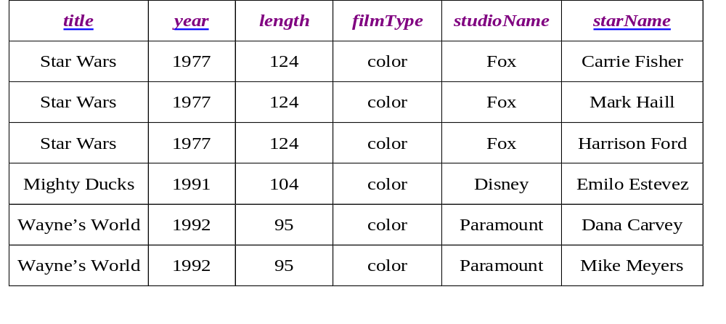
Anomalies
  Insertion anomalies
    Cannot record filmType without starName
  Deletion anomalies
    If we delete the last star, we also lose the movie info.
  Modification (update) anomalies

Slide 3
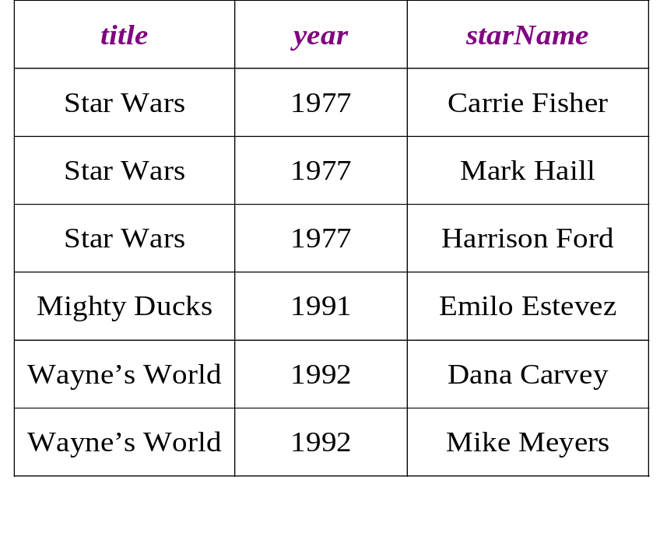
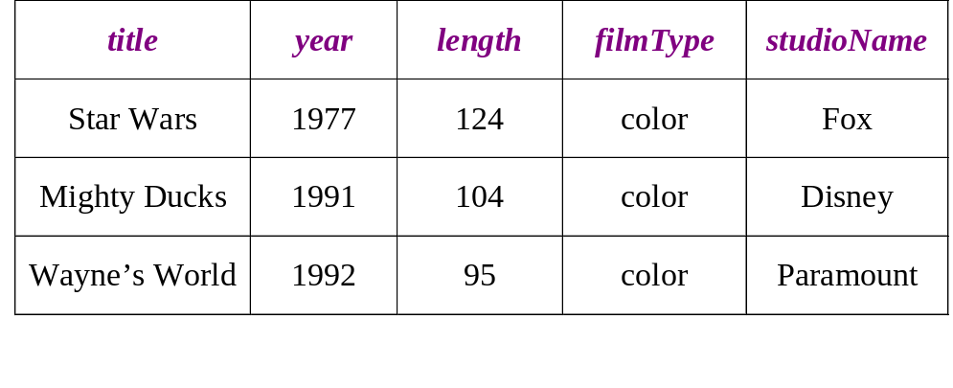
DECOMPOSITION

Slide 4
Schema Refinement
functional dependencies, can be used to identify schemas with problems and to suggest refinements.
Decomposition is used for schema refinement.

Slide 5
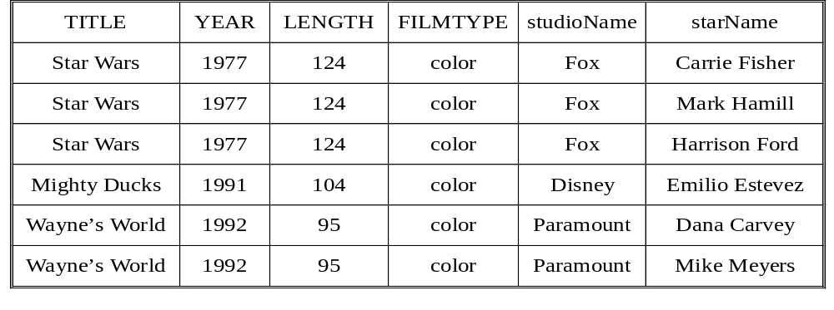
Example FD
  title year → length
  title year → filmType
  title year → studioName
  title year → length filmType studioName

Slide 6
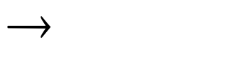
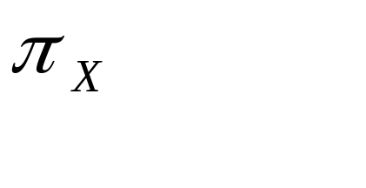
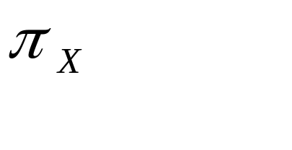
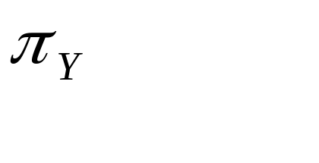
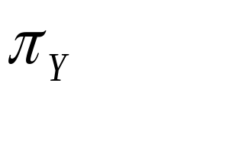
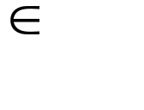
Functional Dependencies (FDs)
A functional dependency X Y holds over relation R if, for every allowable instance r of R:
  t1 r, t2 r, (t1) = (t2) implies (t1) = (t2)
  i.e., given two tuples in r, if the X values agree, then the Y values must also agree. (X and Y are sets of attributes.)
X | Y | Z
1 | a | p
2 | b | q
1 | a | r
2 | b | p
t1
t2

Slide 7
Functional Dependencies (FDs)
Does the following relation instance satisfy X->Y ?
X | Y | Z
1 | a | p
2 | b | q
1 | a | r
2 | c | p

Slide 8
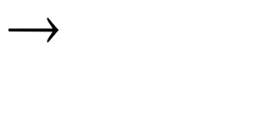

Functional Dependencies (FDs)
A functional dependency X Y holds over relation R if, for every allowable instance r of R:
  t1 r, t2 r, (t1) = (t2) implies (t1) = (t2)
  i.e., given two tuples in r, if the X values agree, then the Y values must also agree. (X and Y are sets of attributes.)
An FD is a statement about all allowable relations.
  Must be identified based on semantics of application.
  Given some allowable instance r1 of R, we can check if it violates some FD f, but we cannot tell if f holds over R!
K is a candidate key for R means that K R
  However, K R does not require K to be minimal!

Slide 9
Functional Dependencies (FDs)
Does the following relation instance satisfy X->Y ?
X | Y | Z
1 | a | p
2 | b | q
1 | a | r
3 | b | p

Slide 10
Functional Dependencies (FDs)
If X is a candidate key, then X -> Y Z !
X | Y | Z
1 | a | p
2 | b | q
1 | a | r
3 | b | p

Slide 11
Functional Dependencies (FDs)
If Y Z -> X can we say YZ is a candidate key?
X | Y | Z
1 | a | p
2 | b | q
1 | a | r
3 | b | p

Slide 12
Example: Constraints on Entity Set
Consider relation obtained from Hourly_Emps:
  Hourly_Emps (ssn, name, lot, rating, hrly_wages, hrs_worked)
Notation: We will denote this relation schema by listing the attributes: SNLRWH
  This is really the set of attributes {S,N,L,R,W,H}.
  Sometimes, we will refer to all attributes of a relation by using the relation name. (e.g., Hourly_Emps for SNLRWH)
Hourly_Emps
S | N | L | R | W | H

Slide 13
Example: Constraints on Entity Set
Some FDs on Hourly_Emps:
  ssn is the key: S SNLRWH
  rating determines hrly_wages: R W
Did you notice anything wrong with the following instance ?
S | N | L | R | W | H
 |  |  | 1 | 100
 |  |  | 2 | 200
 |  |  | 3 | 250
 |  |  | 2 | 300

Slide 14
Example: Constraints on Entity Set
Some FDs on Hourly_Emps:
  ssn is the key: S SNLRWH
  rating determines hrly_wages: R W
Salary should be the same for a given rating!
S | N | L | R | W | H
 |  |  | 1 | 100
 |  |  | 2 | 200
 |  |  | 3 | 250
 |  |  | 2 | 200

Slide 15
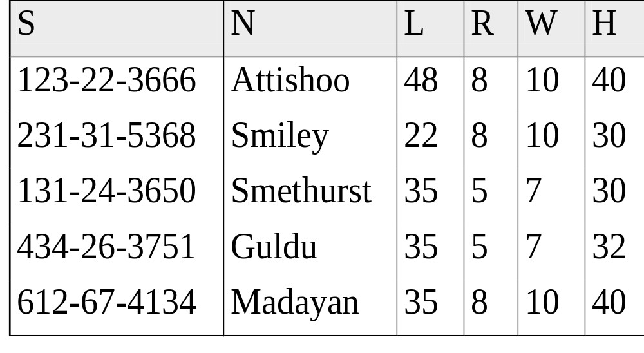

Example
Problems due to R W :
  Update anomaly: Can we change W in just the 1st tuple of SNLRWH?
  Insertion anomaly: What if we want to insert an employee and don’t know the hourly wage for his rating?
  Deletion anomaly: If we delete all employees with rating 5, we lose the information about the wage for rating 5!

Slide 16
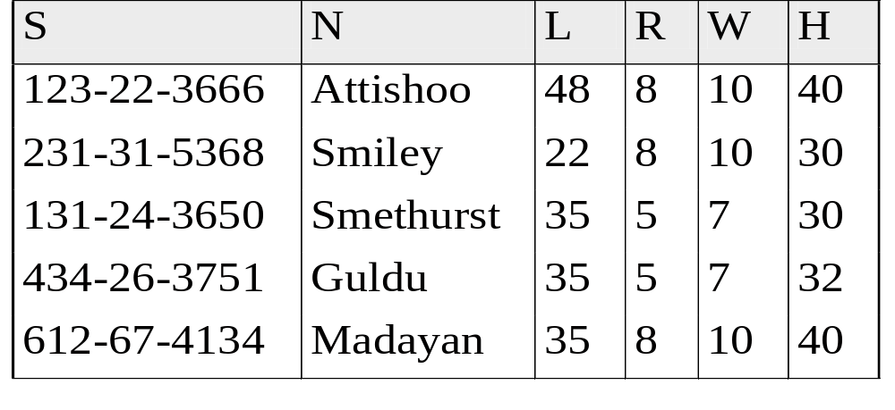
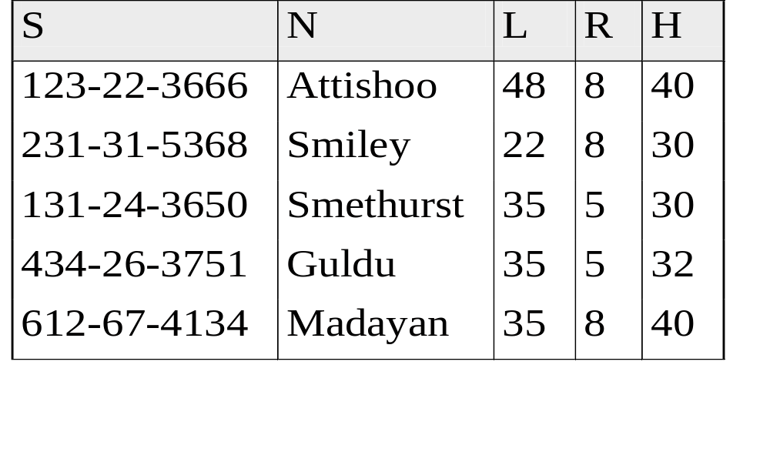
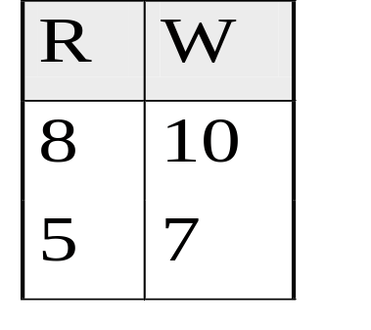
Hourly_Emps
Hourly_Emps2
Wages

Slide 17
Refining an ER Diagram
1st diagram translated: Workers(S,N,L,D,S) Departments(D,M,B)
  Lots associated with workers.
Suppose all workers in a dept are assigned the same lot: D L
since
name
dname
ssn
lot
did
budget
Employees
Works_In
Departments

Slide 18
Refining an ER Diagram
Suppose all workers in a dept are assigned the same lot: D L
Redundancy; fixed by: Workers2(S,N,D,S) Dept_Lots(D,L)
Can fine-tune this: Workers2(S,N,D,S) Departments(D,M,B,L)
budget
since
name
dname
ssn
did
lot
Employees
Works_In
Departments

Slide 19
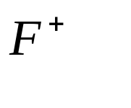

Reasoning About FDs
Given some FDs, we can usually infer additional FDs:
  ssn did, did lot implies ssn lot
An FD f is implied by a set of FDs F if f holds whenever all FDs in F hold.
  = closure of F is the set of all FDs that are implied by F.
Armstrong’s Axioms (X, Y, Z are sets of attributes):
  Reflexivity: If X Y, then Y X (a trivial FD)
  Augmentation: If X Y, then XZ YZ for any Z
  Transitivity: If X Y and Y Z, then X Z
These are sound and complete inference rules for FDs!

Slide 20
Reasoning About FDs
S | N | L | R | W | H
For example, in the above schema
S N -> S is a trivial FD
since {S,N} is a superset of {S}

Slide 21
Reasoning About FDs
S | N | L | R | W | H
For example, in the above schema
If S N -> R W, then S N L -> R W L (by augmentation)

Slide 22
Reasoning About FDs (Contd.)
Couple of additional rules (that follow from AA):
  Union: If X -> Y and X -> Z, then X -> YZ
  Proof:
    From X -> Y, we have XX -> XY (by augmentation)
    Note that XX is X, therefore X -> XY
    From X -> Z, we have XY -> YZ (by augmentation)
    From X -> XY and XY -> YZ, we have X -> YZ (by transitiviy)

Slide 23
Reasoning About FDs (Contd.)
Couple of additional rules (that follow from AA):
  Decomposition: If X -> YZ, then X -> Y and X -> Z
  Try to prove it at home/dorm/IC/Vitamin/DD/Bus!

Slide 24

Reasoning About FDs (Contd.)
Example: Contracts(cid,sid,jid,did,pid,qty,value), and:
  C is the key: C CSJDPQV
  Project purchases each part using single contract: JP C
  Dept purchases at most one part from a supplier: SD P
JP C, C CSJDPQV imply JP CSJDPQV
SD P implies SDJ JP
SDJ JP, JP CSJDPQV imply SDJ CSJDPQV

Slide 25
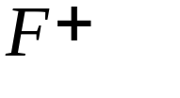
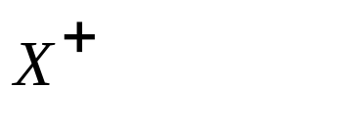
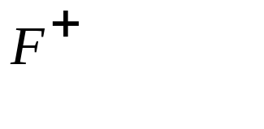
Reasoning About FDs (Contd.)
Computing the closure of a set of FDs ( ) can be expensive. (Size of closure is exponential in # attrs!)
Typically, we just want to check if a given FD X Y is in the closure of a set of FDs F. An efficient check:
  Compute attribute closure of X (denoted ) wrt F:
    Set of all attributes A such that X A is in
    There is a linear time algorithm to compute this.
    For each FD Y -> Z in F, if is a superset of Y then add Y to

Slide 26

Reasoning About FDs (Contd.)
Does F = {A B, B C, C D E } imply A E?
  i.e, is A E in the closure ? Equivalently, is E in ?
  Lets compute A⁺
    Initialize A⁺ to {A} : A⁺ = {A}
    From A -> B, we can add B to A⁺ : A⁺ = {A, B}
    From B -> C, we can add C to A⁺ : A⁺ = {A, B, C}
    We can not add any more attributes, and A⁺ does not contain E therefore A -> E does not hold.

Slide 27
DB Design Guidelines
Design a relation schema with a clearly defined semantics
Design the relation schemas so that there is not insertion, deletion, or modification anomalies. If there may be anomalies, state them clearly
Avoid attributes which may frequently have null values as much as possible.
Make sure that relations can be combined by key-foreign key links

Slide 28
Normal Forms
Normal forms are standards for a good DB schema (introduced by Codd in 1972)
If a relation is in a certain normal form (such as BCNF, 3NF etc.), it is known that certain kinds of problems are avoided/minimized.
Normal forms help us decide if decomposing a relation helps.

Slide 29
Normal Forms
First Normal Form: No set valued attributes (only atomic values)
sid | name | phones
1 | ali | {5332344568, 2165533561}
2 | veli | …
1 | ayse | …
3 | fatma | …

Slide 30
Normal Forms (Contd.)
Role of FDs in detecting redundancy:
  Consider a relation R with 3 attributes, ABC.
    No FDs hold: There is no redundancy here.
    Given A -> B: Several tuples could have the same A value, and if so, they’ll all have the same B value!

Slide 31
Normal Forms (Contd.)
Second Normal Form : Every non-prime attribute should be fully functionally dependent on every key (i.e., candidate keys).
  Prime attribute: any attribute that is part of a key
  Non-prime attributes: rest of the attributes
  Ex: If AB is a key, and C is a non-prime attribute, then if A->C holds then C partially determines C (there is a partial functional dependency to a key)

Slide 32

Third Normal Form (3NF)
Reln R with FDs F is in 3NF if, for all X A in
  A X (called a trivial FD), or
  X contains a key for R, or
  A is part of some key for R.
If R is in 3NF, some redundancy is possible.

Slide 33
What Does 3NF Achieve?
If 3NF violated by X -> A, one of the following holds:
  X is a subset of some key K
    We store (X, A) pairs redundantly.
  X is not a proper subset of any key.
    There is a chain of FDs K -> X -> A, which means that we cannot associate an X value with a K value unless we also associate an A value with an X value.
But: even if reln is in 3NF, these problems could arise.
  e.g., Reserves SBDC, S C, C S is in 3NF, but for each reservation of sailor S, same (S, C) pair is stored.
There is a stricter normal form (BCNF).

Slide 34

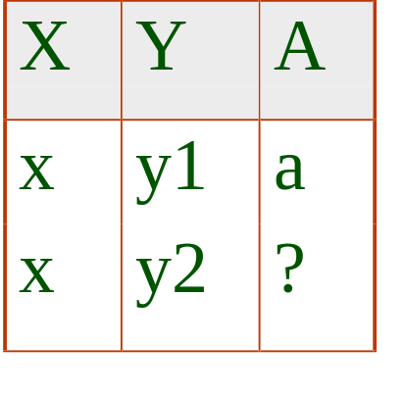
Boyce-Codd Normal Form (BCNF)
Reln R with FDs F is in BCNF if, for all X A in
  A X (called a trivial FD), or
  X contains a key for R. (i.e., X is a superkey)
In other words, R is in BCNF if the only non-trivial FDs that hold over R are key constraints.
  No dependency in R that can be predicted using FDs alone.
  If we are shown two tuples that agree upon the X value, we cannot infer the A value in one tuple from the A value in the other.
  If example relation is in BCNF, the 2 tuples must be identical (since X is a key).

Slide 35
Normal Forms Contd.
Person(SSN, Name, Address, Hobby)
F = {SSN Hobby -> Name Address, SSN ->Name Address}
SSN | Name | Address | Hobby
111111 | Celalettin | Sabanci D. | Stamps
111111 | Celalettin | Sabanci D. | Coins
555555 | Elif | Mutlukent | Skating
555555 | Elif | Mutlukent | Surfing
666666 | Sercan | Esentepe | Math
Is the above relation in 2nd normal form ?

Slide 36
Normal Forms Contd.
Ex: R = ABCD, F={AB->CD, AC->BD}
  What are the (candidate) keys for R?
  Is R in 3NF?
  Is R in BCNF?
A | B | C | D
1 | 1 | 3 | 4
2 | 1 | 3 | 4
Is there a redundancy in the above instance
With respect to F ?

Slide 37
Example
An employee can be assigned to at most one project, but many employees participate in a project
EMP_PROJ(ENAME, SSN, ADDRESS, PNUMBER, PNAME, PMGRSSN)
PMGRSSN is the SSN of the manager of the project
Is this a good design?

Slide 38
Decomposition of a Relation Scheme
Suppose that relation R contains attributes A1 ... An. A decomposition of R consists of replacing R by two or more relations such that:
  Each new relation scheme contains a subset of the attributes of R (and no attributes that do not appear in R), and
  Every attribute of R appears as an attribute of one of the new relations.
Intuitively, decomposing R means we will store instances of the relation schemes produced by the decomposition, instead of instances of R.
E.g., Can decompose SNLRWH into SNLRH and RW.

Slide 39
Decomposition of a Relation Scheme
We can decompose SNLRWH into SNL and RWH.
S | N | L | R | W | H
S | N | L
R | W | H

Slide 40
Example Decomposition
SNLRWH has FDs S -> SNLRWH and R -> W
  Is this in 3NF?
  R->W violates 3NF (W values repeatedly associated with R values)
In order to fix the problem, we need to create a relation RW to store the R->W associations, and to remove W from the main schema:
    i.e., we decompose SNLRWH into SNLRH and RW
S | N | L | R | H
R | W

Slide 41
Problems with Decompositions
There are potential problems to consider:
Some queries become more expensive.
  e.g., How much did Ali earn ? (salary = W*H)
S | N | L | R | H
R | W

Slide 42
Problems with Decompositions
Given instances of the decomposed relations, we may not be able to reconstruct the corresponding instance of the original relation!

Slide 43
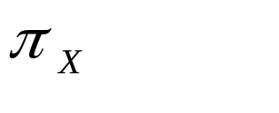
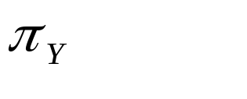


Lossless Join Decompositions
Decomposition of R into X and Y is lossless-join w.r.t. a set of FDs F if, for every instance r that satisfies F:
  (r) (r) = r
It is always true that r (r) (r)
  In general, the other direction does not hold! If it does, the decomposition is lossless-join.
Definition extended to decomposition into 3 or more relations in a straightforward way.
It is essential that all decompositions used to deal with redundancy be lossless! (Avoids Problem (2).)

Slide 44
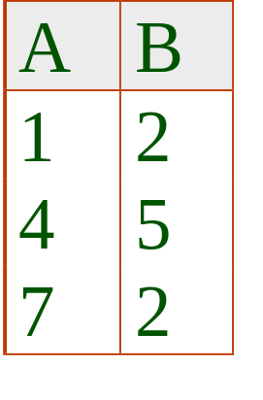
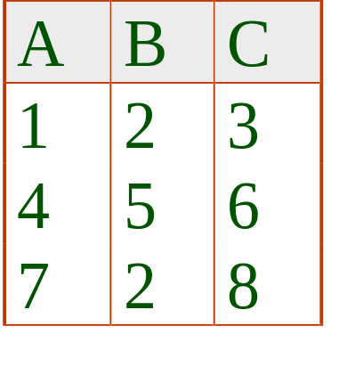
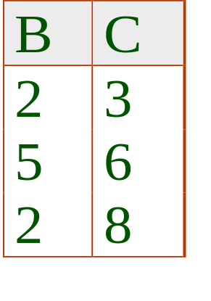



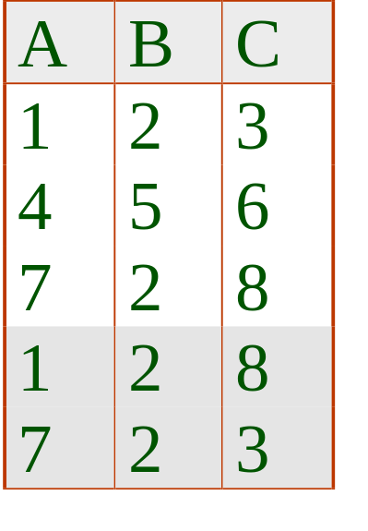
More on Lossless Join
The decomposition of R into X and Y is lossless-join wrt F if and only if the closure of F contains:
  X Y X, or
  X Y Y
In particular, the decomposition of R into UV and R - V is lossless-join if U V holds over R.

Slide 45
Person(SSN, Name, Address, Hobby)
F = {SSN Hobby -> Name Address, SSN ->Name Address}
Person
SSN | Name | Address | Hobby
111111 | Celalettin | Sabanci D. | Stamps
111111 | Celalettin | Sabanci D. | Coins
555555 | Elif | Mutlukent | Skating
555555 | Elif | Mutlukent | Surfing
666666 | Sercan | Esentepe | Math
Person1
Hobby
SSN | Name | Address
111111 | Celalettin | Sabanci D.
555555 | Elif | Mutlukent
666666 | Sercan | Esentepe
SSN | Hobby
111111 | Stamps
111111 | Coins
555555 | Skating
555555 | Surfing
666666 | Math

Slide 46
Person(SSN, Name, Address, Hobby)
F = {SSN Hobby -> Name Address, SSN ->Name Address}
SSN | Name | Address
111111 | Celalettin | Sabanci D.
555555 | Elif | Mutlukent
666666 | Sercan | Esentepe
SSN | Hobby
111111 | Stamps
111111 | Coins
555555 | Skating
555555 | Surfing
666666 | Math
SSN | Name | Address | Hobby
111111 | Celalettin | Sabanci D. | Stamps
111111 | Celalettin | Sabanci D. | Coins
555555 | Elif | Mutlukent | Skating
555555 | Elif | Mutlukent | Surfing
666666 | Sercan | Esentepe | Math

Slide 47
Problems with Decompositions (Contd.)
Checking some dependencies may require joining the instances of the decomposed relations.

Slide 48
Dependency Preserving Decomposition
Consider CSJDPQV, C is key, JP -> C and SD -> P.
  BCNF decomposition: CSJDQV and SDP
  Problem: Checking JP -> C requires a join!
Dependency preserving decomposition:
  A dependency X->Y that appear in F should either appear in one of the sub relations or should be inferred from the dependencies in one of the subrelations.
  Projection of set of FDs F : If R is decomposed into X, ... projection of F onto X (denoted F_{X} ) is the set of FDs U -> V in F⁺ (closure of F ) such that U, V are in X.
  Ex: R=ABC, F={ A -> B, B -> C, C -> A}
    F⁺ includes FDs, {A->B, B->C, C->A, B->A, A->C, C->B }
    F_{AB}= {A->B, B->A}, F_{AC}={C->A, A->C}

Slide 49
Dependency Preserving Decompositions (Contd.)
Decomposition of R into X and Y is dependency preserving if (F_{X} union F_{Y} ) ⁺ = F ⁺
  i.e., if we consider only dependencies in the closure F ⁺ that can be checked in X without considering Y, and in Y without considering X, these imply all dependencies in F ⁺.
Important to consider F ⁺, not F, in this definition:
  ABC, A -> B, B -> C, C -> A, decomposed into AB and BC.
  Is this dependency preserving? Is C ->A preserved?????
    F⁺ includes FDs, {A->B, B->C, C->A, B->A, A->C, C->B }
    F_{AB}= {A->B, B->A}, F_{BC}={B->C, C->B},
    F_{AB} U F_{BC} = {A->B, B->A, B->C, C->B}
    Does the closure of F_{AB} U F_{BC} imply C->A ?

Slide 50
Dependency Preserving Decompositions (Contd.)
Dependency preserving does not imply lossless join:
  Ex: ABC, A -> B, decomposed into AB and BC, is lossy.
And vice-versa! (Example?)

Slide 51
Decomposition into BCNF
Consider relation R with FDs F. If X -> Y violates BCNF, decompose R into R - Y and XY.
  Repeated application of this idea will give us a collection of relations that are in
    BCNF;
    lossless join decomposition,
    and guaranteed to terminate.
In general, several dependencies may cause violation of BCNF. The order in which we ``deal with’’ them could lead to very different sets of relations!

Slide 52
Example: Decomposition into BCNF
R= ABCDEFG with FDs
  ABH->C
  A->DE
  BGH->F
  F->ADH
  BH->GE
Is R in BCNF?
Which FD violates the BCNF ?
  ABH -> C ?
    No, since ABH is a superkey
  A->DE violates BCNF
    Since attribute closure of A is ADE and therefore A is not a superkey
    Decompose R=ABCDEFG into R1=ADE and R2=ABCFGH

Slide 53
Example: Decomposition into BCNF
R= ABCDEFG with FDs
  ABH->C
  A->DE
  BGH->F
  F->ADH
  BH->GE
R1=ADE F1= {A->DE}
R2=ABCFGH F2= {ABH->C, BGH->F, F->AH, BH->G}
  Note that the new FDs are obtained by projecting the original FDs on the attributes in the new relations.
  For example BH->GE is decomposed into {BH->G, BH->E} and BH->E is not included in F1 or F2, BH->G is included into R2.
  Is the decomposition of R into R1 and R2 dependency preserving?
R1 is in BCNF, but we need to apply the algorithm on R2 since it is not in BCNF

Slide 54
BCNF and Dependency Preservation
In general, there may not be a dependency preserving decomposition into BCNF.
  e.g., CSZ, CS -> Z, Z -> C
  Can’t decompose while preserving 1st FD; not in BCNF.
Similarly, decomposition of CSJDQV into SDP, JS and CJDQV is not dependency preserving (w.r.t. the FDs JP -> C, SD -> P and J -> S).
  However, it is a lossless join decomposition.
  In this case, adding JPC to the collection of relations gives us a dependency preserving decomposition.
    JPC tuples stored only for checking FD! (Redundancy!)

Slide 55
Decomposition into 3NF
The algorithm for lossless join decomp into BCNF can be used to obtain a lossless join decomp into 3NF (typically, can stop earlier).
To ensure dependency preservation, one idea:
  If X -> Y is not preserved, add relation XY.
  Problem is that XY may violate 3NF! e.g., consider the addition of CJP to `preserve’ JP -> C. What if we also have J -> C ?
Refinement: Instead of the given set of FDs F, use a minimal cover for F.

Slide 56
Minimal Cover for a Set of FDs
Minimal cover G for a set of FDs F:
  Closure of F = closure of G.
  Right hand side of each FD in G is a single attribute.
  If we modify G by deleting an FD or by deleting attributes from an FD in G, the closure changes.
Intuitively, every FD in G is needed, and ``as small as possible’’ in order to get the same closure as F.
e.g., A -> B, ABCD -> E, EF -> GH, ACDF -> EG has the following minimal cover:
  A -> B, ACD -> E, EF -> G and EF -> H

Slide 57
Obtaining the Minimal Cover
Algorithm Steps:
  Put the FDs in standard form (single attribute on the right hand side)
  Minimize the left hand side of each FD
  Delete the redundant FDs
The steps should be performed in the above order (think why)
Is there a unique minimal cover for a given set of FDs?

Slide 58
Obtaining the Minimal Cover
Example: F = {ABCD->E, E->D, A->B, AC->D}
  Notice that the right hand sides have a single attr (if not we had to decompose the right hand sides first)
  Can we remove B from the left hand side of ABCD->E?
    Check if ABCD->E is implied by F’ (obtained by replacing ABCD->E with ACD->E)
    In order to do this, find the attribute closure ABCD wrt F’
    If E is in the attribute closure, then ABCD->E is implied by F’
  Can we remove D from ACD->E
    Check if ACD->E is implied by F’’ (obtained by replacing ACD->E in F’ with AC->E)
  F’’ = {AC->E, E->D, A->B, AC->D}
    Can we drop any FDs in F’’ ?
    Could we drop any FDs in F before minimizing the left hand sides?

Slide 59
Dependency Preserving Decomposition into 3rdNF
Let R be the relation to be decomposed into 3rd NF
and F be the FDs that is a minimal cover
Algorithm Steps
  Perform lossless-join decomposition of R into R1,R2,..Rn
  Project the FDs in F into F1,F2,…,Fn (that correspond to R1,R2,…,Rn)
  Identify the set of FDs that are not preserved (I.e., that are not in the closure of the union of F1,F2,…,Fn)
  For each FD X->A that is not preserved, create a relation schema XA and it to the decomposition.

Slide 60
Example
Consider the relation R = ABCDE with FDs:
  A->B
  BC->E
  ED->A
Lets first find all the keys
Lets check if R is in 3NF
Lets check if R is in BCNF

