Slide 1
MULTIUSER DATABASES : Concurrency and Transaction Management

Slide 2
Banking Application
Entities in a banking application:
  Customers
  Employees
  Accounts
In an operational bank database, customers use the ATMs, internet, and phones to interact with their accounts
This is a multiuser database since many customers may be connected to the bank database and doing money transfers, checking their balance etc.

Slide 3
Banking Application
Consider that Neco is transferring 100YTL from his account to Muco’s account.
The following operations take place:
  Read the amount of money in the account of Neco (a)
  a := a – 100
  Read the amount of money in Muco’s account (r)
  r = r + 100
At the same time, the bank calculates the total amount of money stored in the accounts
  Read amount of money in the accounts one by one
  Add the amounts to the sum.

Slide 4


Banking Application
Neco
Muco
400 YTL
100 YTL

Slide 5
Banking Application
Neco
Muco
100 YTL
300 YTL
100 YTL

Slide 6
Banking Application
Neco
Muco
300 YTL
200 YTL

Slide 7
Banking Application
Neco
Muco
300 YTL
200 YTL
Sum
0

Slide 8
Banking Application
Neco
Muco
300 YTL
200 YTL
Sum := sum + 300
300

Slide 9
Banking Application
Neco
Muco
300 YTL
200 YTL
Sum := sum + 200
500

Slide 10
Banking Application
Neco
Muco
300 YTL
200 YTL
Things are fine if I finish the money transfer and then
calculate the sum. But consider the following case

Slide 11
Banking Application
Neco
Muco
300 YTL
100 YTL
sum
0

Slide 12
Banking Application
Neco
Muco
300 YTL
100 YTL
Sum := sum + 300
300

Slide 13
Banking Application
Neco
Muco
300 YTL
100 YTL
Sum := sum + 100
400

Slide 14
Banking Application
Neco
Muco
100YTL
300 YTL
200 YTL
sum
400

Slide 15
Concurrency
Interleaving the execution of the operations such as the money transfer and account sum.
Concurrency is needed for performance reasons (ex: using the CPU when somebody else is accessing the disk)
user1
user2
user3
user4
Database

Slide 16
Concurrency
A users program may be doing many different operations but from a database point of view, only R/W operations are of interest.
A transaction is the DBMS’s abstract view of a user program: a sequence of reads and writes.
  Ex: Transaction1: R(Account1), Read(Account2), Write(Account1)

Slide 17
Concurrency in a DBMS
Users submit transactions, and can think of each transaction as executing by itself.
  Concurrency is achieved by the DBMS, which interleaves actions (reads/writes of DB objects) of various transactions.
  Each transaction must leave the database in a consistent state if the DB is consistent when the transaction begins.
DB
Transaction1
DB’

Slide 18
Concurrency in a DBMS
DBMS will enforce some ICs, depending on the ICs declared in CREATE TABLE statements.
Beyond this, the DBMS does not really understand the semantics of the data. (e.g., it does not understand how the interest on a bank account is computed).
Main Issues: Effect of interleaving transactions, and crashes.

Slide 19
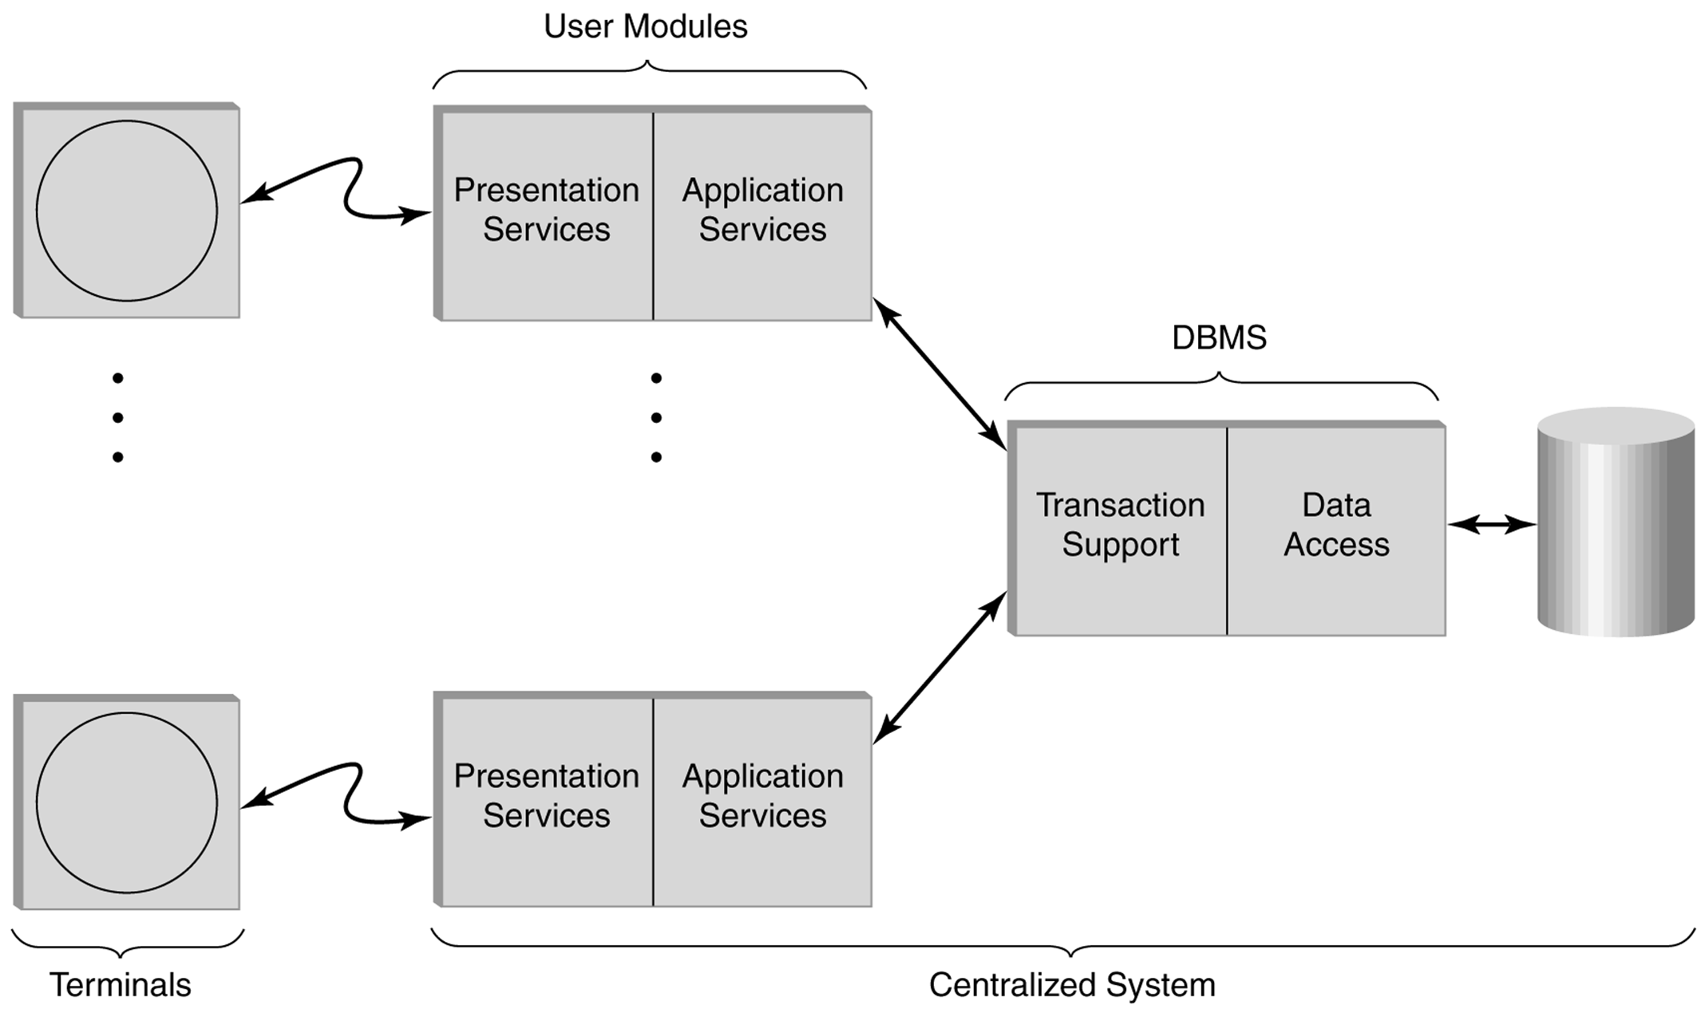
Multiuser centralized transaction processing system.
Databases and Transaction Processing Lewis, Bernstein, Kifer

Slide 20
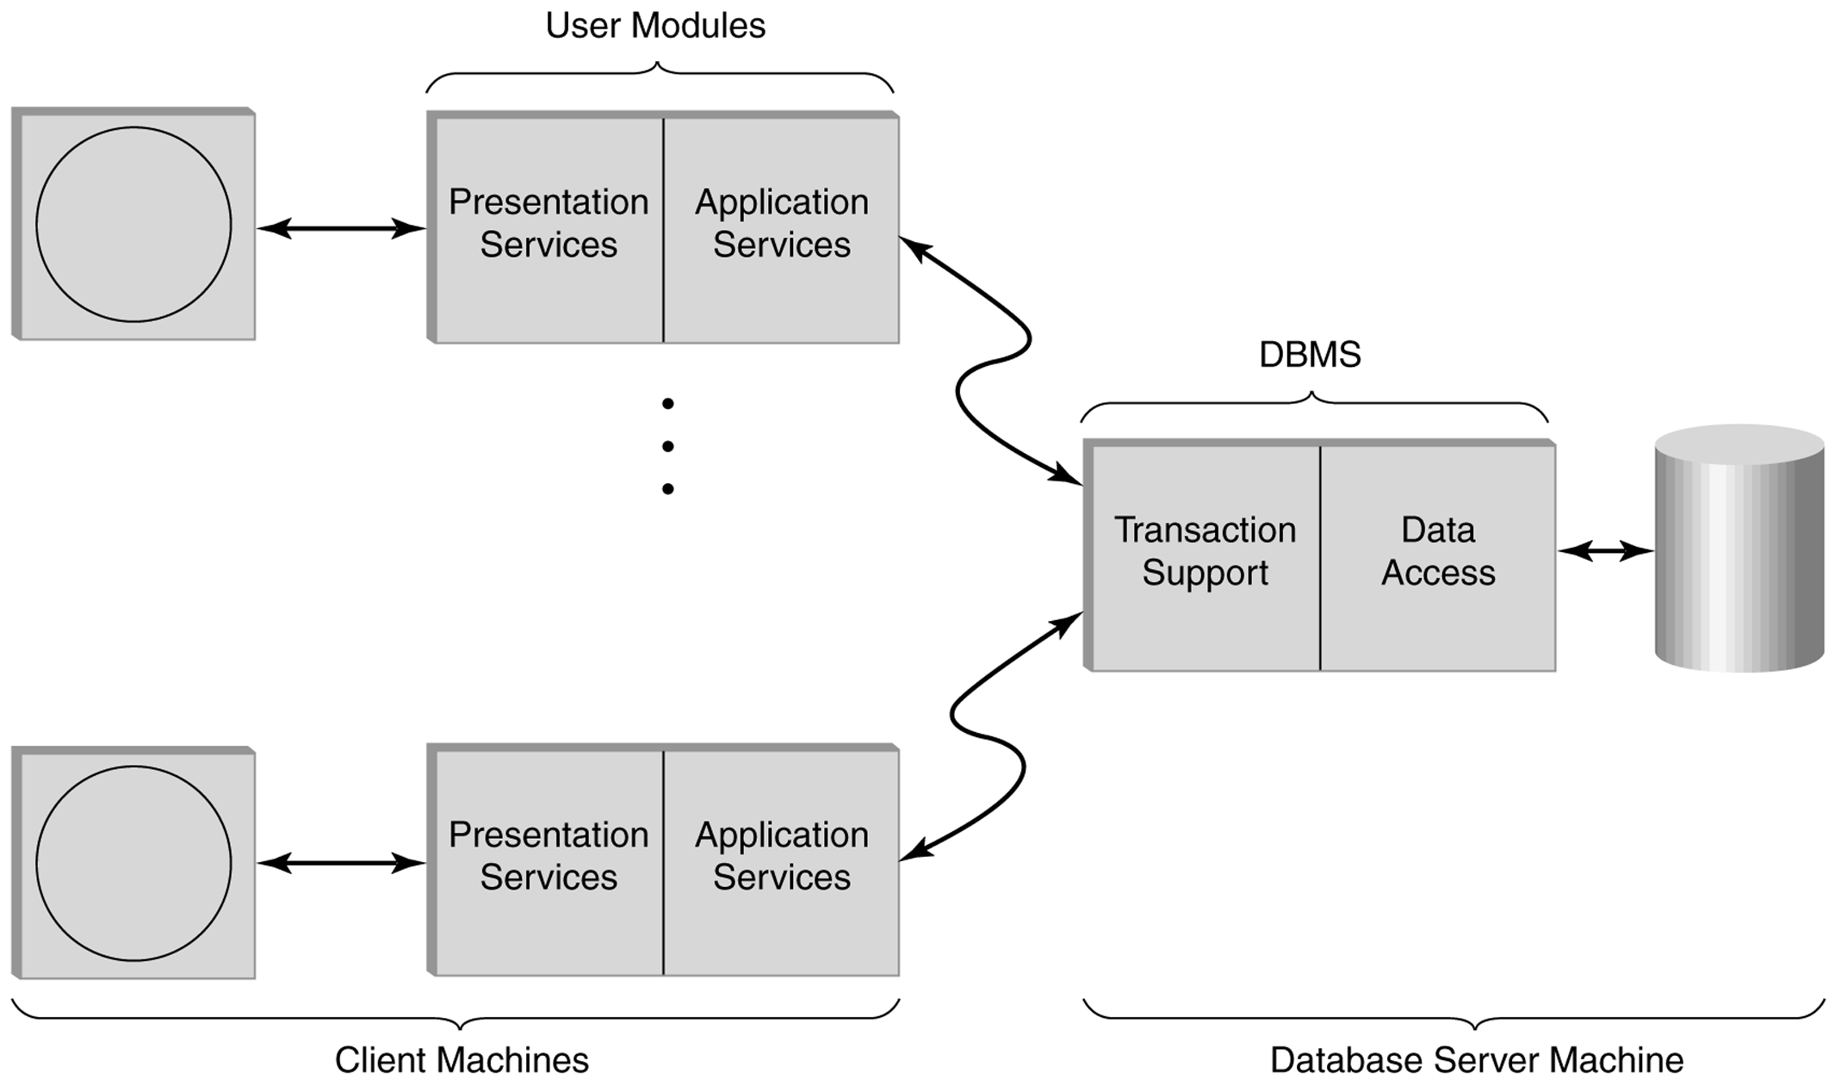
Two-tiered multiuser distributed transaction processing system.
Databases and Transaction Processing (Lewis, Bernstein, Kifer)

Slide 21
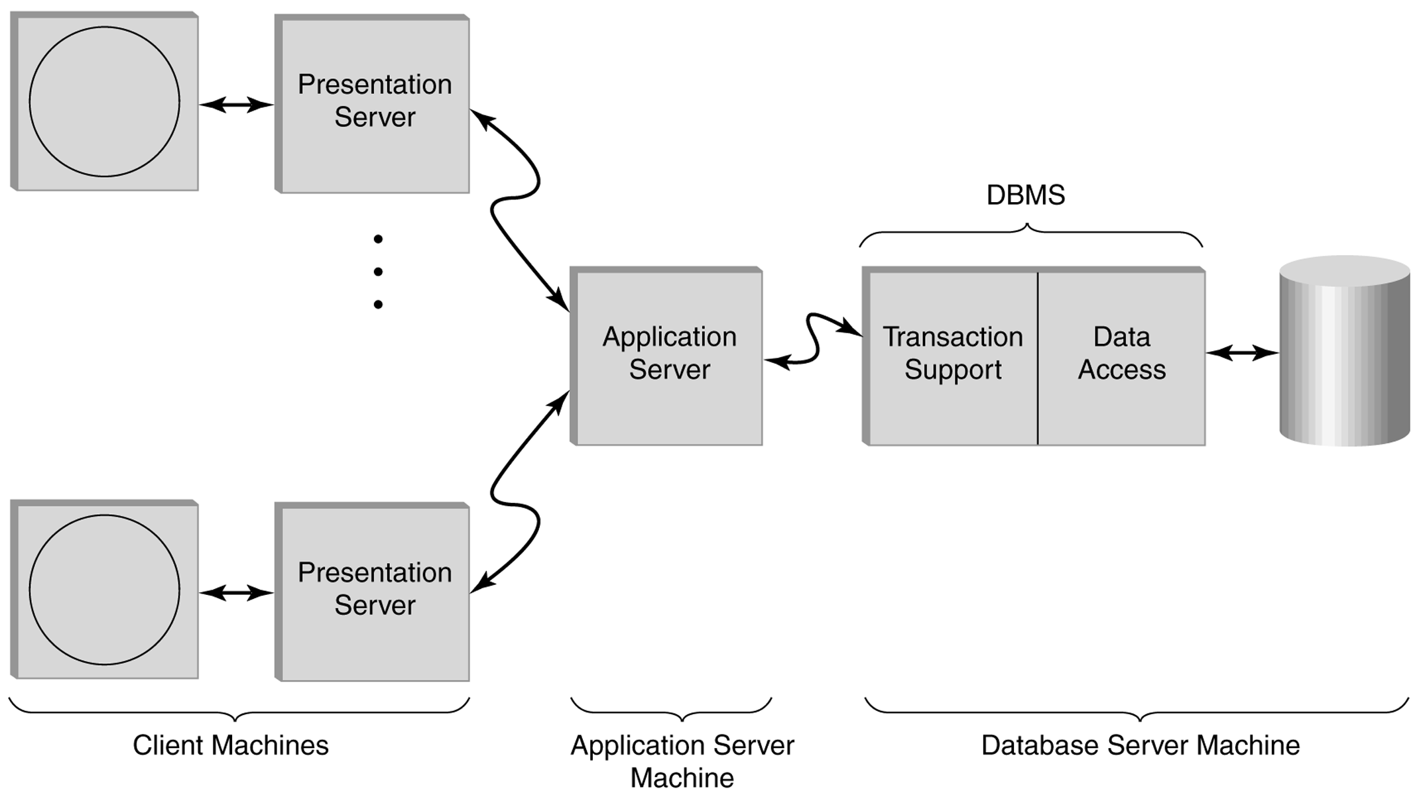
Three-tiered multiuser distributed transaction processing system.
Databases and Transaction Processing (Lewis, Bernstein, Kifer)

Slide 22
ACID Properties of transactions
Atomicity
Consistency
Isolation
Durability

Slide 23
Atomicity of Transactions
A transaction might commit after completing all its actions, or it could abort (or be aborted by the DBMS) after executing some actions.
Transaction
Begin
Transaction
Commit
Transaction
Begin
Transaction
Abort

Slide 24
Atomicity of Transactions
A very important property guaranteed by the DBMS for all transactions is that they are atomic. That is, a user can think of a transaction as always executing all its actions in one step, or not executing any actions at all.
  DBMS logs all actions so that it can undo the actions of aborted transactions.
LOG
Transaction
Begin
Transaction
Abort
head
rollback

Slide 25
Example
Consider two transactions
T1: BEGIN A=A+100, B=B-100 END
T2: BEGIN A=1.06*A, B=1.06*B END
Intuitively, the first transaction is transferring $100 from B’s account to A’s account. The second is crediting both accounts with a 6% interest payment.
There is no guarantee that T1 will execute before T2 or vice-versa, if both are submitted together. However, the net effect must be equivalent to these two transactions running serially in some order.

Slide 26
Example (Contd.)
Consider a possible interleaving (schedule):
T1: A=A+100, B=B-100
T2: A=1.06*A, B=1.06*B
This is OK. But what about:
T1: A=A+100, B=B-100
T2: A=1.06*A, B=1.06*B
The DBMS’s view of the second schedule:
T1: R(A), W(A), R(B), W(B)
T2: R(A), W(A), R(B), W(B)

Slide 27
Scheduling Transactions
Serial schedule: Schedule that does not interleave the actions of different transactions.
T1
T2
T1: A=A+100, B=B-100 T2: A=1.06*A,B=1.06*B

Slide 28
Scheduling Transactions
Equivalent schedules:
  Schedules involving the same set of operations on the same data objects
Schedule 1
T1: R(A), W(A), R(B), W(B)
T2: R(A), W(A)
Schedule 2
T1: R(A), W(A), R(B), W(B)
T2: R(A), W(A)

Slide 29
Scheduling Transactions
Equivalent schedules:
  Schedules with the same set of operations on the same data objects
  And, for any database state, the effect (on the set of objects in the database) of executing the first schedule is identical to the effect of executing the second schedule.
DB’
Schedule 1
DB’ = DB’’
DB
DB’’
Schedule 2

Slide 30
Scheduling Transactions
Serializable schedule: A schedule that is equivalent to some serial execution of the transactions.
Schedule 1
T1: R(A), W(A), R(B), W(B)
T2: R(A), W(A)
Question:
Is schedule 1 Equivalent to serial schedule A or B?
Serial Schedule A
T1: R(A), W(A), R(B), W(B)
T2: R(A), W(A)
Serial Schedule B
T1: R(A), W(A), R(B), W(B)
T2: R(A), W(A)

Slide 31
Scheduling Transactions
If each transaction preserves consistency, every serializable schedule preserves consistency!

Slide 32
Anomalies with Interleaved Execution
Reading Uncommitted Data (WR Conflicts, “dirty reads”):
What happens when T1 aborts?
T1: R(A), W(A), R(B), W(B), Abort
T2: R(A), W(A), C

Slide 33
Anomalies with Interleaved Execution
Unrepeatable Reads (RW Conflicts):
T1: R(A), R(A), W(A), C
T2: R(A), W(A), C

Slide 34
Anomalies (Continued)
Overwriting Uncommitted Data (WW Conflicts):
T1: W(A), W(B), C
T2: W(A), W(B), C

Slide 35
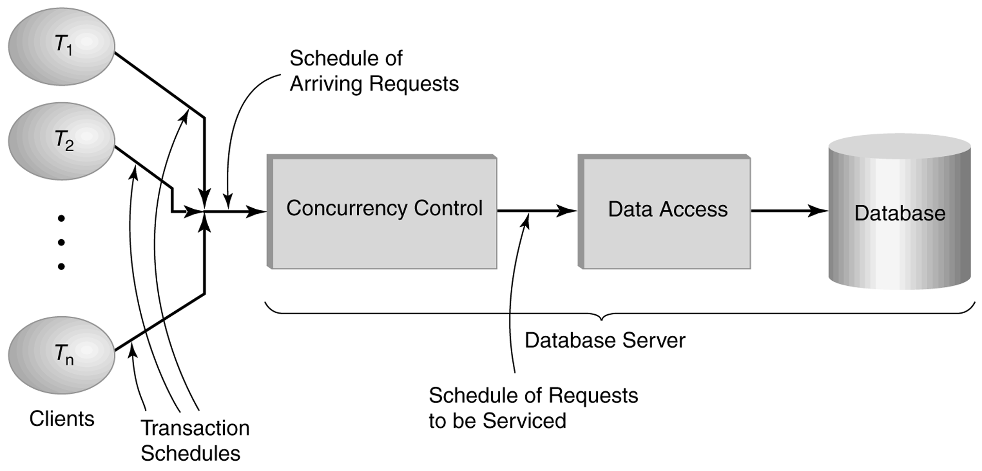
Role of a concurrency control in a database system.
Databases and Transaction Processing (Lewis, Bernstein, Kifer)

Slide 36
Lock-Based Concurrency Control
Each transaction must obtain a S (shared) lock on object before reading, and an X (exclusive) lock on object before writing.
An S or X lock is released when the corresponding object is no longer needed.
  Ex: T1: S(A), R(A), Release_S(A), X(B), W(B), Release_X(B) …

Slide 37
Lock-Based Concurrency Control
X conflicts with X and S
  No transaction can obtain an X lock on an object if some other transaction has an X or S lock on that object.
  No transaction can obtain an S lock on an object if some other transaction has an X lock on that object
S locks do not conflict with each other
  Multiple transactions may obtain an S lock on the same object

Slide 38
Lock-Based Concurrency Control
Strict Two-phase Locking (Strict 2PL) Protocol:
  Each transaction must obtain a S (shared) lock on object before reading, and an X (exclusive) lock on object before writing.
  All locks held by a transaction are released when the transaction completes
  If a transaction holds an X lock on an object, no other transaction can get a lock (S or X) on that object.
Strict 2PL allows only serializable schedules.

Slide 39
Aborting a Transaction
If a transaction Ti is aborted,
  all its actions have to be undone.
  if Tj reads an object last written by Ti, Tj must be aborted as well! (called cascading aborts )
T1: R(A), W(A), R(B), Abort
T2: R(A) ,Abort

Slide 40
Aborting a Transaction
Most systems avoid cascading aborts by releasing a transaction’s locks only at commit time.
  If Ti writes an object, Tj can read this only after Ti commits.
In order to undo the actions of an aborted transaction, the DBMS maintains a log in which every write is recorded.
Log is also used to recover from system crashes: all active transactions at the time of the crash are aborted when the system comes back up.

Slide 41
The Log
The following actions are recorded in the log:
  Ti writes an object: the old value and the new value.
    Log record must go to disk before the changed page!
  Ti commits/aborts: a log record indicating this action.
Log records are chained together by transaction id, so it’s easy to undo a specific transaction.
Log is often duplexed and archived on stable storage.
All log related activities (and in fact, all CC related activities such as lock/unlock, dealing with deadlocks etc.) are handled transparently by the DBMS.

Slide 42
Recovering From a Crash
There are 3 phases in the Aries recovery algorithm:
  Analysis: Scan the log forward (from the most recent checkpoint) to identify all Xacts that were active, and all dirty pages in the buffer pool at the time of the crash.
  Redo: Redoes all updates to dirty pages in the buffer pool, as needed, to ensure that all logged updates are in fact carried out and written to disk.
  Undo: The writes of all Xacts that were active at the crash are undone (by restoring the before value of the update, which is in the log record for the update), working backwards in the log. (Some care must be taken to handle the case of a crash occurring during the recovery process!)

Slide 43
Conflict Serializable Schedules
Two schedules are conflict equivalent if:
  Involve the same actions of the same transactions
  Every pair of conflicting actions is ordered the same way
Schedule 1
T1: R(A), W(A), R(B), W(B)
T2: R(A), W(A) R(B)
Schedule 2
T1: R(A), W(A), R(B), W(B)
T2: R(A), W(A) R(B)
Is schedule1 conflict equivalent to schedule2?

Slide 44
Conflict Serializable Schedules
Schedule S is conflict serializable if S is conflict equivalent to SOME serial schedule!
Schedule 1
T1: R(A), W(A), R(B), W(B)
T2: R(A), W(A) R(B)
Schedule 2 (serial)
T1: R(A), W(A), R(B), W(B)
T2: R(A), W(A), R(B)

Slide 45
Example
A schedule that is not conflict serializable.
Schedule
T1: R(A), W(A), R(B), W(B)
T2: R(A), W(A), R(B), W(B)
Serial1
T1: R(A), W(A), R(B), W(B)
T2: R(A), W(A), R(B), W(B)
Serial2
T1: R(A), W(A), R(B), W(B)
T2: R(A), W(A), R(B), W(B)

Slide 46
How to check conflict serializability?
Precedence graph: (a.k.a serializability graph)
  One node per transaction;
  edge from Ti to Tj if Ti has a conflicting action with Tj and Ti precedes Tj.

Slide 47
Example
A schedule that is not conflict serializable:
The cycle in the graph reveals the problem. The output of T1 depends on T2, and vice-versa.
Theorem: Schedule is conflict serializable if and only if its presedence graph is acyclic (Proof by contradiction)
T1: R(A), W(A), R(B), W(B)
T2: R(A), W(A), R(B), W(B)
A
T1
T2
Presedence graph
B

Slide 48
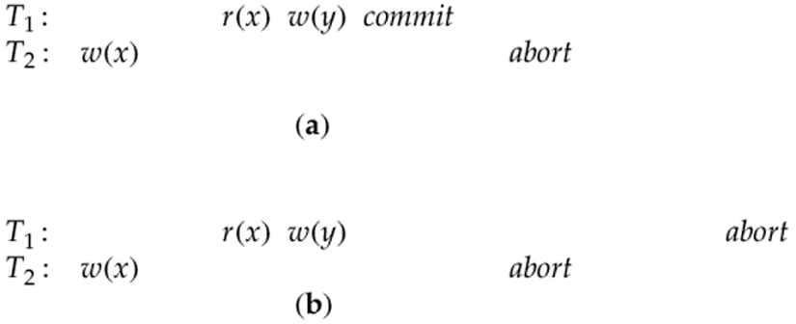
Recoverable schedules: a transaction T is not allowed to
Commit until all other transactions that wrote values that
T read has committed.
Is a or b recoverable?

Slide 49
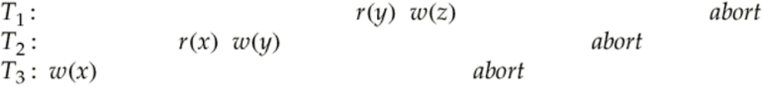
Recoverable schedule that illustrates a cascaded abort. T₃ aborts, forcing T₂ to abort, which then forces T₁ to abort. (Cascading Aborts)

Slide 50
Strict 2PL
Strict Two-phase Locking (Strict 2PL) Protocol:
  Each transaction must obtain a S (shared) lock on object before reading, and an X (exclusive) lock on object before writing.
  All locks held by a transaction are released when the transaction completes
  If a transaction holds an X lock on an object, no other transaction can get a lock (S or X) on that object.
Strict 2PL allows only schedules whose precedence graph is acyclic. (Proof by contradiction)

Slide 51
Two-Phase Locking (2PL) (non-strict)
Two-Phase Locking Protocol
  Each transaction must obtain a S (shared) lock on object before reading, and an X (exclusive) lock on object before writing.
  A transaction can not request additional locks once it releases any locks.
  If a transaction holds an X lock on an object, no other transaction can get a lock (S or X) on that object.

Slide 52
Strict vs non-strict 2PL
Does strict and non-strict 2PL produce serializable schedules?
Does strict 2PL avoid cascading aborts?
Does strict 2PL produce only recoverable schedules?
How about non-strict 2PL?

Slide 53
Lock Management
Lock and unlock requests are handled by the lock manager
Lock table entry:
  Number of transactions currently holding a lock
  Type of lock held (shared or exclusive)
  Pointer to queue of lock requests
Locking and unlocking have to be atomic operations
Lock upgrade: transaction that holds a shared lock can be upgraded to hold an exclusive lock

Slide 54
Deadlocks
Deadlock: Cycle of transactions waiting for locks to be released by each other.
Two ways of dealing with deadlocks:
  Deadlock prevention
  Deadlock detection

Slide 55
Deadlock Detection
Create a wait-for graph:
  Nodes are transactions
  There is an edge from Ti to Tj if Ti is waiting for Tj to release a lock
Periodically check for cycles in the waits-for graph

Slide 56
Deadlock Detection (Continued)
Example:
T1: S(A), R(A), S(B)
T2: X(B),W(B) X(C)
T3: S(C), R(C)
T4: X(B)
T1
T2
T4
T3

Slide 57
Deadlock Detection (Continued)
Example:
T1: S(A), R(A), S(B)
T2: X(B),W(B) X(C)
T3: S(C), R(C)
T4: X(B)
T1
T2
T4
T3

Slide 58
Deadlock Detection (Continued)
Example:
T1: S(A), R(A), S(B)
T2: X(B),W(B) X(C)
T3: S(C), R(C)
T4: X(B)
T1
T2
T4
T3

Slide 59
Deadlock Detection (Continued)
Example:
T1: S(A), R(A), S(B)
T2: X(B),W(B) X(C)
T3: S(C), R(C)
T4: X(B)
T1
T2
T4
T3

Slide 60
Deadlock Detection (Continued)
Example:
T1: S(A), R(A), S(B)
T2: X(B),W(B) X(C)
T3: S(C), R(C) X(A)
T4: X(B)
T1
T2
DEADLOCK!
T4
T3

Slide 61
Deadlock Prevention
Assign priorities based on timestamps. Assume Ti wants a lock that Tj holds. Two policies are possible:
  Wait-Die: It Ti has higher priority, Ti waits for Tj; otherwise Ti aborts
  Wound-wait: If Ti has higher priority, Tj aborts; otherwise Ti waits
If a transaction re-starts, make sure it has its original timestamp

Slide 62
Multiple-Granularity Locks
Hard to decide what granularity to lock (tuples vs. pages vs. tables).
Shouldn’t have to decide!
Data “containers” are nested:
Database
Tables
contains
Pages
Tuples

Slide 63
Solution: New Lock Modes, Protocol
Allow transactions to lock at each level, but with a special protocol using intention locks:
Before locking an item, transact must set “intention locks” on all its ancestors.
For unlock, go from specific to general (i.e., bottom-up).
SIX mode: Like S & IX at the same time.
--
IS
IX
S
X
--
√
√
√
√
√
IS
√
√
√
√
IX
√
√
√
S
√
√
√
X
√

Slide 64
Multiple Granularity Lock Protocol
Each transact starts from the root of the hierarchy.
To get S or IS lock on a node, must hold IS or IX on parent node.
  What if Xact holds SIX on parent? S on parent?
To get X or IX or SIX on a node, must hold IX or SIX on parent node.
Must release locks in bottom-up order.
Protocol is correct in that it is equivalent to directly setting
locks at the leaf levels of the hierarchy.

Slide 65
Examples
T1 scans R, and updates a few tuples:
  T1 gets an SIX lock on R, then repeatedly gets an S lock on tuples of R, and occasionally upgrades to X on the tuples.
T2 uses an index to read only part of R:
  T2 gets an IS lock on R, and repeatedly gets an S lock on tuples of R.
T3 reads all of R:
  T3 gets an S lock on R.
  OR, T3 could behave like T2; can use lock escalation to decide which.
--
IS
IX
S
X
--
√
√
√
√
√
IS
√
√
√
√
IX
√
√
√
S
√
√
√
X
√

Slide 66
Optimistic CC (Kung-Robinson)
Locking is a conservative approach in which conflicts are prevented. Disadvantages:
  Lock management overhead.
  Deadlock detection/resolution.
  Lock contention for heavily used objects.
If conflicts are rare, we might be able to gain concurrency by not locking, and instead checking for conflicts before transactions commit.

Slide 67
Kung-Robinson Model
Transactions have three phases:
  READ: transaction read from the database, but make changes to private copies of objects.
  VALIDATE: Check for conflicts.
  WRITE: Make local copies of changes public.
ROOT

Slide 68
Validation
Test conditions that are sufficient to ensure that no conflict occurred.
Each transaction is assigned a numeric id.
  Just use a timestamp.
Transaction ids assigned at end of READ phase, just before validation begins.
ReadSet(Ti): Set of objects read by transact Ti.
WriteSet(Ti): Set of objects modified by Ti.

Slide 69
Test 1
For all i and j such that Ti < Tj, check that Ti completes before Tj begins.
Ti
Tj
R
V
W
R
V
W

Slide 70
Test 2
For all i and j such that Ti < Tj, check that:
  Ti completes before Tj begins its Write phase +
  WriteSet(Ti) ReadSet(Tj) is empty.
Ti
R
V
W
Tj
R
V
W
Does Tj read dirty data? Does Ti overwrite Tj’s writes?

Slide 71
Test 3
For all i and j such that Ti < Tj, check that:
  Ti completes Read phase before Tj does +
  WriteSet(Ti) ReadSet(Tj) is empty +
  WriteSet(Ti) WriteSet(Tj) is empty.
Ti
R
V
W
Tj
R
V
W
Does Tj read dirty data? Does Ti overwrite Tj’s writes?

Slide 72
Overheads in Optimistic CC
Must record read/write activity in ReadSet and WriteSet per transaction.
  Must create and destroy these sets as needed.
Must check for conflicts during validation, and must make validated writes ``global’’.
  Critical section can reduce concurrency.
  Scheme for making writes global can reduce clustering of objects.
Optimistic CC restarts transactions that fail validation.
  Work done so far is wasted; requires clean-up.

Slide 73
Timestamp CC
Idea: Give each object a read-timestamp (RTS) and a write-timestamp (WTS), give each transaction a timestamp (TS) when it begins:
  If action ai of transaction Ti conflicts with action aj of transaction Tj, and TS(Ti) < TS(Tj), then ai must occur before aj. Otherwise, restart violating transaction.

Slide 74
When transact T wants to read Object O
If TS(T) < WTS(O), this violates timestamp order of T w.r.t. writer of O.
  So, abort T and restart it with a new, larger TS. (If restarted with same TS, T will fail again! Contrast use of timestamps in 2PL for ddlk prevention.)
If TS(T) > WTS(O):
  Allow T to read O.
  Reset RTS(O) to max(RTS(O), TS(T))
Change to RTS(O) on reads must be written to disk! This and restarts represent overheads.

Slide 75
When transact T wants to Write Object O
If TS(T) < RTS(O), this violates timestamp order of T w.r.t. writer of O; abort and restart T.
If TS(T) < WTS(O), violates timestamp order of T w.r.t. writer of O.
  Thomas Write Rule: We can safely ignore such outdated writes; need not restart T! (T’s write is effectively followed by another write, with no intervening reads.) Allows some serializable but non-conflict serializable schedules:
Else, allow T to write O.
T1 T2
R(A)
W(A)
Commit
W(A)
Commit

Slide 76
Timestamp CC and Recoverability
T1 T2
W(A)
R(A)
W(B)
Commit
Unfortunately, unrecoverable schedules are allowed:
Timestamp CC can be modified to allow only recoverable schedules:
  Buffer all writes until writer commits (but update WTS(O) when the write is allowed.)
  Block readers T (where TS(T) > WTS(O)) until writer of O commits.
Similar to writers holding X locks until commit, but still not quite 2PL.

Slide 77

The PHANTOM Problem in RDBMS concurrency control

Slide 78
Transaction Support in SQL-92
Each transaction has an access mode, a diagnostics size, and an isolation level.
Isolation Level
Dirty
Read
Unrepeatable Read
Phantom
Problem
Read Uncommitted
Maybe
Maybe
Maybe
Read Committed
No
Maybe
Maybe
Repeatable Reads
No
No
Maybe
Serializable
No
No
No

Slide 79
QUIZ Number 4
Answer the following question ….

