Slide 1
File Organizations and Indexing
Chapter 8
Notes:
1
The slides for this text are organized into chapters. This lecture covers Chapter 8.
Chapter 1: Introduction to Database Systems
Chapter 2: The Entity-Relationship Model
Chapter 3: The Relational Model
Chapter 4 (Part A): Relational Algebra
Chapter 4 (Part B): Relational Calculus
Chapter 5: SQL: Queries, Programming, Triggers
Chapter 6: Query-by-Example (QBE)
Chapter 7: Storing Data: Disks and Files
Chapter 8: File Organizations and Indexing
Chapter 9: Tree-Structured Indexing
Chapter 10: Hash-Based Indexing
Chapter 11: External Sorting
Chapter 12 (Part A): Evaluation of Relational Operators
Chapter 12 (Part B): Evaluation of Relational Operators: Other Techniques
Chapter 13: Introduction to Query Optimization
Chapter 14: A Typical Relational Optimizer
Chapter 15: Schema Refinement and Normal Forms
Chapter 16 (Part A): Physical Database Design
Chapter 16 (Part B): Database Tuning
Chapter 17: Security
Chapter 18: Transaction Management Overview
Chapter 19: Concurrency Control
Chapter 20: Crash Recovery
Chapter 21: Parallel and Distributed Databases
Chapter 22: Internet Databases
Chapter 23: Decision Support
Chapter 24: Data Mining
Chapter 25: Object-Database Systems
Chapter 26: Spatial Data Management
Chapter 27: Deductive Databases
Chapter 28: Additional Topics

Slide 2
Alternative File Organizations
Many alternatives exist, each ideal for some situation , and not so good in others:
  Heap files: Suitable when typical access is a file scan retrieving all records.
  Sorted Files: Best if records must be retrieved in some order, or only a `range’ of records is needed.
  Hashed Files: Good for equality selections.
    File is a collection of buckets. Bucket = primary page plus zero or more overflow pages.
    Hashing function h: h(r) = bucket in which record r belongs. h looks at only some of the fields of r, called the search fields.
Notes:
2

Slide 3
Cost Model for Our Analysis
We ignore CPU costs, for simplicity:
  B: The number of data pages
  R: Number of records per page
  D: (Average) time to read or write disk page
  Measuring number of page I/O’s ignores gains of pre-fetching blocks of pages; thus, even I/O cost is only approximated.
  Average-case analysis; based on several simplistic assumptions.
  Good enough to show the overall trends!
Notes:
3

Slide 4
Assumptions in Our Analysis
Single record insert and delete.
Heap Files:
  Equality selection on key; exactly one match.
  Insert always at end of file.
Sorted Files:
  Files compacted after deletions.
  Selections on sort field(s).
Hashed Files:
  No overflow buckets, 80% page occupancy.
Notes:
4

Slide 5
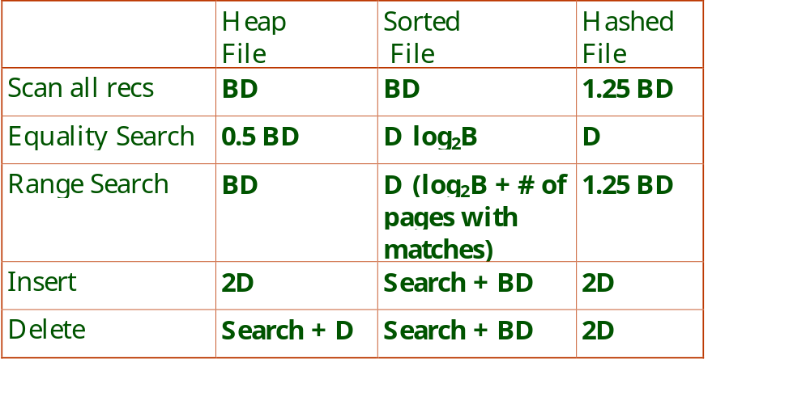
Cost of Operations
Several assumptions underlie these (rough) estimates!
Notes:
6

Slide 6
Cost of Operations
Several assumptions underlie these (rough) estimates!
Notes:
6

Slide 7
Cost of Operations
Several assumptions underlie these (rough) estimates!
Notes:
6

Slide 8
Cost of Operations
Several assumptions underlie these (rough) estimates!
Notes:
6

Slide 9
Cost of Operations
Several assumptions underlie these (rough) estimates!
Notes:
6

Slide 10
Cost of Operations
Several assumptions underlie these (rough) estimates!
Notes:
6

Slide 11
Cost of Operations
Several assumptions underlie these (rough) estimates!
Notes:
6

Slide 12
Cost of Operations
Several assumptions underlie these (rough) estimates!
Notes:
6

Slide 13
Cost of Operations
Several assumptions underlie these (rough) estimates!
Notes:
6

Slide 14
Cost of Operations
Several assumptions underlie these (rough) estimates!
Notes:
6

Slide 15
Cost of Operations
Several assumptions underlie these (rough) estimates!
Notes:
6

Slide 16
Cost of Operations
Several assumptions underlie these (rough) estimates!
Notes:
6

Slide 17
Cost of Operations
Several assumptions underlie these (rough) estimates!
Notes:
6

Slide 18
Cost of Operations
Several assumptions underlie these (rough) estimates!
Notes:
6

Slide 19
Cost of Operations
Several assumptions underlie these (rough) estimates!
Notes:
6

Slide 20
Cost of Operations
Several assumptions underlie these (rough) estimates!
Notes:
6

Slide 21
Indexes
An index on a file speeds up selections on the search key fields for the index.
  Any subset of the fields of a relation can be the search key for an index on the relation.
  Search key is not the same as key (minimal set of fields that uniquely identify a record in a relation).
An index contains a collection of data entries, and supports efficient retrieval of all data entries k* with a given key value k.
Notes:
7

Slide 22
Alternatives for Data Entry k* in Index
Three alternatives:
  Data record with key value k
  <k, rid of data record with search key value k>
  <k, list of rids of data records with search key k>
Choice of alternative for data entries is orthogonal to the indexing technique used to locate data entries with a given key value k.
  Examples of indexing techniques: B+ trees, hash-based structures
  Typically, index contains auxiliary information that directs searches to the desired data entries
Notes:
8

Slide 23
Alternatives for Data Entries (Contd.)
Alternative 1:
  If this is used, index structure is a file organization for data records (like Heap files or sorted files).
  At most one index on a given collection of data records can use Alternative 1. (Otherwise, data records duplicated, leading to redundant storage and potential inconsistency.)
  If data records very large, # of pages containing data entries is high. Implies size of auxiliary information in the index is also large, typically.
Notes:
9

Slide 24
Alternatives for Data Entries (Contd.)
Alternatives 2 and 3:
  Data entries typically much smaller than data records. So, better than Alternative 1 with large data records, especially if search keys are small. (Portion of index structure used to direct search is much smaller than with Alternative 1.)
  If more than one index is required on a given file, at most one index can use Alternative 1; rest must use Alternatives 2 or 3.
  Alternative 3 more compact than Alternative 2, but leads to variable sized data entries even if search keys are of fixed length.
Notes:
10

Slide 25
Index Classification
Primary vs. secondary: If search key contains primary key, then called primary index.
  Unique index: Search key contains a candidate key.
Clustered vs. unclustered: If order of data records is the same as, or `close to’, order of data entries, then called clustered index.
  Alternative 1 implies clustered, but not vice-versa.
  A file can be clustered on at most one search key.
  Cost of retrieving data records through index varies greatly based on whether index is clustered or not!
Notes:
11

Slide 26
Clustered vs. Unclustered Index
Suppose that Alternative (2) is used for data entries, and that the data records are stored in a Heap file.
  To build clustered index, first sort the Heap file (with some free space on each page for future inserts).
  Overflow pages may be needed for inserts. (Thus, order of data recs is `close to’, but not identical to, the sort order.)
Index entries
UNCLUSTERED
CLUSTERED
direct search for
data entries
Data entries
Data entries
(Index File)
(Data file)
Data Records
Data Records
Notes:
12

Slide 27
Index Classification (Contd.)
Dense vs. Sparse: If there is at least one data entry per search key value (in some data record), then dense.
  Alternative 1 always leads to dense index.
  Every sparse index is clustered!
  Sparse indexes are smaller; however, some useful optimizations are based on dense indexes.
Ashby, 25, 3000
Basu, 33, 4003
22
Bristow, 30, 2007
25
Ashby
30
Cass
Cass, 50, 5004
33
Smith
Daniels, 22, 6003
Jones, 40, 6003
40
44
Smith, 44, 3000
44
Tracy, 44, 5004
50
Sparse Index
Dense Index
on
Data File
on
Name
Age
Notes:
13

Slide 28
Index Classification (Contd.)
Composite Search Keys: Search on a combination of fields.
  Equality query: Every field value is equal to a constant value. E.g. wrt <sal,age> index:
    age=20 and sal =75
  Range query: Some field value is not a constant. E.g.:
    age =20; or age=20 and sal > 10
Data entries in index sorted by search key to support range queries.
  Lexicographic order, or
  Spatial order.
Examples of composite key
indexes using lexicographic order.
11,80
11
12,10
12
12,20
name
age
sal
12
13,75
bob
12
10
13
<age, sal>
cal
11
80
<age>
joe
12
20
10,12
sue
13
75
10
20,12
Data records
sorted by name
20
75,13
75
80,11
80
<sal, age>
<sal>
Data entries in index
sorted by <sal,age>
Data entries
sorted by <sal>
Notes:
13

Slide 29
Summary
Many alternative file organizations exist, each appropriate in some situation.
If selection queries are frequent, sorting the file or building an index is important.
  Hash-based indexes only good for equality search.
  Sorted files and tree-based indexes best for range search; also good for equality search. (Files rarely kept sorted in practice; B+ tree index is better.)
Index is a collection of data entries plus a way to quickly find entries with given key values.
Notes:
14

Slide 30
Summary (Contd.)
Data entries can be actual data records, <key, rid> pairs, or <key, rid-list> pairs.
  Choice orthogonal to indexing technique used to locate data entries with a given key value.
Can have several indexes on a given file of data records, each with a different search key.
Indexes can be classified as clustered vs. unclustered, primary vs. secondary, and dense vs. sparse. Differences have important consequences for utility/performance.
Notes:
15

