Slide 1
Induction
Zeph Grunschlag

Slide 2
Agenda
Mathematical Induction Proofs
Well Ordering Principle
Simple Induction
Strong Induction (Second Principle of Induction)
Program Correctness
  Correctness of iterative Fibonacci program

Slide 3

Mathematical Induction
Suppose we have a sequence of propositions which we would like to prove:
P (0), P (1), P (2), P (3), P (4), … P (n), …
EG: P (n) =
“The sum of the first n positive odd numbers is the n^{th} perfect square”
We can picture each proposition as a domino:
P (n)
Notes:
Book typically starts with n=1 instead of n=0. Starting point is arbitrary.

Slide 4
Mathematical Induction
So sequence of propositions is a sequence of dominos.
P (0)
P (1)
P (2)
P (n)
P (n+1)
…

Slide 5
Mathematical Induction
When the domino falls, the corresponding proposition is considered true:
P (n)

Slide 6

Mathematical Induction
When the domino falls (to right), the corresponding proposition is considered true:
P (n)
true

Slide 7
Mathematical Induction
Suppose that the dominos satisfy two constraints.
Well-positioned: If any domino falls (to right), next domino (to right) must fall also.
First domino has fallen to right
P (n)
P (n+1)
P (0)
true

Slide 8

Mathematical Induction
Suppose that the dominos satisfy two constraints.
Well-positioned: If any domino falls to right, the next domino to right must fall also.
First domino has fallen to right
P (n)
P (n+1)
P (0)
true

Slide 9
Mathematical Induction
Suppose that the dominos satisfy two constraints.
Well-positioned: If any domino falls to right, the next domino to right must fall also.
First domino has fallen to right
P (n)
true
P (n+1)
true
P (0)
true

Slide 10
Mathematical Induction
Then can conclude that all the dominos fall!
P (0)
P (1)
P (2)
P (n)
P (n+1)
…

Slide 11
Mathematical Induction
Then can conclude that all the dominos fall!
P (0)
P (1)
P (2)
P (n)
P (n+1)
…

Slide 12
Mathematical Induction
Then can conclude that all the dominos fall!
P (1)
P (2)
P (n)
P (n+1)
P (0)
true
…

Slide 13
Mathematical Induction
Then can conclude that all the dominos fall!
P (2)
P (n)
P (n+1)
P (0)
true
P (1)
true
…

Slide 14
Mathematical Induction
Then can conclude that all the dominos fall!
P (n)
P (n+1)
P (0)
true
P (1)
true
P (2)
true
…

Slide 15
Mathematical Induction
Then can conclude that all the dominos fall!
P (n)
P (n+1)
P (0)
true
P (1)
true
P (2)
true
…

Slide 16
Mathematical Induction
Then can conclude that all the dominos fall!
P (n+1)
P (0)
true
P (1)
true
P (2)
true
…
P (n)
true

Slide 17
Mathematical Induction
Then can conclude that all the dominos fall!
P (0)
true
P (1)
true
P (2)
true
…
P (n)
true
P (n+1)
true

Slide 18
Mathematical Induction
Principle of Mathematical Induction:
If:
[basis] P (0) is true
[induction] ∀n P(n)→P(n+1) is true
Then:
∀n P(n) is true
This formalizes what occurred to dominos.
P (0)
true
P (1)
true
P (2)
true
…
P (n)
true
P (n+1)
true

Slide 19
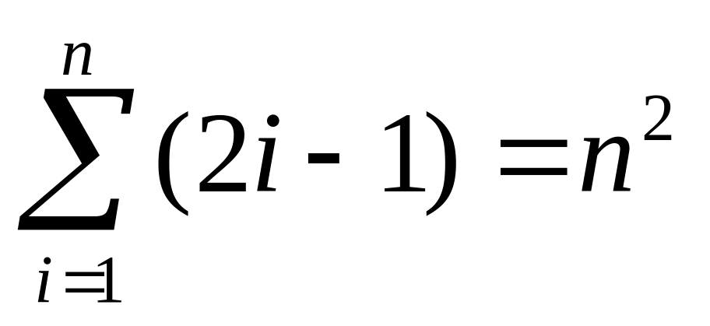
Mathematical Induction
Example
EG: Prove ∀n ≥ 0 P(n) where
P(n) = “The sum of the first n positive odd numbers is the n^{th} perfect square.”
=

Slide 20
Mathematical Induction
Example.
Geometric interpretation. To get next square, need to add next odd number:

Slide 21
Mathematical Induction
Example.
Geometric interpretation. To get next square, need to add next odd number:
1

Slide 22
Mathematical Induction
Example.
Geometric interpretation. To get next square, need to add next odd number:
1
+3

Slide 23
Mathematical Induction
Example.
Geometric interpretation. To get next square, need to add next odd number:
1
+3
+5

Slide 24
Mathematical Induction
Example.
Geometric interpretation. To get next square, need to add next odd number:
1
+3
+5
+7

Slide 25
Mathematical Induction
Example.
Geometric interpretation. To get next square, need to add next odd number:
1
+3
+5
+7
+9

Slide 26
Mathematical Induction
Example.
Geometric interpretation. To get next square, need to add next odd number:
1
+3
+5
+7
+9
+11

Slide 27
Mathematical Induction
Example.
Geometric interpretation. To get next square, need to add next odd number:
1
+3
+5
+7
+9
+11
+13

Slide 28
Mathematical Induction
Example.
Geometric interpretation. To get next square, need to add next odd number:
1
+3
+5
+7
+9
+11
+13 =7²

Slide 29
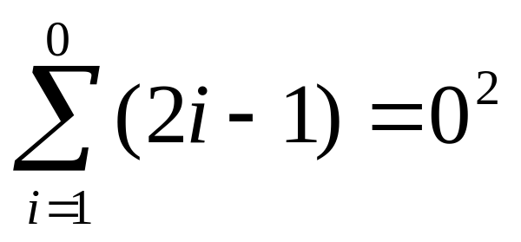
Mathematical Induction
Example
Every induction proof has two parts, the basis and the induction step.
Basis: Show that the statement holds for n = 0 (or whatever the smallest case is). Usually the hardest thing about the base case is understanding what is meant when n=0 (or smallest case). In our case, plugging in 0, we would like to show that:
This seems confusing. RULE: The sum of nothing is 0. So apply rule to get 0=0.

Slide 30
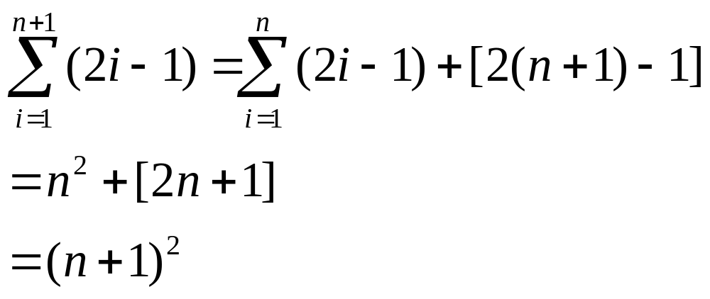
Mathematical Induction
Example
Induction: Show that if statement holds for n, then statement holds for n+1. For formulas, this amounts to playing around with formula for n and algebraically deriving the formula for n+1 (in this case, go in reverse):
(induction hypothesis)
 This completes proof. 

Slide 31
Proof of Induction
Well Ordering Property
A fundamental axiom about the natural numbers:
Well Ordering Property: Any non-empty subset S of N has a smallest element!
Q1: What’s the smallest element of the set { 16.99+1/n | n ∈ Z⁺ } ?
Q2: How about { ⎣16.99+1/n⎦ | n ∈ Z⁺ } ?

Slide 32
Proof of Induction Principle
Well Ordering Property
A1: { 16.99+1/n | n ∈ Z⁺ } doesn’t have a smallest element (though it does have limit-point 16.99)! Well-ordering principle does not apply to subsets of R.
A2: 16 is the smallest element of { ⎣16.99+1/n⎦ | n ∈ Z⁺ }.
(EG: set n = 101)

Slide 33
Well Ordering Property
All Numbers are Cool
“THM”: All natural numbers are interesting.
EG: 0, 1, 2, … interesting, everything else too!
Proof by contradiction: Assume that there are uninteresting numbers in N. Consider the set S of such numbers. By the well ordering principle, there is a number u which is the smallest uninteresting number. But being the smallest uninteresting number is pretty darn interesting. Therefore, u is interesting, contradicting that fact that it is uninteresting. Therefore S must be empty, and all numbers must therefore be interesting.

Slide 34
Proof of Induction Principle
Proof by contradiction. Suppose that the basis assumption –P (0) – and induction assumption – ∀n P (n)→P (n+1) – hold, yet it is not the case that the conclusion –∀n P (n) – holds. Let S be the set of all numbers for which P (n) is false. By assumption S is non-empty, so well ordering principle gives a smallest number m in S. By assumption, P (0) is true, so m>0. Since m is the smallest number for which P (m) is false, and is non-zero, P (m-1) must be true. By assumption
P (m-1)→P (m) is true, so as LHS of conditional is true, by definition of conditional, RHS is true.
Thus, P (m) is true, contradicting fact that m ∈ S. This shows that assumption that S is non-empty was false, and ∀n P (n) must therefore be true. 

Slide 35
Induction
Geometric Example
Let’s come up with a formula for the (maximum) number of intersection points in a plane containing n lines.
Notes:
Maximum is parenthesized, because in general, if pick “random” (I.e. pairwise non-parallel) lines, the maximum will be achieved.

Slide 36
Induction
Geometric Example
The number of intersections points in a plane containing n lines
f (1) = 0

Slide 37
Induction
Geometric Example
The number of intersections points in a plane containing n lines
f (2) = 1

Slide 38
Induction
Geometric Example
The number of intersections points in a plane containing n lines
f (3) = 3

Slide 39
Induction
Geometric Example
The number of intersections points in a plane containing n lines
f (4) = 6

Slide 40
Induction
Geometric Example
The number of intersections points in a plane containing n lines
f (5) = 10

Slide 41
Induction
Geometric Example
The number of intersections points in a plane containing n lines. Denote this number by f (n). We have:
n = 1, 2, 3, 4, 5
f (n) = 0, 1, 3, 6, 10
Q: Come up with a conjectured formula for f (n). Can be in terms of previous values (in recursive notation).

Slide 42
Induction
Geometric Example
A: f (n) = f (n-1) + n –1
Q: How do you find a closed formula?

Slide 43
Induction
Geometric Example
A: Repeatedly insert recursive formula for lower and lower values of n until get down to n=1:

Slide 44
Induction
Geometric Example
A: Repeatedly insert recursive formula for lower and lower values of n until get down to n=1:
f (n) = f (n-1) + n–1

Slide 45
Induction
Geometric Example
A: Repeatedly insert recursive formula for lower and lower values of n until get down to n=1:
f (n) = f (n-1) + n–1
Therefore, f (n-1) = f (n-2) + n–2

Slide 46
Induction
Geometric Example
A: Repeatedly insert recursive formula for lower and lower values of n until get down to n=1:
f (n) = f (n-1) + n–1
Therefore, f (n-1) = f (n-2) + n–2
Plug in (2) into (1) to get: f (n) = f (n-2) + n–2 + n–1

Slide 47
Induction
Geometric Example
A: Repeatedly insert recursive formula for lower and lower values of n until get down to n=1:
f (n) = f (n-1) + n–1
Therefore, f (n-1) = f (n-2) + n–2
Plug in (2) into (1) to get: f (n) = f (n-2) + n–2 + n–1
Repeat this process, plugging in for f (n-2): f (n) = f (n-3) + n-3 + n–2 + n–1

Slide 48
Induction
Geometric Example
A: Repeatedly insert recursive formula for lower and lower values of n until get down to n=1:
f (n) = f (n-1) + n–1
Therefore, f (n-1) = f (n-2) + n–2
Plug in (2) into (1) to get: f (n) = f (n-2) + n–2 + n–1
Repeat this process, plugging in for f (n-2): f (n) = f (n-3) + n-3 + n–2 + n–1
Pattern arises after repeating this i times: f (n) = f (n-i) + n-i + … + n-3 + n–2 + n–1

Slide 49
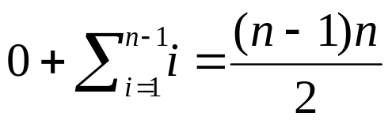
Induction
Geometric Example
A: Repeatedly insert recursive formula for lower and lower values of n until get down to n=1:
f (n) = f (n-1) + n–1
Therefore, f (n-1) = f (n-2) + n–2
Plug in (2) into (1) to get: f (n) = f (n-2) + n–2 + n–1
Repeat this process, plugging in for f (n-2): f (n) = f (n-3) + n-3 + n–2 + n–1
Pattern arises after repeating this i times: f (n) = f (n-i) + n-i + … + n-3 + n–2 + n–1
To get to n = 1, plug in i = n –1: f (n) = f (1) + 1 + 2 + … + n-3 + n–2 + n–1
=

Slide 50
Induction
Geometric Example
…shew. But that’s not the end of the story. This was just the intuitive derivation of the formula, not the proof.
LEMMA: The maximal number of intersection points of n lines in the plane is n(n-1)/2.
Proof. Prove by induction.
Base case: If n = 1, then there is only one line and therefore no intersections. On the other hand, plugging n = 1 into n(n-1)/2 gives 0, so the base case holds.

Slide 51
Induction
Geometric Example
Induction step: Assume n > 1. What is the maximum number of intersection points of n lines? Remove one line.
n –1 lines remain. By induction, we may assume that the maximal number intersections of these lines is (n –1)(n –2)/2. Consider adding back the n ^{th} line. This line intersects at most all the n-1 other lines. For the maximal case, the line can be arranged to intersect all the other lines, by selecting a slope different from all the others. E.g. consider the following:

Slide 52
Induction
Geometric Example
Originally n-1 lines:
2
…n-1
1
3

Slide 53
Induction
Geometric Example
Add n^{th} line:
2
…n-1
1
3

Slide 54
Induction
Geometric Example
Therefore, the maximum number of intersection points of n lines, is the maximum number of intersections of n –1 lines plus the n –1 new intersections; this number is just
(n –1)(n –2)/2 + n –1
= (n –1)((n –2)/2 + 1)
= (n –1)(n –2 + 2)/2 = (n –1)n /2
which is the formula we want to prove for n.
This completes the induction step, and therefore completes the proof. 

Slide 55
Induction and Recursion Example
Induction is natural tool for proving properties of recursively defined objects. For example consider the Fibonacci sequence:
{f_{n} } = 0,1,1,2,3,5,8,13,21,34,55,…
defined by f₀ = 0, f₁ = 1, and for n>1
f_{n} = f_{n-1}+f_{n-2} .
Notice that every third Fibonacci number is even:
LEMMA: For all natural numbers n, 2|f_{3n}.

Slide 56
Induction and Recursion
Example
Proof. Base case n = 0.
f_{3·0} = f₀ =0 which is divisible by 2 
Induction step, n > 0:
f_{3n} = f_{3n-1}+f_{3n-2} = (f_{3n-2}+f_{3n-3})+f_{3n-2}
= 2f_{3n-2} +f_{3n-3} = 2f_{3n-2} +f_{3(n-1)}
By hypothesis, 2|f_{3(n-1)} therefore
2|(2f_{3n-2} +f_{3(n-1)}) so 2|f_{3n} and the proof is complete. 

Slide 57
Induction
Attempted Example
Sometimes a stronger version of induction is needed, one that allows us to go back to smaller values than just the previous value of n. E.g. consider the Fibonacci sequence vs. the sequence 2^{n}:
{f_{n} } = 0, 1, 1, 2, 3, 5, 8, 13, 21, 34
{2^{n} } = 1, 2, 4, 8, 16, 32, 64, 128, 256, 512
LEMMA: For all n, f_{n} < 2^{n}

Slide 58
Induction
Attempted Example
LEMMA: For all n, f_{n} < 2^{n}
Proof. Base n = 0: f₀ = 0 < 1 = 2⁰ 
Induction n > 0:
f_{n} = f_{n-1}+f_{n-2} < 2^{n-1} +f_{n-2} by applying induction hypothesis to n –1.
Q: Now what?

Slide 59
Induction
Attempted Example
A: Would want to apply same formula to n-2. But strictly speaking, can’t because induction hypothesis only let’s us look at previous domino.
This limitation on induction need not be so: If we could assume that the first n dominos falling implies that the n+1st domino falls, would be able to hark back to smaller values, as need here. Strong induction formalizes this ability.

Slide 60
Strong Induction
Principle of Mathematical Induction:
If:
[basis] P (0)
(sometimes need more base cases)
[strong induction]
∀n [P (0)∧P (1)∧ … ∧P (n)] → P(n+1)
Then:
∀n P(n)

Slide 61
Strong Induction
Completing Example
So now can complete stuck proof:
LEMMA: For all n, f_{n} < 2^{n}
Proof. Base cases (both needed as can’t apply induction step on f₁ since f₋₁ is undefined)
n = 0: f₀ = 0 < 1 = 2⁰ 
n = 1: f₁ = 1 < 2 = 2¹ 

Slide 62
Strong Induction
Completing Example
So now can complete stuck proof:
LEMMA: For all n, f_{n} < 2^{n}
Proof. Base cases (both needed as can’t apply induction step on f₁ since f₋₁ is undefined)
n = 0: f₀ = 0 < 1 = 2⁰ 
n = 1: f₁ = 1 < 2 = 2¹ 
Induction n > 0:
f_{n} = f_{n-1}+f_{n-2} < 2^{n-1} + 2^{n-2} applying both P (n-1) and P (n-2) which can be assumed by strong induction hypothesis. Doing more algebra:
2^{n-1}+2^{n-2}=2·2^{n-2}+2^{n-2}=(2+1)·2^{n-2}<2²·2^{n-2} =2^{n}
Therefore, f_{n}< 2^{n} 

Slide 63
Program Correctness
Induction can be used to show that programs using iterative loops are correct.
EG: Prove that the following program correctly calculates Fibonacci sequence:
integer g (non-neg-integer n){
if (n == 0) return 0
curr = 0, next = 1
for (i = 2 to n ) {
next = next + curr
curr = next - curr
}
return next
}

Slide 64
Program Correctness
Fibonacci Example
integer g (non-neg-integer n){
if (n == 0) return 0
curr = 0, next = 1
for (i = 2 to n ) {
next = next + curr
curr = next - curr
}
return next
}
Notation is the biggest hurdle. Let next _{i} be the value of next at the end of for-loop indexed by i. For simplicity extend definition to i = 0, 1 by setting next₀=0 and next₁=1.
The program structure shows that g (n ) = next_{n}

Slide 65
Program Correctness
Fibonacci Example
integer g (non-neg-integer n){
if (n == 0) return 0
curr = 0, next = 1
for (i = 2 to n ) {
next = next + curr
curr = next - curr
}
return next
}
Statement of interest: P (i ) = “next_{i} = f_{i} ”, i.e. next_{i} is the i’th Fibonacci number.
Prove that for all non-negative i, P (i ) is true.

Slide 66
Program Correctness
Fibonacci Example
Prove that for all non-negative i, P (i ) is true.
Proof. Base cases i =0,1 follow from definition
Induction step (i ≥ 2):
Suppose next_{j} = f_{j} for all j < i. The lines
next = next + curr
curr = next - curr
in the iteration indexed by j mean that
(1) next_{j} = next_{j-1} + curr_{j-1}
(2) curr_{j} = next_{j} - curr_{j-1}
= next_{j-1}+curr_{j-1}-curr_{j-1}
= next_{j-1}
Plugging (2) into (1): next_{j} = next_{j-1} + next_{j-2}

Slide 67
Program Correctness
Fibonacci Example
Prove that for all non-negative i, P (i ) is true.
Proof continued (induction step).
So we have:
(3) next_{j} = next_{j-1} + next_{j-2}
But induction hypothesis lets us assume P (i -1) and P (i -2) are true so that next_{j-1} =f_{j-1} and next_{j-2} =f_{j-2} . Therefore, plugging into (3) gives us
next_{i} = f_{i -1} + f_{i-2} = f_{i}
which completes the proof by induction. 

Slide 68
Induction Hazards
Horse Color Consistency
Proof by induction that all horses are the same color.
Let’s “prove” that for all n > 0, the statement P (n ) = “Any group of n horses must have the same color”
Then setting n = the number of horses in the world, we would deduce that all horses have the same color.

Slide 69
Induction Hazards
Horse Color Consistency
Base case: n = 1. A group consisting of 1 horse certainly has the same color as that horse.
Induction n > 1: Consider n horses. Removing last horse we have a group of n-1 horses. By induction, me may assume P (n-1) true, so the first n -1 horses are color consistent. By a similar argument, the last n-1 horses are consistent also. But since the first n-1 horses and last n-1 horses are consistent and there must be overlapping horses in both groups, all n horses must be color consistent.
Q: What’s wrong with this line of reasoning?

Slide 70
Induction Hazards
Horse Color Consistency
A: The proof is invalid for n = 2. The form of the proof is correct. However, domino 1 never hits domino 2 because the claim “there must be overlapping horses in both groups” was wrong when n = 2. For n = 2 taking the first n -1 horses means taking only the first horse. Taking the last n -1 horses means taking only the last horse. There is no overlap in this case, so color consistency fails.

Slide 71
Blackboard Examples
(SKIPPED!)
Prove by induction that if p is prime and divides none of a₁, a₂, … , a_{n} , then p doesn’t divide the product a₁·a₂···a_{n} .
Prove that every number > 1 is the product of of prime numbers and that the factorization is unique. (Fundamental Theorem of Arithmetic)

