Slide 1
Recursion
Zeph Grunschlag

Slide 2
Agenda
Recursion and Induction
Recursive Definitions
  Sets
  Strings
Recursive Algorithms

Slide 3
Recursively Defined Sequences
Often it is difficult to express the members of an object or numerical sequence explicitly.
EG: The Fibonacci sequence:
{f_{n} } = 0,1,1,2,3,5,8,13,21,34,55,…
There may, however, be some “local” connections that can give rise to a recursive definition –a formula that expresses higher terms in the sequence, in terms of lower terms.
EG: Recursive definition for {f_{n} }:
INITIALIZATION: f₀ = 0, f₁ = 1
RECURSION: f_{n} = f_{n-1}+f_{n-2} for n > 1.

Slide 4
Recursive Definitions and Induction
Recursive definition and inductive proofs are complement each other: a recursive definition usually gives rise to natural proofs involving the recursively defined sequence.
This is follows from the format of a recursive definition as consisting of two parts:
Initialization –analogous to induction base cases
Recursion –analogous to induction step
In both induction and recursion, the domino analogy is useful.

Slide 5
Recursive Functions
It is possible to think of any function with domain N as a sequence of numbers, and vice-versa.
Simply set: f_{n} =f (n)
For example, our Fibonacci sequence becomes the Fibonacci function as follows:
f (0) = 0, f (1) = 1, f (2) = 1, f (3) = 2,…
Such functions can then be defined recursively by using recursive sequence definition. EG:
INITIALIZATION: f (0) = 0, f (1) = 1
RECURSION: f (n)=f (n -1)+f (n -2), for n > 1.

Slide 6
Recursive Functions
Factorial
A simple example of a recursively defined function is the factorial function:
n! = 1· 2· 3· 4 ···(n –2)·(n –1)·n
i.e., the product of the first n positive numbers (by convention, the product of nothing is 1, so that 0! = 1).
Q: Find a recursive definition for n!

Slide 7
Recursive Functions
Factorial
A:INITIALIZATION: 0!= 1
RECURSION: n != n · (n -1)!
To compute the value of a recursive function, e.g. 5!, one plugs into the recursive definition obtaining expressions involving lower and lower values of the function, until arriving at the base case.
EG: 5! =

Slide 8
Recursive Functions
Factorial
A:INITIALIZATION: 0!= 1
RECURSION: n != n · (n -1)!
To compute the value of a recursive function, e.g. 5!, one plugs into the recursive definition obtaining expressions involving lower and lower values of the function, until arriving at the base case.
EG: 5! = 5 · 4!
recursion

Slide 9
Recursive Functions
Factorial
A:INITIALIZATION: 0!= 1
RECURSION: n != n · (n -1)!
To compute the value of a recursive function, e.g. 5!, one plugs into the recursive definition obtaining expressions involving lower and lower values of the function, until arriving at the base case.
EG: 5! = 5 · 4! = 5 · 4 · 3!
recursion

Slide 10
Recursive Functions
Factorial
A:INITIALIZATION: 0!= 1
RECURSION: n != n · (n -1)!
To compute the value of a recursive function, e.g. 5!, one plugs into the recursive definition obtaining expressions involving lower and lower values of the function, until arriving at the base case.
EG: 5! = 5 · 4! = 5 · 4 · 3! = 5 · 4 · 3 · 2!
recursion

Slide 11
Recursive Functions
Factorial
A:INITIALIZATION: 0!= 1
RECURSION: n != n · (n -1)!
To compute the value of a recursive function, e.g. 5!, one plugs into the recursive definition obtaining expressions involving lower and lower values of the function, until arriving at the base case.
EG: 5! = 5 · 4! = 5 · 4 · 3! = 5 · 4 · 3 · 2!
= 5 · 4 · 3 · 2 · 1!
recursion

Slide 12
Recursive Functions
Factorial
A:INITIALIZATION: 0!= 1
RECURSION: n != n · (n -1)!
To compute the value of a recursive function, e.g. 5!, one plugs into the recursive definition obtaining expressions involving lower and lower values of the function, until arriving at the base case.
EG: 5! = 5 · 4! = 5 · 4 · 3! = 5 · 4 · 3 · 2!
= 5 · 4 · 3 · 2 · 1! = 5 · 4 · 3 · 2 · 1 · 0!
recursion

Slide 13
Recursive Functions
Factorial
A:INITIALIZATION: 0!= 1
RECURSION: n != n · (n -1)!
To compute the value of a recursive function, e.g. 5!, one plugs into the recursive definition obtaining expressions involving lower and lower values of the function, until arriving at the base case.
EG: 5! = 5 · 4! = 5 · 4 · 3! = 5 · 4 · 3 · 2!
= 5 · 4 · 3 · 2 · 1! = 5 · 4 · 3 · 2 · 1 · 0! = 5 · 4 · 3 · 2 · 1 · 1 = 120
recursion
initialization

Slide 14
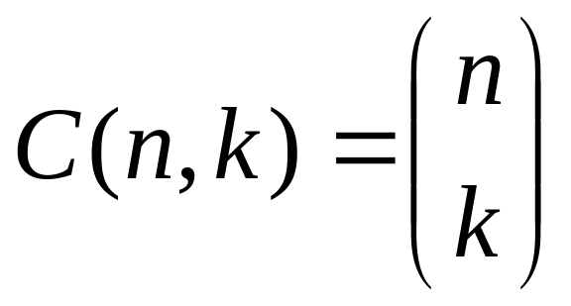
Recursive Functions n choose k
The Binomial coefficients arise in several applications:
Combinatorics/Probability (n choose k): C (n,k) = the number of different groups of size k from an initial group of size n
Algebra:
C (n,k) = coefficient of k ^{th} term in the expansion of the n ^{th} binomial power (x + y )^{n}
Commonly used notation:
Notes:
A closed formula for C(n,k) is given by:
C(n,k) = n!/( k! (n-k)! )

Slide 15
n choose k and Pascal’s Triangle
Typically the fastest way to compute all C (n,k) up to a certain n is via Pascal’s triangle. In Pascal’s triangle, a 1 is put up top (initialization) and every consequent element is recursively defined to be the sum of the numbers to the right and left of it in the previous row. If a number is missing, it is considered to be 0.

Slide 16
n choose k and Pascal’s Triangle
1

Slide 17
n choose k and Pascal’s Triangle
1
1 1

Slide 18
n choose k and Pascal’s Triangle
1
1 1
1 2 1

Slide 19
n choose k and Pascal’s Triangle
1
1 1
1 2 1
1 3 3 1

Slide 20
n choose k and Pascal’s Triangle
1
1 1
1 2 1
1 3 3 1
1 4 6 4 1

Slide 21
n choose k and Pascal’s Triangle
1
1 1
1 2 1
1 3 3 1
1 4 6 4 1
1 5 10 10 5 1

Slide 22
n choose k and Pascal’s Triangle
1
1 1
1 2 1
1 3 3 1
1 4 6 4 1
1 5 10 10 5 1
1 6 15 20 15 6 1

Slide 23
n choose k and Pascal’s Triangle
n = row
0
1
2
3
4
5
6
0 k = diagonal col.
1
2
3
4
5
6
1
1 1
1 2 1
1 3 3 1
1 4 6 4 1
1 5 10 10 5 1
1 6 15 20 15 6 1
Q: Find C (6,4)

Slide 24
n choose k and Pascal’s Triangle
n = row
0
1
2
3
4
5
6
0 k = diagonal col.
1
2
3
4
5
6
1
1 1
1 2 1
1 3 3 1
1 4 6 4 1
1 5 10 10 5 1
1 6 15 20 15 6 1
A:C (6,4)=15. Q: Rec. form. for C (n,k)?

Slide 25
n choose k and Pascal’s Triangle
A: Use Pascal’s triangle.
INITIALIZATION: Top of triangle is 1. Therefore, C (0,0) = 1. If a number is missing, it is considered to be 0. This gives rise to C (n,k) = 0 if k < 0, or k > n.
RECURSION: Next element is sum of the numbers to the right and left of it in the previous row:
C (n,k) = C (n -1,k) + C (n -1,k -1)

Slide 26
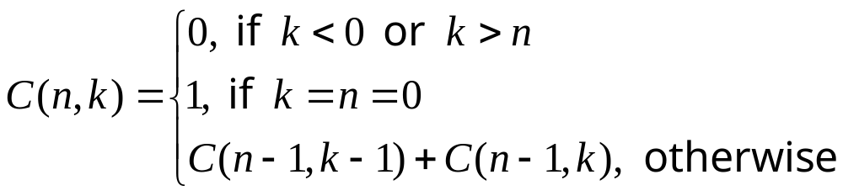
n choose k and Pascal’s Triangle
A standard way of expressing recursive formulas applied to the above:
Q: Find a recursive definition for the gcd function. Hint : Euclid’s algorithm.

Slide 27
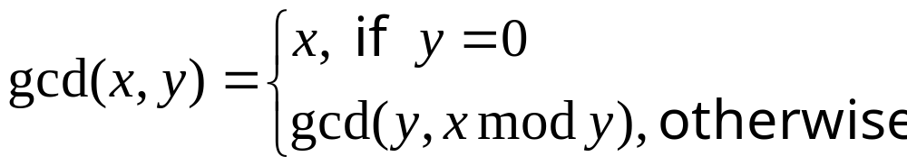
Recursive Definitions gcd
A: Euclid’s algorithm makes use of the fact that gcd(x,y ) = gcd(y, x mod y)
(here we assume that x > 0)

Slide 28
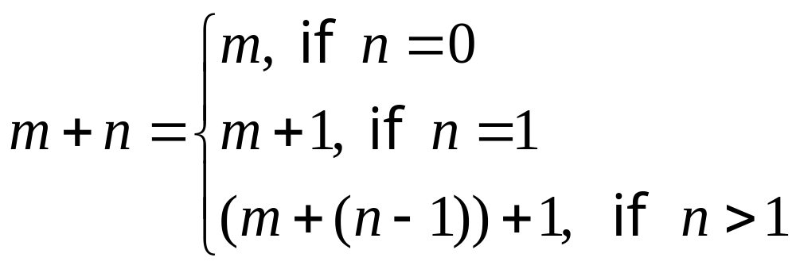
Recursive Definitions of Mathematical Notation
Often, recursion is used to define what is meant by certain mathematical operations, or notations. For example, if we know how to add 1 then can define addition by any other non-neg. number:

Slide 29
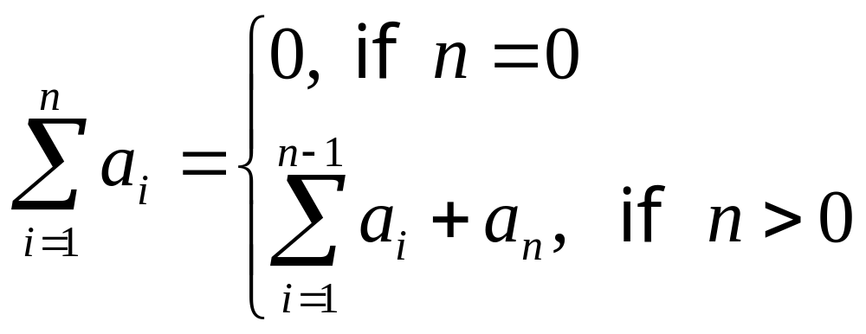
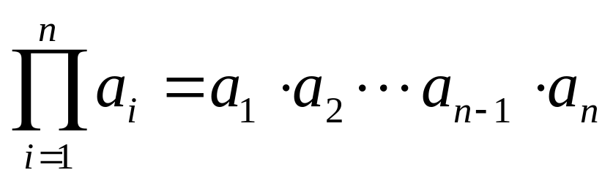
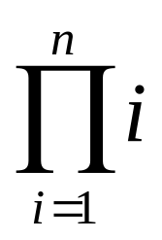
Recursive Definitions of Mathematical Notation
Definition of summation notation:
There is also a general product notation :
Q: Find a simple formula for

Slide 30
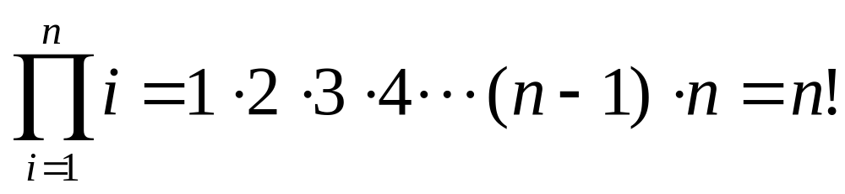
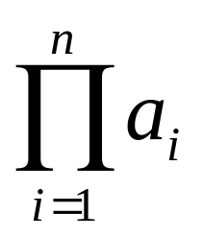
Recursive Definitions of Mathematical Notation
A: This is just the factorial function again.
Q: Find a recursive definition for the product notation

Slide 31
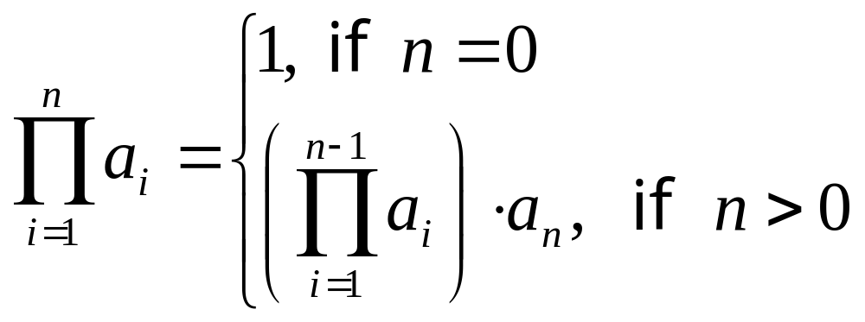
Recursive Definitions of Mathematical Notation
A: This is very similar to definition of summation notation.
Note: Initialization is argument for “product of nothing” being 1, not 0.

Slide 32
Recursive Definition of Sets
Sometimes sets can be defined recursively. One starts with a base set of elements, and recursively defines more and more elements by some operations. The set is then considered to be all elements which can be obtained from the base set under a finite number of allowable operations.
EG: The set S of prices (in cents) payable using only quarters and dimes.
BASE: 0 is a member of S
RECURSE: If x is in S then so are x+10 and x+25
Q: What is the set S ?

Slide 33
Recursive Definition of Sets
A: S = {0, 10, 20,25,30,35,40,45,… }
Notice: elements need not be defined uniquely by the recursion. EG:
50 = 0 + 25 + 25
= 0 + 10 + 10 + 10 + 10 + 10
Q: Find a recursive definition of the set T of negative and positive powers of 2
T = { …,1/32,1/16,1/8, ¼, ½, 1, 2, 4, 8, 16, …}

Slide 34
Recursive Definition of Sets
A:
BASE: 1 ∈ T
RECURSE: 2x ∈T and x/2 ∈T if x ∈T

Slide 35
Character Strings
Strings are the fundamental object of computer science. Everything discrete can be described as a string of characters:
Decimal numbers: 1010230824879
Binary numbers: 0111010101010111
Text. E.g. this document
Computer programs: public class Hello{
Patterns of nature
  DNA
  Proteins
Human language

Slide 36
Strings
Notation
DEF: A string is a finite sequence of 0 or more letters in some pre-set alphabet Σ.
Q: What is the alphabet for each of the following types of strings:
Decimal numbers
Binary numbers
Java programs
DNA

Slide 37
String
Alphabets
Decimal numbers
Σ = { 0, 1, 2, 3, 4, 5, 6, 7, 8, 9 }
Binary numbers
Σ = { 0, 1 }
Java programs
Σ = Unicode
DNA. Σ =
{Adenine, Cytosine, Guanine, Thymine}

Slide 38
Strings
Length
The length of a string is denoted by the absolute value.
(YAUPS = “yet another usage of the pipe symbol” )
Q: What are the values of
|yet|, |another|, |usage|, |pipe|, |symbol|

Slide 39
Strings
Length and the Empty String
A: |yet|=3, |another|=7, |usage|=5,
|pipe|=4, |symbol|=6.
There is a very useful string, called the empty string and denoted by the lower case Greek letter λ (lambda)¹.
Java: Java allows the empty string, which is created by two consecutive double-quotes.
String tmp = ””;
Indeed, tmp.length() = = 0.
Q: Do we really need the empty string?
Notes:
¹In other texts, including the text for computability the Greek letter epsilon is used instead.

Slide 40
Strings
Length and the Empty String
A: YES!!! Strings almost always represent some other types of objects. In many contexts, the empty string is useful in describing a particular object of unique importance.
EG in Java, ”” might represent a cell in a form that wasn’t filled in.
EG in life, λ might represent a message that never got sent.
Notes:
¹In other texts, including the text for computability (CS3261) the Greek letter ε (epsilon) is used instead.

Slide 41
Strings
Concatenation
Given strings u and v can concatenate u and v to obtain u · v (or usually just uv ).
EG. If u = “ire” and v = “land” then uv = “ireland”.
Java: Concatenation is achieved with the + String operator. Following returns true:
(”ire”+”land”).equals(”ireland”)
Q: λ·v = ?
Notes:
¹In other texts, including the text for computability the Greek letter επσιλον is used instead.

Slide 42
Strings
Concatenation
A: λ·v = v · λ = v
The empty string acts like 0 under addition in that it doesn’t affect strings when concatenating them.
Notes:
¹In other texts, including the text for computability the Greek letter ε (epsilon) is used instead.

Slide 43
Strings
Reversal
The reverse of a string is the string read from right to left instead of from left to right. For example the reverse of “oprah” is “harpo”.
The reverse of w is denoted by w ^{R}. So:
oprah^{R} = harpo

Slide 44
Strings
Recursive Sets
One can define sets of strings recursively.
For example B = the set of reduced non-negative binary numbers:
B = {0,1,10,11,100,101,110,111,…}
BASE: 0,1 ∈ B
RECURSE: If u ∈ B and u begins with 1, then u · 0 , u · 1 ∈ B
Palindromes are strings that equal themselves when reversed. E.g. “racecar”, “Madam I’m Adam”, “010010”. The set pal of consists of all palindromes over the alphabet {0,1}.
Q: Find a recursive definition for pal.
Notes:
¹In other texts, including the text for computability the Greek letter ε (epsilon) is used instead.

Slide 45
Strings
Recursive Sets
A:
BASE: λ , 0, 1 ∈ pal
RECURSE: 0u 0, 1u 1 ∈ pal if u ∈ pal
Notes:
¹In other texts, including the text for computability the Greek letter ε (epsilon) is used instead.

Slide 46
Blackboard Exercises
Give a recursive definition for the power set of S, P (S ).
(3.3.27) Give a recursive definition for string reversal w ^{R}.
Prove by induction that pal is generated by the rules:
BASE: λ , 0, 1 ∈ pal
RECURSE: 0u 0, 1u 1 ∈ pal if u ∈ pal

Slide 47
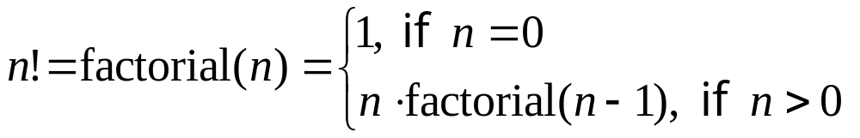
Recursive Algorithms
(Section 3.4)
Once you’ve figured out a recursive definition for a function, one can immediately turn it into a recursive algorithm in languages (such as Java) which can handle recursion.
Consider for example the factorial function n! :

Slide 48
Recursive Algorithms
(Section 3.4)
We can immediately convert the definition
into code:
long factorial(int n){
if (n<=0) return 1;
return n*factorial(n-1);
}
Then we let the Java Virtual Machine to the rest, as follows:
Notes:
n<=0 is used instead of n==0 because Java’s long is signed, and we don’t want the program to crash or enter an infinite loop for negative numbers. Exceptions handling would be more appropriate here, but this is well beyond the scope of 3203.

Slide 49

Recursive Algorithms Computer Implementation
long factorial(int n){
if (n<=0) return 1;
return n*factorial(n-1);
}
Compute 5!

Slide 50
Recursive Algorithms Computer Implementation
long factorial(int n){
if (n<=0) return 1;
return n*factorial(n-1);
}
f(5)=5·f(4)

Slide 51
Recursive Algorithms Computer Implementation
long factorial(int n){
if (n<=0) return 1;
return n*factorial(n-1);
}
f(4)=4·f(3) | f(5)=5·f(4)

Slide 52
Recursive Algorithms Computer Implementation
long factorial(int n){
if (n<=0) return 1;
return n*factorial(n-1);
}
f(3)=3·f(2) | f(4)=4·f(3) | f(5)=5·f(4)

Slide 53
Recursive Algorithms Computer Implementation
long factorial(int n){
if (n<=0) return 1;
return n*factorial(n-1);
}
f(2)=2·f(1) | f(3)=3·f(2) | f(4)=4·f(3) | f(5)=5·f(4)

Slide 54
Recursive Algorithms Computer Implementation
long factorial(int n){
if (n<=0) return 1;
return n*factorial(n-1);
}
f(1)=1·f(0) | f(2)=2·f(1) | f(3)=3·f(2) | f(4)=4·f(3) | f(5)=5·f(4)

Slide 55
Recursive Algorithms Computer Implementation
long factorial(int n){
if (n<=0) return 1;
return n*factorial(n-1);
}
f(0)= 1→ | f(1)=1·f(0) | f(2)=2·f(1) | f(3)=3·f(2) | f(4)=4·f(3) | f(5)=5·f(4)

Slide 56
Recursive Algorithms Computer Implementation
long factorial(int n){
if (n<=0) return 1;
return n*factorial(n-1);
}
1·1= 1→ | f(2)=2·f(1) | f(3)=3·f(2) | f(4)=4·f(3) | f(5)=5·f(4)

Slide 57
Recursive Algorithms Computer Implementation
long factorial(int n){
if (n<=0) return 1;
return n*factorial(n-1);
}
2·1= 2→ | f(3)=3·f(2) | f(4)=4·f(3) | f(5)=5·f(4)

Slide 58
Recursive Algorithms Computer Implementation
long factorial(int n){
if (n<=0) return 1;
return n*factorial(n-1);
}
3·2= 6→ | f(4)=4·f(3) | f(5)=5·f(4)

Slide 59
Recursive Algorithms Computer Implementation
long factorial(int n){
if (n<=0) return 1;
return n*factorial(n-1);
}
4·6= 24→ | f(5)=5·f(4)

Slide 60
Recursive Algorithms Computer Implementation
long factorial(int n){
if (n<=0) return 1;
return n*factorial(n-1);
}
5·24= 120→

Slide 61
Recursive Algorithms Computer Implementation
long factorial(int n){
if (n<=0) return 1;
return n*factorial(n-1);
}
Return 5! = 120

Slide 62
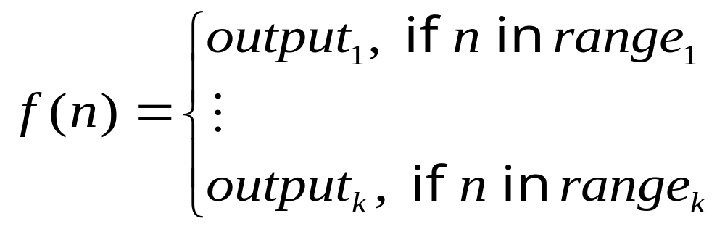
From Recursive Definitions
To Recursive Algorithms
In general, starting a recursive function:
gives a recursive algorithm:
output-type f(input-type n) {
if (n in range₁)
return output₁
…
if (n in range_{k})
return output_{k}
}
Notes:
Here we assume that the ranges are mutually disjoint and cover all possible input values. Strictly speaking, this code will not compile in Java because there is no default return value. This is fixed by changing the last clause:
“if (n in range_{k})
return output_{k} ”
to a simple return statement which removes the conditional:
“return output_{k} ”

Slide 63
Recursive Algorithms
Examples
We can also turn the recursive definitions of the Fibonacci function, the binomial coefficients and the gcd into recursive algorithms, but in the case of Fibonacci and binomial, these algorithms are really bad (as far as running time is concerned).
Here’s the pseudocode for these examples:

Slide 64
Recursive Algorithms
Fibonacci
integer f (non-neg. integer n){
if (n ≤ 1) return n
return f (n -1) + f (n -2)
}
This is an O(2^{n} ) algorithm because going from n to n-1 spawns off 2 method calls, and each of these, in turn, spawns 2 threads, and so on.

Slide 65
Recursive Algorithms
Binomial Coefficients
integer C (integers n,k){
if (k < 0 || k > n ) return 0
if (k == 0 && n == 0) return 1
return C (n -1,k) + C (n -1,k -1)
}
Q: What’s the running time?

Slide 66
Recursive Algorithms
Binomial Coefficients
A: Same as with Fibonacci. O(2^{n} ) because going from n to n-1 spawns 2 method calls.
Q: Is there a better algorithm?

Slide 67
Recursive Algorithms
Binomial Coefficients
A: Yes! Just compute Pascal’s triangle row by row. This is O (n ³ ).

Slide 68
Recursive Algorithms gcd
integer gcd (positive integer x, nonneg-integer y)
{
if (y == 0 ) return x
return gcd(y,x % y)
}
Running time: apparently we don’t have the exponential method explosion problem as with binomial and Fibonacci. Iterative version before is equivalent so this is an O (n ) algorithm in terms of the length of largest input (assuming O(1) mod operation)

