Slide 1
Counting Techniques
Zeph Grunschlag

Slide 2
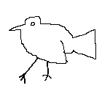
Agenda
Section 4.1: Counting Basics
  Sum Rule
  Product Rule
  Inclusion-Exclusion
Section 4.2
  Basic pigeonhole principle
  Generalized pigeonhole principle

Slide 3
Counting Basics
Counting techniques are important in programming design.
EG: How large an array or hash table or heap is needed?
EG: What is the average case complexity of quick-sort?
Answers depend on being able to count.
Counting is useful in the gambling arena also.
EG: What should your poker strategy be?

Slide 4
Counting Basics
Set Cardinalities
Interested in answering questions such as:
How many bit strings of length n are there?
How many ways are there to buy 13 different bagels from a shop that sells 17 types?
How many bit strings of length 11 contain a streak of one type of bit of exact length 7?
How many ways can a dating service match 13 men to 17 women?
COMMON THEME: convert to set cardinality problems so each question above is a about counting the number of elements in some set:
Q: What is the corresponding set in each case?

Slide 5
Counting Basics
Set Cardinalities
A: The set to measure the cardinality of is…
How many bit strings of length n are there?
  {bit strings of length n}
How many ways are there to buy 13 different bagels from a shop that sells 17 types?
  {S ⊆ {1, 2, … 17} | |S | = 13 } (…arguable)
How many bit strings of length 11 contain a streak of one type of bit of exact length 7?
  {length 11 bit strings with 0-streak of length 7}
  ∪ {length 11 bit strings with 1-streak of length 7}
How many ways to match 13 M to 17 W ?
  { f :{1,2,…,13} → {1,2,…,17} | f is 1-to-1}

Slide 6
Product Rule
As counting problems can be turned into set cardinality problems, useful to express counting principles set theoretically.
Product-Rule: For finite sets A, B:
|A×B| = |A|⋅|B|
Q: How many bit strings of length n are there?

Slide 7
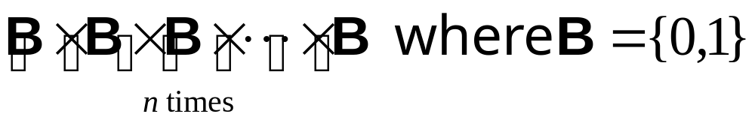
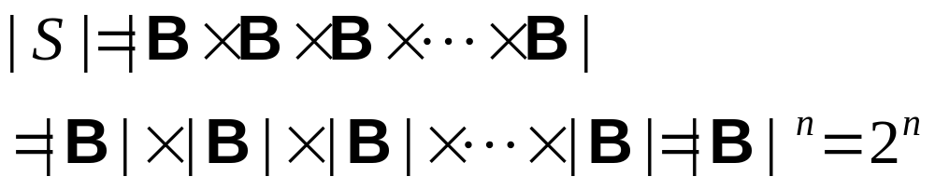
Product Rule
A: 2^{n}.
Proof : Let S = {bit strings of length n}. S is in 1-to-1 correspondence with
Consequently the product rule implies:
Notes:
Less formally, product rule says
2 ways to choose the first bit
2 ways to choose second bit
2 ways to choose second bit
2 ways to choose second bit
…
n. 2 ways to choose second bit
Multiply no. of choices together to get the answer 2^{n}

Slide 8
Cardinality of Power Set
THM: |P ({1,2,3,…,n})| = 2^{n}
Proof . The set of bit strings of length
n is in 1-to-1 correspondence with the P({1,2,3,…,n}) since subsets are represented by length n bit strings.

Slide 9
Sum Rule
Next the number of length 11 bit strings with a streak of length exactly 7.
Q: Which of the following should be counted:
10011001010
0110111101011
10000000011
10000000101
01111111010

Slide 10
Sum Rule
Next the number of length 11 bit strings with a streak of length exactly 7.
Q: Which of the following should be counted:
10011001010
  No!, longest streak has length 2.
0110111101011 No! Too long.
10000000011 No! Streak too long.
10000000101 Yes!
01111111010 Yes!

Slide 11
Sum Rule
We are trying to compute the cardinality of:
{length 11 bit strings with 0-streak of length 7}
∪
{length 11 bit strings with 1-streak of length 7}
Call the first set A and the second set B.
Q: Are A and B disjoint?

Slide 12
Sum Rule
A: Yes. If had both a 0-streak and a 1-streak of length 7 each, string would have length at least 14!
When counting the cardinality of a disjoint union we use:
SUM RULE: If A and B are disjoint, then
|A ∪ B| = |A|+|B|
By symmetry, in our case A and B have the same cardinality. Therefore the answer would be 2|A|.

Slide 13
Sum Rule
Break up
A = {length 11 bit strings with
0-streak of length exactly 7}
into more cases and use sum rule:
A₁ = {00000001***} (* is either 0 or 1)
A₂ = {100000001**}
A₃ = {*100000001*}
A₄ = {**100000001}
A₅ = {***10000000}.
Apply sum rule:
|A| = |A₁| +|A₂| +|A₃| +|A₄| +|A₅|

Slide 14
Sum Rule
So let’s count each set.
A₁ = {00000001***}. There are 3 *’s, each with 2 choices, so product rule gives |A₁| = 2³ = 8
A₂ = {100000001**}. There are 2 *’s. Therefore, |A₂| = 2² = 4
A₃ = {*100000001*}, A₄ = {**100000001}
Similarly: |A₂| = |A₃| = |A₄| = 4
A₅ = {***10000000}.
|A₁| = |A₅| = 8
|A| = |A₁| +|A₂| +|A₃| +|A₄| +|A₅| = 8+4+4+4+8 = 28.
Therefore answer is 56.

Slide 15
Counting Functions
How many ways to match 13M to 17W ?
{ f :{1,2,…,13} → P {1,2,…,17} | f is 1-to-1}
Use product rule thoughtfully.
17 possible output values for f (1)
16 values remain for f (2)
……………………………
17-i+1 values remain for f (i )
……………………………
17-13+1=5 values remain for f (13)
ANS: 17·16·15 ·14 ·… ·7·6·5 = 17! / 4!
Q: In general how many 1-to-1 functions from size k to size n set?

Slide 16
Counting Functions
A: The number of 1-to-1 functions from a size k set to a size n set is
n ! / (n - k) !
As long as k is no larger than n. If k > n there are no 1-to-1 functions.
Q: How about general functions from size k sets to size n sets?

Slide 17
Counting Functions
A: The number of functions from a size k set to a size n set is
n ^{k}

Slide 18
Inclusion-Exclusion
The principle of Inclusion-Exclusion generalized the sum rule the the case of non-empty intersection:
INCLUSION-EXCLUSION: If A and B are sets, then
|A ∪ B | = |A|+|B |- |A ∩B |
This says that when counting all the elements in A or B, if we just add the the sets, we have double-counted the intersection, and must therefore subtract it out.

Slide 19
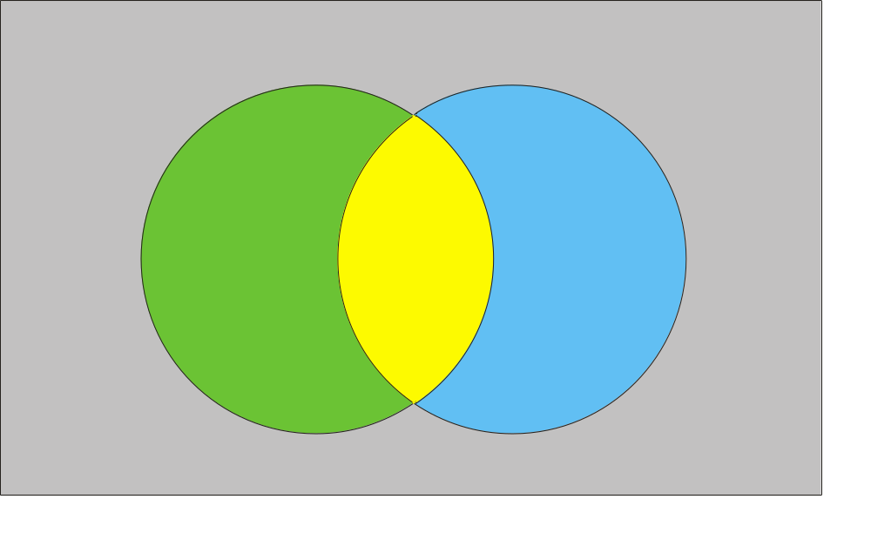
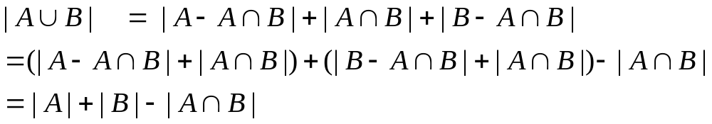
Inclusion-Exclusion
Visualize.
Diagram
gives
proof
Inclusion-
Exclusion principle:
U
A-A∩B
A∩B
B-A∩B

Slide 20
Blackboard Exercises for Section 4.1
Problem 4.1.19 (a,b,c,f). How many positive integers with exactly three decimal digits are…
  …divisible by 7?
  …odd?
  …have the same 3 digits?
  …are not divisible by 3 or 4?
Problem 4.1.49. How many ways can the letters a,b,c,d be arranged such that a is not immediately followed by b?
Link to worked out problems

Slide 21
4.2
The Pigeonhole Principle
The pigeonhole principle is the (rather obvious) statement:
If there are n+1 pigeons, which must fit into n pigeonholes then some pigeonhole contains 2 or more pigeons.
Less obvious: Why this would ever be useful… Principle often applied in surprising ways.

Slide 22
Pigeonhole Principle
EG: Given 12 or more numbers between 0 and 1 inclusive, there are 2 (or more) numbers x,y whose strictly within 0.1 of each other.
Proof. Any pigeonhole principle application involves discovering who are the pigeons, and who are the pigeonholes. In our case:
Pigeons: The 12 numbers
Pigeonholes: The sets
[0,0.1), [0.1,0.2), [0.2,0.3), … ,[0.9,1), {1}
There are 11 pigeonholes so some x,y fall in one of these sets, and have difference < 0.1

Slide 23
Pigeonhole Principle
Harder Example: In a party of 2 or more people, there are 2 people with the same number of friends in the party. (Assuming you can’t be your own friend and that friendship is mutual.)
Proof.
Pigeons –the n people (with n > 1).
Pigeonholes –the possible number of friends. I.e. the set {0,1,2,3,…n-1}
Notes:
0 acquaintances ---means you don’t know anyone
n acquaintances ---means you know everyone

Slide 24
Pigeonhole Principle
The proof proceeds with 2 cases.
There is a pigeonhole which isn’t hit. In that case, left with n -1 remaining pigeonholes, but n pigeons, so done.
Every pigeonhole hit. In particular, the friendship numbers n-1 as well as 0 were hit. Thus someone is friends with everyone while someone else is friends with no-one. This is a contradiction so this case cannot happen! →←


Slide 25
Generalized Pigeonhole Principle
If N objects are placed into k boxes, there is at least one box containing ⎡N/k ⎤ objects.
Specialize to N = n+1 and k = n, gives at least ⎡ (n+1)/n ⎤ = 2 objects in one box, which is the regular pigeonhole principle.
Q: Suppose that NYC has more than 7,000,000 inhabitants and that the human head contains at most 500,000 hairs. Find a guaranteed minimum number of people in NYC that all have the same number of hairs on their heads.

Slide 26
Generalized Pigeonhole Principle
A: ⎡7,000,000 / 500,001 ⎤ = 14
Notes:
Why 5,000,001? Don’t forget the totally bald people with 0 hairs on their heads.

Slide 27
Blackboard Exercises for Section 4.2
Show that if S ⊆ {1,2,3,…,50} & |S |> 9 then there are at least 2 different 5 element subsets in S all having the same sum.
Problem 4.3.27: There are 38 different time periods during which classes at a university can be scheduled. If there are 677 different classes, how many different rooms will be needed?
Link to worked out problems

