Slide 1
Probability and Expectation;
Counting with Repetitions.
Zeph Grunschlag

Slide 2
Agenda
More probability
  Random Variables
  Independence
  Expectation
More counting
  Allowing repetitions
  Stars and Bars
  Counting solutions to integer inequalities

Slide 3
Expectation Motivation
Often need to evaluate risk and decide how to proceed.
EG: How much of an investment portfolio should go to stocks, and how much to bonds?
EG: If you want to take subway from Columbia to Penn-Station should you take the 1/9 all the way or try to transfer to the 2/3?

Slide 4
Expectation Motivation
General Idea: Figure out what the expected outcome is, then act accordingly.
EG: Subway from 116th to 34th. Transfer to express at 96th? Suppose (incorrectly) that:
Express is 5 minutes faster from 96 to 34.
One of only two possibilities occurs:
  Wait at 96th is 2 minutes, so arrive 3 minutes earlier. Probability of this scenario: 0.75
  Wait at 96th is 10 minutes, so arrive 5 minutes late. Probability of this scenario: 0.25
Expected arrival advantage of transferring is:
3·(0.75) - 5·(0.25) = 2.25 - 1.25 = 1 minute
Conclusion: Transferring is worthwhile.

Slide 5
Outcomes with Variable Likelihoods
In the previous definition of probability, p (E ) = |E | / |S | assumed that all outcomes were equally likely. Sometimes can’t assume this. EG:
S = {wait 2 minutes, wait 10 minutes}
First outcome was 3 times as likely as 2nd.
New assumption for set of outcomes S:
  Each outcome s occurs with probability p (s)
  0 ≤ p (s) ≤ 1
  Sum over S of the probabilities equals 1

Slide 6
Random Variables
The definition of random variables seems to involve neither randomness nor variables.
DEF: Let S be a finite sample space. A random variable X is a real function
X : S → R
EG: In terms of previous subway example, can express the amount of time gained under the possible transfer scenarios using random variable:
X : { 2min’s, 10min’s } → R
X (2min’s) = 3, X (10min’s) = -5
Notes:
Perhaps a better name would be “sample space function”. The name makes more sense under a different framework for probability theory than carried out by our textbook.

Slide 7
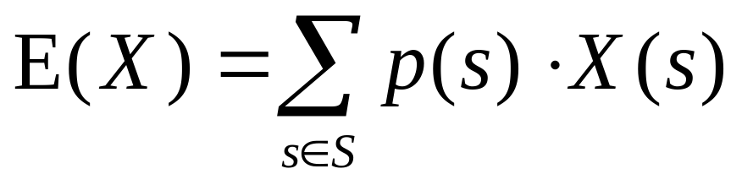
Definition of Expectation
DEF: Let X be a random variable on the finite sample space S. The expected value (or mean) of X is the weighted average:
EG: Consider the NYS lottery. Assume:
ticket costs $0.50
jackpot is $18,000,000
no taxes, no inflation, no shared winnings
consider only first prize
Q: What is the expected net winnings?

Slide 8
Expectation of NYS Lottery
A: The sample space is {win, lose}
p (win) = 1 / 45,057,474 = 0.000000022193876203…
p (lose) = 1 - p (win) = 0.999999977806124797…
The random variable for net winnings is
X (win) = 18,000,000 - 0.50 = 17999999.5
X (lose) = - 0.50
The expected winnings is negative 1 dime:
p (win) ·X (win) + p (lose) ·X (lose) =
0.000000022193876203·17999999.5 - 0.999999977806124797·.5 ≈ -10.1¢

Slide 9
Expectation of NYS Lottery
Detailed Analysis
Actual prizes for 11/10/01 drawing were:
First-prize Payout: $18,000,000.00
  Probability: 0.0000000222
Second-prize Payout: $184,854.00
  Probability: 0.0000001332
Third-prize Payout: $2,225.00
  Probability: 0.0000070577
Fourth-prize Payout: $31.00
  Probability: 0.0004587474
Fifth-prize Payout: $1.00
  Probability: 0.0103982749
None of the above. Probability: 0.9891357646
Notes:
Drawing: Saturday, November 10
The winning LOTTO numbers were:
9 10 20 34 55 56 Bonus #: 8
First-prize winners, matching all six numbers: 1
Payout: $18,000,000.00
Second-prize winners, matching five numbers plus bonus: 1
Payout: $184,854.00
Third-prize winners, matching five numbers: 63
Payout: $2,225.00
Fourth-prize winners, matching four numbers: 5,047
Payout: $31.00
Fifth-prize winners, matching three numbers: 122,342
Payout: $1.00
Winning locations were: Queens(QP)
1 Jackpot winner(s) sold were Quick Pick.

Slide 10
Expectation of NYS Lottery
Detailed Analysis
Expected net winnings. Negative 3.6 cents:
(18,000,000.00 - 0.50) · 0.0000000222
+ (184,854.00 - 0.50) · 0.0000001332
+ (2,225.00 - 0.50) · 0.0000070577
+ (31.00 - 0.50) · 0.0004587474
+ (1.00 - 0.50) · 0.0103982749
+ -0.50 · 0.9891357646
= -0.0355
Q: What BIG factor did we forget?
Notes:
Drawing: Saturday, November 10
The winning LOTTO numbers were:
9 10 20 34 55 56 Bonus #: 8
First-prize winners, matching all six numbers: 1
Payout: $18,000,000.00
Second-prize winners, matching five numbers plus bonus: 1
Payout: $184,854.00
Third-prize winners, matching five numbers: 63
Payout: $2,225.00
Fourth-prize winners, matching four numbers: 5,047
Payout: $31.00
Fifth-prize winners, matching three numbers: 122,342
Payout: $1.00
Winning locations were: Queens(QP)
1 Jackpot winner(s) sold were Quick Pick.

Slide 11
Expectation of NYS Lottery
Bernoulli Trials
A: Forgot about possibility of sharing the jackpot!
Go back to earlier analysis involving only first prize. Suppose n additional tickets were sold. We need to figure out the probability that k of these were winners –call this probability q_{k} . Jackpot winnings split equally among all winners so expected win value is:
X (win) =-0.50+18,000,000(q₀/1+q₁/2+q₂/3 +…)
Need a way of computing q_{k} !
Notes:
Explanation of formula: X (win) =-0.50+18,000,000(q₀/1+q₁/2+q₂/3 +…)
Sample space is S = {“share with 0 others”, “share with 1 other”, “share with 2 others”, …. }
The probability of each outcome is P(“share with n others”) = q_{n} by definition.
Random variable is Y(“share with n others”) = -0.50 + 18,000,000/(n+1) since if jackpot is shared with n additional others, need to divide jackpot by n+1.
Therefore the expected winnings is given by:
Sum(P(s)Y(s))
= q₀[-0.50 + 18,000,000 / 1 ] + q₁[-0.50 + 18,000,000 / 2 ] + q₂[-0.50 + 18,000,000 / 3] + …
= -0.50 (q₀ + q₁+ q₂ + q₃ + q₄ + … ) + 18,000,000 (q₀/1+q₁/2+q₂/3 +…)
= -0.50 + 18,000,000(q₀/1+q₁/2+q₂/3 +…)
Here we used the fact that q₀ + q₁+ q₂ + q₃ + q₄ + … = 1 since by definition, the sum of all probabilities of events in the sample space is equal to 1.

Slide 12
Bernoulli Trials
A Bernoulli trial is an experiment, like flipping coins, where there are two possible outcomes, except that the probabilities of the two outcomes could be different.
In our case, the two outcomes are winning the jackpot or not winning the jackpot and each has its own probability.

Slide 13
Bernoulli Trials
Bernoulli Formula: Consider an experiment which repeats a Bernoulli trial n times. Suppose each Bernoulli trial has possible outcomes A, B with respective probabilities p and 1-p. The probability that A occurs exactly k times in n trials is
p ^{k} · (1-p)^{n-k} ·C (n,k )
Q: Suppose Bernoulli trial consists of flipping a fair coin. What are A, B, p and 1-p.

Slide 14
Bernoulli Trials
A: A = coin comes up “heads”
B = coin comes up “tails”
p = 1-p = ½
Q: What is the probability of getting exactly 10 heads if you flip a coin 20 times?
Recall: P (A occurs k times out of n)
= p ^{k} · (1-p)^{n-k} ·C (n,k )

Slide 15
Bernoulli Trials
A: (1/2)¹⁰ · (1/2)¹⁰ ·C (20,10)
= 184756 / 2²⁰
= 184756 / 1048576
= 0.1762…

Slide 16
Expectation of NYS Lottery
Bernoulli Trials
Apply formula to NY Lotto:
q_{k} = p ^{k} · (1-p) ^{n-k} ·C (n,k )
= 0.00000002219^{k} ·0.99999997781^{n-k} ·C (n,k )
Assume that n = 11,800,000
Notes:
There is actually a way to figure out n from the information that the state gives.
Can approximate this by looking at the number of winners of a particular prize, and comparing with estimated number of winners if there are n ticket buyers. For example, let’s do this given 5th prize winners information. Since the probability of getting the 5th prize is 0.0104, and the number of 5th prize winners was 122,342, we have
n ≈ 122,342 / 0.0104 = 11,800,000

Slide 17
NYS Lottery
Best Expectation Calculation
Used these figures to compute q_{k}:
Values become negligible for higher k. Plug into
X (win)=-0.50+18,000,000(q₀/1+q₁/2+q₂/3+…)
=-0.50 + 18,000,000 · 0.8798 ≈ $15,836,000.
Plugging this back in to above, the most accurate approximation for expected winning is: -7.9¢
k | 0 | 1 | 2 | 3 | 4
q_{k} | 0.77 | 0.20 | 0.026 | 0.0023 | 0.00015
Notes:
Computed the most accurate expectation using formula:
15,836,000 · 0.0000000222
+ (184,854.00 - 0.50) · 0.0000001332
+ (2,225.00 - 0.50) · 0.0000070577
+ (31.00 - 0.50) · 0.0004587474
+ (1.00 - 0.50) · 0.0103982749
+ -0.50 · 0.9891357646

Slide 18
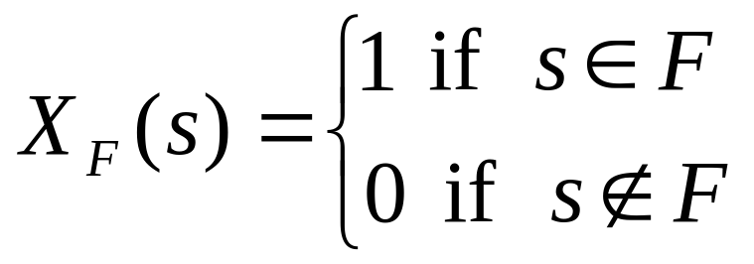
Events as Random Variables
Random variables generalize events as follows.
EG: Consider the event of tossing at least one head in two tries. As a set we have {HH, HT, TH}. So 3 out of a size 4 sample space. Instead we can view the event as the random variable X:
X(HH) = 1, X(HT) = 1, X(TH) = 1, X(TT) = 0.
DEF: The characteristic random variable X_{F} of an event F is the function defined by:

Slide 19
Events as Random Variables
Notice that in our case we have
E(X ) = sum of X’s weighted by probabilities =
X(HH)·p(HH)+X(HT)·p(HT)+X(TH)·p(TH)+X(TT)·p(TT)
=1·¼ + 1·¼ + 1·¼ + 0·¼
= ¾
= |F | / |S | = p(F )
THM: The probability of F is the same as the expectation of X_{F} . I.e. p (F ) = E(X_{F}).
Therefore: We can view random variables as a generalization of random events.
Sometimes this can help prove facts about probability.

Slide 20
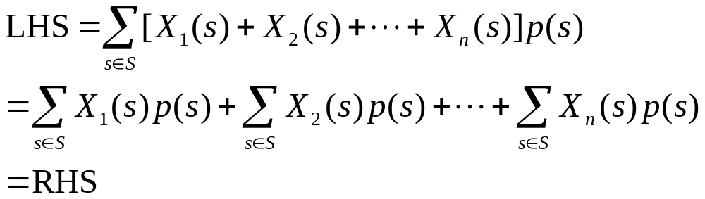
Sum Rule for Expectations
THM: Suppose X₁, X₂, …, X_{n} are random variables over the same sample space. Then:
E(X₁+X₂+…+X_{n} ) = E(X₁)+ E(X₂ )+…+E(X_{n} )
Proof :

Slide 21
Sum Rule for Expectations
EG: Find the expected number heads when n coins are tossed.
Let X be the random variable counting the number of heads in a sequence of n tosses. For example, if n = 3, X(HTH) = 2, X(TTT)=0. We can break X up into a sum X = X₁+X₂+…+X_{n} where X_{i} = 1 if i ^{th} toss comes up H and 0 if T. Therefore:
E(X ) = E(X₁)+ E(X₂ )+…+E(X_{n} )
By symmetry, E(X₁)=E(X₂ )=…=E(X_{n} ) so
E(X ) = n ·E(X₁).
Q: What is E(X₁)?

Slide 22
Sum Rule for Expectations
A: E(X₁) = ½.
(As a probability E(X₁) is just the likelihood that the first head will be a head.)
Plugging back in:
E(X ) = n ·E(X₁) = n / 2 which means that when n coins are tossed, we expect half to come up heads!

Slide 23
Conditional Probability
Often useful to calculate probabilities of an event E assuming that an event F has occurred.
EG:
Sample space S = {days in the year 2000}
Event E = {rainy days in S }
Event F = {overcast days in S }
With the knowledge that a day is over-cast, rain becomes much more likely.

Slide 24
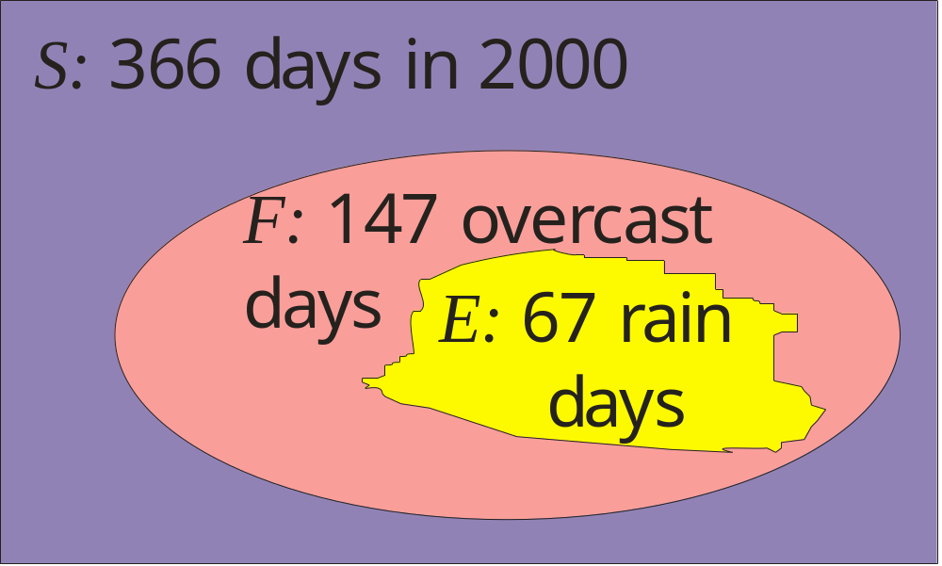
Conditional Probability
Probability of rain with no prior knowledge: p (E ) = |E |/|S | = 67/366
Probability of rain, if day was overcast:
p (E |F ) = |E |/|F | = 67/147
“The probability of E given F”

Slide 25
Conditional Probability
EG: What is the probability that a length 4 bit string contains 00 given that they start with 1?
E = {contain 00} F = {starts with 1}
E∩F = {1000,1001,1100}
p (E\F ) = |E∩F | / |F | = 3/2³
DEF: If E and F are events and p (F ) > 0 then the conditional probability of E given F is defined by:
p (E |F ) = p (E∩F ) / p (F )

Slide 26
Independence
An event E is said to depend on an event F if knowing that F occurs changes the probability that E occurs.
EG: Rain is much likelier on a cloudy day than in general so E and F are dependent.
Conversely, E is independent of F if p (E\F ) = p (E ). In other words:
p (E∩F )/p (F ) = p (E ); equivalently:
p (E∩F ) = p (E ) · p (F )

Slide 27
Independence
Q: In length 4 bit strings. Is containing 00 independent from starting with 1?
E = {contain 00} F = {starts with 1}
E∩F = {1000,1001,1100}

Slide 28
Independence
A: No:
|E | = |{0000,0001,0010,0011,0100,1000,
1001,1100}| = 8; p (E ) = 8/16 = 1/2
|F | = |{1***}| = 8; p (F ) = 8/16 = 1/2
|E∩F | = |{1000,1001,1100}| = 3
p (E∩F ) = 3/16 ≠ 1/4 = p (E ) · p (F )

Slide 29
Independence of Random Variables
Can generalize the previous to random variables, and not just events.
Notice that the characteristic random variable of an intersection of two events F and G is given by:
X_{F ∩G} = X_{F} ·X_{G}
So independence formula p (F ∩G )=p (F )·p (G ) can be restated as E(X_{F} ·X_{G}) =E(X_{F} ) · E(X_{G} ).
Therefore, in generalizing independence we need to make sure that following formula is upheld –for independent random variables X,Y:
E(X·Y ) =E(X ) · E(Y )
Notes:
See proof on p. 279 of text book for proof that this follows from definitions.

Slide 30
Independence of Random Variables
Random variables are defined to be independent if the probabilities that they will take on any particular values is independent:
DEF: The random variables X and Y are independent if for all values x,y the event “X=x” is independent from the event “Y=y”.
Q: Is the value of a cast die independent from the event of casting a 2?

Slide 31
Independence of Random Variables
A: NO! Intuitively, if we know that a cast die comes up “2”, then the value of the die is forced to be 2, so there can’t be independence. Formally:
Sample space: S ={1,2,3,4,5,6}
Rand. var. for die-value: X (i )=i
Rand. var. for casting a 2:
Y(j ) = 1 if j = 2, and Y(j ) = 0 otherwise.
Set x = 2, y = 1 we have p(X=x) = 1/6. p(Y=y) = 1/6. But p(X=x and Y=y) = 1/6 which is not equal to p(X=x)·p(Y=y) = 1/6·1/6 = 1/36.

Slide 32
Variance and Standard Deviation
In reporting midterm score I mentioned mean and standard deviation. Formally, given n students we set up a random variable X which inputs a student and outputs the score of the students. The mean is just the expectation:
m = E(X ) = 66.1
The variance measures how far scores were in general from the expected:
v = E( (X-m)² ) = 419.471
The standard deviation is the root mean square (RMS) of the difference from the expected, i.e. the square-root of the variance:
σ = √v = 20.481

Slide 33
Curving Policy and
Standard Deviation
It usually happens that about 2/3 of random samples (a.k.a. students) are within one standard deviation of the mean. So a convenient curving scheme works by setting mean to a certain grade and every standard deviation away as another grade. EG: A typical Columbia curving scheme:
D’s
and
F’s
low C
≈ 1/6
high B
-low A
≈ 1/3
Solid A
≈ 1/6
high C
-low B
≈ 1/3
D=m -2σ
C = m -σ
B = m
A = m +σ

Slide 34
Blackboard Exercises for 4.5
Monty Hall Puzzle: A great prize is behind one of 3 doors. You choose a door. Then Monty Hall opens a losing door and offers you the opportunity to switch your choices. Should you switch?

Slide 35
Integer Linear Programming
It turns out the the following algorithmic problem is very important to computer science. In fact, almost every algorithmic problem can be converted to this problem as it is “NP-complete”.
Integer Linear Programming: Given integer variable inequalities with integer coefficients, find a solution to all variables simultaneously which maximizes some function.
EG: Find integers x,y,z satisfying:
x ≥ 0, y ≥ 0, z ≥ 0, x+y+z ≤ 136, x+y+z ≥ 136
and maximizing f (x) = 36x - 14y + 17z

Slide 36
Integer Linear Programming
Unfortunately, there is no known fast algorithm for solving this problem. In general, forced to try every possibility and keep track of (x,y,z) with current best f (x,y,z).
Would like to get an idea at least, of how many non-negative integer solutions there are to x+y+z = 136 before commencing search for best (x,y,z) so have idea of how long solution will take to find.

Slide 37
Stars and Bars
Counting with Repetitions
EG: To find the number of non-negative integers solutions to x+y+z = 136 convert to:
Given 136 ’s, how many ways are there to break these up into 3 piles (x-pile, y-pile and z-pile)? This is just the number of way that to |’s can be dropped within the 136 stars:
 … | … | … 
x-pile y-pile z-pile

Slide 38
Stars and Bars
Counting with Repetitions
Allocating fixed places for all ’s and |’s, we require 136+2 = 138 spaces. Out of these spaces, choosing where to put the |’s uniquely determines the solution of x+y+z = 136.
Q: So how many solutions are there?

Slide 39
Stars and Bars
A: C (138,2) = 9453. In general:
LEMMA: The number of different arrangement of n ’s and k |’s, or equivalently, the number of solutions in N of x₁+x₂+…+x_{k+1} = n is:
C (n+k,k) = C (n+k,n)
Intuitively: +’s turn into |’s and n is the number of ’s.
Q: How many ways are there to buy 13 bagels from 17 types with repetitions?

Slide 40
Stars and Bars
A: How many ways are there to buy 13 bagels from 17 types?
Let x_{i} = no. of bagels bought of type i.
Interested in counting the number of solutions to x₁+x₂+…+x₁₇ = 13. Therefore,
answer is C (16+13,13) = C (29,13) = 67,863,915.
Q: How many solutions in N are there to x₁+x₂+x₃+x₄+x₅ = 21 if x₁≥ 1 ?

Slide 41
Stars and Bars
A: x₁+x₂+x₃+x₄+x₅ = 21 & x₁≥ 1 :
|{x₁+x₂+x₃+x₄+x₅ = 21 | x₁≥ 1 } |
= |{x₁+x₂+x₃+x₄+x₅ = 20} |
This is because one  is forced to be on pile 1, so are asking how many ways are there to distribute remaining 20 ’s.
Answer = C (24,4) = 10,626
Q: How many solutions in N are there to
x₁+x₂+x₃+x₄+x₅ = 21
if x₁≥ 2 , x₂≥ 2 , x₃≥ 2 , x₄≥ 2 and x₅≥ 2 ?

Slide 42
Stars and Bars
A: x₁+x₂+x₃+x₄+x₅ = 21, x₁≥2, x₂≥2 , x₃ ≥2, x₄ ≥ 2 and x₅ ≥ 2 :
Same idea. 2 ’s are forced to remain on each of 5 piles. So this is the same as counting solutions of
x₁+x₂+x₃+x₄+x₅ = 11.
So answer is C (15,4) = 1365
Q: How many solutions in N are there to
x₁+x₂+x₃+x₄+x₅ = 21 if x₁ < 11 ?

Slide 43
Stars and Bars
A: x₁+x₂+x₃+x₄+x₅ = 21 & x₁ < 11:
|{x₁+x₂+x₃+x₄+x₅ = 21 | x₁<11} |
= |{all solutions} - {solutions with x₁ ≥ 11}|
= C (25,4) - C (14,4) = 11,649
Q: How many solutions in N are there to
x₁+x₂+x₃+x₄+x₅ = 21, x₁<4, 1≤x₂<4, x₃ ≥ 15 ?

Slide 44
Stars and Bars
A: x₁+x₂+x₃+x₄+x₅ = 21, x₁<4, 1≤x₂<4, x₃ ≥ 15 :
| {x₁+x₂+x₃+x₄+x₅ = 21| x₁<4, 1≤x₂<4, x₃ ≥ 15 } |
= | {x₁+x₂+x₃+x₄+x₅ = 5|x₁<4, x₂<3} |
(1  stuck on pile #2 and 15 ’s stuck on #3)
So: |{all solutions}|-|{solutions with x₁≥ 4 OR x₂≥ 3}|
Inclusion-Exclusion principle implies:
|{x₁≥ 4 OR x₂≥ 3}|=|{x₁≥ 4}|+|{x₂≥ 3}|-|{x₁≥ 4 AND x₂≥ 3}|
Plugging into gives:
=C (9,4)-|{x₁≥ 4}|-|{x₂≥3}|+|{x₁≥ 4 AND x₂≥ 3 }|
=C (9,4) - C (5,4) - C (6,4) + “C (2,4)” = 106

Slide 45
Blackboard Exercises for 4.6
1) How many solutions in N are there to
x₁+x₂+x₃+x₄+x₅ ≤ 21 ?
2) How many solutions in N are there to
x₁+x₂+x₃+x₄+x₅ > 21 ?

