Slide 1
Recurrence Relations;
General Inclusion-Exclusion
Zeph Grunschlag

Slide 2
Agenda
Recurrence relations (Section 5.1)
  Counting strings
  Partition function
Solving recurrence solutions (Section 5.2)
  Fast numerical algorithm “dynamic programming”
  Closed solutions by telescoping (back-substitution)
  Linear recurrences with constant coefficients
    Homogeneous case (RHS = 0)
    General case
Inclusion-Exclusion (Sections 5.5, 5.6)
  Standard (2 sets)
  “Inclusion-Exclusion-Inclusion” (3 sets)
  Generalized (n sets)
    Counting onto functions
    Derangements
    Sieve of Erastothenes (blackboard)

Slide 3
Recurrence Relations
Have already seen recursive definitions for…
Number sequences
  Fibonacci
Integer functions
  Euclidean algorithm
  Binomial coefficients
Sets
Sets of strings
Mathematical definitions
A recurrence relation is the recursive part of a recursive definition of either a number sequence or integer function.

Slide 4
Recursively Defined Sequences
EG: Recall the Fibonacci sequence:
{f_{n} } = 0,1,1,2,3,5,8,13,21,34,55,…
Recursive definition for {f_{n} }:
INITIALIZE: f₀ = 0, f₁ = 1
RECURSE: f_{n} = f_{n-1}+f_{n-2} for n > 1.
The recurrence relation is the recursive part
f_{n} = f_{n-1}+f_{n-2}.Thus a recurrence relation for a sequence consists of an equation that expresses each term in terms of lower terms.
Q: Is there another solution to the Fibonacci recurrence relation?

Slide 5
Recursively Defined Sequences
A: Yes, for example could give a different set of initial conditions such as f₀=1, f₁= -1 in which case would get the sequence
{f_{n} } = 1,-1,0,-1,-2,-3,-5,-8,-13,-21,…
Q: How many solutions are there to the Fibonacci recursion relation?

Slide 6
Recursively Defined Sequences
A: Infinitely many solutions as each pair of integer initial conditions (a,b) generates a unique solution.

Slide 7
Recurrence Relations for Counting
Often it is very hard to come up with a closed formula for counting a particular set, but coming up with recurrence relation easier.
EG: Geometric example of counting the number of points of intersection of n lines.
Q: Find a recurrence relation for the number of bit strings of length n which contain the string 00.

Slide 8
Recurrence Relations for Counting
A: a_{n}= #(length n bit strings containing 00):
If the first n-1 letters contain 00 then so does the string of length n. As last bit is free to choose get contribution of 2a_{n-1}
Else, string must be of the form u00 with u a string of length n-2 not containing 00 and not ending in 0 (why not?). But the number of strings of length n-3 which don’t contain 00 is the total number of strings minus the number that do. Thus get contribution of 2^{n-3}-a_{n-3}
Solution: a_{n} = 2a_{n-1} + 2^{n-3} - a_{n-3}
Q: What are the initial conditions:
Notes:
Answer to “why not”: Then would be back to case I since first n-1 letters would then contain 00.

Slide 9
Recurrence Relations for Counting
A: Need to give enough initial conditions to avoid ensure well-definedness. The smallest n for which length is well defined is n=0. Thus the smallest n for which a_{n} = 2a_{n-1} + 2^{n-3} - a_{n-3} makes sense is n=3. Thus need to give a₀, a₁ and a₂ explicitly.
a₀ = a₁ = 0 (strings to short to contain 00)
a₂ = 1 (must be 00).
Note: example 6 on p. 313 gives the simpler recursion relation b_{n} = b_{n-1} + b_{n-2} for strings which do not contain two consecutive 0’s.
Notes:
a₃ = 2 + 1 – 0 = 3 (000,100,001)
Simpler recursion comes from fact that

Slide 10
Financial Recursion Relation
Most savings plans satisfy certain recursion relations.
Q: Consider a savings plan in which $10 is deposited per month, and a 6%/year interest rate given with payments made every month. If P_{n} represents the amount in the account after n months, find a recurrence relation for P_{n}.

Slide 11
Financial Recursion Relation
A: P_{n} = (1+r)·P_{n-1} +10
where r = 1 + 6%/12 = 1.005

Slide 12
Partition Function
A partition of a set is a way of grouping all the elements disjointly.
EG: All the partitions of {1,2,3} are:
{ {1,2,3} }
{ {1,2}, {3} }
{ {1,3}, {2} }
{ {2,3}, {1} }
{ {1},{2},{3} }
The partition function p_{n} counts the number of partitions of {1,2,…,n}. Thus p₃ = 5.

Slide 13
Partition Function
Let’s find a recursion relation for the partition function. There are n possible scenarios for the number of members on n’s team:
0: n is all by itself ☹ (e.g. {{1,2},{3}})
1: n has 1 friend (e.g. {{1},{2,3}})
2: n has 2 friends (e.g. {{1,2,3}})
…
n-1: n has n-1 friends on its team.
By the sum rule, we need to count the number of partitions of each kind, and then add together.

Slide 14
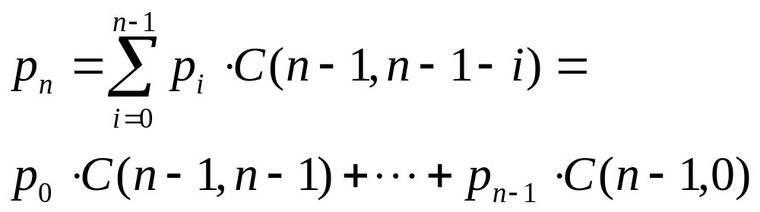
Partition Function
Consider the k’ th case:
k : n has k friends
There are C (n-1,k) ways of choosing fellow members of n’s team.
Furthermore, there are p_{n-k-1} ways of partitioning the rest of the n elements. Using the product and sum rules we get:

Slide 15
Solving Recurrence Relations
We will learn how to give closed solutions to certain kinds of recurrence relations. Unfortunately, most recurrence relations cannot be solved analytically.
EG: If you can find a closed formula for partition function tell me!
However, recurrence relations can all be solved quickly by using dynamic programming.

Slide 16
Numerical Solutions
Dynamic Programming
Recursion + Lookup Table = Dynamic Programming
Consider a recurrence relation of the form:
a_{n} = f (a₀,a₁,…,a_{n-2},a_{n-1})
Then can always solve the recurrence relation for first n values by using following pseudocode:
integer-array a(integers n, a₀)
table₀ = a₀
for(i = 1 to n)
table_{i} = f(table₀,table₁,…,table_{i-1})
return table
Notes:
This pseudocode assumes that there is only one initial condition a₀

Slide 17
Dynamic Program for String Example
Solve a_{n} = 2a_{n-1} + 2^{n-3} - a_{n-3} up to n=7.
Pseudocode becomes:
integer-array a(integer n)
table₀ = table₁ = 0
table₂ = 1
for(i = 3 to n)
table_{i} = 2^{i-3}-table_{i-3}+2*table_{i-1}
return table

Slide 18
Dynamic Program for String Example
Solve a_{n} = 2a_{n-1} + 2^{n-3} - a_{n-3} up to n=7:
i | 2^{i-3}-a_{i-3}+2a_{i-1} = a_{i}
0 | 0
1 | 0
2 | 1
3
4
5
6
7

Slide 19
Dynamic Program for String Example
Solve a_{n} = 2a_{n-1} + 2^{n-3} - a_{n-3} up to n=7:
i | 2^{i-3}-a_{i-3}+2a_{i-1} = a_{i}
0 | 0
1 | 0
2 | 1
3 | 1-0+2·1 = 3
4
5
6
7

Slide 20
Dynamic Program for String Example
Solve a_{n} = 2a_{n-1} + 2^{n-3} - a_{n-3} up to n=7:
i | 2^{i-3}-a_{i-3}+2a_{i-1} = a_{i}
0 | 0
1 | 0
2 | 1
3 | 1-0+2·1 = 3
4 | 2-0+2·3 = 8
5
6
7

Slide 21
Dynamic Program for String Example
Solve a_{n} = 2a_{n-1} + 2^{n-3} - a_{n-3} up to n=7:
i | 2^{i-3}-a_{i-3}+2a_{i-1} = a_{i}
0 | 0
1 | 0
2 | 1
3 | 1-0+2·1 = 3
4 | 2-0+2·3 = 8
5 | 4-1+2·8 = 19
6
7

Slide 22
Dynamic Program for String Example
Solve a_{n} = 2a_{n-1} + 2^{n-3} - a_{n-3} up to n=7:
i | 2^{i-3}-a_{i-3}+2a_{i-1} = a_{i}
0 | 0
1 | 0
2 | 1
3 | 1-0+2·1 = 3
4 | 2-0+2·3 = 8
5 | 4-1+2·8 = 19
6 | 8-3+2·19 = 43
7

Slide 23
Dynamic Program for String Example
Solve a_{n} = 2a_{n-1} + 2^{n-3} - a_{n-3} up to n=7:
i | 2^{i-3}-a_{i-3}+2a_{i-1} = a_{i}
0 | 0
1 | 0
2 | 1
3 | 1-0+2·1 = 3
4 | 2-0+2·3 = 8
5 | 4-1+2·8 = 19
6 | 8-3+2·19 = 43
7 | 16-8+2·43 = 94

Slide 24
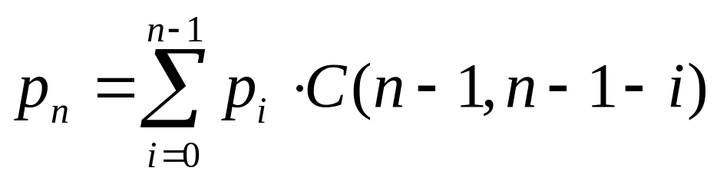
Dynamic Program for String Example
Solve up to n=6.
Pseudocode becomes:
integer-array p(integer n)
table₀ = 1 //unique partition of empty set
for(i = 1 to n)
sum = 1
for(j = 1 to n-1)
sum += table_{j}*C(n-1,n-1-j)
table_{n} = sum
return table

Slide 25
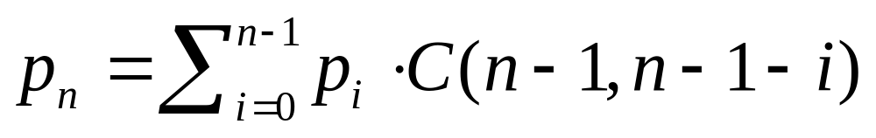
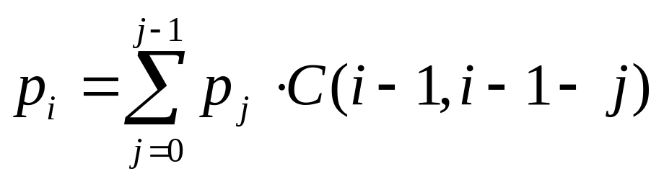
Dynamic Program for String Example
Solve up to n=6:
i
0 | 1
1
2
3
4
5
6

Slide 26
Dynamic Program for String Example
Solve up to n=6:
i
0 | 1
1 | 1
2
3
4
5
6

Slide 27
Dynamic Program for String Example
Solve up to n=6:
i
0 | 1
1 | 1
2 | 1+1·C(1,0) = 2
3
4
5
6

Slide 28
Dynamic Program for String Example
Solve up to n=6:
i
0 | 1
1 | 1
2 | 1+1·C(1,0) = 2
3 | 1+1·C(2,1)+2·C(2,0) = 5
4
5
6

Slide 29
Dynamic Program for String Example
Solve up to n=6:
i
0 | 1
1 | 1
2 | 1+1·C(1,0) = 2
3 | 1+1·C(2,1)+2·C(2,0) = 5
4 | 1+C(3,2)+2C(3,1) +5C(3,0) = 15
5
6

Slide 30
Dynamic Program for String Example
Solve up to n=6:
i
0 | 1
1 | 1
2 | 1+1·C(1,0) = 2
3 | 1+1·C(2,1)+2·C(2,0) = 5
4 | 1+C(3,2)+2C(3,1) +5C(3,0) = 15
5 | 1+C(4,3)+2C(4,2) +5C(4,1)+15 = 52
6

Slide 31
Dynamic Program for String Example
Solve up to n=6:
i
0 | 1
1 | 1
2 | 1+1·C(1,0) = 2
3 | 1+1·C(2,1)+2·C(2,0) = 5
4 | 1+C(3,2)+2C(3,1) +5C(3,0) = 15
5 | 1+C(4,3)+2C(4,2) +5C(4,1)+15 = 52
6 | 1+C(5,4)+2C(5,3)+5C(5,2)+15C(5,1 )+52 = 203

Slide 32
Closed Solutions by Telescoping
We’ve already seen technique in the past:
Plug recurrence into itself repeatedly for smaller and smaller values of n.
See the pattern and then give closed formula in terms of initial conditions.
Plug values into initial conditions getting final formula.
Telescoping also called back-substitution

Slide 33
Telescope Example
Find a closed solution to a_{n} = 2a_{n-1}, a₀= 3:
a_{n}=2a_{n-1}

Slide 34
Telescope Example
Find a closed solution to a_{n} = 2a_{n-1}, a₀= 3:
a_{n}=2a_{n-1}
=2²a_{n-2}

Slide 35
Telescope Example
Find a closed solution to a_{n} = 2a_{n-1}, a₀= 3:
a_{n}=2a_{n-1}
=2²a_{n-2}
=2³a_{n-3}

Slide 36
Telescope Example
Find a closed solution to a_{n} = 2a_{n-1}, a₀= 3:
a_{n}=2a_{n-1}
=2²a_{n-2}
=2³a_{n-3}
=…

Slide 37
Telescope Example
Find a closed solution to a_{n} = 2a_{n-1}, a₀= 3:
a_{n}=2a_{n-1}
=2²a_{n-2}
=2³a_{n-3}
=…
=2^{i}a_{n-i}

Slide 38
Telescope Example
Find a closed solution to a_{n} = 2a_{n-1}, a₀= 3:
a_{n}=2a_{n-1}
=2²a_{n-2}
=2³a_{n-3}
=…
=2^{i}a_{n-i}
=…

Slide 39
Telescope Example
Find a closed solution to a_{n} = 2a_{n-1}, a₀= 3:
a_{n}=2a_{n-1}
=2²a_{n-2}
=2³a_{n-3}
=…
=2^{i}a_{n-i}
=…
=2^{n}a₀

Slide 40
Telescope Example
Find a closed solution to a_{n} = 2a_{n-1}, a₀= 3:
Plug in a₀= 3 for final answer:
a_{n} = 3·2^{n}
a_{n}=2a_{n-1}
=2²a_{n-2}
=2³a_{n-3}
=…
=2^{i}a_{n-i}
=…
=2^{n}a₀

Slide 41
Blackboard Exercise for 5.1
5.1.21: Give a recurrence relation for the number of ways to climb n stairs if the climber can take one or two stairs at a time.

Slide 42
Closed Solutions by Telescoping
The only case for which telescoping works with a high probability is when the recurrence give the next value in terms of a single previous value.
There is a class of recurrence relations which can be solved analytically in general. These are called linear recurrences and include the Fibonacci recurrence.

Slide 43
Linear Recurrences
The only case for which telescoping works with a high probability is when the recurrence gives the next value in terms of a single previous value. But…
There is a class of recurrence relations which can be solved analytically in general. These are called linear recurrences and include the Fibonacci recurrence.
Begin by showing how to solve Fibonacci:

Slide 44
Solving Fibonacci
Recipe solution has 3 basic steps:
Assume solution of the form a_{n} = r ^{n}
Find all possible r’s that seem to make this work. Call these¹ r₁ and r₂. Modify assumed solution to general solution a_{n} = Ar₁^{n} +Br₂^{n} where A,B are constants.
Use initial conditions to find A,B and obtain specific solution.
Notes:
¹In general there may be more then 2 solutions if recurrence is in terms of more than 2 previous terms. In this case would need to generalize to r₁, r₂ , … , r_{k}

Slide 45
Solving Fibonacci
Assume exponential solution of the form a_{n} = r ^{n} :
Plug this into a_{n} = a_{n-1} + a_{n-2} :
r ^{n} = r ^{n-1} + r ^{n-2}
Notice that all three terms have a common r ^{n-2} factor, so divide this out:
r ^{n} /r ^{n-2} = (r ^{n-1}+r ^{n-2} )/r ^{n-2} ➔ r ² = r + 1
This equation is called the characteristic equation of the recurrence relation.

Slide 46
Solving Fibonacci
Find all possible r’s that solve characteristic
r ² = r + 1
Call these r₁ and r₂.¹ General solution is a_{n} = Ar₁^{n} +Br₂^{n} where A,B are constants.
Quadratic formula² gives:
r = (1 ± √5)/2
So r₁ = (1+√5)/2, r₂ = (1-√5)/2
General solution:
a_{n} = A [(1+√5)/2]^{n} +B [(1-√5)/2]^{n}
Notes:
¹In general there may be more then 2 solutions if recurrence is in terms of more than 2 previous terms. In this case would need to generalize to r₁, r₂ , … , r_{k}
²Recall the quadratic formula: ax² + bx + c = 0 is solved by setting x = [b ± √(b²-4ac)] / 2a

Slide 47
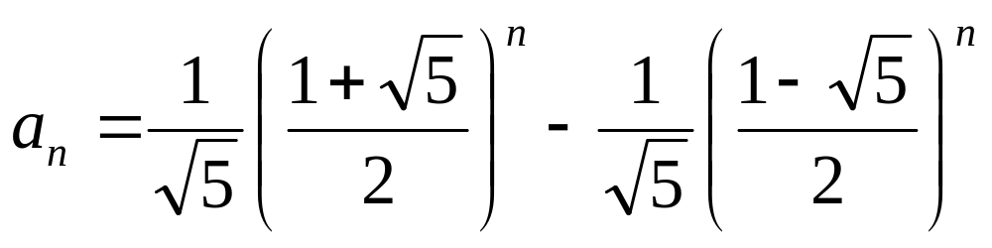
Solving Fibonacci
Use initial conditions a₀ = 0, a₁ = 1 to find A,B and obtain specific solution.
0=a₀ = A [(1+√5)/2]⁰ +B [(1-√5)/2]⁰ = A +B
1=a₁ = A [(1+√5)/2]¹ +B [(1-√5)/2]¹ = A(1+√5)/2 +B (1-√5)/2 = (A+B )/2 + (A-B )√5/2
First equation give B = -A. Plug into 2nd:
1 = 0 +2A√5/2 so A = 1/√5, B = -1/√5
Final answer:
(CHECK IT!)

Slide 48
Linear Recurrences with Constant Coefficients
Previous method generalizes to solving “linear recurrence relations with constant coefficients”:
DEF: A recurrence relation is said to be linear if a_{n} is a linear combination of the previous terms plus a function of n. I.e. no squares, cubes or other complicated function of the previous a_{i} can occur. If in addition all the coefficients are constants then the recurrence relation is said to have constant coefficients.

Slide 49
Linear Recurrences with Constant Coefficients
Q: Which of the following are linear with constant coefficients?
a_{n} = 2a_{n-1}
a_{n} = 2a_{n-1} + 2^{n-3} - a_{n-3}
a_{n} = a_{n-1}²
Partition function:

Slide 50
Linear Recurrences with Constant Coefficients
A:
a_{n} = 2a_{n-1}: YES
a_{n} = 2a_{n-1} + 2^{n-3} - a_{n-3}: YES
a_{n} = a_{n-1}²: NO. Squaring is not a linear operation. Similarly a_{n} = a_{n-1}a_{n-2} and a_{n} = cos(a_{n-2}) are non-linear.
Partition function:
NO. This is linear, but coefficients are not constant as C (n -1, n -1-i ) is a non-constant function of n.

Slide 51
Homogeneous Linear Recurrences
To solve such recurrences we must first know how to solve an easier type of recurrence relation:
DEF: A linear recurrence relation is said to be homogeneous if it is a linear combination of the previous terms of the recurrence without an additional function of n.
Q: Which of the following are homogeneous?
a_{n} = 2a_{n-1}
a_{n} = 2a_{n-1} + 2^{n-3} - a_{n-3}
Partition function:

Slide 52
Linear Recurrences with Constant Coefficients
A:
a_{n} = 2a_{n-1}: YES
a_{n} = 2a_{n-1} + 2^{n-3} - a_{n-3}: No. There’s an extra term f (n) = 2^{n-3}
Partition function:
YES. No terms appear not involving the previous p_{i}

Slide 53
Homogeneous Linear Recurrences with Const. Coeff.’s
The 3-step process used for the Fibonacci recurrence works well for general homogeneous linear recurrence relations with constant coefficients. There are a few instances where some modification is necessary.

Slide 54
Homogeneous
-Complications
Repeating roots in characteristic equation. Repeating roots imply that don’t learn anything new from second root, so may not have enough information to solve formula with given initial conditions. We’ll see how to deal with this on next slide.
Non-real number roots in characteristic equation. If the sequence has periodic behavior, may get complex roots (for example a_{n} = -a_{n-2})¹. We won’t worry about this case (in principle, same method works as before, except use complex arithmetic).
Notes:
¹The characteristic equation of a_{n} = -a_{n-2} is r ²+1 = 0 which gives r = i,-i where i is the square root of -1. Nominally, this means that the general solutions has the form:
a_{n} = Ai ^{n} +B(-i )^{n}
which is seemingly a non-real number

Slide 55
Complication: Repeating Roots
EG: Solve a_{n} = 2a_{n-1}-a_{n-2} , a₀ = 1, a₁ = 2
Find characteristic equation by plugging in a_{n} = r ^{n}:
r ² - 2r +1 = 0
Since r ² - 2r +1 = (r -1)² the root r = 1 repeats.
If we tried to solve by using general solution
a_{n} = Ar₁^{n}+Br₂^{n} = A1^{n}+B1^{n} = A+B
which forces a_{n} to be a constant function (→←).
SOLUTION: Multiply second solution by n so general solution looks like:
a_{n} = Ar₁^{n}+Bnr₁^{n}
Notes:
If had more repeating roots, would multiply each new solution by another n. So if r₁ is repeated four times general solution would look like:
a_{n} = Ar₁^{n}+Bnr₁^{n} +Cn²r₁^{n} +Dn³r₁^{n}

Slide 56
Complication: Repeating Roots
Solve a_{n} = 2a_{n-1}-a_{n-2}, a₀ = 1, a₁ = 2
General solution: a_{n} = A1^{n}+Bn1^{n} = A+Bn
Plug into initial conditions
1 = a₀ = A+B·0·1⁰= A
2 = a₀ = A·1¹+B·1·1¹= A+B
Plugging first equation A = 1 into second:
2 = 1+B implies B = 1.
Final answer: a_{n} = 1+n
(CHECK IT!)

Slide 57
The Nonhomogeneous Case
Consider the Tower of Hanoi recurrence (see Rosen p. 311-313) a_{n} = 2a_{n-1}+1.
Could solve using telescoping. Instead let’s solve it methodically. Rewrite:
a_{n} - 2a_{n-1} = 1
Solve with the RHS set to 0, i.e. solve the homogeneous case.
Add a particular solution to get general solution. I.e. use rule:
General
Nonhomogeneous
General
homogeneous
Particular
Nonhomogeneous
=
+

Slide 58
The Nonhomogeneous Case
a_{n} - 2a_{n-1} = 1
Solve with the RHS set to 0, i.e. solve
a_{n} - 2a_{n-1} = 0
Characteristic equation: r - 2 = 0
so unique root is r = 2. General solution to homogeneous equation is
a_{n} = A·2^{n}

Slide 59
The Nonhomogeneous Case
Add a particular solution to get general solution for a_{n} - 2a_{n-1} = 1. Use rule:
There are little tricks for guessing particular nonhomogeneous solutions. For example, when the RHS is constant, the guess should also be a constant.¹
So guess a particular solution of the form b_{n}=C.
Plug into the original recursion:
1 = b_{n} – 2b_{n-1} = C – 2C = -C. Therefore C = -1.
General solution: a_{n} = A·2^{n} -1.
General
Nonhomogeneous
General
homogeneous
Particular
Nonhomogeneous
=
+
Notes:
¹If the non-homogeneous part of the equation is a polynomial P (n) of degree k, then you should guess a particular solution of the form:
A_{k} n ^{k} + A_{k-1} n ^{k-1} + A_{k-2} n ^{k-2} + … + A₁ n + A₀
Where the A_{i} are constants that are determined by plugging into the recurrence relation. If instead, the inhomogeneous part is P (n)·s ^{n} [polynomial·exponential] and s is not a root of the characteristic equation, the guess should be modified to:
[A_{k} n ^{k} + A_{k-1} n ^{k-1} + A_{k-2} n ^{k-2} + … + A₁ n + A₀] ·s ^{n}
Finally, if the inhomogeneous part is P (n)·s ^{n} s a root of the characteristic equation which is repeated m times [m=1 means the root occurs but is not repeating], the guess should be modified to:
[A_{k} n ^{k} + A_{k-1} n ^{k-1} + A_{k-2} n ^{k-2} + … + A₁ n + A₀] ·s ^{n} n ^{m}

Slide 60
The Nonhomogeneous Case
Finally, use initial conditions to get closed solution. In the case of the Towers of Hanoi recursion, initial condition is:
a₁ = 1
Using general solution a_{n} = A·2^{n} -1 we get:
1 = a₁ = A·2¹ -1 = 2A –1.
Therefore, 2 = 2A, so A = 1.
Final answer: a_{n} = 2^{n} -1

Slide 61
More Complicated
EG: Find the general solution to recurrence from the bit strings example: a_{n} = 2a_{n-1} + 2^{n-3} - a_{n-3}
Rewrite as a_{n} - 2a_{n-1} + a_{n-3} = 2^{n-3} and solve homogeneous part:
Characteristic equation: r ³ - 2r +1 = 0.
Guess root r = ±1 as integer roots divide.
r = 1 works, so divide out by (r -1) to get
r ³ - 2r +1 = (r -1)(r ² +r -1).

Slide 62
More Complicated
r ³ - 2r +1 = (r -1)(r ² +r -1).
Quadratic formula on r ² +r -1:
r = (-1 ± √5)/2
So r₁ = 1, r₂ = (-1+√5)/2, r₃ = (-1-√5)/2
General homogeneous solution:
a_{n} = A + B [(-1+√5)/2]^{n} +C [(-1-√5)/2]^{n}

Slide 63
More Complicated
Nonhomogeneous particular solution to a_{n} - 2a_{n-1} + a_{n-3} = 2^{n-3}
Guess the form b_{n} = k 2^{n}. Plug guess in:
k 2^{n} - 2k 2^{n-1} + k 2^{n-3} = 2^{n-3}
Simplifies to: k =1.
So particular solution is b_{n} = 2^{n}
Final answer:
a_{n}=A + B [(-1+√5)/2]^{n} + C [(-1-√5)/2]^{n} + 2^{n}
General
Nonhomogeneous
General
homogeneous
Particular
Nonhomogeneous
=
+

Slide 64
Blackboard Exercise for 5.2
Solve the following recurrence relation in terms of a₁ assuming n is odd:
a_{n} = (n-1)a_{n-2}

Slide 65
Sections 5.4, 5.5
Crazy Bagel Example
Suppose need to buy bagels for 13 students (1 each) out of 17 types but George and Harry are totally in love with Francesca and will only want the type of bagel that she has. Furthermore, Francesca only likes garlic or onion bagels.
Q: How many ways are there of buying 13 bagels from 17 types if repetitions are allowed, order doesn’t matter and at least 3 are garlic or at least 3 are onion?

Slide 66
Crazy Bagel Example
A: Same approach as before
Let x_{i} = no. of bagels bought of type i.
Let i = 1 represents garlic and i = 2 onion.
Interested in counting the set
{x₁+x₂+…+x₁₇ = 13 | x₁ ≥ 3 or x₂ ≥ 3}
Inclusion-Exclusion principle gives:
|{RHS=13 with x₁ ≥ 3 }|+|{RHS=13 with x₂ ≥ 3}|
-|{RHS=13 with x₁ ≥ 3 and x₂ ≥ 3}|
=|{RHS=10}| + |{RHS=10}|}| - |{RHS=7}|
=C (16+10,10)+C (16+10,10)-C (16+7,7)
=10,378,313.
RHS

Slide 67
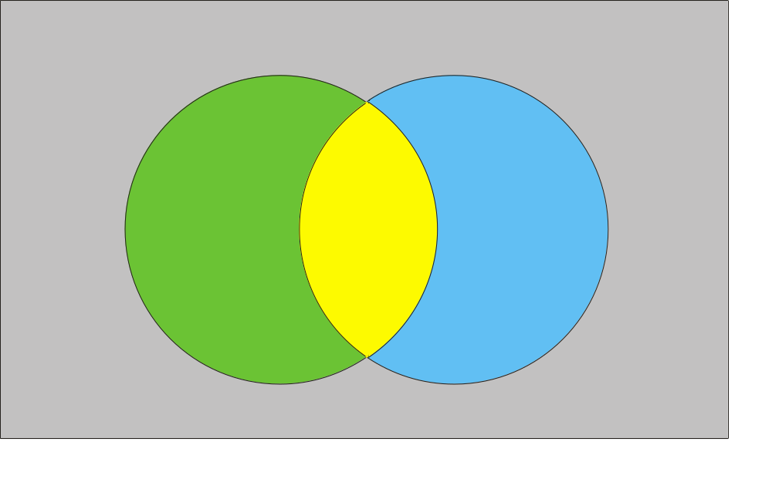

Standard Inclusion-Exclusion
Inclusion-Exclusion principle:
U
A-A∩B
A∩B
B-A∩B

Slide 68

Inclusion-Exclusion-Inclusion
“Inclusion-Exclusion-Inclusion” principle:
U
A-(B∪C)
A∩B
-A∩B∩C
B-(A∪C)
A∩B∩C
A∩C
-A∩B∩C
B∩C
-A∩B∩C
C-(A∪B)

Slide 69
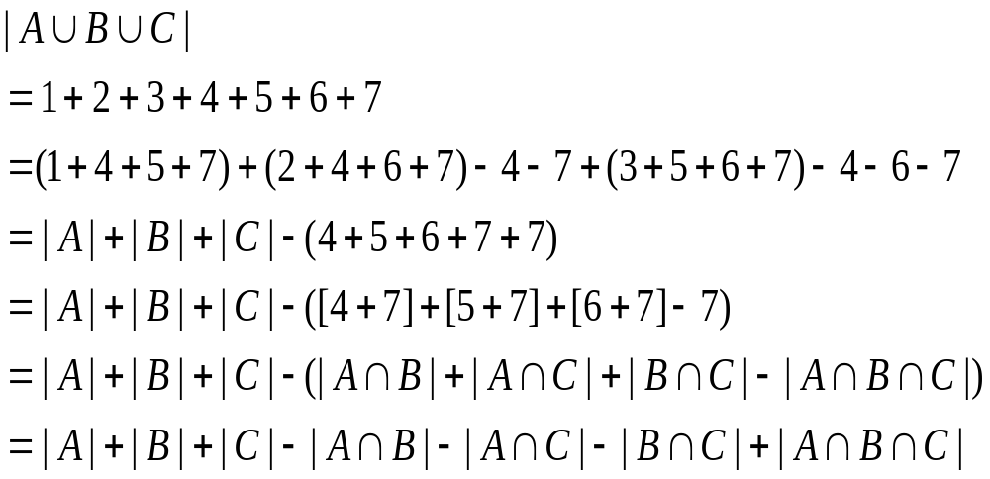
Proof of
Inclusion-Exclusion-Inclusion
1
4
2
7
6
5
3

Slide 70
Inclusion-Exclusion-Inclusion
Q: How many numbers between 1 and 1000 are divisible by 3, 5, or 7.

Slide 71
Inclusion-Exclusion-Inclusion
A: Use the formula that the number of positive integers up to N which are divisible by d is ⎣N/d⎦. With I-E-I principle get and the fact that for relatively prime a, b both numbers divide x iff their product ab divides x :
Total = ⎣1000/3⎦ + ⎣1000/5⎦ + ⎣1000/7⎦ - ⎣1000/15⎦ - ⎣1000/21⎦ - ⎣1000/35⎦ + ⎣1000/105⎦
= 333 + 200 + 142 - 66 - 47 - 28 + 9
= 543

Slide 72
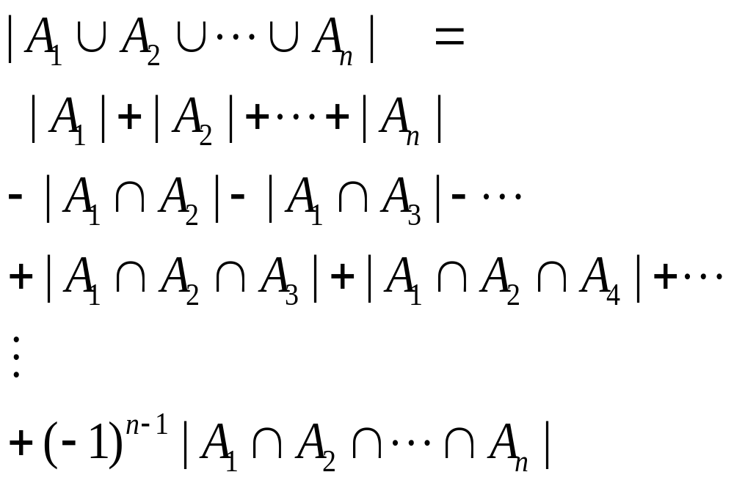
Inclusion-Exclusion-Inclusion
Using induction, could prove:
THM: General Inclusion-Exclusion Principle:
union =
all terms
- all pairs
+ all triples
…
+/- total intersection

Slide 73
Counting Pigeon Feedings
Suppose you throw 6 crumbs in the park and 3 pigeons eat all the crumbs. How many ways could the 3 pigeons have eaten the crumbs if we only care about which pigeons ate which crumbs?
Q: What are we counting?
Valid
Crumb 1 Crumb 2 Crumb 3 Crumb 4 Crumb 5 Crumb 6
Invalid
Crumb 1 Crumb 2 Crumb 3 Crumb 4 Crumb 5 Crumb 6
Pigeon 1 Pigeon 2 Pigeon 3
Pigeon 1 Pigeon 2 Pigeon 3

Slide 74
Counting Pigeon Feedings
A: Functions from crumbs to pigeons, so the answer is 3⁶ = 729
Next, insist that every pigeon gets fed:
Q: What sort of function are we counting now?
Invalid
Crumb 1 Crumb 2 Crumb 3 Crumb 4 Crumb 5 Crumb 6
Valid
Crumb 1 Crumb 2 Crumb 3 Crumb 4 Crumb 5 Crumb 6
Pigeon 1 Pigeon 2 Pigeon 3
Pigeon 1 Pigeon 2 Pigeon 3

Slide 75
Counting Onto Functions
A: Onto functions from crumbs to pigeons.
We calculate this number using generalized Inclusion-Exclusion.
|{onto functions}| = |{arbitrary}|-|{non-onto}|
A function is non-onto if it misses some element in the codomain. So consider following sets for each pigeon i :
A_{i} = {functions which miss pigeon no. i }
|{non-onto}|=|A₁∪A₂∪A₃|=
|A₁|+|A₂|+|A₃|-|A₁∩A₂|-|A₁∩A₃|-|A₂∩A₃|
(don’t need |A₁∩A₂∩A₃| term because impossible)

Slide 76
Counting Onto Functions
By symmetry, |A₁|=|A₂|=|A₃| as no pigeon is special. Also, A₁∩A₂ is the set of functions which miss both 1 and 2. Again, by symmetry |A₁∩A₂|=|A₁∩A₃|=|A₁∩A₃|. So:
|{non-onto}| = 3|A₁| - 3|A₁∩A₂|
Finally, A₁ is just the set of functions into {2,3} while A₁∩A₂ is the set of functions into {3} so:
|{non-onto}| = 3·2⁶ - 3·1⁶
Taking the complement:
|{onto functions}| = 3⁶ - 3·2⁶ + 3·1⁶ = 540

Slide 77
Counting Onto Functions
General Formula
THM: The number of onto functions from a set with m elements to a set with n elements (m ≥ n) is given by the formula:
n^{m} - C (n,1)·(n -1)^{m} + C (n,2)·(n -2)^{m}+…
+(-1)^{i}C (n,i )·(n-i )^{m} +…+ (-1)^{n-1}C (n,n-1)·1^{m}
Proof.
choose i
elements to miss
Remaining n -i
elements hit arbitrarily
from I-E
Principle

Slide 78
An Evil Witch Party
4 evil but naïve witches decide to have a trick-or-treat party. Each witch is supposed to bring a treat. The treats are thrown inside a bag and are randomly redistributed, 1 treat per witch. Suppose that each treat is poisonous, but that each witch assumes that he/she is the only one that brought a poisonous treat.
Q: What is the probability that everyone dies?

Slide 79
Counting Derangements
A: What we are asking to count is the number of derangements from a set of 4 elements to itself.
DEF: A derangement of {1,2,3,…,n} is a permutation f on the set such that for no element i does f (i ) = i.
So the answer to the witch problem is:
|{ derangements of {1,2,3,4} }| / |{permutations}|

Slide 80
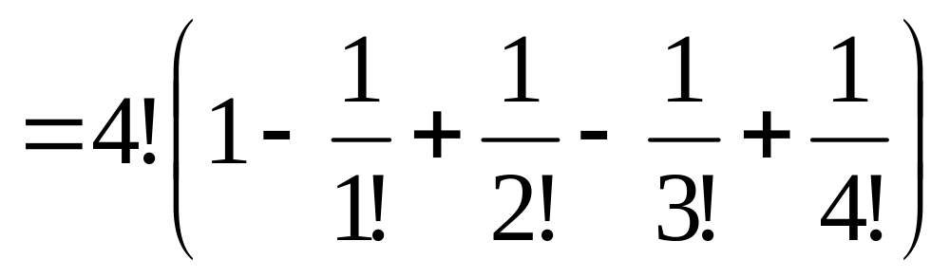
Counting Derangements
Define: A_{i} = {permutations which bring i to i }
Inclusion-Exclusion and symmetry imply:
|{witch←→poison derangements}|
= |{4-perm’s}|-C (4,1)|A₁|+C (4,2)|A₁∩A₂|
-C (4,3)|A₁∩A₂∩A₃|+C (4,4)|A₁∩A₂∩A₃∩A₄|
= 4!-C (4,1)3!+C (4,2)2!-C (4,3)1!+C (4,4)0!
= 4!-4·3!/1!+ 4·3·2!/2!-4·3·2·1!/3!+4·3·2·1/4!

Slide 81
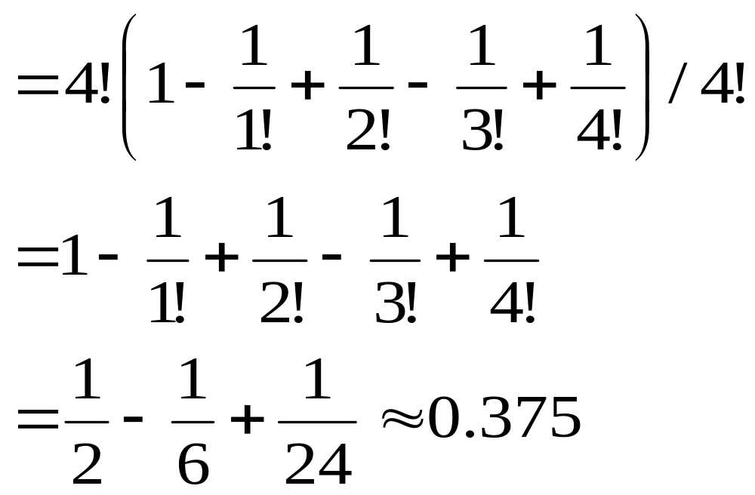
Witch Problem
Finally, divide the number of derangements by the number of permutations to get the probability that all die:

Slide 82
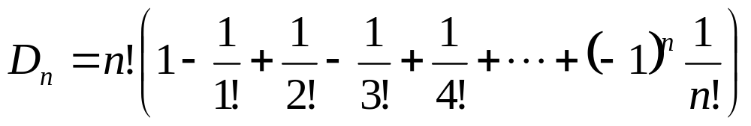
Counting Derangements
General Formula
THM: The number of derangements of a set with n elements is given by:
The proof is just a generalization of the argument in the witch party problem.

Slide 83
Blackboard Exercise: 5.5, 5.6
(5.5.7)
2504 CS students
1876 took Pascal, 999 took Fortran, 345 took C
876 took P and F, 231 took F and C, 290 took P and C
189 took P and F and C
How many took no programming at all?

Slide 84
Blackboard Exercise: 5.5, 5.6
(5.5.11) Find the number of positive integers not exceeding 100 which are either odd or the square of an integer.
Find the number of primes not exceeding 100 by using Erastothene’s Sieve + Inclusion-Exclusion. (Explains picture on web-site).

Slide 85
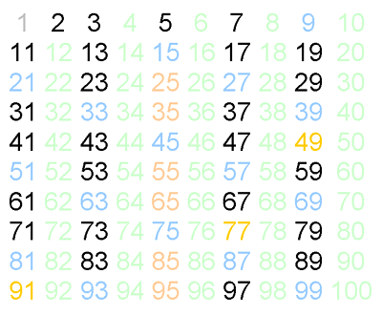
Blackboard Exercise: 5.5, 5.6

