Slide 1
Relations
Zeph Grunschlag

Slide 2
Announcements
HW9 due now
HWs 10 and 11 are available
Midterm 2 regrades: bring to my attention Monday 4/29
Clerical errors regarding scores can be fixed through reading period

Slide 3
Agenda –Relations
Representing Relations
  As subsets of Cartesian products
  Column/line diagrams
  Boolean matrix
  Digraph
Operations on Relations
  Boolean
  Inverse
  Composition
  Exponentiation
  Projection
  Join

Slide 4
Relational Databases
Relational databases standard organizing structure for large databases
  Simple design
  Powerful functionality
  Allows for efficient algorithms
Not all databases are relational
  Ancient database systems
  XML –tree based data structure
  Modern database must: easy conversion to relational

Slide 5
Example 1
A relational database with schema :
1 | Name
2 | Favorite Soap
3 | Favorite Color
4 | Occupation
1 | Kate Winslet | Leonardo DiCaprio
2 | Dove | Dial
3 | Purple | Green
4 | Movie star | Movie star
…etc.

Slide 6
Example 2
The table for mod 2 addition:
+ | 0 | 1
0 | 0 | 1
1 | 1 | 0

Slide 7
Example 3
Example of a pigeon to crumb pairing where pigeons may share a crumb:
Crumb 1
Pigeon 1 Crumb 2
Pigeon 2 Crumb 3
Pigeon 3 Crumb 4
Crumb 5

Slide 8
Example 4
The concept of “siblinghood”.

Slide 9
Relations:
Generalizing Functions
Some of the examples were function-like (e.g. mod 2 addition, or crumbs to pigeons) but violations of definition of function were allowed (not well-defined, or multiple values defined).
All of the 4 examples had a common thread: They related elements or properties with each other.

Slide 10
Relations: Represented as Subsets of Cartesian Products
In more rigorous terms, all 4 examples could be represented as subsets of certain Cartesian products.
Q: How is this done for examples 1, 2, 3 and 4?

Slide 11
Relations: Represented as Subsets of Cartesian Products
The 4 examples:
Database ⊆
mod 2 addition ⊆
Pigeon-Crumb feeding ⊆
Siblinghood ⊆

Slide 12
Relations: Represented as Subsets of Cartesian Products
A:
Database ⊆ {Names}×{Soaps}×{Colors}×{Jobs}
mod 2 addition ⊆
{0,1}×{0,1}×{0,1}
Pigeon-Crumb feeding ⊆
{pigeons}×{crumbs}
Siblinghood ⊆
{people}×{people}
Q: What is the actual subset for mod 2 addition?

Slide 13
Relations as Subsets of Cartesian Products
A: The subset for mod 2 addition:
{ (0,0,0), (0,1,1), (1,0,1), (1,1,0) }

Slide 14
Relations as Subsets of Cartesian Products
DEF: Let A₁, A₂, … , A_{n} be sets. An n-ary relation on these sets (in this order) is a subset of A₁×A₂× … ×A_{n}.
Most of the time we consider n = 2 in which case have a binary relation and also say the the relation is “from A₁ to A₂”. With this terminology, all functions are relations, but not vice versa.
Q: What additional property ensures that a relation is a function?

Slide 15
Relations as Subsets of Cartesian Products
A: Vertical line test : For every a in A₁ there is a unique b in A₂ for which (a,b) is in the relation. Here A₁ is thought of as the x-axis, A₂ is the y-axis and the relation is represented by a graph.
Q: How can this help us visualize the square root function:

Slide 16
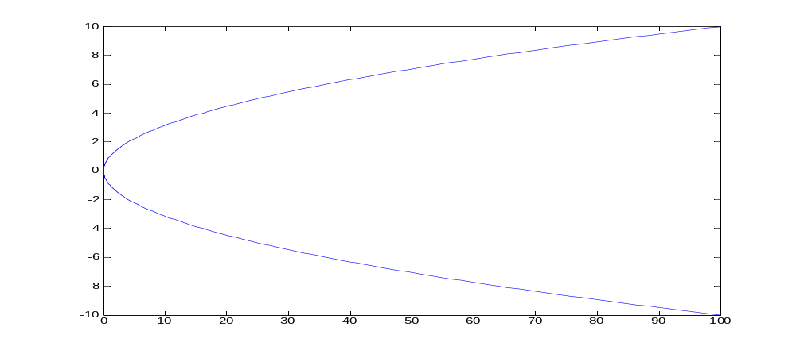
Graph Example
A: Visualize both branches of solution to x = y ² as the graph of a relation:
y
x

Slide 17
Relations as Subsets of Cartesian Products
Q: How many n-ary relations are there on A₁, A₂, … , A_{n} ?

Slide 18
Relations as Subsets of Cartesian Products
A: Just the number of subsets of
A₁×A₂× … ×A_{n} or 2^{|A1|·|A2|· … ·|An|}
DEF: A relation on the set A is a subset of A × A.
Q: Which of examples 1, 2, 3, 4 was a relation on A for some A ?
(Celebrity Database, mod 2 addition, Pigeon-Crumb feeding, Siblinghood)

Slide 19
Relations as Subsets:
∪, ∩, ⊕, -,‾
A: Siblinghood. A = {people}
Because relations are just subsets, all the usual set theoretic operations are defined between relations which belong to the same Cartesian product.
Q: Suppose we have relations on {1,2} given by R = {(1,1), (2,2)}, S = {(1,1),(1,2)}. Find:
The union R ∪S
The intersection R ∩ S
The symmetric difference R ⊕S
The difference R-S
The complement R

Slide 20
Relations as Subsets:
∪, ∩, ⊕, -,‾
A: R = {(1,1),(2,2)}, S = {(1,1),(1,2)}
R ∪S = {(1,1),(1,2),(2,2)}
R ∩S = {(1,1)}
R ⊕S = {(1,2),(2,2)}.
R-S = {(2,2)}.
R = {(1,2),(2,1)}
Notes:
In principle could represent Google’s database as a subset of {words} X {url’s} but for efficiency’s sake, Google has to use a more sophisticated data structure.

Slide 21
Relations as Bit-Valued Functions
In general subsets can be thought of as functions from their universe into {0,1}. The function outputs 1 for elements in the set and 0 for elements not in the set.
This works for relations also. In general, a relation R on A₁×A₂× … ×A_{n} is also a bit function R (a₁,a₂, … ,a_{n}) = 1 iff (a₁,a₂, … ,a_{n}) ∈ R.
Q: Suppose that R = “mod 2 addition”
What is R (0,1,0) ?
What is R (1,1,0) ?
What is R (1,1,1) ?

Slide 22
Relations as Bit-Valued Functions
A: R = “mod 2 addition”
R (0,1,0) = 0
R (1,1,0) = 1
R (1,1,1) = 0
Q: Give a Java method for R (allowing true to be 1 and false to be 0)

Slide 23
Binary Relations
A:
boolean R(int a, int b, int c){
return (a + b) % 2 == c;
}
For binary relations, often use infix notation aRb instead of prefix notation R (a,b).
EG: R = “<”. Thus can express the fact that 3 isn’t less than two with following equivalent (and confusing) notation:
(3,2) ∉ < , <(3,2) = 0 , (3 < 2) = 0

Slide 24
Representing Binary Relations
-Boolean Matrices
Can represent binary relations using Boolean matrices, i.e. 2 dimensional tables consisting of 0’s and 1’s.
For a relation R from A to B define matrix M_{R} by:
Rows –one for each element of A
Columns –one for each element of B
Value at i ^{th} row and j ^{th} column is
  1 if i ^{th} element of A is related to j ^{th} element of B
  0 otherwise
Usually whole block is parenthesized.
Q: How is the pigeon-crumb relation represented?

Slide 25
Representing Binary Relations
-Boolean Matrices
Crumb 1
Pigeon 1 Crumb 2
Pigeon 2 Crumb 3
Pigeon 3 Crumb 4
Crumb 5

Slide 26
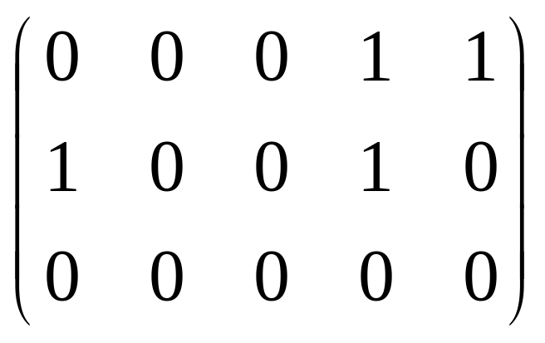
Representing Binary Relations
-Boolean Matrices
Crumb 1
Pigeon 1 Crumb 2
Pigeon 2 Crumb 3
Pigeon 3 Crumb 4
Crumb 5
A:
Q: What’s M_{R}’s shape for a relation on A?

Slide 27
Properties of Binary Relations
A: Square.
Special properties for relation on a set A:
reflexive : every element is self-related. I.e. aRa for all a ∈A
symmetric : order is irrelevant. I.e. for all a,b ∈A aRb iff bRa
transitive : when a is related to b and b is related to c, it follows that a is related to c. I.e. for all a,b,c ∈A aRb and bRc implies aRc
Q: Which of these properties hold for:
1) “Siblinghood” 2) “<” 3) “≤”

Slide 28
Properties of Binary Relations
A:
1) “Siblinghood”: not reflexive (I’m not my brother), is symmetric, is transitive.
If ½-brothers allowed, not transitive.
2) “<”: not reflexive, not symmetric, is transitive
3) “≤”: is reflexive, not symmetric, is transitive
DEF: An equivalence relation is a relation on A which is reflexive, symmetric and transitive.
Generalizes the notion of “equals”.

Slide 29
Properties of Binary Relations
Warnings
Warnings: there are additional concepts with confusing names
antisymmetric : not equivalent to “not symmetric”. Meaning: it’s never the case for a ≠ b that both aRb and bRa hold.
asymmetric : also not equivalent to “not symmetric”. Meaning: it’s never the case that both aRb and bRa hold.
irreflexive : not equivalent to “not reflexive”. Meaning: it’s never the case that aRa holds.

Slide 30
Visualizing the Properties
For relations R on a set A.
Q: What does M_{R} look like when when R is reflexive?

Slide 31
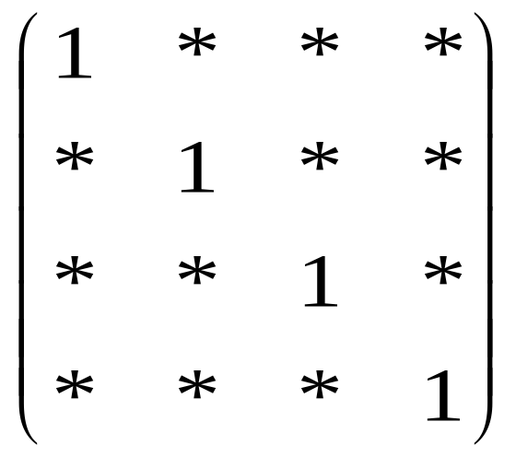
Visualizing the Properties
A: Reflexive. Upper-Left corner to Lower-Right corner diagonal is all 1’s. EG:
M_{R} =
Q: How about if R is symmetric?

Slide 32
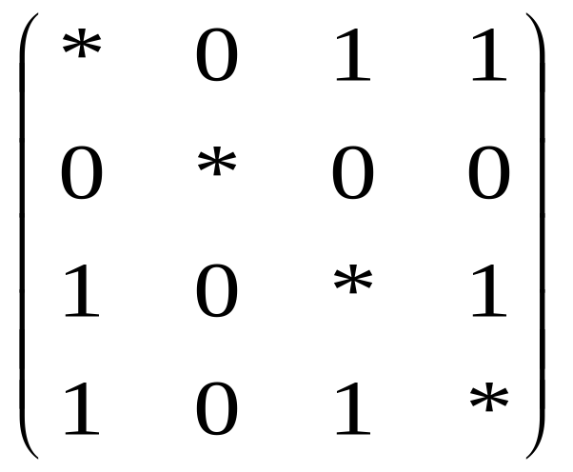
Visualizing the Properties
A: A symmetric matrix. I.e., flipping across diagonal does not change matrix. EG:
M_{R} =
Notes:
Official name for “flipping across diagonal” is transposing

Slide 33
Inverting Relations
Relational inversion amounts to just reversing all the tuples of a binary relation.
DEF: If R is a relation from A to B, the composite of R is the relation R ⁻¹ from B to A defined by setting cR ⁻¹a if and only aRc.
Q: Suppose R defined on N by: xRy iff y = x ². What is the inverse R ⁻¹ ?

Slide 34
Inverting Relations
A: xRy iff y = x ².
R is the square function so R ⁻¹ is sqaure root: i.e. the union of the two square-root branches. I.e:
yR ⁻¹x iff y = x ²
or in terms of square root:
xR ⁻¹y iff y = ±√x where x is non-negative

Slide 35
Composing Relations
Just as functions may be composed, so can binary relations:
DEF: If R is a relation from A to B, and S is a relation from B to C then the composite of R and S is the relation S •R (or just SR ) from A to C defined by setting a (S •R )c if and only if there is some b such that aRb and bSc.
Notation is weird because generalizing functional composition: f •g (x) = f (g (x)).

Slide 36
Composing Relations
Q:
Suppose R defined on N by: xRy iff y = x ²
and S defined on N by: xSy iff y = x ³
What is the composite SR ?

Slide 37
Composing Relations
Picture
xRy iff y = x ² xSy iff y = x ³
A: These are functions (squaring and cubing) so the composite SR is just the function composition (raising to the 6th power). xSRy iff y = x ⁶ (in this odd case RS = SR )
Q: Compose the following:
1 1 1 1
2 2 2 2
3 3 3 3
4 4 4
5 5
Notes:
More detail on: xRSy iff y = x ⁶
1) xRx²
2) ySy³ so x²S(x²) ³
3) Composing (1) and (2) we get xRSx⁶

Slide 38
Composing Relations
Picture
1 1 1
2 2 2
3 3 3
4 4
5
A: Draw all possible shortcuts. In our case, all shortcuts went through 1:
1 1
2 2
3 3
4

Slide 39
Composing Relations
Picture
1 1 1
2 2 2
3 3 3
4 4
5
A: Draw all possible shortcuts. In our case, all shortcuts went through 1:
1 1
2 2
3 3
4

Slide 40
Composing Relations
Picture
1 1 1
2 2 2
3 3 3
4 4
5
A: Draw all possible shortcuts. In our case, all shortcuts went through 1:
1 1
2 2
3 3
4

Slide 41
Composing Relations
Picture
1 1 1
2 2 2
3 3 3
4 4
5
A: Draw all possible shortcuts. In our case, all shortcuts went through 1:
1 1
2 2
3 3
4

Slide 42
Composing Relations
Picture
1 1 1
2 2 2
3 3 3
4 4
5
A: Draw all possible shortcuts. In our case, all shortcuts went through 1:
1 1
2 2
3 3
4

Slide 43
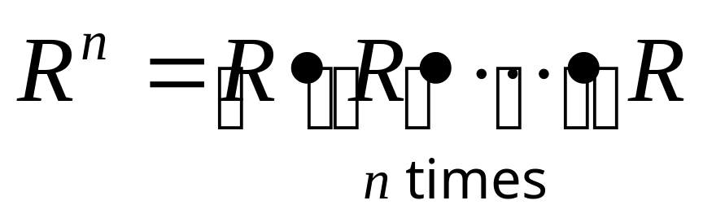
Exponentiation
A relation R on A can be composed with itself, so can exponentiate:
DEF:
Q: Find R ³ if R is given by:
1 1
2 2
3 3
4 4

Slide 44
Exponentiation
A: R R
1 1 1
2 2 2
3 3 3
4 4 4

Slide 45
Exponentiation
A: R R R ²
1 1 1 1 1
2 2 2 2 2
3 3 3 3 3
4 4 4 4 4

Slide 46
Exponentiation
A: R R R ²
1 1 1 1 1
2 2 2 2 2
3 3 3 3 3
4 4 4 4 4
R ² R
1 1 1
2 2 2
3 3 3
4 4 4

Slide 47
Exponentiation
A: R R R ²
1 1 1 1 1
2 2 2 2 2
3 3 3 3 3
4 4 4 4 4
R ² R R ³
1 1 1 1 1
2 2 2 2 2
3 3 3 3 3
4 4 4 4 4

Slide 48
Digraph Representation
The last way of representing a relation R on a set A is with a digraph which stands for “directed graph”. The set A is represented by nodes (or vertices) and whenever aRb occurs, a directed edge (or arrow) a→b is created. Self pointing edges (or loops) are used to represent aRa.
Q: Represent previous page’s R ³ by a digraph.

Slide 49
Digraph Representation
R ³
1 1
2 2
3 3
4 4

Slide 50
Digraph Representation
R ³
1 1
2 2
3 3
4 4
A:
2
1
3
4

Slide 51
Database Operations
Many more operations are useful for databases. We’ll study 2 of these:
Join: a generalization of intersection as well as Cartesian product.
Projection: restricting to less coordinates.

Slide 52
Join
The join of two relations R, S is the combination of the relations with respect to the last few types of R and the first few types of S (assuming these types are the same). The result is a relation with the special types of S the common types of S and R and the special types of R.
I won’t give the formal definition (see the book). Instead I’ll give examples:

Slide 53
Join
EG: Suppose R is mod 2 addition and S is mod 2 multiplication:
R = { (0,0,0), (0,1,1), (1,0,1), (1,1,0) }
S = { (0,0,0), (0,1,0), (1,0,0), (1,1,1) }
In the 2-join we look at the last two coordinates of R and the first two coordinates of S. When these are the same we join the coordinates together and keep the information from R and S. For example, we generate an element of the join as follows:
(0,1,1)
2-join
(0,1,1,1)
(1,1,1)

Slide 54
Join
R = { (0,0,0), (0,1,1), (1,0,1), (1,1,0) }
S = { (0,0,0), (0,1,0), (1,0,0), (1,1,1) }
We use the notation J₂(R,S) for the 2-join.
J₂(R,S) =
{ (0,0,0,0), (0,1,1,1), (1,0,1,0), (1,1,0,0) }
Q: For general R,S, what does each of the following represent?
J₀(R,S)
J_{n}(R,S) assuming n is the number of coordinates for both R and S.

Slide 55
Join
For general R,S, what does each of the following represent?
J₀(R,S) is the Cartesian product
J_{n}(R,S) is the intersection when n is the number of coordinates

Slide 56
Projection
Projection is a “forgetful” operation. You simply forget certain unmentioned coordinates. EG, consider R again:
R = { (0,0,0), (0,1,1), (1,0,1), (1,1,0) }
By projecting on to the 1st and 3rd coordinates, we simply forget the 2nd coordinate. we generate an element of the 1,3 projection as follows:
1,3 projection
(0,1,1)
(0,1)

Slide 57
Projection
R = { (0,0,0), (0,1,1), (1,0,1), (1,1,0) }
We use the notation P_{1,3}(R) for 1,3 projection.
P_{1,3}(R) = { (0,0), (0,1), (1,1),(1,0) }

Slide 58
Relations Blackboard Exercises
1. Define the relation R by setting
R(a,b,c) = “a^{b} = c“
with a,b,c non-negative integers. Describe in English what P_{1,3} (R ) represents.
2. Define composition in terms of projection and join.

