Slide 1
Graphs
Zeph Grunschlag

Slide 2
Agenda –Graphs
Graph basics and definitions
  Vertices/nodes, edges, adjacency, incidence
  Degree, in-degree, out-degree
  Degree, in-degree, out-degree
  Subgraphs, unions, isomorphism
  Adjacency matrices
Types of Graphs
  Trees
  Undirected graphs
    Simple graphs, Multigraphs, Pseudographs
  Digraphs, Directed multigraph
  Bipartite
  Complete graphs, cycles, wheels, cubes, complete bipartite

Slide 3
Uses of Graph Theory in CS
Car navigation system
Efficient database
Build a bot to retrieve info off WWW
Representing computational models
Many other applications.
This course we focus more on the properties of abstract graphs rather on algorithms (3137 has the algorithmics)

Slide 4
Graphs –Intuitive Notion
A graph is a bunch of vertices (or nodes) represented by circles which are connected by edges, represented by line segments .
Mathematically, graphs are binary-relations on their vertex set (except for multigraphs).
In Data Structures one often starts with trees and generalizes to graphs. In this course, opposite approach: We start with graphs and restrict to get trees.

Slide 5
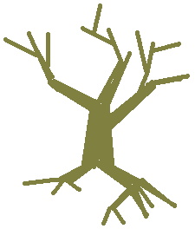
Trees
A very important type of graph in CS is called a tree:
Real
Tree

Slide 6
Trees
A very important type of graph in CS is called a tree:
Real
Tree
transformation

Slide 7
Trees
A very important type of graph in CS is called a tree:
Real
Tree
transformation

Slide 8
Trees
A very important type of graph in CS is called a tree:
Real Abstract
Tree Tree
transformation

Slide 9
Simple Graphs
Different purposes require different types of graphs.
EG: Suppose a local computer network
  Is bidirectional (undirected)
  Has no loops (no “self-communication”)
  Has unique connections between computers
Sensible to represent as follows:

Slide 10
Simple Graphs
{1,2}
Vertices are labeled to associate with particular computers
Each edge can be viewed as the set of its two endpoints
1
2
{1,3}
{2,3}
{2,4}
{3,4}
3
4
{1,4}

Slide 11
Simple Graphs
DEF: A simple graph G = (V,E ) consists of a non-empty set V of vertices (or nodes) and a set E (possibly empty) of edges where each edge is a subset of V with cardinality 2 (an unordered pair).
Q: For a set V with n elements, how many possible edges there?

Slide 12
Simple Graphs
A: The number of pairs in V
= C (n,2) = n · (n -1) / 2
Q: How many possible graphs are there for the same set of vertices V ?

Slide 13
Simple Graphs
A: The number of subsets in the set of possible edges. There are n · (n -1) / 2 possible edges, therefore the number of graphs on V is 2^{n(n -1)/2}

Slide 14
Multigraphs
If computers are connected via internet instead of directly, there may be several routes to choose from for each connection. Depending on traffic, one route could be better than another. Makes sense to allow multiple edges, but still no self-loops:

Slide 15
Multigraphs
e₁
e₂
Edge-labels distinguish between edges sharing same endpoints. Labeling can be thought of as function:
e₁ → {1,2}, e₂ → {1,2}, e₃ → {1,3}, e₄ → {2,3}, e₅ → {2,3}, e₆ → {1,2}
1
2
e₃
e₄
e₅
e₆
3
4

Slide 16
Multigraphs
DEF: A multigraph G = (V,E,f ) consists of a non-empty set V of vertices (or nodes), a set E (possibly empty) of edges and a function f with domain E and codomain the set of pairs in V.

Slide 17
Pseudographs
If self-loops are allowed we get a pseudograph:
Now edges may be associated with a single vertex, when the edge is a loop
e₁ → {1,2}, e₂ → {1,2}, e₃ → {1,3},
e₄ → {2,3}, e₅ → {2}, e₆ → {2}, e₇ → {4}
e₆
e₁
1
e₂
2
e₃
e₅
e₄
e₇
3
4

Slide 18
Multigraphs
DEF: A pseudograph G = (V,E,f ) consists of a non-empty set V of vertices (or nodes), a set E (possibly empty) of edges and a function f with domain E and codomain the set of pairs and singletons in V.
Notes:
A singleton is a set of cardinality 1.

Slide 19
Undirected Graphs
Terminology
Vertices are adjacent if they are the endpoints of the same edge.
Q: Which vertices are adjacent to 1? How about adjacent to 2, 3, and 4?
e₁
1
e₂
2
e₃
e₄
e₅
e₆
3
4

Slide 20
Undirected Graphs
Terminology
e₁
A: 1 is adjacent to 2 and 3
2 is adjacent to 1 and 3
3 is adjacent to 1 and 2
4 is not adjacent to any vertex
1
e₂
2
e₃
e₄
e₅
e₆
3
4

Slide 21
Undirected Graphs
Terminology
A vertex is incident with an edge (and the edge is incident with the vertex) if it is the endpoint of the edge.
Q: Which edges are incident to 1? How about incident to 2, 3, and 4?
e₁
1
e₂
2
e₃
e₄
e₅
e₆
3
4

Slide 22
Undirected Graphs
Terminology
e₁
A: e₁, e₂, e₃, e₆ are incident with 2
2 is incident with e₁, e₂, e₄, e₅, e₆
3 is incident with e₃, e₄, e₅
4 is not incident with any edge
1
e₂
2
e₃
e₄
e₅
e₆
3
4

Slide 23
Digraphs
Last time introduced digraphs as a way of representing relations:
Q: What type of pair should each edge be (multiple edges not allowed)?
2
1
3
4

Slide 24
Digraphs
A: Each edge is directed so an ordered pair (or tuple) rather than unordered pair.
Thus the set of edges E is just the represented relation on V.
(2,2)
2
(1,2)
(2,3)
(1,1)
(1,3)
(3,3)
1
3
(2,4)
(3,4)
4
(4,4)

Slide 25
Digraphs
DEF: A directed graph (or digraph) G = (V,E ) consists of a non-empty set V of vertices (or nodes) and a set E of edges with E ⊆V ×V.
The edge (a,b) is also denoted by a →b and a is called the source of the edge while b is called the target of the edge.
Q: For a set V with n elements, how many possible digraphs are there?

Slide 26
Digraphs
A: The same as the number of relations on V, which is the number of subsets of V ×V so 2^{n·n}.

Slide 27
Directed Multigraphs
If also want to allow multiple edges in a digraph, get a directed multigraph (or multi-digraph).
Q: How to use sets and functions to deal with multiple directed edges, loops?
2
1
3

Slide 28
Directed Multigraphs
A: Have function with domain the edge set and codomain V ×V .
e₁→(1,2), e₂→(1,2), e₃→(2,2), e₄ → (2,3),
e₅ → (2,3), e₆ → (3,3), e₇ → (3,3)
e₃
e₁
2
e₄
e₆
e₂
e₅
1
3
e₇

Slide 29
Degree
The degree of a vertex counts the number of edges that seem to be sticking out if you looked under a magnifying glass:
e₆
e₁
1
e₂
2
e₅
e₃
e₄
3

Slide 30
Degree
The degree of a vertex counts the number of edges that seem to be sticking out if you looked under a magnifying glass:
e₆
e₁
magnify
1
e₂
2
e₅
e₃
e₄
3

Slide 31
Degree
The degree of a vertex counts the number of edges that seem to be sticking out if you looked under a magnifying glass:
Thus deg(2) = 7 even though 2 only incident with 5 edges.
Q: How to define this formally?
e₆
e₁
magnify
1
e₂
2
e₅
e₃
e₄
3

Slide 32
Degree
A: Add 1 for every regular edge incident with vertex and 2 for every loop. Thus deg(2) = 1 + 1 + 1 + 2 + 2 = 7
e₆
e₁
magnify
1
e₂
2
e₅
e₃
e₄
3

Slide 33
Oriented Degree when Edges Directed
The in-degree of a vertex (deg⁻) counts the number of edges that stick in to the vertex. The out-degree (deg⁺) counts the number sticking out.
Q: What are in-degrees and out-degrees of all the vertices?
2
1
3

Slide 34
Oriented Degree when Edges Directed
A: deg⁻(1) = 0
deg⁻(2) = 3
deg⁻(3) = 4
deg⁺(1) = 2
deg⁺(2) = 3
deg⁺(3) = 2
2
1
3

Slide 35
Handshaking Theorem
e₆
e₁
There are two ways to count the number of edges in the above graph:
Just count the set of edges: 7
Count seeming edges vertex by vertex and divide by 2 because double-counted edges: ( deg(1)+deg(2)+deg(3)+deg(4) )/2 = (3+7+2+2)/2 = 14/2 = 7
1
e₂
2
e₃
e₅
e₄
e₇
3
4

Slide 36
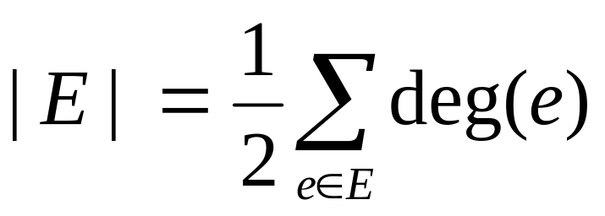
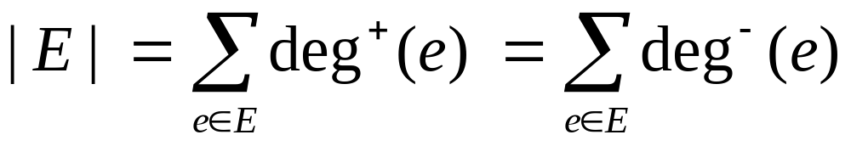
Handshaking Theorem
THM: In an undirected graph
In a directed graph
Q: In a party of 5 people can each person be friends with exactly three others?

Slide 37
Handshaking Theorem
A: Imagine a simple graph with 5 people as vertices and edges being undirected edges between friends (simple graph assuming friendship is symmetric and irreflexive). Number of friends each person has is the degree of the person.
Handshaking would imply that
|E | = (sum of degrees)/2 or
2|E | = (sum of degrees) = (5·3) = 15.
Impossible as 15 is not even. In general:

Slide 38
Handshaking Theorem
Lemma: The number of vertices of odd degree must be even in an undirected graph.
Proof : Otherwise would have
2|E | = Sum of even no.’s
+ an odd number of odd no.’s
even = even + odd
–this is impossible. 

Slide 39
Graph Patterns
Complete Graphs - K_{n}
A simple graph is complete if every pair of distinct vertices share an edge. The notation K_{n} denotes the complete graph on n vertices.
K₁ K₂ K₃ K₄ K₅

Slide 40
Graph Patterns
Cycles - C_{n}
The cycle graph C_{n} is a circular graph with V = {0,1,2,…,n-1} where vertex i is connected to i +1 mod n and to i -1 mod n. They look like polygons:
C₁ C₂ C₃ C₄ C₅
Q: What type of graph are C₁ and C₂ ?

Slide 41
Graph Patterns
Wheels - W_{n}
A: Pseudographs
The wheel graph W_{n} is just a cycle graph with an extra vertex in the middle:
W₁ W₂ W₃ W₄ W₅
Usually consider wheels with 3 or more spokes only.

Slide 42
Graph Patterns
Cubes - Q_{n}
The n-cube Q_{n} is defined recursively. Q₀ is just a vertex. Q_{n+1} is gotten by taking 2 copies of Q_{n} and joining each vertex v of Q_{n} with its copy v’ :
Q₀ Q₁ Q₂ Q₃ Q₄ (hypercube)

Slide 43
Bipartite Graphs
A simple graph is bipartite if V can be partitioned into V = V₁ ∪V₂ so that any two adjacent vertices are in different parts of the partition. Another way of expressing the same idea is bichromatic : vertices can be colored using two colors so that no two vertices of the same color are adjacent.

Slide 44
Bipartite Graphs
EG: C₄ is a bichromatic:
And so is bipartite, if we redraw it:

Slide 45
Bipartite Graphs
EG: C₄ is a bichromatic:
And so is bipartite, if we redraw it:

Slide 46
Bipartite Graphs
EG: C₄ is a bichromatic:
And so is bipartite, if we redraw it:

Slide 47
Bipartite Graphs
EG: C₄ is a bichromatic:
And so is bipartite, if we redraw it:

Slide 48
Bipartite Graphs
EG: C₄ is a bichromatic:
And so is bipartite, if we redraw it:

Slide 49
Bipartite Graphs
EG: C₄ is a bichromatic:
And so is bipartite, if we redraw it:

Slide 50
Bipartite Graphs
EG: C₄ is a bichromatic:
And so is bipartite, if we redraw it:

Slide 51
Bipartite Graphs
EG: C₄ is a bichromatic:
And so is bipartite, if we redraw it:

Slide 52
Bipartite Graphs
EG: C₄ is a bichromatic:
And so is bipartite, if we redraw it:

Slide 53
Bipartite Graphs
EG: C₄ is a bichromatic:
And so is bipartite, if we redraw it:

Slide 54
Bipartite Graphs
EG: C₄ is a bichromatic:
And so is bipartite, if we redraw it:

Slide 55
Bipartite Graphs
EG: C₄ is a bichromatic:
And so is bipartite, if we redraw it:
Q: For which n is C_{n} bipartite?

Slide 56
Bipartite Graphs
A: C_{n} is bipartite when n is even. For even n color all odd numbers red and all even numbers green so that vertices are only adjacent to opposite color.
If n is odd, C_{n} is not bipartite. If it were, color 0 red. So 1 must be green, and 2 must be red. This way, all even numbers must be red, including vertex n-1. But n-1 connects to 0 →←.

Slide 57
Graph Patterns
Complete Bipartite - K_{m,n}
When all possible edges exist in a simple bipartite graph with m red vertices and n green vertices, the graph is called complete bipartite and the notation K_{m,n} is used. EG:
K_{2,3} K_{4,5}

Slide 58
Subgraphs
Notice that the 2-cube occurs
inside the 3-cube . In other
words, Q₂ is a subgraph of Q₃ :
DEF: Let G = (V,E ) and H = (W,F ) be graphs. H is said to be a subgraph of G, if W ⊆ V and F ⊆ E.
Q: How many Q₂ subgraphs does Q₃ have?

Slide 59
Subgraphs
A: Each face of Q₃ is a Q₂ subgraph so the answer is 6, as this is the number of faces on a 3-cube:

Slide 60
Unions
In previous example can actually reconstruct the 3-cube from its 6 2-cube faces:

Slide 61
Unions
If we assign the 2-cube faces (aka Squares) the names S₁, S₂, S₃, S₄, S₅, S₆ then Q₃ is the union of its faces:
Q₃ = S₁∪S₂∪S₃∪S₄∪S₅∪S₆

Slide 62
Unions
DEF: Let G₁ = (V₁, E₁ ) and G₂ = (V₂, E₂ ) be two simple graphs (and V₁,V₂ may or may not be disjoint). The union of G₁, G₂ is formed by taking the union of the vertices and edges. I.E: G₁∪G₂ = (V₁∪V₂, E₁∪E₂ ).
A similar definitions can be created for unions of digraphs, multigraphs, pseudographs, etc.

Slide 63
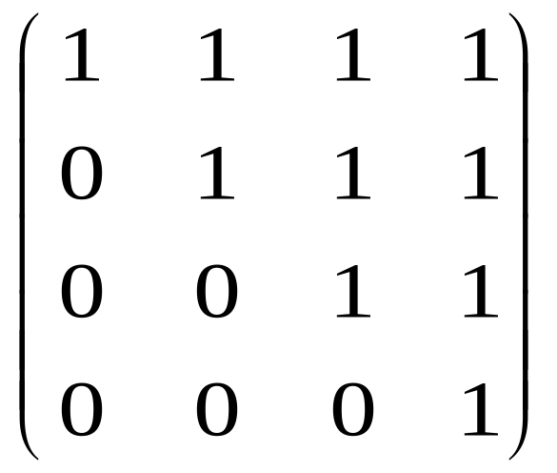
Adjacency Matrix
We already saw a way of representing relations on a set with a Boolean matrix:
R digraph(R) M_{R}
1 1
2 2
3 3
4 4
2
1
3
4

Slide 64
Adjacency Matrix
Since digraphs are relations on their vertex sets, can adopt the concept to represent digraphs. In the context of graphs, we call the representation an adjacency matrix :
For a digraph G = (V,E ) define matrix A_{G} by:
Rows, Columns –one for each vertex in V
Value at i ^{th} row and j ^{th} column is
  1 if i ^{th} vertex connects to j ^{th} vertex (i → j )
  0 otherwise

Slide 65
Adjacency Matrix
-Directed Multigraphs
Can easily generalize to directed multigraphs by putting in the number of edges between vertices, instead of only allowing 0 and 1:
For a directed multigraph G = (V,E ) define the matrix A_{G} by:
Rows, Columns –one for each vertex in V
Value at i ^{th} row and j ^{th} column is
  The number of edges with source the i ^{th} vertex and target the j ^{th} vertex

Slide 66
Adjacency Matrix
-Directed Multigraphs
Q: What is the adjacency matrix?
2
1
4
3

Slide 67
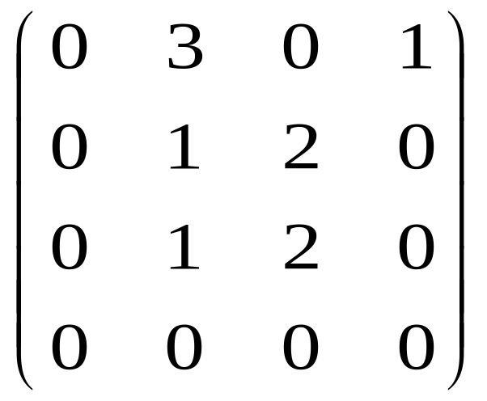
Adjacency Matrix
-Directed Multigraphs
A:
2
1
4
3

Slide 68
Adjacency Matrix
-General
Undirected graphs can be viewed as directed graphs by turning each undirected edge into two oppositely oriented directed edges, except when the edge is a self-loop in which case only 1 directed edge is introduced. EG:
1
2
1
2
3
4
3
4

Slide 69
Adjacency Matrix
-General
Q: What’s the adjacency matrix?
1
2
3
4

Slide 70
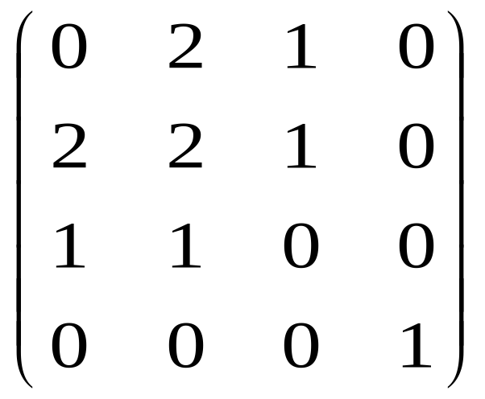
Adjacency Matrix
-General
1
2
A:
Notice that answer is symmetric.
3
4

Slide 71
Adjacency Matrix
-General
For an undirected graph G = (V,E ) define the matrix A_{G} by:
Rows, Columns –one for each element of V
Value at i ^{th} row and j ^{th} column is the number of edges incident with vertices i and j.
This is equivalent to converting first to a directed graph as above. Or by allowing undirected edges to take us from i to j can simply use definition for directed graphs.

Slide 72



Graph Isomorphism
Various mathematical notions come with their own concept of equivalence, as opposed to equality:
Equivalence for sets is bijectivity:
  EG { , , } ≈ {12, 23, 43}
Equivalence for graphs is isomorphism:
  EG
  ≈

Slide 73
Graph Isomorphism
Intuitively, two graphs are isomorphic if can bend, stretch and reposition vertices of the first graph, until the second graph is formed. Etymologically, isomorphic means “same shape”.
EG: Can twist or relabel:
to obtain:

Slide 74
Graph Isomorphism
Undirected Graphs
DEF: Suppose G₁ = (V₁, E₁ ) and G₂ = (V₂, E₂ ) are pseudographs. Let f :V₁→V₂ be a function s.t.:
f is bijective
for all vertices u,v in V₁, the number of edges between u and v in G₁ is the same as the number of edges between f (u) and f (v ) in G₂.
Then f is called an isomorphism and G₁ is said to be isomorphic to G₂.

Slide 75
Graph Isomorphism
Digraphs
DEF: Suppose G₁ = (V₁, E₁ ) and G₂ = (V₂, E₂ ) are directed multigraphs. Let f :V₁→V₂ be a function s.t.:
f is bijective
for all vertices u,v in V₁, the number of edges from u to v in G₁ is the same as the number of edges between f (u) and f (v ) in G₂.
Then f is called an isomorphism and G₁ is said to be isomorphic to G₂.
Note: Only difference between two definitions is the italicized “from” in no. 2 (was “between”).

Slide 76
Graph Isomorphism
-Example
EG: Prove that
is isomorphic to .
First label the vertices:
2
2
1
3
1
3
5
4
5
4

Slide 77
Graph Isomorphism
-Example
Next, set f (1) = 1 and try to walk around clockwise on the star.
2
2
1
3
1
3
5
4
5
4

Slide 78
Graph Isomorphism
-Example
Next, set f (1) = 1 and try to walk around clockwise on the star. The next vertex seen is 3, not 2 so set f (2) = 3.
2
2
1
3
1
3
5
4
5
4

Slide 79
Graph Isomorphism
-Example
Next, set f (1) = 1 and try to walk around clockwise on the star. The next vertex seen is 3, not 2 so set f (2) = 3. Next vertex is 5 so set f (3) = 5.
2
2
1
3
1
3
5
4
5
4

Slide 80
Graph Isomorphism
-Example
Next, set f (1) = 1 and try to walk around clockwise on the star. The next vertex seen is 3, not 2 so set f (2) = 3. Next vertex is 5 so set f (3) = 5. In this fashion we get f (4) = 2
2
2
1
3
1
3
5
4
5
4

Slide 81
Graph Isomorphism
-Example
Next, set f (1) = 1 and try to walk around clockwise on the star. The next vertex seen is 3, not 2 so set f (2) = 3. Next vertex is 5 so set f (3) = 5. In this fashion we get f (4) = 2, f (5) = 4.
2
2
1
3
1
3
5
4
5
4

Slide 82
Graph Isomorphism
-Example
Next, set f (1) = 1 and try to walk around clockwise on the star. The next vertex seen is 3, not 2 so set f (2) = 3. Next vertex is 5 so set f (3) = 5. In this fashion we get f (4) = 2, f (5) = 4. If we would continue, we would get back to f (1) =1 so this process is well defined and f is a morphism.
2
2
1
3
1
3
5
4
5
4

Slide 83
Graph Isomorphism
-Example
Next, set f (1) = 1 and try to walk around clockwise on the star. The next vertex seen is 3, not 2 so set f (2) = 3. Next vertex is 5 so set f (3) = 5. In this fashion we get f (4) = 2, f (5) = 4. If we would continue, we would get back to f (1) =1 so this process is well defined and f is a morphism. Finally since f is bijective, f is an isomorphism.
2
2
1
3
1
3
5
4
5
4

Slide 84
Properties of Isomorphims
Since graphs are completely defined by their vertex sets and the number of edges between each pair, isomorphic graphs must have the same intrinsic properties. I.e. isomorphic graphs have the same…
…number of vertices and edges
…degrees at corresponding vertices
…types of possible subgraphs
…any other property defined in terms of the basic graph theoretic building blocks!

Slide 85
Graph Isomorphism
-Negative Examples
Once you see that graphs are isomorphic, easy to prove it. Proving the opposite, is usually more difficult. To show that two graphs are non-isomorphic need to show that no function can exist that satisfies defining properties of isomorphism. In practice, you try to find some intrinsic property that differs between the 2 graphs in question.

Slide 86
Graph Isomorphism
-Negative Examples
A: Why are the following non-isomorphic?
u₂
v₂
u₃
u₁
v₁
v₃
u₅
u₄
v₄

Slide 87
Graph Isomorphism
-Negative Examples
A: 1st graph has more vertices than 2nd.
Q: Why are the following non-isomorphic?
u₂
v₂
u₃
v₃
u₁
v₁
u₅
u₄
v₅
v₄

Slide 88
Graph Isomorphism
-Negative Examples
A: 1st graph has more edges than 2nd.
Q: Why are the following non-isomorphic?
u₂
v₂
u₃
v₃
u₁
v₁
u₅
u₄
v₅
v₄

Slide 89
Graph Isomorphism
-Negative Examples
A: 2nd graph has vertex of degree 1, 1st graph doesn't.
Q: Why are the following non-isomorphic?
u₁
u₂
u₃
u₄
u₅
u₆
v₁
v₂
v₃
v₄
v₅
v₆
u₇
u₈
u₉
v₇
v₈
v₉

Slide 90
Graph Isomorphism
-Negative Examples
A: 1st graph has 2 degree 1 vertices, 4 degree 2 vertex and 2 degree 3 vertices. 2nd graph has 3 degree 1 vertices, 3 degree 2 vertex and 3 degree 3 vertices.
Q: Why are the following non-isomorphic?
u₁
u₂
u₃
u₄
u₅
u₆
v₁
v₂
v₃
v₄
v₅
v₆
u₇
u₈
v₇
v₈

Slide 91
Graph Isomorphism
-Negative Examples
A: None of the previous approaches work as there are the same no. of vertices, edges, and same no. of vertices per degree.
LEMMA: If G and H are isomorphic, then any subgraph of G will be isomorphic to some subgraph of H.
Q: Find a subgraph of 2nd graph which isn’t a subgraph of 1st graph.
u₁
u₂
u₃
u₄
u₅
u₆
v₁
v₂
v₃
v₄
v₅
v₆
u₇
u₈
v₇
v₈

Slide 92
Graph Isomorphism
-Negative Examples
A: This subgraph is not a subgraph of the left graph.
Why not? Deg. 3 vertices must map to deg. 3 vertices. Since subgraph and left graph are symmetric, can assume v₂ maps to u₂. Adjacent deg. 1 vertices to v₂ must map to degree 1 vertices, forcing the deg. 2 adjacent vertex v₃ to map to u₃. This forces the other vertex adjacent to v₃, namely v₄ to map to u₄. But then a deg. 3 vertex has mapped to a deg. 2 vertex→← 
u₁
u₂
u₃
u₄
u₅
u₆
v₁
v₂
v₃
v₄
v₅
v₆
u₇
u₈
v₇
v₈

Slide 93
Blackboard Exercise
Show that W₆ is not bipartite.

