Slide 1
Lecture 3: Propositional Equivalences
Zeph Grunschlag

Slide 2
Announcements
OH’s today moved to 3:30-5pm
HW1 due next Monday
CVN (Columbia Video Network) is hiring work-study camera operators, multi-media and video streaming people. No experience required. Contact technical@cvn.columbia.edu.

Slide 3
Agenda
Tautologies
Logical Equivalences

Slide 4
Tautologies, contradictions, contingencies
DEF: A compound proposition is called a tautology if no matter what truth values its atomic propositions have, its own truth value is T.
EG: p ∨ ¬p (Law of excluded middle)
The opposite to a tautology, is a compound proposition that’s always false –a contradiction.
EG: p ∧ ¬p
On the other hand, a compound proposition whose truth value isn’t constant is called a contingency.
EG: p → ¬p
Notes:
Question: why is the last a contingency?

Slide 5
Tautologies and contradictions
The easiest way to see if a compound proposition is a tautology/contradiction is to use a truth table.
p
¬p
p ∨¬p
p
¬p
p ∧¬p
F
T
T
F
T
T
F
T
T
F
F
F

Slide 6
Tautology example (1.2.8.a)
Part 1
Demonstrate that
[¬p ∧(p ∨q )]→q
is a tautology in two ways:
Using a truth table – show that [¬p ∧(p ∨q )]→q is always true
Using a proof (will get to this later).

Slide 7
Tautology by truth table
p | q | ¬p | p ∨q | ¬p ∧(p ∨q ) | [¬p ∧(p ∨q )]→q
T | T
T | F
F | T
F | F

Slide 8
Tautology by truth table
p | q | ¬p | p ∨q | ¬p ∧(p ∨q ) | [¬p ∧(p ∨q )]→q
T | T | F
T | F | F
F | T | T
F | F | T

Slide 9
Tautology by truth table
p | q | ¬p | p ∨q | ¬p ∧(p ∨q ) | [¬p ∧(p ∨q )]→q
T | T | F | T
T | F | F | T
F | T | T | T
F | F | T | F

Slide 10
Tautology by truth table
p | q | ¬p | p ∨q | ¬p ∧(p ∨q ) | [¬p ∧(p ∨q )]→q
T | T | F | T | F
T | F | F | T | F
F | T | T | T | T
F | F | T | F | F

Slide 11
Tautology by truth table
p | q | ¬p | p ∨q | ¬p ∧(p ∨q ) | [¬p ∧(p ∨q )]→q
T | T | F | T | F | T
T | F | F | T | F | T
F | T | T | T | T | T
F | F | T | F | F | T

Slide 12
Tautologies, contradictions and programming
Tautologies and contradictions in your code usually correspond to poor programming design. EG:
    while(x <= 3 || x > 3)
    x++;
    if(x > y)
    if(x == y)
    return “never got here”;

Slide 13
Logical Equivalences
DEF: Two compound propositions p, q are logically equivalent if their biconditional joining p ↔ q is a tautology. Logical equivalence is denoted by p ⇔ q.
EG: The contrapositive of a logical implication is the reversal of the implication, while negating both components. I.e. the contrapositive of p →q is ¬q →¬p . As we’ll see next: p →q ⇔ ¬q →¬p

Slide 14
Logical Equivalence of Conditional and Contrapositive
The easiest way to check for logical equivalence is to see if the truth tables of both variants have identical last columns:
p
q
p →q
p
q
¬q
¬p
¬q→¬p
Q: why does this work given definition of ⇔ ?

Slide 15
Logical Equivalence of Conditional and Contrapositive
The easiest way to check for logical equivalence is to see if the truth tables of both variants have identical last columns:
p
q
p →q
p
q
¬q
¬p
¬q→¬p
T
T
F
F
T
F
T
F
T
F
T
T
Q: why does this work given definition of ⇔ ?

Slide 16
Logical Equivalence of Conditional and Contrapositive
The easiest way to check for logical equivalence is to see if the truth tables of both variants have identical last columns:
p
q
p →q
p
q
¬q
¬p
¬q→¬p
T
T
F
F
T
F
T
F
T
F
T
T
T
T
F
F
T
F
T
F
Q: why does this work given definition of ⇔ ?

Slide 17
Logical Equivalence of Conditional and Contrapositive
The easiest way to check for logical equivalence is to see if the truth tables of both variants have identical last columns:
p
q
p →q
p
q
¬q
¬p
¬q→¬p
T
T
F
F
T
F
T
F
T
F
T
T
T
T
F
F
T
F
T
F
F
T
F
T
Q: why does this work given definition of ⇔ ?

Slide 18
Logical Equivalence of Conditional and Contrapositive
The easiest way to check for logical equivalence is to see if the truth tables of both variants have identical last columns:
p
q
p →q
p
q
¬q
¬p
¬q→¬p
T
T
F
F
T
F
T
F
T
F
T
T
T
T
F
F
T
F
T
F
F
T
F
T
F
F
T
T
Q: why does this work given definition of ⇔ ?

Slide 19
Logical Equivalence of Conditional and Contrapositive
The easiest way to check for logical equivalence is to see if the truth tables of both variants have identical last columns:
p
q
p →q
p
q
¬q
¬p
¬q→¬p
T
T
F
F
T
F
T
F
T
F
T
T
T
T
F
F
T
F
T
F
F
T
F
T
F
F
T
T
T
F
T
T
Q: why does this work given definition of ⇔ ?

Slide 20
Logical Equivalences
A: p ⇔q by definition means that p ↔ q is a tautology. Furthermore, the biconditional is true exactly when the truth values of p and of q are identical. So if the last column of truth tables of p and of q is identical, the biconditional join of both is a tautology.

Slide 21
Logical Non-Equivalence of Conditional and Converse
The converse of a logical implication is the reversal of the implication. I.e. the converse of p →q is q →p.
EG: The converse of “If Donald is a duck then Donald is a bird.” is “If Donald is a bird then Donald is a duck.”
As we’ll see next: p →q and q →p are not logically equivalent.

Slide 22
Logical Non-Equivalence of Conditional and Converse
p | q | p →q | q →p | (p →q) ↔ (q →p)

Slide 23
Logical Non-Equivalence of Conditional and Converse
p | q | p →q | q →p | (p →q) ↔ (q →p)
T T F F | T F T F

Slide 24
Logical Non-Equivalence of Conditional and Converse
p | q | p →q | q →p | (p →q) ↔ (q →p)
T T F F | T F T F | T F T T

Slide 25
Logical Non-Equivalence of Conditional and Converse
p | q | p →q | q →p | (p →q) ↔ (q →p)
T T F F | T F T F | T F T T | T T F T

Slide 26
Logical Non-Equivalence of Conditional and Converse
p | q | p →q | q →p | (p →q) ↔ (q →p)
T T F F | T F T F | T F T T | T T F T | T F F T

Slide 27
Derivational Proof Techniques
When compound propositions involve more and more atomic components, the size of the truth table for the compound propositions increases
Q1: How many rows are required to construct the truth-table of:
( (q↔(p→r )) ∧ (¬(s∧r)∨¬t) ) → (¬q→r )
Q2: How many rows are required to construct the truth-table of a proposition involving n atomic components?

Slide 28
Derivational Proof Techniques
A1: 32 rows, each additional variable doubles the number of rows
A2: In general, 2^{n} rows
Therefore, as compound propositions grow in complexity, truth tables become more and more unwieldy. Checking for tautologies/logical equivalences of complex propositions can become a chore, especially if the problem is obvious.

Slide 29
Derivational Proof Techniques
EG: consider the compound proposition
(p →p ) ∨ (¬(s∧r)∨¬t) ) ∨ (¬q→r )
Q: Why is this a tautology?

Slide 30
Derivational Proof Techniques
A: Part of it is a tautology (p →p ) and the disjunction of True with any other compound proposition is still True:
(p →p ) ∨ (¬(s∧r)∨¬t )) ∨ (¬q→r )
T ∨ (¬(s∧r)∨¬t )) ∨ (¬q→r )
T
Derivational techniques formalize the intuition of this example.

Slide 31
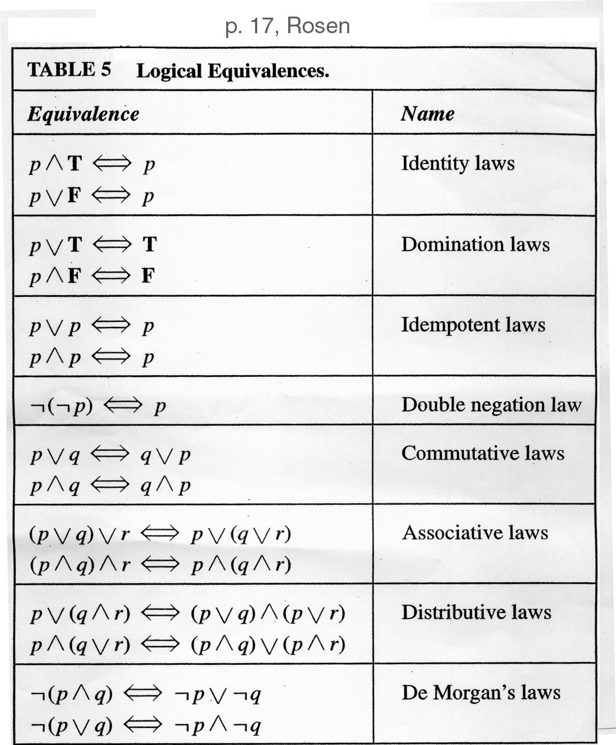
Tables of Logical Equivalences
    Identity laws
      Like adding 0
    Domination laws
      Like multiplying by 0
    Idempotent laws
      Delete redundancies
    Double negation
      “I don’t like you, not”
    Commutativity
      Like “x+y = y+x”
    Associativity
      Like “(x+y)+z = y+(x+z)”
    Distributivity
      Like “(x+y)z = xz+yz”
    De Morgan

Slide 32
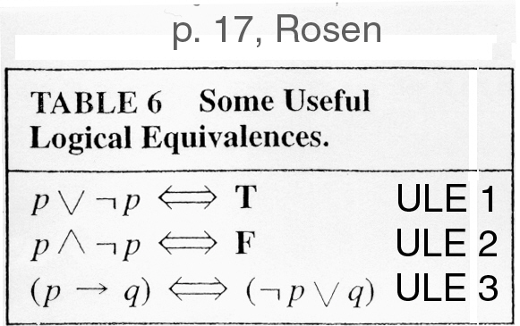
Tables of Logical Equivalences
    Excluded middle
    Negating creates opposite
    Definition of implication in terms of Not and Or

Slide 33
DeMorgan Identities
DeMorgan’s identities allow for simplification of negations of complex expressions
Conjunctional negation:
  ¬(p₁∧p₂∧…∧p_{n}) ⇔ (¬p₁∨¬p₂∨…∨¬p_{n})
  “It’s not the case that all are true iff one is false.”
Disjunctional negation:
  ¬(p₁∨p₂∨…∨p_{n}) ⇔ (¬p₁∧¬p₂∧…∧¬p_{n})
  “It’s not the case that one is true iff all are false.”

Slide 34
Tautology example (1.2.8.a) Part 2
Demonstrate that
[¬p ∧(p ∨q )]→q
is a tautology in two ways:
Using a truth table (did above)
Using a proof relying on Tables 5 and 6 of Rosen, section 1.2 to derive True through a series of logical equivalences

Slide 35
Tautology by proof
[¬p ∧(p ∨q )]→q

Slide 36
Tautology by proof
[¬p ∧(p ∨q )]→q
⇔ [(¬p ∧p)∨(¬p ∧q)]→q Distributive

Slide 37
Tautology by proof
[¬p ∧(p ∨q )]→q
⇔ [(¬p ∧p)∨(¬p ∧q)]→q Distributive
⇔ [ F ∨ (¬p ∧q)]→q ULE

Slide 38
Tautology by proof
[¬p ∧(p ∨q )]→q
⇔ [(¬p ∧p)∨(¬p ∧q)]→q Distributive
⇔ [ F ∨ (¬p ∧q)]→q ULE
⇔ [¬p ∧q ]→q Identity

Slide 39
Tautology by proof
[¬p ∧(p ∨q )]→q
⇔ [(¬p ∧p)∨(¬p ∧q)]→q Distributive
⇔ [ F ∨ (¬p ∧q)]→q ULE
⇔ [¬p ∧q ]→q Identity
⇔ ¬ [¬p ∧q ] ∨ q ULE

Slide 40
Tautology by proof
[¬p ∧(p ∨q )]→q
⇔ [(¬p ∧p)∨(¬p ∧q)]→q Distributive
⇔ [ F ∨ (¬p ∧q)]→q ULE
⇔ [¬p ∧q ]→q Identity
⇔ ¬ [¬p ∧q ] ∨ q ULE
⇔ [¬(¬p)∨ ¬q ] ∨ q DeMorgan

Slide 41
Tautology by proof
[¬p ∧(p ∨q )]→q
⇔ [(¬p ∧p)∨(¬p ∧q)]→q Distributive
⇔ [ F ∨ (¬p ∧q)]→q ULE
⇔ [¬p ∧q ]→q Identity
⇔ ¬ [¬p ∧q ] ∨ q ULE
⇔ [¬(¬p)∨ ¬q ] ∨ q DeMorgan
⇔ [p ∨ ¬q ] ∨ q Double Negation

Slide 42
Tautology by proof
[¬p ∧(p ∨q )]→q
⇔ [(¬p ∧p)∨(¬p ∧q)]→q Distributive
⇔ [ F ∨ (¬p ∧q)]→q ULE
⇔ [¬p ∧q ]→q Identity
⇔ ¬ [¬p ∧q ] ∨ q ULE
⇔ [¬(¬p)∨ ¬q ] ∨ q DeMorgan
⇔ [p ∨ ¬q ] ∨ q Double Negation
⇔ p ∨ [¬q ∨q ] Associative

Slide 43
Tautology by proof
[¬p ∧(p ∨q )]→q
⇔ [(¬p ∧p)∨(¬p ∧q)]→q Distributive
⇔ [ F ∨ (¬p ∧q)]→q ULE
⇔ [¬p ∧q ]→q Identity
⇔ ¬ [¬p ∧q ] ∨ q ULE
⇔ [¬(¬p)∨ ¬q ] ∨ q DeMorgan
⇔ [p ∨ ¬q ] ∨ q Double Negation
⇔ p ∨ [¬q ∨q ] Associative
⇔ p ∨ [q ∨¬q ] Commutative

Slide 44
Tautology by proof
[¬p ∧(p ∨q )]→q
⇔ [(¬p ∧p)∨(¬p ∧q)]→q Distributive
⇔ [ F ∨ (¬p ∧q)]→q ULE
⇔ [¬p ∧q ]→q Identity
⇔ ¬ [¬p ∧q ] ∨ q ULE
⇔ [¬(¬p)∨ ¬q ] ∨ q DeMorgan
⇔ [p ∨ ¬q ] ∨ q Double Negation
⇔ p ∨ [¬q ∨q ] Associative
⇔ p ∨ [q ∨¬q ] Commutative
⇔ p ∨ T ULE

Slide 45
Tautology by proof
[¬p ∧(p ∨q )]→q
⇔ [(¬p ∧p)∨(¬p ∧q)]→q Distributive
⇔ [ F ∨ (¬p ∧q)]→q ULE
⇔ [¬p ∧q ]→q Identity
⇔ ¬ [¬p ∧q ] ∨ q ULE
⇔ [¬(¬p)∨ ¬q ] ∨ q DeMorgan
⇔ [p ∨ ¬q ] ∨ q Double Negation
⇔ p ∨ [¬q ∨q ] Associative
⇔ p ∨ [q ∨¬q ] Commutative
⇔ p ∨ T ULE
⇔ T Domination

Slide 46
Examples for section 1.2
Worked out on the black-board.
“I don’t drink and drive” is logically equivalent to “If I drink, then I don’t drive”
Write a Java method that represents the compound proposition (p→q)←→r

