Slide 1
Functions;
Sequences, Sums, Countability
Zeph Grunschlag

Slide 2
Announcements
HW 2 is due
As explained last lecture, announcement went up over week-end moving last 3 problems to HW3.

Slide 3
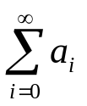
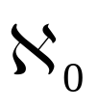
Agenda
Section 1.6: Functions
  Domain, co-domain, range
  Image, pre-image
  One-to-one, onto, bijective, inverse
  Functional composition and exponentiation
  Ceiling “⎡ ⎤” and floor “⎣ ⎦”
Section 1.7: Sequences and Sums
  Sequences a_{i}
  Summations
  Countable and uncountable sets

Slide 4
Functions
In high-school, functions are often identified with the formulas that define them.
EG: f (x ) = x ²
This point of view does not suffice in Discrete Math. In discrete math, functions are not necessarily defined over the real numbers.
EG: f (x ) = 1 if x is odd, and 0 if x is even.
So in addition to specifying the formula one needs to define the set of elements which are acceptable as inputs, and the set of elements into which the function outputs.

Slide 5
Functions. Basic-Terms.
DEF: A function f : A →B is given by a domain set A, a codomain set B, and a rule which for every element a of A, specifies a unique element f (a) in B. f (a) is called the image of a, while a is called the pre-image of f (a). The range (or image) of f is defined by
f (A) = {f (a) | a ∈ A }.

Slide 6
Functions. Basic-Terms.
EG: Let f : Z → R be given by f (x ) = x ²
Q1: What are the domain and co-domain?
Q2: What’s the image of -3 ?
Q3: What are the pre-images of 3, 4?
Q4: What is the range f (Z) ?

Slide 7
Functions. Basic-Terms.
f : Z → R is given by f (x ) = x ²
A1: domain is Z, co-domain is R
A2: image of -3 = f (-3) = 9
A3: pre-images of 3: none as √3 isn’t an integer!
pre-images of 4: -2 and 2
A4: range is the set of perfect squares
f (Z) = {0,1,4,9,16,25,…}

Slide 8
Functions and Java
Java: Functions are like non-void Java methods. The domain is the parameter type and the codomain is the return type. The image is the return value.
EG: int f(double x){
return x<0 ? –1 :
( x>0 ? 1 : 0 );
}
The domain is double the codomain is int.
Q: What does this function do?

Slide 9
Functions and Java
A: This is the signature function which returns the sign of a given number. The range of f is {-1,0,+1}.

Slide 10
Functions. Sub-ranges.
The effect of functions on subsets of the domain is often important.
DEF: Given a function f : A →B. The pre-image set (or inverse image) of b is defined by f ⁻¹(b) = {a ∈ A | f (a)=b }. Given subsets S ⊆ A and T ⊆ B, the image set of S is defined by f (S ) = {f(a ) | a ∈ S } and the pre-image set (or inverse image) of T is defined by
f ⁻¹(T ) = {a ∈ A | f (a)∈T }.
NOTE: Even when f is not invertible, the inverse image is defined!

Slide 11
Functions. Sub-ranges.
EG: f : Z → R with f (x ) = x ²
Q1: Calculate f ^{–1}(3)
Q2: Calculate f ^{–1}(4)
Q3: Calculate f ( {-9,-5,-3,0,1,2,3,4} )
Q4: Calculate
f ^{–1}({-9,-5,-3,0,0.25,1,2,2.25,3,4})

Slide 12
Functions. Sub-ranges.
EG: f : Z → R with f (x ) = x ²
A1: f ^{–1}(3) = ∅
A2: f ^{–1}(4) = {-2, 2}
A3: f ( {-9,-5,-3,0,1,2,3,4} )
= {81,25,9,0,1,4,16}
A4: f ^{–1}({-9,-5,-3,0,0.25,1,2,2.25,3,4})
= {0,-1,1,-2,2}

Slide 13
One-to-One, Onto, Bijection. Intuitively.
Represent functions using “node and arrow” notation:
One-to-One means that no clashes occur.
  BAD: a clash occurred, not 1-to-1
  GOOD: no clashes, is 1-to-1
Onto means that every possible output is hit
  BAD: 3rd output missed, not onto
  GOOD: everything hit, onto

Slide 14
One-to-One, Onto, Bijection. Intuitively.
Bijection means that when arrows reversed, a function results. Equivalently, that both one-to-one’ness and onto’ness occur.
  BAD: not 1-to-1. Reverse over-determined:
  BAD: not onto. Reverse under-determined:
  GOOD: Bijection. Reverse is a function:

Slide 15
One-to-One, Onto, Bijection. Formal Definition.
DEF: A function f : A →B is:
one-to-one (or injective) if different elements of A always result in different images in B.
onto (or surjective) if every element in B is hit by f. I.e., f (A ) = B.
a one-to-one correspondence (or a bijection, or invertible) if f is both one-to-one as well as onto.
If f is invertible, its inverse f ⁻¹ : B →A is well defined by taking the unique element in the pre-image of b, for each b ∈ B.
Notes:
Alternate definitions using cardinality of pre-image:
Injective: |f ⁻¹(b)| ≤ 1 for all b ∈ B.
Surjective: |f ⁻¹(b)|≥ 1 for all b ∈ B.
Bijective: |f ⁻¹(b)| = 1 for all b ∈ B.

Slide 16
One-to-One, Onto, Bijection. Examples.
Q: Which of the following are 1-to-1, onto, a bijection? If f is invertible, what is its inverse?
f : Z → R is given by f (x ) = x ²
f : Z → R is given by f (x ) = 2x
f : R → R is given by f (x ) = x ³
f : Z → N is given by f (x ) = |x |
f : {people} → {people} is given by f (x ) = the father of x.

Slide 17
One-to-One, Onto, Bijection. Examples.
f : Z → R, f (x ) = x ²: none
f : Z → Z, f (x ) = 2x : 1-1
f : R → R, f (x ) = x ³: 1-1, onto, bijection, inverse is f (x ) = x ^{(1/3)}
f : Z → N, f (x ) = |x |: onto
f (x ) = the father of x : none

Slide 18
Composition
When a function f spits out elements of the same kind that another function g eats, f and g may be composed by letting g immediately eat each output of f.
DEF: Suppose that g : A → B and f : B → C are functions. Then the composite
f •g : A → C is defined by setting
f •g (a) = f ( g (a) )

Slide 19
Composition. Examples.
Q: Compute g •f where
1. f : Z → R, f (x ) = x ²
and g : R → R, g (x ) = x ³
2. f : Z → Z, f (x ) = x + 1
and g = f ⁻¹ so g (x ) = x – 1
3. f : {people} → {people},
f (x ) = the father of x, and g = f

Slide 20
Composition. Examples.
1. f : Z → R, f (x ) = x ²
and g : R → R, g (x ) = x ³
f •g : Z → R , f •g (x ) = x ⁶
2. f : Z → Z, f (x ) = x + 1
and g = f ⁻¹
f •g (x ) = x (true for any function composed with its inverse)
3. f : {people} → {people},
f (x ) = g(x ) = the father of x
f •g (x ) = grandfather of x from father’s side

Slide 21
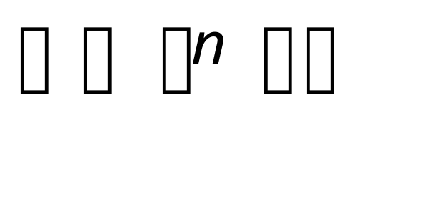
Repeated Composition
When the domain and codomain are equal, a function may be self composed. The composition may be repeated as much as desired resulting in functional exponentiation. The whole process is denoted by
f ^{n} (x ) = f •f •f •f • … •f (x )
where f appears n –times on the right side.
Q1: Given f : Z → Z, f (x ) = x ² find f ⁴
Q2: Given g : Z → Z, g (x ) = x + 1 find g ^{n}
Q3: Given h(x ) = the father of x, find h^{n}

Slide 22
Repeated Composition
A1: f : Z → Z, f (x ) = x ².
f ⁴(x ) = x ^{(2*2*2*2)} = x ¹⁶
A2: g : Z → Z, g (x ) = x + 1
g^{n} (x ) = x + n
A3: h (x ) = the father of x,
h^{n} (x ) = x ’s n’th patrilineal ancestor

Slide 23
Ceiling and Floor
This being a course on discrete math, it is often useful to discretize numbers, sets and functions. For this purpose the ceiling and floor functions come in handy.
DEF: Given a real number x : The floor of x is the biggest integer which is smaller or equal to x The ceiling of x is the smallest integer greater or equal to x.
NOTATION: floor(x) = ⎣x ⎦, ceiling(x) = ⎡x ⎤
Q: Compute ⎣1.7⎦, ⎣-1.7⎦, ⎡1.7⎤, ⎡-1.7⎤.

Slide 24
Ceiling and Floor
A: ⎣1.7⎦ = 1, ⎣-1.7⎦ = -2,
⎡1.7⎤ = 2, ⎡-1.7⎤ = -1
Q: What’s the difference between the floor function and the (int) casting function in Java?

Slide 25
Ceiling and Floor
A: Casting to int in Java always truncates towards 0. Ceiling and floor are not symmetric in this way.
EG: (int)(-1.7) == -1
⎣-1.7⎦ = -2

Slide 26
Example for section 1.6
Consider the function f : R² → R² defined by the formula
f (x,y ) = ( ax+by, cx+dy )
where a,b,c,d are constants. Give a condition on the constants which guarantees that f is one-to-one.
More detailed example

Slide 27
Sequences
Sequences are a way of ordering lists of objects. Java arrays are a type of sequence of finite size. Usually, mathematical sequences are infinite.
To give an ordering to arbitrary elements, one has to start with a basic model of order. The basic model to start with is the set
N = {0, 1, 2, 3, …} of natural numbers.
For finite sets, the basic model of size n is:
n = {1, 2, 3, 4, …, n-1, n }

Slide 28
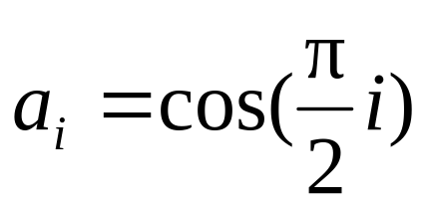
Sequences
DEF: Given a set S, an (infinite) sequence in S is a function N → S. A finite sequence in S is a function
n → S.
Symbolically, a sequence is represented using the subscript notation a_{i} . This gives a way of specifying formulaically
Note: Other sets can be taken as ordering models. The book often uses the positive numbers Z⁺ so counting starts at 1 instead of 0. I’ll usually assume the ordering model N.
Q: Give the first 5 terms of the sequence defined by the formula

Slide 29
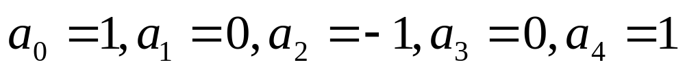
Sequence Examples
A: Plug in for i in sequence 0, 1, 2, 3, 4:
Formulas for sequences often represent patterns in the sequence.
Q: Provide a simple formula for each sequence:
3,6,11,18,27,38,51, …
0,2,8,26,80,242,728,…
1,1,2,3,5,8,13,21,34,…

Slide 30
Sequence Examples
A: Try to find the patterns between numbers.
3,6,11,18,27,38,51, …
a₁=6=3+3, a₂=11=6+5, a₃=18=11+7, … and in general a_{i +1} = a_{i} +(2i +3). This is actually a good enough formula. Later we’ll learn techniques that show how to get the more explicit formula:
a_{i} = 6 + 4(i –1) + (i –1)²
b) 0,2,8,26,80,242,728,…
If you add 1 you’ll see the pattern more clearly.
a_{i} = 3^{i} –1
1,1,2,3,5,8,13,21,34,…
This is the famous Fibonacci sequence given by
a_{i +1} = a_{i} + a_{i-1}

Slide 31
Bit Strings
Bit strings are finite sequences of 0’s and 1’s. Often there is enough pattern in the bit-string to describe its bits by a formula.
EG: The bit-string 1111111 is described by the formula a_{i} =1, where we think of the string of being represented by the finite sequence a₁a₂a₃a₄a₅a₆a₇
Q: What sequence is defined by
a₁ =1, a₂ =1 a_{i+2} = a_{i} ⊕a_{i+1}

Slide 32
Bit Strings
A: a₀ =1, a₁ =1 a_{i+2} = a_{i} ⊕a_{i+1}:
1,1,0,1,1,0,1,1,0,1,…

Slide 33
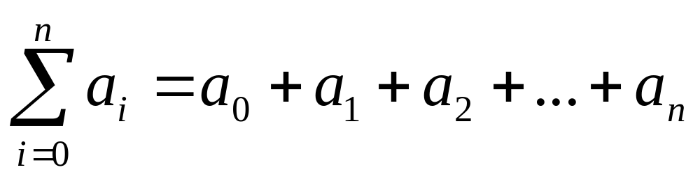
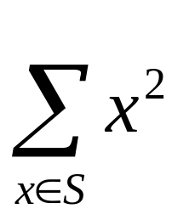
Summations
The symbol “Σ” takes a sequence of numbers and turns it into a sum.
Symbolically:
This is read as “the sum from i =0 to i =n of a_{i}”
Note how “Σ” converts commas into plus signs.
One can also take sums over a set of numbers:

Slide 34
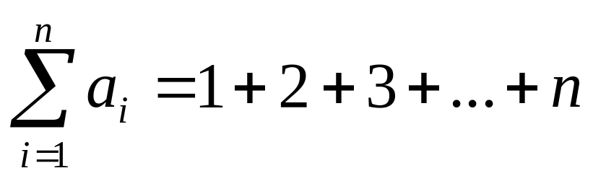
Summations
EG: Consider the identity sequence
a_{i} = i
Or listing elements: 0, 1, 2, 3, 4, 5,…
The sum of the first n numbers is given by:
(The first term 0 is dropped)

Slide 35
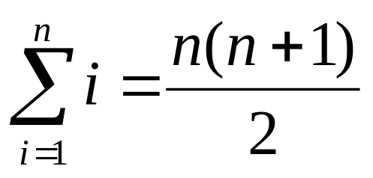
Summation Formulas –Arithmetic
There is an explicit formula for the previous:
Intuitive reason: The smallest term is 1, the biggest term is n so the avg. term is (n+1)/2. There are n terms. To obtain the formula simply multiply the average by the number of terms.

Slide 36
Summation Formulas – Geometric
Geometric sequences are number sequences with a fixed constant of proportionality r between consecutive terms. For example:
2, 6, 18, 54, 162, …
Q: What is r in this case?

Slide 37
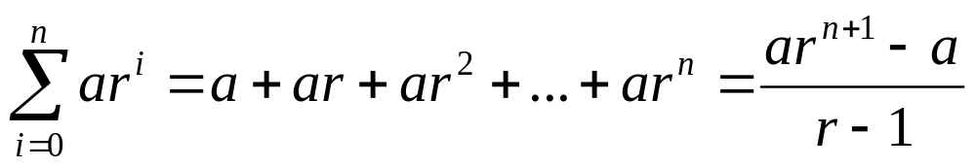
Summation Formulas
2, 6, 18, 54, 162, …
A: r = 3.
In general, the terms of a geometric sequence have the form
a_{i} = a r ^{i}
where a is the 1st term when i starts at 0.
A geometric sum is a sum of a portion of a geometric sequence and has the following explicit formula:

Slide 38
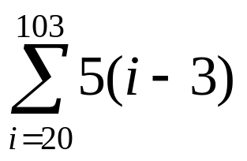
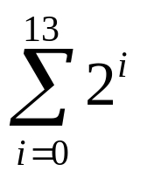
Summation Examples
If you are curious about how one could prove such formulas, your curiosity will soon be “satisfied” as you will become adept at proving such formulas a few lectures from now!
Q: Use the previous formulas to evaluate each of the following

Slide 39
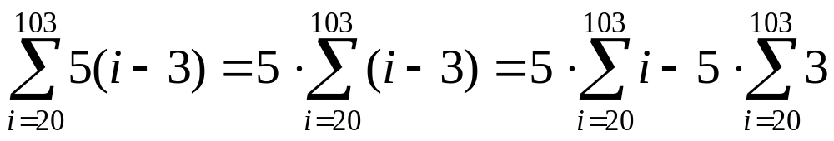
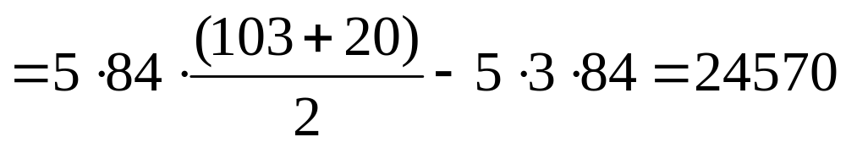
Summation Examples
A:
Use the arithmetic sum formula and additivity of summation:

Slide 40
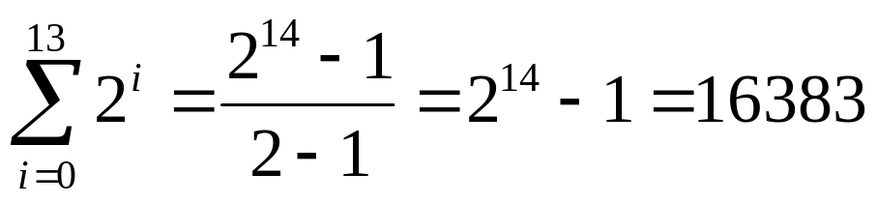
Summation Examples
A:
2. Apply the geometric sum formula directly by setting a = 1 and r = 2:

Slide 41


Cardinality and Countability
Up to now cardinality has been the number of elements in a finite sets. Really, cardinality is a much deeper concept. Cardinality allows us to generalize the notion of number to infinite collections and it turns out that many type of infinities exist.
EG:
  {☺,☹}
  { , }
  {Ø , {Ø,{Ø,{Ø}}} }
These all share “2-ness”.

Slide 42
Cardinality and Countability
For finite sets, can just count the elements to get cardinality. Infinite sets are harder.
First Idea: Can tell which set is bigger by seeing if one contains the other.
  {1, 2, 4} ⊂ N
  {0, 2, 4, 6, 8, 10, 12, …} ⊂ N
So set of even numbers ought to be smaller than the set of natural number because of strict containment.
Q: Any problems with this?

Slide 43
Cardinality and Countability
A: Set of even numbers is obtained from N by multiplication by 2. I.e.
{even numbers} = 2•N
For finite sets, since multiplication by 2 is a one-to-one function, the size doesn’t change.
EG: {1,7,11} – ×2 → {2,14,22}
Another problem: set of even numbers is disjoint from set of odd numbers. Which one is bigger?

Slide 44
Cardinality and Countability – Finite Sets
DEF: Two sets A and B have the same cardinality if there’s a bijection
f : A → B
For finite sets this is the same as the old definition:
{☺,☹}
{ , }

Slide 45
Cardinality and Countability – Infinite Sets
But for infinite sets…
…there are surprises.
DEF: If S is finite or has the same cardinality as N, S is called countable.
Notation, the Hebrew letter Aleph is often used to denote infinite cardinalities. Countable sets are said to have cardinality .
Intuitively, countable sets can be counted in the sense that if you allocate 1 second to count each member, eventually any particular member will be counted after a finite time period. Paradoxically, you won’t be able to count the whole set in a finite time period!

Slide 46
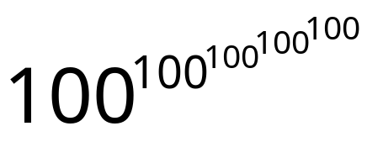
Countability – Examples
Q: Why are the following sets countable?
{0,2,4,6,8,…}
{1,3,5,7,9,…}
{1,3,5,7, }
Z

Slide 47
Countability – Examples
{0,2,4,6,8,…}: Just set up the bijection f (n ) = 2n
{1,3,5,7,9,…} : Because of the bijection f (n ) = 2n + 1
{1,3,5,7, } has cardinality 5 so is therefore countable
Z: This one is more interesting. Continue on next page:

Slide 48
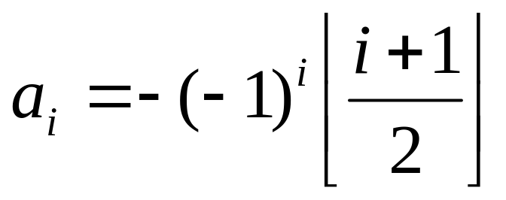
Countability of the Integers
Let’s try to set up a bijection between N and Z. One way is to just write a sequence down whose pattern shows that every element is hit (onto) and none is hit twice (one-to-one). The most common way is to alternate back and forth between the positives and negatives. I.e.:
0,1,-1,2,-2,3,-3,…
It’s possible to write an explicit formula down for this sequence which makes it easier to check for bijectivity:

Slide 49
Demonstrating Countability. Useful Facts
Because is the smallest kind of infinity, it turns out that to show that a set is countable one can either demonstrate an injection into N or a surjection from N.
THM: Suppose A is a set. If there is an one-to-one function f : A → N, or there is an onto function g : N → A then A is countable.
The proof requires the principle of mathematical induction, which we’ll get to at a later date.
Notes:
the “axiom of choice” is the needed axiom ----but that’s outside the scope of this course

Slide 50
Uncountable Sets
But R is uncountable (“not countable”)
Q: Why not ?

Slide 51
Uncountability of R
A: This is not a trivial matter. Here are some typical reasonings:
R strictly contains N so has bigger cardinality. What’s wrong with this argument?
R contains infinitely many numbers between any two numbers. Surprisingly, this is not a valid argument. Q has the same property, yet is countable.
Many numbers in R are infinitely complex in that they have infinite decimal expansions. An infinite set with infinitely complex numbers should be bigger than N.

Slide 52
Uncountability of R
Last argument is the closest.
Here’s the real reason: Suppose that R were countable. In particular, any subset of R, being smaller, would be countable also. So the interval [0,1] would be countable. Thus it would be possible to find a bijection from Z⁺ to [0,1] and hence list all the elements of [0,1] in a sequence.
What would this list look like?
r₁ , r₂ , r₃ , r₄ , r₅ , r₆ , r₇, …

Slide 53
Uncountability of R
Cantor’s Diabolical Diagonal
So we have this list
r₁ , r₂ , r₃ , r₄ , r₅ , r₆ , r₇, …
supposedly containing every real number between 0 and 1.
Cantor’s diabolical diagonalization argument will take this supposed list, and create a number between 0 and 1 which is not on the list. This will contradict the countability assumption hence proving that R is not countable.

Slide 54
Cantor's Diagonalization Argument
← Decimal expansions of r_{i} →
r₁ | 0.
r₂ | 0.
r₃ | 0.
r₄ | 0.
r₅ | 0.
r₆ | 0.
r₇ | 0.
:
r_{evil} | 0.

Slide 55
Cantor's Diagonalization Argument
← Decimal expansions of r_{i} →
r₁ | 0. | 1 | 2 | 3 | 4 | 5 | 6 | 7
r₂ | 0.
r₃ | 0.
r₄ | 0.
r₅ | 0.
r₆ | 0.
r₇ | 0.
:
r_{evil} | 0.

Slide 56
Cantor's Diagonalization Argument
← Decimal expansions of r_{i} →
r₁ | 0. | 1 | 2 | 3 | 4 | 5 | 6 | 7
r₂ | 0. | 1 | 1 | 1 | 1 | 1 | 1 | 1
r₃ | 0.
r₄ | 0.
r₅ | 0.
r₆ | 0.
r₇ | 0.
:
r_{evil} | 0.

Slide 57
Cantor's Diagonalization Argument
← Decimal expansions of r_{i} →
r₁ | 0. | 1 | 2 | 3 | 4 | 5 | 6 | 7
r₂ | 0. | 1 | 1 | 1 | 1 | 1 | 1 | 1
r₃ | 0. | 2 | 5 | 4 | 2 | 0 | 9 | 0
r₄ | 0.
r₅ | 0.
r₆ | 0.
r₇ | 0.
:
r_{evil} | 0.

Slide 58
Cantor's Diagonalization Argument
← Decimal expansions of r_{i} →
r₁ | 0. | 1 | 2 | 3 | 4 | 5 | 6 | 7
r₂ | 0. | 1 | 1 | 1 | 1 | 1 | 1 | 1
r₃ | 0. | 2 | 5 | 4 | 2 | 0 | 9 | 0
r₄ | 0. | 7 | 8 | 9 | 0 | 6 | 2 | 3
r₅ | 0.
r₆ | 0.
r₇ | 0.
:
r_{evil} | 0.

Slide 59
Cantor's Diagonalization Argument
← Decimal expansions of r_{i} →
r₁ | 0. | 1 | 2 | 3 | 4 | 5 | 6 | 7
r₂ | 0. | 1 | 5 | 1 | 1 | 1 | 1 | 1
r₃ | 0. | 2 | 5 | 4 | 2 | 0 | 9 | 0
r₄ | 0. | 7 | 8 | 9 | 0 | 6 | 2 | 3
r₅ | 0. | 0 | 1 | 1 | 0 | 1 | 0 | 1
r₆ | 0.
r₇ | 0.
:
r_{evil} | 0.

Slide 60
Cantor's Diagonalization Argument
← Decimal expansions of r_{i} →
r₁ | 0. | 1 | 2 | 3 | 4 | 5 | 6 | 7
r₂ | 0. | 1 | 5 | 1 | 1 | 1 | 1 | 1
r₃ | 0. | 2 | 5 | 4 | 2 | 0 | 9 | 0
r₄ | 0. | 7 | 8 | 9 | 0 | 6 | 2 | 3
r₅ | 0. | 0 | 1 | 1 | 0 | 1 | 0 | 1
r₆ | 0. | 5 | 5 | 5 | 5 | 5 | 5 | 5
r₇ | 0.
:
r_{evil} | 0.

Slide 61
Cantor's Diagonalization Argument
← Decimal expansions of r_{i} →
r₁ | 0. | 1 | 2 | 3 | 4 | 5 | 6 | 7
r₂ | 0. | 1 | 5 | 1 | 1 | 1 | 1 | 1
r₃ | 0. | 2 | 5 | 4 | 2 | 0 | 9 | 0
r₄ | 0. | 7 | 8 | 9 | 0 | 6 | 2 | 3
r₅ | 0. | 0 | 1 | 1 | 0 | 1 | 0 | 1
r₆ | 0. | 5 | 5 | 5 | 5 | 5 | 5 | 5
r₇ | 0. | 7 | 6 | 7 | 9 | 5 | 4 | 4
:
r_{evil} | 0.

Slide 62
Cantor's Diagonalization Argument
← Decimal expansions of r_{i} →
r₁ | 0. | 1 | 2 | 3 | 4 | 5 | 6 | 7
r₂ | 0. | 1 | 5 | 1 | 1 | 1 | 1 | 1
r₃ | 0. | 2 | 5 | 4 | 2 | 0 | 9 | 0
r₄ | 0. | 7 | 8 | 9 | 0 | 6 | 2 | 3
r₅ | 0. | 0 | 1 | 1 | 0 | 1 | 0 | 1
r₆ | 0. | 5 | 5 | 5 | 5 | 5 | 5 | 5
r₇ | 0. | 7 | 6 | 7 | 9 | 5 | 4 | 4
:
r_{evil} | 0. | 5 | 4 | 5 | 5 | 5 | 4 | 5

Slide 63
Uncountability of R
Cantor’s Diabolical Diagonal
GENERALIZE: To construct a number not on the list “r_{evil}”, let r_{i,j} be the j ’th decimal digit in the fractional part of r_{i}.
Define the digits of r_{evil} by the following rule:
The j ’th digit of r_{evil} is 5 if r_{i,j} ≠ 5. Otherwise the j’ ’th digit is set to be 4.
This guarantees that r_{evil} is an anti-diagonal. I.e., it does not share any elements on the diagonal. But every number on the list contains a diagonal element. This proves that it cannot be on the list and contradicts our assumption that R was countable so the list must contain r_{evil}. //QED

Slide 64
Impossible Computations
Notice that the set of all bit strings is countable. Here’s how the list looks:
0,1,00,01,10,11,000,001,010,011,100,101,110,111,0000,…
DEF: A decimal number
0.d₁d₂d₃d₄d₅d₆d₇…
Is said to be computable if there is a computer program that outputs a particular digit upon request.
EG:
0.11111111…
0.12345678901234567890…
0.10110111011110….

Slide 65
Impossible Computations
CLAIM: There are numbers which cannot be computed by any computer.
Proof : It is well known that every computer program may be represented by a bit-string (after all, this is how it’s stored inside). Thus a computer program can be thought of as a bit-string. As there are
bit-strings yet R is uncountable, there can be no onto function from computer programs to decimal numbers. In particular, most numbers do not correspond to any computer program so are incomputable!

Slide 66
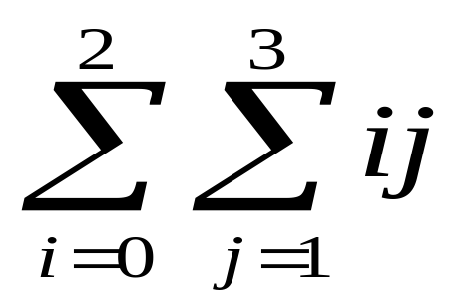
Section 1.7 Blackboard Exercises
1.7.17(d) Evaluate the double summation:
1.7.33: Show that if A is uncountable and B is countable then A-B is uncountable.

