Slide 1
Algorithms and Complexity
Zeph Grunschlag

Slide 2
Agenda
Section 2.1: Algorithms
  Pseudocode
  Recursive Algorithms (Section 3.4)
Section 2.2: Complexity of Algorithms
Section 1.8: Growth of Functions
  Big-O
  Big-Ω (Omega)
  Big-Θ (Theta)

Slide 3
Section 2.1
Algorithms and Pseudocode
DEF: An algorithm is a finite set of precise instructions for performing a computation or solving a problem.
Synonyms for a algorithm are: program, recipe, procedure, and many others.

Slide 4
Pseudo-Java
Possible alternative to text’s pseudo-Java
Start with “real” Java and simplify:
int f(int[] a){
int x = a[0];
for(int i=1; i<a.length; i++){
if(x > a[i])
x = a[i];
}
return x;
}

Slide 5
Pseudo-Java
Version 1
integer f(integer_array (a₁, a₂, …, a_{n}) ){
x = a₁
for(i =2 to n){
if(x > a_{i})
x = a_{i}
}
return x
}

Slide 6
Pseudo-Java version 2
INPUT: integer_array V = (a₁, a₂, …, a_{n})
begin
x = a₁
for(y ∈ V)
if(x > y)
x = y
end
OUTPUT: x

Slide 7
Algorithm for Surjectivity
boolean isOnto( function f: (1, 2,…, n) → (1, 2,…, m) ){
if( m > n ) return false // can’t be onto
soFarIsOnto = true
for( j = 1 to m ){
soFarIsOnto = false
for(i = 1 to n ){
if ( f(i ) == j )
soFarIsOnto = true
if( !soFarIsOnto ) return false;
}
}
return true;
}

Slide 8
Improved Algorithm for Surjectivity
boolean isOntoB( function f: (1, 2,…, n) → (1, 2,…, m) ){
if( m > n ) return false // can’t be onto
for( j = 1 to m )
beenHit[ j ] = false; // does f ever output j ?
for(i = 1 to n )
beenHit[ f(i ) ] = true;
for(j = 1 to m )
if( !beenHit[ j ] )
return false;
return true;
}

Slide 9
Recursive Algorithms
(Section 3.4)
“Real” Java:
long factorial(int n){
if (n<=0) return 1;
return n*factorial(n-1);
}
Notes:
n<=0 is used instead of n==0 because Java’s long is signed, and we don’t want the program to crash or enter an infinite loop for negative numbers. Exceptions handling would be more appropriate here, but this is well beyond the scope of 3203.

Slide 10

Recursive Algorithms
long factorial(int n){
if (n<=0) return 1;
return n*factorial(n-1);
}
Compute 5!

Slide 11
Recursive Algorithms
long factorial(int n){
if (n<=0) return 1;
return n*factorial(n-1);
}
f(5)=5·f(4)

Slide 12
Recursive Algorithms
long factorial(int n){
if (n<=0) return 1;
return n*factorial(n-1);
}
f(4)=4·f(3) | f(5)=5·f(4)

Slide 13
Recursive Algorithms
long factorial(int n){
if (n<=0) return 1;
return n*factorial(n-1);
}
f(3)=3·f(2) | f(4)=4·f(3) | f(5)=5·f(4)

Slide 14
Recursive Algorithms
long factorial(int n){
if (n<=0) return 1;
return n*factorial(n-1);
}
f(2)=2·f(1) | f(3)=3·f(2) | f(4)=4·f(3) | f(5)=5·f(4)

Slide 15
Recursive Algorithms
long factorial(int n){
if (n<=0) return 1;
return n*factorial(n-1);
}
f(1)=1·f(0) | f(2)=2·f(1) | f(3)=3·f(2) | f(4)=4·f(3) | f(5)=5·f(4)

Slide 16
Recursive Algorithms
long factorial(int n){
if (n<=0) return 1;
return n*factorial(n-1);
}
f(0)= 1→ | f(1)=1·f(0) | f(2)=2·f(1) | f(3)=3·f(2) | f(4)=4·f(3) | f(5)=5·f(4)

Slide 17
Recursive Algorithms
long factorial(int n){
if (n<=0) return 1;
return n*factorial(n-1);
}
1·1= 1→ | f(2)=2·f(1) | f(3)=3·f(2) | f(4)=4·f(3) | f(5)=5·f(4)

Slide 18
Recursive Algorithms
long factorial(int n){
if (n<=0) return 1;
return n*factorial(n-1);
}
2·1= 2→ | f(3)=3·f(2) | f(4)=4·f(3) | f(5)=5·f(4)

Slide 19
Recursive Algorithms
long factorial(int n){
if (n<=0) return 1;
return n*factorial(n-1);
}
3·2= 6→ | f(4)=4·f(3) | f(5)=5·f(4)

Slide 20
Recursive Algorithms
long factorial(int n){
if (n<=0) return 1;
return n*factorial(n-1);
}
4·6= 24→ | f(5)=5·f(4)

Slide 21
Recursive Algorithms
long factorial(int n){
if (n<=0) return 1;
return n*factorial(n-1);
}
5·24= 120→

Slide 22
Recursive Algorithms
long factorial(int n){
if (n<=0) return 1;
return n*factorial(n-1);
}
Return 5! = 120

Slide 23
Section 2.2
Algorithmic Complexity
Compare the running time of 2 previous algorithms for testing surjectivity.
Measure running time by counting the number of “basic operations”.

Slide 24
Running Time
Basic steps—
  Assignment Increment
  Comparison Negation
  Return Random array access
  Function output access etc.
In a particular problem, may tell you to consider other operations (e.g. multiplication) and ignore all others

Slide 25
Running time of 1st algorithm
boolean isOnto( function f: (1, 2,…, n) → (1, 2,…, m) ){
if( m > n ) return false soFarIsOnto = true
for( j = 1 to m ){
soFarIsOnto = false
for(i = 1 to n ){
if ( f(i ) == j )
soFarIsOnto = true
if( !soFarIsOnto )
return false
}
}
return true;
}
1 step OR:
1 step (assigment)
m loops: 1 increment plus
1 step (assignment)
n loops: 1 increment plus
1 step possibly leads to:
1 step (assignment)
1 step possibly leads to:
1 step (return)
possibly 1 step

Slide 26
Running time of 1st algorithm
1 step (m>n) OR:
1 step (assigment)
m loops: 1 increment plus
1 step (assignment)
n loops: 1 increment plus
1 step possibly leads to:
1 step (assignment)
1 step possibly leads to:
1 step (return)
possibly 1 step
WORST-CASE running time:
Number of steps = 1 OR 1+
1 +
m ·
(1+ 1 +
n ·
(1+1
+ 1
+ 1
+ 1
)
+ 1
)
= 1 (if m>n) OR 5mn+3m+2

Slide 27
Running time of 2nd algorithm
boolean isOntoB( function f: (1, 2,…, n) → (1, 2,…, m) ){
if( m > n ) return false
for( j = 1 to m )
beenHit[ j ] = false
for(i = 1 to n )
beenHit[ f(i ) ] = true
for(j = 1 to m )
if( !beenHit[ j ] )
return false
return true
}
1 step OR:
m loops: 1 increment plus
1 step (assignment)
n loops: 1 increment plus
1 step (assignment)
m loops: 1 increment plus
1 step possibly leads to:
1 step
possibly 1 step
.

Slide 28
Running time of 2nd algorithm
1 step (m>n) OR:
m loops: 1 increment plus
1 step (assignment)
n loops: 1 increment plus
1 step (assignment)
m loops: 1 increment plus
1 step possibly leads to:
1 step
possibly 1 step
.
WORST-CASE running time:
Number of steps = 1 OR 1+
m · (1+
1)
+ n · (1+
1 )
+ m · (1+
1
+ 1)
+ 1
= 1 (if m>n) OR 5m + 2n + 2

Slide 29
Comparing Running Times
At most 5mn+3m+2 for first algorithm
At most 5m+2n+2 for second algorithm
Worst case when m ≤ n so replace m by n:
5n ²+3n+2 vs. 8n+2
To tell which is better, look at dominant term:
5n ²+3n+2 vs. 8n+2
So second algorithm is better.

Slide 30
Comparing Running Times.
Issues
5n ²+3n+2 , 8n+2 are more than just their biggest term. Consider n = 1.
Number of “basic steps” doesn’t give accurate running time.
Actual running time depends on platform.
Overestimated number of steps: under some conditions, portions of code will not be seen.

Slide 31
Running Times Issues
Big-O Response
Asymptotic notation (Big-O, Big-Ω , Big-Θ) gives partial resolution to problems:
For large n the largest term dominates so 5n ²+3n+2 is modeled by just n ².

Slide 32
Running Times Issues
Big-O Response
Asymptotic notation (Big-O, Big-Ω , Big-Θ) gives partial resolution to problems:
Different lengths of basic steps, just change 5n ² to Cn ² for some constant, so doesn’t change largest term

Slide 33
Running Times Issues
Big-O Response
Asymptotic notation (Big-O, Big-Ω , Big-Θ) gives partial resolution to problems:
Basic operations on different (but well-designed) platforms will differ by a constant factor. Again, changes 5n ² to Cn ² for some constant.

Slide 34
Running Times Issues
Big-O Response
Asymptotic notation (Big-O, Big-Ω , Big-Θ) gives partial resolution to problems:
Even if overestimated by assuming iterations of while-loops that never occurred, may still be able to show that overestimate only represents different constant multiple of largest term.

Slide 35
Worst Case vs. Average Case
Worst case complexity: provides absolute guarantees for time a program will run. The worst case complexity as a function of n is longest possible time for any input of size n.
Average case complexity: suitable if small function is repeated often or okay to take a long time –very rarely. The average case as a function of n is the avg. complexity over all possible inputs of that length.
Avg. case complexity analysis usually requires probability theory. (Delayed till later)

Slide 36
Section 1.8
Big-O, Big-Ω, Big-Θ
Useful for computing algorithmic complexity, i.e. the amount of time that it takes for computer program to run.

Slide 37
Notational Issues
Big-O notation is a way of comparing functions. Notation unconventional:
EG: 3x ³ + 5x ² – 9 = O (x ³)
Doesn’t mean
“3x ³ + 5x ² – 9 equals the function O (x ³)”
Which actually means
“3x ³+5x ² –9 is dominated by x ³”
Read as: “3x ³+5x ² –9 is big-Oh of x ³”

Slide 38
Intuitive Notion of Big-O
Asymptotic notation captures behavior of functions for large values of x.
EG: Dominant term of 3x ³+5x ² –9 is x ³.
As x becomes larger and larger, other terms become insignificant and only x ³ remains in the picture:

Slide 39
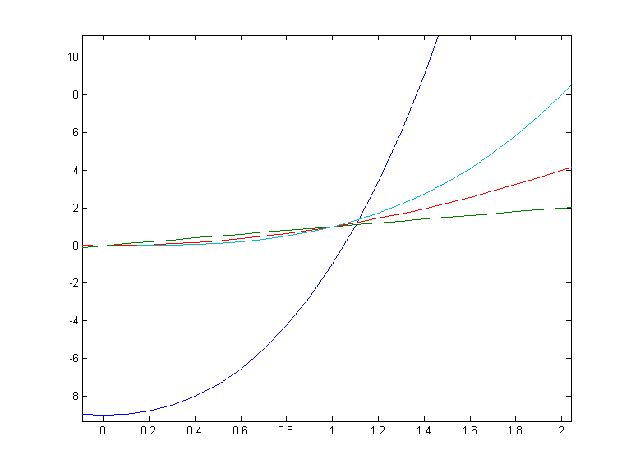
Intuitive Notion of Big-O domain – [0,2]
y = 3x ³+5x ² –9
y = x ³
y = x ²
y = x

Slide 40
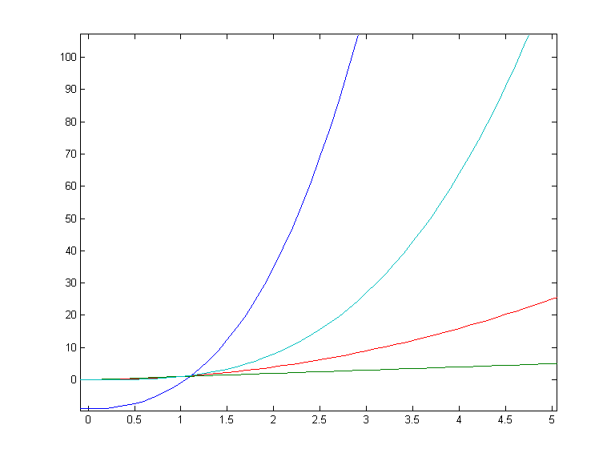
Intuitive Notion of Big-O domain – [0,5]
y = 3x ³+5x ² –9
y = x ³
y = x ²
y = x

Slide 41
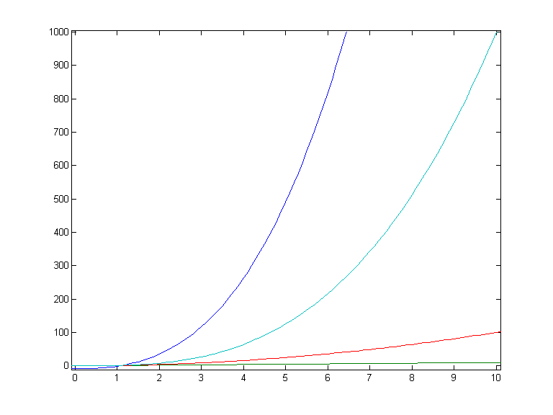
Intuitive Notion of Big-O domain – [0,10]
y = 3x ³+5x ² –9
y = x ³
y = x ²
y = x

Slide 42
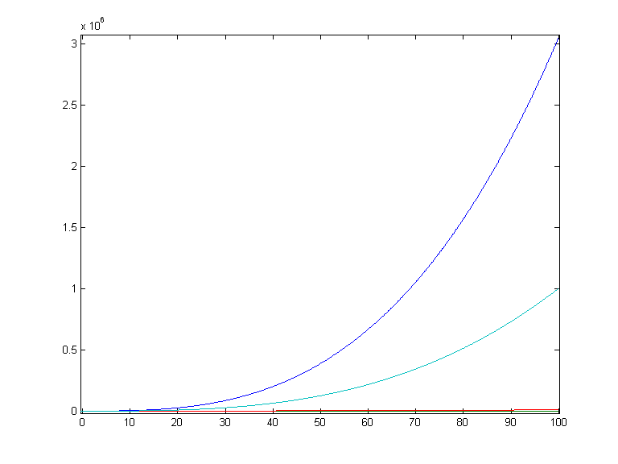
Intuitive Notion of Big-O domain – [0,100]
y = 3x ³+5x ² –9
y = x ³
y = x ²
y = x

Slide 43
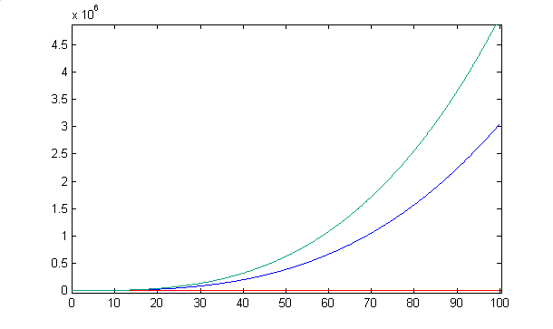
Intuitive Notion of Big-O
In fact, 3x ³+5x ² –9 is smaller than 5x ³ for large enough values of x:
y = 5x ³
y = 3x ³+5x ² –9
y = x ²
y = x

Slide 44
Big-O. Formal Definition
f (x ) is asymptotically dominated by g (x ) if there’s a constant multiple of g (x ) bigger than f (x ) as x goes to infinity:
DEF: Let f , g be functions with domain R_{≥0} or N and codomain R. If there are constants C and k such
∀ x > k, |f (x )| ≤ C ⋅ |g (x )|
then we write:
f (x ) = O ( g (x ) )

Slide 45
Common Misunderstanding
It’s true that 3x ³ + 5x ² – 9 = O (x ³) as we’ll prove shortly. However, also true are:
  3x ³ + 5x ² – 9 = O (x ⁴)
  x ³ = O (3x ³ + 5x ² – 9)
  sin(x) = O (x ⁴)
NOTE: C.S. usage of big-O typically involves mentioning only the most dominant term.
“The running time is O (x ^{2.5})”
Mathematically big-O is more subtle.

Slide 46
Big-O. Example
EG: Show that 3x ³ + 5x ² – 9 = O (x ³).
Previous graphs show C = 5 good guess.
Find k so that
3x ³ + 5x ² – 9 ≤ 5x ³
for x > k
Notes:
As was mentioned in class by a student, there is a simpler proof:
For x > 1, 3x ³ + 5x ² – 9 < 5x ³ + 5x ² < 5x ³ + 5x ³ = 10x ³
Therefore let C=10 and k=1 in the definition of big-O to complete the proof

Slide 47
EG: Show that
3x ³ + 5x ² – 9 = O (x ³).
Find k so that
3x ³ + 5x ² – 9 ≤ 5x ³
for x > k
Collect terms: 5x ² ≤ 2x ³ + 9

Slide 48
EG: Show that
3x ³ + 5x ² – 9 = O (x ³).
Find k so that
3x ³ + 5x ² – 9 ≤ 5x ³
for x > k
Collect terms: 5x ² ≤ 2x ³ + 9
What k will make 5x ² ≤ x ³ for x > k ?

Slide 49
EG: Show that
3x ³ + 5x ² – 9 = O (x ³).
Find k so that
3x ³ + 5x ² – 9 ≤ 5x ³
for x > k
Collect terms: 5x ² ≤ 2x ³ + 9
What k will make 5x ² ≤ x ³ for x > k ?
k = 5 !

Slide 50
EG: Show that
3x ³ + 5x ² – 9 = O (x ³).
Find k so that
3x ³ + 5x ² – 9 ≤ 5x ³
for x > k
Collect terms: 5x ² ≤ 2x ³ + 9
What k will make 5x ² ≤ x ³ for x > k ?
k = 5 !
So for x > 5, 5x ² ≤ x ³ ≤ 2x ³ + 9

Slide 51
EG: Show that
3x ³ + 5x ² – 9 = O (x ³).
Find k so that
3x ³ + 5x ² – 9 ≤ 5x ³
for x > k
Collect terms: 5x ² ≤ 2x ³ + 9
What k will make 5x ² ≤ x ³ for x > k ?
k = 5 !
So for x > 5, 5x ² ≤ x ³ ≤ 2x ³ + 9
Solution: C = 5, k = 5 (not unique!)

Slide 52
EG: Show that
3x ³ + 5x ² – 9 = O (x ³).
Find k so that
3x ³ + 5x ² – 9 ≤ 5x ³
for x > k
Collect terms: 5x ² ≤ 2x ³ + 9
What k will make 5x ² ≤ x ³ for x > k ?
k = 5 !
So for x > 5, 5x ² ≤ x ³ ≤ 2x ³ + 9
Solution: C = 5, k = 5 (not unique!)

Slide 53
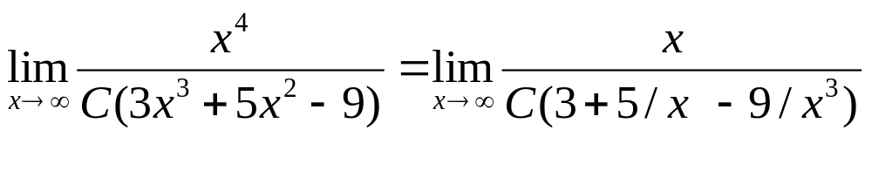
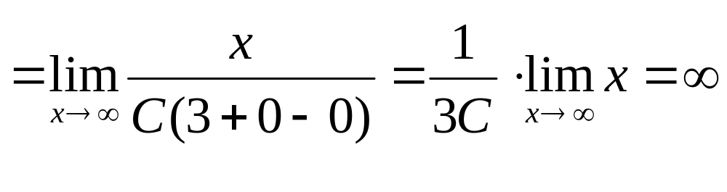
Big-O. Negative Example
x ⁴ ≠ O (3x ³ + 5x ² – 9) :
No pair C, k exist for which x > k implies C (3x ³ + 5x ² – 9) ≥ x ⁴
Argue using limits:
x ⁴ always catches up regardless of C. 

Slide 54
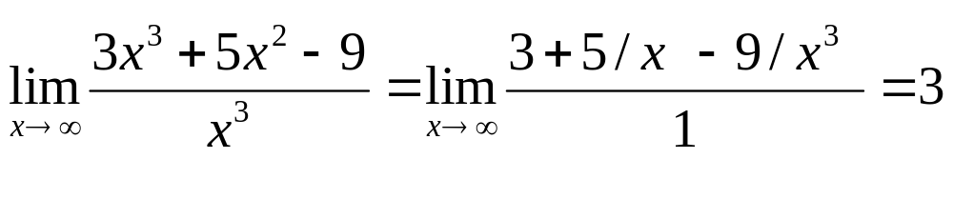
Big-O and limits
LEMMA: If the limit as x → ∞ of the quotient |f (x) / g (x)| exists then f (x ) = O ( g (x ) ).
EG: 3x ³ + 5x ² – 9 = O (x ³ ). Compute:
…so big-O relationship proved.

Slide 55
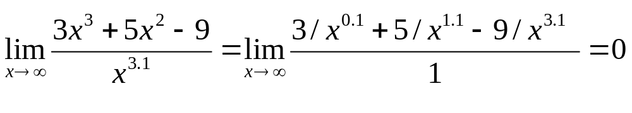
Little-o and limits
DEF: If the limit as x → ∞ of the quotient |f (x) / g (x)| = 0 then f (x ) = o (g (x ) ).
EG: 3x ³ + 5x ² – 9 = o (x ^{3.1} ). Compute:

Slide 56
Big-Ω and Big-Θ
Big-Ω: reverse of big-O. I.e.
f (x ) = Ω(g (x )) ←→ g (x ) = O (f (x ))
so f (x ) asymptotically dominates g (x ).
Big-Θ: domination in both directions. I.e.
f (x ) = Θ(g (x ))
←→
f (x ) = O (g (x )) ∧ f (x ) = Ω(g (x ))
Synonym for f = Θ(g): “f is of order g ”

Slide 57
Useful facts
Any polynomial is big-Θ of its largest term
  EG: x ⁴/100000 + 3x ³ + 5x ² – 9 = Θ(x ⁴)
The sum of two functions is big-O of the biggest
  EG: x ⁴ ln(x ) + x ⁵ = O (x ⁵)
Non-zero constants are irrelevant:
  EG: 17x ⁴ ln(x ) = O (x ⁴ ln(x ))

Slide 58
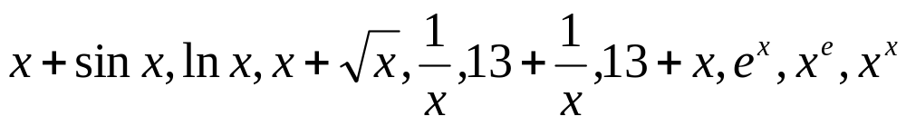
Big-O, Big-Ω, Big-Θ. Examples
Q: Order the following from smallest to largest asymptotically. Group together all functions which are big-Θ of each other:

Slide 59
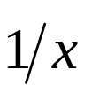
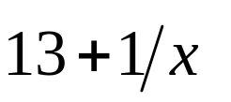

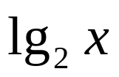
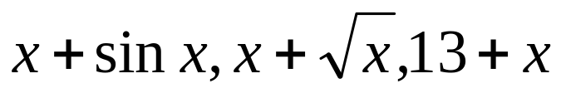

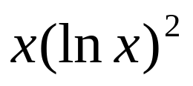

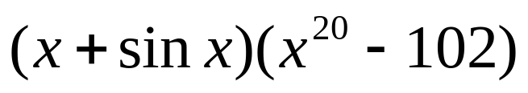


Big-O, Big-Ω, Big-Θ. Examples
A:
1.
2.
3. , (change of base formula)
4.
5.
6.
7.
8.
9.
10.

Slide 60
Incomparable Functions
Given two functions f (x ) and g (x ) it is not always the case that one dominates the other so that f and g are asymptotically incomparable.
E.G:
f (x) = |x ² sin(x)| vs. g (x) = 5x ^{1.5}

Slide 61
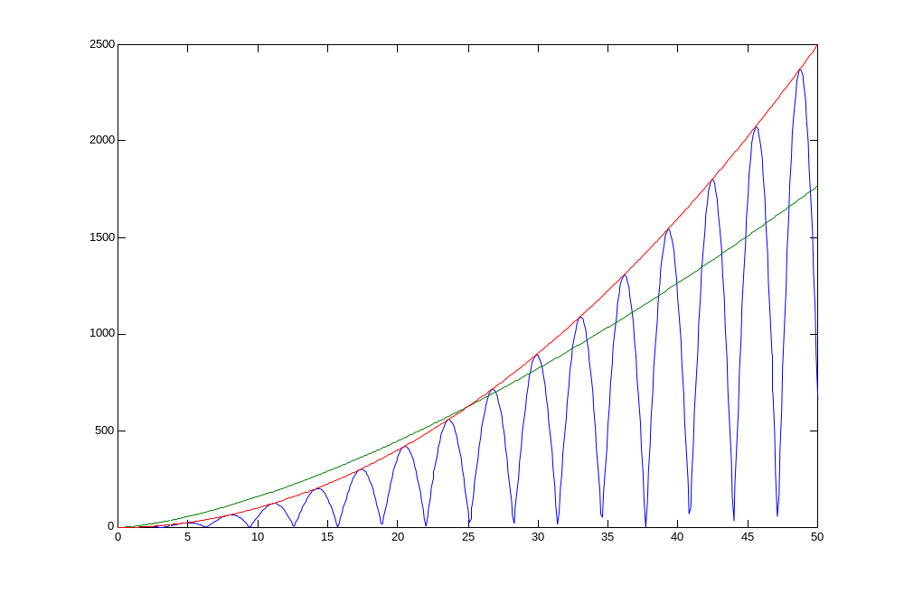
Incomparable Functions
y = x ²
y = |x ² sin(x)|
y = 5x ^{1.5}

Slide 62
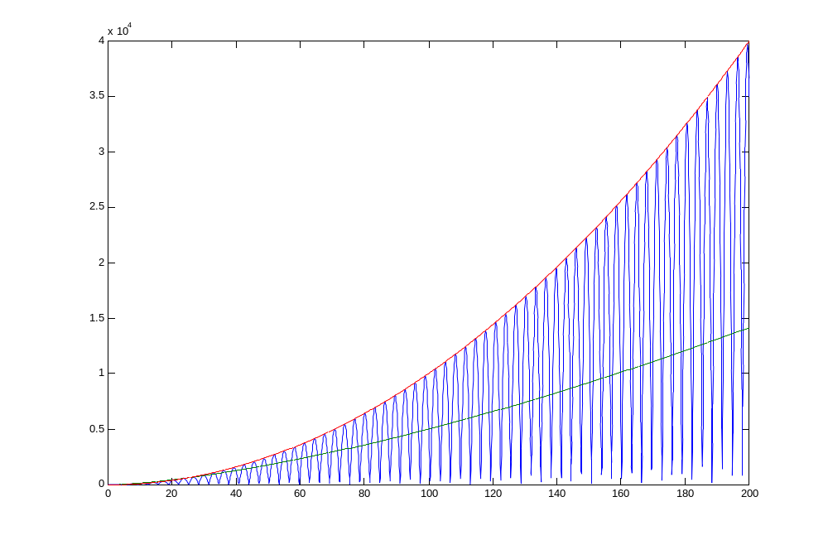
Incomparable Functions
y = x ²
y = 5x ^{1.5}
y = |x ² sin(x)|

Slide 63
Big-O
A Grain of Salt
Big-O notation gives a good first guess for deciding which algorithms are faster. In practice, the guess isn’t always correct.
Consider time functions n ⁶ vs. 1000n ^{5.9}. Asymptotically, the second is better. Often catch such examples of purported advances in theoretical computer science publications. The following graph shows the relative performance of the two algorithms:

Slide 64
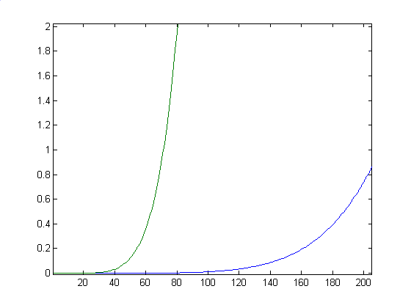
Big-O
A Grain of Salt
Running-time
In days
Assuming each operation
takes a nano-second, so
computer runs at 1 GHz
T(n) =
1000n ^{5.9}
T(n) = n ⁶
Input size n

Slide 65
Big-O
A Grain of Salt
In fact, 1000n ^{5.9} only catches up to n ⁶ when 1000n ^{5.9} = n ⁶, i.e.:
1000= n ^{0.1}, i.e.:
n = 1000¹⁰ = 10³⁰ operations
= 10³⁰/10⁹ = 10²¹ seconds ≈ 10²¹/(3x10⁷) ≈ 3x10¹³ years
≈ 3x10¹³/(2x10¹⁰)
≈ 1500 universe lifetimes!

Slide 66
Example for Section 1.8
Link to example proving big-Omega of a sum.

