Slide 1
Basic Number Theory
Zeph Grunschlag

Slide 2
Announcement
Last 4 problems will be added tonight to HW4.

Slide 3
Agenda
Section 2.3
    Divisors
    Primality
    Fundamental Theorem of Arithmetic
    Division Algorithm
    Greatest common divisors/least common multiples
    Relative Primality
    Modular arithmetic
    Caesar’s Cipher

Slide 4
Importance of Number Theory
Before the dawn of computers, many viewed number theory as last bastion of “pure math” which could not be useful and must be enjoyed only for its aesthetic beauty.
No longer the case. Number theory is crucial for encryption algorithms. Of utmost importance to everyone from Bill Gates, to the CIA, to Osama Bin Laden.
E.G., of great importance in COMS 4180 “Network Security”.

Slide 5
Importance of Number Theory
The encryption algorithms depend heavily on modular arithmetic. We need to develop various machinery (notations and techniques) for manipulating numbers before can describe algorithms in a natural fashion.
First we start with divisors.

Slide 6
Divisors
DEF: Let a, b and c be integers such that
a = b ·c .
Then b and c are said to divide (or are factors) of a, while a is said to be a multiple of b (as well as of c). The pipe symbol “|” denotes “divides” so the situation is summarized by:
b | a ∧ c | a .
NOTE: Students find notation confusing, and think of “|” in the reverse fashion, perhaps confuse pipe with forward slash “/”

Slide 7
Divisors.
Examples
Q: Which of the following is true?
77 | 7
7 | 77
24 | 24
0 | 24
24 | 0

Slide 8
Divisors.
Examples
A:
77 | 7: false bigger number can’t divide smaller positive number
7 | 77: true because 77 = 7 · 11
24 | 24: true because 24 = 24 · 1
0 | 24: false, only 0 is divisible by 0
24 | 0: true, 0 is divisible by every number (0 = 24 · 0)

Slide 9
Formula for Number of Multiples up to given n
Q: How many positive multiples of 15 are less than 100?

Slide 10
Formula for Number of Multiples up to given n
A: Just list them:
15, 30, 45, 60, 75, 80, 95.
Therefore the answer is 6.
Q: How many positive multiples of 15 are less than 1,000,000?

Slide 11
Formula for Number of Multiples up to Given n
A: Listing is too much of a hassle. Since 1 out of 15 numbers is a multiple of 15, if 1,000,000 were were divisible by 15, answer would be exactly 1,000,000/15. However, since 1,000,000 isn’t divisible by 15, need to round down to the highest multiple of 15 less than 1,000,000 so answer is ⎣1,000,000/15⎦.
In general: The number of d-multiples less than N is given by:
|{m ∈ Z⁺ | d |m and m ≤ N }| = ⎣N/d⎦

Slide 12
Divisor Theorem
THM: Let a, b, and c be integers. Then:
a|b ∧ a|c → a|(b + c )
a|b → a|bc
a|b ∧ b|c → a|c
EG:
17|34 ∧ 17|170 → 17|204
17|34 → 17|340
6|12 ∧ 12|144 → 6 | 144

Slide 13
Divisor Theorem.
Proof of no. 2
In general, such statements are proved by starting from the definitions and manipulating to get the desired results.
EG. Proof of no. 2 (a|b → a|bc ):
Suppose a|b. By definition, there is a number m such that b = am. Multiply both sides by c to get bc = amc = a (mc ). Consequently, bc has been expressed as a times the integer mc so by definition of “|”, a|bc 

Slide 14
Prime Numbers
DEF: A number n ≥ 2 prime if it is only divisible by 1 and itself. A number n ≥ 2 which isn’t prime is called composite.
Q: Which of the following are prime?
0,1,2,3,4,5,6,7,8,9,10

Slide 15
Prime Numbers
A: 0, and 1 not prime since not positive and greater or equal to 2
2 is prime as 1 and 2 are only factors
3 is prime as 1 and 3 are only factors.
4,6,8,10 not prime as non-trivially divisible by 2.
5, 7 prime.
9 = 3 · 3 not prime.
Last example shows that not all odd numbers are prime.

Slide 16
Fundamental Theorem of Arithmetic
THM: Any number n ≥ 2 is expressible as as a unique product of 1 or more prime numbers.
Note: prime numbers are considered to be “products” of 1 prime.
We’ll need induction and some more number theory tools to prove this.
Q: Express each of the following number as a product of primes: 22, 100, 12, 17

Slide 17
Fundamental Theorem of Arithmetic
A: 22 = 2·11, 100 = 2·2·5·5,
12 = 2·2·3, 17 = 17
Convention: Want 1 to also be expressible as a product of primes. To do this we define 1 to be the “empty product”. Just as the sum of nothing is by convention 0, the product of nothing is by convention 1.
➔Unique factorization of 1 is the factorization that uses no prime numbers at all.

Slide 18
Primality Testing
Prime numbers are very important in encryption schemes. Essential to be able to verify if a number is prime or not. It turns out that this is quite a difficult problem. First try:
boolean isPrime(integer n)
if ( n < 2 ) return false
for(i = 2 to n -1)
if( i |n ) // “divides”! not disjunction
return false
return true
Q: What is the running time of this algorithm?

Slide 19
Primality Testing
A: Assuming divisibility testing is a basic operation –so O (1) (this is an invalid assumption)– then above primality testing algorithm is O (n).
Q: What is the running time in terms of the input size k ?

Slide 20
Primality Testing
A: Consider n = 1,000,000. The input size is k = 7 because n was described using only 7 digits. In general we have
n = O (10^{k} ). Therefore, running time is O (10^{k} ). REALLY HORRIBLE!
Q: Can we improve algorithm?

Slide 21

Primality Testing
A:
Don’t try number bigger than n/2
After trying 2, don’t try any other even numbers, because know n is odd by this point.
In general, try only smaller prime numbers
In fact, only need to try to divide by prime numbers no larger than as we’ll see next:

Slide 22

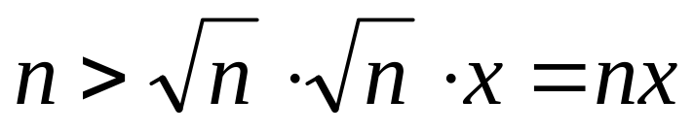
Primality Testing
LEMMA: If n is a composite, then its smallest prime factor is ≤
Proof (by contradiction). Suppose the smallest prime factor is > . Then by the fundamental theorem of arithmetic we can decompose n = pqx where p and q are primes > and x is some integer. Therefore
implying that n>n, which is impossible showing that the original supposition was false and the theorem is correct. 

Slide 23
Primality Testing.
Example
EG: Test if 139 and 143 are prime.
List all primes up to and check if they divide the numbers.
2: Neither is even
3: Sum of digits trick: 1+3+9 = 13, 1+4+3 = 8 so neither divisible by 3
5: Don’t end in 0 or 5
7: 140 divisible by 7 so neither div. by 7
11: Alternating sum trick: 1-3+9 = 7 so 139 not div. By 11. 1-4+3 = 0 so 143 is divisible by 11.
STOP! Next prime 13 need not be examined since bigger than .
Conclude: 139 is prime, 143 is composite.

Slide 24
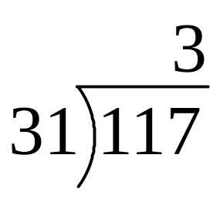
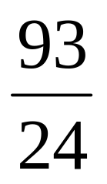
Division
Remember long division?
117 = 31·3 + 24
a = dq + r
q the quotient
d the divisor
a the dividend
r the remainder

Slide 25
Division
THM: Let a be an integer, and d be a positive integer. There are unique integers q, r with r ∈ {0,1,2,…,d-1} satisfying
a = dq + r
The proof is a simple application of long-division. The theorem is called the division algorithm though really, it’s long division that’s the algorithm, not the theorem.

Slide 26
Greatest Common Divisor
Relatively Prime
DEF Let a,b be integers, not both zero. The greatest common divisor of a and b (or gcd(a,b) ) is the biggest number d which divides both a and b.
Equivalently: gcd(a,b) is smallest number which divisibly by any x dividing both a and b.
DEF: a and b are said to be relatively prime if gcd(a,b) = 1, so no prime common divisors.

Slide 27
Greatest Common Divisor
Relatively Prime
Q: Find the following gcd’s:
gcd(11,77)
gcd(33,77)
gcd(24,36)
gcd(24,25)

Slide 28
Greatest Common Divisor
Relatively Prime
A:
gcd(11,77) = 11
gcd(33,77) = 11
gcd(24,36) = 12
gcd(24,25) = 1. Therefore 24 and 25 are relatively prime.
NOTE: A prime number are relatively prime to all other numbers which it doesn’t divide.

Slide 29
Greatest Common Divisor
Relatively Prime
EG: More realistic. Find gcd(98,420).
Find prime decomposition of each number and find all the common factors:
98 = 2·49 = 2·7·7
420 = 2·210 = 2·2·105 = 2·2·3·35
= 2·2·3·5·7
Underline common factors: 2·7·7, 2·2·3·5·7
Therefore, gcd(98,420) = 14

Slide 30
Greatest Common Divisor
Relatively Prime
Pairwise relatively prime: the numbers a, b, c, d, … are said to be pairwise relatively prime if any two distinct numbers in the list are relatively prime.
Q: Find a maximal pairwise relatively prime subset of
{ 44, 28, 21, 15, 169, 17 }

Slide 31
Greatest Common Divisor
Relatively Prime
A: A maximal pairwise relatively prime subset of {44, 28, 21, 15, 169, 17} :
{17, 169, 28, 15} is one answer.
{17, 169, 44, 15} is another answer.

Slide 32
Least Common Multiple
DEF: The least common multiple of a, and b (lcm(a,b) ) is the smallest number m which is divisible by both a and b.
Equivalently: lcm(a,b) is biggest number which divides any x divisible by both a and b
Q: Find the lcm’s:
lcm(10,100)
lcm(7,5)
lcm(9,21)

Slide 33
Least Common Multiple
A:
lcm(10,100) = 100
lcm(7,5) = 35
lcm(9,21) = 63
THM: lcm(a,b) = ab / gcd(a,b)
Notes:
Skip proof in lecture

Slide 34
lcm in terms of gcd
Proof
THM: lcm(a,b) = ab / gcd(a,b)
Proof. Let g = gcd(a,b).
Notes:
Skip proof in lecture

Slide 35
lcm in terms of gcd
Proof
THM: lcm(a,b) = ab / gcd(a,b)
Proof. Let g = gcd(a,b). Factor a and b using g: a = gx, b = gy where x and y are relatively prime.
Notes:
Skip proof in lecture

Slide 36
lcm in terms of gcd
Proof
THM: lcm(a,b) = ab / gcd(a,b)
Proof. Let g = gcd(a,b). Factor a and b using g: a = gx, b = gy where x and y are relatively prime. Therefore, ab/gcd(a,b) = gxgy/g = gxy. Notice that a and b both divide gxy. On the other hand, let m be divisible by both a and b.
Notes:
Skip proof in lecture

Slide 37
lcm in terms of gcd
Proof
THM: lcm(a,b) = ab / gcd(a,b)
Proof. (continued) On the other hand, let m be divisible by both a and b: So m/g is divisible by both x and y. As x and y have no common prime factors, the fundamental theorem of arithmetic implies that m/g must be divisible by xy.
Notes:
Skip proof in lecture

Slide 38
lcm in terms of gcd
Proof
THM: lcm(a,b) = ab / gcd(a,b)
Proof. (continued) …m/g must be divisible by xy. Therefore, m must be divisible by gxy. This shows that any multiple of a and b is bigger than gxy so by definition, gxy = ab/gcd(a,b) is the lcm.
Notes:
Skip proof in lecture

Slide 39
Modular Arithmetic
There are two types of “mod” (confusing):
the mod function
  Inputs a number a and a base b
  Outputs a mod b a number between 0 and b –1 inclusive
  This is the remainder of a÷b
  Similar to Java’s % operator.
the (mod) congruence
  Relates two numbers a, a’ to each other relative some base b
  a ≡ a’ (mod b) means that a and a’ have the same remainder when dividing by b

Slide 40
mod function
Similar to Java’s “%” operator except that answer is always positive. E.G.
-10 mod 3 = 2, but in Java –10%3 = -1.
Q: Compute
113 mod 24
-29 mod 7

Slide 41
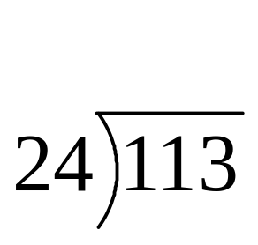

mod function
A: Compute
113 mod 24:
-29 mod 7

Slide 42
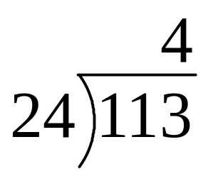
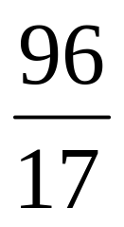
mod function
A: Compute
113 mod 24:
-29 mod 7

Slide 43
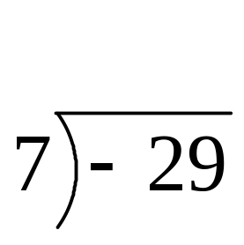
mod function
A: Compute
113 mod 24:
-29 mod 7

Slide 44
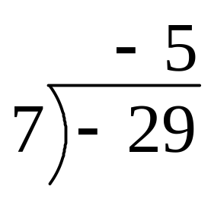
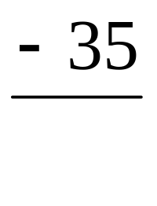
mod function
A: Compute
113 mod 24:
-29 mod 7

Slide 45
(mod) congruence
Formal Definition
DEF: Let a,a’ be integers and b be a positive integer. We say that a is congruent to a’ modulo b (denoted by a ≡ a’ (mod b) ) iff b | (a – a’ ).
Equivalently: a mod b = a’ mod b
Q: Which of the following are true?
3 ≡ 3 (mod 17)
3 ≡ -3 (mod 17)
172 ≡ 177 (mod 5)
-13 ≡ 13 (mod 26)

Slide 46
(mod) congruence
A:
3 ≡ 3 (mod 17) True. any number is congruent to itself (3-3 = 0, divisible by all)
3 ≡ -3 (mod 17) False. (3-(-3)) = 6 isn’t divisible by 17.
172 ≡ 177 (mod 5) True. 172-177 = -5 is a multiple of 5
-13 ≡ 13 (mod 26) True: -13-13 = -26 divisible by 26.

Slide 47
(mod) congruence
Identities
The (mod) congruence is useful for manipulating expressions involving the mod function. It lets us view modular arithmetic relative a fixed base, as creating a number system inside of which all the calculations can be carried out.
a mod b ≡ a (mod b)
Suppose a ≡ a’ (mod b) and c ≡ c’ (mod b) Then:
  a+c ≡ (a’+c’ )(mod b)
  ac ≡ a’c’ (mod b)
  a ^{k} ≡ a’ ^{k} (mod b)

Slide 48
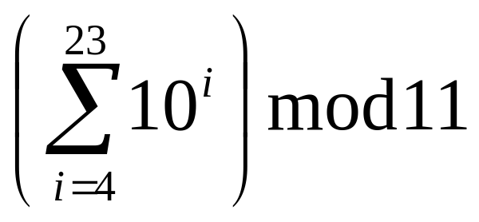
Modular arithmetic harder examples
Q: Compute the following.
307¹⁰⁰¹ mod 102
(-45 · 77) mod 17

Slide 49
Modular arithmetic harder examples
A: Use the previous identities to help simplify:
Using multiplication rules, before multiplying (or exponentiating) can reduce modulo 102:
307¹⁰⁰¹ mod 102 ≡ 307¹⁰⁰¹ (mod 102)
≡ 1¹⁰⁰¹ (mod 102) ≡ 1 (mod 102). Therefore, 307¹⁰⁰¹ mod 102 = 1.

Slide 50
Modular arithmetic harder examples
A: Use the previous identities to help simplify:
Repeatedly reduce after each multiplication:
(-45·77) mod 17 ≡ (-45·77) (mod 17)
≡(6·9) (mod 17) ≡ 54 (mod 17) ≡ 3 (mod 17). Therefore (-45·77) mod 17 = 3.

Slide 51
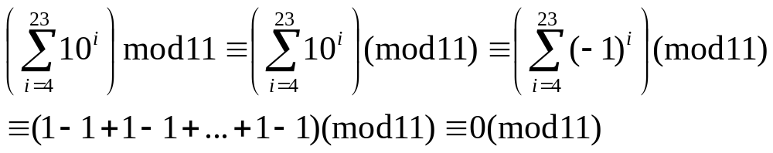
Modular arithmetic harder examples
A: Use the previous identities to help simplify:
Similarly, before taking sum can simplify modulo 11:
Therefore, the answer is 0.

Slide 52
Proving Modular Identities
We first need:
THM: a ≡ a’ (mod b) ←→ ∃k a = a’ + kb
Proof. ← direction: If a = a’ + kb, then (a-a’ ) = kb so that b | (a-a’ ) which by definition means that a ≡ a’ (mod b)
→ direction: If a ≡ a’ (mod b), by definition
b | (a-a’ ) so for some k we have (a-a’ ) = kb which becomes a = a’ + kb 
This is a handy little theorem as we’ll see next:

Slide 53
Proving Modular Identities
Prove the identity
a ≡ a’ (mod b) ∧ c ≡ c’ (mod b)
---→ ac ≡ a’ c’ (mod b)
Proof. By the previous, we can assume that there are k and l such that
a = a’ + bk and c = c’ + bl
Thus ac = (a’ + bk)(c’ + bl )
= a’c’ +b(kc’+la’+bkl). Therefore
(ac-a’c’ ) = b(kc’+la’+bkl) is divisible by b and hence by definition, ac ≡ a’ c’ (mod b)

Slide 54
Simple Encryption
Variations on the following have been used to encrypt messages for thousands of years.
Convert a message to capitals.
Think of each letter as a number between 1 and 26.
Apply an invertible modular function to each number.
Convert back to letters (0 becomes 26).

Slide 55
Letter ←→ Number
Conversion Table
A | B | C | D | E | F | G | H | I | J | K | L | M
1 | 2 | 3 | 4 | 5 | 6 | 7 | 8 | 9 | 10 | 11 | 12 | 13
N | O | P | Q | R | S | T | U | V | W | X | Y | Z
14 | 15 | 16 | 17 | 18 | 19 | 20 | 21 | 22 | 23 | 24 | 25 | 26

Slide 56
Encryption example
Let the encryption function be
f (a) = (3a + 9) mod 26
Encrypt “Stop Thief”
STOP THIEF (capitals)
19,20,15,16 20,8,9,5,6
14,17,2,5 17,7,10,24,1
NQBE QGJXA

Slide 57
Decryption example
Decryption works the same, except that you apply the inverse function.
EG: Find the inverse of
f (a) = (3a + 9) mod 26
If we didn’t have to deal with mod 26, inverse would be
g (a) = 3⁻¹ (a - 9)
We’ll see that since gcd(3,26) = 1, the inverse of 3 is actually well defined modulo 26 and is the number 9. This gives:
g (a) = 9 (a - 9) mod 26 = (9a – 3) mod 26

Slide 58
Caesar’s Cipher
f (a) = (a+3) mod 26

Slide 59
Blackboard Exercise
Prove that there are infinitely many prime numbers. (Discovered by Euclid).

Slide 60
Importance of Number Theory
Before the dawn of computers, many viewed number theory as last bastion of “pure math” which could not be useful and must be enjoyed only for its aesthetic beauty.
No longer the case. Number theory is crucial for encryption algorithms. Of utmost importance to everyone from Bill Gates, to the CIA, to Osama Bin Laden.
Check out Angelos Keromytis's lecture---
www.cs.columbia.edu/~angelos/teaching/lecture8/index.html
---from COMS 4180 “Network Security” in which he applies number theory to encryption.
Notes:
Link not functioning this semester

