Slide 1
Processes and Threads
Yücel Saygın
|These slides are based on your text book and on the slides prepared by Andrew S. Tanenbaum

Slide 2
Sequential Computation
Algorithm: collection of instructions along with their sequential order of execution
  Algorithm is the basis for sequential execution
  Has one entry point and instructions are executed in sequence with branches and loops until termination
Source program: algorithm encoded in a programming language (Java, C, C++)
Computer systems have tools that can convert a source program into a binary program (object code, executable)
Binary program can be executed directly by the computer

Slide 3
Sequential Computation
OS procedure calls are used inside the binary code to interact with the OS: for using I/O devices and to terminate execution.
Programmers write their code with the assumption that it will be executed in sequential fashion
But OS may interleave the execution of multiple programs

Slide 4
Process
Process is a program in execution
It includes
  Program itself
  Data
  resources (such as files)
  Execution info (process relation information kept by OS)

Slide 5
Processor’s Point of View
Program Counter
Main Memory

Slide 6

Processes
The Process Model
Multiprogramming of four programs
Conceptual model of 4 independent, sequential processes
Only one program active at any instant

Slide 7
Process Creation
Principal events that cause process creation
  System initialization
  Execution of a process creation system call
  User request to create a new process

Slide 8
Process Termination
Conditions which terminate processes
Normal exit (voluntary)
Error exit (voluntary)
Fatal error (involuntary)
Killed by another process (involuntary)

Slide 9
Process Hierarchies
Parent creates a child process, child processes can create its own process
Forms a hierarchy
  UNIX calls this a "process group"
Windows has no concept of process hierarchy
  all processes are created equal

Slide 10
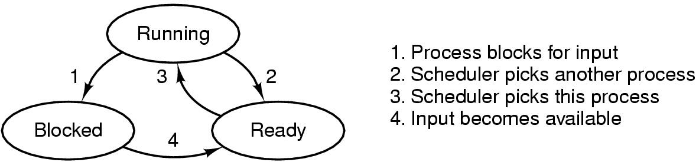
Process States (1)
Possible process states
  running
  blocked
  ready
Transitions between states shown

Slide 11
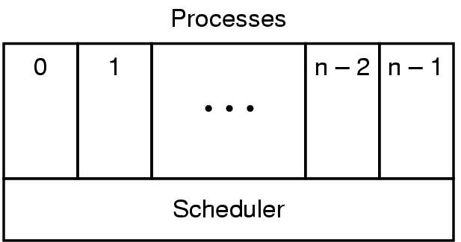
Process States (2)
Scheduler is the lowest layer of process-structured OS
  handles interrupts, scheduling
Above that layer are sequential processes

Slide 12
Queues Maintained by OS
Ready Queue :
  list of processes waiting to be executed
  Scheduler picks a process from ready queue to execute (dispatching)
Blocked Queue :
  Lust of processes waiting for I/O

Slide 13
Process Related OS Tables
Memory Tables
Memory
Devices
I/O Tables
Process 1
Image
Files
Processes
File Tables
Primary Process Table
……
Process 1
Process 2
Process n
Image
…..
Process n

Slide 14
Process Related Structures
Process Location: the address of the location where we keep info about the process and process related structures
Process control block : attributes related to a process
Program text, data, stack, heap
Collection of all of the above is called the process image

Slide 15
Process Related Structures
Process Location
  Process images are usually kept in the secondary storage (disk)
  In order to run a process, we need to bring the process image into memory (or at least part of it)
Memory
Process
Image
Disk

Slide 16
Process Related Structures
Process Attributes (kept in process control block)
  Process identification
  Processor state information
  Process control information

Slide 17
Process Attributes
Process identification
  process id : identifies the process (may be an index to the primary process table)
  parent id : id of the parent process
  user id : id of the user responsible for the process

Slide 18
Process Attributes
Processor state information
  Contents of the processor registers
    User-visible registers
    Control and status registers
    Stack pointers
  When the process is interrupted, contents of the registers must be saved for restoring the process state later on

Slide 19
Process Attributes
Process control information
  Scheduling and state information
    Process state (running, ready, blocked)
    Priority
    Scheduling related information (how much it waited, how much it used the CPU)
    Event (the id of the event the process is waiting for)
  Data structuring
    queues,
    priority levels,
    parent-child relationships
  Memory management
  Resource ownership (open files etc)
  Interprocess communication (flags, signals)

Slide 20
Processes in UNIX
Two different types of processes:
  System processes
    run in kernel mode and execute operating system code for administrative functions like process swapping, memory management, etc
  User processes
    run in user mode to execute user processes
    run in kernel mode to execute instructions from the kernel

Slide 21
Processes in UNIX
There are two important processes in UNIX
  Process 0 is a special process that is created when the system boots and its task is to do process swapping
  Process 0 creates process 1 (the init process) which spawns the user process when the user logs on to the system
Processes in UNIX are represented by complex data structures for managing and dispatching processes

Slide 22
Processes in UNIX
Process
identification
Process State
information
Image of a process contains:
  User-level context (program text, data, stack, shared memory)
  Register context (Program counter, processor status register, stack pointer, general purpose registers)
  System-level context
    Process table entry which defines the state of the process,
    user area which contains the process control information ,
    per process region table which does the mapping from virtual to physical addresses,
    kernel stack which contains the stack frame of kernel procedures as the process executes in kernel mode.)
Process Control
information
User stack
Private user
address space
(Programs, data)
Kernel stack
Shared address
space

Slide 23
Process Control in UNIX
Kernel system call fork() is used to create a process
When a process (parent) issues a fork() command to create a child process, the OS performs the following (in kernel mode):
  Allocates a slot in the process table for the new process
  Assigns a unique process ID to the child process
  It makes a copy of the parent process image except the shared memory
  It assigns the child process to “ready to run” state
  It returns the ID number of the child process to the parent process, and “0” value to the child process

Slide 24
Process Control in UNIX
After completing the process creation tasks, the OS can do the following
  Stay in parent process (parent resumes in user mode at the statement just after the fork call)
  Transfer control to the child process, and child executes from the point of the fork call
  Transfer control to another process (both parent and child are left in ready to run state)

Slide 25
UNIX Shell as a case study for process creation
Unix shell is a command line interpreter for users to interact with OS
It is yet another application program that lets users make system calls and run some application level programs
You can write your own shell if you don’t like the one you are using.

Slide 26
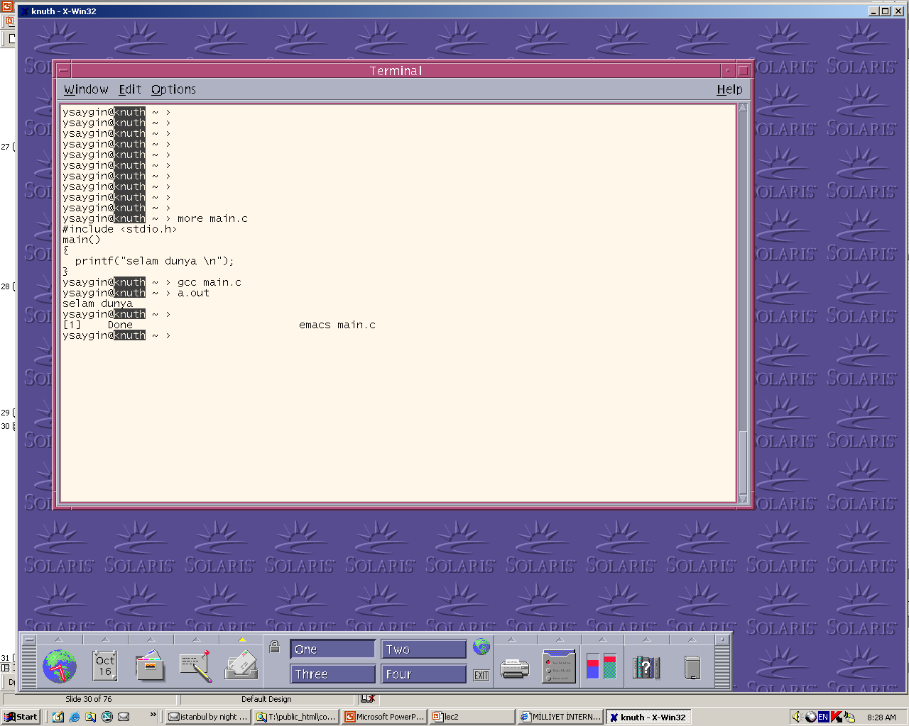

Slide 27
UNIX Shell
Shell presents the user with (usually) a text based interface
It accepts a command line from the user
  Ex : knuth> gcc main.c
Parse the command line and execute it with the given parameters as a child process
In the case of “gcc main.c”, shell
  finds the gcc program in the /bin directory (/usr/local/bin)
  Executes it in a child process with the parameter “main.c”
  The gcc compiler compiles main.c, and writes the executable code to a default file a.out
You can also execute your own compiled programs
  knuth> a.out
  In this case shell finds the command in the local directory, and executes it directly

Slide 28
UNIX Shell
Shell provides a set of environment variables (defined in .login file)
PATH environment variable is an ordered list of absolute path names that specifies where the shell should search for command files.
You can set the PATH by set PATH = (.:/bin:/usr/bin)
The command to be executed is searched in every directory specified in the PATH.

Slide 29

Threads
The Thread Model (1)
(a) Three processes each with one thread
(b) One process with three threads

Slide 30
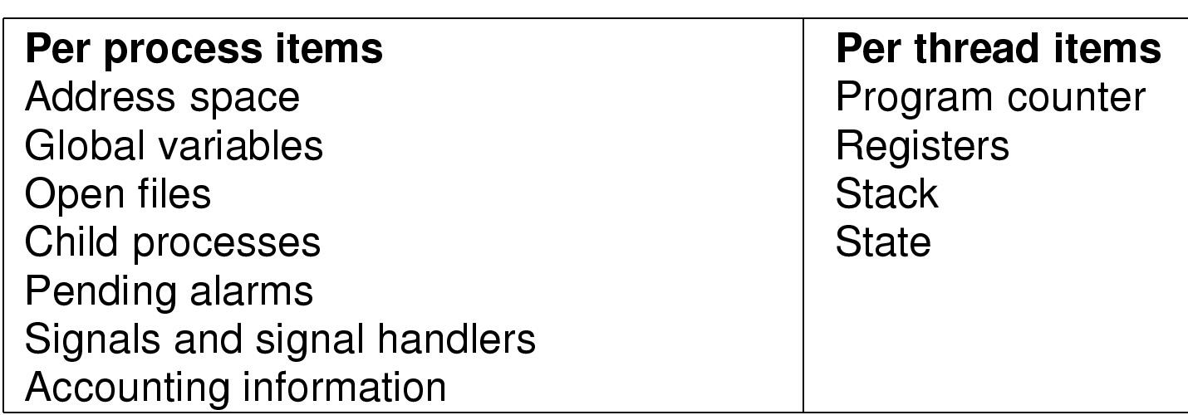
The Thread Model (2)
Items shared by all threads in a process
Items private to each thread

Slide 31

The Thread Model (3)
Each thread has its own stack

Slide 32

Thread Usage (1)
A word processor with three threads

Slide 33
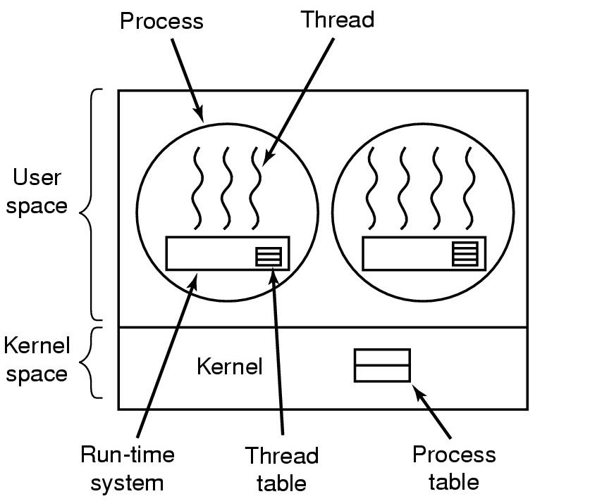
Implementing Threads in User Space
A user-level threads package

Slide 34
User Level Threads
Underlying OS implements the classic processes
A user level thread library (such as POSIX thread library) implements the threads
OS is not aware of the threads
Scheduling by OS is done at the process level
Advantages:
  Portable
  Fast switching from one thread to another
Disadvantages:
  When one thread switches to kernel space and blocks (say for I/O) all the others will block
  Threads can not be scheduled to different processors

Slide 35
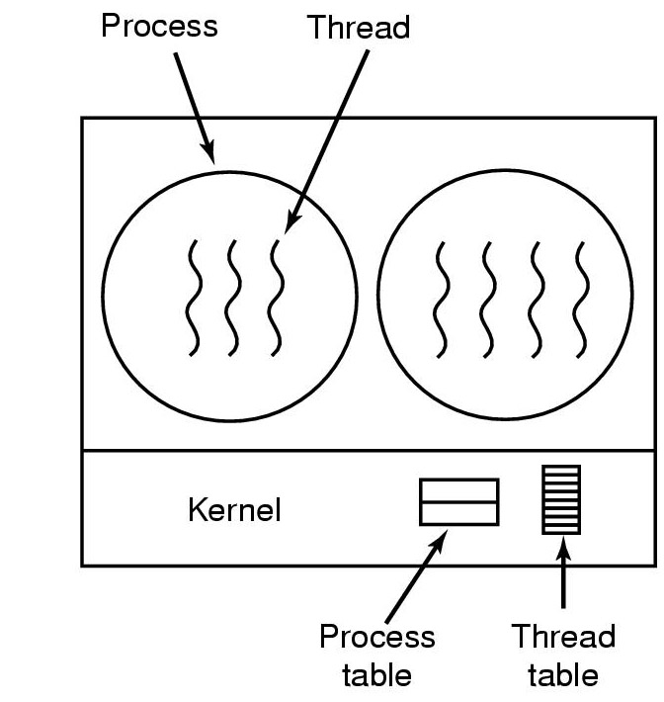
Implementing Threads in the Kernel
A threads package managed by the kernel

Slide 36
Kernel Level Threads
In Modern Operating Systems such as Solaris, Windows NT, Linux (>2.2.0) threads are implemented at kernel level
Later version of Linux implements threads at kernel but the thread interface is still at the user level
Threads and processes are managed separately
Advantage:
  Threads can be scheduled to multiple processors
  If one thread is blocked, the others may execute
Disadvantage:
  Switching from one thread to the other is faster than process switch but slower then user level thread switch

Slide 37
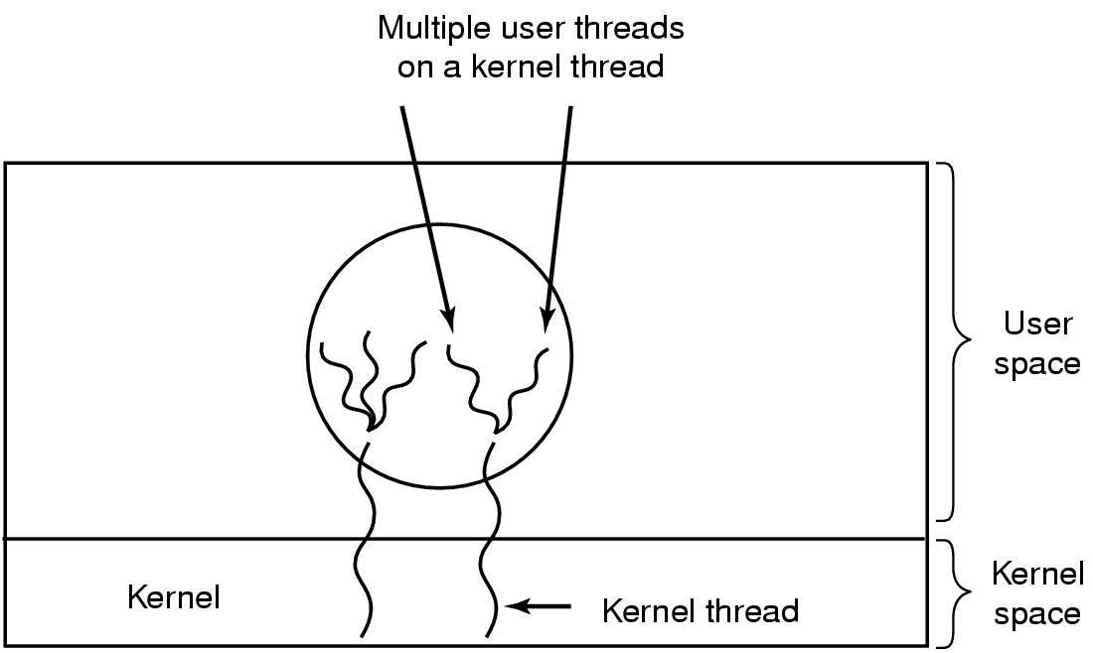
Hybrid Implementations
Multiplexing user-level threads onto kernel- level threads

Slide 38
Hybrid Approach
Solaris Threads (Solaris 2.x):
Has multi-threaded architecture:
  Process: like a unix process, includes user’s address space, stack, and process control block
  User-level threads: Invisible to OS, implemented through threads library
  Kernel threads: unit of scheduling at kernel level (to multiple processors if there are any)
  Lightweight processes (LWP): mapping from user level threads to kernel threads. Each LWP handles multiple user level threads and mapped to one kernel thread

Slide 39
Scheduler Activations
Goal – mimic functionality of kernel threads
  gain performance of user space threads
Avoids unnecessary user/kernel transitions
Kernel assigns virtual processors to each process
  lets runtime system allocate threads to processors
Problem:
Fundamental reliance on kernel (lower layer)
calling procedures in user space (higher layer)

Slide 40
More on Windows NT processes and threads during the recitations with program fragments

