Slide 1
Interprocess Communication
Yücel Saygın
|These slides are based on your text book and on the slides prepared by Andrew S. Tanenbaum

Slide 2
Inter-process Communication
Race Conditions: two or more processes are reading and writing on shared data and the final result depends on who runs precisely when
Mutual exclusion : making sure that if one process is accessing a shared memory, the other will be excluded form doing the same thing
Critical region: the part of the program where shared variables are accessed

Slide 3

Interprocess Communication
Race Conditions
Two processes want to access shared memory at same time

Slide 4
Critical Regions (1)
Four conditions to provide mutual exclusion
No two processes simultaneously in critical region
No assumptions made about speeds or numbers of CPUs
No process running outside its critical region may block another process
No process must wait forever to enter its critical region

Slide 5

Critical Regions (2)
Mutual exclusion using critical regions

Slide 6
Mutual Exclusion via Disabling Interrupts
Process disables all interrupts before entering its critical region
Enables all interrupts just before leaving its critical region
CPU is switched from one process to another only via clock or other interrupts
So disabling interrupts guarantees that there will be no process switch
Disadvantage:
  Should give the power to control interrupts to user (what if a user turns off the interrupts and never turns them on again?)
  Does not work in case of one CPU. Only the CPU that executes the disable instruction is effected.
Not suitable approach for the general case but can be used by the Kernel when needed

Slide 7
Mutual Exclusion with Busy Waiting:
(1)Lock Variables
Testing a variable until some value appears is called busy waiting.
A lock that uses busy waiting is called a spin lock
A single shared lock variable (lock) initially 0
When a process wants to enter its critical region
  Check if the lock is 0
  If lock = 0 then set it to 1 and enter the critical region, set it back to 0 before leaving the critical region.
  If lock = 1 then wait until it is set to 0
Does the above scheme work?

Slide 8
Mutual Exclusion with Busy Waiting:
(2)Strict Alternation
A variable (turn) is used to run two processes in alternation (i.e., process 1 runs, then process 2 runs, then process 1 runs again, and so on).

Slide 9
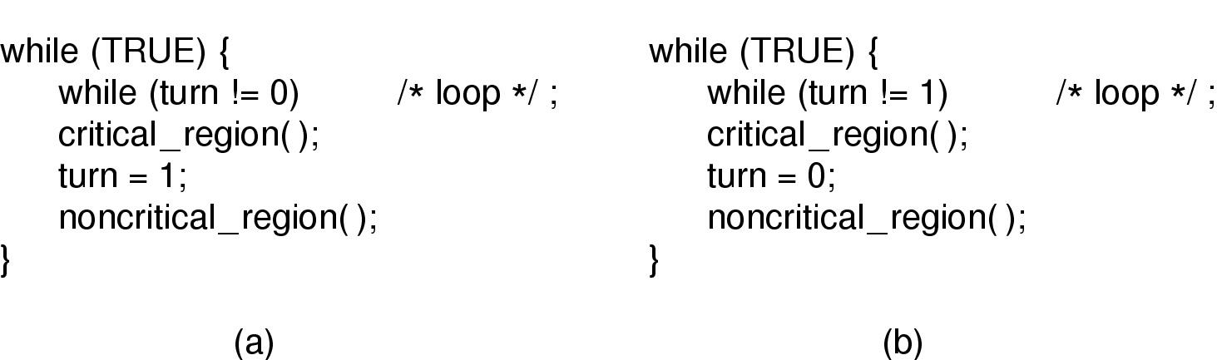
Mutual Exclusion with Busy Waiting:
Strict Alternation
Initially turn = 0
  (a) Process 0. (b) Process 1.
It wastes CPU time, so we should avoid busy waiting as much as we can
Can be used only when the waiting period is expected to be short
However there is a problem in the above approach!

Slide 10
ALS

Slide 11
Mutual Exclusion with Busy Waiting:
Strict Alternation
  (a) Process 0. (b) Process 1.
A problem exists in the above approach
Scenario :
    Process 0 leaves its critical region and sets turn to 1, enters its non critical region
    Process 1 enters its critical region, sets turn to 0 and leaves its critical region
    Process 1 enters its non-critical region, quickly finishes its job and goes
    back to the while loop
    Since turn is 0, process 1 has to wait for process 0 to finish its non-critical region
    so that it can enter its critical region
    This violates the third condition of providing mutual exclusion

Slide 12
How About this solution?
While (TRUE) {
turn = 0;
while (turn ==0);
critical_region();
noncritical_region();
}
While (TRUE) {
turn = 1;
while (turn ==1);
critical_region();
noncritical_region();
}

Slide 13
How About this solution then?
Initially flag1 and flag2 are both 0
While (TRUE) {
flag1 = 1;
turn = 0;
while ((turn ==0) && (flag2 == 1));
critical_region();
flag1 = 0;
noncritical_region();
}
While (TRUE) {
flag2 = 1;
turn = 1;
while ((turn ==1) && (flag1 == 1));
critical_region();
flag 2 = 0;
noncritical_region();
}
How can you solve this problem for more than two processes?

Slide 14
Mutual Exclusion with Busy Waiting:
(3) Peterson’s Solution
The previous solution solves the problem of one process blocking another process while its outside its critical section (not a good mutual exclusion)
Peterson’s Solution is a neat solution with busy waiting, that defines the procedures for entering and leaving the critical region.

Slide 15
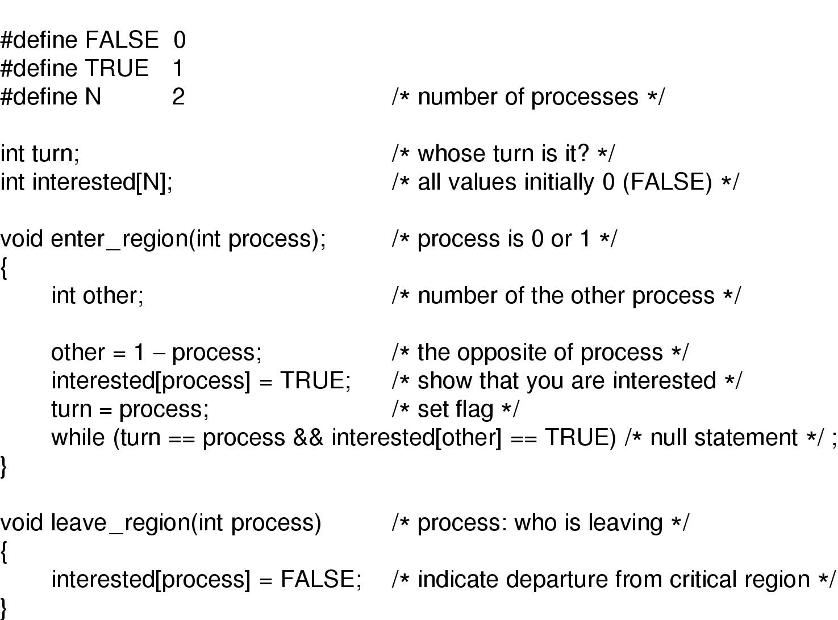
Mutual Exclusion with Busy Waiting (2)
Wait until the other process sets the turn : while (turn == process)
Wait while the another process is interested: while (interested[other]==TRUE)
Go out of the while loop after the other process has left its critical region

Slide 16
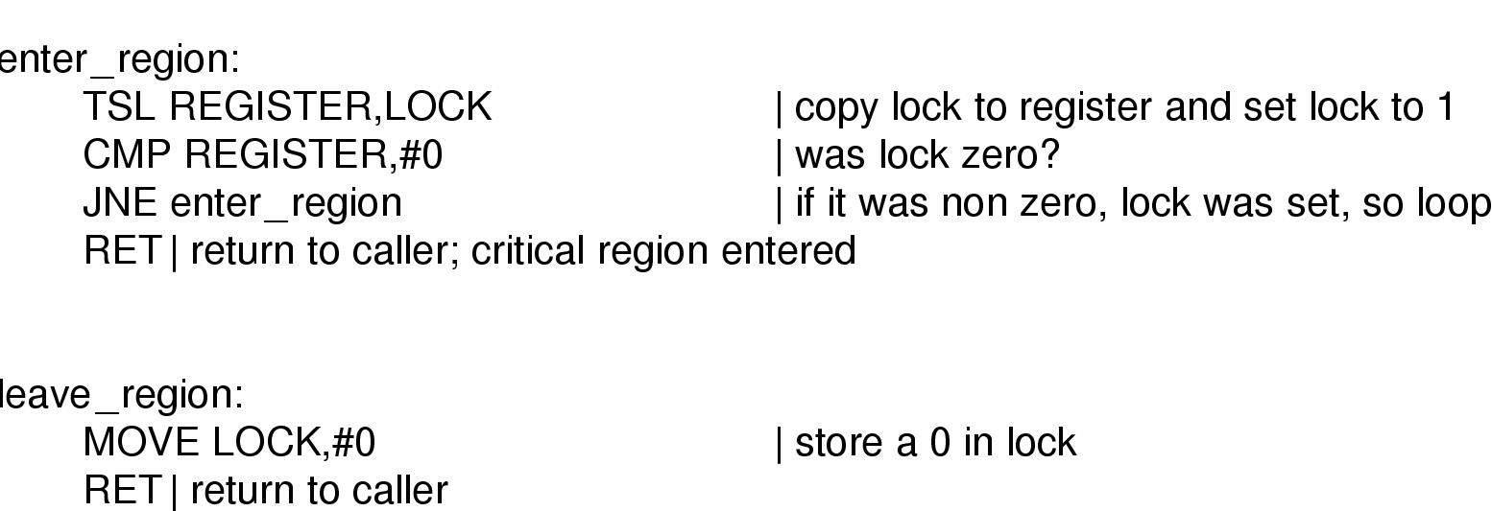
Mutual Exclusion with Busy Waiting
(3)TSL Instruction
TSL instruction is provided by the hardware
TSL REGISTER, LOCK reads the contents of the lock into REGISTER and sets LOCK to 1 in an atomic fashion
No other processor can reach LOCK during TSL
  In order to achieve that, CPU executing TSL instruction locks the bus to prevent other processors accessing LOCK

Slide 17
Mutual Exclusion with Busy Waiting
Causes a problem called “PRIORITY INVERSION”
Two processes: H (high priority) and L (Low Priority)
Scheduler must make sure that H is executed whenever it is in ready state
Scenario:
  Process H blocks for I/O
  Process L now can execute and enters its critical section
  I/O operation H waits for is now complete
  H is scheduled now but since L is in the critical section, H does busy waiting
  But L is never scheduled while H is running
  And the system is blocked forever.

Slide 18
Mutual Exclusion with Busy Waiting
HIGH LOW
Scenario:
  Process H blocks for I/O
  Process L now can execute and enters its critical section
  I/O operation H waits for is now complete
  H is scheduled now but since L is in the critical section, H does busy waiting
  But L is never scheduled while H is running
  And the system is blocked forever.

Slide 19
Producer Consumer (bounded buffer) Problem
Formalizes the programs that use a buffer (queue)
Two processes: producer and consumer that share a fixed size buffer
Producer puts an item to the buffer
Consumer takes out an item from the buffer
Buffer
Max size = 10
producer
consumer

Slide 20
Producer Consumer (bounded buffer) Problem
Formalizes the programs that use a buffer (queue)
Two processes: producer and consumer that share a fixed size buffer
Producer puts an item to the buffer
Consumer takes out an item from the buffer
What happens when the producer wants to put an item to the buffer while the buffer is already full?
Buffer
Max size = 10
producer
consumer

Slide 21
Producer Consumer (bounded buffer) Problem
Formalizes the programs that use a buffer (queue)
Two processes: producer and consumer that share a fixed size buffer
Producer puts an item to the buffer
Consumer takes out an item from the buffer
What happens when the producer wants to put an item to the buffer while the buffer is already full?
OR when the consumer wants to consume an item from the buffer when the buffer is empty?
Buffer
Max size = 10
producer
consumer

Slide 22
Mutual Exclusion with Sleep and wakeup
Solution is to use sleep and wakeup
Sleep: a system call that causes the caller process to block
Wakeup: a system call that wakes up a process (given as parameter)
When the producer wants to put an item to the buffer and the buffer is full then it sleeps
When the consumer wants to remove an item from the buffer and the buffer is empty, then it sleeps.

Slide 23
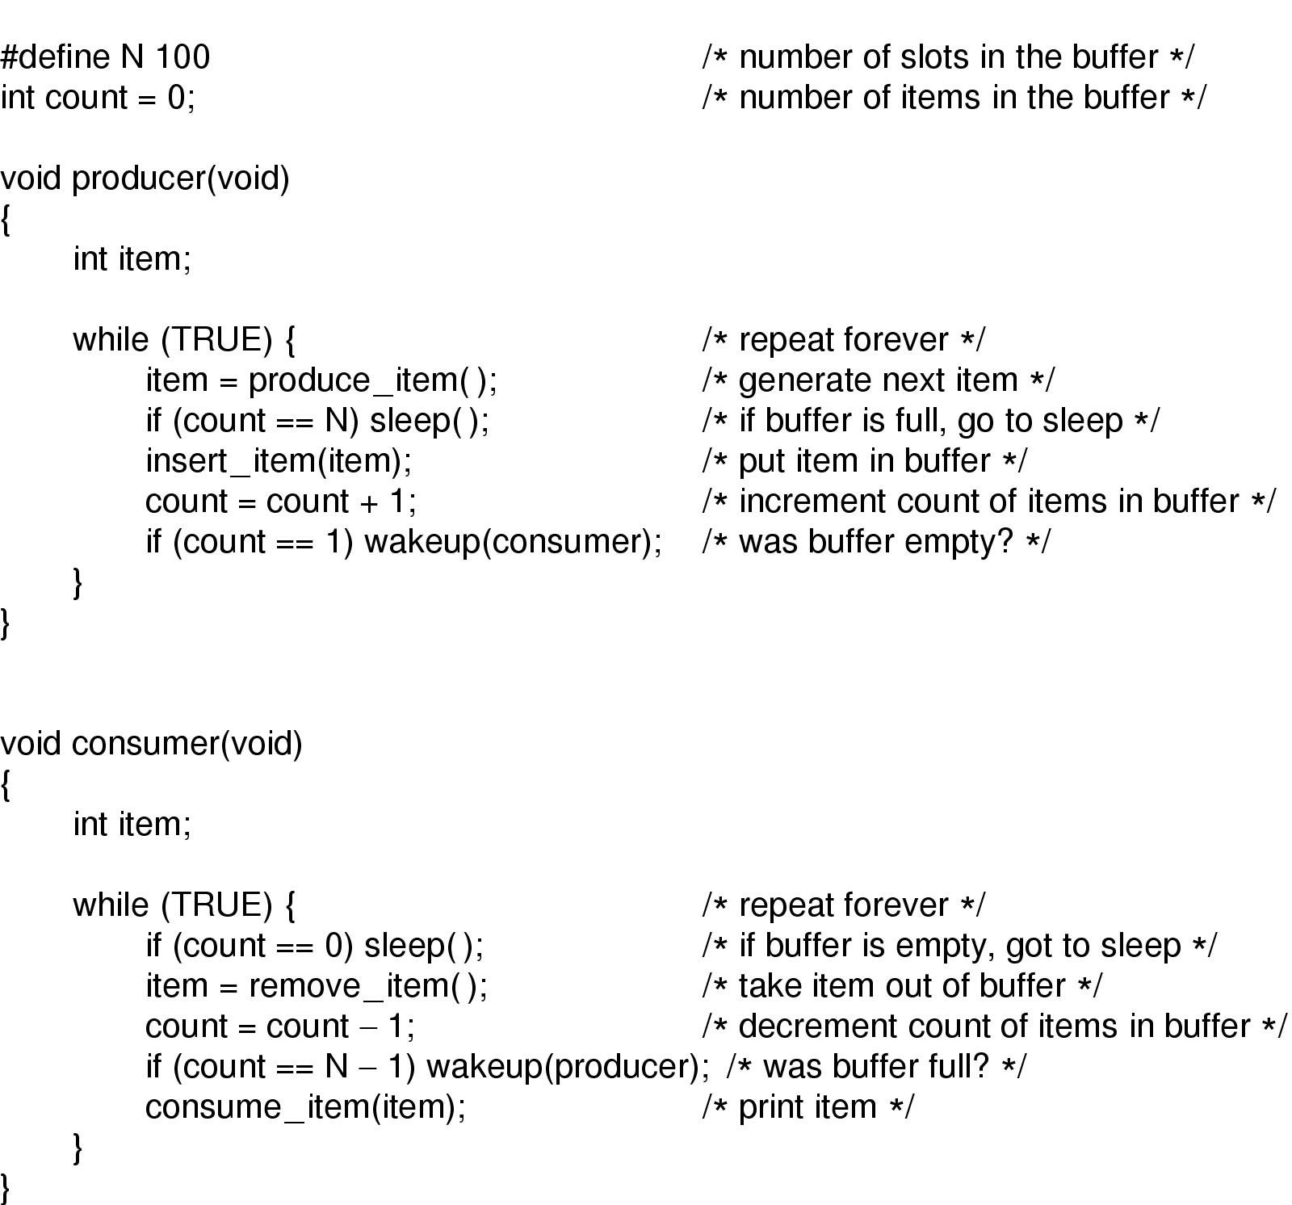
Sleep and Wakeup
Consumer is running
It checks count when count == 0
Scheduler decides to run Producer just before consumer sleeps
Producer inserts an item and increments the count
Producer notices that count is 1, and issues a wakeup call.
Since consumer is not sleeping yet, the wakeup signal is lost
Scheduler decides to run the consumer
Consumer sleeps
Producer is scheduled, which runs N times, and after filling up the buffer it sleeps
Both processes sleep forever (or until the prince OS comes and sends a kiss signal to kill both)
What problems exist in this solution?

Slide 24
Solution is to use Semaphores
Proposed by Dijkstra ( 11 May 1930 -- 6 August 2002)
Born in Rotterdam, The Netherlands
1972 recipient of the ACM Turing Award (Nobel Prize for computing)
responsible for
  the idea of building operating systems as explicitly synchronized sequential processes,
  the formal development of computer programs
He is known for
  His efficient shortest path algorithm and
  for having designed and coded the first Algol 60 compiler.
He famously campaigned for the abolition of the GOTO statement from programming!!!!

Slide 25
Solution is to use Semaphores
A semaphore can have
  value 0 when no wakeups are present
  Or value > 0 when there are pending wakeups
Two operations on a semaphore
  Down : checks the value of the semaphore
    if value is > 0, then it decrements it (by using one wakeup signal) and continues
    If value = 0, then the process is put to sleep without completing its down operation
  Up : increments the value of the semaphore
    If there are processes sleeping on the semaphore, then one of them is chosen, and it is allowed to complete its down operation
Checking the value of a semaphore and updating them is done in an atomic fashion (Disabling interrupts when one CPU exists or TSL instruction could be used when multiple CPUs exist)

Slide 26
Semaphores (contd)
Binary Semaphores are called mutex variables
They can assume values 0 and 1 only.
We will see the examples of the usage of mutex variables with threads during the recitations
In the following slide we will see how mutexes and semaphores are used for mutual exclusion and process synchronization

Slide 27
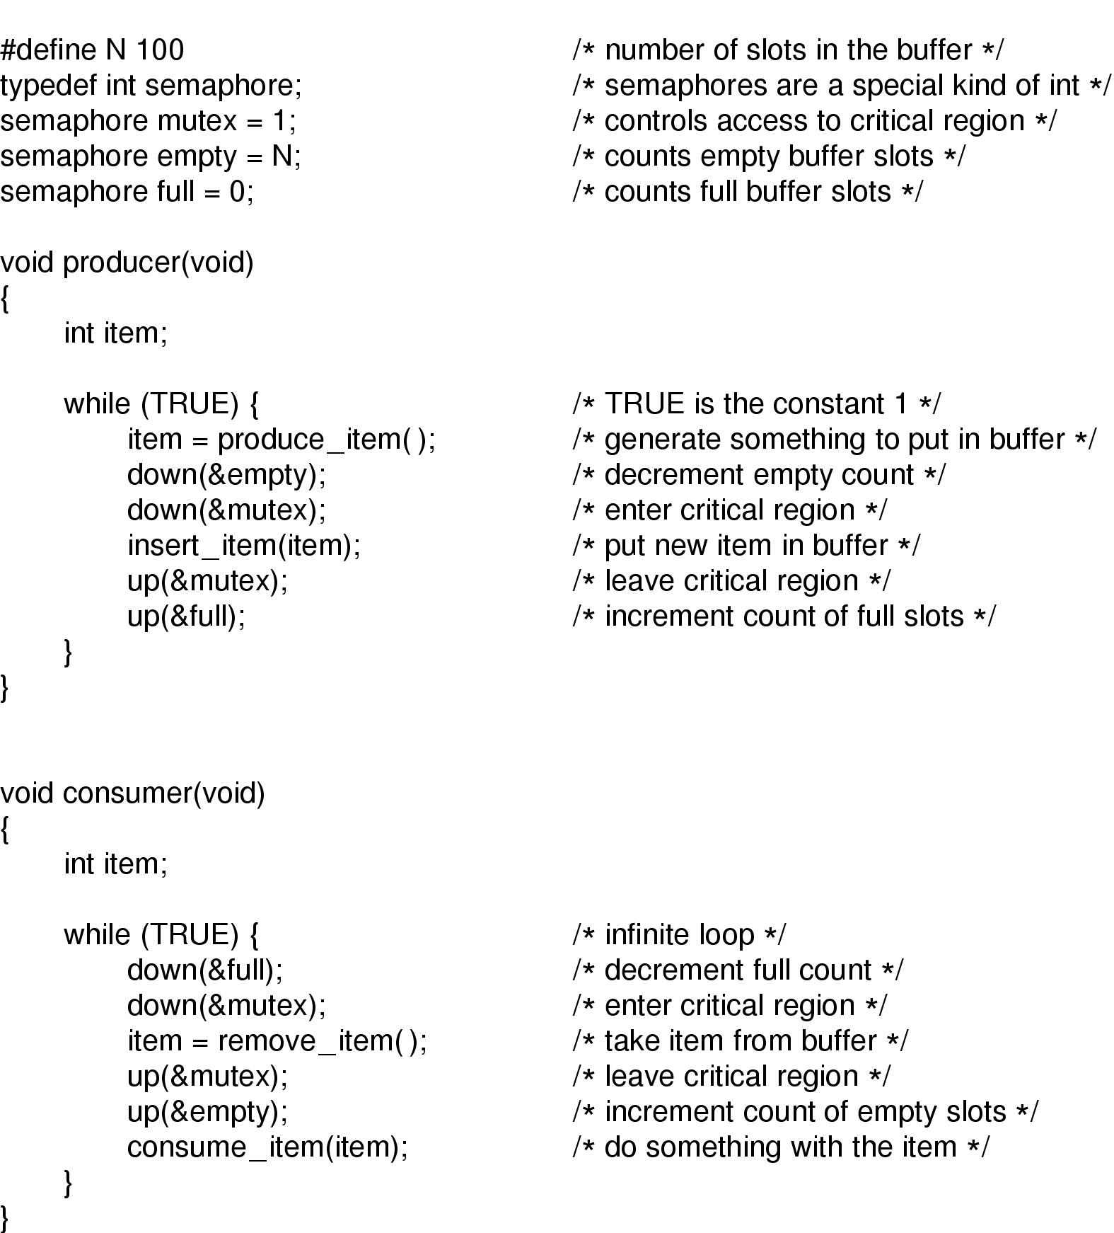
Semaphores
The producer-consumer problem using semaphores

Slide 28
Mutexes
Mutexes are simplified versions of semaphores
they are used when the semaphores ability to count is not needed
Mutex is a variable that can be in one of two states :
  Locked (1)
  Unlocked (0)
When a thread (or process) needs access to a critical region, it calls mutex_lock() on a mutex
While leaving the critical region it calls mutex_unlock()
If a mutex is already in locked state, then the thread calling the mutex_lock() on that mutex blocks
When a thread calls mutex_unlock, then one of the threads blocked on the mutex is unblocked and allowed to acquire the lock.

Slide 29
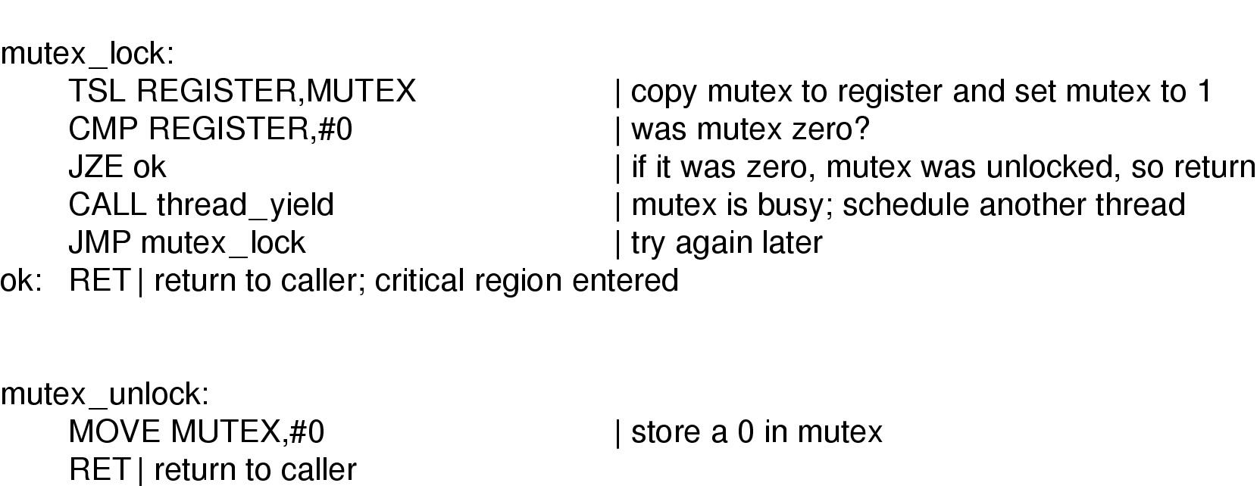
Mutexes
Implementation of mutex_lock and mutex_unlock using TSL instruction
A thread calls thread_yield() to voluntarily give up the CPU to
another thread
Thread yield is a call to the thread scheduler in user space therefore it is very fast
What if we do not use thread_yield() in case we are have a “user level” thread library?

Slide 30
Semaphores
What happens when we do a down on mutex first in the producer function?

Slide 31
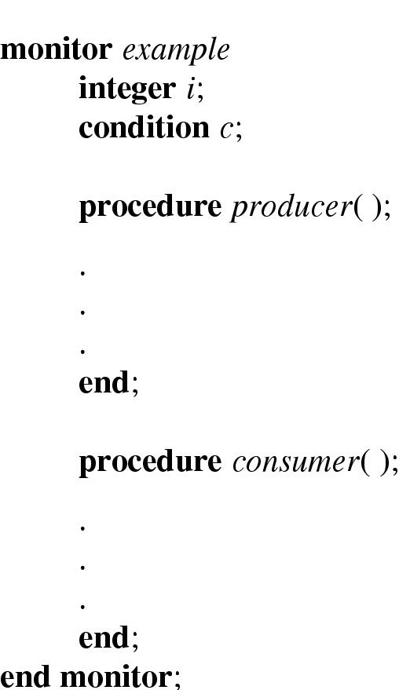
Monitors (1)
A High level synchronization primitive
Makes our life easier when writing concurrent programs
It is a collection of procedures, variables, and data structures that are all grouped together in a special kind of module
Processes may call the procedures in a monitor
Processes can NOT directly access internal data structures of a monitor from procedures declared outside of the monitor
Example of a monitor

Slide 32
Monitors (1)
Only one process can be active in a monitor at any instant
Monitors are programming language constructs, so compiler handles calls to monitor procedures.
When a process calls a monitor procedure:
  the first couple of instructions of the procedure will check to see if any other process is currently using the monitor,
  if so the calling process will will suspended until the other process leaves the monitor.
  If no process is using the monitor, the calling process may enter.

Slide 33
Monitors
For ensuring mutual exclusion, programmer turns all the critical regions into monitor procedures, this way no two process can enter their critical region at the same time
Condition variables are used to block processes
When a monitor procedure discovers that it can not continue, then it blocks on a condition variable
A process can wake up another process waiting on a condition variable by issuing a signal operation on that condition variable.
When a process does a wait on a condition variable, then it blocks, and another process can now enter its critical region (i.e., execute a procedure inside a monitor)
When a process signals another process waiting on a condition variable, then it must block or exit the monitor immediately! (think why?)
  Signal should be the last statement of a monitor procedure (we will assume this approach is used)
  Or the process that will wakeup will wait for the process which issued the signal to exit the monitor

Slide 34
Monitors
Condition variables are not counters (unlike semaphores)
The signal is lost forever if nobody is waiting for it
So wait operation must precede the signal!!

Slide 35
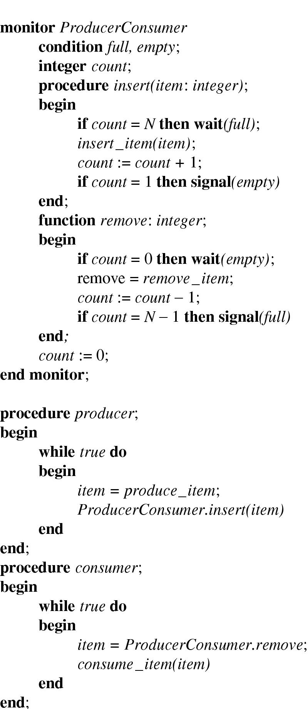
Monitors (2)
Outline of producer-consumer problem with monitors
  only one monitor procedure active at one time
  buffer has N slots

Slide 36
Monitors in Java
Java is an object oriented programming language that supports user-level threads
By adding the keyword synchronized to a method declaration guarantees that only one thread may execute the synchronized methods inside a class.
  Ex: class MyClass { public synchronized foo() { // ... } }
“wait” and “notify” are the equivalents of “wait” and “signal” for monitors

Slide 37
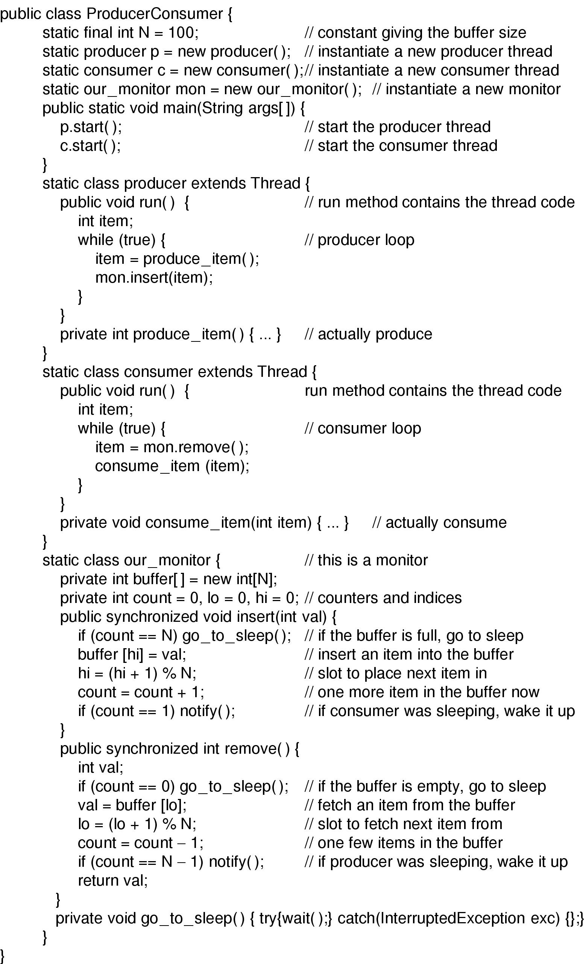
Monitors (3)
Solution to producer-consumer problem in Java (part 1)

Slide 38
Monitors (4)
go_to_sleep is like
Wait but it is uninterruptable
It performs waiting plus exception handling when wait is interrupted
Solution to producer-consumer problem in Java (part 2)

Slide 39
Monitors
Need to be supported by the programming language such as java
Monitors (like semaphores) solve the mutual exclusion problem for multiple CPUs with one shared memory.
In distributed systems where there are multiple CPUs with their own memory then message passing is needed for synchronizing processes

Slide 40
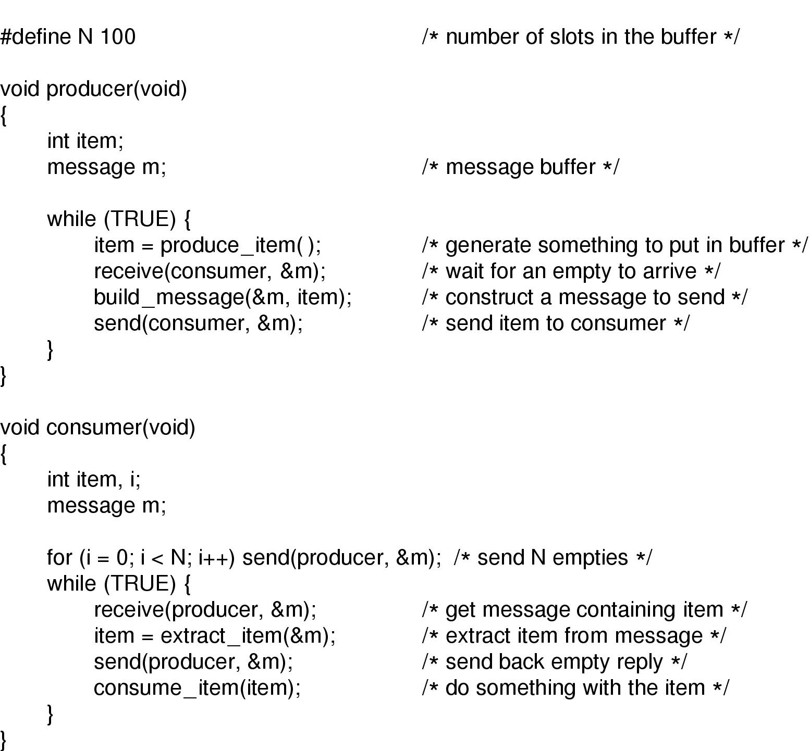
Message Passing
Two primitives are used : send() and receive() which are system calls
  Send(destination, &message)
  Receive(source, &message)
The producer-consumer problem with N messages

Slide 41
Message Passing
Challenges:
  Lost messages (handled through ack messages, but what happens when the ack message is lost?)
  Naming processes for sending and receiving mesaages
  Authentication
Buffering: mailboxes are used to hold messages that have been sent to the destination but that have not been accepted
Rendezvous: no buffering at all, blocking send and receive calls, i.e., sender is blocked until the receiver receives the message.
Example message passing system: MPI (Message Passing Interface)
POSIX msgsnd, and msgrcv are used for sending an receiving messages among processes.

Slide 42
Barriers
Some applications are divided into phases and no process may go to next phase until all processes are ready for it.
This can be achieved by
  placing a barrier at the end of each phase
  And when a process reaches a barrier, it is blocked untill all others reach the barrier

Slide 43
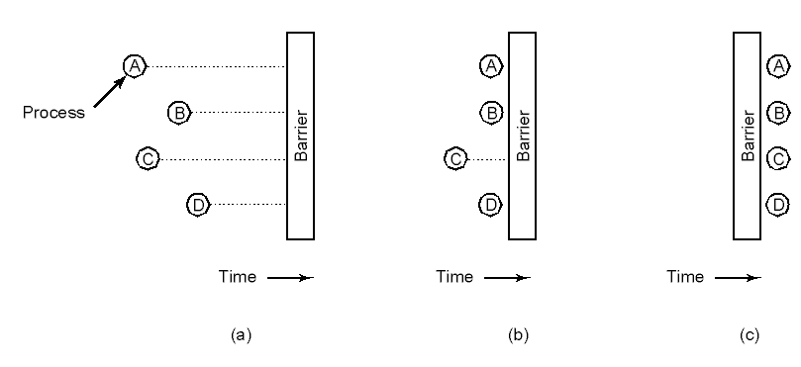
Barriers
Use of a barrier
  processes approaching a barrier
  all processes but one blocked at barrier
  last process arrives, all are let through

Slide 44
Classical IPC Problems
Dining philosophers problem (Dijkstra)
  Models processes competing for exclusive access to a limited number of resources such as I/O devices
Readers and writers problem (Courtois et al.)
  Models access to a database (both read and write)
Sleeping barber problem
  Models queuing situations such as a multi-person helpdesk with a computerized call waiting system for holding a limited number of incoming calls

Slide 45

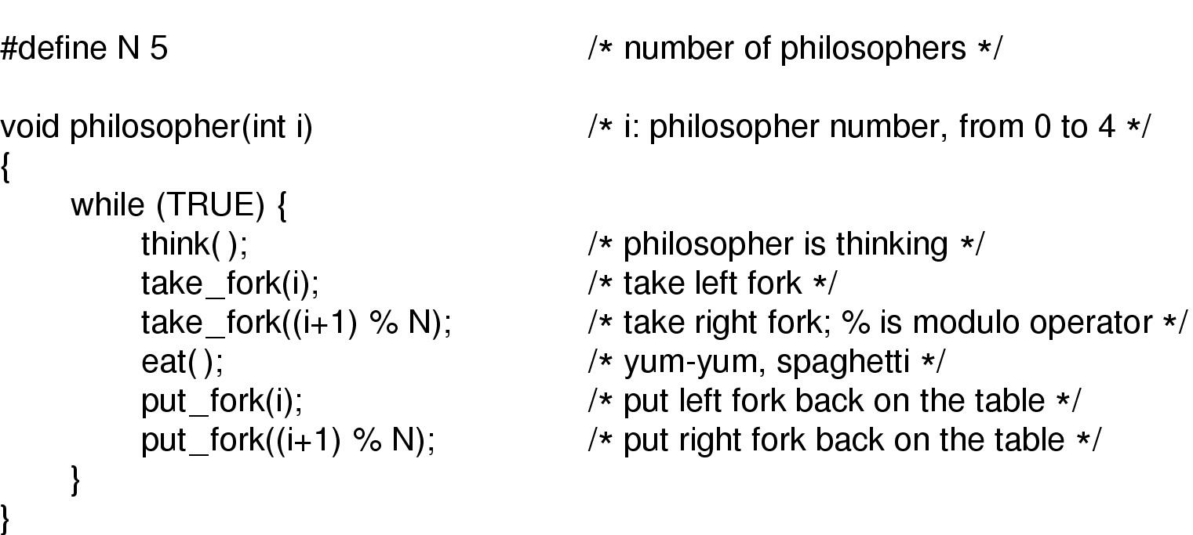
Dining Philosophers (1)
5 Philosophers around a table and 5 forks
Philosophers eat/think
Eating needs 2 forks
Pick one fork at a time (first the right fork then the left one and eat)
What problems may occur in this case?

Slide 46
Dining Philosophers (1)
All philosophers may take their right fork at the same time and block when the left forks are not available.
Solution: (like collusion detection in Ethernet protocol)
  pick left fork,
  if the right fork is not available then release left fork and wait for sometime
There is still a problem!!!!

Slide 47
Dining Philosophers (1)
What happens when all philosophers do the same thing at the same time?
This situation is called starvation: a type of deadlock where everybody is doing something but no progress is made
Solution is to use use a mutex_lock before taking the forks and release the lock after putting the forks back to the table
Is this a good solution?
No, because only one philosopher can eat at a time but there
Are enough forks for two!!!

Slide 48
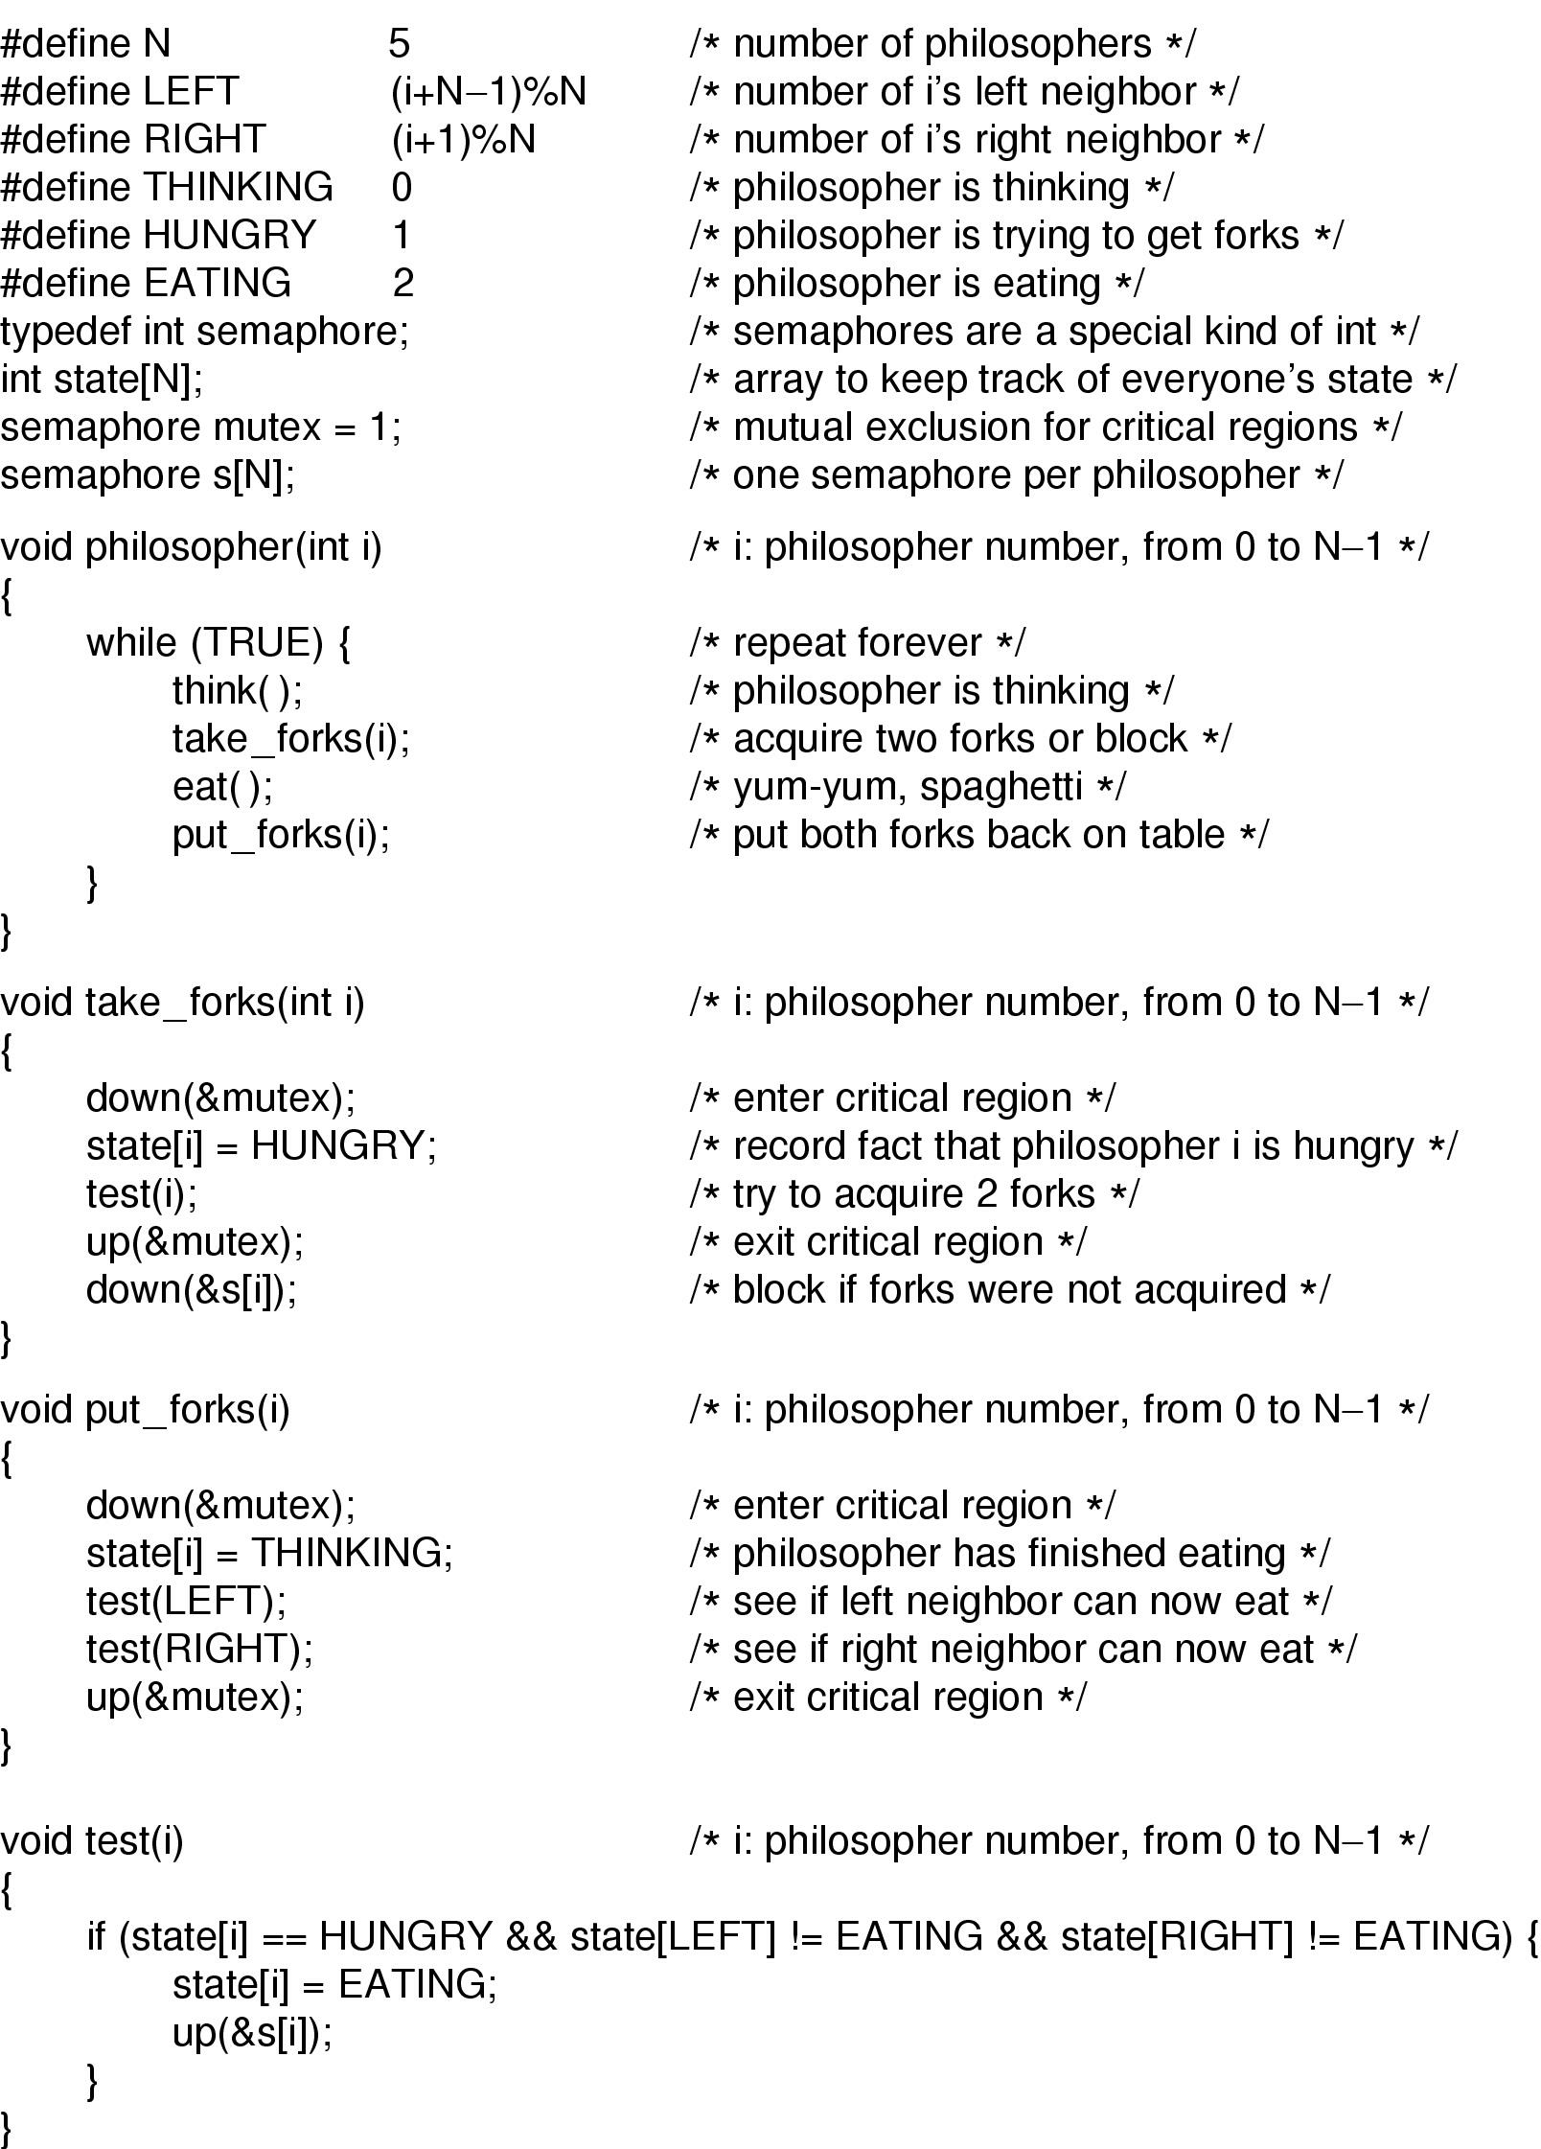
Dining Philosophers (3)
Solution to dining philosophers problem (part 1)

Slide 49
Dining Philosophers (4)
Solution to dining philosophers problem (part 2)

Slide 50
Readers and Writers Problem
Assume that there is a database, and processes compete for reading from and writing to the database
Multiple processes may read the database without any problem
A process can write to the database only if there are no other processes reading or writing the database
Here are the basic steps or r/w problem assuming that rc is the reader count (processes currently reading the database)
  A reader who gains access to the database increments rc (when rc=1, it will lock the database against writers)
  A reader that finishes reading will decrement rc (when the rc=0 it will unlock the database so that a writer can proceed)
  A writer can have access to the database when rc = 0 and it will lock the database for other readers or writers
  Readers will access the database only when there are no writers (but there may be other readers)

Slide 51
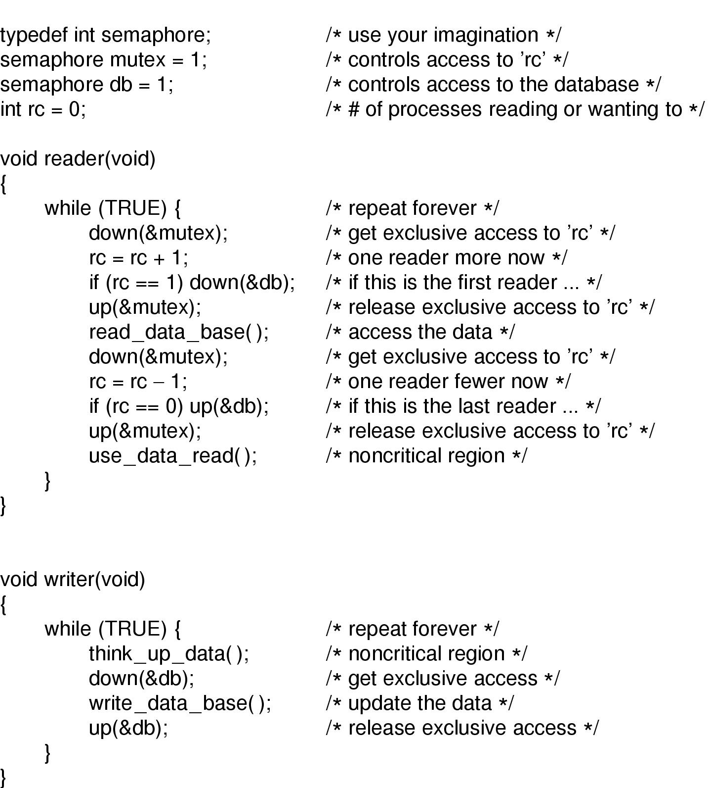
The Readers and Writers Problem
What is the problem with this solution?
The writer will starve when there is constant supply op readers !!!!
Solution is to queue new readers behind the current writer at the expense of reduced concurrency
A solution to the readers and writers problem

Slide 52
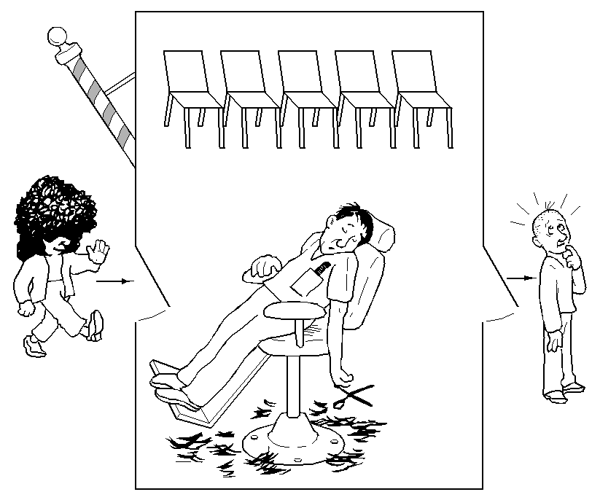
The Sleeping Barber Problem (1)
There is one barber, and n chain of waiting customers
If there are no customers, then the barber sits in his chair and sleeps (as illustrated in the picture)
When a new customer arrives and the barber is sleeping, then he will wakeup the barber
When a new customer arrives, and the barber is busy, then he will sit on the chairs if there is any available, otherwise (when all the chairs are full) he will leave.

Slide 53
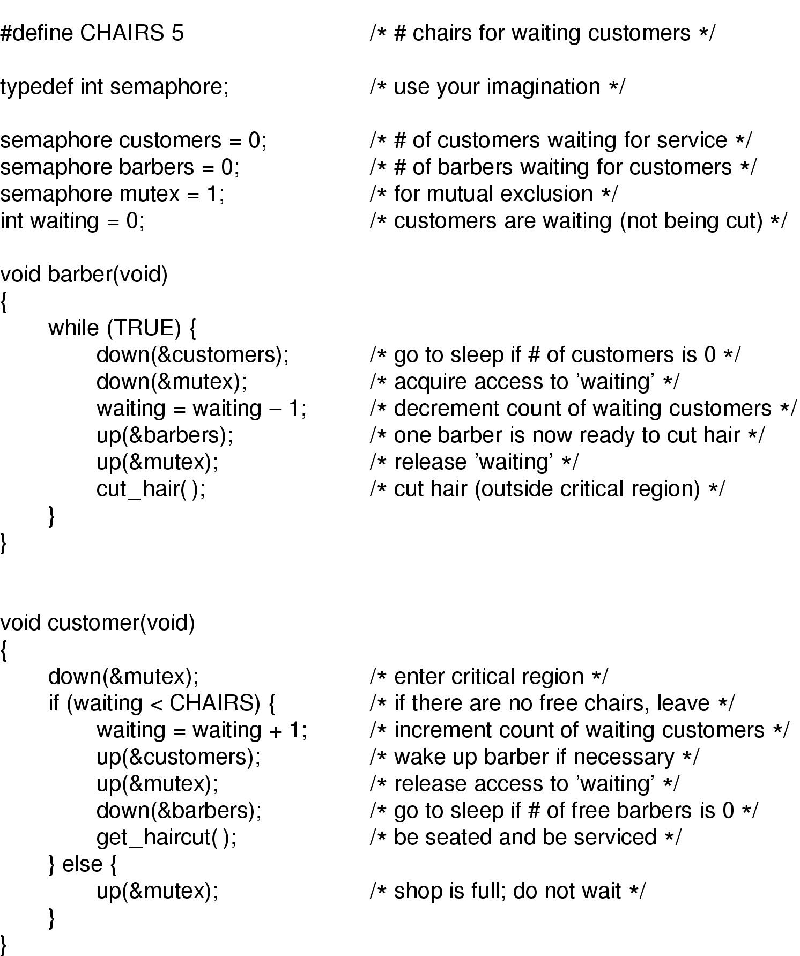
The Sleeping Barber Problem (2)
Solution to sleeping barber problem.

