Slide 1
Scheduling
Yücel Saygın
|These slides are based on your text book and on the slides prepared by Andrew S. Tanenbaum

Slide 2

Scheduling
Introduction to Scheduling (1)
Bursts of CPU usage alternate with periods of I/O wait
  a CPU-bound process
  an I/O bound process

Slide 3
Introduction to Scheduling:
Scheduling Algorithm Goals
All Systems:
  Fairness: giving each process a fair share of the CPU
  Policy enforcement: seeing that stated policy is carried out
  Balance: keeping all parts of the system busy
Batch Systems:
  Maximize jobs per hour
  Minimize time between submission and termination of a task
  CPU utilization: keep the CPU busy at all times
Interactive systems:
  Respond to requests quickly
  Meet users’ expectations (a task that is supposed to take a short time should finish quickly, and not surprise the user in terms of his/her expectations)
Real-time systems:
  Meeting deadlines: avoid losing data
  Predictability: avoid quality degradation in multimedia systems

Slide 4
Introduction to Scheduling:
Preemptive vs. non-preemptive scheduling
  With preemptive scheduling scheduler will run a process for a maximum specified time (not as much as it has to run) and then picks another process to run
  With non-preemptive scheduling the scheduler pricks a process to run and lets it run until it blocks or voluntarily releases the CPU (how did that happen with threads?). A process will not be forcibly suspended.

Slide 5
Introduction to Scheduling (2)
Current Systems usually run a mix of batch, (soft) real-time, interactive
Therefore it is essential to understand the issues in all such systems individually.

Slide 6
Scheduling in Batch Systems (1)
Two important parameters:
  Turnaround time: statistical average of time from the moment a batch job is submitted till the moment it is completed (less is better)
  Throughput : number of jobs per unit time that the system completes (usually an hour, and more is better)
Scheduling algorithm that maximizes throughput may not necessarily minimize turnaround time
  Ex: running short jobs only, and never running the long jobs will maximize throughput but induce terrible turnaround time for long jobs (making the turnaround time infinite in the long run)

Slide 7
Scheduling in Batch Systems (1)
First-Come First-Served:
  Assign the the CPU to processes in the order requested
  A single queue of ready processes, as the jobs come in, they are put onto the end of the queue.
  When the running process blocks, the first process (in the ready queue) is run next
  When a blocked process becomes ready, it is appended at the end of the queue (like a new coming process)
Advantages:
  Very simple to understand, easy to implement with a single queue
  Fair (in the sense that early bird catches the worm)
Disadvantage:
  Consider I/O bound processes that use little CPU but have to perform 1000 disk reads to complete, and one big CPU bound process that runs for 1 sec and reads a disk block continuously.
  With FCFS, I/O bound processes will finish in 1000 seconds (will all quickly finish using CPU, and wait for the CPU bound process for a second after each disk read)

Slide 8
Scheduling in Batch Systems (1)
Shortest Job First
  Assumes that the running times of jobs can be predicted (e.g. taking the backup of a 1GB database to the tape, reading 100 records from the database)
  The scheduler picks the shortest job and assigns the CPU to that job.

Slide 9
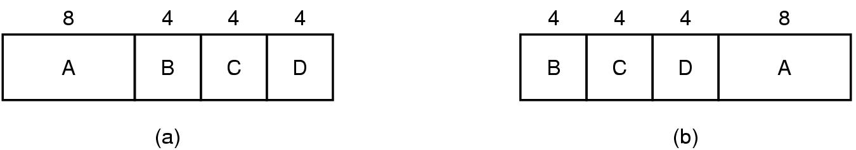
Scheduling in Batch Systems (1):
Shortest Job First
Assume that we have 4 jobs: A, B, C, D with run times 8, 4, 4, 4 minutes respectively.
If we run them in the order of arrival (FCFS), then the average turnaround time will be 14 mins
  Since Turnaround time for A is 8 mins, for B: 12 mins, C: 16mins, D: 20 mins, average is (8+12+16+20)/4= 14 mins
If we use Shortest Job First (SJF) then it will be 11 mins
  (4 + 8 + 12 + 20)/4 = 11
Consider the running times of processes as a, b, c, d and calculate the average (mean) turnaround time. And see why SJF is used to minimize turnaround time.

Slide 10
Scheduling in Batch Systems (1):
Shortest Job First
SJF is optimal when all the jobs are available at the start
Consider 5 jobs, A, B, C, D, E, with run times: 2, 4, 1, 1, 1, respectively and their arrival times are: 0, 0, 3,3, 3 respectively.
Using SJF what will be the order of execution and mean turnaround time?
What is the turnaround time when we run them in the order B, C, D, E, A?

Slide 11
Scheduling in Batch Systems (1):
Shortest Remaining Time First
Shortest Remaining Time First is the preemptive version of SJF.
The scheduler chooses the process that has the shortest remaining time.
When a new process arrives, the time for that process is compared with the running process’ remaining time. If the new job needs less time to finish then the current process, the current process is suspended and the new job is started.
This allows new short jobs to get good service
However the remaining times of jobs need to be known in advance!

Slide 12
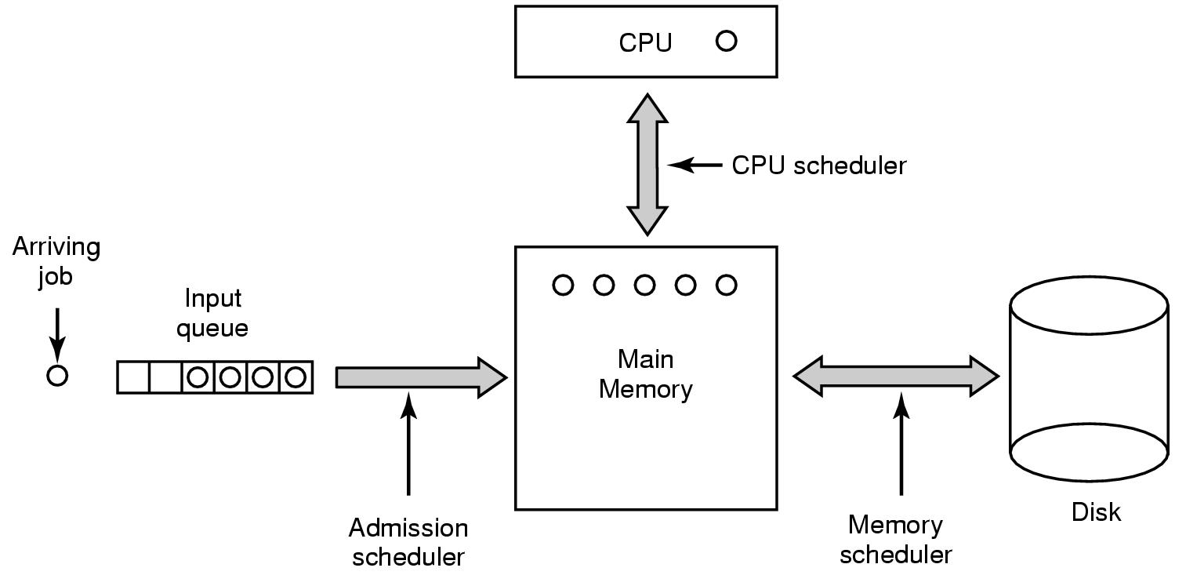
Scheduling in Batch Systems (2)
Three level scheduling

Slide 13
Three Level Scheduling (Cont’d)
Admission Scheduler
  Submitted jobs are kept in the input queue
  Admission Scheduler decides which job to admit to the system
  Usually accepts a mix of I/O and CPU bound processes to keep all parts of the system busy
Memory Scheduler
  Decides which processes should be kept in memory and which ones in disk
  Decides on the Degree of multiprogramming (number of processes in main memory) and maintains a mix of I/O CPU bound processes in memory
  Tries to achieve a fair allocation of memory
CPU scheduler
  Is the scheduler that we speak about in general

Slide 14
Scheduling in Interactive Systems (1)
Only two levels of scheduling are used (memory and CPU scheduling)
CPU Scheduling is the main focus and we will see the following scheduling algorithms
  Round Robin Scheduling
  Priority Scheduling
  Multiple Queues (a hybrid of round robin and priority scheduling)
  Shortest process next
  Guaranteed Scheduling
  Lottery Scheduling
  Fair-share scheduling

Slide 15
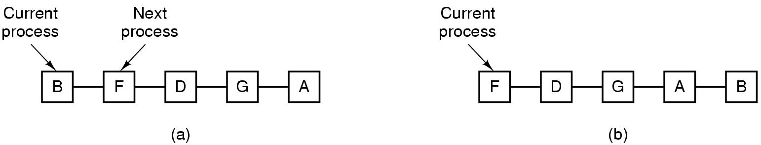
Scheduling in Interactive Systems :
Round Robin Scheduling
RR Scheduling is simple, fair, and the most widely used scheduling algorithm
There is a list of runnable processes maintained as a queue
Each process is assigned a a time interval (called its quantum) for which it is allowed to run
A process using the CPU is preempted if it used up its quantum (note that a process may be blocked say for I/O, before its quantum has elapsed)
The queue structure is shown in the figure
  Figure (a) depicts the case when B is still running
  Figure (b) shows the queue after B used all its quantum (or blocked for I/O) and preempted by the scheduler

Slide 16
Scheduling in Interactive Systems :
Round Robin Scheduling
The length of the quantum is an important parameter for RR scheduling
Switching from one process to another (context switch) requires some administrative work (saving, loading registers, flushing/reloading the cache, updating various tables, lists etc)
Suppose quantum is 4 msec, and context switch takes 1 msec, then 20% of the CPU time is wasted for administrative overhead.
Setting the quantum to 99 msec cause only 1% of the CPU to be wasted but this is too high in interactive systems (consider 10 people using the system in a queue, the last one will get a chance to get a response after 1 sec is all the processes fully use their quantum)
20-50 msec quantum time seems to be a reasonable compromise

Slide 17
Scheduling in Interactive Systems :
Priority Scheduling
Each process is assigned a priority
A runnable process with the highest priority is allowed to run
  Ex: a daemon process sending an email in the background should have a lower priority than a process displaying a film in real time
Priorities could be assigned
  statically
  Or dynamically (e.g., giving higher priority to I/O bound processes that use little CPU, 1/f is a good heuristic where f is the fraction of the last quantum the process used)

Slide 18
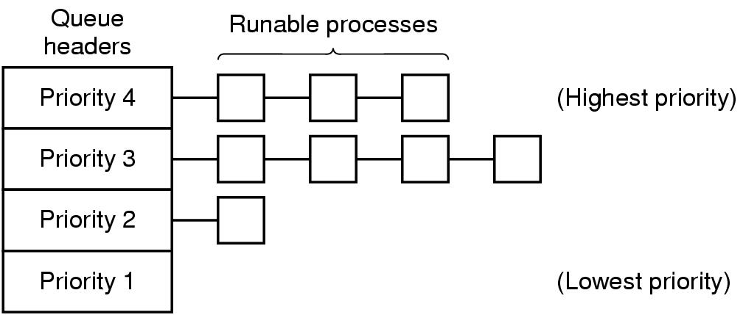
Scheduling in Interactive Systems (2)
Instead of absolute priorities, we may assign priority classes to processes (from high to low)
A scheduling algorithm with four priority classes is shown above
Runnable processes with the highest priority is executed first in round robin fashion with a certain quantum.

Slide 19
Scheduling in Interactive Systems :
Priority Scheduling
With priority scheduling, low priority jobs may starve. To prevent this:
  The priority of the running process may be decreased at each clock tick
  Processes may have a quantum during which they are allowed to run. When the current process uses up its quantum, next higher priority process is scheduled.

Slide 20
Scheduling in Interactive Systems :
Priority Scheduling with multiple queues (CTSS system)
CTSS (Compatible Time Sharing System), One of the earliest (1963) experiments in the design of interactive time-sharing operating systems, can be considered as the ancestor of Multics and Unix.
Memory could hold only one process, so switching from one process to the other was slow
To decrease the number of swaps for long running processes,
  priority classes were defined (a queue for each class)
  Processes in the highest priority class could run for one quantum, in the second highest priority class, for 2 quanta, next higher, 4 quanta, next higher 8 quanta, and son on.
  A new process starts at the highest priority level and each time it uses all the quanta allocated to it, it is moved down one class.
  Long processes run less frequently for longer quanta. This way short interactive processes would be favored for CPU assignment.
Whenever “enter” was typed at a terminal, the process was assumed to be interactive, and moved to the highest class, at the end people abused this by pressing enter all the time.

Slide 21
Shortest Process Next
Tries the adopt the shortest process first used in batch systems to interactive systems
Estimation of the running times is important
Running time of a command is estimated by the formula (aT₀ + (1-a)T₁) where T₀ is the estimated running time and T₁ is the measured time in the next run.
For a = ½, successive estimates are:
  T0
  T0/2 + T1/2
  T0/4 + T1/4 + T2/2
  T0/8 + T1/8 + T2/4 + T3/2
This technique is called aging (reducing the weight of old estimates but still incorporating them in the estimation)

Slide 22
Guaranteed Scheduling
Tries to give a fair share of CPU to each process (i.e 1/N of the CPU time to each process if there are N processes)
Computes the ratio of actual CPU time used to the CPU time that the process should have been assigned (for a fair CPU assignment)
Runs the process with the lowest ration until the ratio moves above its closest competitor.

Slide 23
Lottery Scheduling
Gives processes lottery tickets for CPU time.
Whenever a scheduling decision is going to be made, a ticket is drawn randomly, and the process that owns the ticket is allowed to use the CPU.
Processes with more tickets have a higher chance of running.
Cooperating processes may exchange tickets if they wish (for example a client process may give its tickets to the server to finish its job quickly)
Very handy for resource allocation
  For example when client processes need different frame rates from a video server such as 10, 20, and 25 frames/sec/ By allocating these processes 10, 20, and 25 tickets, respectively will automatically divide the CPU approximately the correct proportion

Slide 24
Fair-Share Scheduling
Takes into account the owner of the process when scheduling
CPU time is shared among the users fairly (otherwise a user with many processes would have most of the CPU time)
Eg: User 1 has 4 processes, A, B, C, D, and user 2 has 1 process E. Then with round robin scheduling the execution sequence would be:
  A E B E C E D E …..

Slide 25
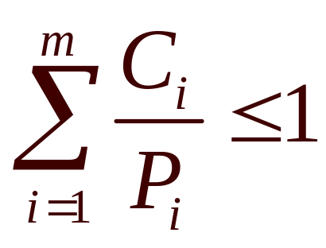
Scheduling in Real-Time Systems
Hard real-time systems (absolute deadlines must be met)
Soft real-time systems (missing an occasional deadline is not desirable but tolerable)
Schedulable real-time system
  m periodic events
  event i occurs within period P_{i} and requires C_{i} seconds
Then the load can only be handled if

Slide 26
Scheduling in UNIX
Uses Fair-Share Scheduling
Gives pre-specified rate of system resources to a related set of users.
Specific users are assigned to fair share groups (ex. TA, Professor)
Distributes unused resources by one fair share group to other fair share groups wrt their relative needs
System Resources
100%
|Fair Share Scheduler
50%
25%
25%
Process
Scheduler
Process
Scheduler
Process
Scheduler
Group1
Group2
Group3

Slide 27
Scheduling In Unix
BSD Unix has 32 queues
  0…7 are for system processes
  8…31 are user space processes
  Each queue is executed in round robin fashion
  External priority, nice() is used to affect the priority queue
  Priorities are recomputed after each quantum by looking at the CPU demand of each process (more demand -> less priority)

Slide 28
Scheduling Mechanism of Linux
(http://www.oreilly.com/catalog/linuxkernel/chapter/ch10.html)
Each process has a quantum and priority associated with it
Linux (like all Unix kernels) implicitly favors I/O-bound processes over CPU-bound ones.
In order to select a process to run, the Linux scheduler must consider the priority of each process. Actually, there are two kinds of priority:
  Static priority assigned by the users to real-time processes and ranges from 1 to 99. It is never changed by the scheduler.
  Dynamic priority (applies only to conventional processes); it is essentially the sum of the base time quantum (which is therefore also called the base priority of the process) and of the number of ticks of CPU time left to the process before its quantum expires in the current epoch.
The static priority of a real-time process is always higher than the dynamic priority of a conventional one: the scheduler will start running conventional processes only when there is no real-time process in a TASK_RUNNING state.

Slide 29
Process Preemption in Linux
http://www.oreilly.com/catalog/linuxkernel/chapter/ch10.html
The previous version of the Linux kernel were not preemptive, which means that a process can be preempted only while running in User Mode;
Therefore previous versions of Linux could not be considered as a “real” real-time operating system
nonpreemptive kernel design is much simpler, since most synchronization problems involving the kernel data structures are easily avoided
Starting from version 2.6, Linux kernel is fully preemptive.
Process preemption (for processes running in user mode):
  When a process becomes ready to run, kernel checks whether the dynamic priority of the new process is greater than the priority of the running process. If it is, the execution of current is interrupted and the scheduler is invoked to select another process to run (usually the process that just became runnable).
  process may also be preempted when its time quantum expires

Slide 30
Process Scheduling in Linux
http://www.oreilly.com/catalog/linuxkernel/chapter/ch10.html
The Linux scheduling algorithm works by dividing the CPU time into epochs.
In a single epoch, every process has a specified time quantum computed when the epoch begins. Different processes may have different time quantum durations.
When a process has exhausted its time quantum, it is preempted and replaced by another runnable process.
A process can be selected several times from the scheduler in the same epoch, as long as its quantum has not been exhausted--for instance, if it suspends itself to wait for I/O, it preserves some of its time quantum and can be selected again during the same epoch.
The epoch ends when all runnable processes have exhausted their quantum; in this case, the scheduler algorithm recomputes the time-quantum durations of all processes and a new epoch begins.

Slide 31
Process Scheduling in Linux
http://www.oreilly.com/catalog/linuxkernel/chapter/ch10.html
The users can change the time quantum of their processes by using the nice( ) and setpriority( ) system calls
A new process always inherits the base time quantum (the time quantum assigned at the beginning of the epoch) of its parent.

Slide 32
Policy versus Mechanism
Separate what is allowed to be done with how it is done
  a process knows which of its children threads are important and need priority
Scheduling algorithm parameterized
  mechanism in the kernel
Parameters filled in by user processes
  policy set by user process

Slide 33
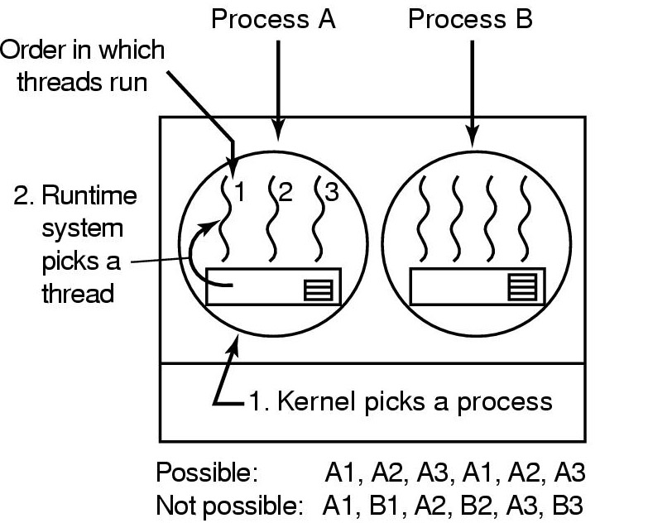
Thread Scheduling (1)
Possible scheduling of user-level threads
50-msec process quantum
threads run 5 msec/CPU burst

Slide 34
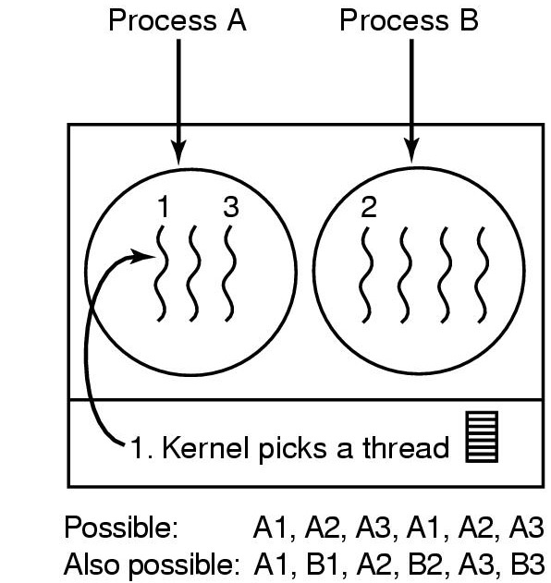
Thread Scheduling (2)
Possible scheduling of kernel-level threads
50-msec process quantum
threads run 5 msec/CPU burst

