Slide 1
Deadlocks
Chapter 3
3.1. Resource
3.2. Introduction to deadlocks
3.3. The ostrich algorithm
3.4. Deadlock detection and recovery
3.5. Deadlock avoidance
3.6. Deadlock prevention
3.7. Other issues

Slide 2
Resources
Examples of computer resources
  printers
  tape drives
  tables
Processes need access to resources in reasonable order
Suppose a process holds resource A and requests resource B
  at same time another process holds B and requests A
  both are blocked and remain so

Slide 3
Resources (1)
Deadlocks occur when …
  processes are granted exclusive access to devices
  we refer to these devices generally as resources
Preemptable resources
  can be taken away from a process with no ill effects
Nonpreemptable resources
  will cause the process to fail if taken away

Slide 4
Resources (2)
Sequence of events required to use a resource
  request the resource
  use the resource
  release the resource
Must wait if request is denied
  requesting process may be blocked
  may fail with error code

Slide 5
Resource Acquisition
typedef int semaphore;
semaphore resource_1;
semaphore resource_2;
void process_A(void)
{
down(&resource_1);
down(&resource_2);
use_both_resources();
up(&resource_2);
up(&resource_1);
}
typedef int semaphore;
semaphore resource_1;
void process_A(void)
{
down(&resource_1);
use_resource_1();
up(&resource_1);
}
(a) Acquiring 1 resource
(b) Acquiring 2 resources

Slide 6
Resource Acquisition
typedef int semaphore;
semaphore resource_1;
semaphore resource_2;
void process_A(void)
{
down(&resource_1);
down(&resource_2);
use_both_resources();
up(&resource_2);
up(&resource_1);
}
void process_B(void)
{
down(&resource_2);
down(&resource_1);
use_both_resources();
up(&resource_1);
up(&resource_2);
}
typedef int semaphore;
semaphore resource_1;
semaphore resource_2;
void process_A(void)
{
down(&resource_1);
down(&resource_2);
use_both_resources();
up(&resource_2);
up(&resource_1);
}
void process_B(void)
{
down(&resource_1);
down(&resource_2);
use_both_resources();
up(&resource_2);
up(&resource_1);
}
(a) Deadlock free code
(b)Code with potential deadlock

Slide 7
Introduction to Deadlocks
Formal definition :
A set of processes is deadlocked if each process in the set is waiting for an event that only another process in the set can cause
Usually the event is release of a currently held resource
None of the processes can …
  run
  release resources
  be awakened

Slide 8
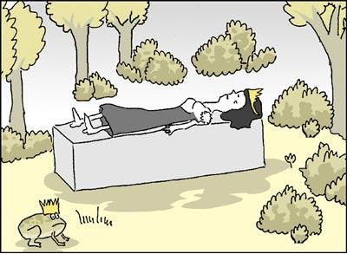
DEADLOCK ILLUSTRATION

Slide 9
Four Conditions for Deadlock
Mutual exclusion condition
  each resource assigned to 1 process or is available
Hold and wait condition
  process holding resources can request additional resources
No preemption condition
  previously granted resources cannot forcibly taken away
Circular wait condition
  must be a circular chain of 2 or more processes
  each is waiting for resource held by next member of the chain

Slide 10
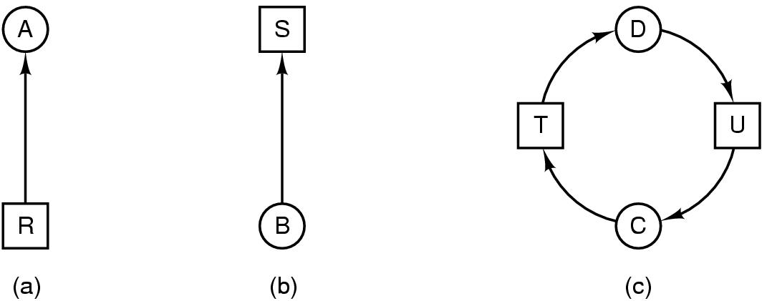
Deadlock Modeling (2)
Modeled with directed graphs
  resource R assigned to process A
  process B is requesting/waiting for resource S
  process C and D are in deadlock over resources T and U

Slide 11
Deadlock Modeling (3)
Strategies for dealing with Deadlocks
  just ignore the problem altogether
  detection and recovery
  dynamic avoidance
    careful resource allocation
  prevention
    negating one of the four necessary conditions

Slide 12
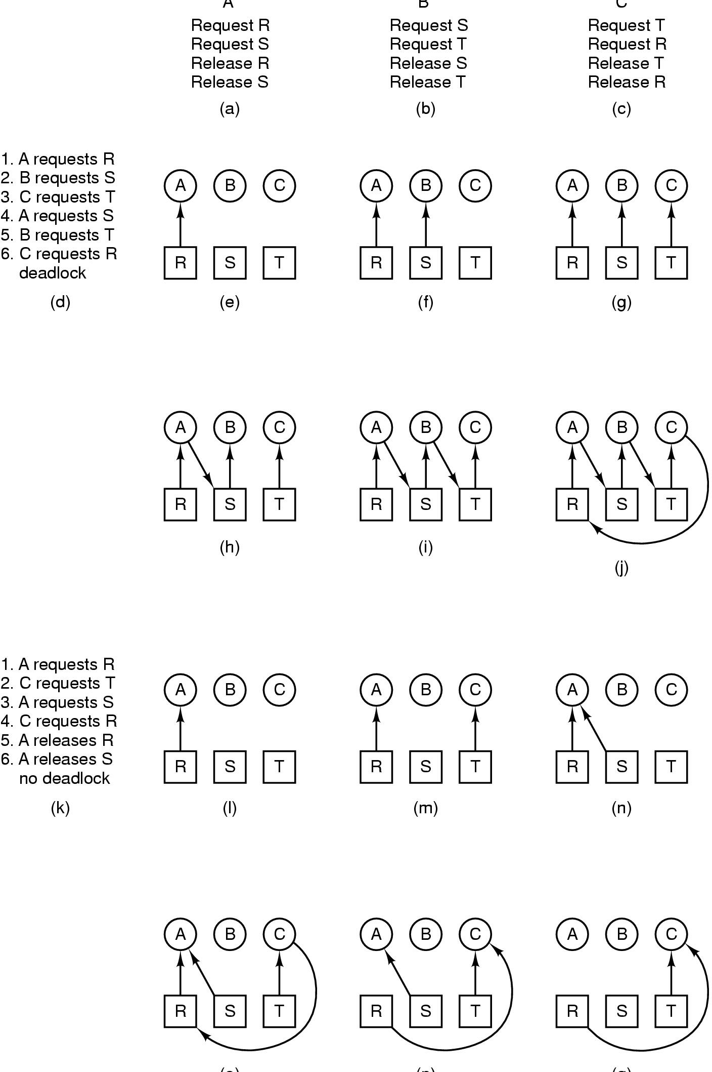
Deadlock Modeling (4)
A B C
How deadlock occurs

Slide 13
Deadlock Modeling (5)
(o) (p) (q)
How deadlock can be avoided

Slide 14
The Ostrich Algorithm
Pretend there is no problem
Reasonable if
  deadlocks occur very rarely
  cost of prevention is high
UNIX and Windows takes this approach
It is a trade off between
  convenience
  correctness

Slide 15

Detection with One Resource of Each Type (1)
Note the resource ownership and requests
A cycle can be found within the graph, denoting deadlock

Slide 16
Deadlock Detection Algorithm for one resource of each type
For each node N in the graph, perform the following 5 steps with N as the starting node
Initialize L (i.e., list of nodes) to the empty list and designate all the arcs as unmarked
Add the current node to the end of L and check to see if the node now appears in L two times. If it does, the graph contains a cycle (listed in L) and the algorithm terminates
For the given node, see if there are any unmarked outgoing arcs. If so, go to step 5; if not, go to step 6.
Pick and unmarked outgoing arc at random and mark it. Then follow it to the new current node and go to step 3.
We have now reached a dead end. Remove it and go back to the previous node, that is, the one that was current just before this one, make that one the current node, and go to step 3. IF this node is the initial node, the graph does not contain any cycles and the algorithm terminates.

Slide 17
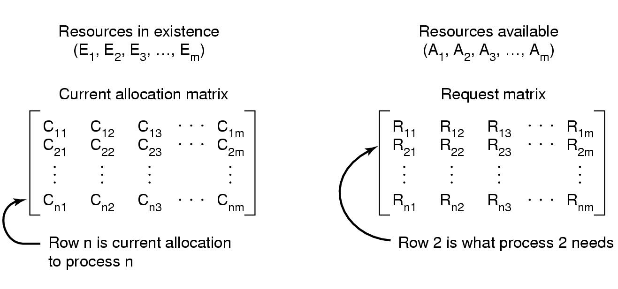
Detection with Multiple Resources of Each Type (2)
Data structures needed by deadlock detection algorithm

Slide 18
Deadlock detection with multiple Resources of each type
Each process is initially unmarked. And the algorithm progresses, processes will be marked, indicating that they are able to complete and are thus not deadlocked
When the algorithm terminates, any unmarked processes are known to be deadlocked.
The deadlock detection alg is as below:
  Look for an unmarked process Pi, for which the ith row of R is less than or equal to A.
  If such a process is found, add the i^{th} row of C to A mark the process, and go back to step 1.
  If no such process exists, the algorithm terminates.

Slide 19
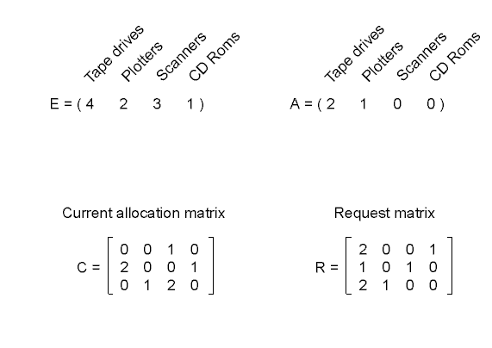
Detection with Multiple Resource of Each Type (3)
An example for the deadlock detection algorithm

Slide 20
Recovery from Deadlock (1)
Recovery through preemption
  take a resource from some other process
  depends on nature of the resource
Recovery through rollback
  checkpoint a process periodically
  use this saved state
  restart the process if it is found deadlocked

Slide 21
Recovery from Deadlock (2)
Recovery through killing processes
  crudest but simplest way to break a deadlock
  kill one of the processes in the deadlock cycle
  the other processes get its resources
  choose process that can be rerun from the beginning

Slide 22
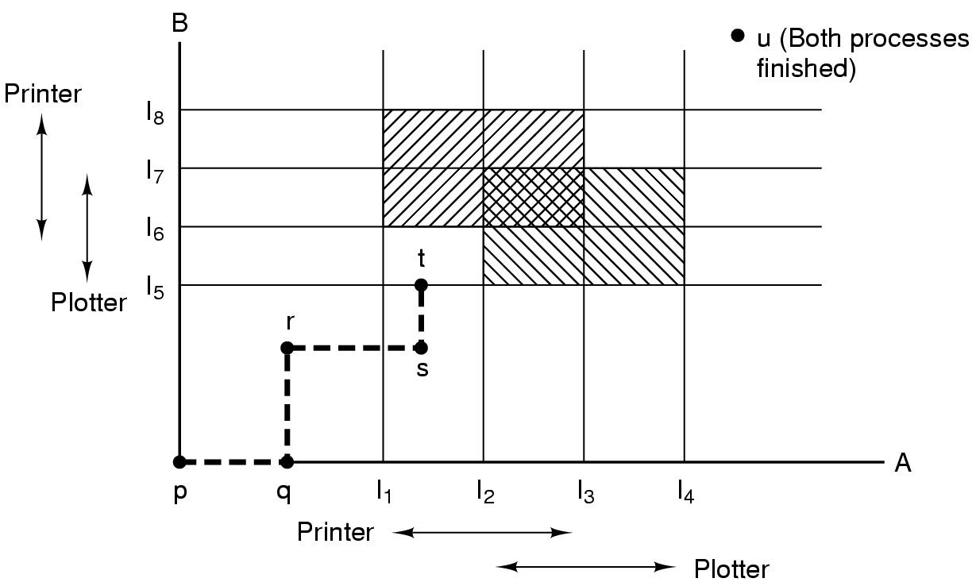
Deadlock Avoidance
Resource Trajectories
Two process resource trajectories

Slide 23
Safe and Unsafe states
A state is called safe if it is not deadlocked and there is some scheduling order in which every process can run to completion even if all of them suddenly requests their maximum number of resources immediately.
Otherwise the state of the system is said to be unsafe
Safe/unsafe states are anonymous to a banker with loans
Note that an unsafe state is not a deadlocked state, but there is a possibility that the system MAY go into a deadlocked state

Slide 24
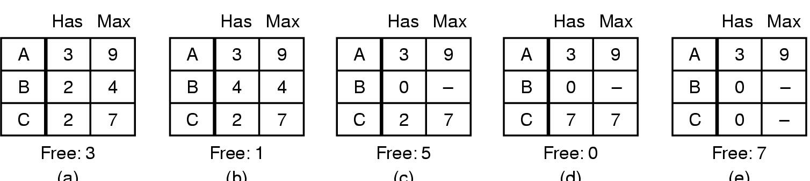
Safe and Unsafe States (1)
Demonstration with one resource where 10 instances of the same resource exists
(a) (b) (c) (d) (e)
Demonstration that the state in (a) is safe cause deadlock can be avoided with careful scheduling

Slide 25
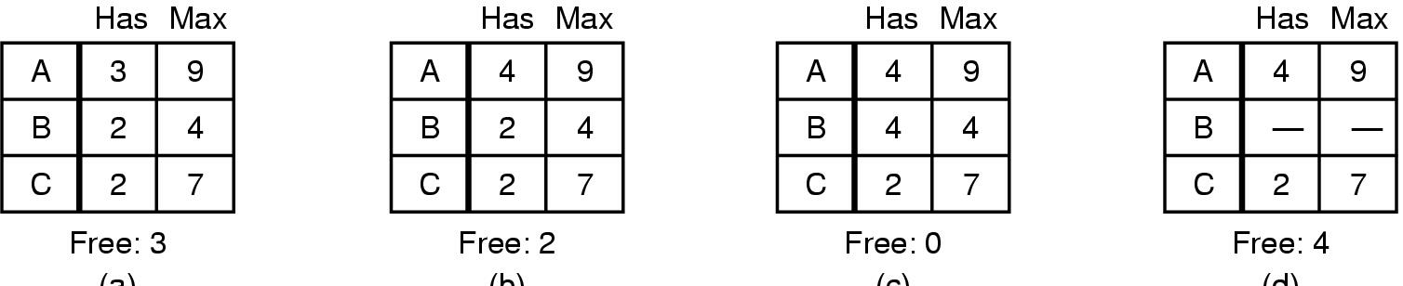
Safe and Unsafe States (2)
(a) (b) (c) (d)
Demonstration that the sate in b is not safe (after A requests one more resource and the resource is granted to A)

Slide 26
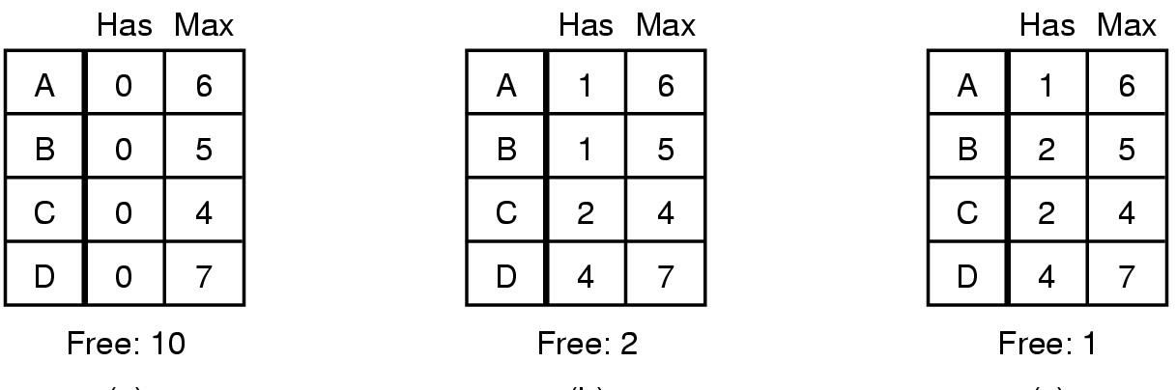
The Banker's Algorithm by Dijksta for a Single Resource for deadlock avoidance
(a) (b) (c)
Two resource allocation states
  (a) safe
  (b) Unsafe
Grant a request only if it leads to a safe state, otherwise delay the request

Slide 27
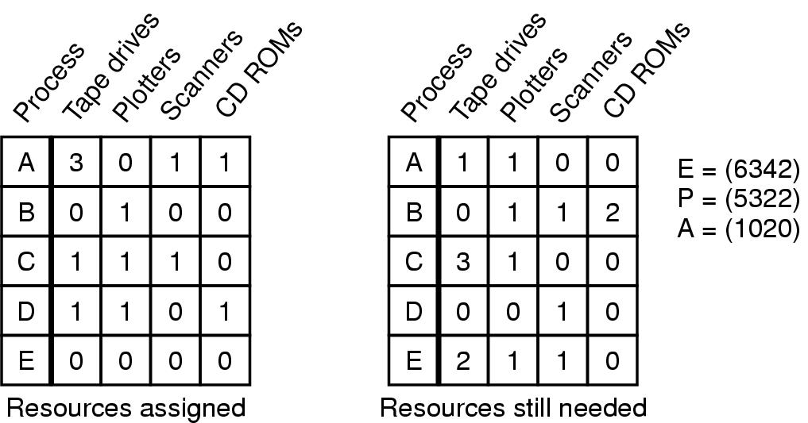
Banker's Algorithm for Multiple Resources
Example of banker's algorithm with multiple resources
E (Existing), P (Possessed), A (Available)

Slide 28
Deadlock Prevention
Attacking the Mutual Exclusion Condition
Some devices (such as printer) can be spooled
  only the printer daemon uses printer resource
  thus deadlock for printer eliminated
Not all devices can be spooled
Principle:
  avoid assigning resource when not absolutely necessary
  as few processes as possible actually claim the resource

Slide 29
Attacking the Hold and Wait Condition
Require processes to request resources before starting
  a process never has to wait for what it needs
Problems
  may not know required resources at start of run
  also ties up resources other processes could be using
Variation:
  process must give up all resources
  then request all immediately needed

Slide 30
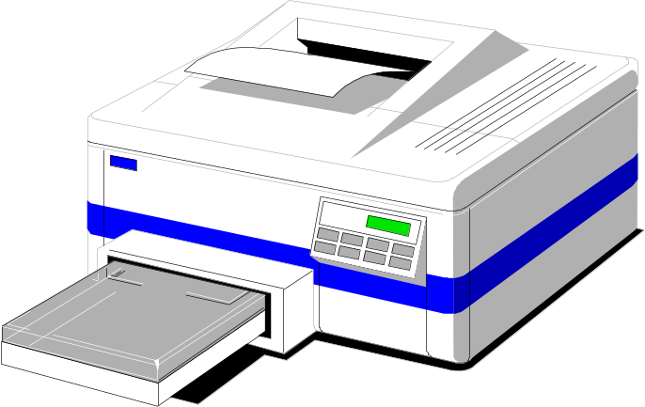
Attacking the No Preemption Condition
This is not a viable option
Consider a process given the printer
  halfway through its job
  now forcibly take away printer
  !!??

Slide 31
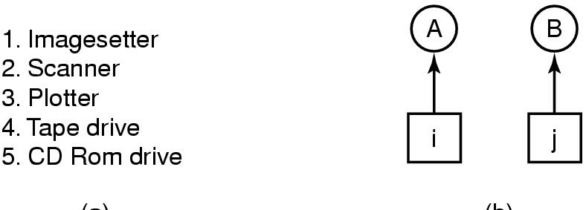
Attacking the Circular Wait Condition (1)
(a) (b)
Normally ordered resources
A resource graph

Slide 32
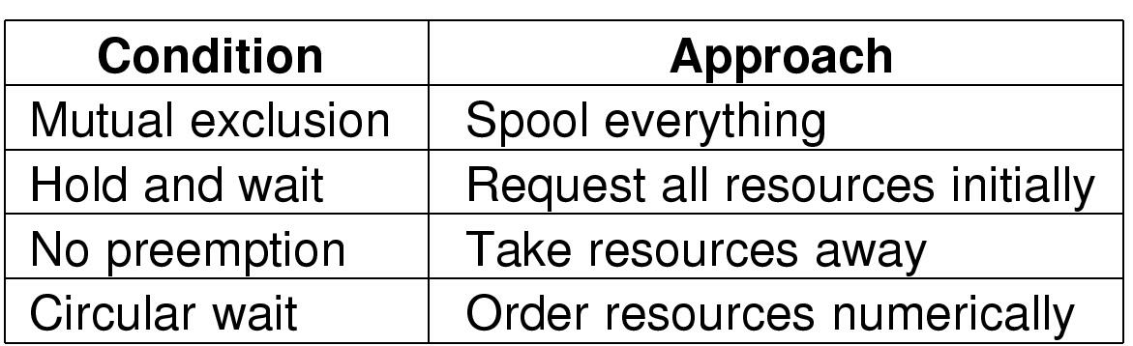
Attacking the Circular Wait Condition (1)
Summary of approaches to deadlock prevention

Slide 33
Other Issues
Two-Phase Locking
Phase One
  process tries to lock all records it needs, one at a time
  if needed record found locked, start over
  (no real work done in phase one)
If phase one succeeds, it starts second phase,
  performing updates
  releasing locks
Note similarity to requesting all resources at once
Algorithm works where programmer can arrange
  program can be stopped, restarted

Slide 34
Nonresource Deadlocks
Possible for two processes to deadlock
  each is waiting for the other to do some task
Can happen with semaphores
  each process required to do a down() on two semaphores (mutex and another)
  if done in wrong order, deadlock results

Slide 35
Starvation
Algorithm to allocate a resource
  may be to give to shortest job first
Works great for multiple short jobs in a system
May cause long job to be postponed indefinitely
  even though not blocked
Solution:
  First-come, first-serve policy

