Slide 1
Memory Management
Yücel Saygın
|These slides are based on your text book and on the slides prepared by Andrew S. Tanenbaum

Slide 2
Memory Management
Ideally programmers want memory that is
  large
  fast
  non volatile
Memory hierarchy
  small amount of fast, expensive memory – cache
  some medium-speed, medium price main memory
  gigabytes of slow, cheap disk storage
Memory manager handles the memory hierarchy

Slide 3

Basic Memory Management
Monoprogramming without Swapping or Paging
Three simple ways of organizing memory for an OS with one process.
(a) was used for mainframes and minicomputers
(b) is used on some palmtop computers and embedded systems
(c) was used by early PCs running MS-DOS where BIOS device drivers were in ROM

Slide 4
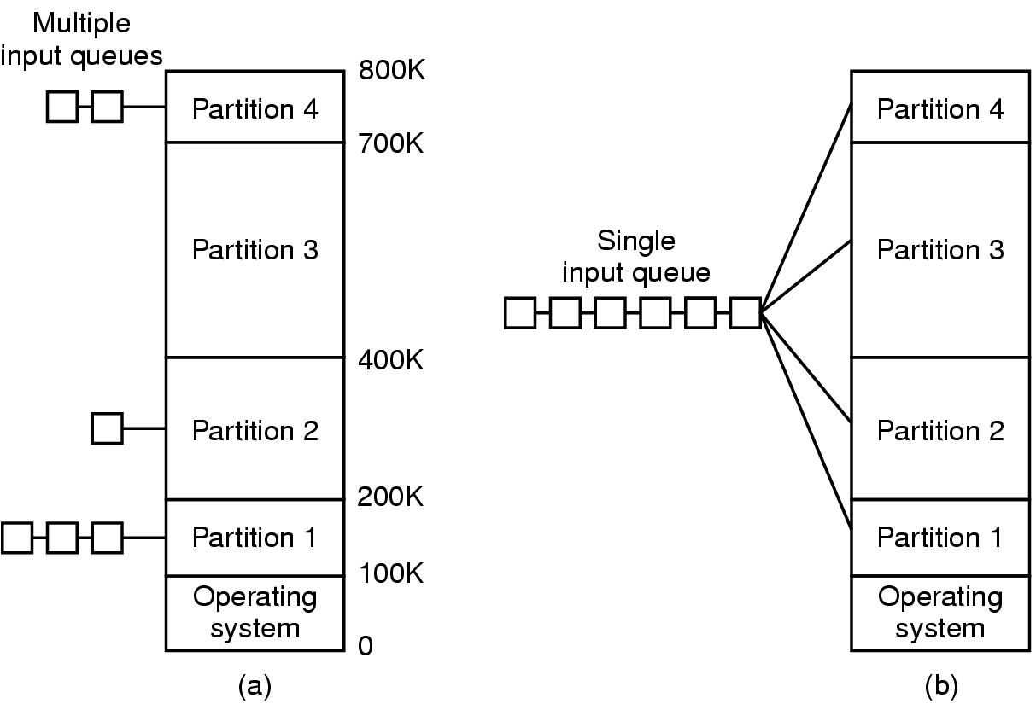
Multiprogramming with Fixed Partitions
(used by OS/360 on large IBM mainframes, mostly for batch systems not supported anymore)
Fixed size memory partitions
  Option 1: separate input queues for each partition
  Option 2: single input queue
Multiple Queues: Put the job in
The input queue for the smallest
Partition large enough to hold it
Single Queue: When a partition becomes
Available, choose the closest job in the
queue that could fit or the largest job that can fit

Slide 5
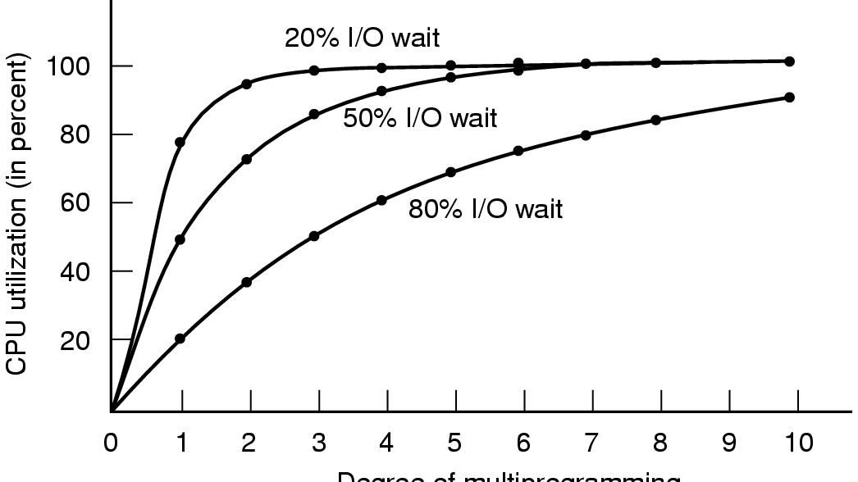
Modeling Multiprogramming
CPU utilization as a function of number of processes in memory
Degree of multiprogramming
Suppose that a process spends a fraction p of its time waiting for I/O to complete
with n processes in memory at a time, the probability that all n processes are waiting
for I/O is p^n. CPU utilization is 1 - p^n (with the assumption that the processes are
independent)

Slide 6
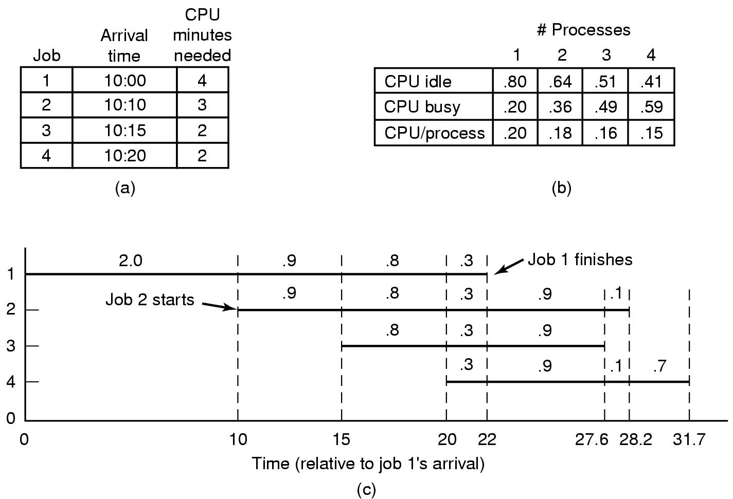
Analysis of Multiprogramming System Performance
Arrival and work requirements of 4 jobs
CPU utilization for 1 – 4 jobs with 80% I/O wait
Sequence of events as jobs arrive and finish
  note numbers show amout of CPU time jobs get in each interval

Slide 7
Relocation and Protection
Cannot be sure where program will be loaded in memory
  address locations of variables, code routines cannot be absolute
  must keep a program out of other processes’ partitions
Use base and limit values
  address locations added to base value to map to physical addr
  address locations larger than limit value is an error

Slide 8

Swapping (1)
Memory allocation changes as
  processes come into memory
  leave memory
Shaded regions are unused memory

Slide 9
Swapping
Fragmentation: Small memory blocks that can not fit a reasonable size program
  External fragmentation
  Internal fragementation
What happens when the process needs more memory?

Slide 10

Swapping (2)
Allocating space for growing data segment
Allocating space for growing stack & data segment

Slide 11

Memory Management with Bit Maps
Part of memory with 5 processes, 3 holes
  tick marks show allocation units
  shaded regions are free
Corresponding bit map
Same information as a list

Slide 12
Memory Allocation
Memory allocation is done in chunks (memory units of fixed size)
What is the tradeoff between having small and large chunks?
In case of bitmaps for memory management:
  Bitmap size depends on the size of the chunks when the memory size is fixed
  Internal fragmentation
In case of linked list based memory management
  External fragmentation

Slide 13
Memory Allocation
Bitmaps vs Linked Lists
Searching bitmaps for k units of consecutive free memory chunks is time consuming
Maintaining linked lists is hard

Slide 14
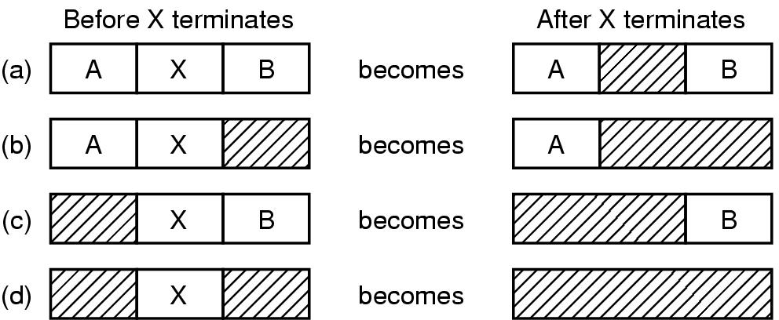
Memory Management with Linked Lists
Four neighbor combinations for the terminating process X

Slide 15
MM with Linked Lists :
Searching for available memory
First fit is the simplest method that searches the linked list until it finds a hole that is big enough
  Relatively fast
Next fit is like first fit but it starts the search from where it left off last time (slightly worse than first fit as simulations showed)
Best fit searches the entire list and takes the smallest hole large enough to fit the request. (slower and wastes a lot of memory, think why)
Worst fit is the opposite of best fit

Slide 16
MM with Linked Lists :
Searching for available memory
Keep separate lists for processes and holes to speed up the search (actually holes themselves can be used to form the data structure)
Sort the list of holes wrt size to make best fit and first fit faster (next fit does not make sense in this case)
Now extra overhead of maintaining two separate lists but it may be worth it
Quick fit maintains separate lists of holes for some of the more common sizes requested

Slide 17
Buddy System (Used for Unix Memory Allocation)
Overcomes the drawbacks of dynamic and fixed partitioning
  Dynamic partitioning is complex to maintain and needs compaction due to external fragmentation
  Fixed partitoning may use space inefficiently when process sizes and partition sizes do not match
In buddy system memory blocks are of size 2^K, L <= K <= U where 2^L is the smallest size block that is allocated and 2^U is the largest size block allocated (usually entire memory)
Initially the entire memory is treated as a single empty block
If a request for a block of size S arrives and 2^(U-1) < S <= 2^(U), then the entire block is allocated, otherwise the block is split into two equal buddies of size 2^(U-1). And check is done recursively on a free buddy.
The checking process continues until smallest block greater than or equal to s is generated and allocated to the request.
The system maintains a list of free blocks of each size 2^I
When a pair of buddies on the i list both become free then they are removed from the i list and combined into a single block and moved to (i+1) list

Slide 18
Example of Buddy System
1 Megabyte Block 1M
Request 100K (A) A=128K 128K 256K 512K
Request 240K (B) A=128K 128K B=256K 512K
Request 256K (D) A=128K 128K B=256K D=256K 256K
Release B A=128K 128K 256K D=256K 256K
Release A 512K D=256K 256K
Request 75K (E) E=128K 128K 256K D=256K 256K
Release E 512K D=256K 256K
Release D 1M

Slide 19
Tree Representation of Buddy System
1M
512K
256K
128K
A=128K 128K B=256K D=256K 256K

Slide 20
Addresses referenced in a program
Physical address: (also called absolute address) is an actual location in main memory
Logical address: is a reference to a memory location independent of the current assignment to memory. Must be translated to physical address before the actual memory reference is made
Relative address: is a special case of a logical address where all the references are made relative to the beginning of the program.

Slide 21
Address Space Abstraction
A process is provided with a linear address space that is used to read and write the array of bytes in the primary memory hardware
In early systems the linear address space used by the programmer was the physical memory address space and an executing program could directly access any primary memory address in the machine
Starting from 60s multiprogramming OSs introduced the address space abstraction for primary memory.
process

Slide 22
Paging
Memory is arranged into fixed size chunks called page frames
This scheme allows external fragmentation but external fragmentation is not a problem since nonconsecutive blocks of memory can be allocated for a process
Physical Memory

Slide 23
Paging
A process’ address space is divided into pages, a number of page frames are allocated in main memory to store the pages belonging to a process
Operating system maintains a page table for each process to keep track of which page frames are allocated for the process
OS also maintains a single list of free page frames
Address Space
of the process
Physical Memory
process

Slide 24
Memory addresses
A memory address is expressed as a sequence of bits.
For example if we have a very tiny memory of 4 bytes, and the memory is byte-addressable
Question: How many bits are needed to address this memory?

Slide 25
Memory addresses
A memory address is expressed as a sequence of bits.
For example if we have a very tiny memory of 4 bytes, and the memory is byte-addressable
2 bits are enough to address this tiny memory as shown below:
00
01
10
11

Slide 26
Memory addresses
if we have a tiny memory of 16 bytes, and the memory is byte-addressable then we need to have 4 bits
In general if we have n bytes, then we need log₂n bits to address this memory
0000
0001
0010
0011
0100
0101
0110
0111
1000
1001
1010
1011
1100
1101
1110
1111

Slide 27
Memory addresses with Paging
A logical address is expressed as a page number and an offset
Now we need to set the page size, lets say 4 bytes.
Then we will have 4 pages in this memory that has a total of 16 bytes
How many bits are we going to need to address these 4 pages?
0000
Page 0
0001
0010
0011
0100
Page 1
0101
0110
0111
1000
Page 2
1001
1010
1011
1100
Page 3
1101
1110
1111

Slide 28
Memory addresses with Paging
0000
00
Page 0
0001
0010
0011
0100
Page 1
0101
01
0110
0111
1000
10
Page 2
1001
1010
1011
1100
11
Page 3
1101
1110
1111

Slide 29
Memory addresses with Paging
0000
00
Page 0
0001
0010
0011
0100
Page 1
0101
01
0110
0111
1000
10
Page 2
1001
1010
1011
1100
11
Page 3
1101
1110
1111

Slide 30
Memory addresses with Paging
0100
Page 1
0101
01
0110
0111

Slide 31
Memory addresses with Paging
00
Page 1
01
01
10
11

Slide 32
Memory addresses with Paging
Example:
  assume 16 bit addresses are used and the page size is 1K = 1024 bytes
  Questions
    How many pages do we have in the memory?
    How many bits are needed to address a page?
    How many bits are needed to address a specific byte within a page?

Slide 33
Memory addresses with Paging
Example:
  assume 16 bit addresses are used and the page size is 1K = 1024 bytes
  Another question: Consider the logical address 1502 whose binary representation is (0000010111011110)
    What is the page number referred by this address?
    What is the offset?

Slide 34
Memory addresses with Paging
Example:
  assume 16 bit addresses are used and the page size is 1K = 1024 bytes
  A logical address 1502 (0000010111011110) has 10 bits to represent the offset in the page (0111011110) and the most significant part after the offset bits represent the page number (000001).

Slide 35

Virtual Memory with Paging
Address Space is the set of addresses that a process can reference
Virtual (logical) addresses are used by processes to reference memory
Memory Management Unit (MMU) maps virtual addresses to physical addresses

Slide 36
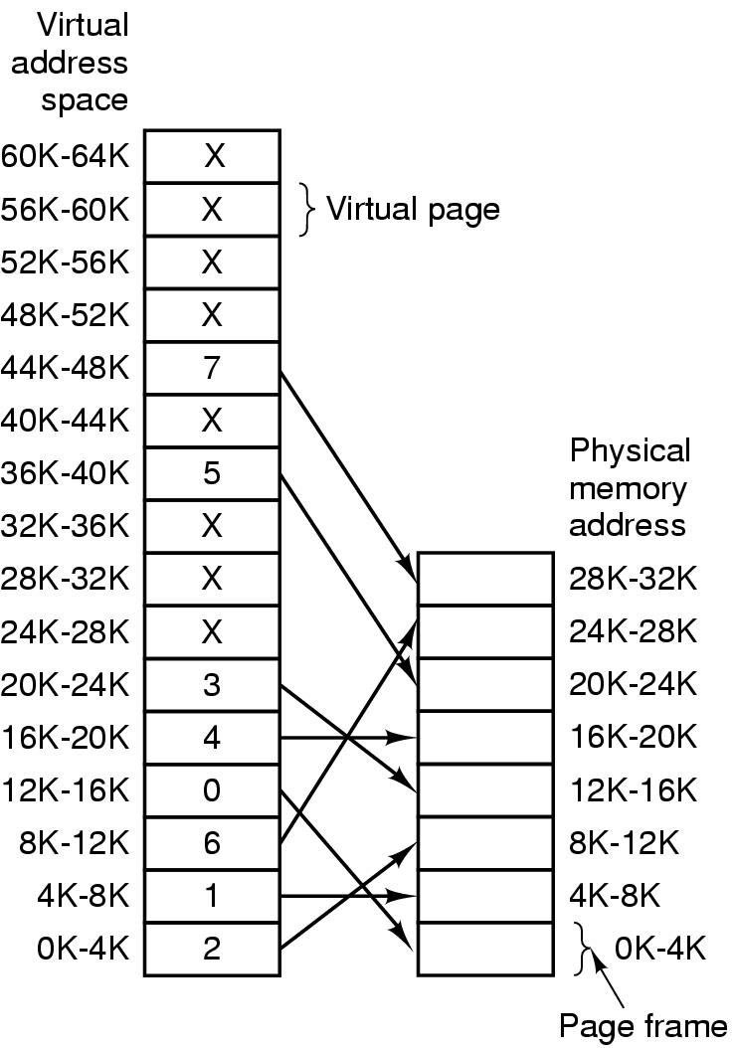
Paging (2)
The relation between
virtual addresses
and physical
memory addres-
ses given by
page table

Slide 37

Memory addresses with Paging
Translation of the logical addresses to physical addresses:
  A page table is used to store which pages are stored in which page frame
  The page number in the logical address is used as an index to the page table.
  The corresponding page table entry contains the page frame number that stores the page
  Offset field of the logical address is used to find the offset within the page frame
Internal operation of MMU with 16 4 KB pages

Slide 38

Page Tables (3)
Typical page table entry
Present/absent bit keeps track of which pages are present in main memory
If the present/absent bit is 0, then a page fault occurs and a trap to the operating system is caused which then brings the requested page from the disk to the main memory (does and I/O)
Modified (or dirty) bit is used to decide if the page stored in the corresponding page frame needs to be written back to disk.
Referenced bit is set when a page is referenced for reading or writing. It is used by page replacement algorithms

Slide 39
Where to store the page tables
Page tables could be stored in registers:
  When a process is started up, the OS loads the registers with the page table (from a copy in the main memory)
  No more memory references are needed to access the page table during process execution
  But it is expensive the load the whole page table into the registers (it could be very large)
Page tables can be stored entirely in main memory:
  A single register is needed to point to the start of the page table (to change the memory map when a context switch occurs)
  One or more memory references are needed to read the page tables during the process execution
Usually none of the above is used in its pure form

Slide 40

Page Tables (2)
32 bit address with 2 page table fields
Two-level page tables

Slide 41
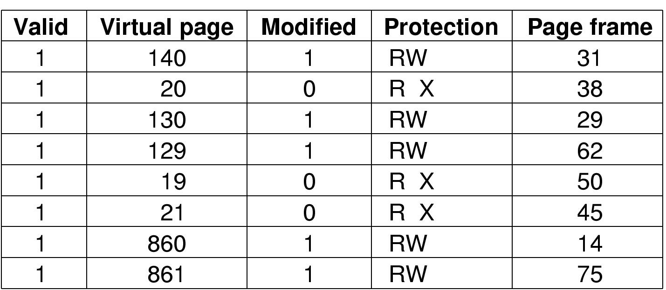
TLBs – Translation Lookaside Buffers
A TLB to speed up paging
TLB concept is based on the observation that a large number of page references are done to a small number of pages. Therefore a small number of page table entries are heavily referenced
A small hardware component inside the MMU (called TLB) is used to map virtual addresses to physical addresses without going through the page table.
When a virtual address is presented to the MMU for translation, the hardware first checks to see if the virtual page number is in TLB (all TLB entries are compared in parallel). If the page number is found and the access does not violate the protection then the page frame number is directly taken.

Slide 42
TLBs – Translation Lookaside Buffers
TLB fault occurs when the corresponding virtual page number is not found in the TLB then depending on the system, either
  the MMU detects the miss and does a page table lookup to bring the page table entry to the TLB
  or MMU generates a TLB fault and passes the problem of bringing the page table entry to TLB

Slide 43
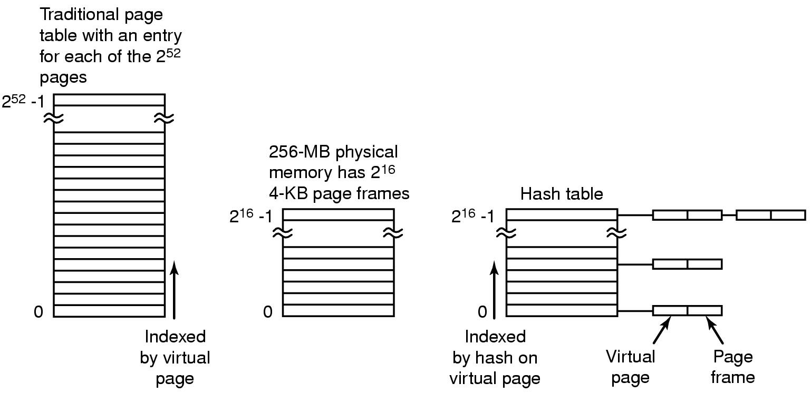
Inverted Page Tables
Comparison of a traditional page table with an inverted page table

Slide 44
Page Replacement Algorithms
Page fault forces choice
  which page must be removed
  make room for incoming page
Modified page must first be saved
  unmodified just overwritten
Better not to choose an often used page
  will probably need to be brought back in soon

Slide 45
Optimal Page Replacement Algorithm
Replace page needed at the farthest point in future
  Optimal but unrealizable
Estimate by …
  logging page use on previous runs of process
  although this is impractical

Slide 46
Not Recently Used Page Replacement Algorithm
Each page has Reference bit, Modified bit
  bits are set when page is referenced, modified
Pages are classified
  not referenced, not modified
  not referenced, modified
  referenced, not modified
  referenced, modified
NRU removes page at random
  from lowest numbered non empty class

Slide 47
FIFO Page Replacement Algorithm
Maintain a linked list of all pages
  in order they came into memory
Page at beginning of list replaced
Disadvantage
  page in memory the longest may be often used

Slide 48
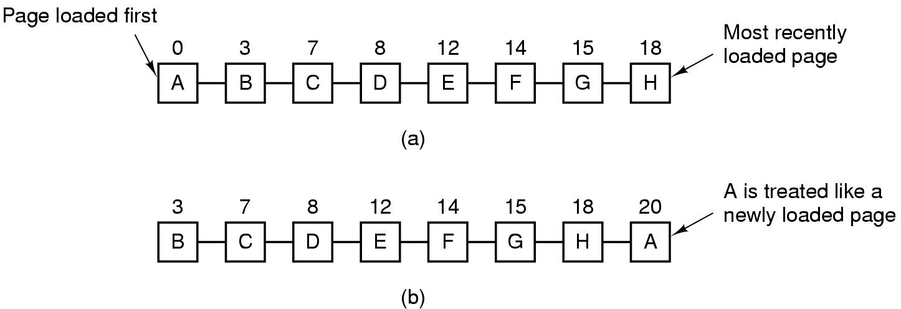
Second Chance Page Replacement Algorithm
Operation of a second chance
  pages sorted in FIFO order
  Page list if fault occurs at time 20, A has R bit set
  (numbers above pages are loading times)

Slide 49
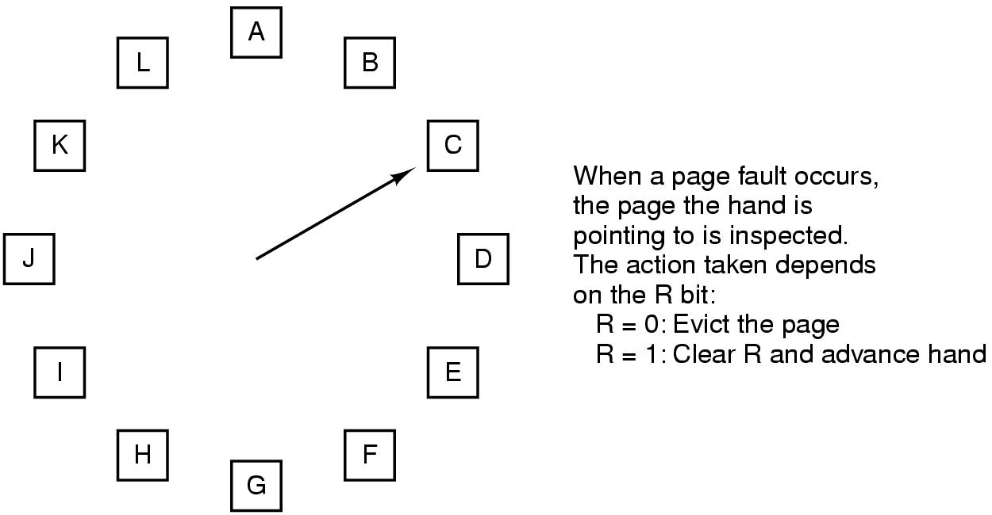
The Clock Page Replacement Algorithm

Slide 50
Least Recently Used (LRU)
Assume pages used recently will used again soon (Locality of reference)
  throw out page that has been unused for longest time
Must keep a linked list of pages
  most recently used at front, least at rear
  update this list every memory reference !!
Alternatively you can implement LRU by a special hardware that maintains a 64 bit counter and stores the current counter value for the page when referenced
  choose page with lowest counter value
  periodically zero the counter

Slide 51
Simulating LRU in Hardware
For a machine with n page frames, the LRU hardware can maintain a matrix of n x n bits
Initially all of them are 0
Whenever a page frame k is referenced, the hardware first sets all the bits of row k to 1, then sets all the bits of column k to 0.
At any instant, the row whose binary value is lowest is the least recently used.

Slide 52
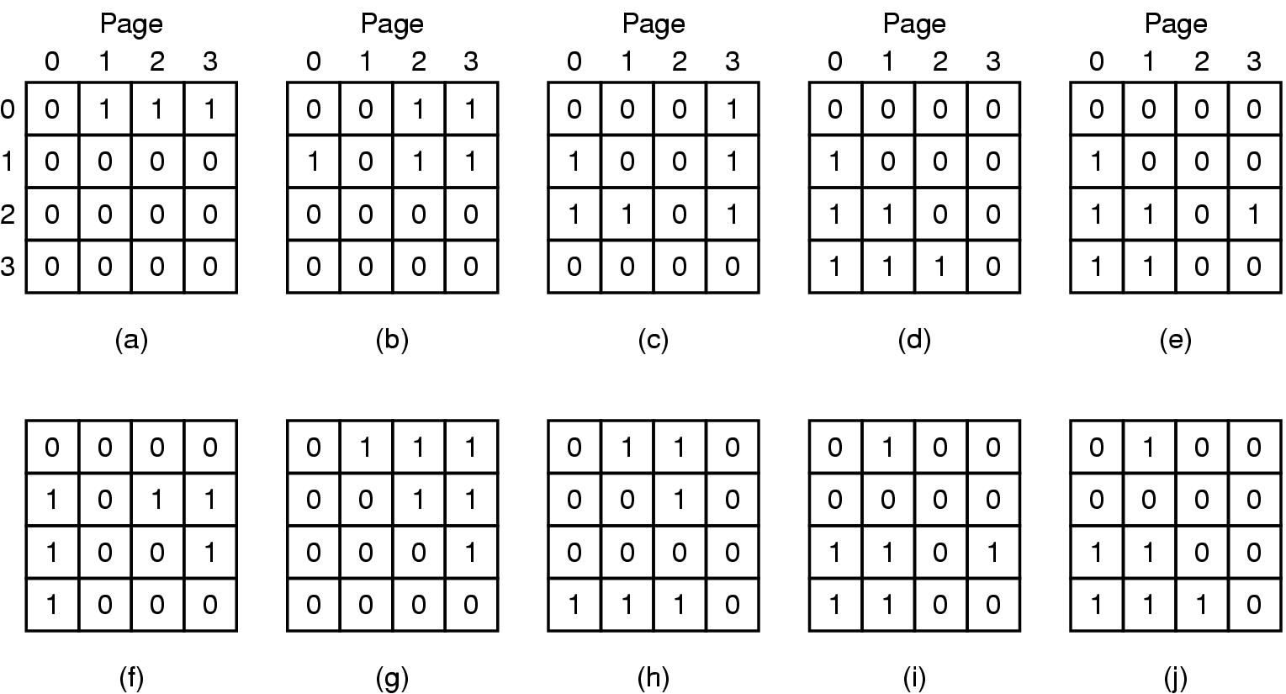
Simulating LRU in Hardware
LRU using a matrix – pages referenced in order 0,1,2,3,2,1,0,3,2,3

Slide 53
Simulating LRU in Software
When a machine does not have special hardware, then LRU can be implemented in software
A version of LRU is called NFU (Not Frequently Used)
  Requires a software counter associated with each page, which is initially 0
  At each clock interrupt, the OS scans all the pages in memory, and for each page, R bit is added to the counter.
  When a page fault occurs, page with the lowest counter value is chosen for replacement
One drawback of the algorithm is that it never forgets!

Slide 54
Simulating LRU in Software
NRU with aging is used to overcome this drawback
With aging, counters are shifted one position to the right, and R bit is added to the most significant bit
Again, when page fault occurs, the page with the lowest counter value is chosen for replacement

Slide 55
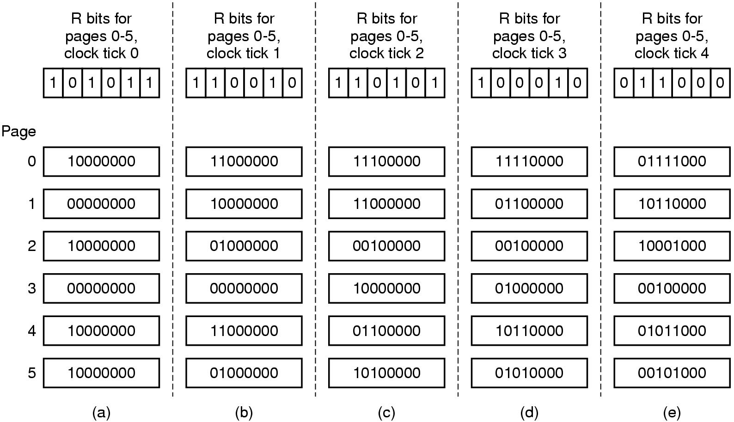
Simulating LRU in Software

Slide 56
Simulating LRU in Software

Slide 57
The Working Set Page Replacement Algorithm (1)
Demand paging: pages are loaded to MM when needed
Processes do not reference all the pages in their address space in sequence, instead locality of reference is observed
Locality of reference means that during any phase of execution, the process references only a relatively small fraction of the pages in its address space
The set of pages that a process is currently using is called its working set, and it slowly changes over time as the process goes into a new execution phase.
If the entire working set is in memory then very few page faults will occur
Prepaging (i.e., loading pages in the working set to MM before letting the process run) is used to reduce the initial page faults.

Slide 58
The Working Set Page Replacement Algorithm (1)
What happens if the MM is small and the working set can not fit in MM?

Slide 59
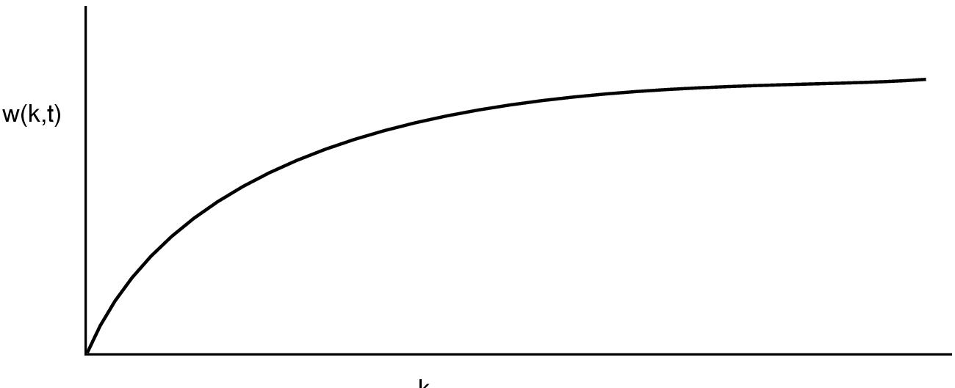
The Working Set Page Replacement Algorithm (1)
Most recent k memory references
The working set is the set of pages used by the k most recent memory references
w(k,t) is the size of the working set at time, t

Slide 60
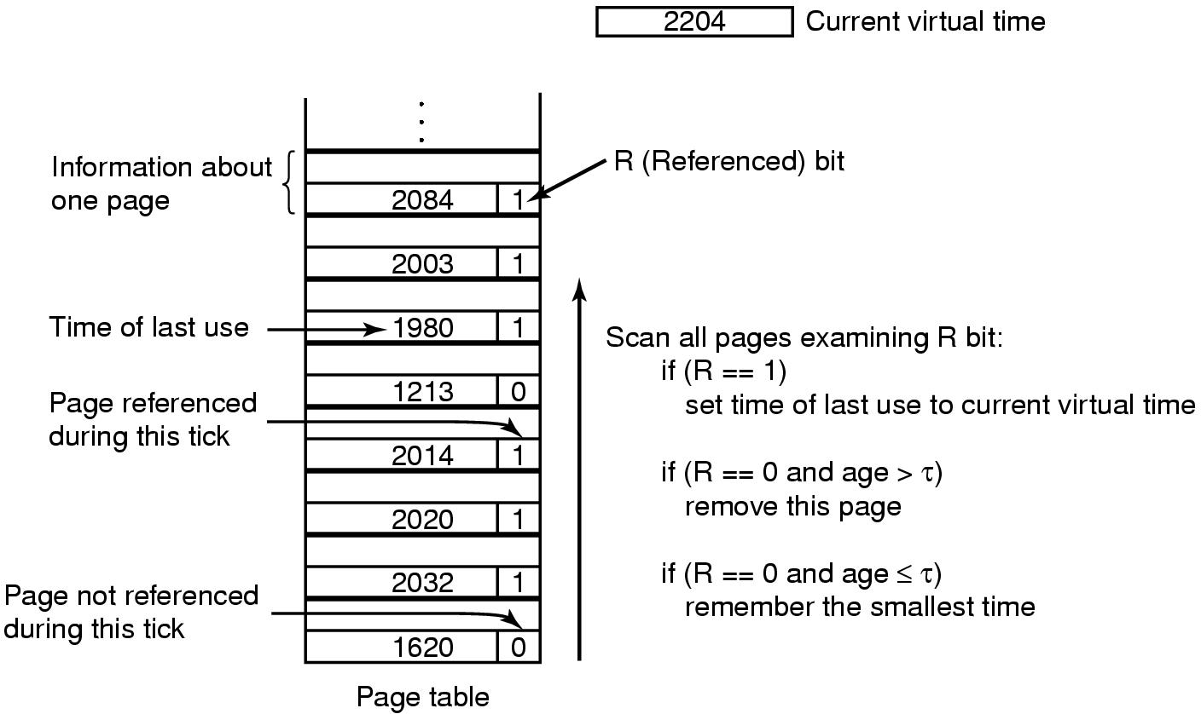
The Working Set Page Replacement Algorithm (2)
The working set algorithm

Slide 61
The Working Set Page Replacement Algorithm (2)
Working sets can be maintained by shift registers and duplicate elimination
Use a shift register of size k (I.e., size of the working set)
With every memory reference shift the registers one position and and insert the most referenced page number to the register
The set of k page number in the shift register is the working set
However it is hard to maintain the shift register at every page fault so an approximation based on the virtual time of the process is used.

Slide 62
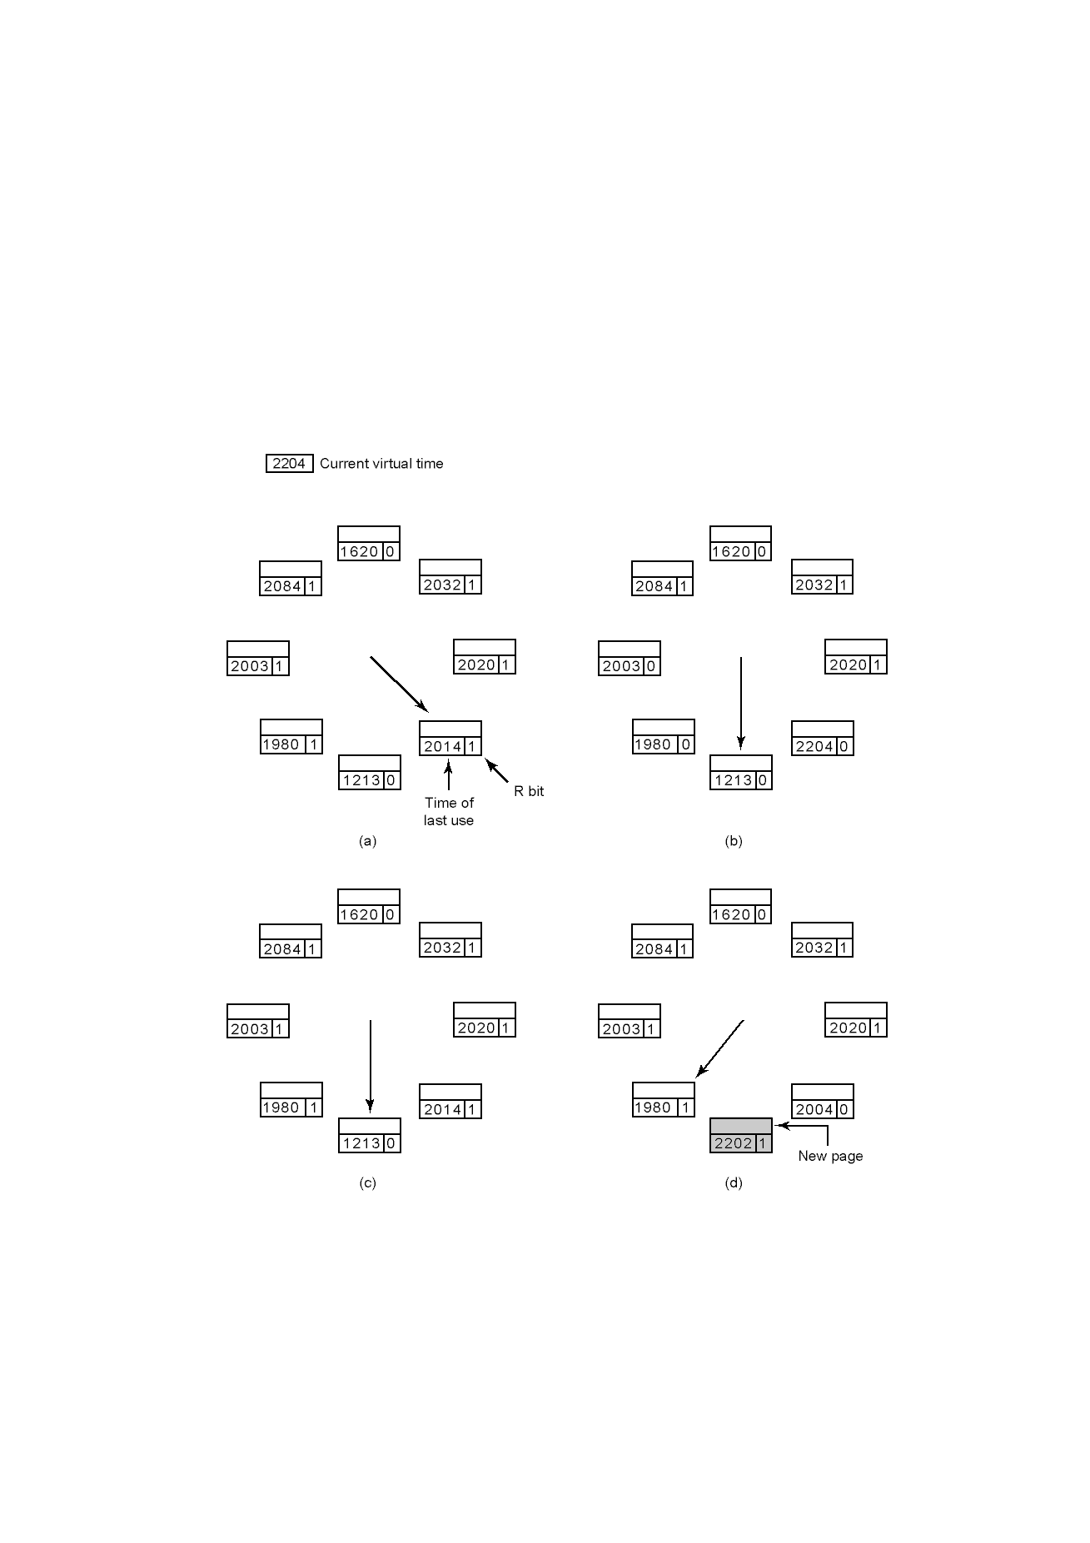
The WSClock Page Replacement Algorithm
Each entry contains: time of last use together with the R and M bits (M bit is not shown here).
Page repl alg:
If the R b it of the page is set to 1, then R bit is set to 0 (no good candidate for page repl.)
If the R bit is 0, then
  - if the age is > T and the page is clean, then it is replaced. If the
  - if the age is > T and the page is dirty, then a write to disk is scheduled and the clock head advances one position.
Operation of the WSClock algorithm

Slide 63
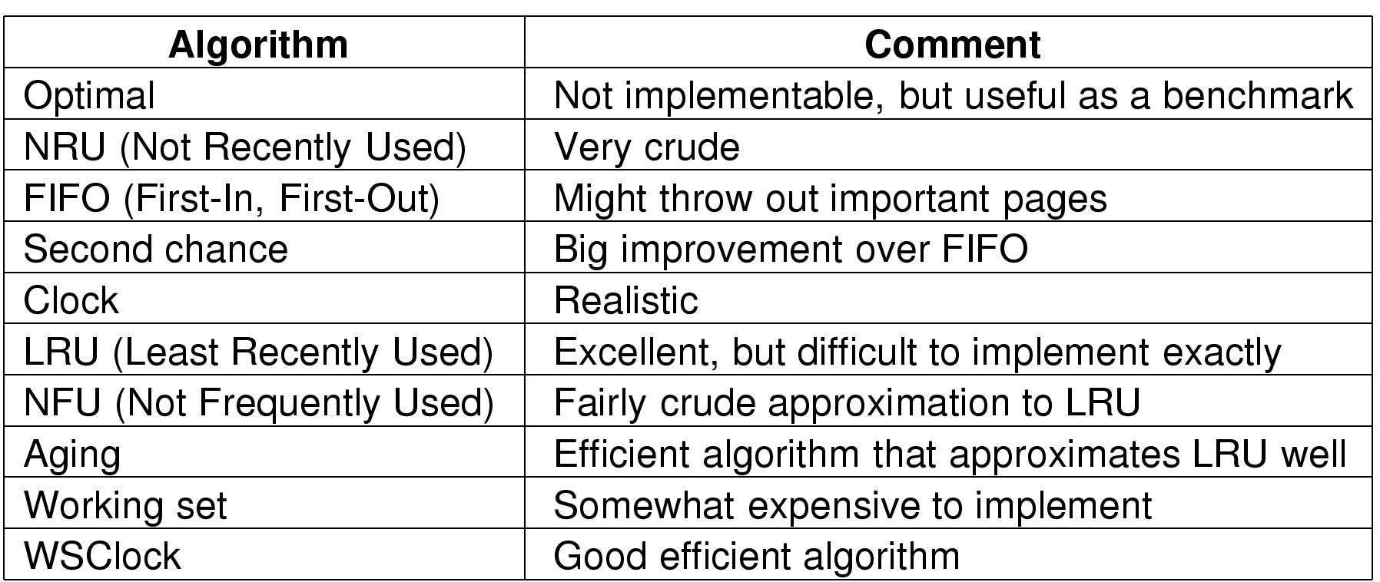
Review of Page Replacement Algorithms

Slide 64
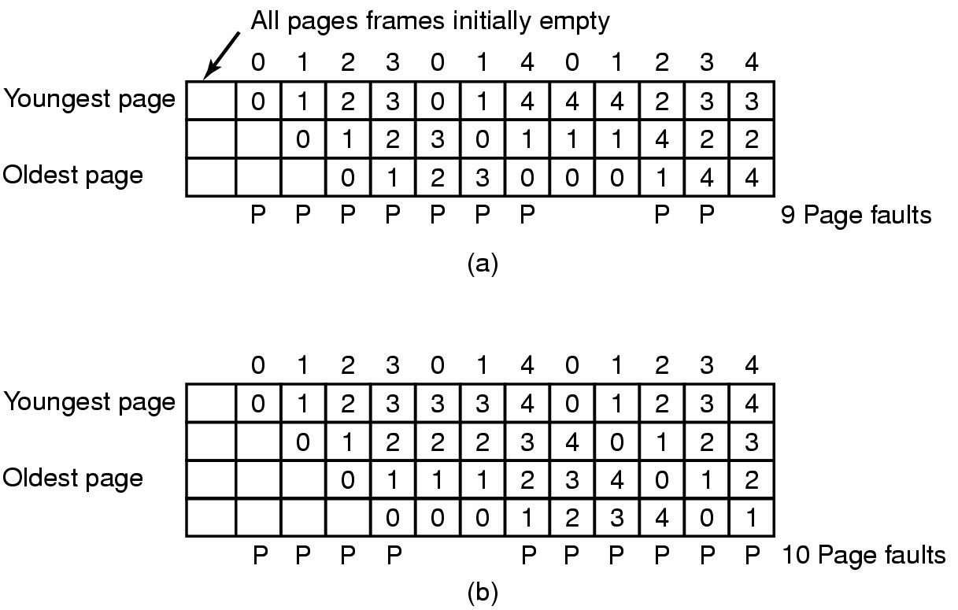
Modeling Page Replacement Algorithms
Belady's Anomaly
FIFO with 3 page frames
FIFO with 4 page frames
P's show which page references show page faults

Slide 65
Paging Systems
Paging systems can be characterized by three items
  The reference string of the executing process
  The page replacement algorithm
  The number of page frames available in memory, m.

Slide 66
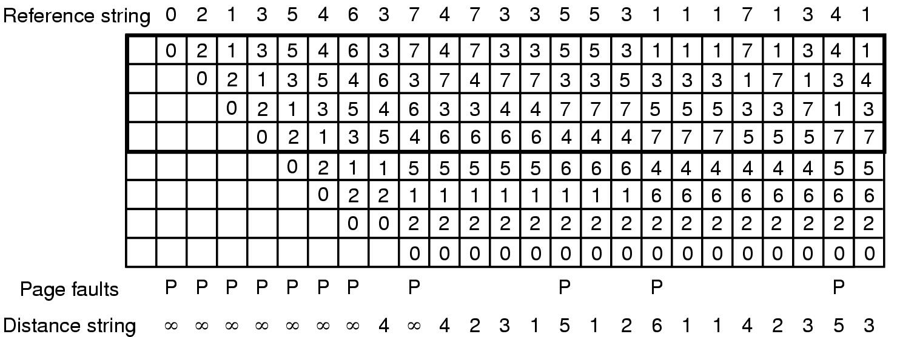
Stack Algorithms
State of memory array, M, after each item in reference string is processed

Slide 67
Stack Algorithms
State of memory array, M, after each item in reference string is processed

Slide 68
Stack Algorithms
State of memory array, M, after each item in reference string is processed

Slide 69
Stack Algorithms
State of memory array, M, after each item in reference string is processed

Slide 70
Stack Algorithms
State of memory array, M, after each item in reference string is processed

Slide 71
Stack Algorithms
State of memory array, M, after each item in reference string is processed

Slide 72
Stack Algorithms
State of memory array, M, after each item in reference string is processed

Slide 73
Stack Algorithms
State of memory array, M, after each item in reference string is processed

Slide 74
Stack Algorithms
State of memory array, M, after each item in reference string is processed

Slide 75
Stack Algorithms
State of memory array, M, after each item in reference string is processed

Slide 76
Stack Algorithms
State of memory array, M, after each item in reference string is processed

Slide 77
Stack Algorithms
State of memory array, M, after each item in reference string is processed

Slide 78
Stack Algorithms
State of memory array, M, after each item in reference string is processed

Slide 79
Stack Algorithms
State of memory array, M, after each item in reference string is processed

Slide 80
Stack Algorithms
State of memory array, M, after each item in reference string is processed

Slide 81
Stack Algorithms Cont’d
Stack algorithms have the following property:
  The set of pages included in the top part of M for a memory with m page frames after r memory references are also included in M for a memory with m+1 page frames.
The algorithms that have this property, i.e., stack algorithms do not suffer from Belady’s anomaly.

Slide 82
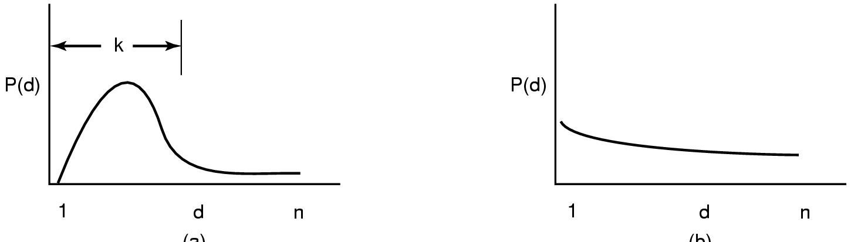
The Distance String
Probability density functions for two hypothetical distance strings

Slide 83
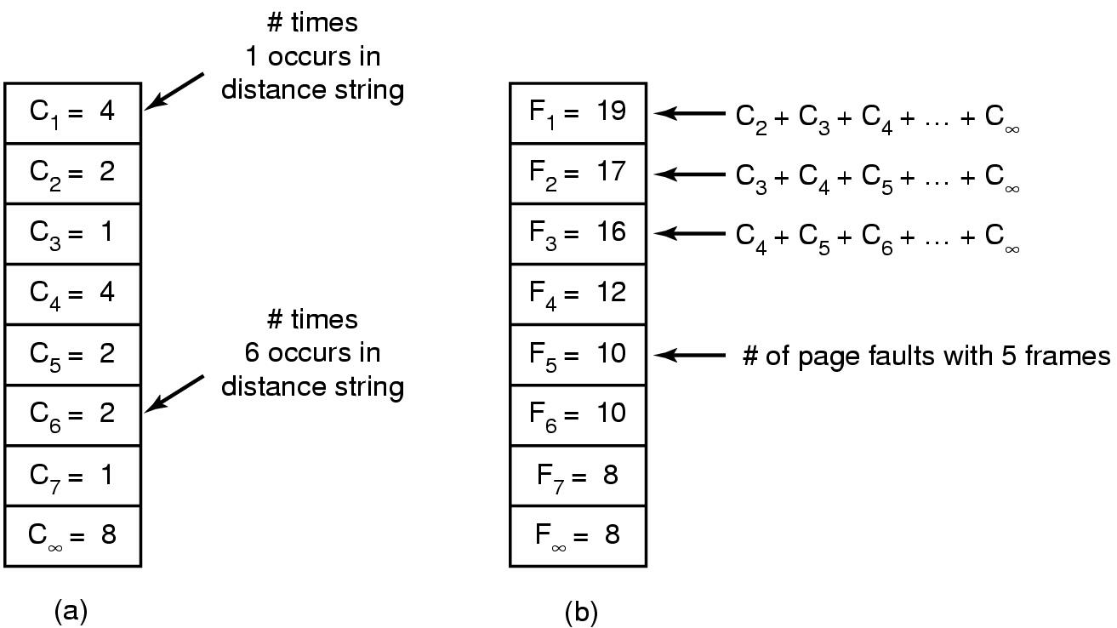
The Distance String
Computation of page fault rate from distance string
  the C vector
  the F vector

Slide 84
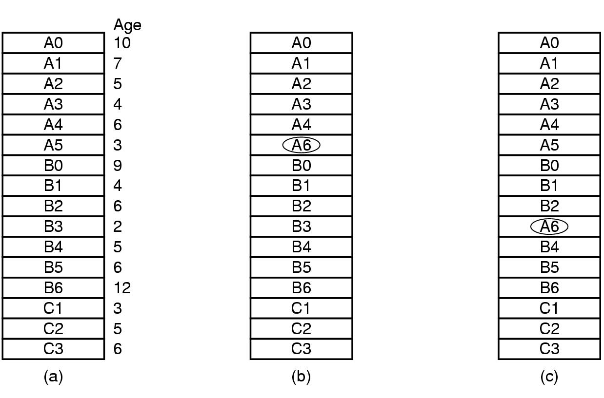
Design Issues for Paging Systems
Local versus Global Allocation Policies (1)
Last ref
Original configuration
Local page replacement (Each process is assigned a fixed number of page frames)
Global page replacement (Num of page frames of each process is dynamic)
A hybrid approach would be to adopt the num of pages assigned by looking at page fault frequency (PFF)

Slide 85
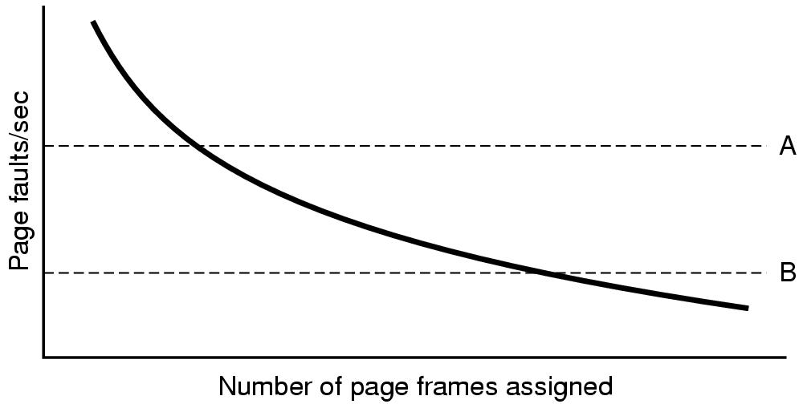
Local versus Global Allocation Policies (2)
Page fault rate as a function of the number of page frames assigned

Slide 86
Load Control
Despite good designs, system may still thrash
When PFF algorithm indicates
  some processes need more memory
  but no processes need less
Solution :
Reduce number of processes competing for memory
  swap one or more to disk, divide up pages they held
  reconsider degree of multiprogramming

Slide 87
Page Size (1)
Small page size
Advantages
  less internal fragmentation
Disadvantages
  programs need many pages, larger page tables
  Transferring a small page from disk to memory is same as transferring a large page due to seek time and rotational delay.

Slide 88
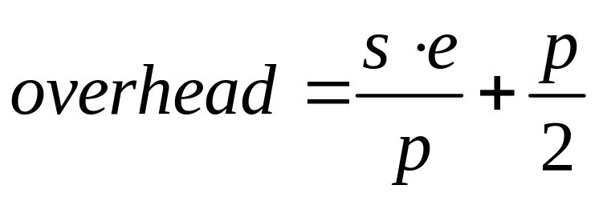
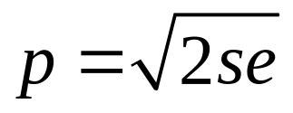
Page Size (2)
Overhead due to page table and internal fragmentation
Where
  s = average process size in bytes
  p = page size in bytes
  e = page entry
page table space
internal fragmentation
Optimized when

Slide 89
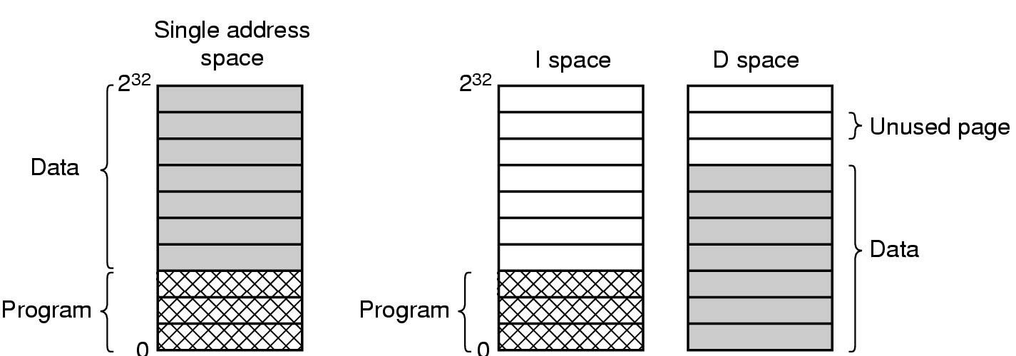
Separate Instruction and Data Spaces
One address space
Separate I and D spaces

Slide 90
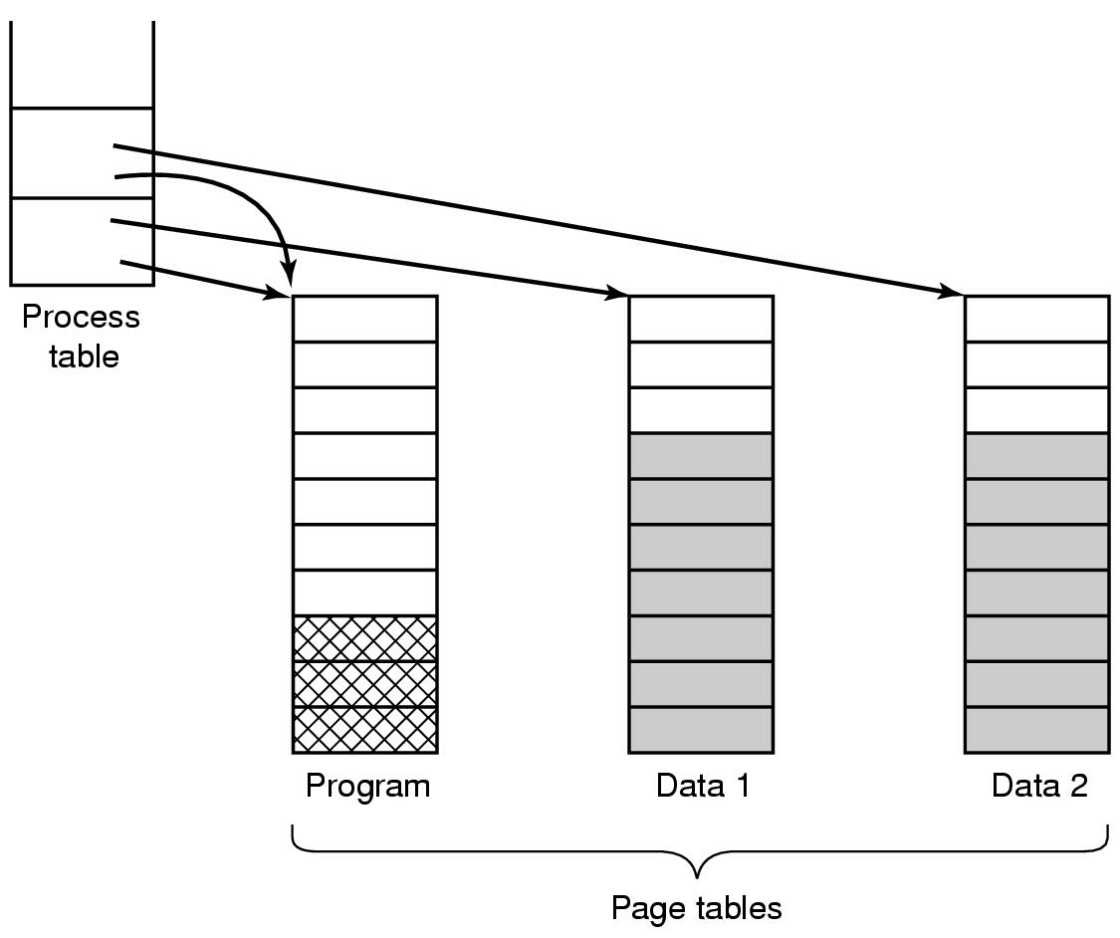
Shared Pages
Two processes sharing same program sharing its page table

Slide 91
Cleaning Policy
Need for a background process, paging daemon
  periodically inspects state of memory
When too few frames are free
  selects pages to evict using a replacement algorithm
It can use same circular list (clock)
  as regular page replacement algorithm but with different pointers for clean and dirty pages

Slide 92
Implementation Issues
Operating System Involvement with Paging
Four times when OS involved with paging
Process creation
  determine program size
  create page table
Process execution
  MMU reset for new process
  TLB flushed
Page fault time
  determine virtual address causing fault
  swap target page out, needed page in
Process termination time
  release page table, pages

Slide 93
Page Fault Handling (1)
Hardware traps to kernel
General registers saved
OS determines which virtual page needed
OS checks validity of address, seeks page frame
If selected frame is dirty, write it to disk

Slide 94
Page Fault Handling (2)
OS brings schedules new page in from disk
Page tables updated
Faulting instruction backed up to when it began
Faulting process scheduled
Registers restored
Program continues

Slide 95
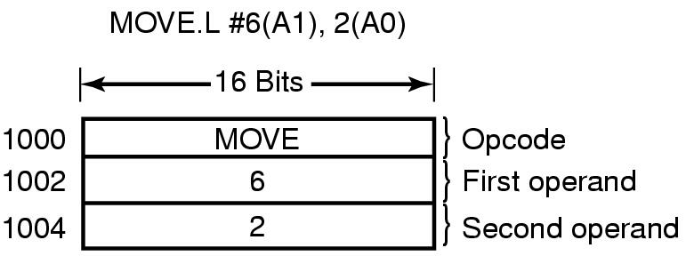
Instruction Backup
An instruction causing a page fault

Slide 96
Locking Pages in Memory
Virtual memory and I/O occasionally interact
Proc issues call for read from device into buffer
  while waiting for I/O, another processes starts up
  has a page fault
  buffer for the first proc may be chosen to be paged out
Need to specify some pages locked
  exempted from being target pages

Slide 97
The SWAP Area
Swap area is the disk space allocated for storing process images
Two approaches to implement the swap area:
  Static swap area: contains the images of all processes
  Dynamic swap area: contains images of swapped out processes only

Slide 98
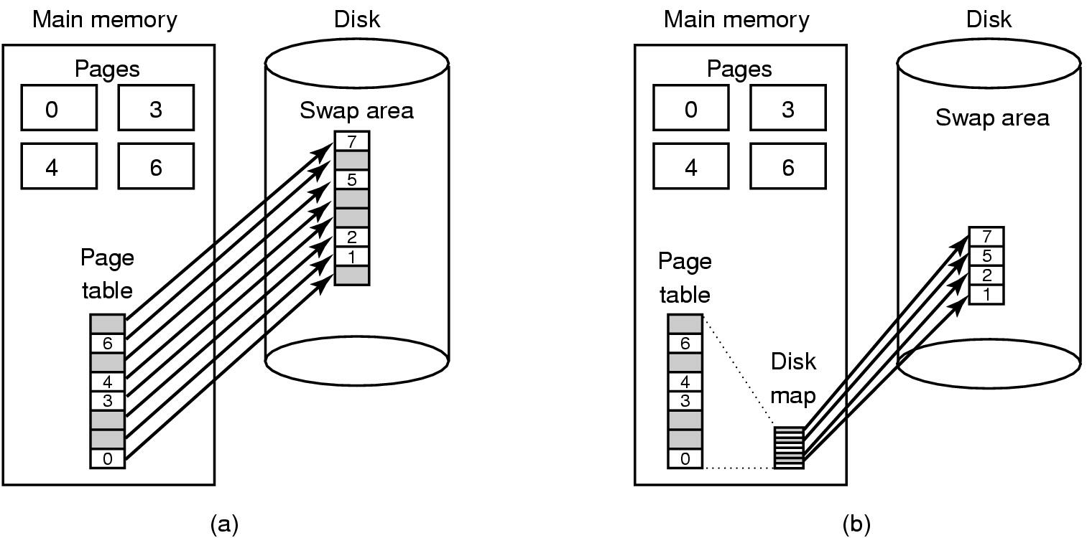
Backing Store
(a) Paging to static swap area
(b) Backing up pages dynamically

Slide 99
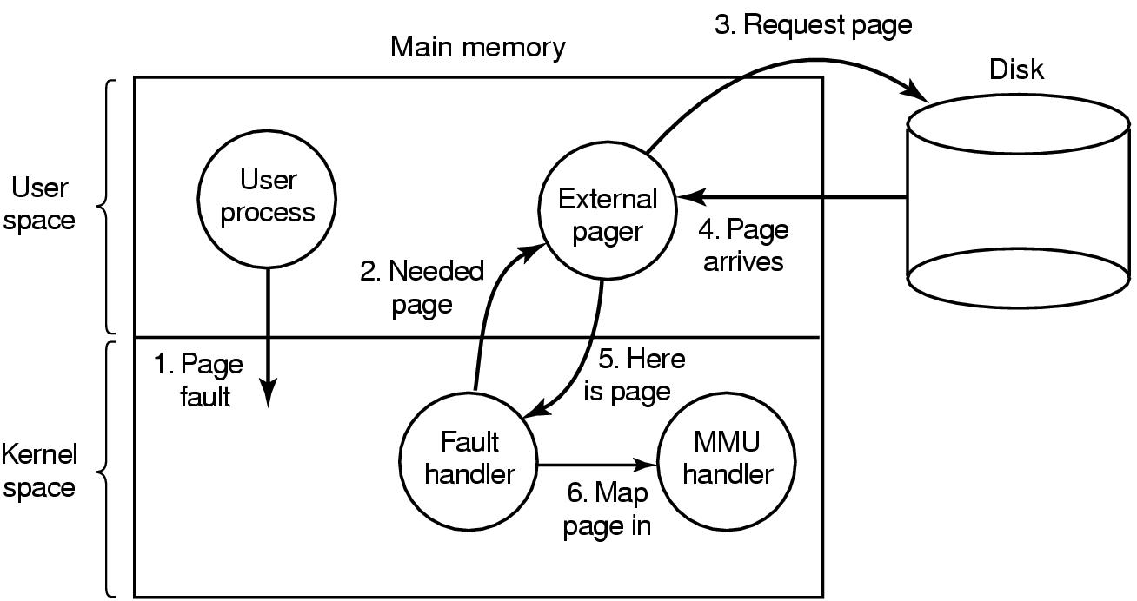
Separation of Policy and Mechanism
Page fault handling with an external pager

Slide 100

Segmentation (1)
One-dimensional address space with growing tables
One table may bump into another

Slide 101
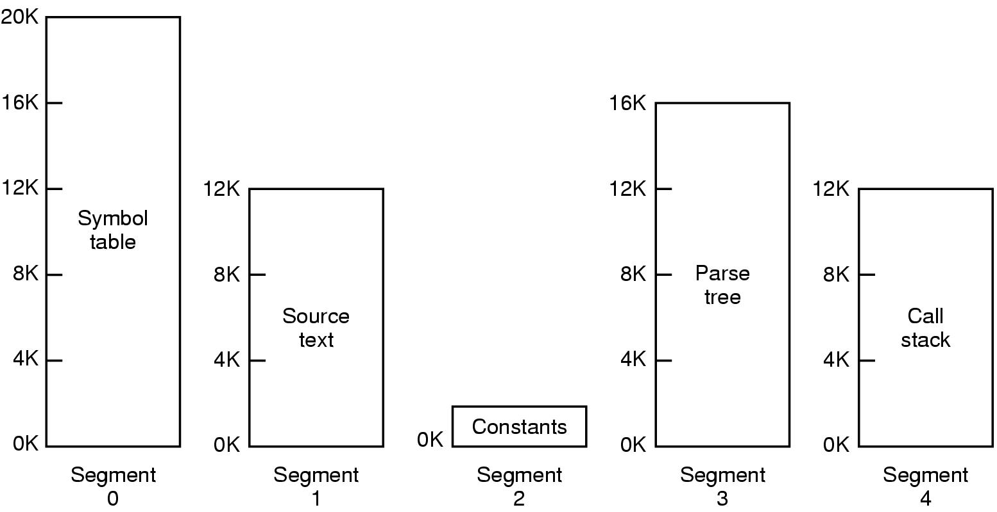
Segmentation (2)
Allows each table to grow or shrink, independently

Slide 102

Segmentation (3)
Comparison of paging and segmentation

Slide 103
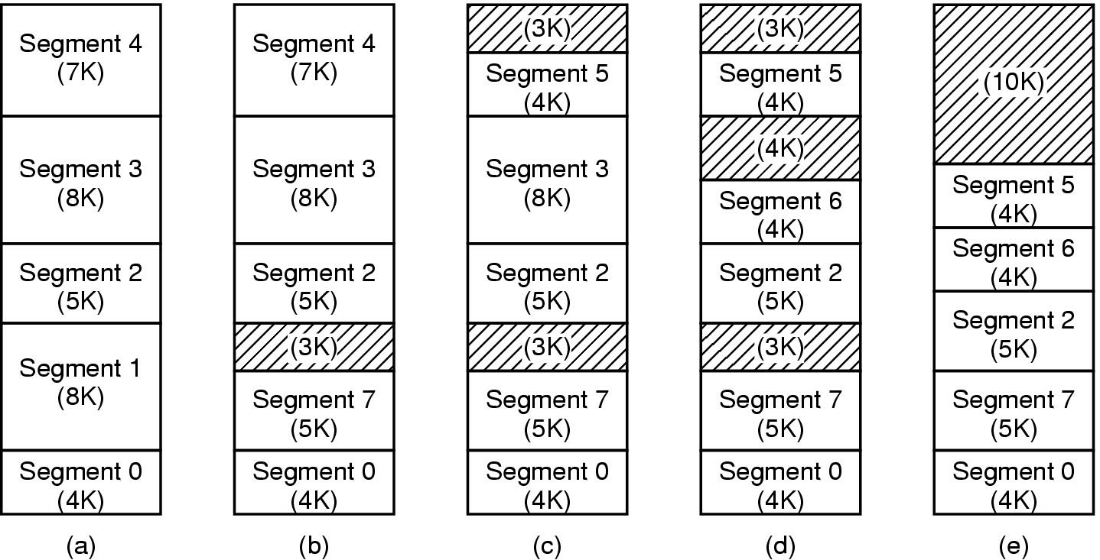
Implementation of Pure Segmentation
(a)-(d) Development of checkerboarding
(e) Removal of the checkerboarding by compaction

Slide 104
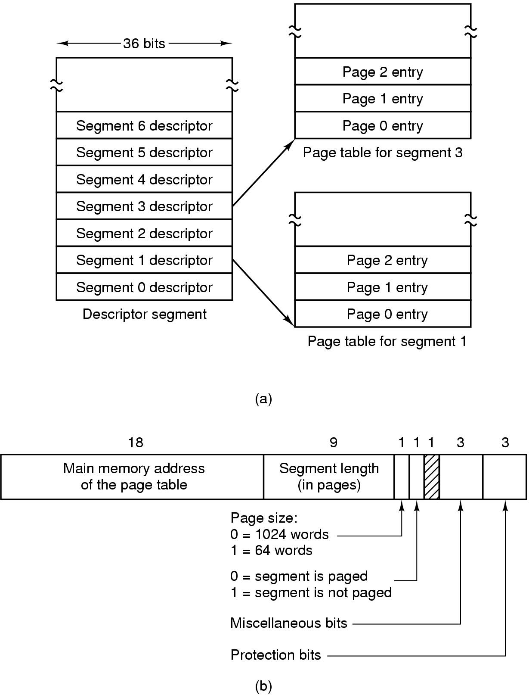
Segmentation with Paging: MULTICS (1)
Descriptor segment points to page tables
Segment descriptor – numbers are field lengths

Slide 105
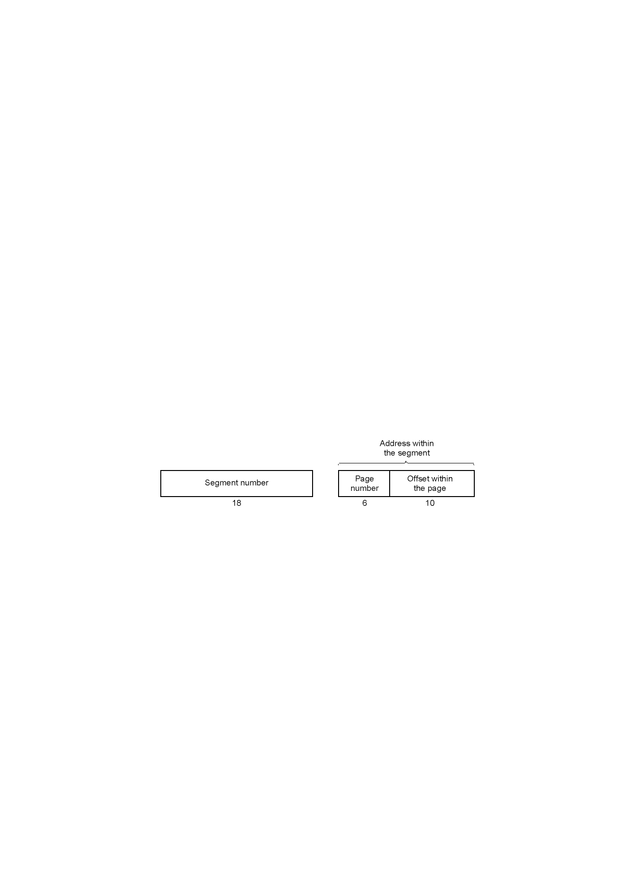
Segmentation with Paging: MULTICS (2)
A 34-bit MULTICS virtual address

Slide 106
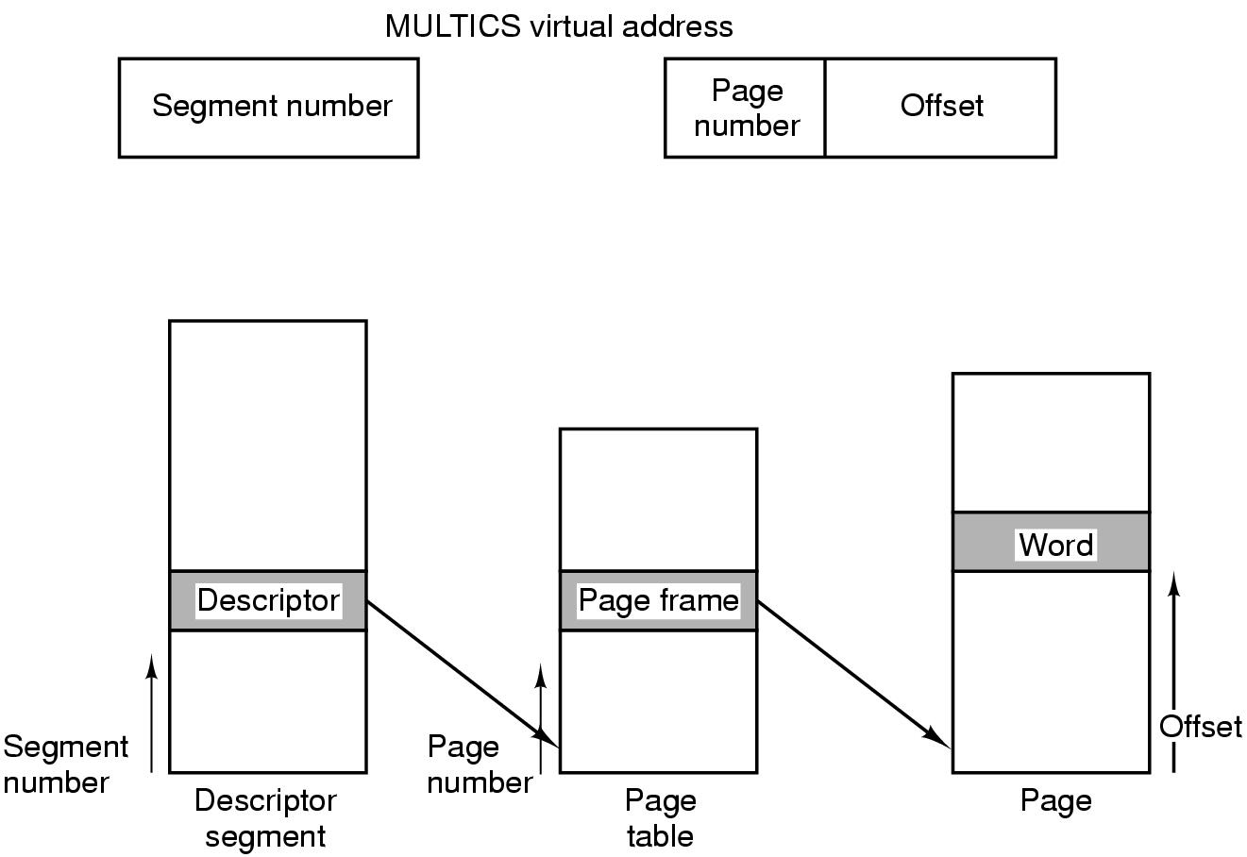
Segmentation with Paging: MULTICS (3)
Conversion of a 2-part MULTICS address into a main memory address

Slide 107
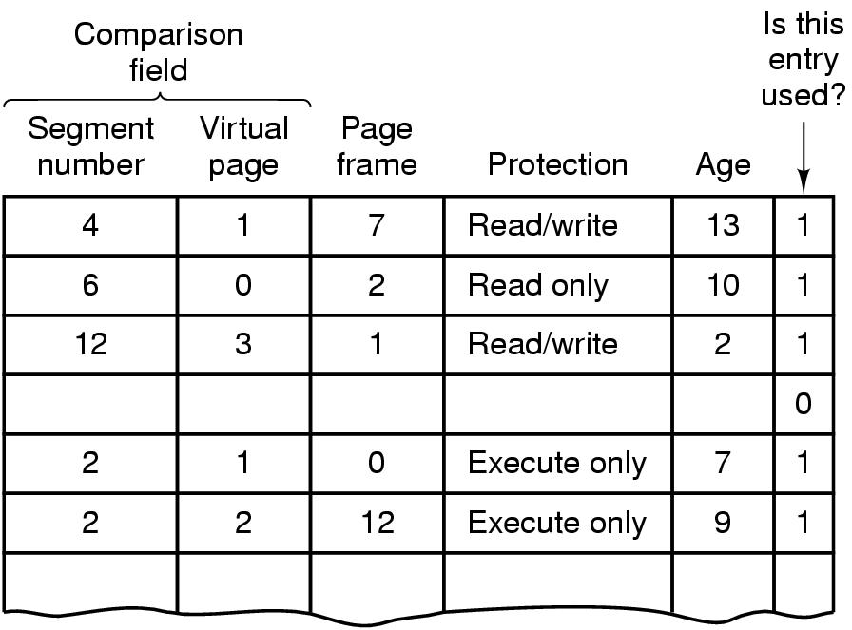
Segmentation with Paging: MULTICS (4)
Simplified version of the MULTICS TLB
Existence of 2 page sizes makes actual TLB more complicated

Slide 108
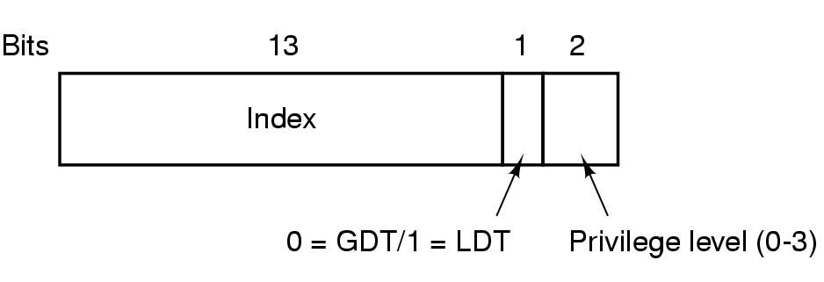
Segmentation with Paging: Pentium (1)
A Pentium selector
Pentium has 16K independent segments
Two segment tables:
  GDT (Global Descriptor Table) : for system segments, including the OS
  LDT (Local Descriptor Tables) : For segments local to each program
To access a segment, a Pentium program first loads a selector for that segment into one of the machine’s segment registers (ex: CS, DS registers)
How many segments descriptors exist in LDT?

Slide 109
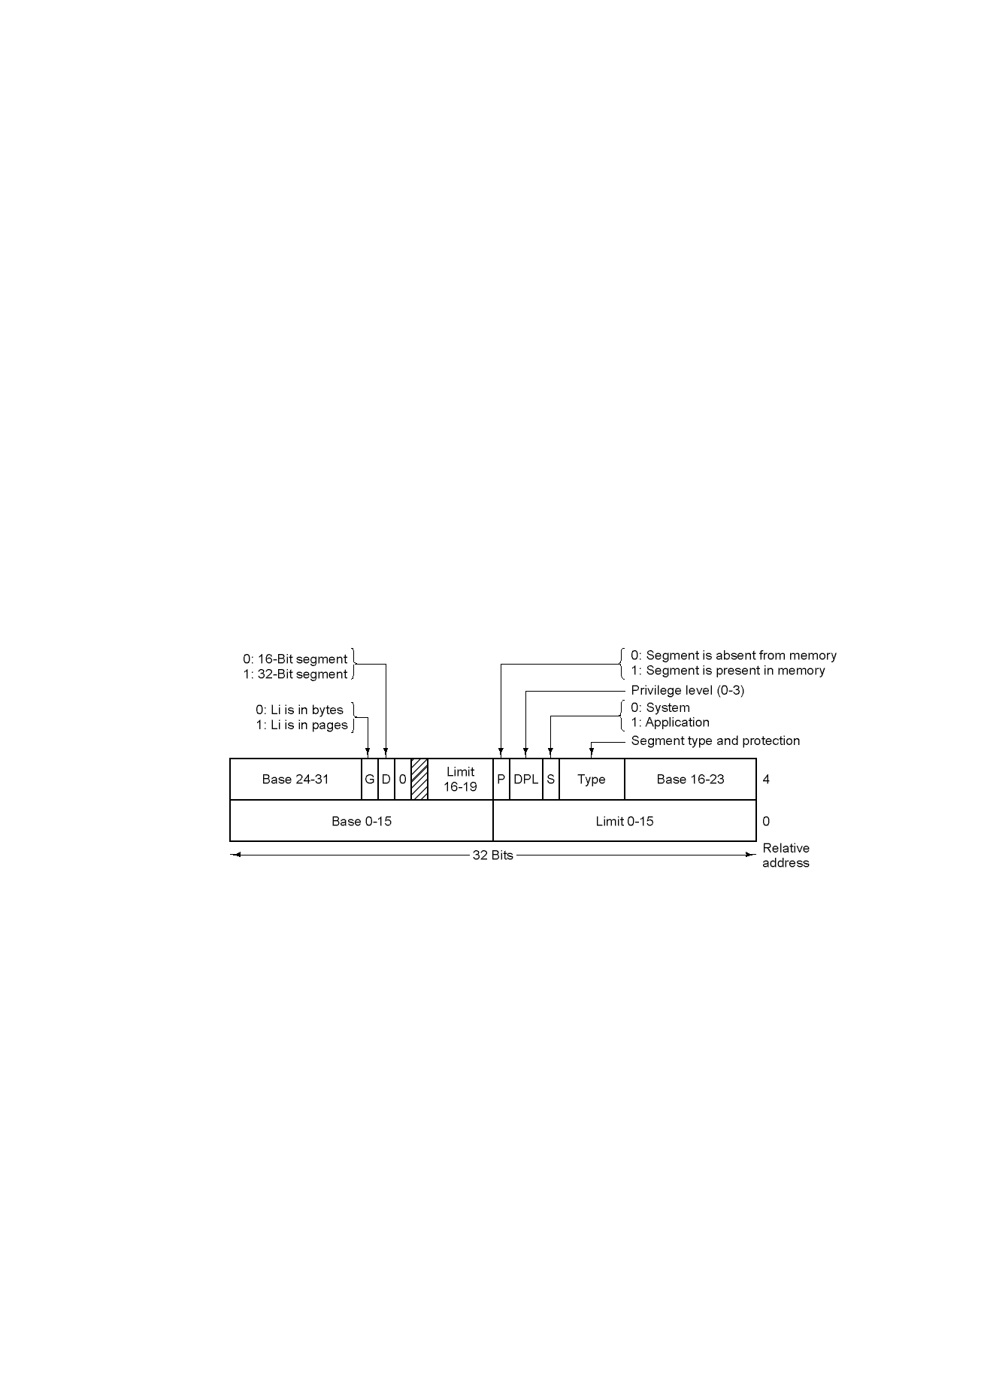
Segmentation with Paging: Pentium (2)
Pentium code segment descriptor
Data segments differ slightly

Slide 110
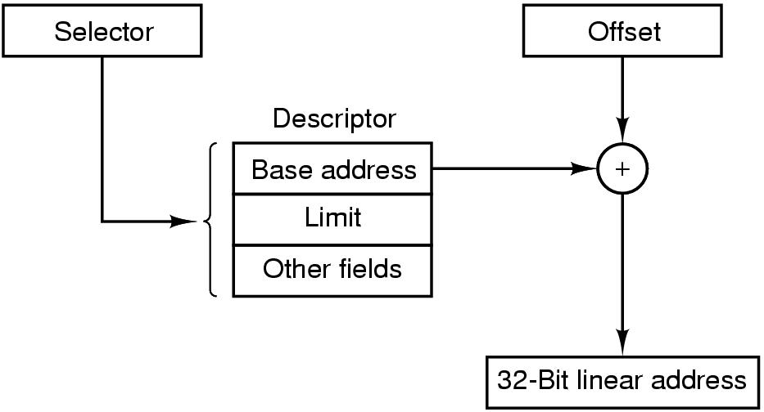
Segmentation with Paging: Pentium (3)
Conversion of a (selector, offset) pair to a linear address

Slide 111
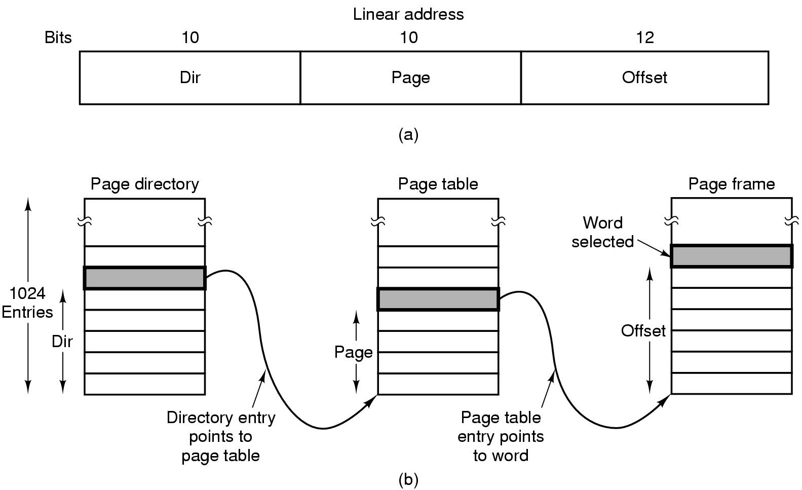
Segmentation with Paging: Pentium (4)
Mapping of a linear address onto a physical address

Slide 112
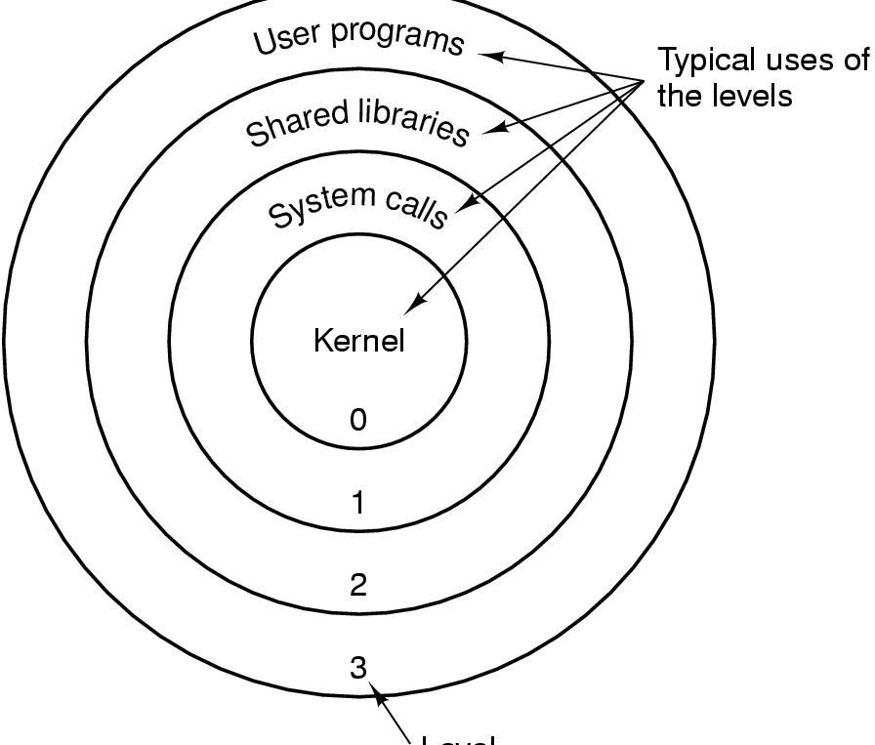
Segmentation with Paging: Pentium (5)
Level
Protection on the Pentium

