Slide 1
File Systems
Chapter 6
6.1 Files
6.2 Directories
6.3 File system implementation
6.4 Example file systems

Slide 2
Long-term Information Storage
Must store large amounts of data
Information stored must survive the termination of the process using it
Multiple processes must be able to access the information concurrently

Slide 3
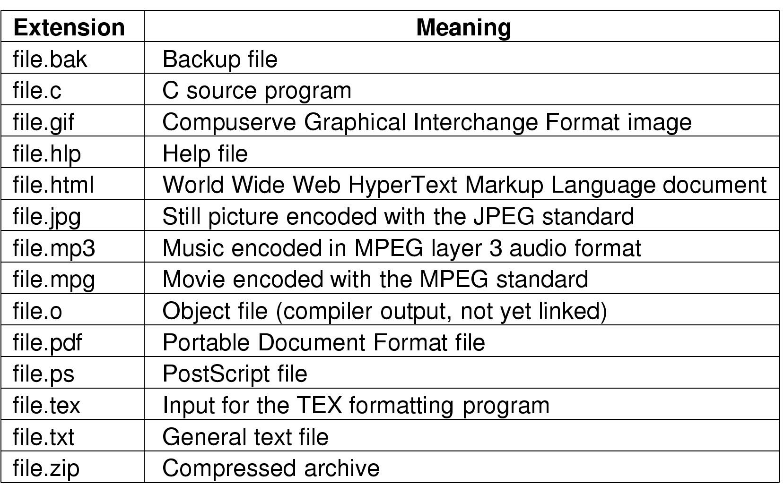
File Naming
Typical file extensions.

Slide 4
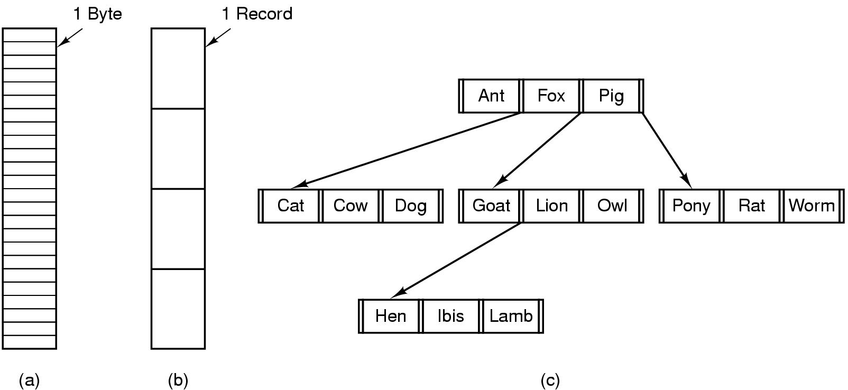
File Structure
Three kinds of files
  byte sequence
  record sequence
  tree

Slide 5
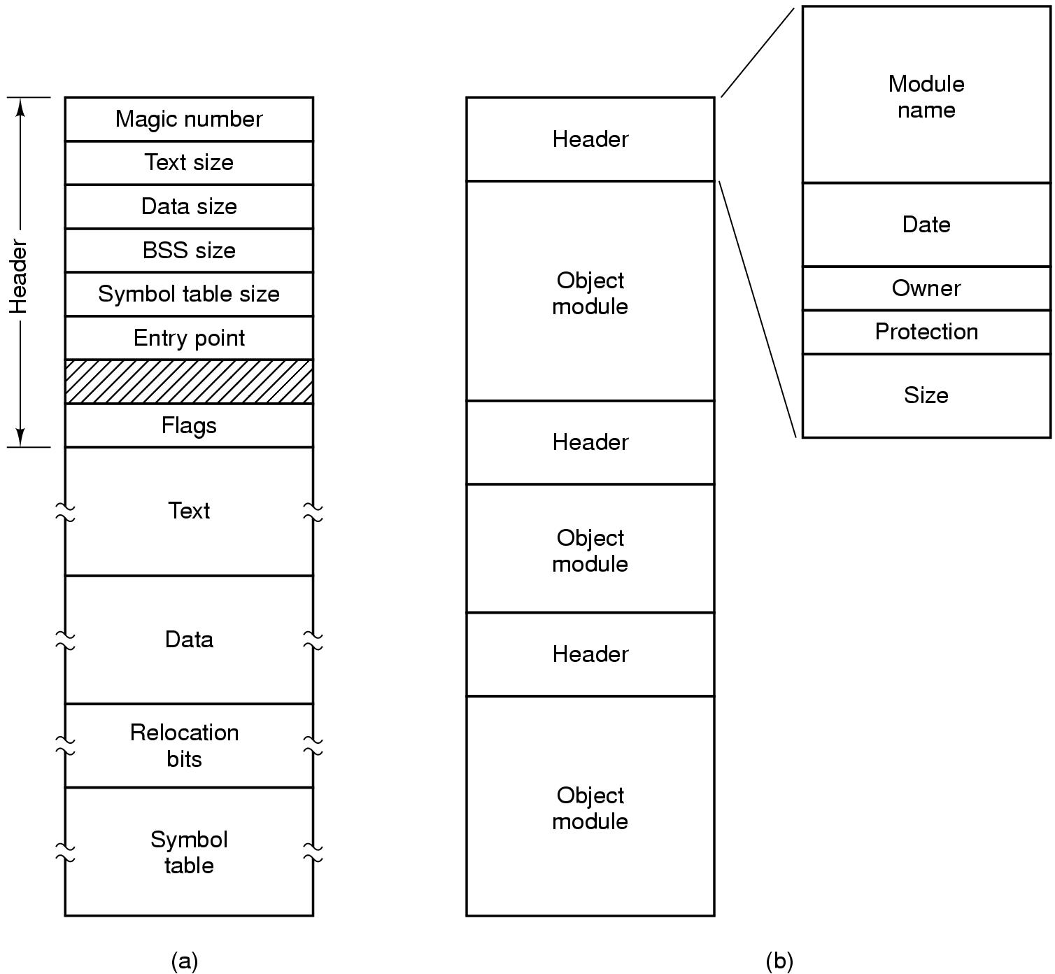
File Types
(a) An executable file (b) An archive

Slide 6
File Access
Sequential access
  read all bytes/records from the beginning
  cannot jump around, could rewind or back up
  convenient when medium was mag tape
Random access
  bytes/records read in any order
  essential for data base systems
  read can be …
    move file marker (seek), then read or …
    read and then move file marker

Slide 7
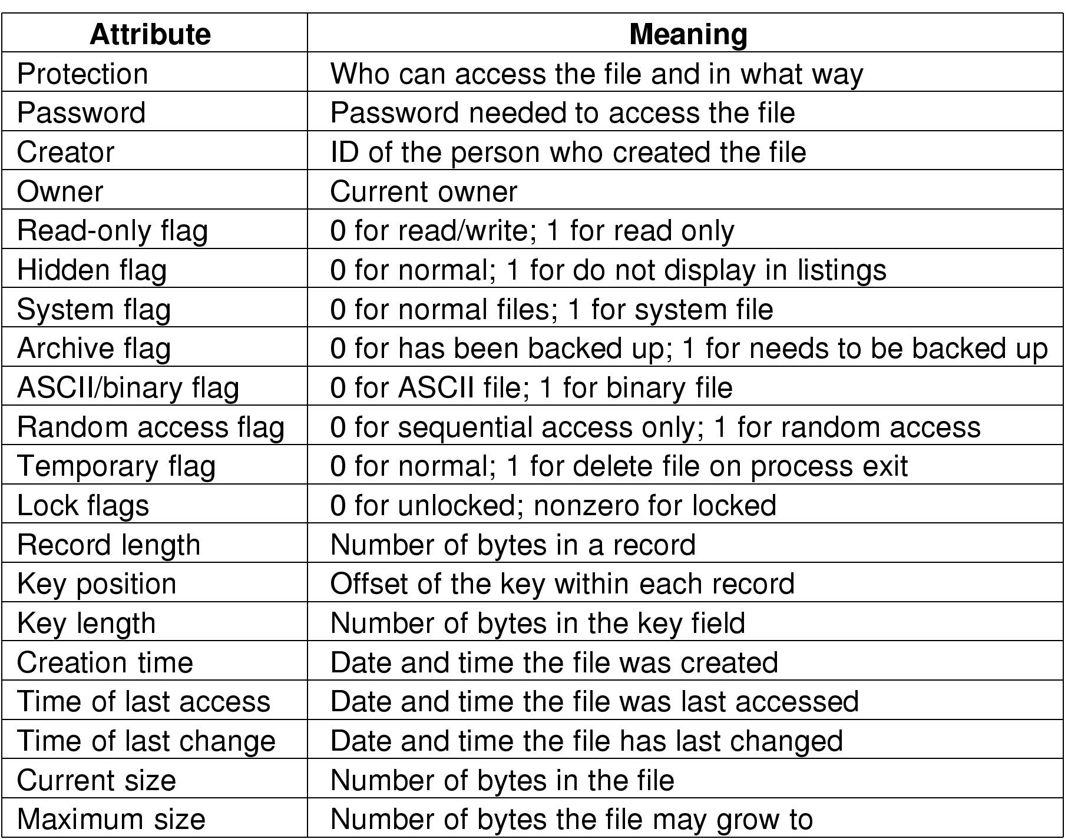
File Attributes
Possible file attributes

Slide 8
File Operations
  Create
  Delete
  Open
  Close
  Read
  Write
  Append
  Seek
  Get attributes
  Set Attributes
  Rename

Slide 9
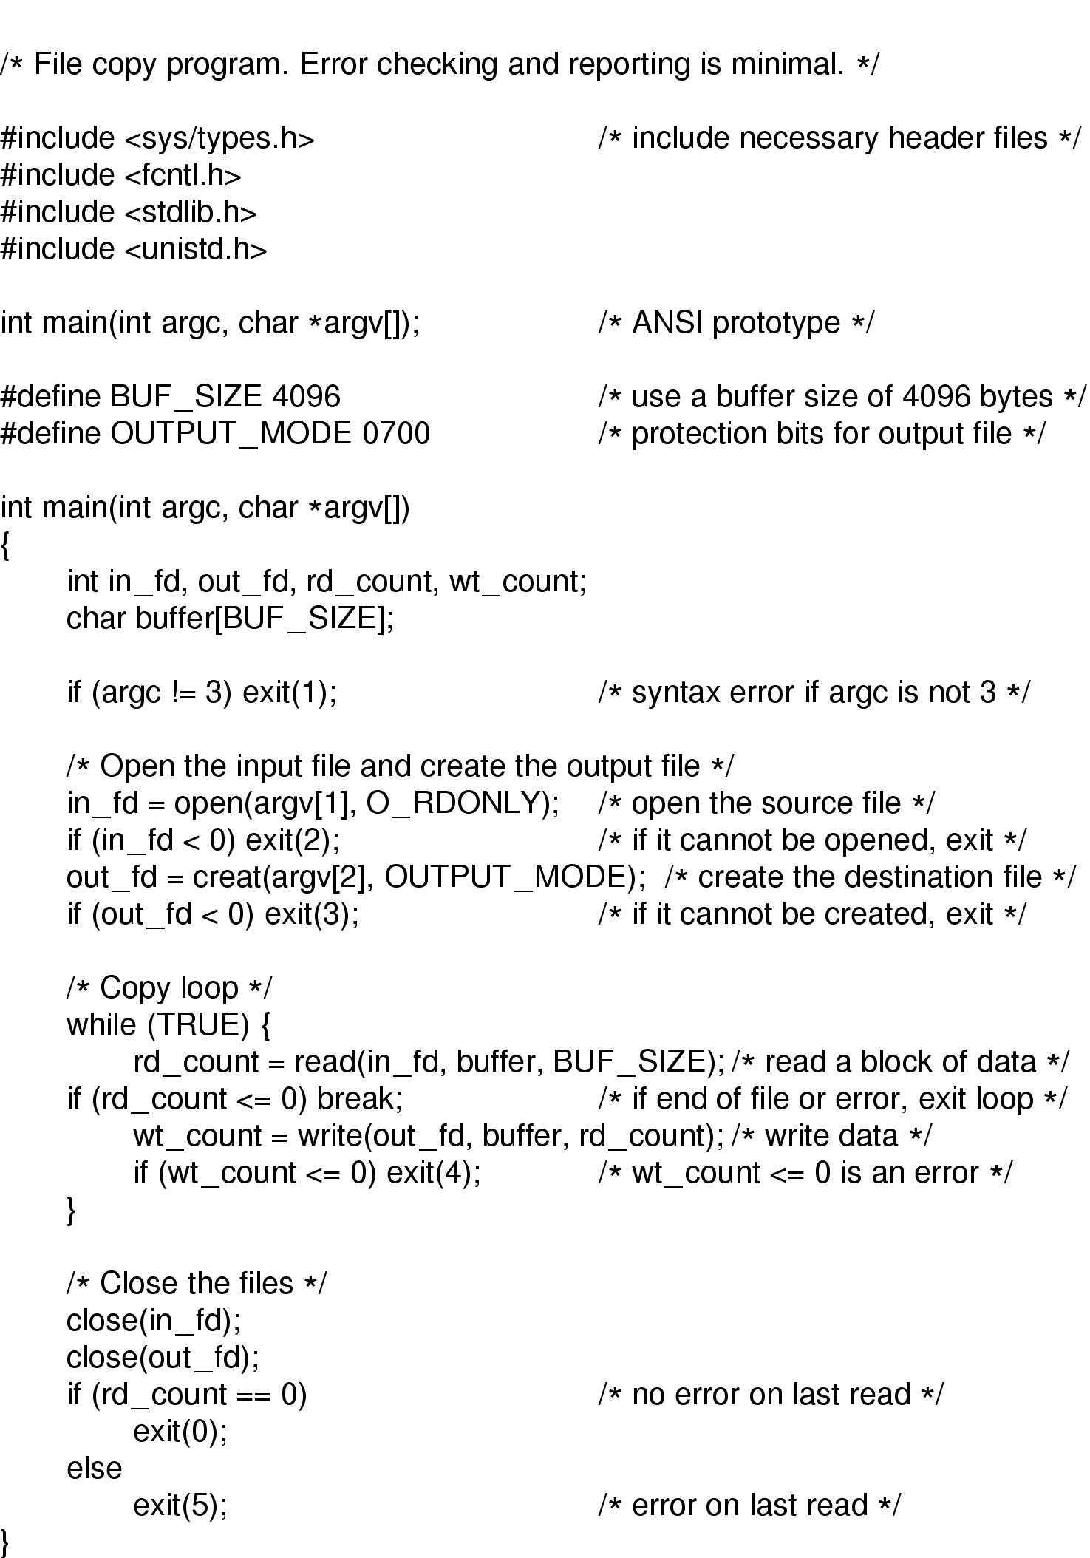
An Example Program Using File System Calls (1/2)

Slide 10
An Example Program Using File System Calls (2/2)

Slide 11
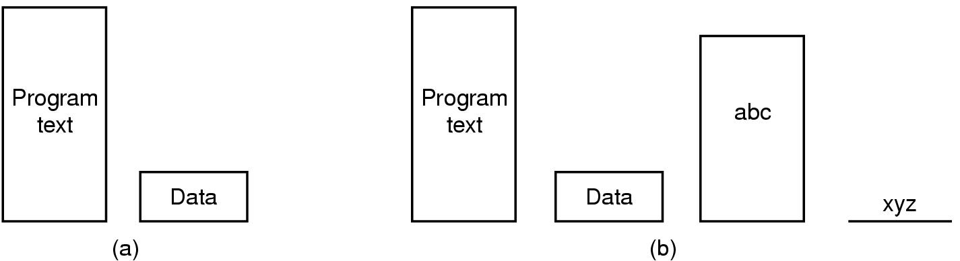
Memory-Mapped Files
(a) Segmented process before mapping files into its address space
(b) Process after mapping
  existing file abc into one segment
  creating new segment for xyz

Slide 12
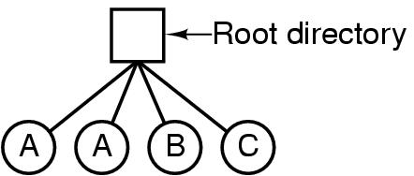
Directories
Single-Level Directory Systems
A single level directory system
  contains 4 files
  owned by 3 different people, A, B, and C

Slide 13
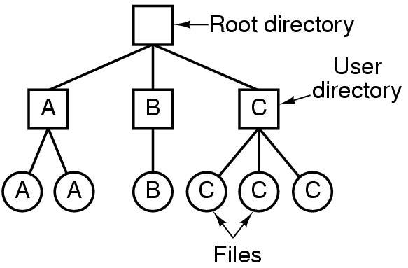
Two-level Directory Systems
Letters indicate owners of the directories and files

Slide 14
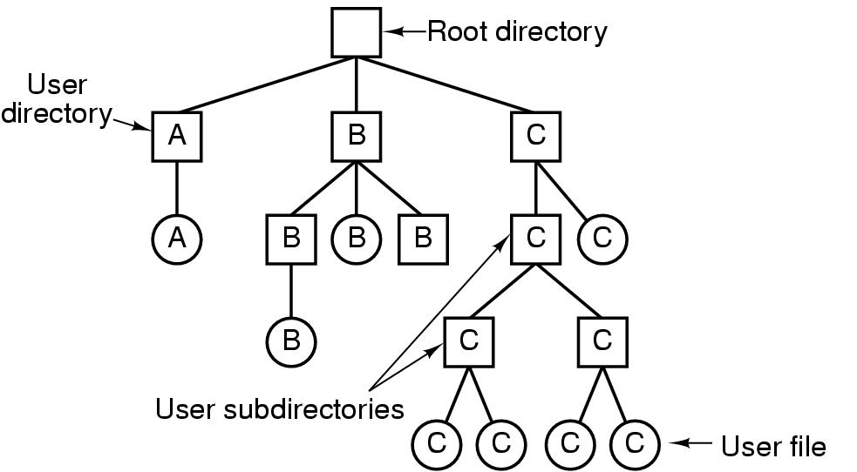
Hierarchical Directory Systems
A hierarchical directory system

Slide 15
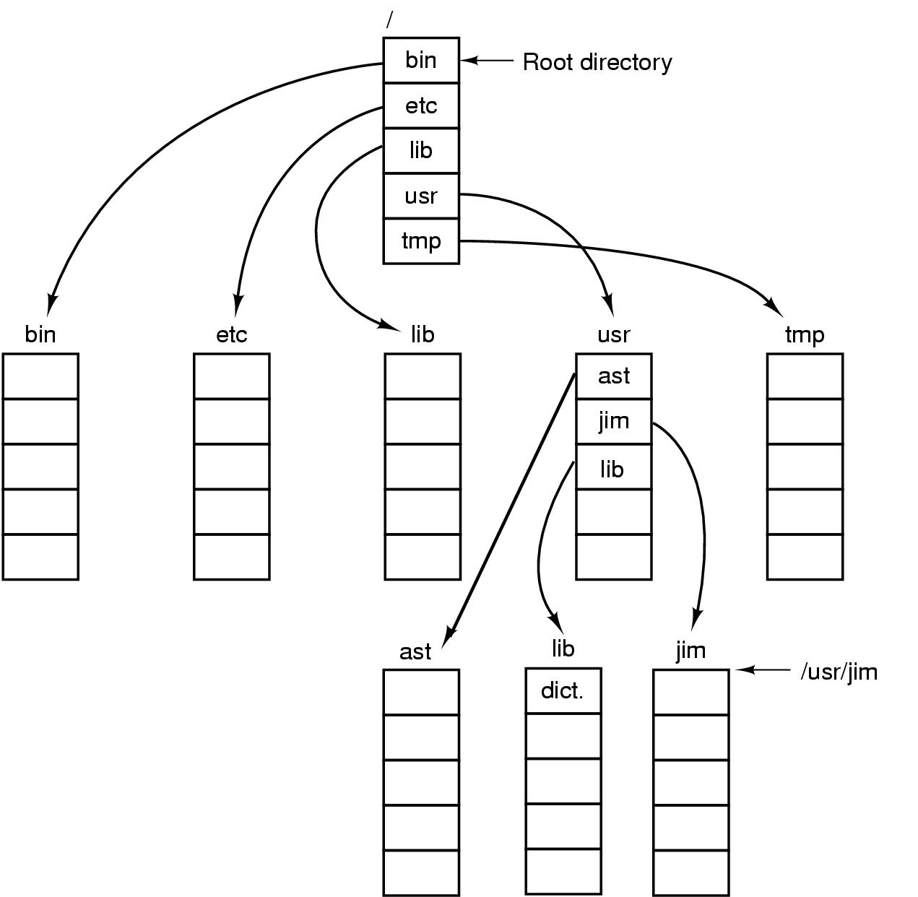
Path Names
A UNIX directory tree

Slide 16
Path Names
Absolute path name: consists of the path from the root directory to the file
  Ex: /usr/ast/mailbox
Relative path name: path name relative to the current directory (called the current working directory, unix pwd command shows the current working directory)
  If the current working directory is /usr/ast, the the file whose absolute path is /usr/ast/mailbox can be referenced simply as mailbox
There are two special entries in each directory for easy navigation in the directory tree
  “.” for the current directory
  “..” for the previous directory

Slide 17
Directory Operations
Create
Delete
Opendir
Closedir
Readdir
Rename
Link
Unlink

Slide 18
Linking
Linking allows a file to appear in more than one directory
  Ex: >link existing-file new-file
  This creates a link from the existing file to the new file (I.e., new file is a link to the existing file)
Unlink removes the link

Slide 19
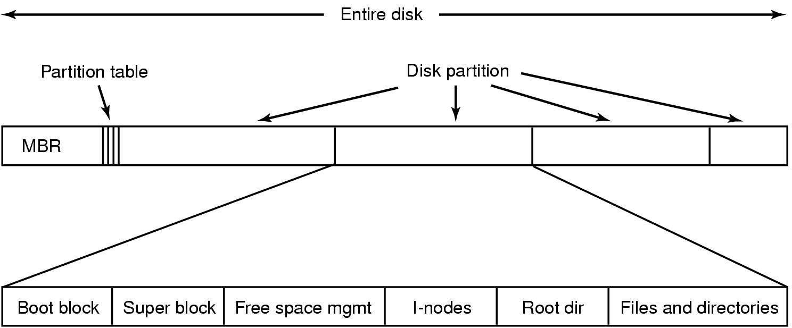
File System Layout
MBR (sector 0 of the disk) is used to boot the computer
Partition table keeps the start and end of each partition
One of the partitions is active, MBR program locates the active partition and reads its first block (called the boot block) and execute it
The program in the boot block loads the OS in that partition
Superblock keeps all the important parameters about the file system and it is read into memory when the computer is booted or the file system is used

Slide 20

File System Implementation:
(1) Contiguous Allocation
(a) Contiguous allocation of disk space for 7 files
(b) State of the disk after files D and E have been removed

Slide 21
Contiguous Allocation
Advantages
  Very easy to implement (just keep the first block and the number of blocks for each file)
  Excellent read performance (why?)
Disadvantages:
  External fragmentation
  May need to move files to a larger hole when they grow
  Needs frequent compaction which is very expensive
It is a good approach when the file sizes are know in advance and they do not change (ex: CD-ROMS)

Slide 22

Implementing Files
(2) Linked List Allocation
A file is stored as a linked list of disk blocks
The first couple of bytes of each block is used as a pointer to the next block
The rest of the block is used for storing actual data
Advantages
  No external fragmentation
  Easy to keep track of files(what do we need to store for each file to locate its blocks?)
Disadvantages:
  Block size is no longer a power of two (why?)
  Random access is very slow (why?)

Slide 23
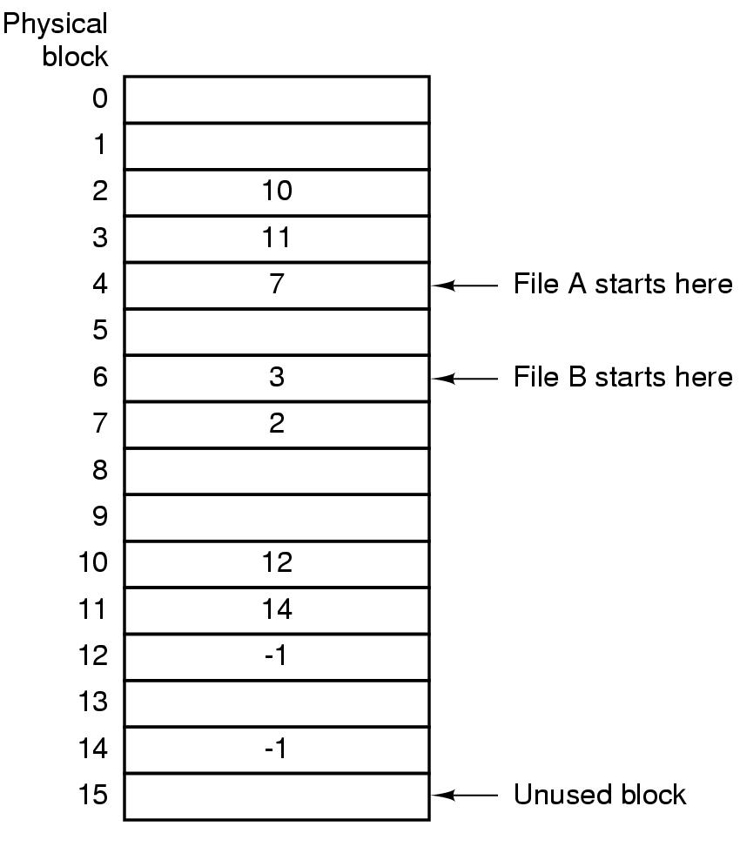
Implementing Files
(3) Linked list with a table
The pointer in the linked list method is kept in a table in the memory (instead of keeping it in the disk blocks)
This table is called FAT (File Allocation Table)
Chains of blocks are terminated with a special symbol (-1)
Advantages:
  Fast random access (though chaining used)
  Keeping the starting block of each file is enough to locate its disk blocks
Disadvantage
  The whole FAT should be in main memory which takes a lot of space (Think of 60GB disk, 1KB disk blocks, and each entry in FAT being 4 bytes)

Slide 24
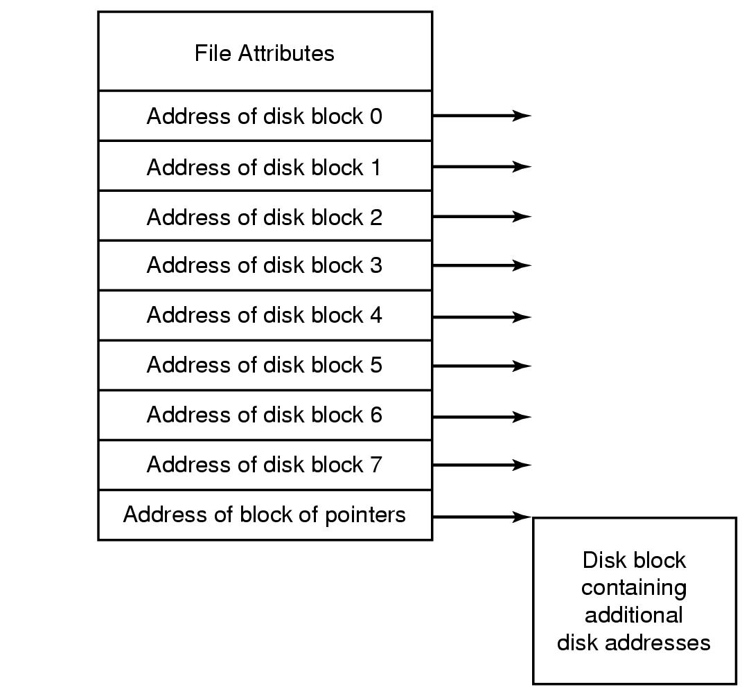
Implementing Files : (4) I-nodes
Each file is associated with a data structure called its I-node (index node)
I-node stores the attributes and disk addresses of the blocks of a file
Only the I-node of open files need to be in the memory (as opposed to FAT technique)
I-node scheme requires an array in memory whose size is proportional to the maximum number of files that may be open at once (I.e., it is independent of the disk size as opposed to FAT scheme)
Extra disk blocks may be reserved to store the block addresses of a large file.

Slide 25
Implementing Directories
Before a file can be accessed it must be opened
When a file is opened, the OS uses the path name to locate the directory entry
The directory entry provides the information needed to find the disk blocks of the file
Every file system maintains some file attributes (as seen the the previous slides). Storage of file attributes is shown in the next slide

Slide 26
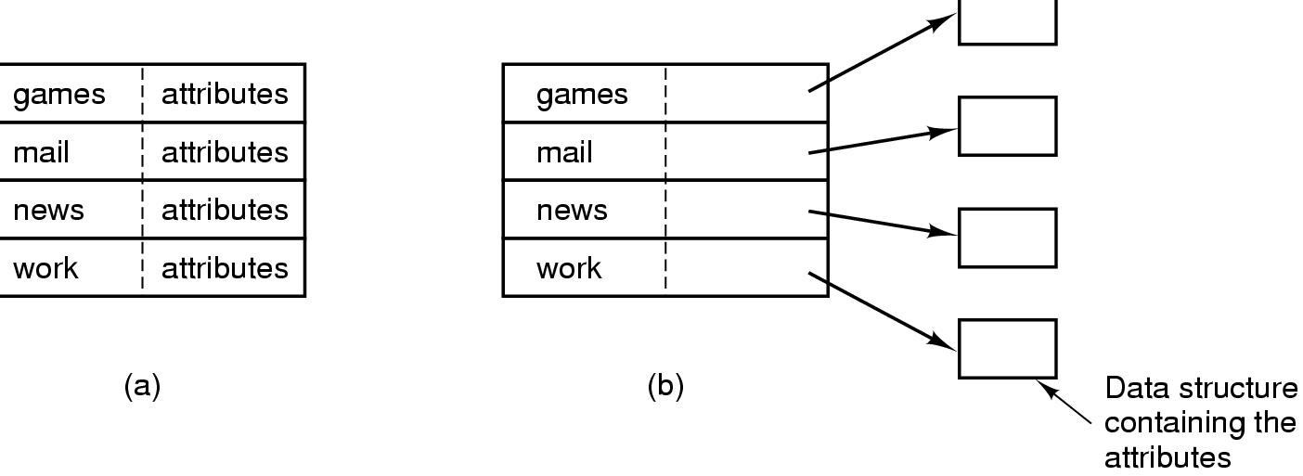
Implementing Directories (1)
(a) A simple directory
  fixed size entries
  disk addresses and attributes in directory entry
(b) Directory in which each entry just refers to an i-node

Slide 27
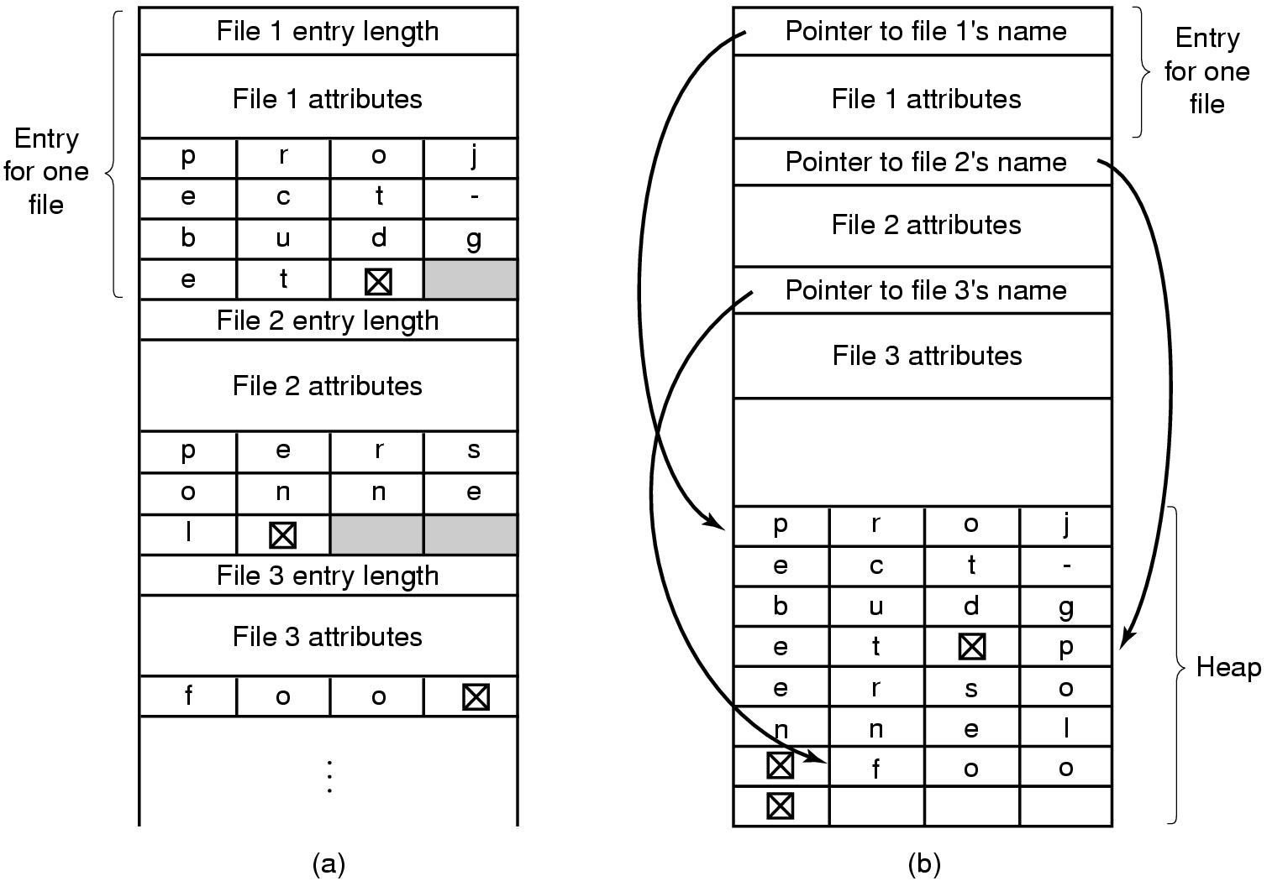
Implementing Directories (2)
Two ways of handling long file names in directory
  (a) In-line
  (b) In a heap

Slide 28
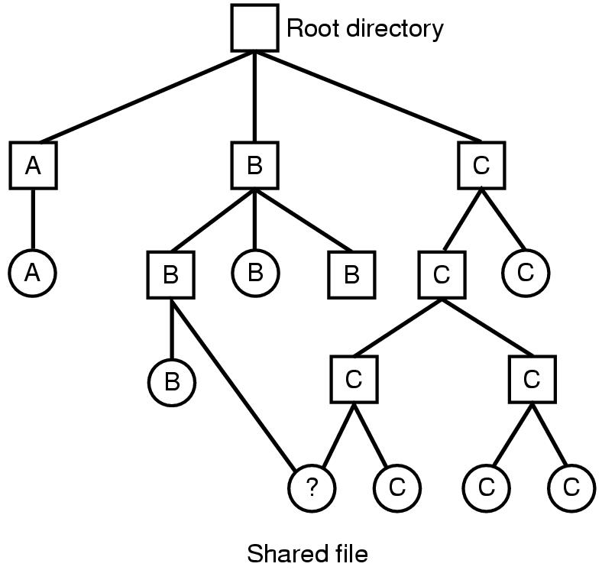
Shared Files
A shared file (denoted with ? in the figure) appears in multiple directories (B and C in the figure)
A link is created for the shared file (in B’s directory in this case).
If directories contain disk addresses of the blocks belonging to the file then they should be copied to the new directory entry (which causes problems when the file is modified)
If I-nodes are used then a pointer is added for the new directory entry
Or we can create a special file of type link, and write the pathname of the original file as the new directory entry (called symbolic linking)

Slide 29
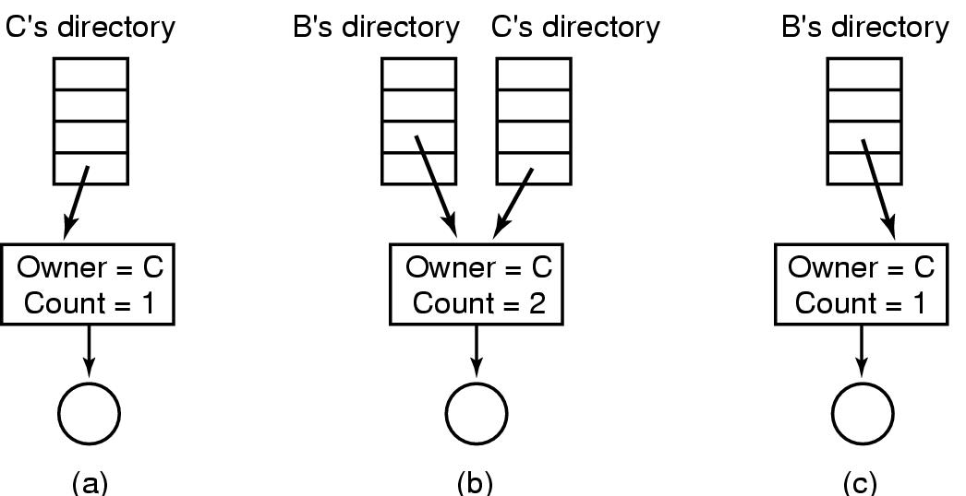
Shared Files (by inserting a pointer for the shared file that points to the i-node)
(a) before linking
(b) after linking
(c) after C (the original owner) removes the file

Slide 30
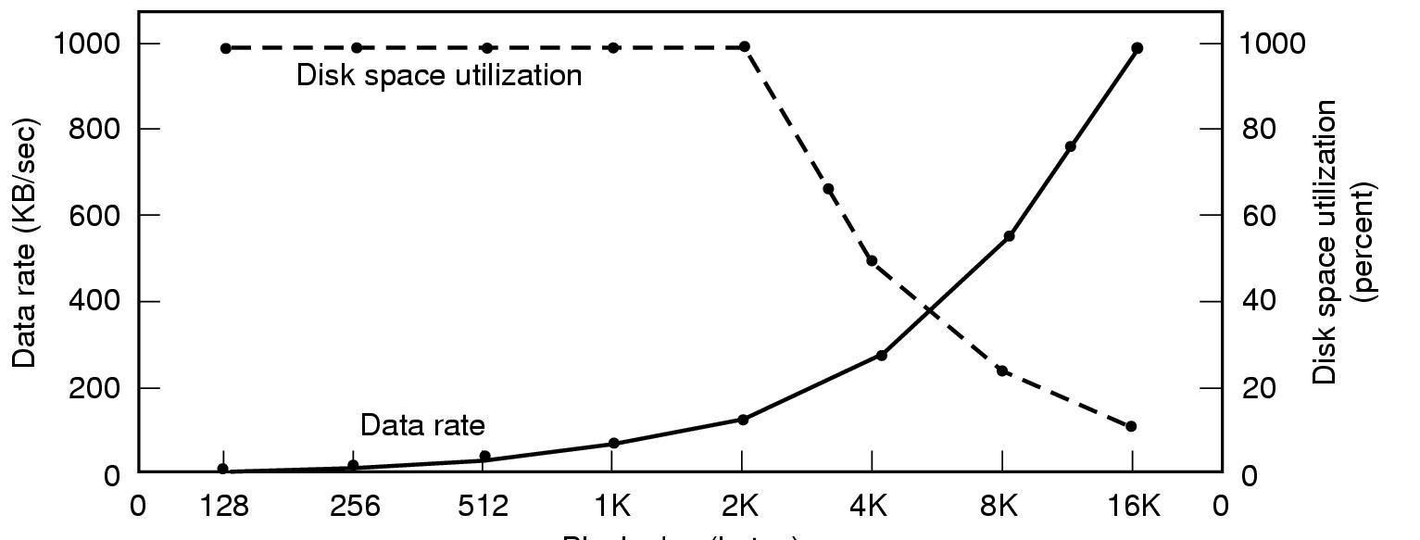
Disk Space Management (1)
Block size
Dark line (left hand scale) gives data rate of a disk
Dotted line (right hand scale) gives disk space efficiency
All files 2KB

Slide 31
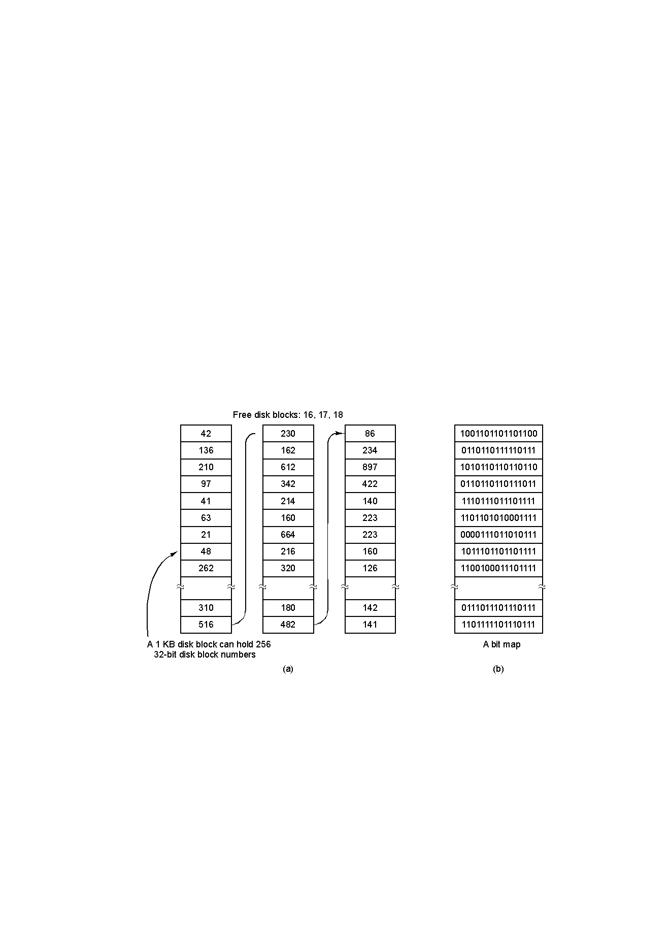
Disk Space Management (2)
(a) Storing the free list on a linked list of disk blocks (with 1KB disk blocks with 32-bit disk block numbers how many block numbers can be stored in one disk block? Note that the disk blocks should form a linked list)
(b) A bit map where 1s represent free disk blocks and 0s represent allocated blocks (or vice versa) How many disk blocks are needed to store the bitmap for a 16GB disk with block size 1KB?

Slide 32
Linked lists vs Bitmaps for Disk Space Management
Size of the linked list that keeps the free blocks is dynamic cause it shrinks when the disk blocks are used.
Linked list is kept in free disk blocks and the blocks allocated for the linked list can be used later on as the linked list size shrinks
Bitmap size is static but much smaller than the linked list size.
As the disk fills up the linked list size may become smaller than the bitmap size eventually.
Keeping only one block of free disk addresses in memory is enough for disk space allocation.

Slide 33
Linked lists
One block of pointers (i.e., disk addresses) are kept in memory
When a file is created , the needed blocks are taken from the block in memory
When the block runs out of pointers, a new block of free pointers is read from the disk
When a file is deleted, its blocks are freed, and added to the block of pointers in memory
When the block fills up, it is written to the disk
Consider what happens
  when a the block of pointers is nearly full and there are only 2 free locations
  And a temporary file of size 3 disk blocks is created and deleted all the time.

Slide 34
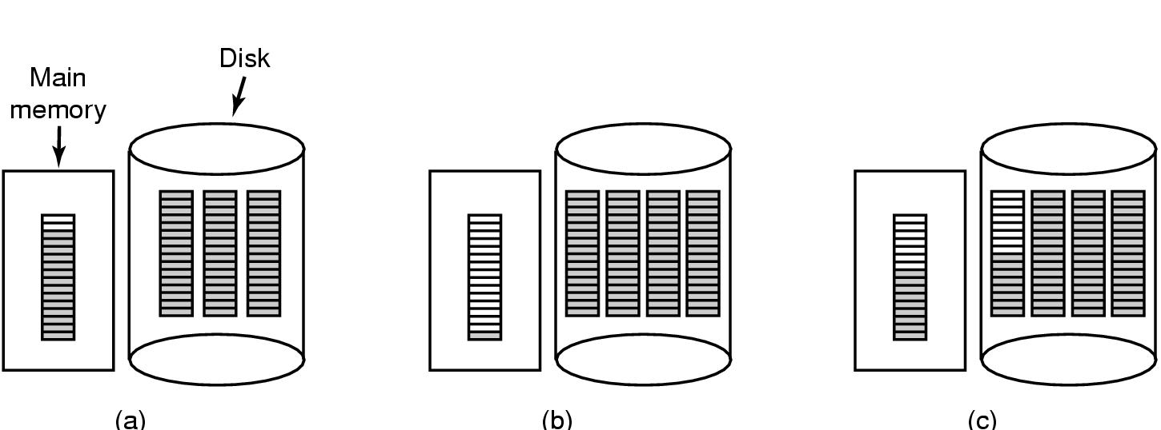
Disk Space Management (3)
(a) Almost-full (2 empty slots only) block of pointers to free disk blocks in RAM
  - three blocks of pointers on disk
(b) Result of freeing a 3-block file
(c) Alternative strategy for handling 3 free blocks
  - shaded entries are pointers to free disk blocks

Slide 35
Disk space management with bitmaps
We can also keep just one block of the bitmap in the memory and use it for allocation/deallocation of disk blocks.
This way we try to reduce the disk arm motion when reading the files cause the disk blocks close to each other will be close together when they are allocated from the same block of the bitmap (is it the same when linked lists are used?)

Slide 36
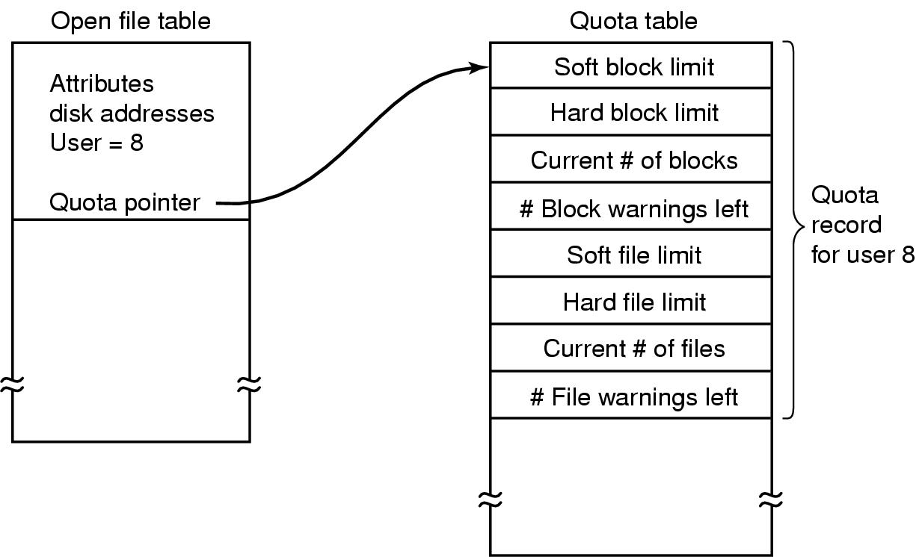
Disk Space Management: Quotas
Each user is assigned a quota for multi-user systems which needs to be enforced
When a user opens a file, an entry is inserted for it to the open file table.
A second table contains the quota record for every user with a currently open file.
Every time a block is added to a file, the total number of blocks for the owner of the file is increment and a check is made against the hard and soft quota limits

Slide 37
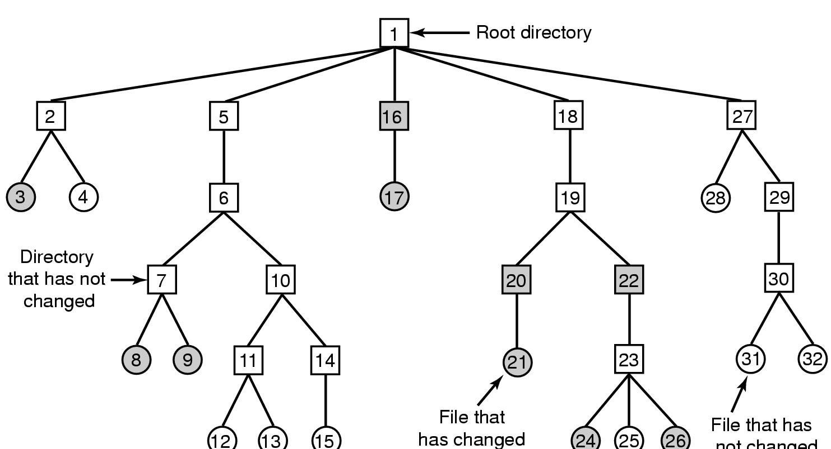
File System Reliability : Backups
File that has
not changed
A file system to be dumped
  squares are directories, circles are files
  shaded items, modified since last dump
  each directory & file labeled by i-node number

Slide 38
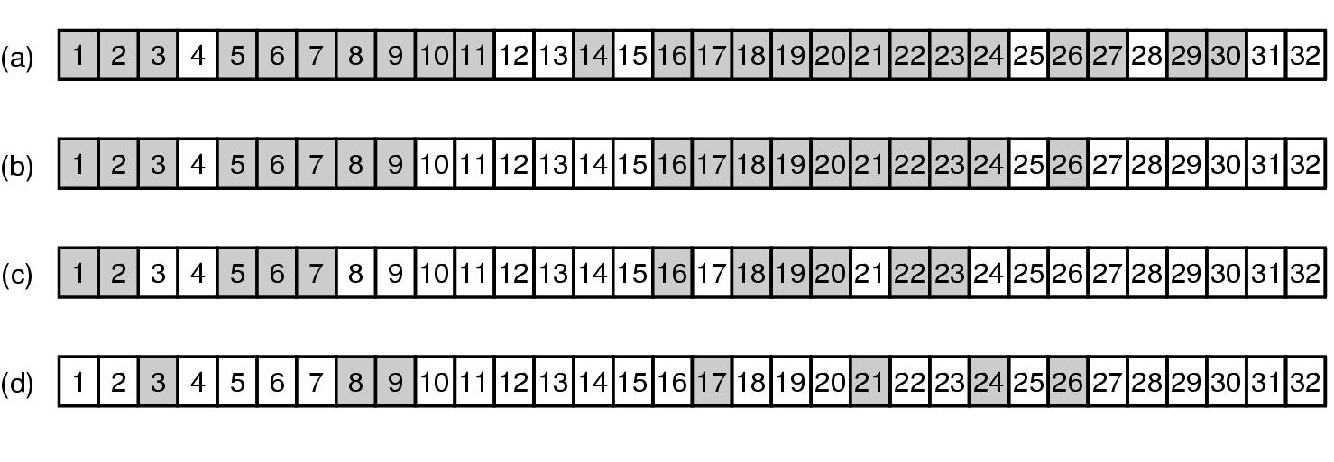
File System Reliability : Backups
Bit maps used by the logical dumping algorithm

Slide 39
File System Consistency
Many systems read blocks, modify them and write them back to disk later on
If the system crashes before all modified blocks have been written back to disk, then the file system can be left in an inconsistent state
This is more serious when the blocks in concern are I-nodes, directory blocks, of block containing free lists.
After the crash, the file systems consistency check should be made just in case.

Slide 40
File System Consistency
To check for block consistency (i.e., the correctness of free/allocated block info) two tables are needed:
  Table for free blocks
  Table for used blocks
Each slot in the table is a counter.
The block consistency checker
  As the first step reads all the i-nodes and for each block in the I-node, its counter in the table of used blocks is incremented
  As the second step reads the free block lists (or bitmap) and increments the corresponding counters of the block numbers that appear in the list of free blocks.

Slide 41
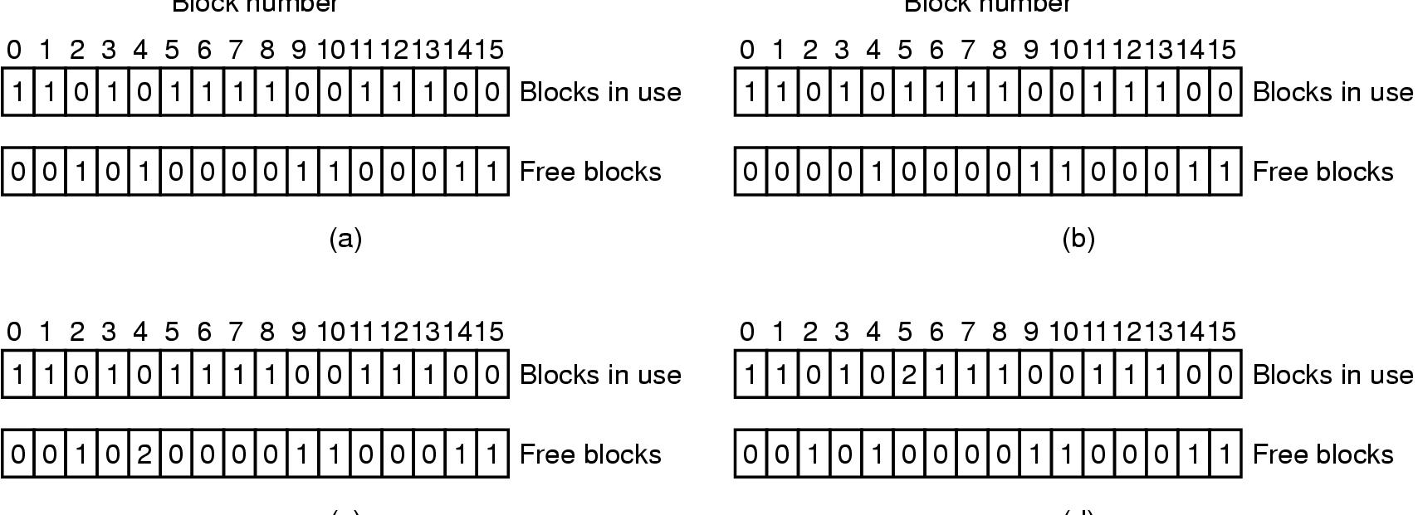
File System Consistency
File system states after the consistency check
  (a) Consistent (each block will have a 1 in either used or free blocks tables)
  (b) missing block (a block does not appear in either table, then include it free blocks)
  (c) duplicate block in free list (a block is listed more than once in the free list, rebuild the free list)
  (d) duplicate data block (same block is used by two files, allocate another block and copy the contents to the new one)

Slide 42
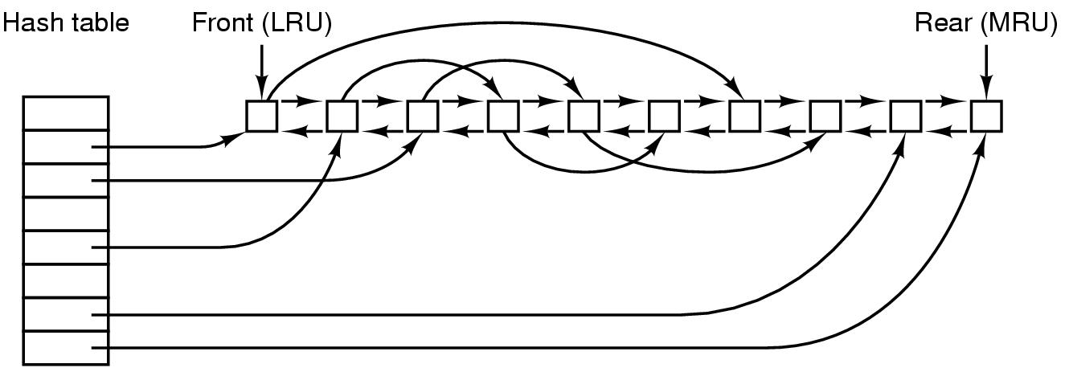
File System Performance (1)
The block cache data structures

Slide 43
MS-DOS vs UNIX
MS-DOS used write-through cache where the modified blocks are written back to the disk immediately
  Requires more disk I/O
  Especially when you are writing a file character by character
  File system consistency is easy to maintain after a power failure or system crash
  Better for removable disks
UNIX will defer the write to a later time (cache management determines when)
  Less disk I/O
  File system is most probably not consistent when you take out the disk (a special command sync is needed to ensure file system consistency)
  Good for hard disks

Slide 44
Block Read Ahead
Blocks are read into memory before they are actually requested to improve file system performance
Does this approach work equally well with sequential and random access?

Slide 45
Reducing Disk Arm Motion
Put blocks that are likely to be accessed in sequence close to each other preferably in the same cylinder
Is it easier to do this with bitmaps or linked lists of free blocks?
How can you make sure that consecutive disk blocks are allocated for the same file in case of bitmaps and linked list allocation?
Placing I-nodes in the cylinder that contain the disk blocks for the corresponding file is a good approach to increase file system performance

Slide 46

File System Performance (2)
I-nodes placed at the start of the disk
Disk divided into cylinder groups
  each with its own blocks and i-nodes

Slide 47
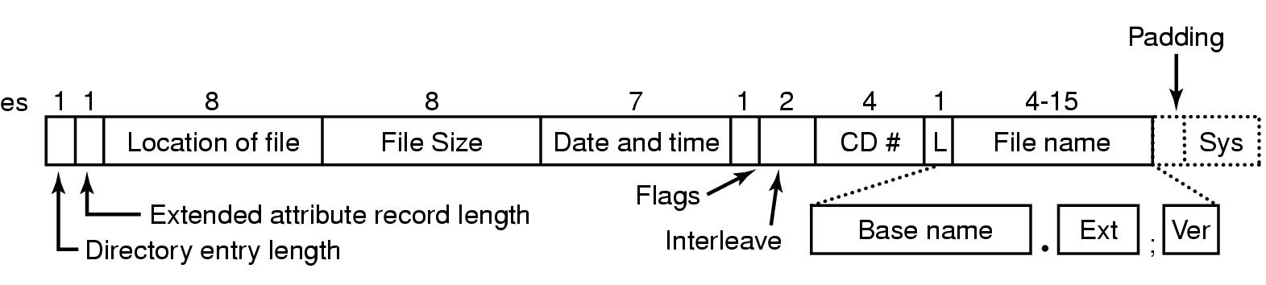
Example File Systems
CD-ROM File Systems
The ISO 9660 directory entry

Slide 48
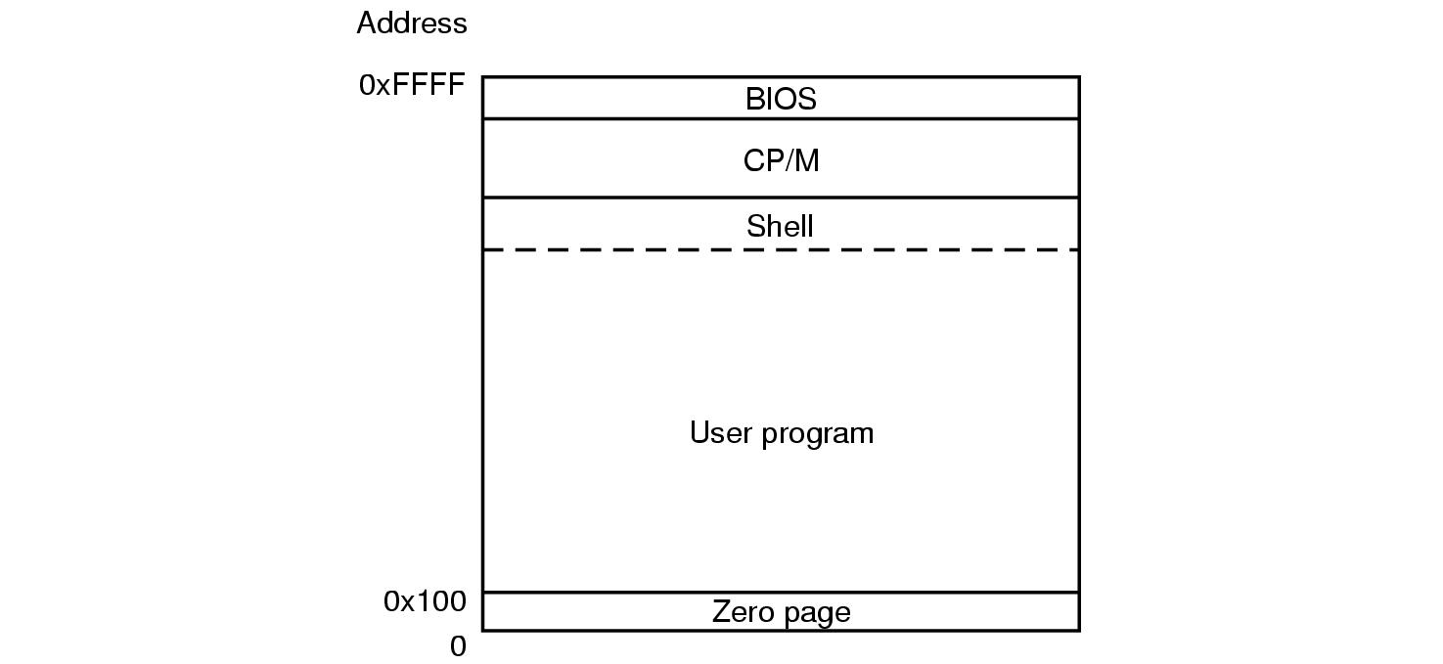
The CP/M File System (1)
Memory layout of CP/M

Slide 49
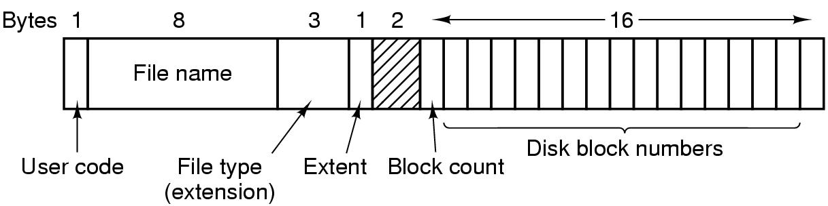
The CP/M File System (2)
The CP/M directory entry format

Slide 50
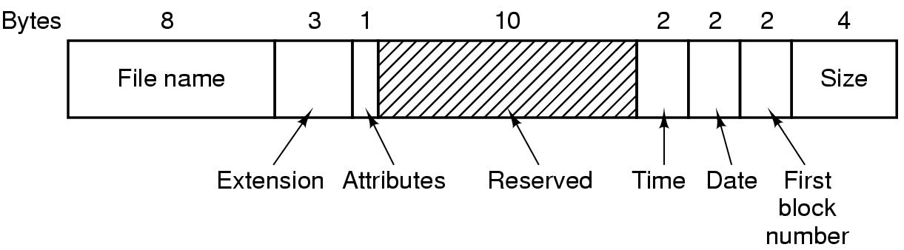
The MS-DOS File System (1)
The MS-DOS directory entry

Slide 51
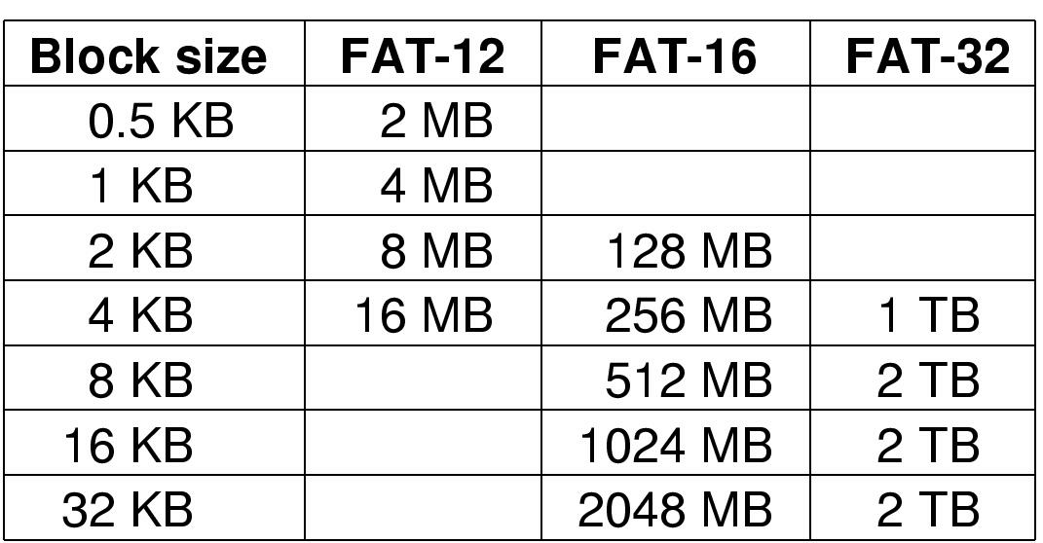
The MS-DOS File System (2)
12, 16, and 32 specify the number of entries in FAT (2^12, 2^16, and 2^32 respectively)
What would be the size of a FAT-12 table in case the block size is 0.5KB, and block size of 1KB in MS-DOS?
What would be the size of the disk in case the max allowed block size is 4KB and max 4 partitions in a disk?
Do you notice anything strange in the last column?

Slide 52
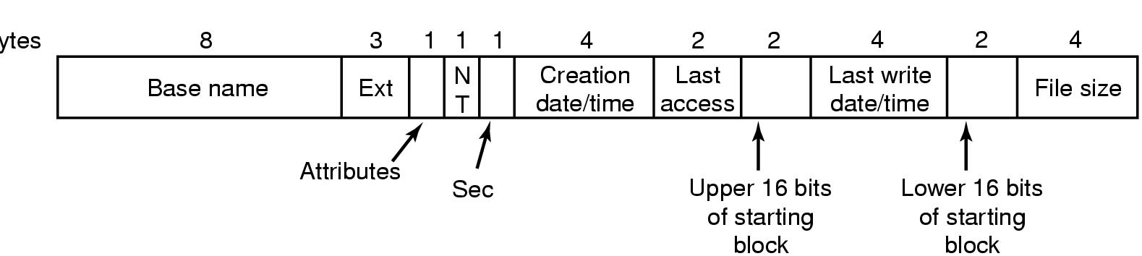
The Windows 98 File System (1)
Bytes
The extended MOS-DOS directory entry used in Windows 98

Slide 53
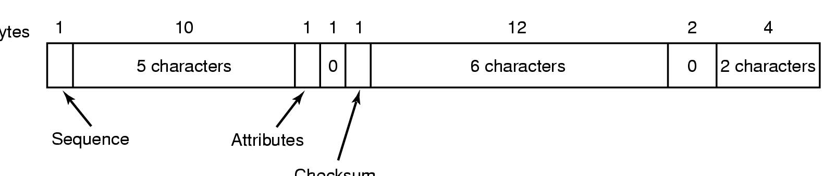
The Windows 98 File System (2)
Bytes
Checksum
An entry for (part of) a long file name in Windows 98

Slide 54
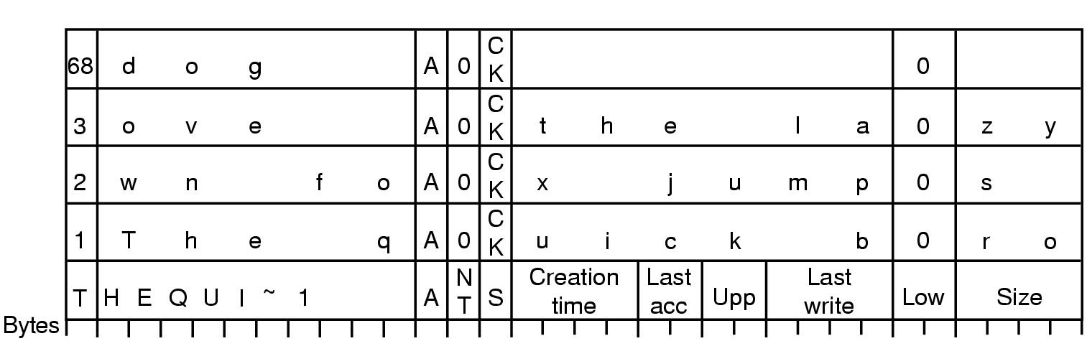
The Windows 98 File System (3)
An example of how a long name is stored in Windows 98

Slide 55
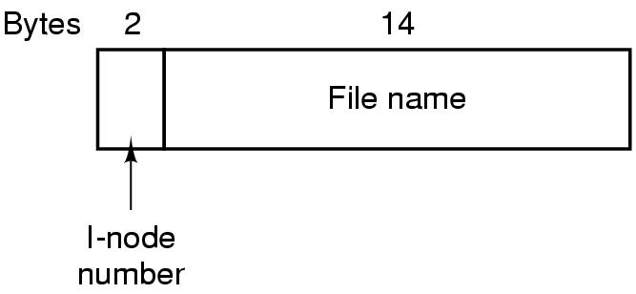
The UNIX V7 File System (1)
A UNIX V7 directory entry

Slide 56
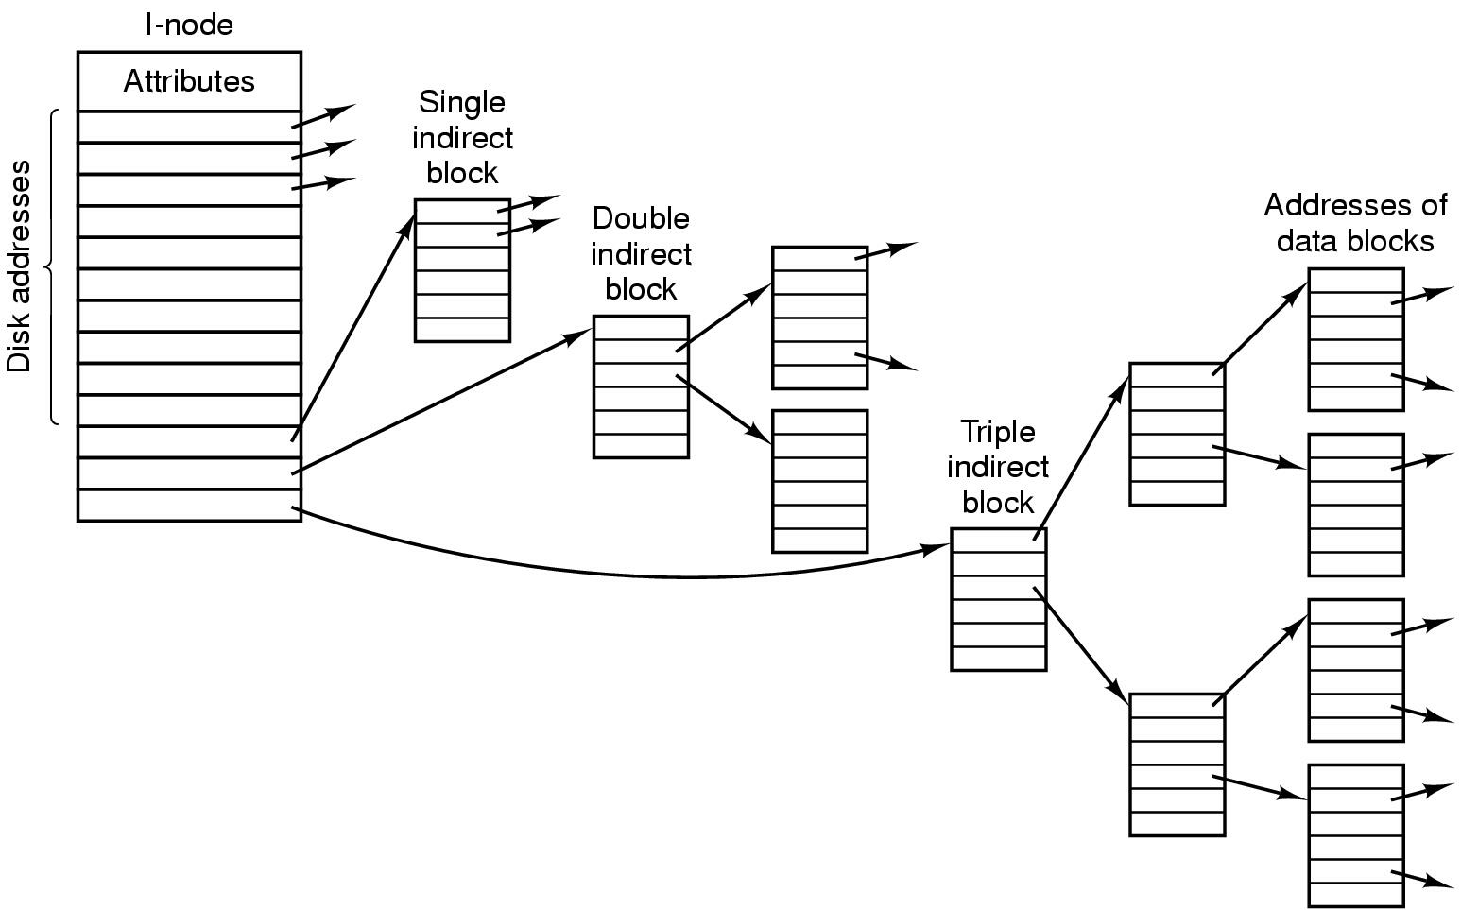
The UNIX V7 File System (2)
A UNIX i-node

Slide 57
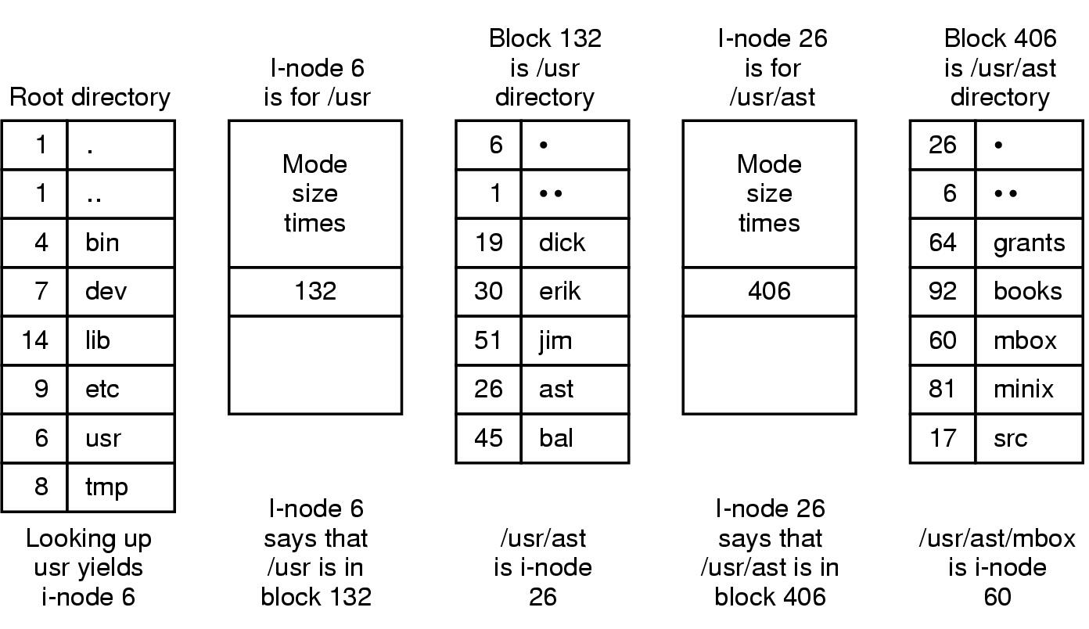
The UNIX V7 File System (3)
The steps in looking up /usr/ast/mbox

