Slide 1
Introduction to
Computer System
Some of these slides are based on
http://www.site.uottawa.ca/~ivan/
and the Modern Operating Systems book by Andrew Tannenbaum

Slide 2
Computer System
Computers are automatic, electronic machines that
  accept data & instructions from a user (INPUT)
  store the data & instructions (STORAGE)
  manipulate the data according to the instructions (PROCESSING)
  store &/or output the results to the user (OUTPUT)
A computer system is composed of hardware and software
Hardware components are the physical, tangible pieces that we can see and touch

Slide 3
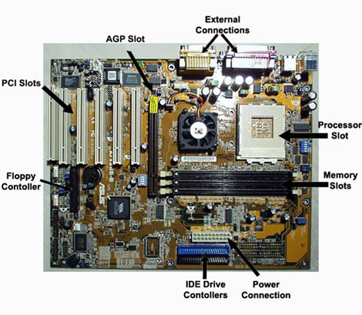

Slide 4
Software
Program
  a sequence of instructions to accomplish a result
  a computer processes information under the direction of a program
Data
  information to be processed by a program
Example
  Data: for each employee, the employee number, hours worked & hourly pay rate
  Program: instructions on how to process the data to produce pay cheques, payroll register, etc.

Slide 5
Hardware
Digital Technology
  The information is broken down into pieces, and each piece is represented separately
  Analogue information is measured many times per second (the sampling rate) and each measurement is represented as a number
  How music is stored on a compact disc - the disc stores numbers representing specific voltage levels sampled at specific times
  Can be used to digitize sound, video, graphics, etc.
Our computers work with digital technology, hence the term digital computers

Slide 6
Storage of Programs and Data
Since our computers work ONLY with numbers, everything (not just analogue information such as sound and video) must be converted to numbers
  Text (letters and special characters) gets converted to numbers (A = 65), using a standard coding convention called ASCII
  Graphics (images), gets broken down into pieces (pixels) and each colour gets a number

Slide 7
Binary Numbers
But how do we store numbers in a computer?
  We could use the digits 0, 1, 2,….., 9 from the base 10 (decimal) numbering system that we are used to?
  We would need a unique physical representation in the computer for each of the 10 digits, 0, 1, 2,……..,9

Slide 8
Binary Numbers
A single binary digit (0 or 1) is called a bit
A single bit can represent two possible states, like a light bulb that is either on (1) or off (0)
Permutations of bits are used to store values. All information is represented as combinations of the two digits 0 and 1.

Slide 9
Binary Numbers
A single binary digit (0 or 1) is called a bit
A single bit can represent two possible states, like a light bulb that is either on (1) or off (0)
Permutations of bits are used to store values. All information is represented as combinations of the two digits 0 and 1.

Slide 10
Binary Numbers
1 bit
2 bits
3 bits
4 bits
0
1
00
01
10
11
000
001
010
011
100
101
110
111
0000
0001
0010
0011
0100
0101
0110
0111
1000
1001
1010
1011
1100
1101
1110
1111
Each permutation can represent a particular item
1 bit = 2 choices, a 0 or a 1
8 bits = 1 byte = 256 different combinations of 0’s and 1’s
There are 2^{N} permutations of N bits
Therefore, N bits are needed to represent 2^{N} unique items

Slide 11
Hardware
Units of measure
  All done relative to a Byte (8 bits - 1 character)
  KB = Kilobyte - 1 thousand bytes (1024)
  MB = Megabyte - 1 million bytes (1,048,576)
  GB = Gigabyte - 1 billion bytes
  TB = Terabyte - 1 trillion bytes

Slide 12
Hardware Devices
Input Devices (Get information)
  Keyboard
  Mouse
  Scanner
Output Devices (Give information)
  Screen/monitor
  Printer

Slide 13
Hardware Devices
Processing Device (Arithmetic/logic/repetition)
  Central Processing Unit (CPU)
    286, 386, 486, Pentium, K5, K6
  Has three basic parts
    Arithmetic Logic Unit (ALU)
      executes all the arithmetic and logic instructions
    Control Unit
      decodes instructions and determines which is next to be executed
    Buses/Registers
      Buses are paths for information entering/exiting the CPU
      Registers are memory for processing information

Slide 14
The Central Processing Unit
The CPU continuously follows the fetch-decode-execute cycle:
Retrieve an instruction from main memory
fetch
execute
decode
Carry out the
instruction
Determine what the
instruction is

Slide 15
Hardware Devices
Storage
  Two types
    Primary and secondary
Primary Storage (main memory)
  On board memory (located on the motherboard)
  Very fast, but expensive
  Two types
    RAM – Random Access Memory
    ROM – Read Only Memory

Slide 16
Hardware Devices
RAM - Random Access Memory
  Read/write capability
  Contents lost when computer is turned off (volatile)
  A program must be in RAM for it to execute
  GBs for a typical desktop computer

Slide 17
Hardware Devices
ROM - Read Only Memory
  Read but not write capability
  Permanent (non volatile)
  Stores the preliminary instructions to be executed when the computer is turned on, for example
    To check RAM
    To check communications with peripheral devices
    Bootstrap loader program

Slide 18
Hardware Devices
Address
9278
9279
9280
9281
9282
9283
9284
9285
9286
Content
Main memory is divided into many memory locations (or cells)
Each memory cell stores a set number of bits (usually 8 bits, or one byte)
10011010
Large values are
stored in consecutive
memory locations
Each memory cell has a numeric address, which uniquely identifies it

Slide 19
Hardware Devices
Secondary Storage (secondary memory)
  External devices (not on the motherboard); either inside or outside the computer
  Store programs and data permanently
  Slower, but cheaper
    RAM - nanoseconds, Drive - milliseconds
  Different sizes/styles
    Floppy Disk - 1.4MB (portable)
    Zip Drive - 100-750MB (portable)
    CD - 650MB (portable)
    Hard Disk Drive >=20GB (not portable)
    Tape - 50GB (portable, very slow)
    Flash drives (portable)

Slide 20
Hardware Devices
Other devices
  Port
    For connecting peripheral devices
    USB, Parallel and serial ports
  Modem (internal or external)
    For communicating over telephone lines

Slide 21
Software
A computer program is a series of instructions
  each instruction is expressed in a format consistent with a predefined set of rules
  a computer processes data under the direction of the instructions in a program
  there are instructions to input, process, store and output data

Slide 22
Software
Programming Languages
  1st generation
    machine language
    instructions coded using combinations of 0’s & 1’s
  2nd generation
    assembly languages (low-level symbolic languages)
    instructions coded using letters & numbers
    one assembly language instruction is translated into one machine language instruction

Slide 23
Software
Programming Languages
  3rd generation
    high-level symbolic languages
    one instruction generates multiple machine language instructions

Slide 24
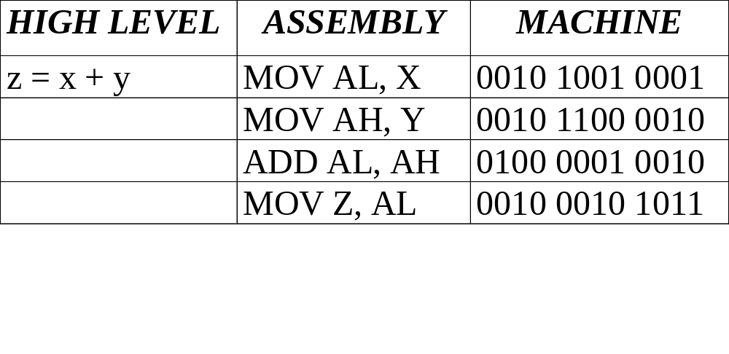
Software

Slide 25
Software
Translation Software
  Interpreters
    translate each instruction as it is entered
      Advantage: easier to find/correct mistakes
      Disadvantage: redundant translation
  Compilers
    translate a group of instructions
      Advantage: generally faster
      Disadvantage: all errors are given at one time

Slide 26
Software
A file is a unit for storing information
All information on a computer is stored in files
  Data Files
    created by the user of the computer
      My_Thesis.doc, Assign1.xls
  Program Files
    created by a programmer
      Word, Excel, Windows98
  Naming Convention
    [File Name].[Extension]
      the extension, (usually 3 letters long), describes the type of program used for that file
        doc(Word), xls(Excel), ppt(PowerPoint)

Slide 27
Software categories
Operating System
  controls all machine activities
  provides the user interface to the computer
  manages resources such as the CPU and memory
  Windows XP, Unix, Linux, Mac OS
Application program
  generic term for any other kind of software
  word processors, games, . . .
Most operating systems and application programs have a graphical user interface (GUI)

Slide 28
Software
Operating Systems
  The most important software on a computer
    always running to perform the following tasks
      create and manage files
      run programs
      control information going to/from the peripherals
    Eg: MS-DOS
      create and manage files - several programs
      run programs - COMMAND.COM
      peripherals - IO.SYS, MSDOS.SYS

Slide 29
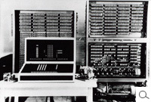
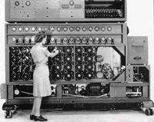
History of Computing http://www.computerhistory.org/
Konrad Zuse: Zuse Z3
Computer wars:
  Germany vs Britain
Alan Turing: The bombe

Slide 30
Famous Forcast
"Computers in the future may weigh no more than 1.5 tons." –
  Popular Mechanics, forecasting the relentless march of science, 1949

Slide 31
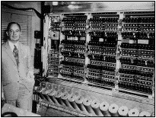
Computer Architecture
Computers of Today:
  “It is evident that the machine must be capable of storing in some manner not only the digital information needed in a given computation…, but also the instructions which govern the actual routines to be performed on the numerical data”
  Von Neumann computer architecture
    Based on the idea that the machine has a fixed set of electronic parts whose actions are determined by a variable program
  Hardware in Von Neumann computer
    CPU (Arithmetic Logic Unit + Control Unit)
    Memory Unit
    I/O Devices
    Busses to interconnect the other components

Slide 32
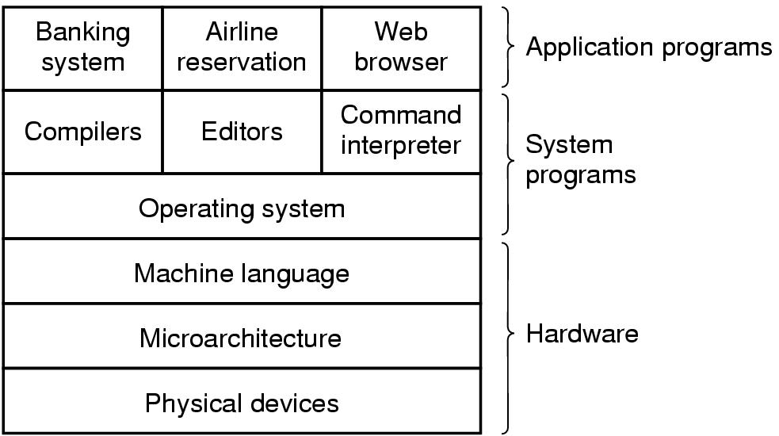
Current Computer Systems
A computer system consists of
  hardware
  system programs
  application programs
Notes:
Show cmd

Slide 33
History of OS
MULTICS, third generation OS introduced the concept of client server computing and influenced other OS
MULTICS (father of all modern OS) led to the development of UNIX
UNIX (1970, ATT) became popular with companies and government agencies, and people started to develop their own UNIX OS
IEEE developed a standard for UNIX, called POSIX (Portable Operating System Interface for Unix) to prevent chaos.
POSIX defined a standard set of system call interface that conformant UNIX systems should support.

Slide 34
History of OS
Tanenbaum wrote a version of UNIX called MINIX with POSIX support for educational use.
A Finnish student Linus Torvalds wrote a free production of MINIX called Linux
Android is based on Linux
IOS (mobile version of OS X) is based on Unix

Slide 35
An interesting movie
Pirates of Silicon Valley

Slide 36
Computer Architecture
Computers of Today:
  “It is evident that the machine must be capable of storing in some manner not only the digital information needed in a given computation…, but also the instructions which govern the actual routines to be performed on the numerical data”
  Von Neumann computer architecture
    Based on the idea that the machine has a fixed set of electronic parts whose actions are determined by a variable program
  Hardware in Von Neumann computer
    CPU (Arithmetic Logic Unit + Control Unit)
    Memory Unit
    I/O Devices
    Busses to interconnect the other components

Slide 37

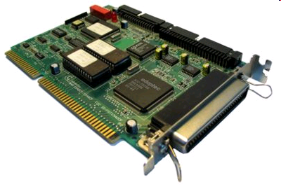
Computer Hardware
Monitor
Bus
Components of a simple personal computer
SCSI Device Controller

Slide 38
CPU
Brain of the computer
  ALU (Arithmetical- Logical Unit)
  CU (Control Unit, fetch-execute-decode instructions)
Has a certain set of instructions it can recognize and execute
Basic CPU cycle
  Fetch the next instruction
  Decode it to determine its type and operands
  Execute it
  …..
Programs are list of instructions executed by the CPU
When the computer powers up, CU of CPU starts the fetch-decode-execute cycle
Instructions may be OS instructions or other programs

Slide 39
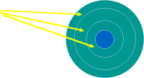
Disk Structure
Picture is from : http://www.jegsworks.com/Lessons/lesson6/lesson6-3.htm
Track is a sequence of bits on a circular region on the surface of the plate
A surface with 3 tracks

Slide 40


Disk Structure
Picture is from : http://www.jegsworks.com/Lessons/lesson6/lesson6-3.htm
A track consists of a set of sectors defined with a magnetic marking and and ID number
Cluster is a collection of sectors

Slide 41

Disk Structure
Picture is from : http://www.jegsworks.com/Lessons/lesson6/lesson6-3.htm
Cylinder is the collection of tracks with the same radius
Addressing : 1) CHS (Cylinder-head-sector) used in most IDE drives
2) LBA (Logical Block Address) used in
SCSI and advanced IDE drives
Disk Cache (Buffer) : Frequently used data is stored in the RAM of the Hard Disk to improve read performance

Slide 42
Disk Access
Data Transfer Rate (DTR) : The rate at which bits are read from disk and sent to the controller
Rotational Latency: The avg time to locate a bit on a track
Seek time : Avg time for locating the track

Slide 43
Memory Hierarchy
Disks and tapes are mechanical devices, therefore they are slow compared to (RAM and Cache)
Main Memory (Random Access Memory) :
  Volatile
  Much Much faster than magnetic disks but more expensive too
Cache:
  Faster than RAM and more expensive
  CPU requests first go to cache, and if they are there (cache hit) then fine, if not there (cache miss) then RAM is accessed
  There can be multiple cache levels
  Cache is divided into cache lines (usually 64 bytes at each line)

Slide 44
Memory Hierarchy
Registers
  They are the fastest accessible memory locations
  Placed at the CPU.
  They are usually of size 32 bits, or 64 bits depending on the CPU type

Slide 45
Yet another famous quote!
"640K ought to be enough for anybody."
  Bill Gates, 1981

Slide 46
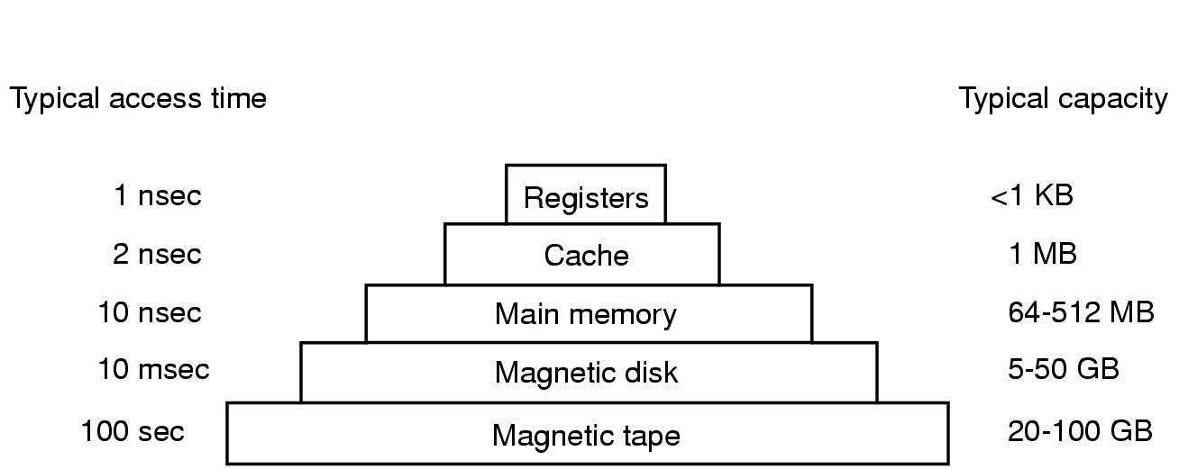
Computer Hardware Review (3)
Typical memory hierarchy
  numbers shown are rough approximations

Slide 47
Moore’s Law
The figures in the previous slide reflect the state of year 2001, and typical numbers change every year.
In General Moore’s Law:
  The observation made in 1965 by Gordon Moore (co-founder of Intel)
  He observed that the number of transistors per square inch on integrated circuits had doubled every year since the integrated circuit was invented.
  He predicted that this will continue for the near future.
  The pace slowed down a little to 18 months (instead of 12) and this is the current definition of Moore's Law,
  Most experts expect Moore's Law to hold for at least another two decades.

Slide 48
THATS ALL FOR INTRO!

