Slide 1
Set Operations
Zeph Grunschlag

Slide 2
Announcements
HW2 due next time
  Check homepage for possible announcements over week-end. May change a couple of problems.

Slide 3

Agenda
Section 1.5: Set Operations
  Union ∪ and Disjoint union
  Intersection ∩
  Difference “−”
  Complement “‾ ”
  Symmetric Difference ⊕

Slide 4
Universe of Reference
When talking about a set, a universe of reference (universal set ) needs to be specified. Even though a set is defined by the elements which it contains, those elements cannot be arbitrary. If arbitrary elements are allowed paradoxes can result arising from self reference.

Slide 5
Russel’s Paradox
If we allow arbitrary elements, we should also allow sets to be elements, and sets of sets, and so on. So it would be perfectly reasonable to consider the following set:
S = the set containing all sets which do not contain themselves
CLAIM: This set cannot exist.
Proof: If it existed, it would either contain itself, or not. Let’s consider both cases:

Slide 6
Russel’s Paradox
S contains itself as an element. Therefore, since the elements of S do not contain themselves as elements, it does not contain S. This contradicts the assumption, so that the first case cannot happen.
S doesn’t contain itself. Therefore, since S contains all sets not containing themselves, it must contain S. This contradicts the assumption, so that the second case cannot happen.
As neither case can happen, S cannot exist. 

Slide 7
Russel’s Paradox
It is of paramount importance that when a set is specified by stating certain conditions, that it ought to exist as a set. The set could be empty, but that’s fine, as long as it actually exists.
EG: The set of all pigs which can fly. The condition is not achievable so that this set is the empty set ∅. It is still a set, however.
To guarantee set existentiality, a universal set U should always be fixed.
Q: Is there a universe of reference in which the set of all sets not containing themselves is well-defined?

Slide 8
Russel’s Paradox
A: Yes. In fact any universe. For example
U ={ {1,2} , {1,2,{1,2}} , {1,2,{1,2},{3}} }
Q: What is the set S of all sets not containing themselves in this case?

Slide 9
Russel’s Paradox
A: S = U
Notes:
Solution to exercise:
Yes. Consider for example

Slide 10
Set Builder Notation
Up to now sets have been defined using the curly brace notation “{ … }” or descriptively “the set of all natural numbers”. The set builder notation allows for concise definition of new sets. For example
  { x | x is an even integer }
  { 2x | x is an integer }
are equivalent ways of specifying the set of all even integers.

Slide 11
Set Builder Notation
In general, one specifies a set by writing
{ f (x ) | P (x ) }
Where f (x ) is a function of x (okay we haven’t really gotten to functions yet…) and P (x ) is a propositional function of x. The notation is read as
“the set of all elements f (x ) such that P (x ) holds”
Stuff between “{“ and “|”
  specifies how elements look
Stuff between the “|” and “}”
  gives properties elements satisfy
Pipe symbol “|” is
  short-hand for “such that”.
Notes:
We can think of set builder notation analogously to a WHILE loop in a programming language.
P(x) specifies the condition satisfied in the WHILE loop and f(x) is the output the from the WHILE loop.

Slide 12
Set Builder Notation.
Shortcuts.
To specify a subset of a pre-defined set, f (x ) takes the form x∈S. For example
{x ∈ N | ∃y (x = 2y ) }
defines the set of all even natural numbers (assuming universe of reference Z).
When universe of reference is understood,
don’t need to specify propositional function EG: { x ³ | } or simply {x ³ } specifies the set of perfect cubes
{0,1,8,27,64,125, …}
assuming U is the set of natural numbers.

Slide 13
Set Builder Notation.
Examples.
Q1: U = N. { x | ∀y (y ≥ x ) } = ?
Q2: U = Z. { x | ∀y (y ≥ x ) } = ?
Q3: U = Z. { x | ∃y (y ∈ R ∧ y ² = x )} = ?
Q4: U = Z. { x | ∃y (y ∈ R ∧ y ³ = x )} = ?
Q5: U = R. { |x | | x ∈ Z } = ?
Q6: U = R. { |x | } = ?

Slide 14
Set Builder Notation.
Examples.
A1: U = N. { x | ∀y (y ≥ x ) } = { 0 }
A2: U = Z. { x | ∀y (y ≥ x ) } = { }
A3: U = Z. { x | ∃y (y ∈ R ∧ y ² = x )}
= { 0, 1, 2, 3, 4, … } = N
A4: U = Z. { x | ∃y (y ∈ R ∧ y ³ = x )} = Z
A5: U = R. { |x | | x ∈ Z } = N
A6: U = R. { |x | } = non-negative reals.

Slide 15
Set Theoretic Operations
Set theoretic operations allow us to build new sets out of old, just as the logical connectives allowed us to create compound propositions from simpler propositions. Given sets A and B, the set theoretic operators are:
  Union (∪)
  Intersection (∩)
  Difference (−)
  Complement (“—”)
  Symmetric Difference (⊕)
give us new sets A∪B, A∩B, A-B, A⊕B, and‾A .

Slide 16
Venn Diagrams
Venn diagrams are useful in representing sets and set operations. Various sets are represented by circles inside a big rectangle representing the universe of reference.

Slide 17
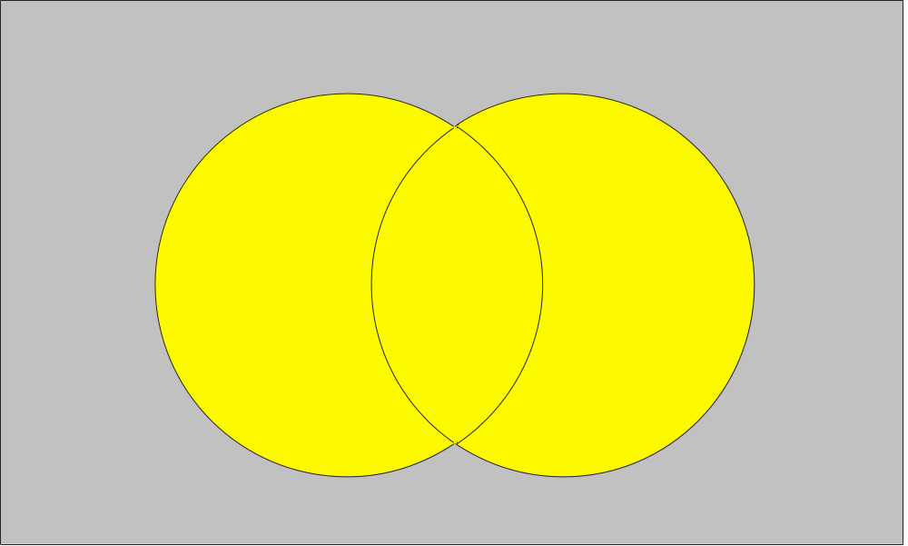
Union
Elements in at least one of the two sets:
A∪B = { x | x ∈ A ∨ x ∈ B }
U
A∪B
A
B

Slide 18
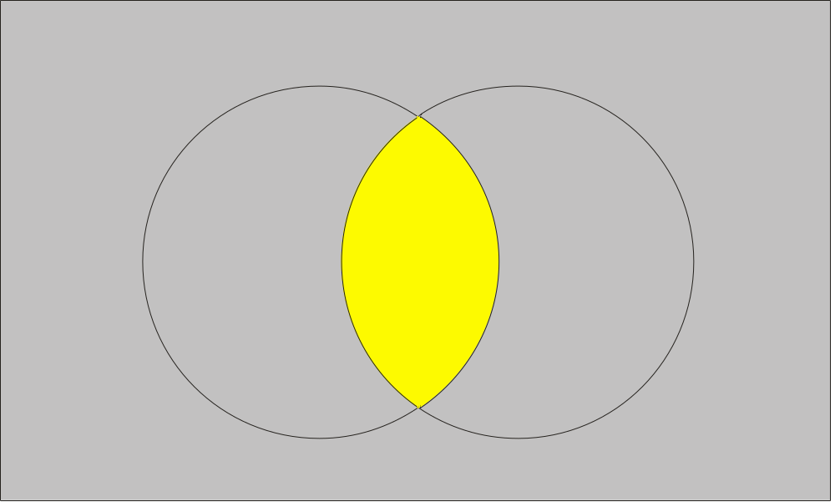
Intersection
Elements in exactly one of the two sets:
A∩B = { x | x ∈ A ∧ x ∈ B }
U
A
A∩B
B

Slide 19
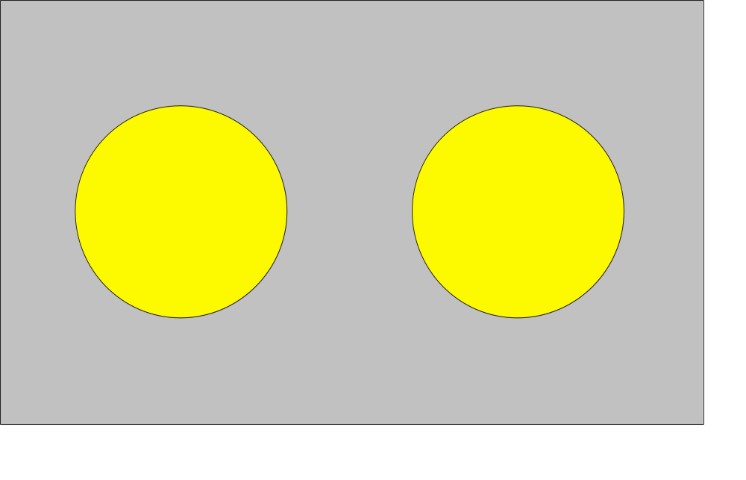
Disjoint Sets
DEF: If A and B have no common elements, they
are said to be disjoint, i.e. A ∩B = ∅ .
U
A
B

Slide 20

Disjoint Union
When A and B are disjoint, the disjoint union operation is well defined. The circle above the union symbol indicates disjointedness.
U
A
B

Slide 21
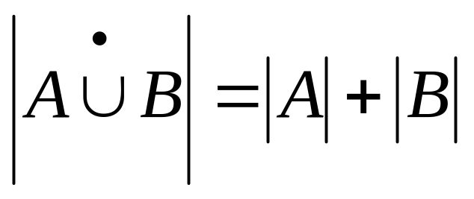
Disjoint Union
FACT: In a disjoint union of finite sets, cardinality of the union is the sum of the cardinalities. I.e.

Slide 22
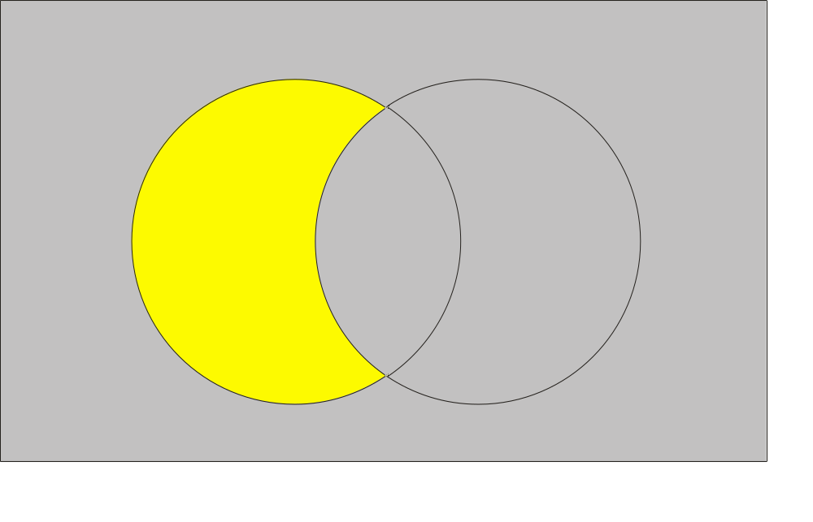
Set Difference
Elements in first set but not second:
A−B = { x | x ∈ A ∧ x ∉ B }
U
A−B
B
A

Slide 23
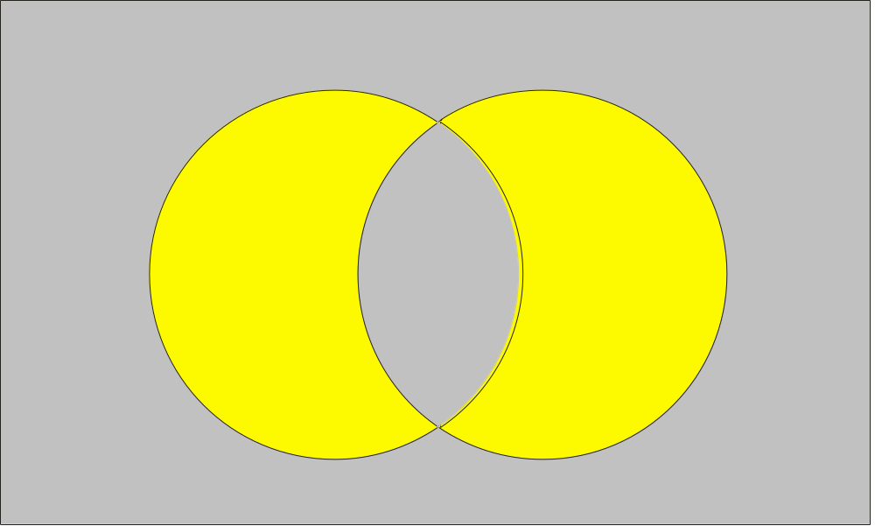
Symmetric Difference
Elements in exactly one of the two sets:
A⊕B = { x | x ∈ A ⊕ x ∈ B }
A⊕B
U
A
B

Slide 24

Complement
Elements not in the set (unary operator):
‾A = { x | x ∉ A }
U
‾A
A

Slide 25
Set Identities
Table 1, Rosen p. 49
    Identity laws
    Domination laws
    Idempotent laws
    Double complementation
    Commutativity
    Associativity
    Distribuitivity
    DeMorgan
This table is gotten from the previous table of logical identities (Table 5, p. 17) by rewriting as follows:
  disjunction “∨” becomes union “∪”
  conjunction “∧” becomes intersection “∩”
  negation “¬” becomes complementation “–”
  false “F” becomes the empty set ∅
  true “T” becomes the universe of reference U

Slide 26
Set Identities
In fact, the logical identities create the set identities by applying the definitions of the various set operations. For example:
LEMMA: (Associativity of Unions)
(A∪B )∪C = A∪(B ∪C )

Slide 27
Set Identities
In fact, the logical identities create the set identities by applying the definitions of the various set operations. For example:
LEMMA: (Associativity of Unions)
(A∪B )∪C = A∪(B ∪C )
Proof : (A∪B )∪C = {x | x ∈ A ∪B ∨ x ∈ C } (by def.)

Slide 28
Set Identities
In fact, the logical identities create the set identities by applying the definitions of the various set operations. For example:
LEMMA: (Associativity of Unions)
(A∪B )∪C = A∪(B ∪C )
Proof : (A∪B )∪C = {x | x ∈ A ∪B ∨ x ∈ C } (by def.)
= {x | (x ∈ A ∨ x ∈ B ) ∨ x ∈ C } (by def.)

Slide 29
Set Identities
In fact, the logical identities create the set identities by applying the definitions of the various set operations. For example:
LEMMA: (Associativity of Unions)
(A∪B )∪C = A∪(B ∪C )
Proof : (A∪B )∪C = {x | x ∈ A ∪B ∨ x ∈ C } (by def.)
= {x | (x ∈ A ∨ x ∈ B ) ∨ x ∈ C } (by def.)
= {x | x ∈ A ∨ ( x ∈ B ∨ x ∈ C ) } (logical assoc.)

Slide 30
Set Identities
In fact, the logical identities create the set identities by applying the definitions of the various set operations. For example:
LEMMA: (Associativity of Unions)
(A∪B )∪C = A∪(B ∪C )
Proof : (A∪B )∪C = {x | x ∈ A ∪B ∨ x ∈ C } (by def.)
= {x | (x ∈ A ∨ x ∈ B ) ∨ x ∈ C } (by def.)
= {x | x ∈ A ∨ ( x ∈ B ∨ x ∈ C ) } (logical assoc.)
= {x | x ∈ A ∨ x ∈ B ∪ C ) } (by def.)

Slide 31
Set Identities
In fact, the logical identities create the set identities by applying the definitions of the various set operations. For example:
LEMMA: (Associativity of Unions)
(A∪B )∪C = A∪(B ∪C )
Proof : (A∪B )∪C = {x | x ∈ A ∪B ∨ x ∈ C } (by def.)
= {x | (x ∈ A ∨ x ∈ B ) ∨ x ∈ C } (by def.)
= {x | x ∈ A ∨ ( x ∈ B ∨ x ∈ C ) } (logical assoc.)
= {x | x ∈ A ∨ (x ∈ B ∪ C ) } (by def.)
= A∪(B ∪C ) (by def.)

Other identities are derived similarly.

Slide 32
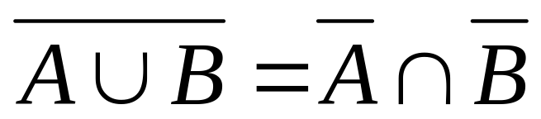
Set Identities via Venn
It’s often simpler to understand an identity by drawing a Venn Diagram.
For example DeMorgan’s first law
can be visualized as follows.

Slide 33
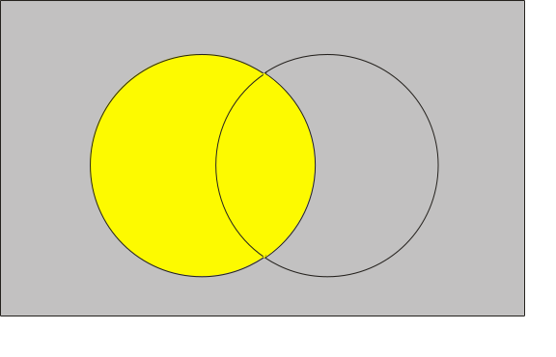
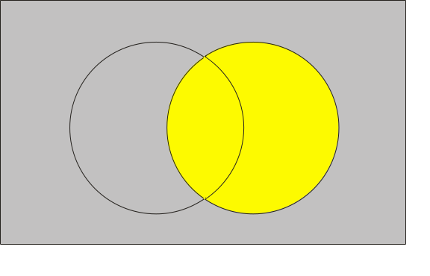
Visual DeMorgan
A:
B:

Slide 34
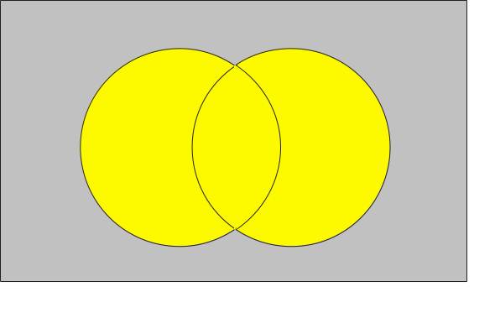
Visual DeMorgan
A:
B:
A∪B :

Slide 35
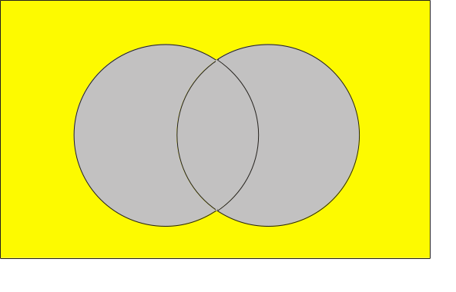
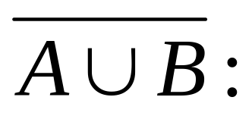
Visual DeMorgan
A:
B:
A∪B :

Slide 36
Visual DeMorgan
A:
B:

Slide 37
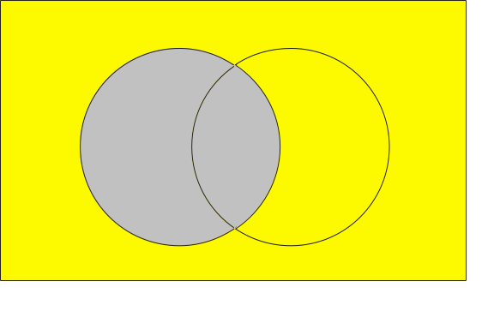
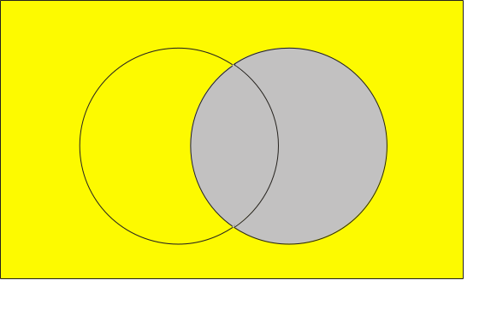
Visual DeMorgan
A:
B:
‾A:
‾B:

Slide 38
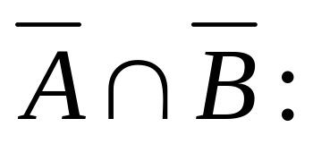
Visual DeMorgan
A:
B:
‾A:
‾B:

Slide 39
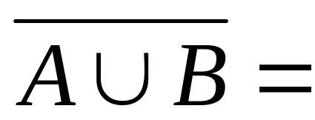
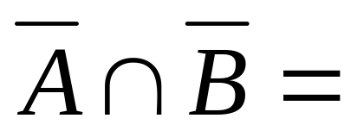
Visual DeMorgan
=

Slide 40
Sets as Bit-Strings
If we order the elements of our universe, we can represent sets by bit-strings. For example, consider the universe
U = {ant, beetle, cicada, dragonfly}
Order the elements alphabetically. Subsets of U are represented by bit-strings of length 4. Each bit in turn, tells us whether the corresponding element is contained in the set. EG: {ant, dragonfly} is represented by the bit-string 1001.
Q: What set is represented by 0111 ?

Slide 41
Sets as Bit-Strings
A: 0111 represents
{beetle, cicada, dragonfly}
Conveniently, under this representation the various set theoretic operations become the logical bit-string operators that we saw before. For example, the symmetric difference of {beetle} with {ant, beetle, dragonfly} is represented by:
0100
⊕ 1101
1001 = {ant, dragonfly}

Slide 42
Example for section 1.5
Principle of Inclusion-Exclusion

