Slide 1



SSPayWMN: Secure and Seamless Payment for Wireless Mesh Networks
Albert Levi
Can Serhat Leloğlu
levi@sabanciuniv.edu, canleloglu@sabanciuniv.edu
Final Presentation as of January 16, 2013

Slide 2
Outline
Project description
Building blocks of the system
Protocol specifications
Simulation environment
Unit test results
Client models and actions
Real-life scenario simulation results
Discussion on success of SSPayWMN
Conclusions

Slide 3
Project Description in a Nutshell
A secure prepaid payment scheme for broadband Internet access is designed and developed in a simulation environment.
This scheme will be particularly for Wireless Mesh Networks with multiple operators.

Slide 4
Motivation and Objectives
With the potential number of active users, it is inevitable that there will be more than one operator, who will charge the general use of the clients and provide connection in the metropolitan area.
The operators may unintentionally overcharge their users. Users may unfairly dispute charges. Thus a payment scheme that is fair to both users and the operators is inevitably needed.
On top of the classical security requirements such as confidentiality, authentication and non-repudiation (fraud protection), as a critical contribution we plan to address users' anonymity.

Slide 5
Project Timeline and WPs
Kickoff: April 1, 2011
WP1: Requirements Specification
M1 – M4
Deliverable 1: Requirements Specification Document
Deliverable 2: Simulation tool evaluation report
WP2 – Setting up the Simulation Tool
M5 – M6
Milestone 1: Simulation tool up and running
WP3 – Protocol Design and Engineering
M5 – M12
Deliverable 3: Protocol Design Document
2nd Year
WP1 – Unit Protocol Implementation over the Simulation Environment
M1 – M6
Deliverable 1: Preliminary performance results of the unit implementations of the protocols using simple scenarios
WP2- Performance Evaluation
M5 – M12
Simulation Results and Performance Evaluation

Slide 6

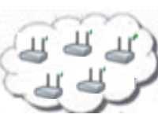

System Entities
 | Mobile user (client)
 | Access Point (AP) with mesh routing capability. From now on in this document, it is called as AP, but please note that it also has routing capability.
 | Mesh backbone of the operator
 | Gateway (GW) that connects the mesh backbone to outer world and also to the operator's server
 | Operator's server (OP). Keeps necessary logs and user info.
 | Trusted Third Party (TTP). Payment related logs are mostly to be generated by the TTP.

Slide 7
Connection Card
Prepaid System
Connection Cards
has unique Serial Number (SN) and credits.
SNs are used for alias computation
credits can be refilled
Credits
implemented as hash tokens which are generated using hash chains.

Slide 8
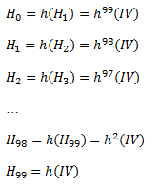
Hash Tokens
For each set of tokens, the operator picks on a random IV (Initialization Vector) and take hashes of it many times.
Can be used by sending in clear
This is secure since they hash functions are one-way
Generation Order
Spending Order

Slide 9
Aliases
Temporary identifiers for clients.
By changing the aliases frequently, we provide anonymity in our system to some extent.
Computed by the clients and also by the TTP (Trusted Third Party).

Slide 10
Alias Computation
The serial number (SN) of the Connection Card, which is bought from an operator, will be used as a base for client’s aliases. An alias will be computed by performing the following operations.
Client picks a random 128-bit unsigned number called nonce
Client performes XOR operation with SN and Nonce and take their hash and use the output as the Alias.
Client will use this alias whenever her identity is required.
Aliases are 128-bit values; even if it is a very small possibility to have the same alias with another client at a given point of time, there is still a nonzero probability. To address this problem, TTP checks the proposed alias to be a unique one. This check is done in Change Alias protocol which will be explained later.

Slide 11
Initial Authorization and Reuse of a Connection Card
Initial Authorization is the beginning for system usage. Whenever a client purchases new hash tokens from the TTP, she will need to authorize herself to TTP.
Reuse of a Connection Card (Reuse-CC) protocol allows the clients to connect using the remaining credits in a card. Reuse-CC protocol does not differ extensively from Initial Authorization protocol. The main difference is instead of sending first hash token; the client sends whichever token is the next one.

Slide 12
Initial Authorization and Reuse of a Connection Card

Slide 13
Access Point Authentication
After authentication processes of the client with the TTP, a second authentication step begins.
Client and access point will mutually authenticate each other for safe communication.

Slide 14
Access Point Authentication

Slide 15
Packet Transfer
After mutual authentication of client and access point, client starts to send data packets to access point.

Slide 16
Packet Transfer
After mutual authentication of client and access point, client starts to send data packets to access point.

Slide 17
Providing Unlinkability
Adversary should not be able to track down a user
Aliases should change periodically to achieve unlinkability
They change in the reuse protocol
But they also have to change while the connection resumes

Slide 18
Changing Alias
Anonymity property is easily achieved by using aliases, but complicated part is achieving untraceability.
The aliases should change on a basis that an adversary, who knows a certain client’s alias, could not be able to trace client’s activity on her home network, and also could not trace her movements among the operators or access points.

Slide 19
Changing Alias

Slide 20
Update Packets
Access points keep track of ongoing communications, after some time passed without update from a user it sends disconnection request by itself.

Slide 21
Disconnection
To be able to run Reuse-CC, the client has to run a proper disconnection protocol.
The Update Packets protocol brings stability to the system in case of a connection interruption, but the main assumption is that most of the users will be disconnecting from the operator using the disconnection protocol.

Slide 22
Disconnection

Slide 23
Distributing Access Point Public Keys
Achieving seamless mobility in home operator and also to support seamless roaming, a public key distribution mechanism is integrated in SSPayWMN system.
This protocol has two parts; one is certificate generation for access point public keys, the other one is distribution of the public keys. The part between operator and the TTP is offline.

Slide 24
Distributing Access Point Public Keys

Slide 25
Seamless Roaming
When the clients need to get service from an access point of a new operator, they roam between old operator and new one.
In this kind of situations, we do not bother TTP and save time and computational power.
Every access point has
Public/Private key pairs and certificates
Ability to broadcast certificates
We can handle roaming in a seamless way without running the authorization process from scratch.

Slide 26
Seamless Roaming

Slide 27
Seamless Mobility in Home Operator
When a client moves out of the coverage area of its associated AP or if another AP provides a better service, the client may want to hand off to another AP.
We develop seamless mobility protocol in order to avoid a full authorization process during such a hand off.

Slide 28
Seamless Mobility in Home Operator

Slide 29
Simulations of SSPayWMN
The simulations of SSPayWMN are conducted using ns-3.
The simulator was run on a computer with 2.4 GHz Intel Core 2 Duo, 2 GB 1067 MHz DDR3, Apple MacBook OSX v10.6.8.

Slide 30
Simulation Environment
The network topology is hierarchical and WMN supports connections with other IEEE 802.11 protocols, clients communicate with TTP via access points, GWs and operators in sequence.
Access point specifications are given below.
AP-Gateway Connection bit rate | 6-54 Mbps – Wi-Fi
AP-Gateway Distance | 70 m
Service Duration per token | 5 minutes
Update Interval | 11 minutes

Slide 31
Simulation Environment
Our network has 100 access points, 32 gateways, 2 operators ans a TTP server covering a 1 km² metropolitan area.
There are 300 clients simultaneously trying to get internet service in a day.

Slide 32
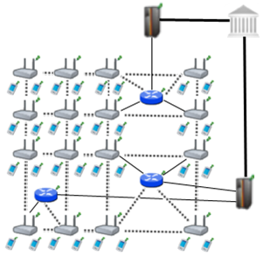
Simulation Environment

Slide 33
SSPayWMN Simulations
We have conducted the simulations of SSPayWMN in two groups.
Unit Tests: These simulations aim to simulate protocols of protocols of SSPayWMN, independent from each other to analyze the delay caused by protocols.
Real-life Scenario Simulation: These simulations evaluate the system’s overall performance in an ordinary day usage with client mobility and high Internet service demand.

Slide 34
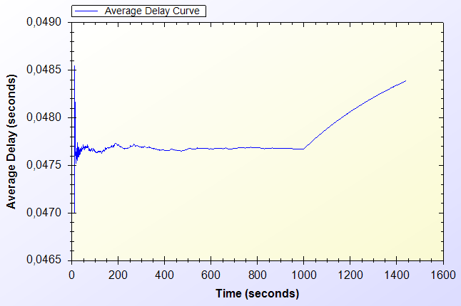
Unit Test Results
Unit Test Result for End-to-end Two-Way Protocols

Slide 35
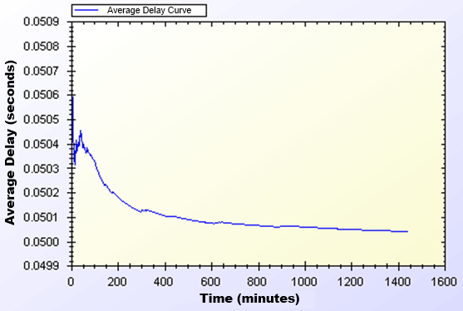
Unit Test Results
Unit Test Results for Access Point Authentication

Slide 36
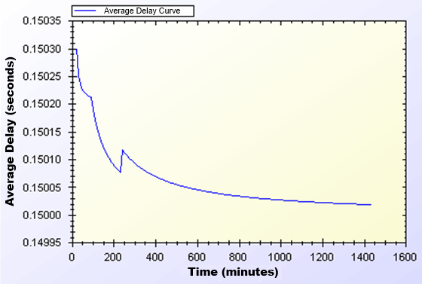
Unit Test Results
Unit Test Result for Seamless Mobility and Roaming

Slide 37
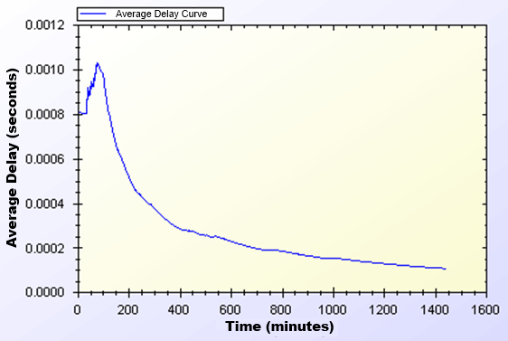
Unit Test Results
Unit Test Result for Packet Transfer

Slide 38
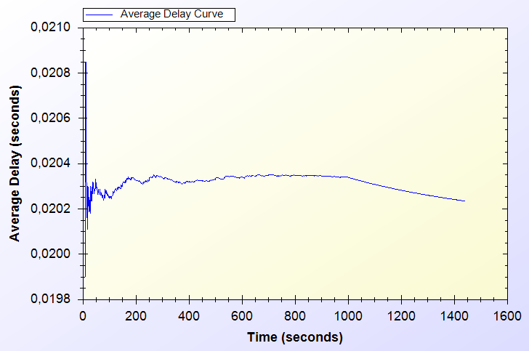
Unit Test Results
Unit Test Result for Update Packets

Slide 39
User Modeling and Mobility in Real-Life Scenario
The proposed system intends to serve a variety of users (a.k.a. network clients).
Certain kinds of actions are defined, such as authorization (initial or reuse of a connection card), disconnection, packet transfer (network usage), payment related roaming and payment related AP handover.
All of these actions are triggered as a result of a random event.

Slide 40
User Actions
In real-life scenario simulations, network usage related actions are modeled using two-state Markov Chain.
There are two states that a user could be in: Connected and Not Connected. State transitions or staying in the same state triggers actions.

Slide 41
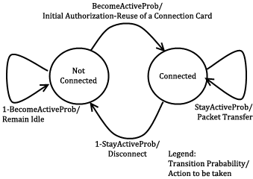
User Actions

Slide 42
Client Types
Three different user types are outlined with different networking and mobility requirements.
Students: The most mobile type of clients. They are assumed to be active in the evening hours.
Workers: This kind of clients has routine lives. They are immobile and not so active during evenings. However, during the daytime, they are very active and use network services at their work places.
Non-Workers: This type of users does not work outside and spend their time at home. Usually the domestics get Internet service in an immobile way. These users are highly active at all times.

Slide 43
Real-Life Scenario Simulation Results
In these simulations clients have mobility patterns.
Client’s network usage frequency is affected by their socio-economical status.

Slide 44
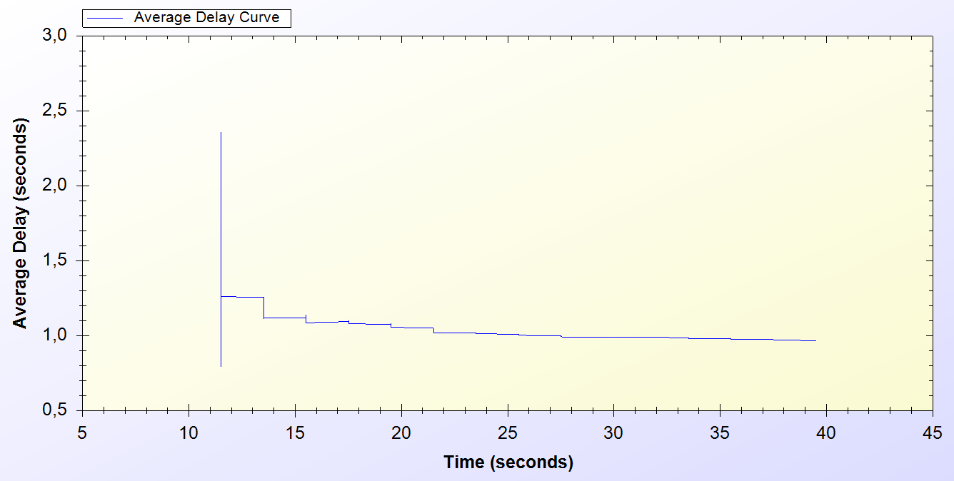
Simulation Results of Protocols
Real-Life Scenario Simulation Result for Initial Authorization Protocol

Slide 45
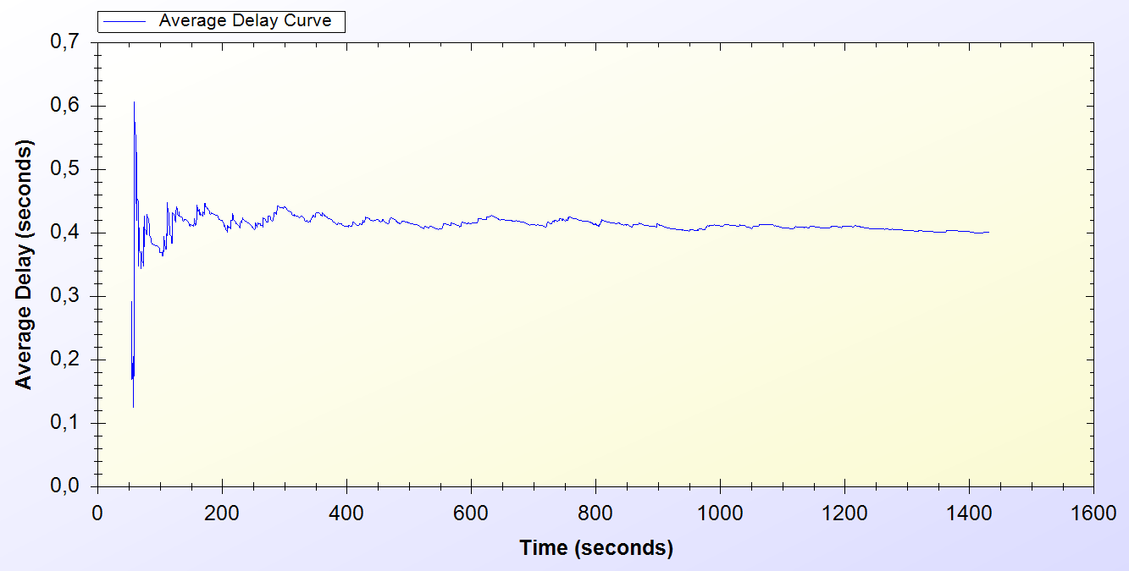
Simulation Results of Protocols
Real-Life Scenario Simulation Result for Reuse of a Connection Card Protocol

Slide 46
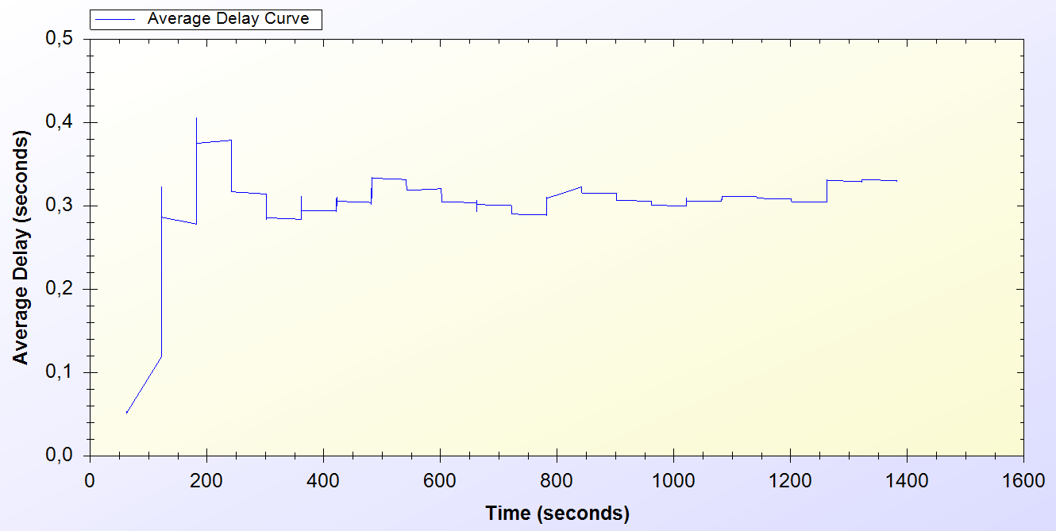
Simulation Results of Protocols
Real-Life Scenario Simulation Result for Changing Alias

Slide 47
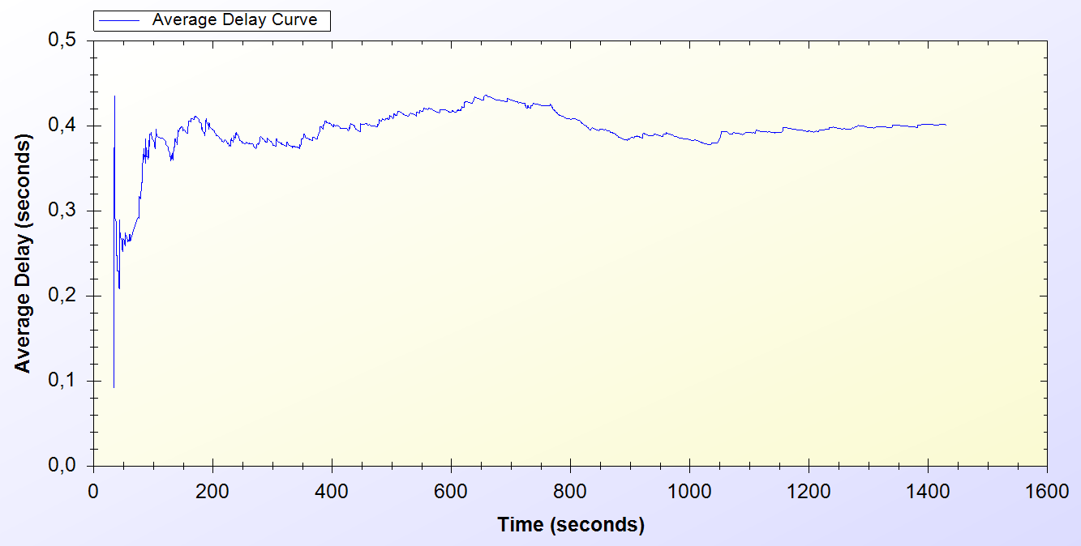
Simulation Results of Protocols
Real-Life Scenario Simulation Result for Disconnection

Slide 48
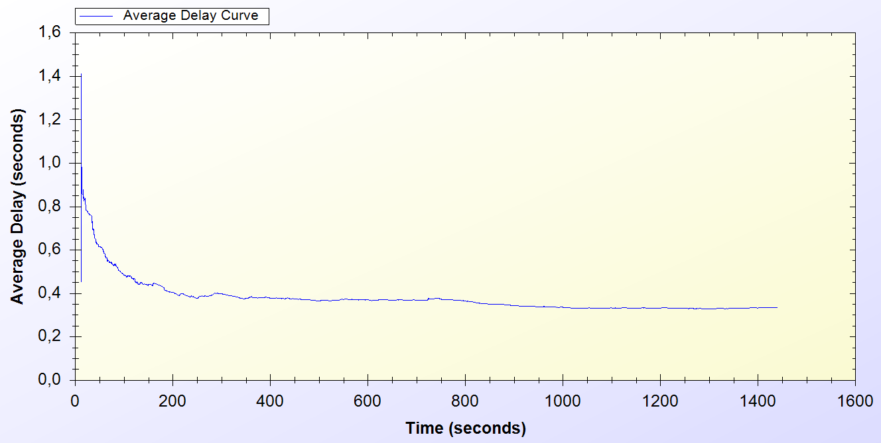
Simulation Results of Protocols
Real-Life Scenario Simulation Result for Update Packets

Slide 49
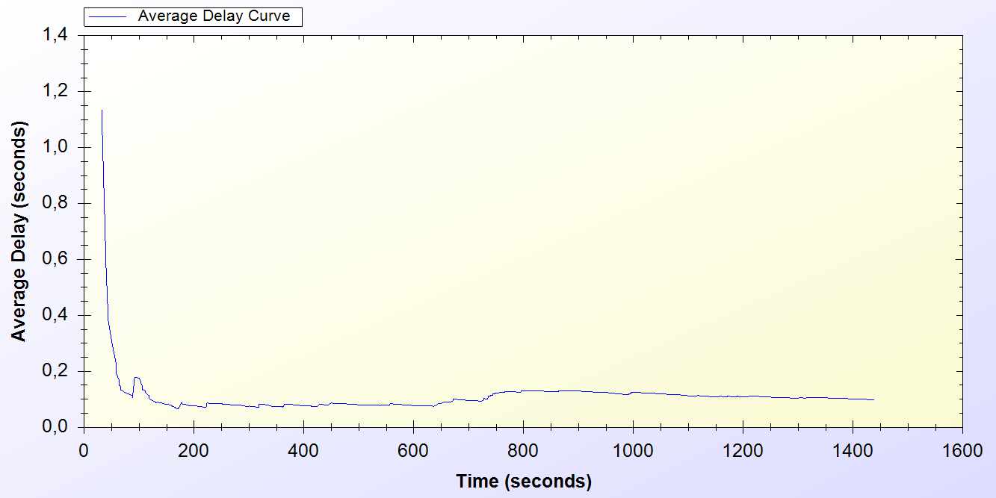
Simulation Results of Protocols
Real-Life Scenario Simulation Result for Seamless Mobility in Home Operator Protocol

Slide 50
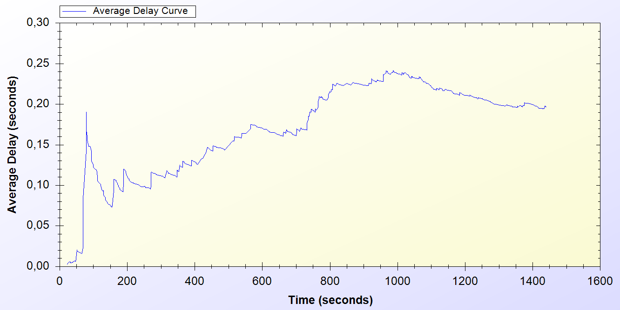
Simulation Results of Protocols
Real-Life Scenario Simulation Result for Roaming Protocol

Slide 51
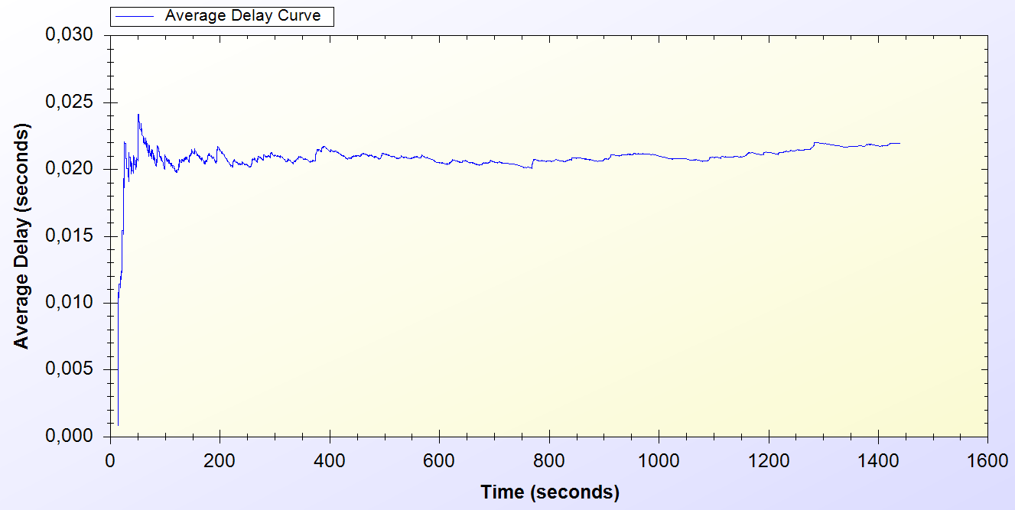
Simulation Results of Protocols
Real-Life Scenario Simulation Result for Packet Transfer

Slide 52
Overall Burden of the System
Considering the results it could be calculated that over 100 minutes of Internet service, workers have only waited for 1 minute for system delays.
In average, over 1000 minutes of Internet service needs a delay of 13 to 16 minutes of waiting.

Slide 53
Overall Burden of the System
Simulation Results for Client Types
 | Total Internet Usage Time | Total Internet Usage Delay | Average Internet Usage Time for a Client | Average Internet Usage Delay for a Client
Student | 95899 Minutes | 1698 Minutes | 958 Minutes | 16 Minutes
Worker | 101681 Minutes | 1316 Minutes | 1016 Minutes | 13 Minutes
Non-Worker | 105335 Minutes | 1456 Minutes | 1053 Minutes | 14 Minutes

Slide 54
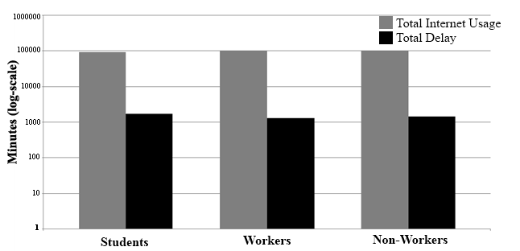
Overall Burden of the System
Total Amount of Service Usage Times for Client Types vs. Total Delays

Slide 55
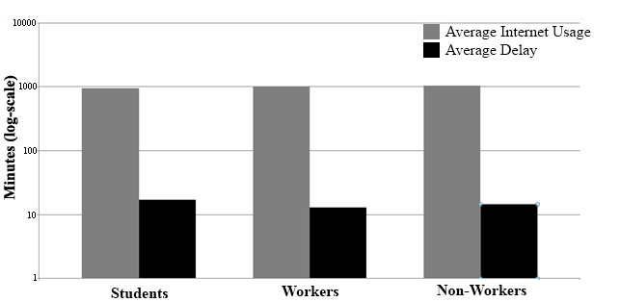
Overall Burden of the System
Average Service Usage Times for Client Types vs. Average Delays

Slide 56
Discussion
Wide Coverage: Every access point could serve within a 100 meters radius. It is proven that with 100 access points, 1 km² area is covered for Internet service.
Seamless Mobility and Roaming: Users are able to switch between access points no matter what operator they belong to. The delays are low enough to maintain current connection without any interruption.
Anonymity: For law-enforcement reasons, users must give their identities to Trusted Third Party (TTP) for getting connection cards. Therefore, as far as TTP keeps clients’ identities secret, users can remain anonymous. Identity verifications are performed using aliases, which change periodically.
Mutual authentication: Initial Authorization and Reuse-CC protocols ensure the authentication of the user. TTP signs the acknowledgement values and a handshake protocol is run between the serving access point and the client. These processes ensure mutual authentication.

Slide 57
Discussion
Two-way honesty: Since the tokens are issued by TTP, only the TTP and connection cardholder knows all the tokens that are related with a specific connection card. Hence whenever a Client sends a new token, it is not possible for him to say, “I did not use it”. Since TTP has verified the token, in the authentication phase, operators cannot say that they provided service for non-used tokens.
Untraceability: Our protocols provide untraceability to some extent by changing aliases periodically. Clients are only traceable between the times they change their aliases.
Performance: The performance of SSPayWMN has been evaluated with simulations using ns-3. Two groups of simulations are performed: unit tests and a real-life scenario. In both groups, our protocols achieved steady state with reasonable delays. Moreover, in overall, the latency cost of SSPayWMN is 1% of the actual usage.

Slide 58
Conclusion
We have proposed a secure and seamless prepayment scheme for wireless mesh networks (SSPayWMN).
This system provides fairness to both operators and to clients.
SSPayWMN provides privacy and untraceability to some extent.
SSPayWMN can successfully handle seamless handover between operators by eliminating the need for re-authentication from the scratch.

Slide 59
Conclusion (continued)
We have conducted two types of simulations to evaluate our system using ns-3: Unit tests and real-life scenario simulations.
Both simulation types gave results ensuring the stability of the system and steady state performce.

Slide 60
Questions?
Thank you for listening.

