Slide 1



SSPayWMN: Secure and Seamless Payment for Wireless Mesh Networks
Albert Levi
Can Serhat Leloğlu
levi@sabanciuniv.edu, canleloglu@sabanciuniv.edu
Final Presentation as of January 16, 2013

Slide 2
Outline
Project description
Building blocks of the system
Protocol specifications
Simulation environment
Unit test results
Client models and actions
Real-life scenario simulation results
Discussion on success of SSPayWMN
Conclusions

Slide 3
Project Description in a Nutshell
A secure prepaid payment scheme for broadband Internet access is designed and developed in a simulation environment.
This scheme will be particularly for Wireless Mesh Networks with multiple operators.

Slide 4
Motivation and Objectives
Wide coverage
Seamless Roaming
Seamless Mobility (Handoff)
Anonymity
Mutual Authentication
Two-way honesty
Untraceability
Performance

Slide 5
Project Timeline and WPs
Kickoff: April 1, 2011
WP1: Requirements Specification
M1 – M4
Deliverable 1: Requirements Specification Document
Deliverable 2: Simulation tool evaluation report
WP2 – Setting up the Simulation Tool
M5 – M6
Milestone 1: Simulation tool up and running
WP3 – Protocol Design and Engineering
M5 – M12
Deliverable 3: Protocol Design Document
2nd Year
WP1 – Unit Protocol Implementation over the Simulation Environment
M1 – M6
Deliverable 1: Preliminary performance results of the unit implementations of the protocols using simple scenarios
WP2- Performance Evaluation
M5 – M12
Execution of final simulations

Slide 6

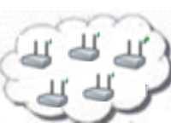

System Entities
 | Mobile user (client)
 | Access Point (AP) with mesh routing capability. From now on in this document, it is called as AP, but please note that it also has routing capability.
 | Mesh backbone of the operator
 | Gateway (GW) that connects the mesh backbone to outer world and also to the operator's server
 | Operator's server (OP). Keeps necessary logs and user info.
 | Trusted Third Party (TTP). Payment related logs are mostly to be generated by the TTP.

Slide 7
Connection Card
Prepaid System
Connection Cards
has unique Serial Number (SN) and credits.
SNs are used for alias computation
credits can be refilled
Credits
implemented as hash tokens which are generated using hash chains.

Slide 8
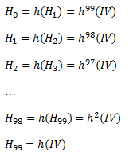
Hash Tokens
For each set of tokens, the operator picks on a random IV (Initialization Vector) and take hashes of it many times.
Can be used by sending in clear
This is secure since they hash functions are one-way
Generation Order
Spending Order

Slide 9
Aliases
Temporary identifiers for clients.
By changing the aliases frequently, we provide anonymity in our system to some extent.
Computed by the clients and also by the TTP (Trusted Third Party).

Slide 10
Alias Computation
The serial number (SN) of the Connection Card, which is bought from an operator, will be used as a base for client’s aliases. An alias will be computed by performing the following operations.
Client picks a random 128-bit unsigned number called nonce
Client performs XOR operation with SN and Nonce and take their hash and use the output as the Alias.
Client will use this alias whenever her identity is required.

Slide 11
Initial Authorization and Reuse of a Connection Card
Initial Authorization is the beginning for system usage, clients authorize themselves to join the system.
Reuse of a Connection Card (Reuse-CC) protocol allows the clients to connect using the remaining credits in a card.

Slide 12
Initial Authorization and Reuse of a Connection Card

Slide 13
Access Point Authentication
In order to authenticate the network by the client

Slide 14
Packet Transfer
After mutual authentication of client and access point, client starts to send data packets to access point.

Slide 15
Providing Unlinkability
Adversary should not be able to track down a user
Aliases should change periodically to achieve unlinkability

Slide 16
Changing Alias

Slide 17
Update Packets
Access points keep track of ongoing communications, after some time passed without update from a user it sends disconnection request by itself.

Slide 18
Disconnection
The Update Packets protocol brings stability to the system in case of a connection interruption, but the main assumption is that most of the users will be disconnecting from the operator using the disconnection protocol.

Slide 19
Disconnection

Slide 20
Distributing Access Point Public Keys
Achieving seamless mobility in home operator and also to support seamless roaming, a public key distribution mechanism is integrated in SSPayWMN system.

Slide 21
Distributing Access Point Public Keys

Slide 22
Seamless Roaming
When the clients need to get service from an access point of a new operator, they roam between old operator and new one.
In this kind of situations, we do not bother TTP and save time and computational power.
We can handle roaming in a seamless way without running the authorization process from scratch.

Slide 23
Seamless Roaming

Slide 24
Seamless Mobility in Home Operator
When a client moves out of the coverage area of its associated AP or if another AP provides a better service, the client may want to hand off to another AP.
We develop seamless mobility protocol in order to avoid a full authorization process.

Slide 25
Seamless Mobility in Home Operator

Slide 26
Performance Evaluation of SSPayWMN
The simulations of SSPayWMN are conducted using ns-3.
The simulator was run on a computer with 2.4 GHz Intel Core 2 Duo, 2 GB 1067 MHz DDR3, Apple MacBook OSX v10.6.8.

Slide 27
Simulation Environment
The network topology is hierarchical and WMN supports connections with other IEEE 802.11 protocols, clients communicate with TTP via access points, GWs and operators in sequence.
Access point specifications are given below.
AP-Gateway Connection bit rate | 6-54 Mbps – Wi-Fi
AP-Gateway Distance | 70 m
Service Duration per token | 5 minutes
Update Interval | 11 minutes

Slide 28
Simulation Environment
Our network has 100 access points, 32 gateways, 2 operators and a TTP server covering a 1 km² metropolitan area.
There are 300 clients simultaneously trying to get internet service in a day.

Slide 29
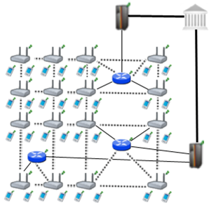
Simulation Environment

Slide 30
SSPayWMN Simulations
We have conducted the simulations of SSPayWMN in two groups.
Unit Tests: These simulations aim to simulate protocols of SSPayWMN, independent from each other to analyze the delay caused by protocols.
Real-life Scenario Simulation: These simulations evaluate the system’s overall performance in an ordinary day usage with client mobility and realistic Internet service demand.

Slide 31
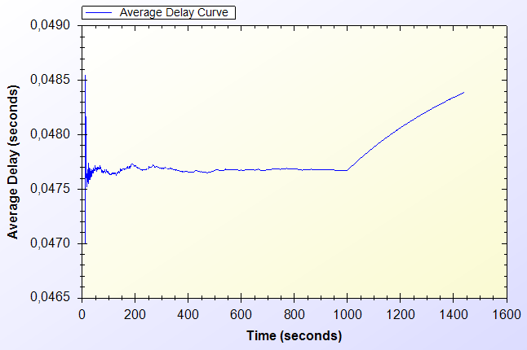
Unit Test Results
Unit Test Result for End-to-end Two-Way Protocols

Slide 32
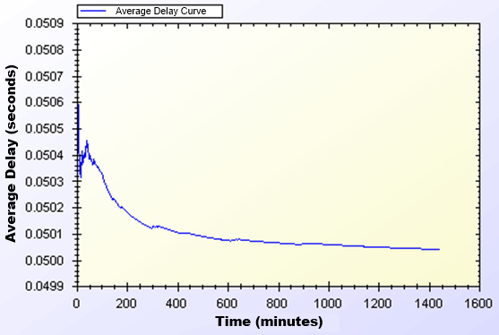
Unit Test Results
Unit Test Results for Access Point Authentication

Slide 33
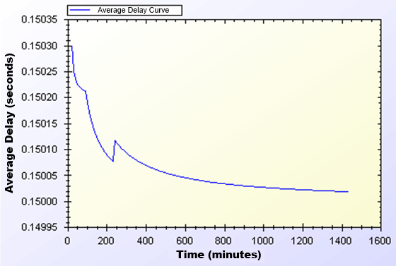
Unit Test Results
Unit Test Result for Seamless Mobility and Roaming

Slide 34
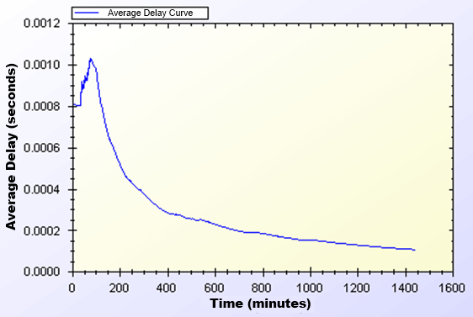
Unit Test Results
Unit Test Result for Packet Transfer

Slide 35
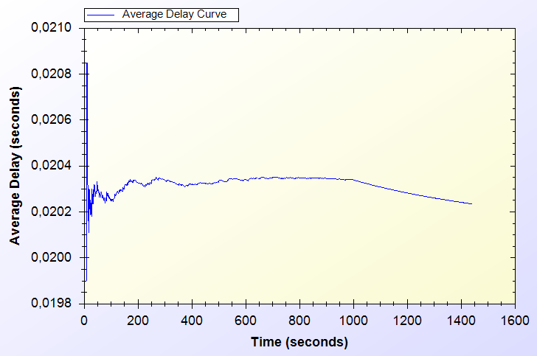
Unit Test Results
Unit Test Result for Update Packets

Slide 36
User Modeling and Mobility in Real-Life Scenario
The proposed system intends to serve a variety of users.
Certain kinds of actions are defined, such as authorization (initial or reuse of a connection card), disconnection, packet transfer (network usage), payment related roaming and payment related AP handover.
All of these actions are triggered as a result of a random event.

Slide 37
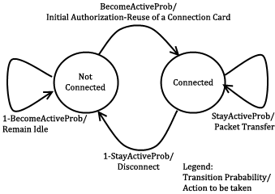
User Actions
In real-life scenario simulations, network usage related actions are modeled using two-state Markov Chain.

Slide 38
Client Types
Three different user types are outlined with different networking and mobility requirements.
Students
Employees
Domestics

Slide 39
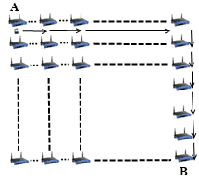
Mobility
Clients move on a grid, to reach a randomly selected destination. The speed and the distance to destination differ according to client’s type.

Slide 40
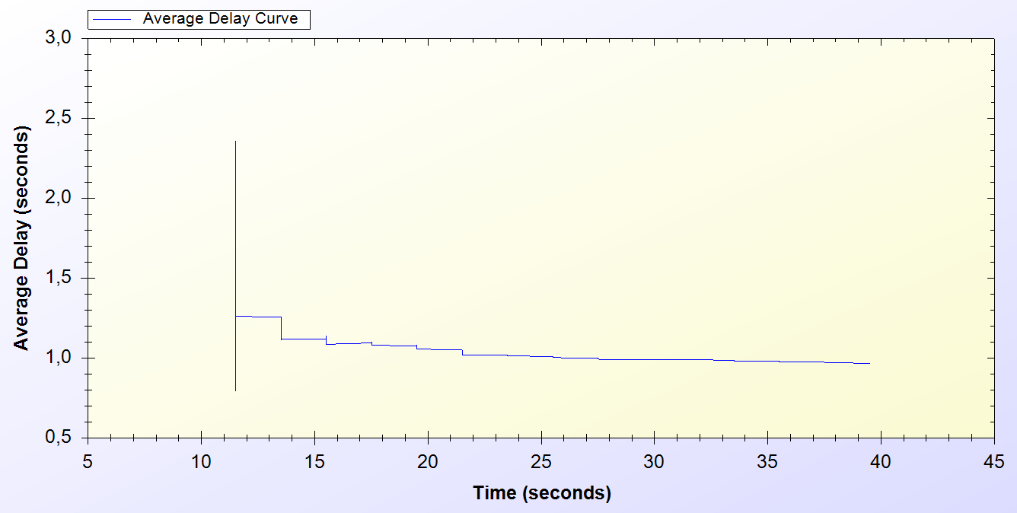
Simulation Results of Protocols
Real-Life Scenario Simulation Result for Initial Authorization Protocol

Slide 41
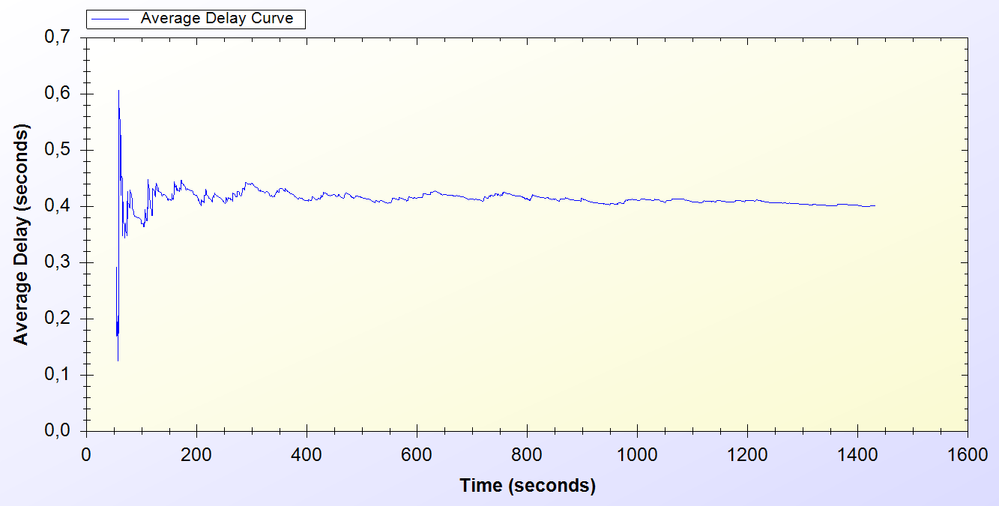
Simulation Results of Protocols
Real-Life Scenario Simulation Result for Reuse of a Connection Card Protocol

Slide 42
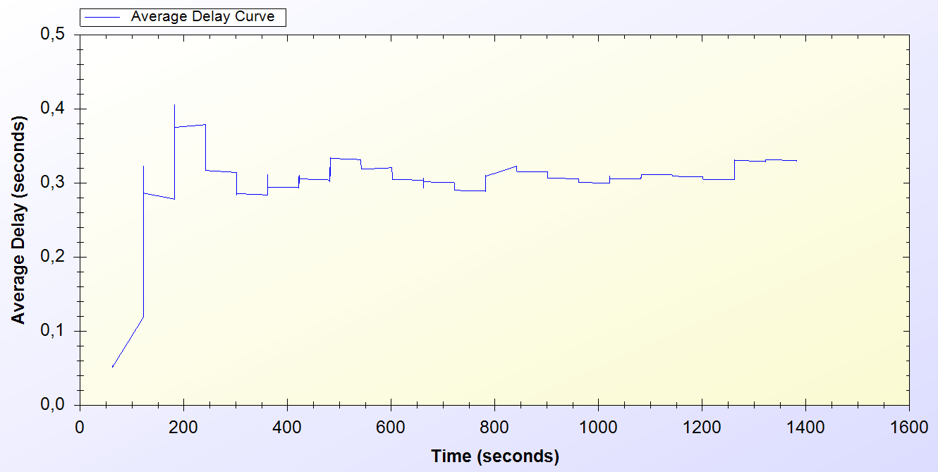
Simulation Results of Protocols
Real-Life Scenario Simulation Result for Changing Alias

Slide 43
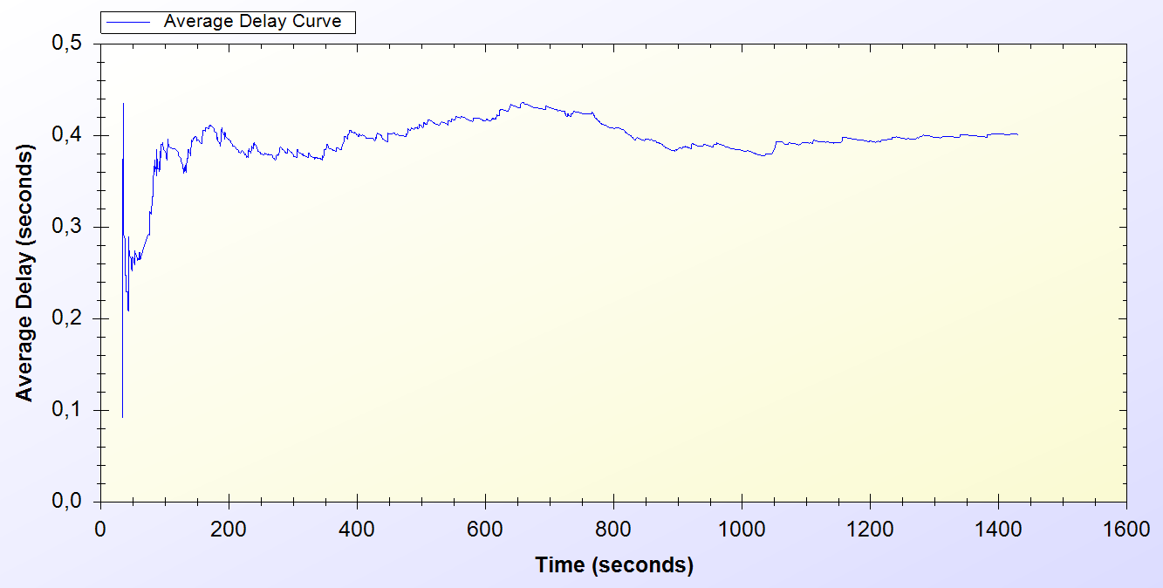
Simulation Results of Protocols
Real-Life Scenario Simulation Result for Disconnection

Slide 44
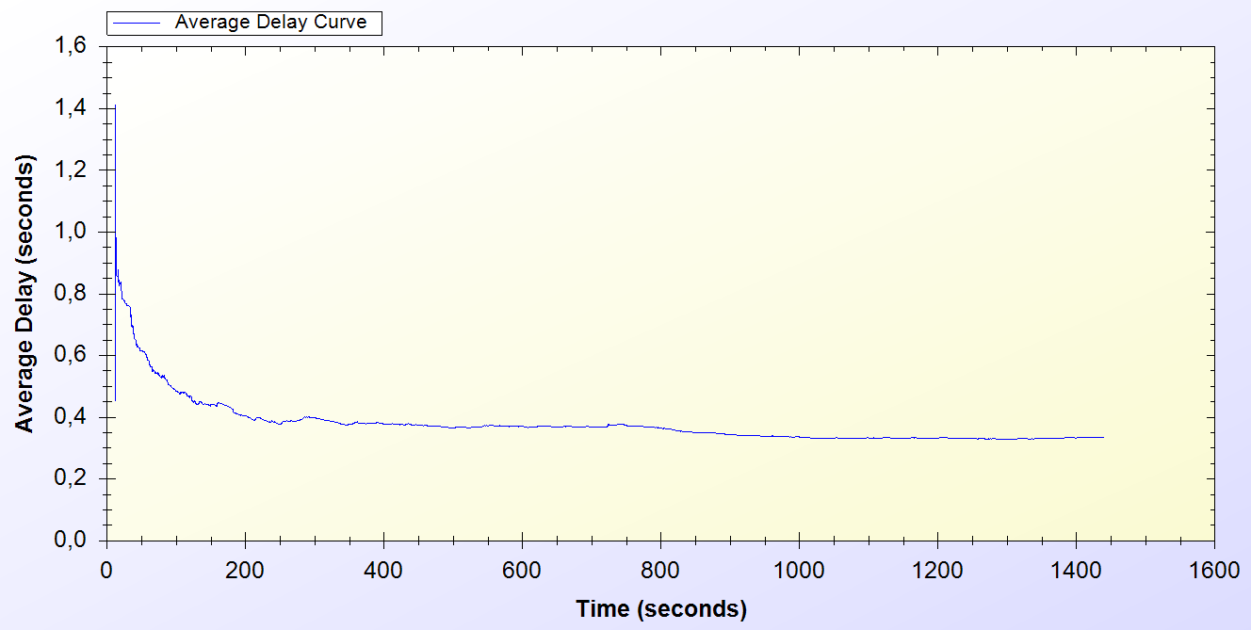
Simulation Results of Protocols
Real-Life Scenario Simulation Result for Update Packets

Slide 45
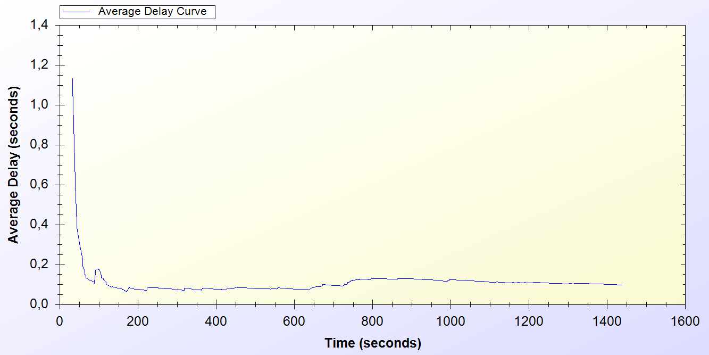
Simulation Results of Protocols
Real-Life Scenario Simulation Result for Seamless Mobility in Home Operator Protocol

Slide 46
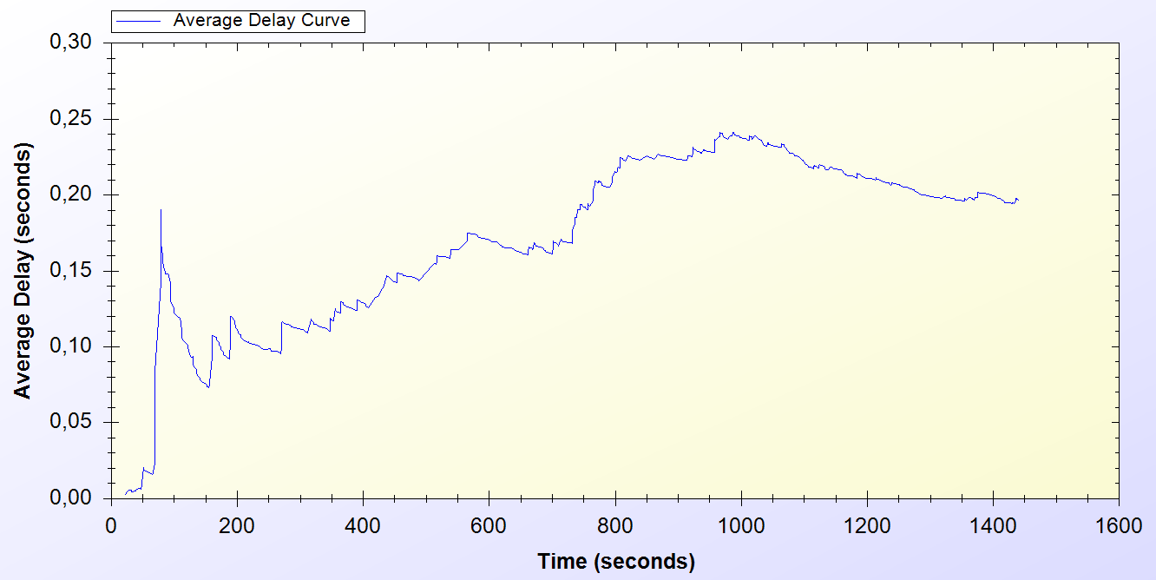
Simulation Results of Protocols
Real-Life Scenario Simulation Result for Roaming Protocol

Slide 47
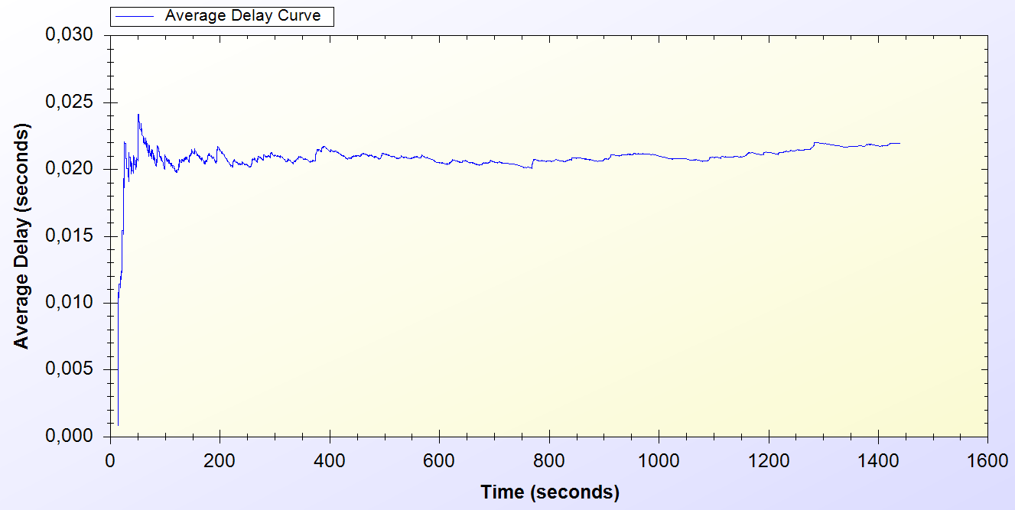
Simulation Results of Protocols
Real-Life Scenario Simulation Result for Packet Transfer

Slide 48
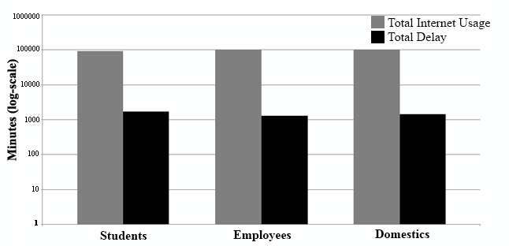
Overall Burden of the System
Total Amount of Service Usage Times for Client Types vs. Total Delays

Slide 49
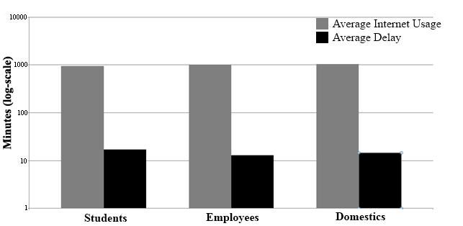
Overall Burden of the System
Average Service Usage Times for Client Types vs. Average Delays

Slide 50
Discussion
Wide Coverage: Every access point could serve within a 100 meters radius. It is proven that with 100 access points, 1 km² area is covered for Internet service.
Seamless Mobility and Roaming: Users are able to switch between access points no matter what operator they belong to. The delays are low enough to maintain current connection without any interruption.
Anonymity: For law-enforcement reasons, users must give their identities to Trusted Third Party (TTP) for getting connection cards. Therefore, as far as TTP keeps clients’ identities secret, users can remain anonymous. Identity verifications are performed using aliases, which change periodically.
Mutual authentication: Initial Authorization and Reuse-CC protocols ensure the authentication of the user. TTP signs the acknowledgement values and a handshake protocol is run between the serving access point and the client. These processes ensure mutual authentication.

Slide 51
Discussion
Two-way honesty: Since the tokens are issued by TTP, only the TTP and connection cardholder knows all the tokens that are related with a specific connection card. Hence whenever a Client sends a new token, it is not possible for him to say, “I did not use it”. Since TTP has verified the token, in the authentication phase, operators cannot say that they provided service for non-used tokens.
Untraceability: Our protocols provide untraceability to some extent by changing aliases periodically. Clients are only traceable between the times they change their aliases.
Performance: The performance of SSPayWMN has been evaluated with simulations using ns-3. Two groups of simulations are performed: unit tests and a real-life scenario. In both groups, our protocols achieved steady state with reasonable delays. Moreover, in overall, the latency cost of SSPayWMN is 1% of the actual usage.

Slide 52
Conclusion
We have proposed a secure and seamless prepayment scheme for wireless mesh networks (SSPayWMN).
This system provides fairness to both operators and to clients.
SSPayWMN provides privacy and untraceability to some extent.
SSPayWMN can successfully handle seamless handover between operators by eliminating the need for re-authentication from the scratch.

Slide 53
Conclusion (continued)
We have conducted two types of simulations to evaluate our system using ns-3: Unit tests and real-life scenario simulations.
Both simulation types gave results ensuring the stability of the system and steady state performance.
Overall burden of the system is 1% of the actual network usage.

Slide 54
Questions?
Thank you for listening.

