Slide 1


Undeniable Mobile Billing Schemes
Shiqun Li ^{1, 2}, Guilin Wang ²,
Jianying Zhou ², and Kefei Chen ¹
¹ Shanghai Jiaotong Univ., China
² I2R, Singapore
EuroPKI ’07
Mallorca, Balearic Islands, Spain; 28-30 June, 2007

Slide 2
Outline
Introduction
The CJC Scheme and Its Security
The Proposed Scheme
Conclusion

Slide 3
Introduction: Background
In the traditional GSM billing system, the billing information is generated by the Mobile Network Service Provider (MNSP) alone.
This is not fair for mobile users.
Billing information is deniable in case of dispute.

Slide 4
Introduction: Background
To provide undeniable billing evidences for call services in GSM, Chen, Jan, and Chen proposed a mobile billing scheme (CJC scheme) in 2005.
They introduced a TTP -- Observer and used hash chain to provide billing information.
Y.-Y. Chen, J.-K. Jan,, and C.-L. Chen. A fair and secure mobile billing system. Computer Networks, 48(4): 517–524, 2005.

Slide 5
Introduction: Related Work
Zhou-Lam’s Scheme [MobiCom’98]
- An undeniable billing system for mobile users roaming in foreign networks
- Mobile users have PKI certificates
Chen et al.’s and Martin et al.’s schemes [96 & 98]
Secure billing for mobile information services in UMTS (Universal Mobile Telecommunications System)
Using PKI and micropayment mechanism

Slide 6
Introduction: Related Work
Compared with those solutions, the CJC scheme
is designed to provide undeniable billing evidences for call services in GSM and
does not require public key operations for mobile users.
Therefore, the CJC scheme is an efficient GSM billing system. However, …

Slide 7
Introduction: Our Contribution
We show that the CJC scheme is unfair.
- Attack 1: Dishonest mobile users can make free calls
- Attack 2: Malicious MNSP can overcharge mobile users
We propose a new undeniable billing scheme, which is secure, and also efficient.

Slide 8
The CJC Scheme and Its Security
Basic Ideas:
The Observer generates two digital signatures on T_{start} and T_{end}.
T_{end} -T_{start} determines the duration of a call.
MSU (Mobile Subscriber Unit) is authenticated by the Observer using a shared hash chain.

Slide 9
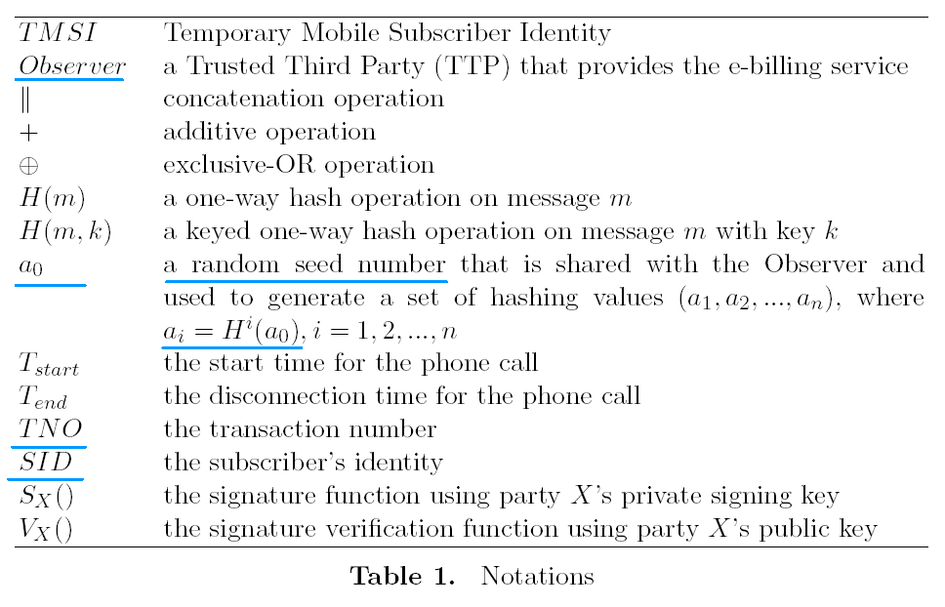
The CJC Scheme and Its Security

Slide 10
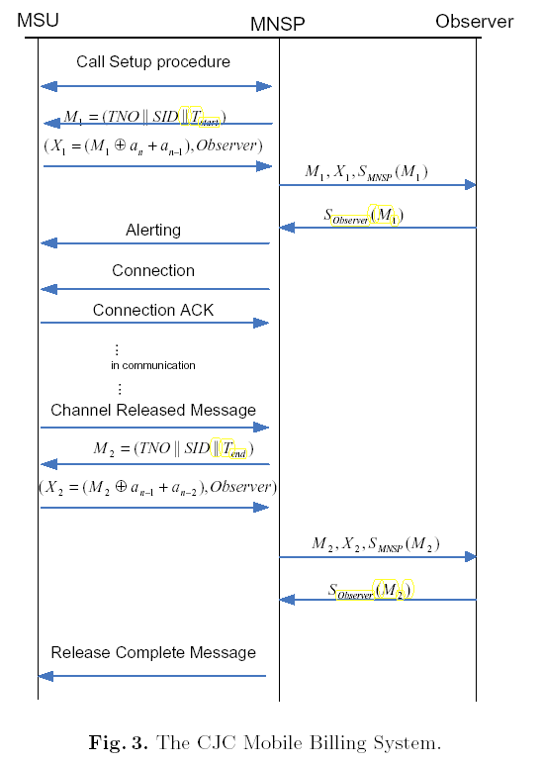

Slide 11
The CJC Scheme and Its Security
The CJC scheme is efficient but unfair for both MNSP and mobile users.
Attack 1: If a call is set up successfully but terminated abnormally later, then the MNSP cannot get the signature on T_{end}.
In practice, a call may be terminated abnormally because of power failure, operation error or the caller's deliberate cheating (e.g., shutting down the device or unplugging the battery suddenly).
Moreover, such an attack is indistinguishable from a no-answer call.

Slide 12
The CJC Scheme and Its Security
Attack 2: The MNSP can overcharge mobile users.
- At some time T_{start}, a mobile user tried but failed making a call. However, the MNSP gets S_{Observer}(M₁) from the Observer.
- The user re-calls at T’_{start}. Now, the MNSP generates M’₁=(TNO||SID|| T’_{start}) by using the same transaction number TNO in M₁, and makes a direct link for the user without interacting the Observer.
- The MNSP gets S_{Observer}(M₂) for the T_{end} as usual.
- So, the MNSP can charge the user on the call duration of T_{end} - T_{start}, instead of the correct interval T_{end} - T’_{start}.
Note: No special requirement on TNO.

Slide 13
The Proposed Scheme
Basic Ideas:
The Observer generates one digital signature on T_{start}.
In each period of time interval L, a mobile user is required to release a pre-image of a hash chain.
The duration of a call is determined by T_{start} and the last pre-image of the hash chain, (i, H^{m-i}(a)).
MSU is authenticated by the Observer using a shared key K_{MO}.

Slide 14
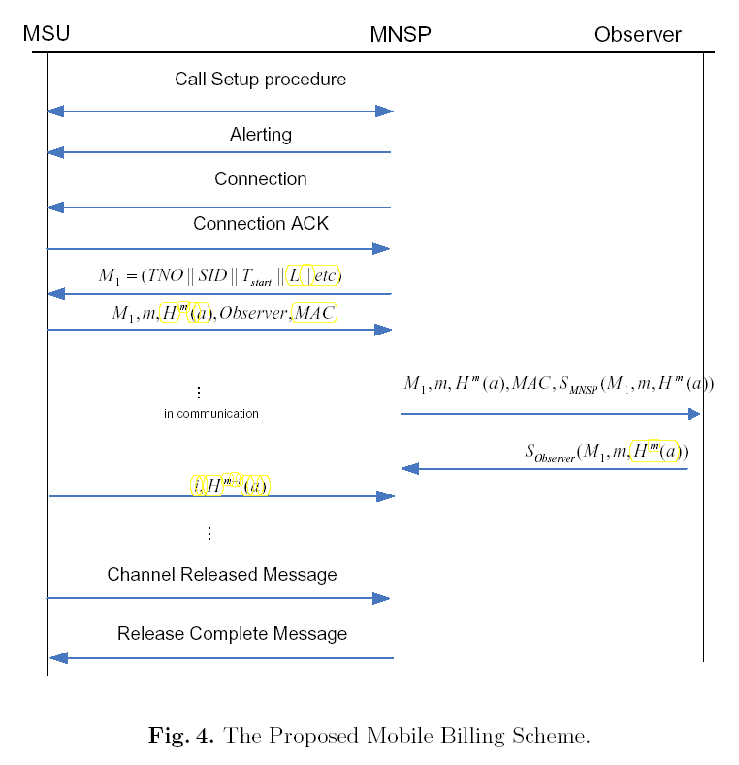

Slide 15
The Proposed Scheme: Properties
Authentication: A mobile user is authenticated by the Observer using the keyed hash, i.e.,
MAC=H(M₁,m, H^{m}(a), K_{MO}).
Non-Repudiation: Billing info is clear and undeniable.
Fairness: No party can cheat the other.
- The Observer is a TTP and its signature is unforgeable.
- The MNSP cannot forge MAC.
- A mobile use has to continuously release the hash chain.

Slide 16
The Proposed Scheme: Comparison
 | Comm. Steps | Public Key Operations
CJC Scheme Our Scheme | 8 5 | 8 4

Slide 17
The Proposed Scheme: Extensions
Limitation:
In our scheme, there would be a difference (less than L) btw the real call time and the undeniable call time.
Extensions:
If the MNSP only cares how many times a user calls, the hash chain can be removed in our scheme.
If the MNSP only cares how long a user calls in a given period (e.g. one month), one hash chain can be continuously used for multiple calls.
If each mobile device is assigned a PKI certificate, the Observer can be removed.

Slide 18
Conclusions
We analyzed a mobile billing scheme.
We proposed a new such scheme.
We showed that our scheme is efficient and secure.

