Slide 1

SSPayWMN: Secure and Seamless Prepayment for Wireless Mesh Networks
Can Serhat Leloğlu
canleloglu@sabanciuniv.edu
MS Thesis Defense
January 18, 2013

Slide 2
Outline
Thesis description
Building blocks of the system
Protocol specifications
Simulations of SSPayWMN
Discussion on success of SSPayWMN
Conclusions

Slide 3
Thesis Description in a Nutshell
A secure prepaid payment scheme for broadband Internet access is designed and developed in a simulation environment.
This scheme will be particularly for Wireless Mesh Networks with multiple operators.

Slide 4
Motivation and Objectives
With the potential number of active users, it is inevitable that there will be more than one operator, who will charge the general use of the clients and provide connection in the metropolitan area.
The operators may unintentionally overcharge their users. Users may unfairly dispute charges. Thus a payment scheme that is fair to both users and the operators is inevitably needed.
On top of the classical security requirements such as confidentiality and authentication, as a critical contribution we address users' anonymity and untraceability.

Slide 5
Objectives
Wide coverage
Seamless Roaming
Seamless Mobility (Handoff)
Anonymity
Mutual Authentication
Two-way honesty
Untraceability
Performance

Slide 6
Differences and Similarities with an Earlier Work
Can Yücel, in his thesis, proposed a preliminary version of SSPayWMN.
Access Point Authentication protocol is used intact, all of the protocols are altered, two new protocols are added.
We improved his work by adding new features:
Anonymity
Untraceability
Seamless Roaming
Real-life scenario, user models and user mobility
Used real IEEE 802.11s in the mesh backbone
The simulation codes are implemented from scratch

Slide 7

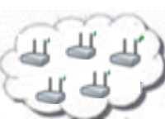

System Entities
 | Mobile user (client)
 | Access Point (AP) with mesh routing capability. From now on in this document, it is called as AP, but please note that it also has routing capability.
 | Mesh backbone of the operator
 | Gateway (GW) that connects the mesh backbone to outer world and also to the operator's server
 | Operator's server (OP). Keeps necessary logs and user info.
 | Trusted Third Party (TTP). Payment related logs are mostly to be generated by the TTP.

Slide 8
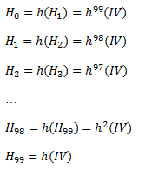
Building Blocks
Connection Cards
Hash tokens
Aliases
Generation Order
Spending Order

Slide 9
Alias Computation
The serial number (SN) of the Connection Card will be used as a base for client’s aliases.
Steps:
Client picks a random 128-bit unsigned number called nonce
Client performs XOR operation with SN and Nonce and take their hash and use the output as the Alias.
Client will use this alias whenever her identity is required.

Slide 10
Initial Authorization and Reuse of a Connection Card

Slide 11
Access Point Authentication
In order to authenticate the network by the client

Slide 12
Packet Transfer
After mutual authentication of client and access point, client starts to send data packets to access point.

Slide 13
Changing Alias

Slide 14
Disconnection

Slide 15
Seamless Mobility in Home Operator
When a client moves out of the coverage area of its associated AP or if another AP provides a better service, the client may want to hand off to another AP.

Slide 16
Seamless Roaming
When the clients need to get service from an access point of a new operator, they roam between old operator and new one.

Slide 17
Operator Settlement and Money Flow
Operators receive their money from the TTP.
Operators show connection requests and disconnection requests to the TTP.
TTP decrypts these packets and calculate the service that is provided.
TTP pays the operators the appropriate amount.
If an operator misbehaves it will be easily understood by looking at other operators’ logs

Slide 18
Performance Evaluation of SSPayWMN
The simulations of SSPayWMN are conducted using ns-3.
The simulator was run on a computer with 2.4 GHz Intel Core 2 Duo, 2 GB 1067 MHz DDR3, Apple MacBook OSX v10.6.8.

Slide 19
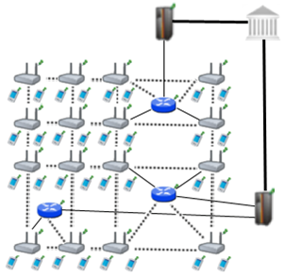
Simulation Environment
The network topology is hierarchical and WMN supports connections with other IEEE 802.11 protocols, clients communicate with TTP via access points, GWs and operators in sequence.
Access point specifications are given below.
AP-Gateway Connection bit rate | 6-54 Mbps – Wi-Fi
AP-Gateway Distance | 70 m
Service Duration per token | 5 minutes
Update Interval | 11 minutes

Slide 20
SSPayWMN Simulations
We have conducted the simulations of SSPayWMN in two groups.
Unit Tests: Independent protocol runs to analyze the delay caused by protocols.
Real-life Scenario Simulation: These simulations evaluate the system’s overall performance in an ordinary day usage with client mobility and realistic Internet service demand.

Slide 21
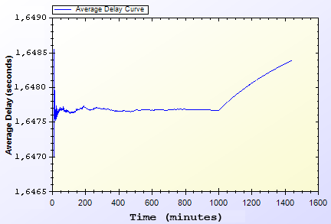
Unit Test Results
Unit Test Result for End-to-end Two-Way Protocols

Slide 22
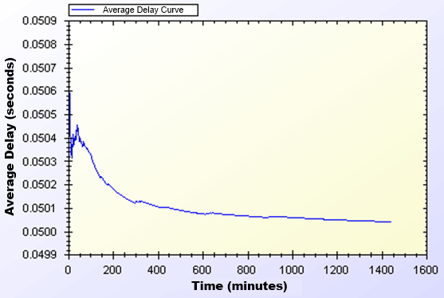
Unit Test Results
Unit Test Results for Access Point Authentication

Slide 23
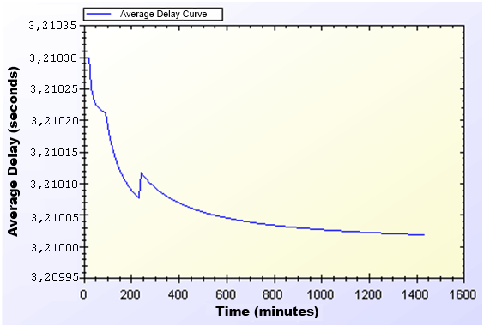
Unit Test Results
Unit Test Result for Seamless Mobility and Roaming

Slide 24
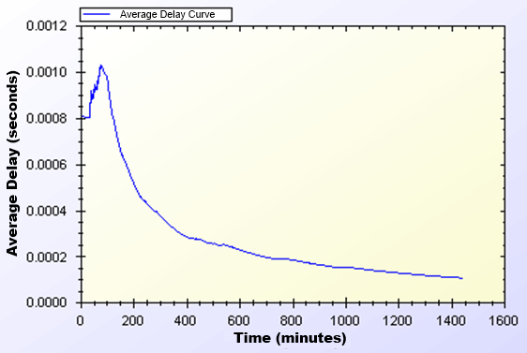
Unit Test Results
Unit Test Result for Packet Transfer

Slide 25
Client Types
Three different user types are outlined with different networking and mobility requirements.
Students
Employees
Domestics

Slide 26
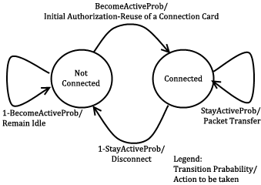
User Actions
In real-life scenario simulations, network usage related actions are modeled using two-state Markov Chain.

Slide 27
User Modeling and Mobility in Real-Life Scenario
The proposed system intends to serve a variety of users.
Clients perform certain kinds of actions and all of these actions are triggered as a result of a random event.
 | Morning | Daytime | Evening
Domestics | 0,40 | 0,60 | 0,60
Students | 0,20 | 0,20 | 0,80
Employees | 0,20 | 0,99 | 0,20
Become Active
Probabilities
 | Morning | Daytime | Evening
Domestics | 0,90 | 0,98 | 0,80
Students | 0,30 | 0,20 | 0,98
Employees | 0,30 | 0,99 | 0,20
Stay Active
Probabilities

Slide 28
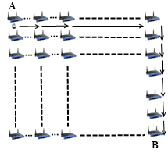
Mobility
Clients move on a grid, to reach a randomly selected destination. The speed and the distance to destination differ according to client’s type.

Slide 29
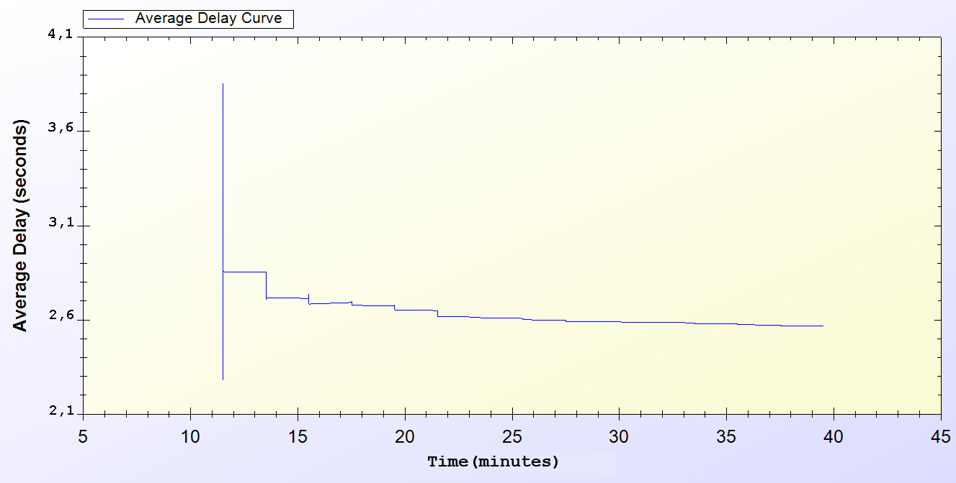
Simulation Results of Protocols
Real-Life Scenario Simulation Result for Initial Authorization Protocol

Slide 30
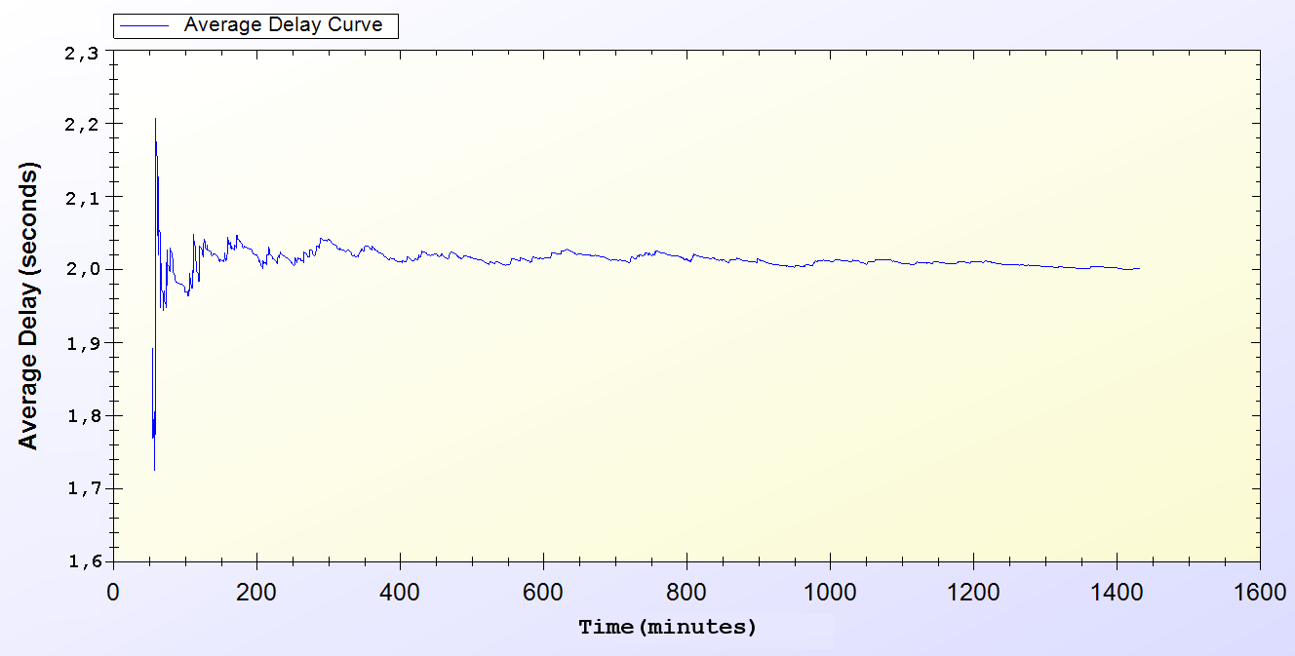
Simulation Results of Protocols
Real-Life Scenario Simulation Result for Reuse of a Connection Card Protocol

Slide 31
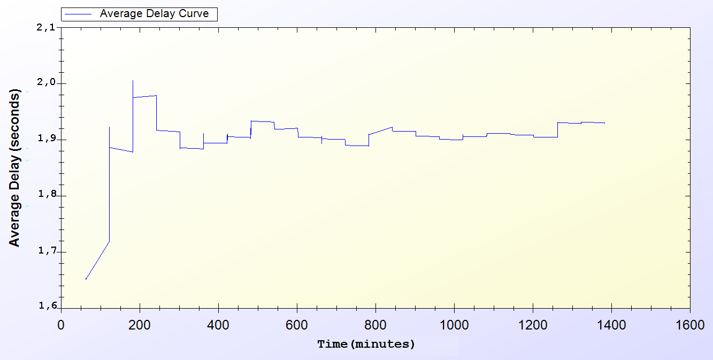
Simulation Results of Protocols
Real-Life Scenario Simulation Result for Changing Alias

Slide 32
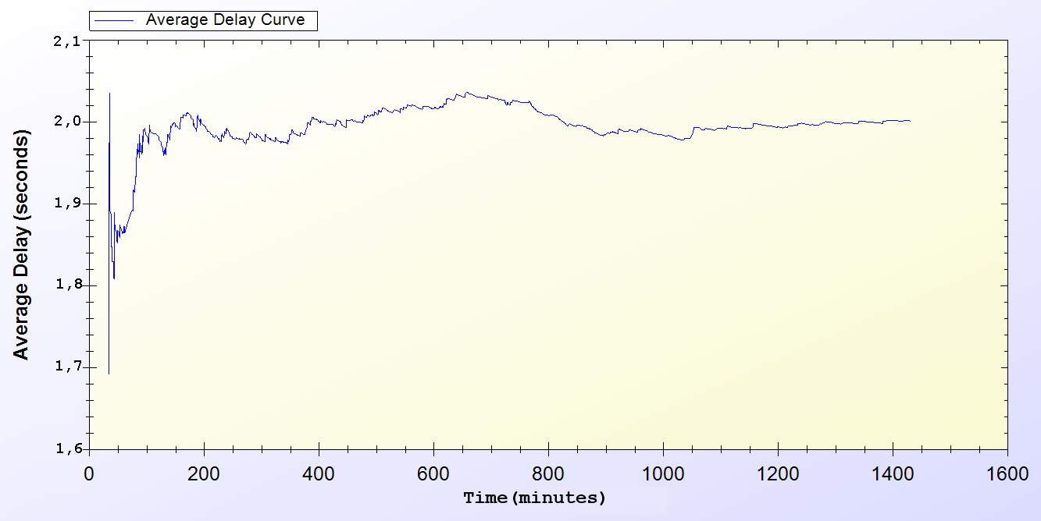
Simulation Results of Protocols
Real-Life Scenario Simulation Result for Disconnection

Slide 33
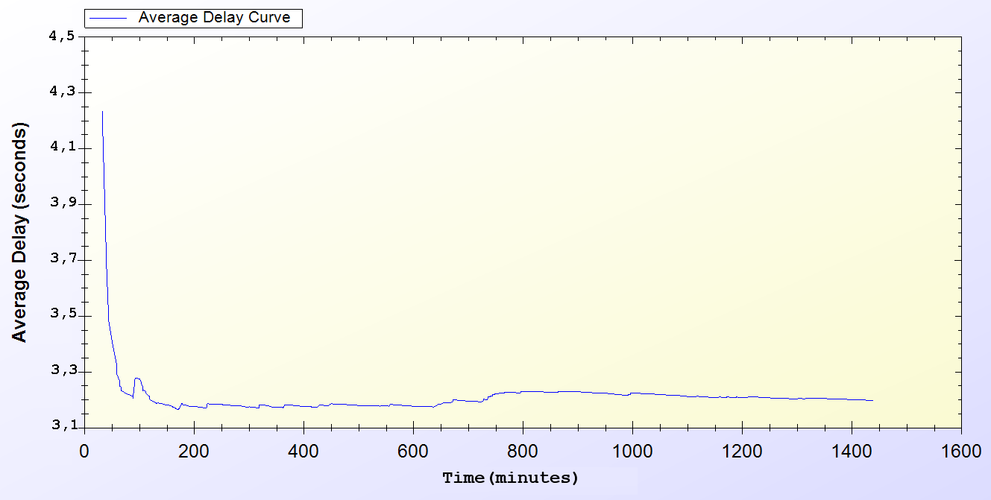
Simulation Results of Protocols
Real-Life Scenario Simulation Result for Seamless Mobility in Home Operator Protocol

Slide 34
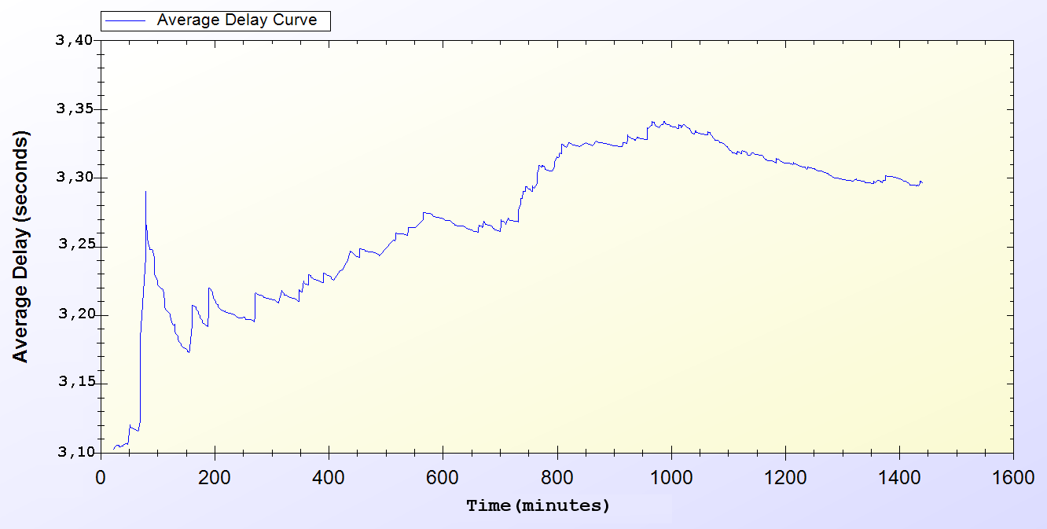
Simulation Results of Protocols
Real-Life Scenario Simulation Result for Roaming Protocol

Slide 35
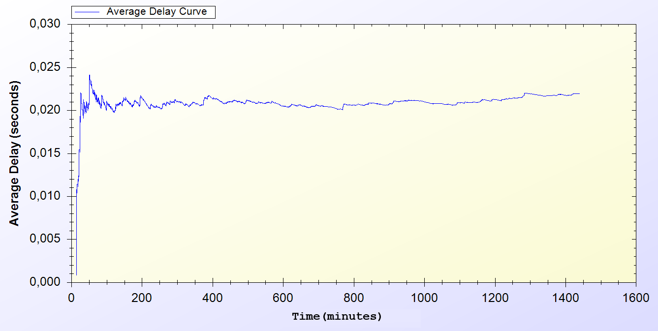
Simulation Results of Protocols
Real-Life Scenario Simulation Result for Packet Transfer

Slide 36
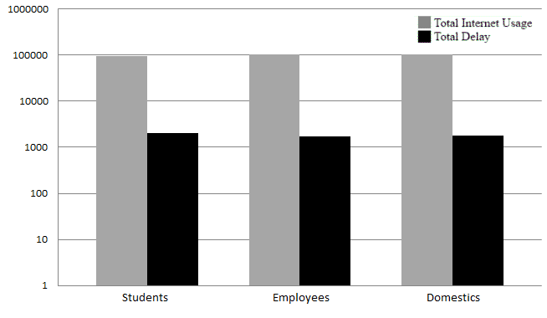
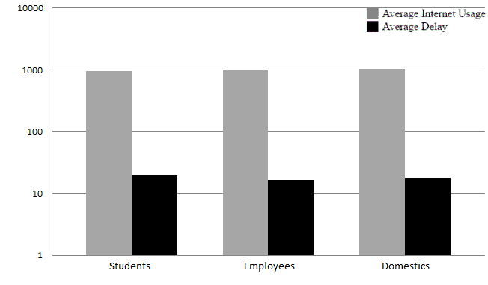
Overall Burden of the System

Slide 37
Discussion
Wide Coverage
Seamless Mobility and Roaming
Anonymity
Mutual authentication
Two-way honesty
Untraceability
Performance

Slide 38
Conclusion
SSPayWMN is a secure and seamless prepayment scheme, which provides privacy and untraceability for the clients.
This system provides fairness to both operators and to clients.
Seamless mobility and roaming
Unit test simulations and real-life scenario simulation results ensures the system’s stability and steady state performance.

Slide 39
Thank you
Very much

