Slide 1

SSPayWMN: Secure and Seamless Payment for Wireless Mesh Networks
Albert Levi
Can Serhat Leloğlu
levi@sabanciuniv.edu, canleloglu@sabanciuniv.edu
Thesis Presentation as of January 18, 2013

Slide 2
Outline
Thesis description
Building blocks of the system
Protocol specifications
Simulation environment
Unit test results
Client models and actions
Real-life scenario simulation results
Discussion on success of SSPayWMN
Conclusions

Slide 3
Thesis Description in a Nutshell
A secure prepaid payment scheme for broadband Internet access is designed and developed in a simulation environment.
This scheme will be particularly for Wireless Mesh Networks with multiple operators.

Slide 4
Motivation and Objectives
Wide coverage
Seamless Roaming
Seamless Mobility (Handoff)
Anonymity
Mutual Authentication
Two-way honesty
Untraceability
Performance

Slide 5

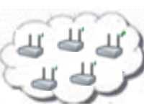

System Entities
 | Mobile user (client)
 | Access Point (AP) with mesh routing capability. From now on in this document, it is called as AP, but please note that it also has routing capability.
 | Mesh backbone of the operator
 | Gateway (GW) that connects the mesh backbone to outer world and also to the operator's server
 | Operator's server (OP). Keeps necessary logs and user info.
 | Trusted Third Party (TTP). Payment related logs are mostly to be generated by the TTP.

Slide 6
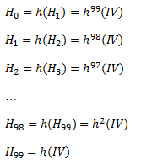
Building Blocks
Connection Cards
Hash tokens
Aliases
Generation Order
Spending Order

Slide 7
Initial Authorization and Reuse of a Connection Card

Slide 8
Access Point Authentication
In order to authenticate the network by the client

Slide 9
Packet Transfer
After mutual authentication of client and access point, client starts to send data packets to access point.

Slide 10
Changing Alias

Slide 11
Disconnection

Slide 12
Seamless Mobility in Home Operator
When a client moves out of the coverage area of its associated AP or if another AP provides a better service, the client may want to hand off to another AP.

Slide 13
Seamless Roaming
When the clients need to get service from an access point of a new operator, they roam between old operator and new one.

Slide 14
Performance Evaluation of SSPayWMN
The simulations of SSPayWMN are conducted using ns-3.
The simulator was run on a computer with 2.4 GHz Intel Core 2 Duo, 2 GB 1067 MHz DDR3, Apple MacBook OSX v10.6.8.

Slide 15
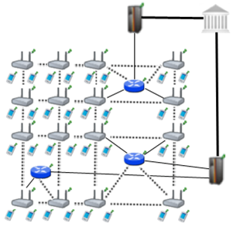
Simulation Environment
The network topology is hierarchical and WMN supports connections with other IEEE 802.11 protocols, clients communicate with TTP via access points, GWs and operators in sequence.
Access point specifications are given below.
AP-Gateway Connection bit rate | 6-54 Mbps – Wi-Fi
AP-Gateway Distance | 70 m
Service Duration per token | 5 minutes
Update Interval | 11 minutes

Slide 16
SSPayWMN Simulations
We have conducted the simulations of SSPayWMN in two groups.
Unit Tests: Independent protocol runs to analyze the delay caused by protocols.
Real-life Scenario Simulation: These simulations evaluate the system’s overall performance in an ordinary day usage with client mobility and realistic Internet service demand.

Slide 17
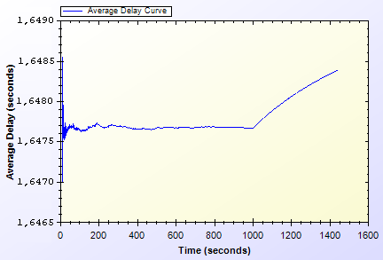
Unit Test Results
Unit Test Result for End-to-end Two-Way Protocols

Slide 18
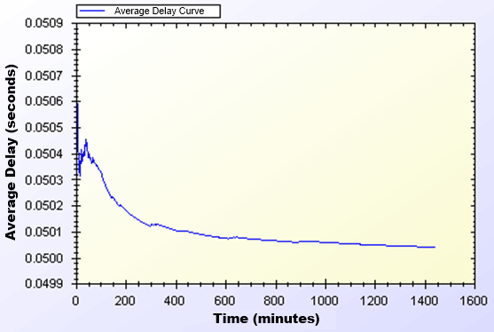
Unit Test Results
Unit Test Results for Access Point Authentication

Slide 19
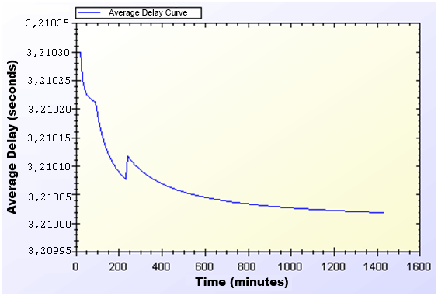
Unit Test Results
Unit Test Result for Seamless Mobility and Roaming

Slide 20
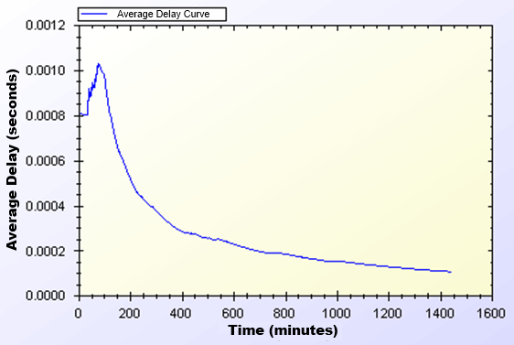
Unit Test Results
Unit Test Result for Packet Transfer

Slide 21
User Modeling and Mobility in Real-Life Scenario
The proposed system intends to serve a variety of users.
Clients perform certain kinds of actions and all of these actions are triggered as a result of a random event.
beco𝑚eActiveProb<Domestic> = {0.40, 0.60, 0.60};
becomeActiveProb<Student> = {0.20, 0.20, 0.80};
becomeActiveProb<Employee> = {0.20, 0.99, 0.20};
stayActiveProb<Domesti𝑐> = {0.90, 0.98, 0.80};
stayActiveProb<Student> = {0.30, 0.20, 0.98};
stayActiveProb<Employee> = {0.30, 0.99, 0.20};

Slide 22
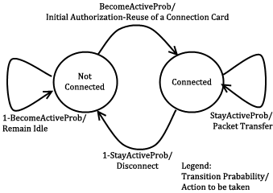
User Actions
In real-life scenario simulations, network usage related actions are modeled using two-state Markov Chain.

Slide 23
Client Types
Three different user types are outlined with different networking and mobility requirements.
Students
Employees
Domestics

Slide 24
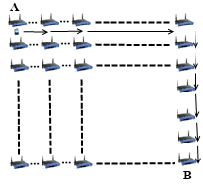
Mobility
Clients move on a grid, to reach a randomly selected destination. The speed and the distance to destination differ according to client’s type.

Slide 25
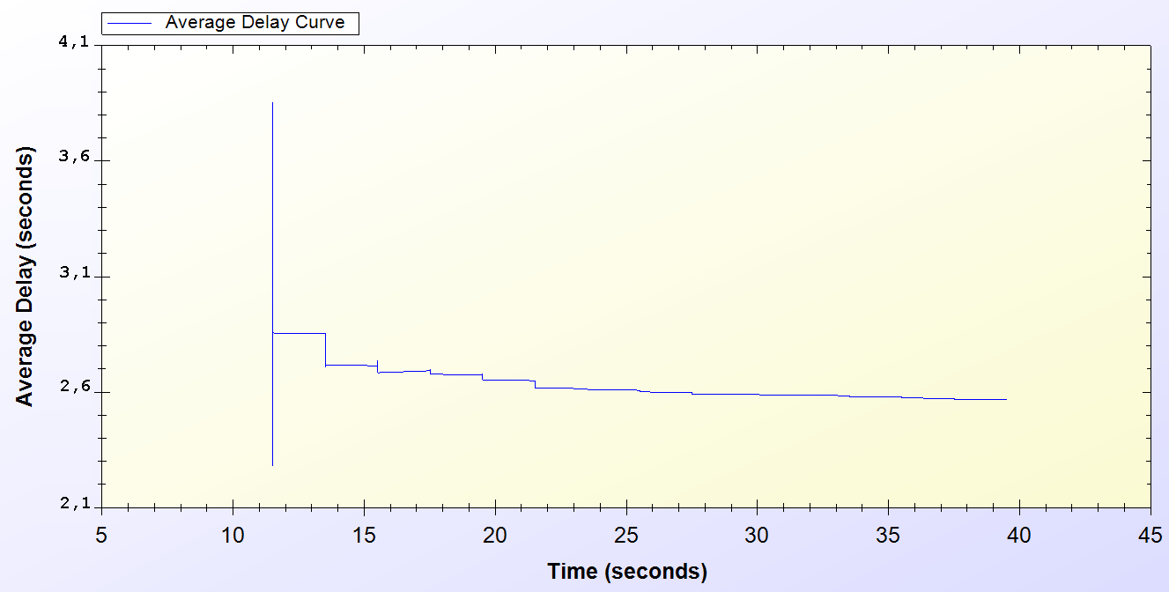
Simulation Results of Protocols
Real-Life Scenario Simulation Result for Initial Authorization Protocol

Slide 26
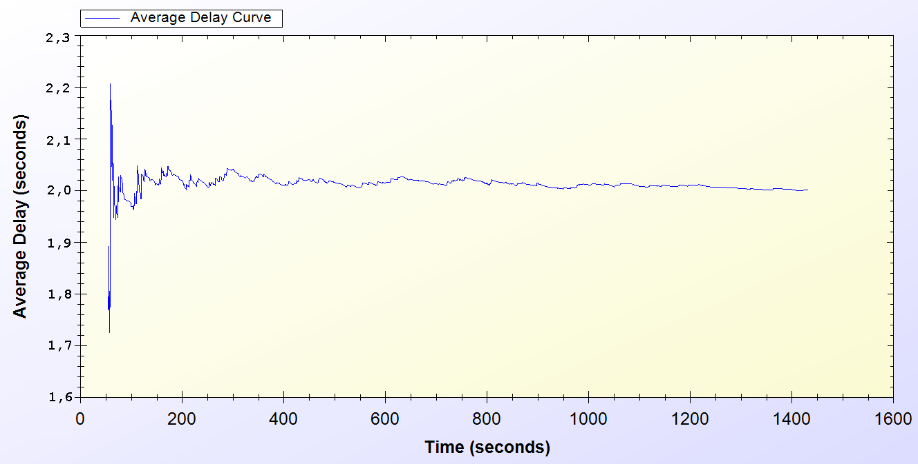
Simulation Results of Protocols
Real-Life Scenario Simulation Result for Reuse of a Connection Card Protocol

Slide 27
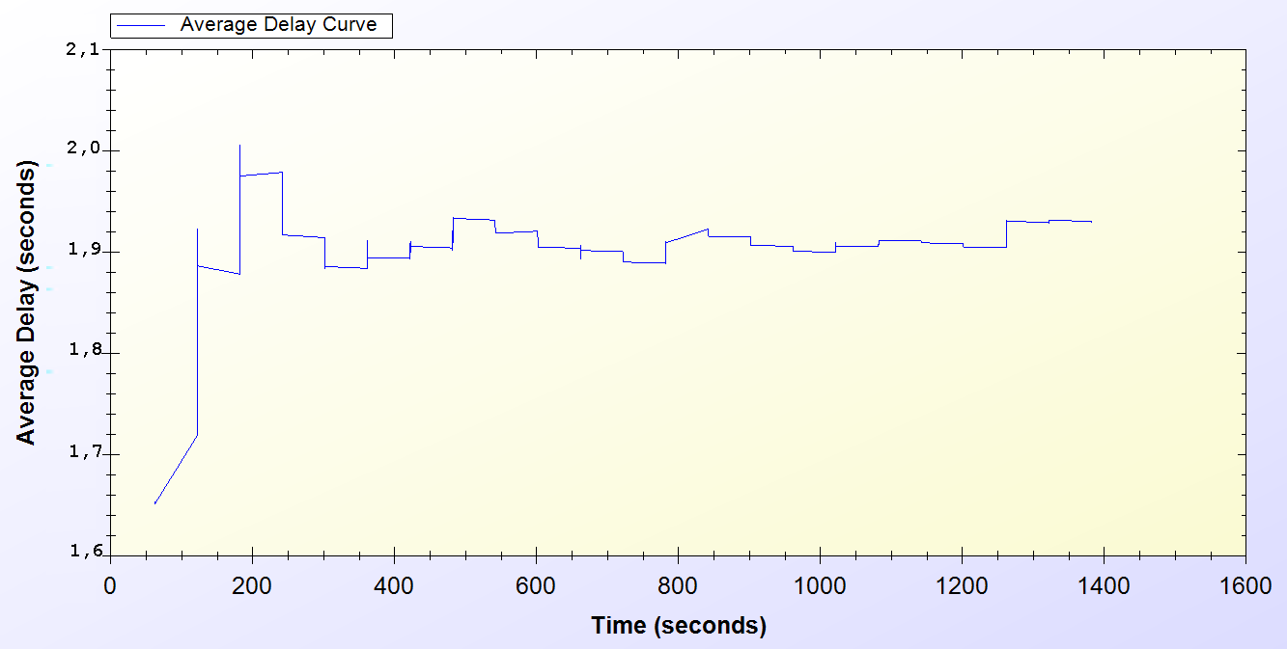
Simulation Results of Protocols
Real-Life Scenario Simulation Result for Changing Alias

Slide 28
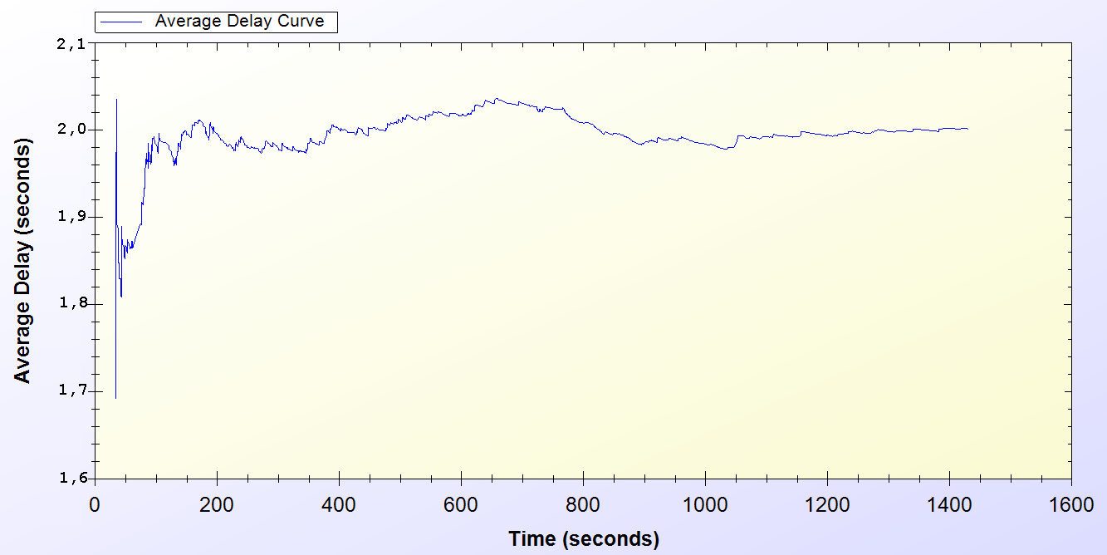
Simulation Results of Protocols
Real-Life Scenario Simulation Result for Disconnection

Slide 29
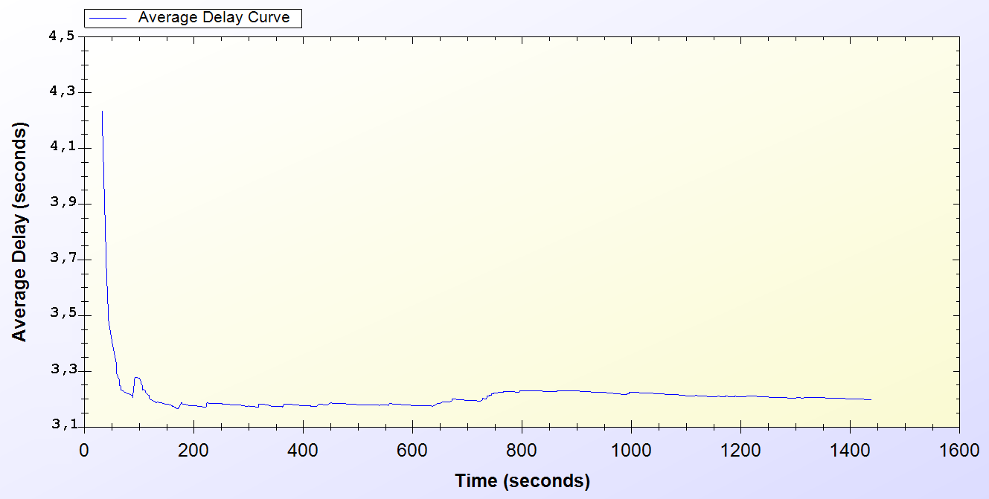
Simulation Results of Protocols
Real-Life Scenario Simulation Result for Seamless Mobility in Home Operator Protocol

Slide 30
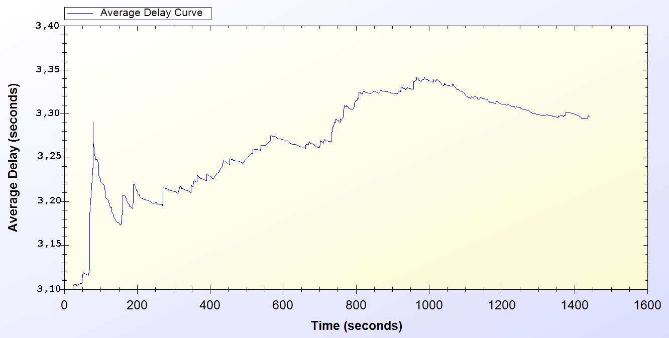
Simulation Results of Protocols
Real-Life Scenario Simulation Result for Roaming Protocol

Slide 31
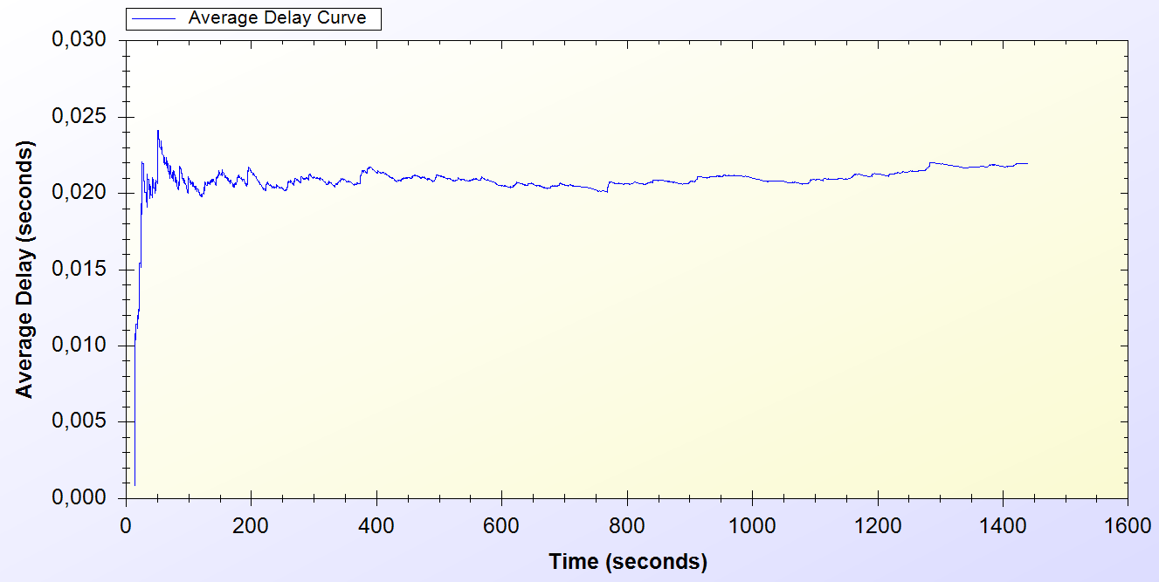
Simulation Results of Protocols
Real-Life Scenario Simulation Result for Packet Transfer

Slide 32
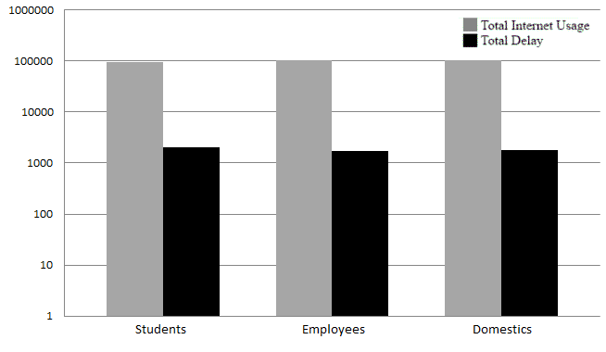
Overall Burden of the System
Total Amount of Service Usage Times for Client Types vs. Total Delays

Slide 33
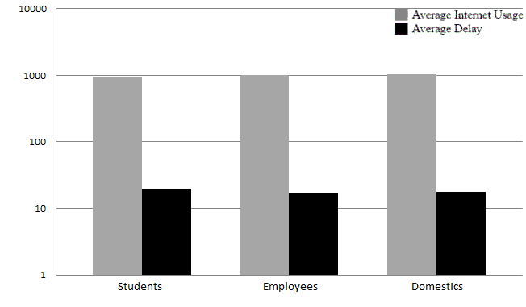
Overall Burden of the System
Average Service Usage Times for Client Types vs. Average Delays

Slide 34
Discussion
Wide Coverage
Seamless Mobility and Roaming
Anonymity
Mutual authentication
Two-way honesty
Untraceability
Performance

Slide 35
Conclusion
SSPayWMN is a secure and seamless prepayment scheme, which provides privacy and untraceability for the clients.
This system provides fairness to both operators and to clients.
Seamless mobility and roaming
Unit test simulations and real-life scenario simulation results ensures the system’s stability and steady state performance.

Slide 36
Thank you
Very much

