Slide 1



SSPayWMN: Secure and Seamless Payment for Wireless Mesh Networks
Albert Levi
Can Serhat Leloğlu
levi@sabanciuniv.edu, canleloglu@sabanciuniv.edu
Progress Presentation as of May 3, 2012

Slide 2
Outline
Project description
Overview of current progress
Basic building blocks
Protocol specifications
Conclusions and plan for 2nd year
If time permits
Some early simulation results

Slide 3
Project Description in a Nutshell
A secure prepaid payment scheme for broadband Internet access will be designed and developed in a simulation environment.
This scheme will be particularly for Wireless Mesh Networks with multiple operators.

Slide 4
Motivation and Objectives
With the potential number of active users, it is inevitable that there will be more than one operator, who will charge the general use of the clients and provide connection in the metropolitan area.
The operators may unintentionally overcharge their users. Users may unfairly dispute charges. Thus a payment scheme that is fair to both users and the operators is inevitably needed.
On top of the classical security requirements such as confidentiality, authentication and non-repudiation (fraud protection), as a critical contribution we plan to address users' anonymity.

Slide 5
Project Timeline and WPs
Kickoff: April 1, 2011
WP1: Requirements Specification
M1 – M4
Deliverable 1: Requirements Specification Document
Deliverable 2: Simulation tool evaluation report
WP2 – Setting up the Simulation Tool
M5 – M6
Milestone 1: Simulation tool up and running
WP3 – Protocol Design and Engineering
M5 – M12
Deliverable 3: Protocol Design Document
2nd Year
WP1 – Unit Protocol Implementation over the Simulation Environment
M1 – M6
Deliverable 1: Preliminary performance results of the unit implementations of the protocols using simple scenarios
WP2- Performance Evaluation
M5 – M12
Deliverables 2 and 3: Simulation Codes and Performance Evaluation Report

Slide 6
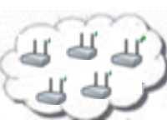

System Entities
 | Mobile user (client)
 | Access Point (AP) with mesh routing capability. From now on in this document, it is called as AP, but please note that it also has routing capability.
 | Mesh backbone of the operator
 | Gateway (GW) that connects the mesh backbone to outer world and also to the operator's server
 | Operator's server (OP). Keeps necessary logs and user info.
 | Trusted Third Party (TTP). Payment related logs are mostly to be generated by the TTP.

Slide 7
Connection Card
Prepaid System
Connection Cards
has unique Serial Number (SN) and credits.
SNs are used for alias computation
credits can be refilled
Credits
implemented as hash tokens which are generated using hash chains.

Slide 8
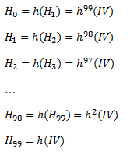
Hash Tokens
For each set of tokens, the operator picks on a random IV (Initialization Vector) and take hashes of it many times.
Can be used by sending in clear
This is secure since they hash functions are one-way
Generation Order
Spending Order

Slide 9
Aliases
Temporary identifiers for clients.
By changing the aliases frequently, we provide anonymity in our system to some extent.
Computed by the clients and also by the TTP (Trusted Third Party).

Slide 10
Alias Computation

Slide 11
Initial Authorization
Whenever a client buys some new hash tokens from an operator, he will need to authorize himself to TTP.
Initial Authorization Protocol achieves authentication and authorization of the user.

Slide 12
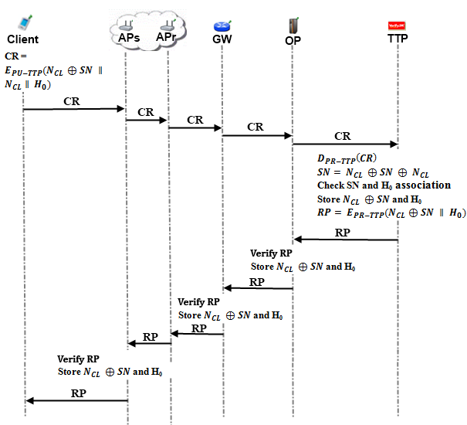
Initial Authorization

Slide 13
Reuse of a Connection Card
Reuse of a connection card protocol allows a user to connect using the remaining credits in a card.
The main difference with the Initial Authorization, is instead of sending first hash token; client sends whichever token is the next one.

Slide 14
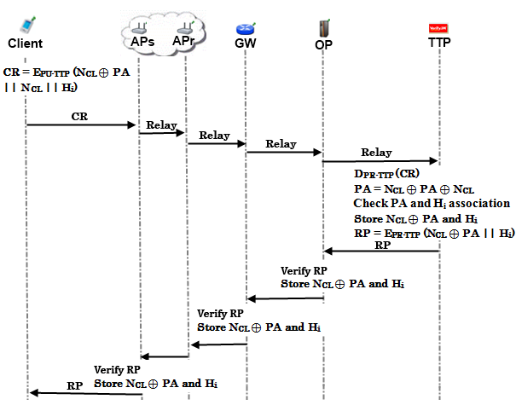
Reuse of a Connection Card

Slide 15
Access Point Authentication
After authentication processes of the client with the TTP, a second authentication step begins.
Client and access point will mutually authenticate each other for safe communication.

Slide 16
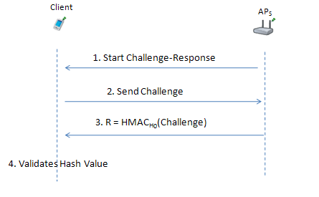
Access Point Authentication

Slide 17
Packet Transfer
After mutual authentication of client and access point, client starts to send data packets to access point.

Slide 18
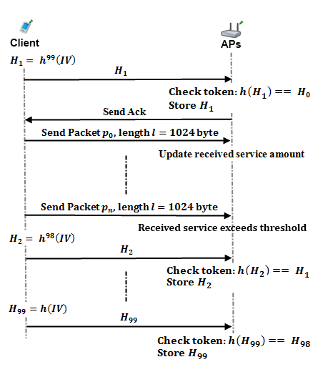
Packet Transfer
After mutual authentication of client and access point, client starts to send data packets to access point.

Slide 19
Providing Unlinkability
Adversary should not be able to track down a user
Aliases should change periodically to achieve unlinkability
They change in the reuse protocol
But they also have to change while the connection resumes

Slide 20
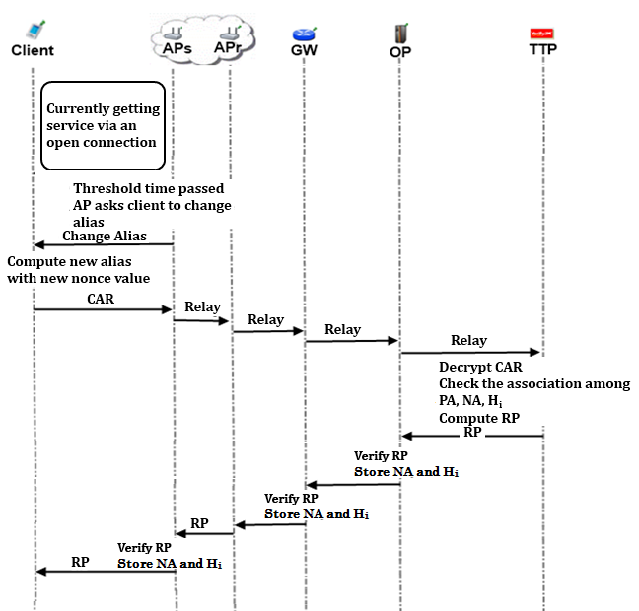
Changing Alias

Slide 21
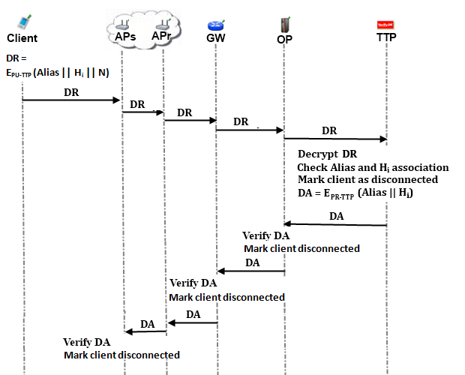
Disconnection

Slide 22
Seamless Roaming
When the clients need to get service from an access point of a new operator, they roam between old operator and new one.
In this kind of situations, we do not bother TTP and save time and computational power.
Every access point has
Public/Private key pairs and certificates
Ability to broadcast certificates
We can handle roaming in a seamless way without running the authorization process from scratch.

Slide 23
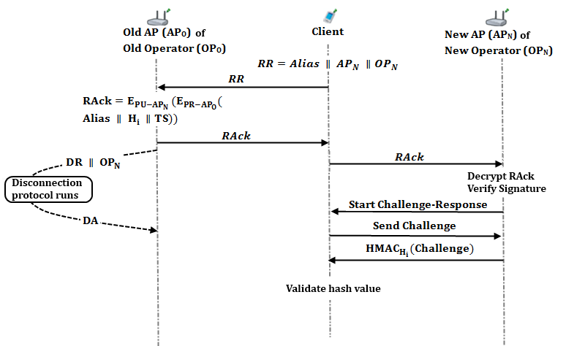
Seamless Roaming

Slide 24
Seamless Mobility in Home Operator
When a client moves out of the coverage area of its associated AP or if another AP provides a better service, the client may want to hand off to another AP.
We develop seamless mobility protocol in order to avoid a full authorization process during such a hand off.

Slide 25
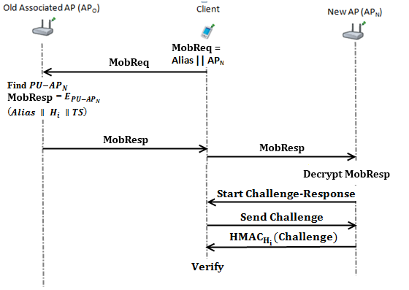
Seamless Mobility in Home Operator

Slide 26
Conclusions
We designed the protocols to be used in the SSPayWMN protocol. With these protocols, the following security requirements are met.
Roaming/mobility
Seamless connection
Seamless roaming
Anonymity
Mutual authentication
Three-way honesty
Preventing double spending
Unlinkability

Slide 27
Plan for Next Year
We have finished the planned tasks of the first year of the SSPayWMN project.
Next stage is the implementation of the protocols in the selected simulator (ns-3).
Actually, some individual implementations have already been done.
We will also define the user profiles and parameters for the simulations.
Finally, we will run the simulations and make the performance analyses.
We expect to finish all these tasks and the project until the end of March 2013, as planned.
We plan to write a conference paper after obtaining some more results
June 2012

Slide 28
Some Early Simulation Results

Slide 29
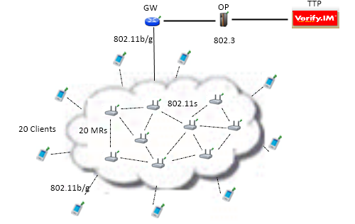
Network Topology
We have 20 mesh router and a client for each of them.
Mesh backbone uses 802.11s protocol.
Clients use 802.11b/g protocol (can be 3G as well).
GW, OP, and TTP uses 802.3 protocol.

Slide 30
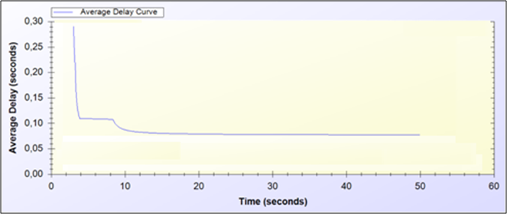
Initial Authorization & Reuse of a Connection Card
Average end-to-end delay.
Reuse period is 0.5 second.
Notes:
Diğer clientlar traffic yaratmıyorlar. Tek bir client 0.5 saniye aralıklarla ttp’ye connection request gönderip response geri alıyor.

Slide 31
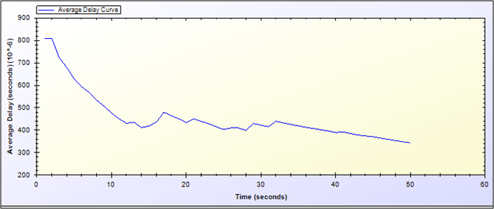
Access Point Authentication & Packet Transfer
One packet is sent in every 0.5 second.
At the beginning access point authentication protocol runs and brings extra overhead.
Notes:
En başta access point authentication protokolü çalıştırılıyor, daha sonra her 0.5 saniyede bir packet atılıyor access pointe.

Slide 32
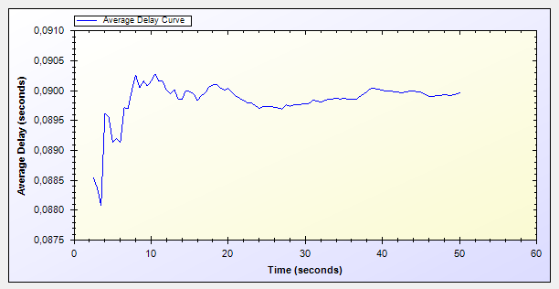
Changing Alias
On average each client sends one packet in every 2 seconds.
Traffic is doubled between 20th and 40th seconds.
Average end-to-end delay is calculated as seen from a particular client.
Notes:
Burada random traffic yaratıyoruz ve 20-40 saniyeler arası trafiği ikiye katlıyoruz. Burada traffic normalken de ölçüm yaptığımız client dışında random birisi de mesh bakbonu kullanıyor. En baştaki delayin çokluğunun sebebi, bakbone içinde ARP paketlerinin fazlalığı.

Slide 33
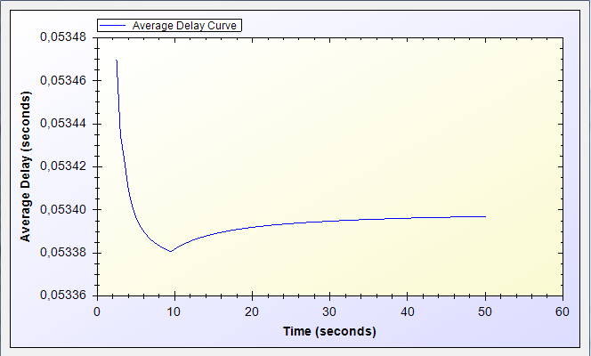
Seamless Mobility
Client changes his access point in every 0.5 seconds.
Notes:
Bir client iki access pointin ortasında bir oraya bir buraya commit ediyor. 0.5 saniyede bir seamless mobility protokolü çalıştırıyoruz.

Slide 34
Questions?
Thank you for listening.

