Slide 1

SSPayWMN: Secure and Seamless Prepayment for Wireless Mesh Networks
Can Serhat Leloğlu
canleloglu@sabanciuniv.edu
Thesis Presentation as of January 18, 2013

Slide 2
Outline
Thesis description
Building blocks of the system
Protocol specifications
Simulations of SSPayWMN
Discussion on success of SSPayWMN
Conclusions

Slide 3
Thesis in a Nutshell
A secure prepaid payment scheme for broadband Internet access is designed and developed in a simulation environment.
This scheme will be particularly for Wireless Mesh Networks with multiple operators.
Proposed scheme provides privacy and untraceability.
System performance is evaluated using network simulations.

Slide 4
Objectives
Wide coverage
Seamless Roaming
Seamless Mobility (Handoff)
Anonymity
Mutual Authentication
Two-way honesty
Untraceability
Performance

Slide 5
Differences and Similarities with an Earlier Work

Slide 6

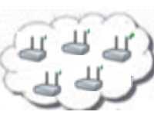

System Entities
 | Mobile user (client)
 | Access Point (AP) with mesh routing capability. From now on in this document, it is called as AP, but please note that it also has routing capability.
 | Mesh backbone of the operator
 | Gateway (GW) that connects the mesh backbone to outer world and also to the operator's server
 | Operator's server (OP). Keeps necessary logs and user info.
 | Trusted Third Party (TTP). Payment related logs are mostly to be generated by the TTP.

Slide 7
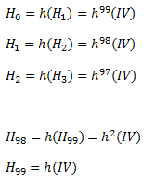
Building Blocks
Connection Cards
Hash tokens
Aliases
Generation Order
Spending Order

Slide 8
Initial Authorization and Reuse of a Connection Card

Slide 9
Access Point Authentication
In order to authenticate the network by the client

Slide 10
Packet Transfer
After mutual authentication of client and access point, client starts to send data packets to access point.

Slide 11
Changing Alias

Slide 12
Disconnection

Slide 13
Seamless Mobility in Home Operator
When a client moves out of the coverage area of its associated AP or if another AP provides a better service, the client may want to hand off to another AP.

Slide 14
Seamless Roaming
When the clients need to get service from an access point of a new operator, they roam between old operator and new one.

Slide 15
Performance Evaluation of SSPayWMN
The simulations of SSPayWMN are conducted using ns-3.
The simulator was run on a computer with 2.4 GHz Intel Core 2 Duo, 2 GB 1067 MHz DDR3, Apple MacBook OSX v10.6.8.

Slide 16
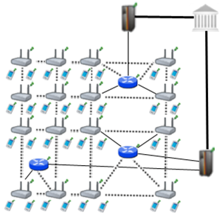
Simulation Environment
The network topology is hierarchical and WMN supports connections with other IEEE 802.11 protocols, clients communicate with TTP via access points, GWs and operators in sequence.
Access point specifications are given below.
AP-Gateway Connection bit rate | 6-54 Mbps – Wi-Fi
AP-Gateway Distance | 70 m
Service Duration per token | 5 minutes
Update Interval | 11 minutes

Slide 17
SSPayWMN Simulations
We have conducted the simulations of SSPayWMN in two groups.
Unit Tests: Independent protocol runs to analyze the delay caused by protocols.
Real-life Scenario Simulation: These simulations evaluate the system’s overall performance in an ordinary day usage with client mobility and realistic Internet service demand.

Slide 18
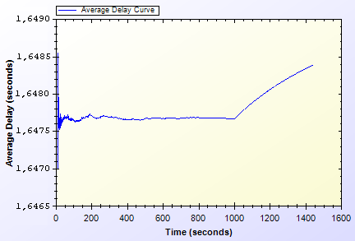
Unit Test Results
Unit Test Result for End-to-end Two-Way Protocols

Slide 19
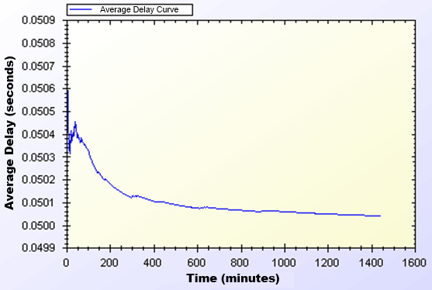
Unit Test Results
Unit Test Results for Access Point Authentication

Slide 20
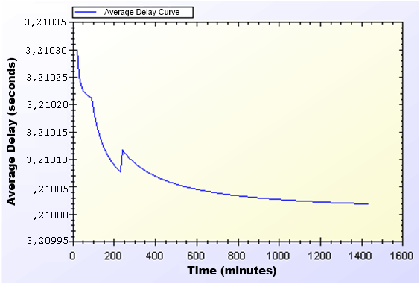
Unit Test Results
Unit Test Result for Seamless Mobility and Roaming

Slide 21
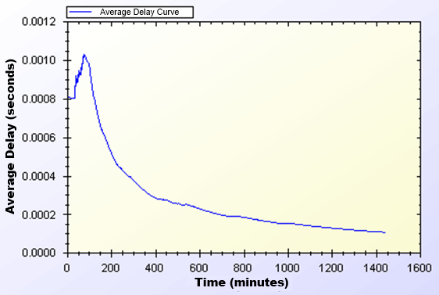
Unit Test Results
Unit Test Result for Packet Transfer

Slide 22
Client Types
Three different user types are outlined with different networking and mobility requirements.
Students
Employees
Domestics

Slide 23
User Modeling and Mobility in Real-Life Scenario
The proposed system intends to serve a variety of users.
Clients perform certain kinds of actions and all of these actions are triggered as a result of a random event.
 | Morning | Daytime | Evening
Domestics | 0,40 | 0,60 | 0,60
Students | 0,20 | 0,20 | 0,80
Employees | 0,20 | 0,99 | 0,20
Become Active
Probabilities
 | Morning | Daytime | Evening
Domestics | 0,90 | 0,98 | 0,80
Students | 0,30 | 0,20 | 0,98
Employees | 0,30 | 0,99 | 0,20
Stay Active
Probabilities

Slide 24
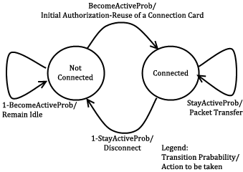
User Actions
In real-life scenario simulations, network usage related actions are modeled using two-state Markov Chain.

Slide 25
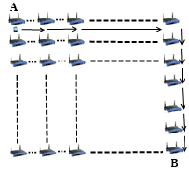
Mobility
Clients move on a grid, to reach a randomly selected destination. The speed and the distance to destination differ according to client’s type.

Slide 26
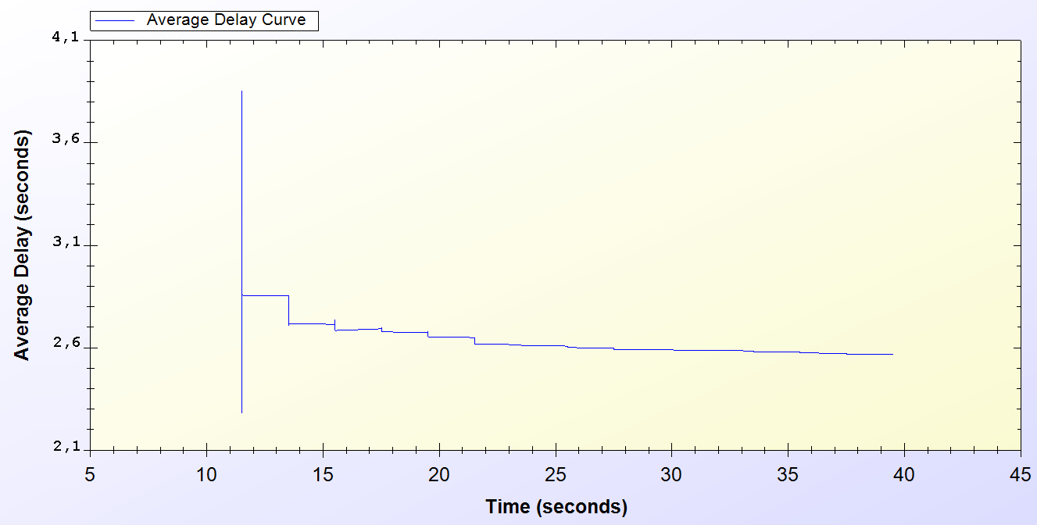
Simulation Results of Protocols
Real-Life Scenario Simulation Result for Initial Authorization Protocol

Slide 27
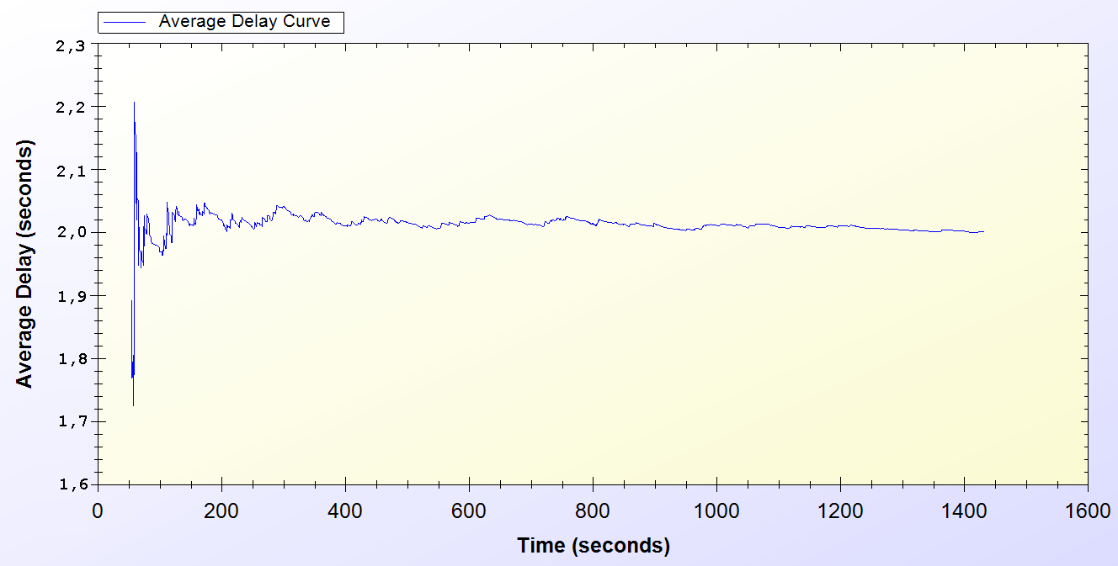
Simulation Results of Protocols
Real-Life Scenario Simulation Result for Reuse of a Connection Card Protocol

Slide 28
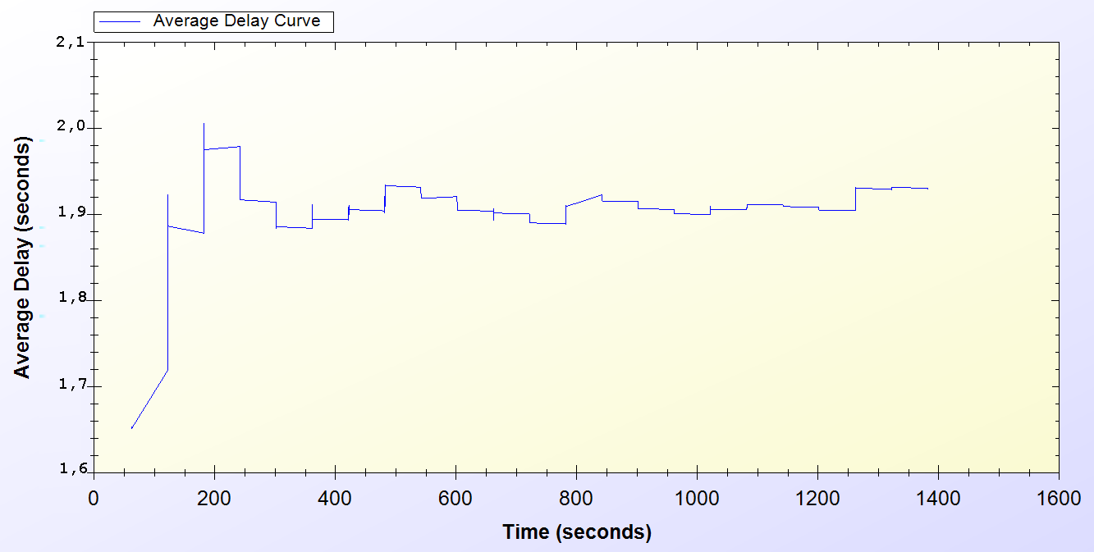
Simulation Results of Protocols
Real-Life Scenario Simulation Result for Changing Alias

Slide 29
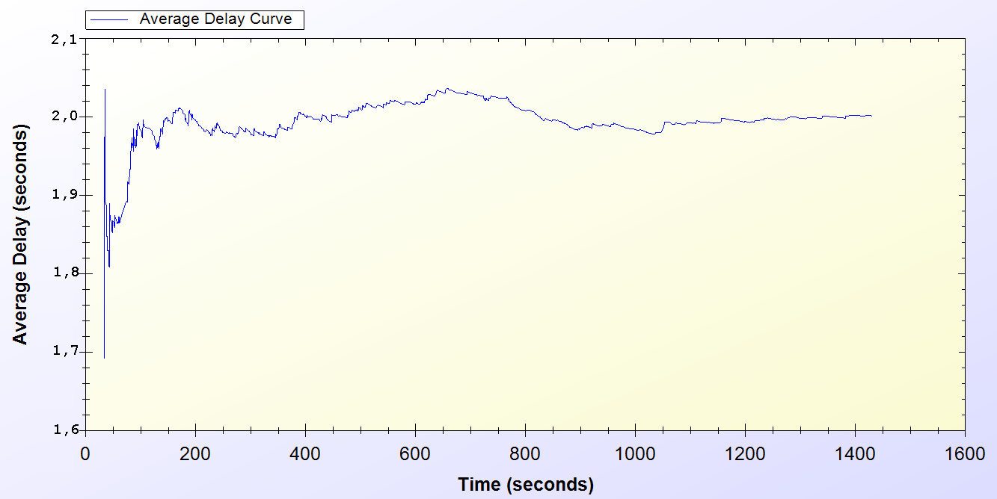
Simulation Results of Protocols
Real-Life Scenario Simulation Result for Disconnection

Slide 30
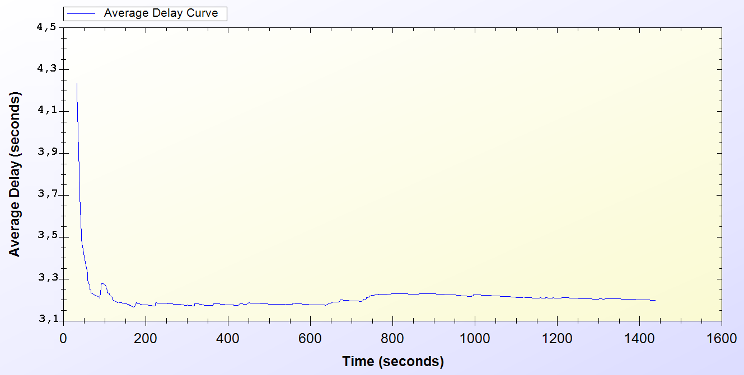
Simulation Results of Protocols
Real-Life Scenario Simulation Result for Seamless Mobility in Home Operator Protocol

Slide 31
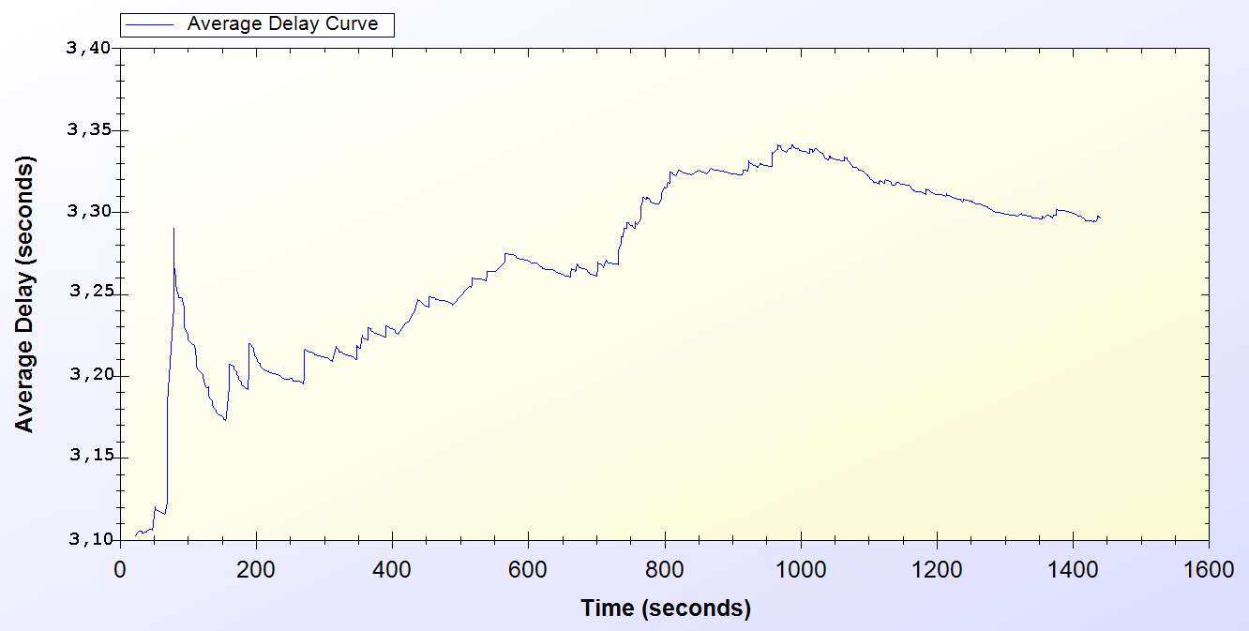
Simulation Results of Protocols
Real-Life Scenario Simulation Result for Roaming Protocol

Slide 32
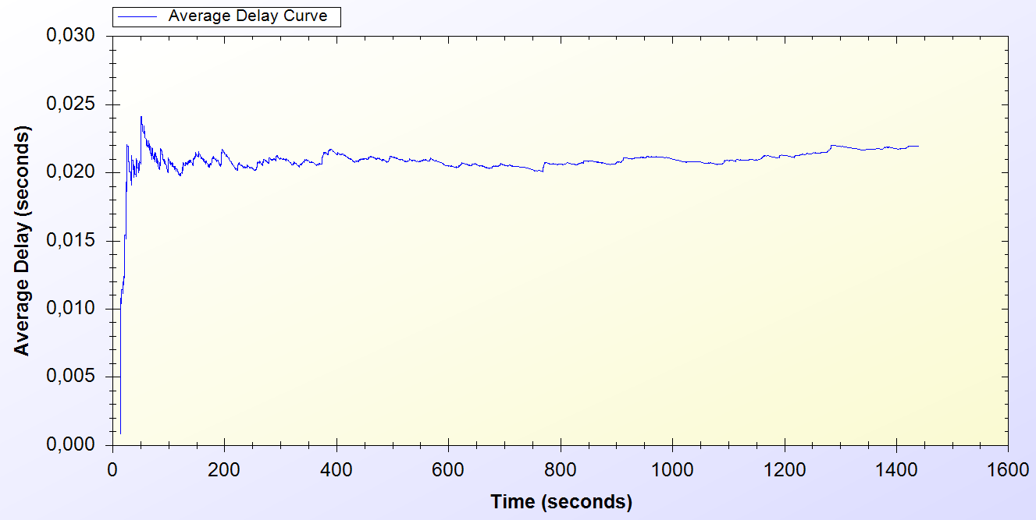
Simulation Results of Protocols
Real-Life Scenario Simulation Result for Packet Transfer

Slide 33
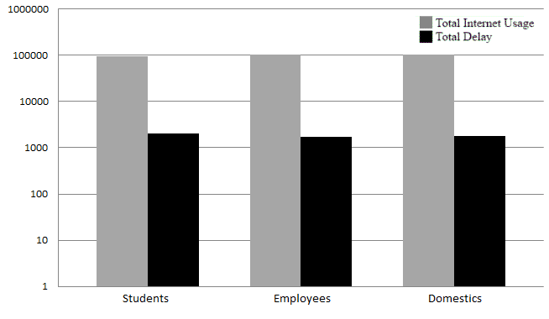
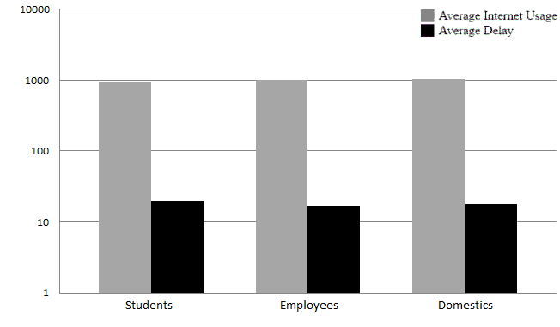
Overall Burden of the System

Slide 34
Discussion
Wide Coverage
Seamless Mobility and Roaming
Anonymity
Mutual authentication
Two-way honesty
Untraceability
Performance

Slide 35
Conclusion
SSPayWMN is a secure and seamless prepayment scheme, which provides privacy and untraceability for the clients.
This system provides fairness to both operators and to clients.
Seamless mobility and roaming
Unit test simulations and real-life scenario simulation results ensures the system’s stability and steady state performance.

Slide 36
Thank you
Very much

