Slide 1

Real Estate Market Prediction Using Apache Spark’s Distributed Framework
Guided By- Dr. Manju Venugopalan
Presented By- Debanjan Shil
M.Tech Data Science
BL.SC.P2DSC24032

Slide 2


Slide 3
Regression in Spark ML
Builds and trains regression models with Spark
Utilizes Apache Spark libraries: Spark Mllib or Spark ML
Scalable and distributed ML library
Integrates with the Spak ecosystem

Slide 4
Regression Algorithm :-
Linear Regression
Decision Tree Regression
Random Forest Regression
Gradient –Boosted Tree Regression

Slide 5
Memory Configuration
Compute Configuration
Parameter | Value | Purpose
spark.driver.memory | 8g | Allocate 8GB RAM to the driver process
spark.executor.memory | 8g | Allocate 8GB RAM to each executor process (simulated in local mode)
spark.driver.memoryOverhead | 2g | Reserve 2GB for non-JVM memory in driver (Python processes, etc.)
spark.driver.maxResultSize | 2g | Limit results collected to driver to 2GB to prevent OOM errors
Parameter | Value | Purpose
spark.executor.cores | 4 | Allocate 4 CPU cores to each executor
spark.sql.shuffle.partitions | 10 | Use 10 partitions for operations requiring data redistribution

Slide 6
Network & Timing Configuration
Parameter | Value | Purpose
spark.network.timeout | 1200s | Set timeout for all network interactions to 1200 seconds
spark.executor.heartbeatInterval | 120s | Set interval for executor heartbeats to driver to 120 seconds
Serialization & Data Transfer
Parameter | Value | Purpose
spark.serializer | org.apache.spark.serializer.KryoSerializer | Use Kryo serializer for more efficient object serialization
spark.sql.execution.arrow.pyspark.enabled | false | Disable Apache Arrow for conversion between Spark and pandas

Slide 7
Node Structure
The configuration establishes:
Physical Nodes: 1 (local machine)
Logical Components:
1 driver process (8GB + 2GB overhead)
1 executor process with 4 cores (8GB)
Total Resources: 4 cores, ~18GB memory
Key Observations
Development-Oriented: This is a local mode configuration for development and testing
Single-Machine Deployment: All processes run on one machine, simulating a small cluster
Medium Resource Allocation: Sufficient for processing the 100,000 Property synthetic dataset
Optimized Serialization: Uses Kryo for better performance with complex objects
Extended Timeouts: Network timeouts are set high to accommodate long-running operations

Slide 8
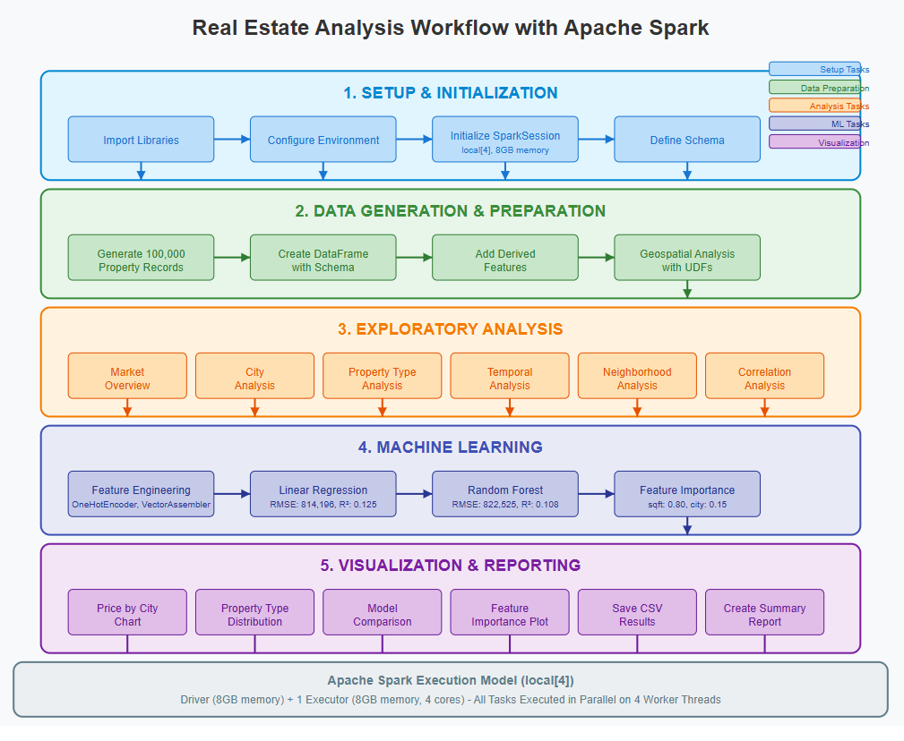

Slide 9
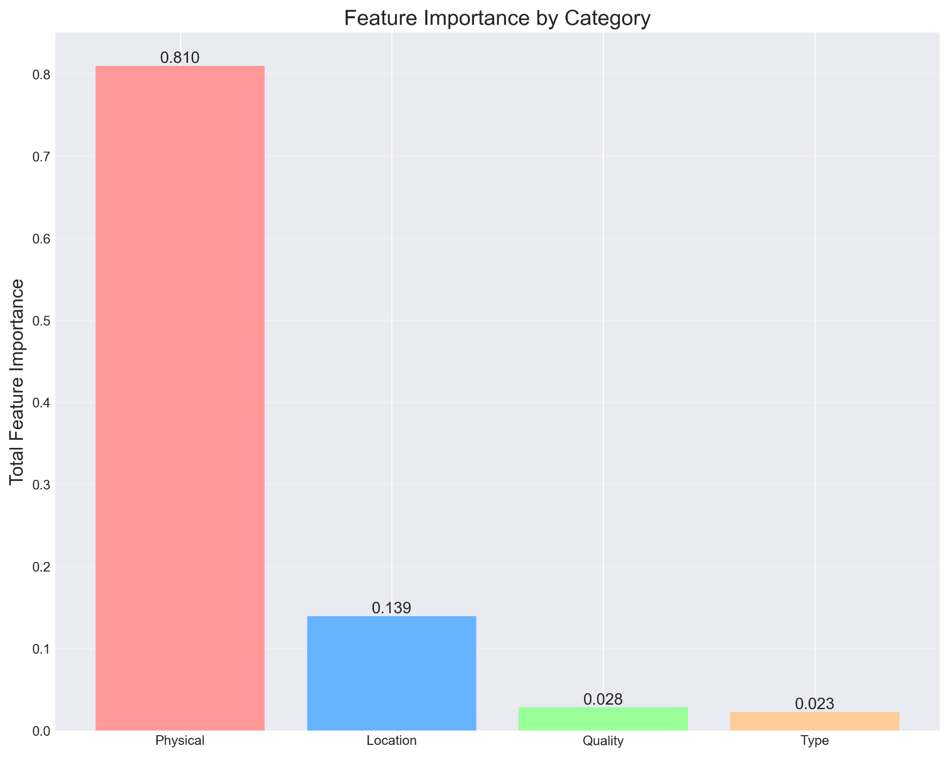

Slide 10
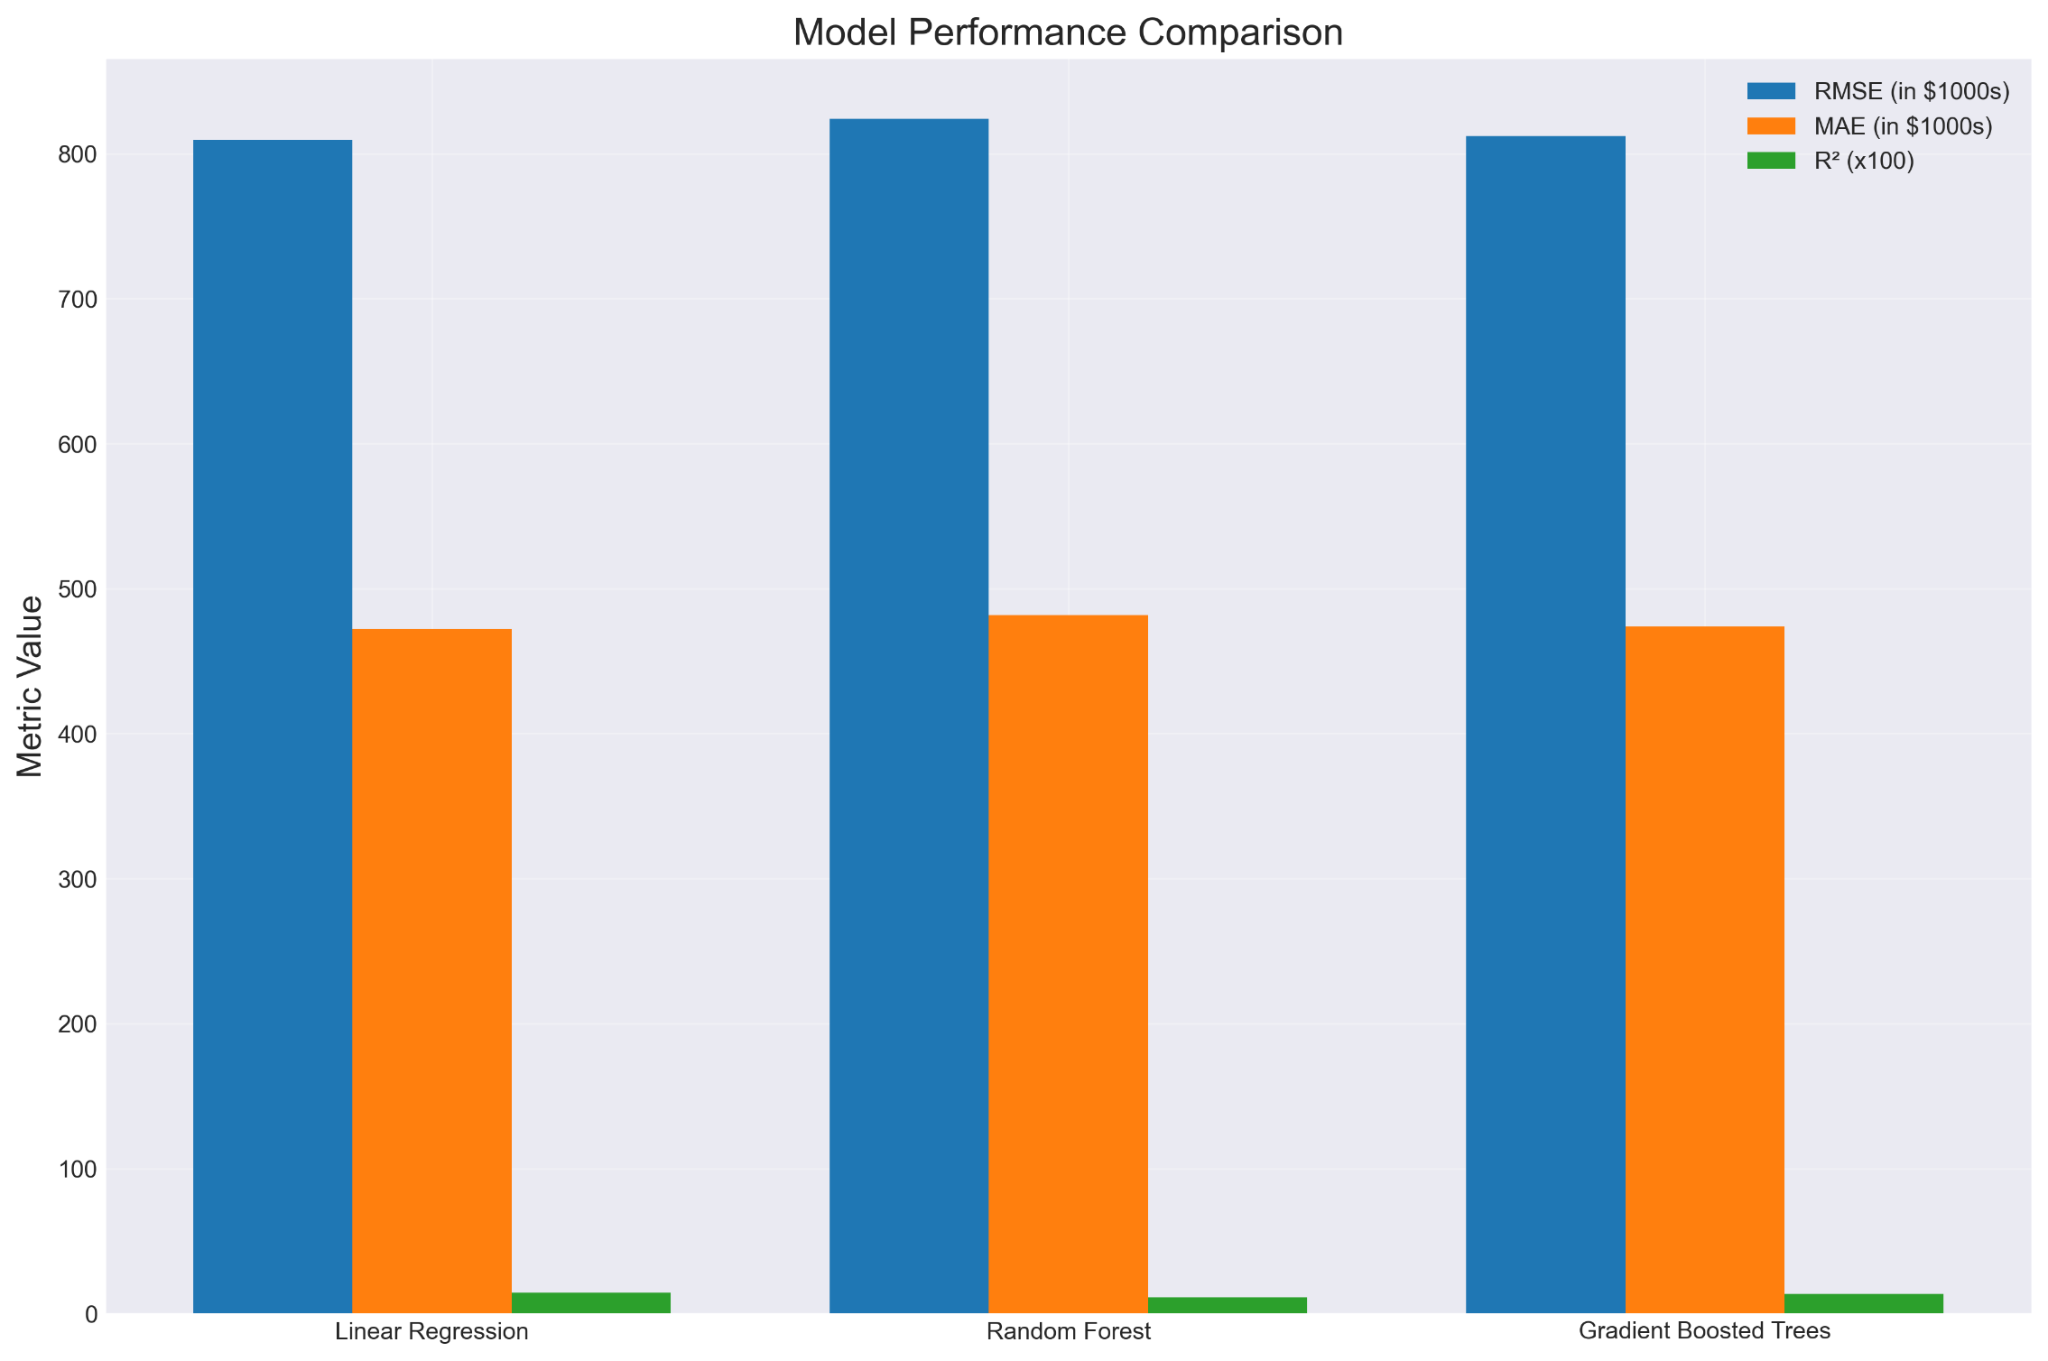

Slide 11
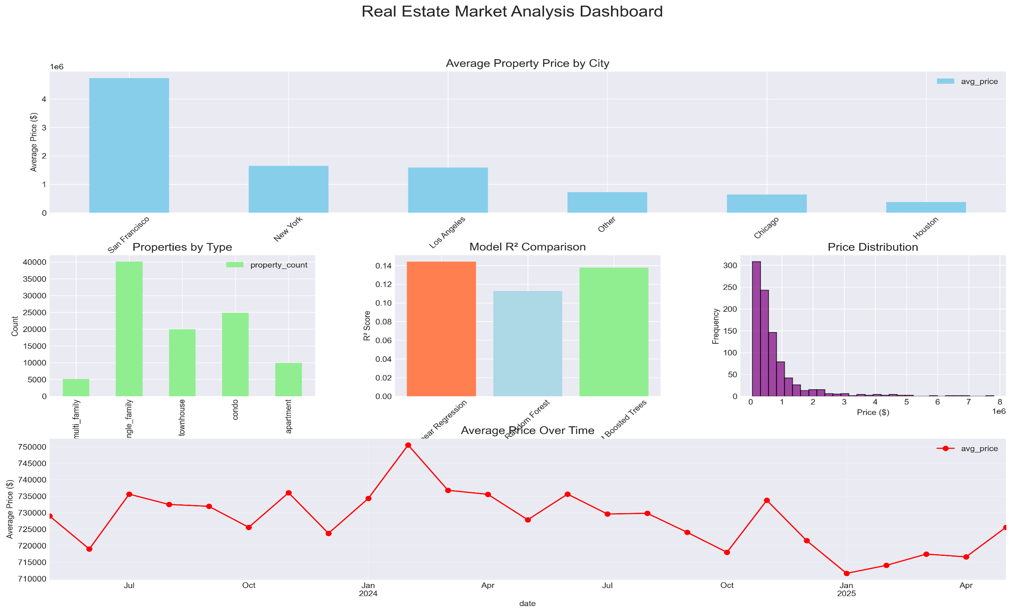

Slide 12
Reference
[1] X. Meng, J. Bradley, B. Yavuz, E. Sparks, S. Venkataraman, D. Liu,J. Freeman, D. Tsai, M. Amde, S. Owen, et al., “Mllib: Machine learning in apache spark,” Journal of Machine Learning Research, vol. 17, no. 34,pp. 1–7, 2016.
[2] H. S. Munawar, S. Qayyum, F. Ullah, and S. Sepasgozar, “Big dataand its applications in smart real estate and the disaster managementlife cycle: A systematic analysis,” Big Data and Cognitive Computing,vol. 4, no. 2, p. 4, 2020.
[3] J. Boehm, K. Liu, and C. Alis, “Sideloading–ingestion of large pointclouds into the apache spark big data engine,” The International Archivesof the Photogrammetry, Remote Sensing and Spatial Information Sci-ences, vol. 41, pp. 343–348, 2016.
[4] M. Assefi, E. Behravesh, G. Liu, and A. P. Tafti, “Big data machinelearning using apache spark mllib,” in 2017 ieee international conferenceon big data (big data), pp. 3492–3498, IEEE, 2017.
[5] S. Harifi, E. Byagowi, and M. Khalilian, “Comparative study of apachespark mllib clustering algorithms,” in Data Mining and Big Data: SecondInternational Conference, DMBD 2017, Fukuoka, Japan, July 27–August1, 2017, Proceedings 2, pp. 61–73, Springer, 2017.
[6] G. Lansley, M. de Smith, M. Goodchild, and P. Longley, “Big data andgeospatial analysis,” arXiv preprint arXiv:1902.06672, 2019.
[7] H. Karau and R. Warren, High performance Spark: best practices forscaling and optimizing Apache Spark. ” O’Reilly Media, Inc.”, 2017.

