Slide 1
CAR PRICE PREDICTION SYSTEM
CSE4062 – TERM PROJECT
# | Name | Student ID | Department
1 | Doğukan Onmaz | 150120071 | CSE
2 | Muhammed Furkan Kahyaoğlu | 150420058 | ME
3 | Niyazi Ozan Ateş | 150121991 | CSE
4 | Özlem Demirtaş | 150320006 | IE
5 | Şükrü Can Mayda | 150120031 | CSE

Slide 2
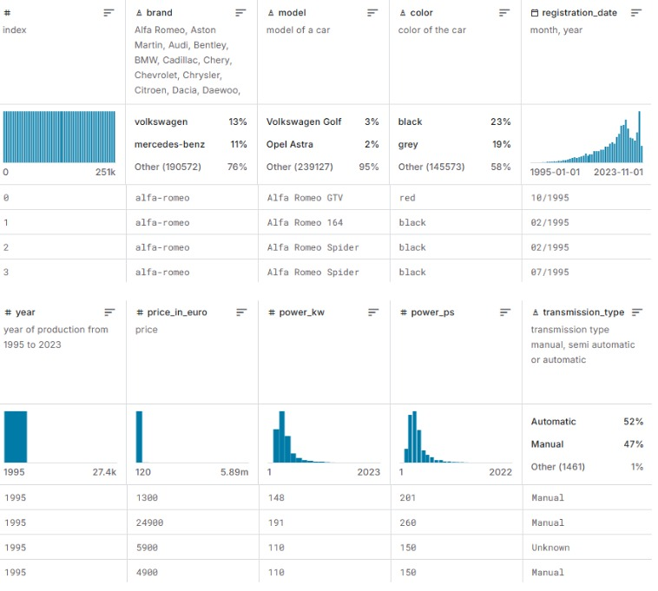
DATASET OVERVIEW
Vehicles Manufactured in 1995-2023
251,078 Instances
14 Attributes
5 Nominal
3 Text
5 Numeric
1 Date
Samples From the Dataset

Slide 3
FEATURE TYPES & EXAMPLES
Nominal: brand, model, color, fuel type, transmission
Text: description, fuel consumption, emissions
Numeric: price, mileage, engine power (kW, PS)
Date: registration_date

Slide 4
WHY THIS DATASET?
Real-world relevance
Suitable for regression & classification
Cross-domain value (CSE, ME, IE)
High-quality source (Kaggle, 9.41 usability score)
Project Goals: Price prediction, feature analysis, market insights

Slide 5
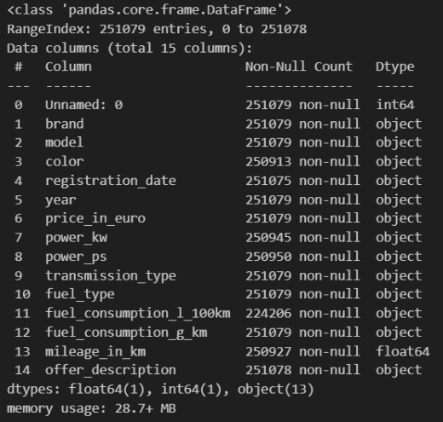
DATA PREPROCESSING
Initial type check
Dropping irrelevant columns
Handling missing values
Types Before Preprocessing

Slide 6
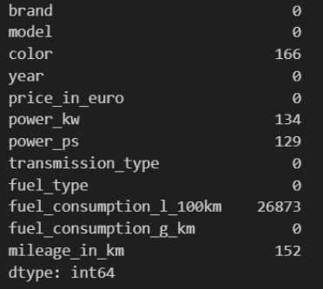
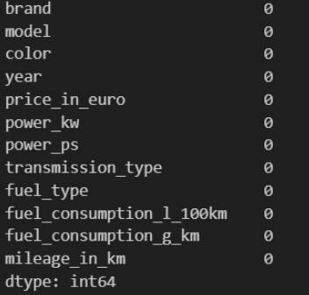
Handling Missing Values & Normalization
Filling;
Categorical with 'unknown’
Numerical with mean
Missing Values After Column Dropping
Missing Values After Normalization & Imputation

Slide 7
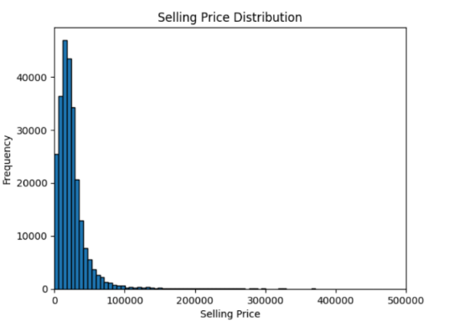
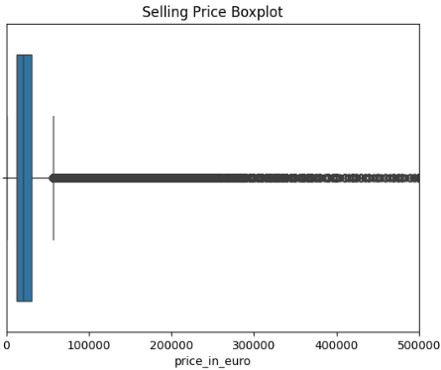
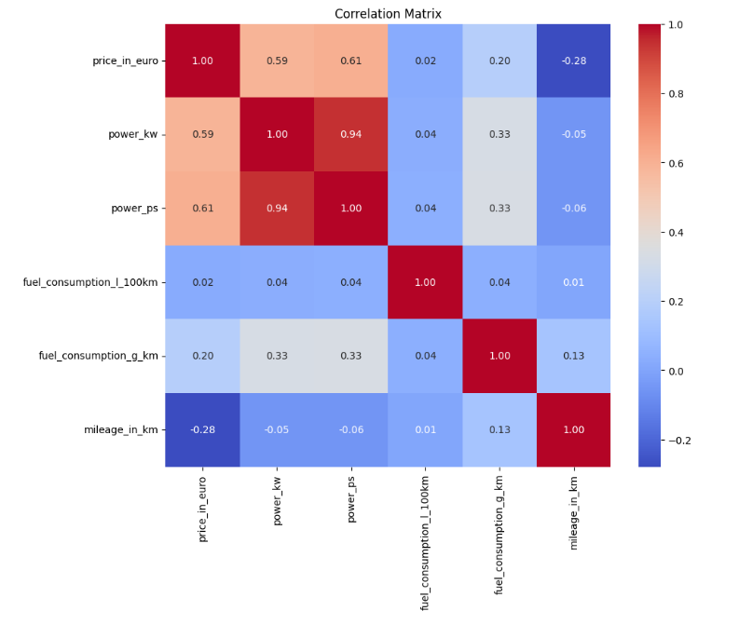
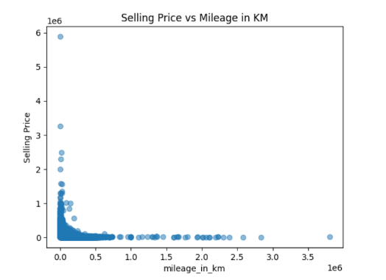
Key Data Distributions & Correlations
Price concentration
Mileage vs. Price: Negative
Numerical feature correlations
Presence of outliers

Slide 8
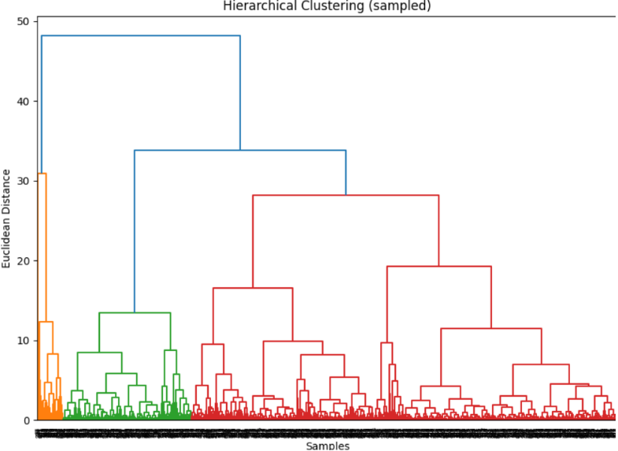
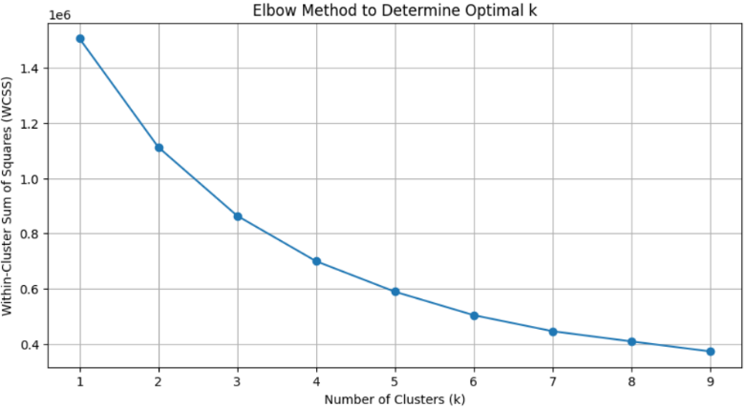
Clustering Analysis: K-Means & Hierarchical
Z-Score Normalization
K-Means for optimal ‘k’
Dendrogram for relationships
Sampled data for efficiency

Slide 9
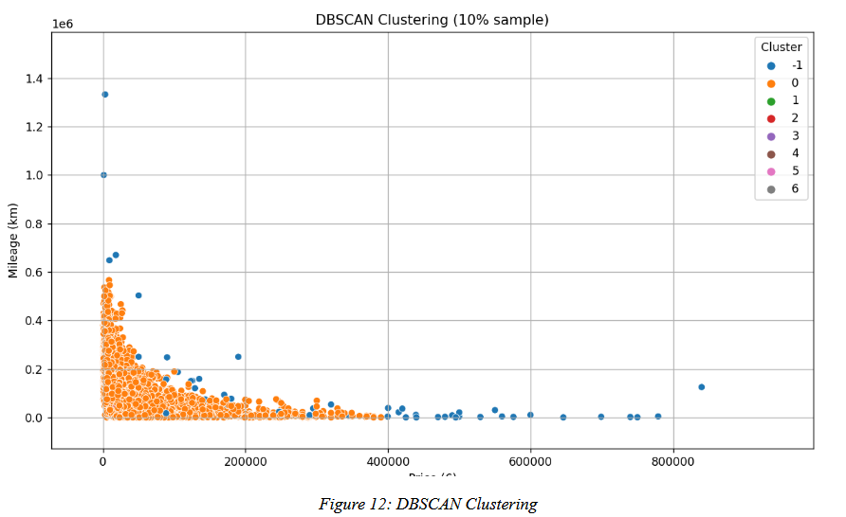
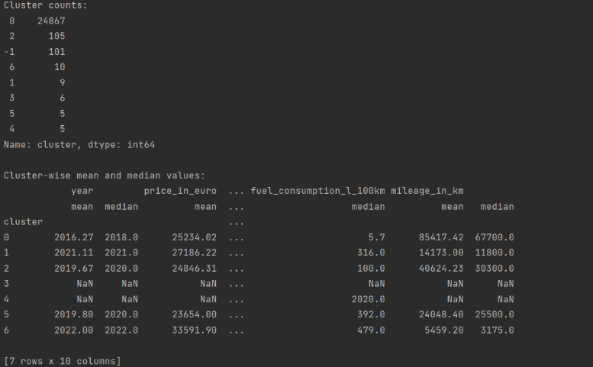
DBSCAN Clustering & Interpretations
Algorithm parameters (eps=1.0, min_samples=5)
7 clusters + noise
Cluster characteristics
Price (£)
Average and Median Values per Cluster

Slide 10
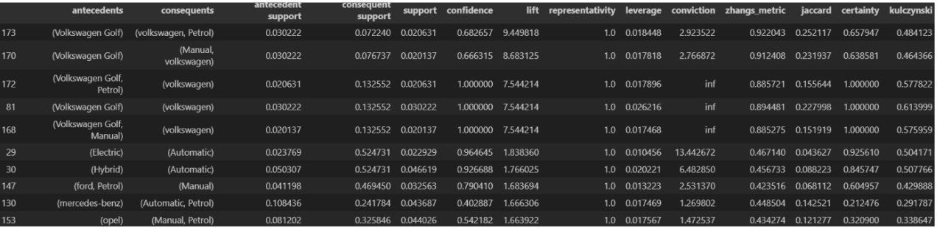
Association Rule Mining (ARM) - Key Findings
Key Rules:
Manual Transmission → Petrol Engine (Confidence: 69%)
Mid-Low Price → Manual Transmission (Confidence: 64%)
Volkswagen Golf → Petrol Engine (Lift: 9.44, Confidence: 68%)
Electric/Hybrid Car → Automatic Transmission (High Confidence)

Slide 11
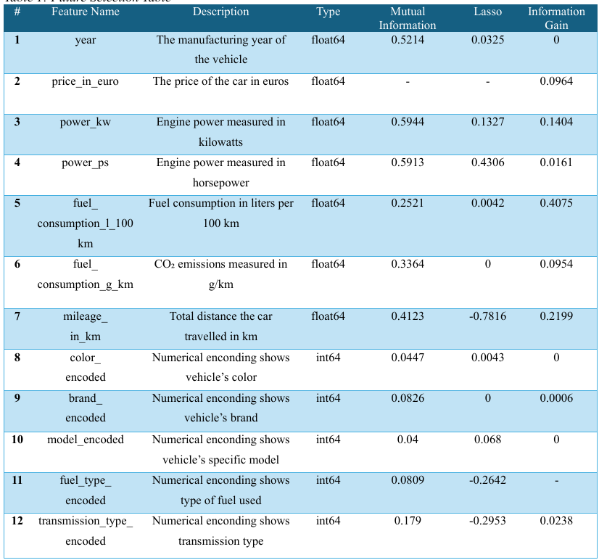
Feature Selection
Feature Importance was evaluated within:
Mutual Information
Lasso Regression
Infromation Gain

Slide 12
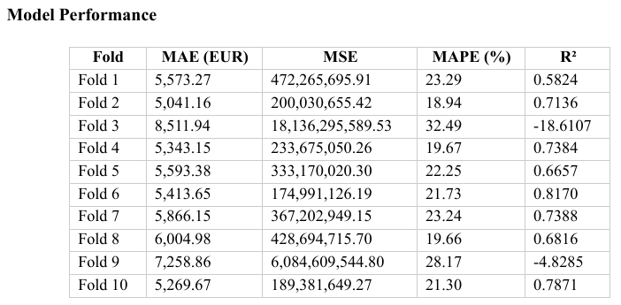
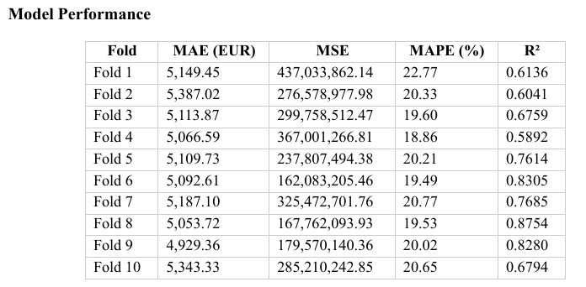
Regression Experiments
To build an effective regression model for predicting the price_in_euro, we employed Artificial Neural Network (ANN) & Support Vector Regression (SVR). Logrithmic Transformation and Dataset Sampling methods applied on preprocessing.
ANN
SVR

Slide 13
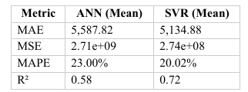

Comparison of ANN & SVR Models
A sample of 20,000 instances was used to reduce training time. Both models were evaluated using 10-fold cross-validation, and their performance metrics—MAE, MSE, MAPE, and R²—were compared.
Statistical Significance Test: A paired t-test was conducted on the MAE values across the 10 folds to determine if the performance difference between ANN and SVR is statistically significant.

Slide 14
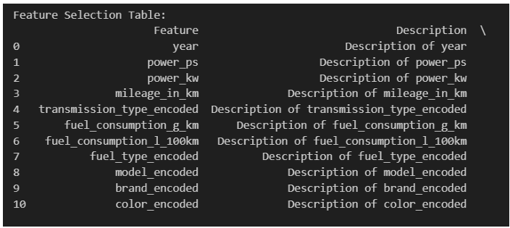
Classification Experiments
Preprocessing
As preprocessing, all objectes converted to numeric values and NaN values filled by their mean or median.
Price Binning, Mileage Binning, and Year Binning applied to convert them into categorical variables.
Feature Selection Using Multiple Methods
Mutual Information
ANOVA F-value
Random Forest Feature Importance

Slide 15
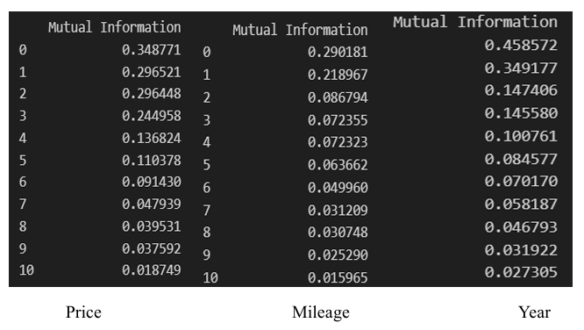
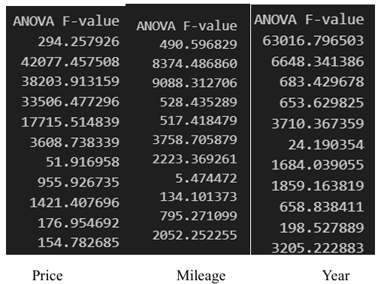
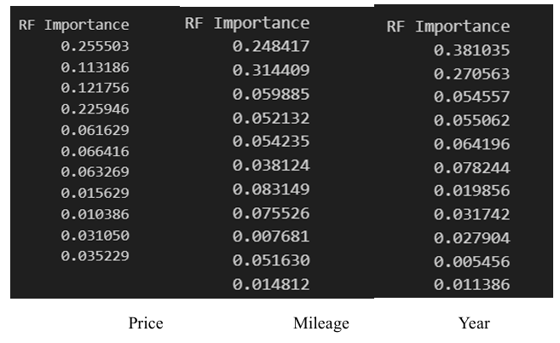
Mutual Information
ANOVA F-value
Random Forest Feature Importance

Slide 16
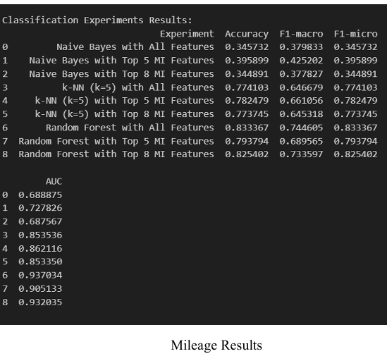
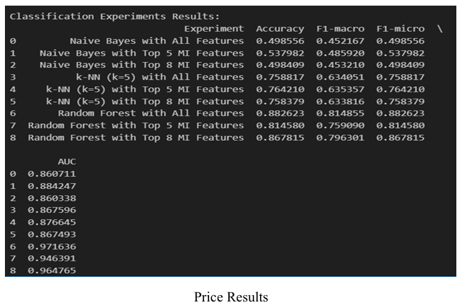
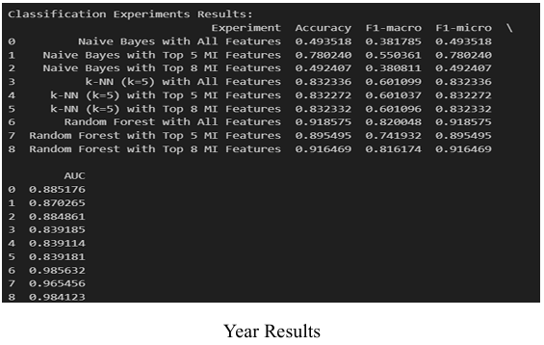
Within 3 classification models, and 3 feature subsets, we made 9 experiments.
Naive Bayes
K-Nearest Neighbors (k=5)
Random Forest
All Features
Top 5 MI Features
Top 8 MI Features
Following metrics are computed for each fold:
Accuracy, F1 Score (Macro), F1 Score (Micro), AUC (Area Under Curve)

Slide 17
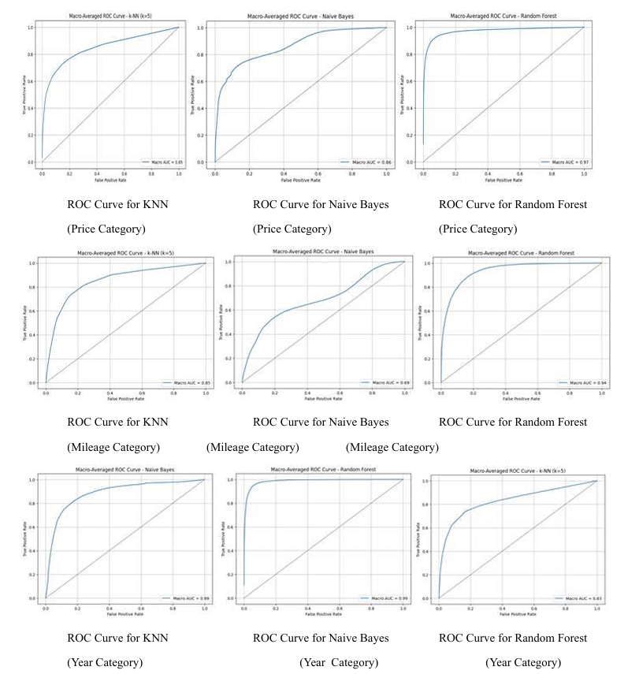
ROC Curves
The goal is to show how well each model can distinguish between classes across all categories, not just the most frequent ones.
Only one-fold (the first split) from the cross-validation is used to ensure a fair and consistent comparison.
The target labels are binarized using the one-vs-rest approach for multi-class ROC analysis. This means for each class, it's treated as the positive class while the rest are negative.
The predicted probabilities from each model are used to calculate: o False Positive Rate (FPR) o True Positive Rate (TPR) for each class individually.
Then, the macro-average ROC curve is computed by averaging the TPR values across all classes for each unique FPR value.
The macro AUC (Area Under the Curve) is also calculated to represent the overall discriminative ability of the model.

Slide 18
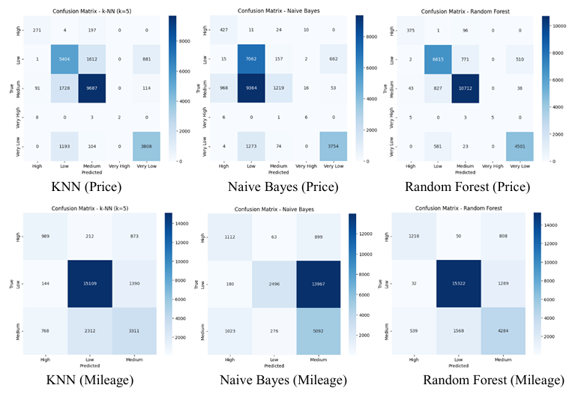
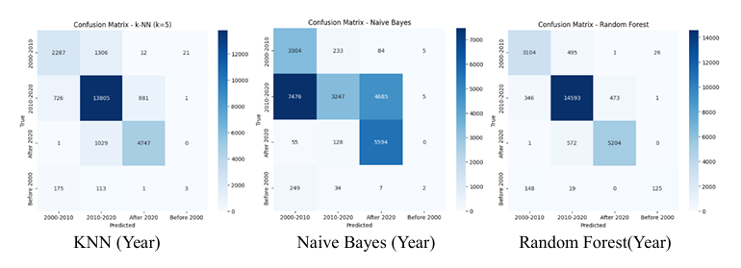
Confusion Matrices
For each model (Naive Bayes, k-NN, Random Forest), the best feature subset is used (based on earlier feature selection).
The model is trained on the selected features and then tested on a consistent test set.
The confusion matrix is computed by comparing the predicted labels to the true labels.
A heatmap is used to visualize this matrix clearly.

Slide 19
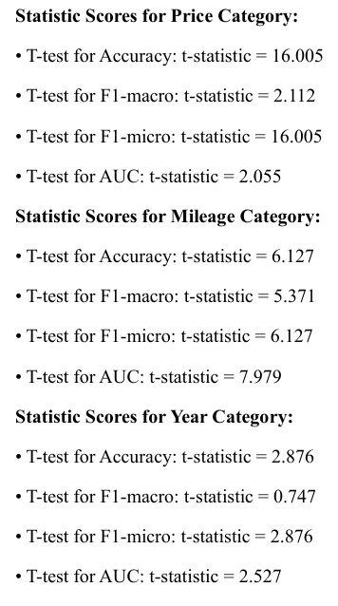
Statistical Significance Analysis
Here the goal is to see if the top 2 models (based on F1-macro score) are truly different in performance, or if their performance differences are just due to random chance in cross-validation folds.
In most cases, Random Forest’s improvements were significant. These findings suggest that ensemble-based methods like Random Forest provide robust and reliable classification for categorical predictions in this domain.

Slide 20
THANKS FOR LISTENING !

