Slide 1
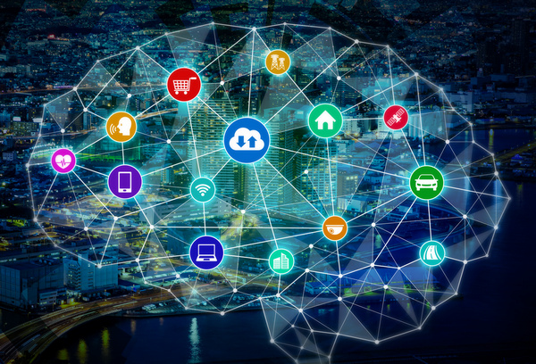
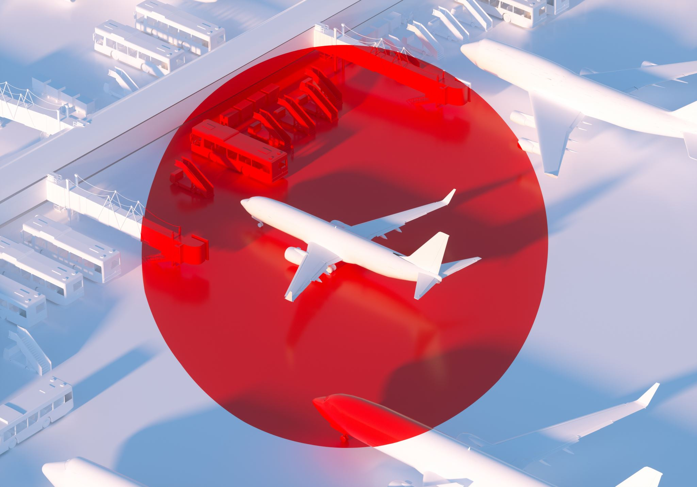

AirAsia Data Breach
LIS5775 – Organizational Information Security
Instructor: Dr. Bill Hunkapiller
Date: April 23, 2023
Group: Team C
Students: Adam MacDougall, Thomas Matejek, Madhu Nepal, Mehmet Ozmen, Chris Panczak, Chandra Rawat, Shavaughn Robinson
This Photo by Unknown author is licensed under CC BY-NC.

Slide 2


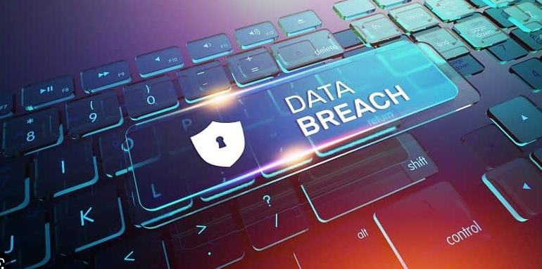
Overview
Analyze the recent ransomware attack on Air Asia.
Attack
Financial Cost Analysis
Detection and Prevention
Solutions

Slide 3

Introduction
Air Asia
Founded in 1993
Largest fleet in Malaysia
Popular in Asia
Data breaches are a significant concern
Since 2021, ransomware has been involved in 25% of all breaches.
Attack exposed the personal data of millions of people.
Caused by a ransomware attack on Accellion, AirAsia's file transfer service provider.

Slide 4
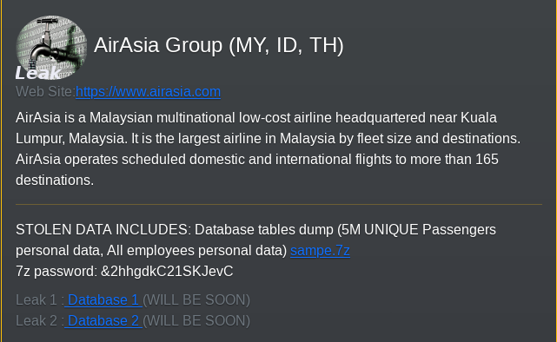
Attacks
Daixin Team gained unauthorized access to the AirAsia's VPN servers via spear phishing and VPN vulnerabilities.
After gaining access, attackers resetted passwords of privileged accounts and dumped credentials to obtain account logins.
Attackers then used reverse proxy tool called "Ngrok" to extort data from the VMware ESXi servers.
After retrieval of unauthorized data of confidential information of the companies' customer and employees, attackers installed a ransomware similar to "Babuk Locker" to their VMware ESXi servers inflicting all the machines in the network to be locked.

Slide 5
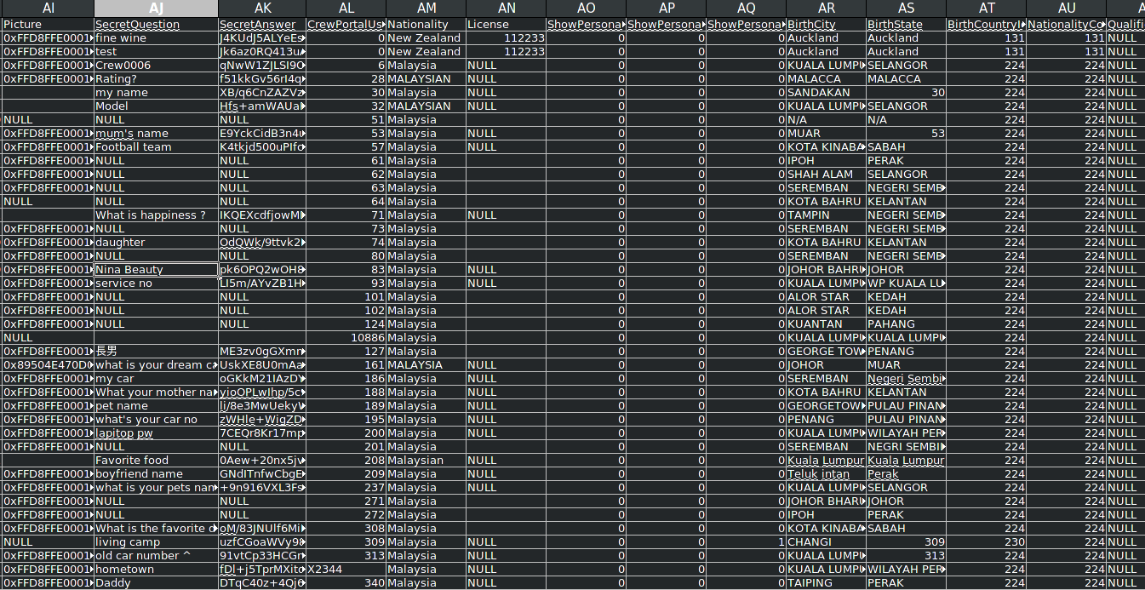
A .csv file with personal and work-related information
Notes:
“One file contained information on named passengers. The second file contained employee information with numerous fields that included name, date of birth, country of birth, location, date employment started, their “secret question,” “answer,” and salt.”

Slide 6
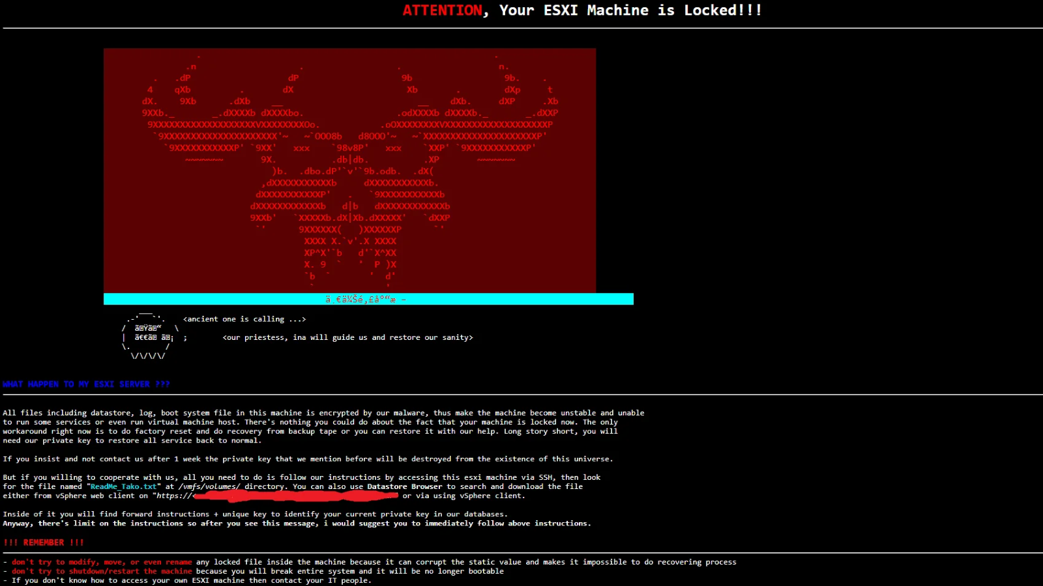
An example screenshot of a ransomware affecting VMware ESXi machine
Notes:
VMware ESXi is a hypervisor for enterprises that allows for creating and managing virtual machines across the network. Due to this when VMware ESXi is compromised, all of the virtual machines in the network will be compromised. Unlike, when ransomware is installed on a single machine that is running for example, Windows, it can be resetted via backup or resetted completely with the negative of losing the data but positive of removal of malware.

Slide 7
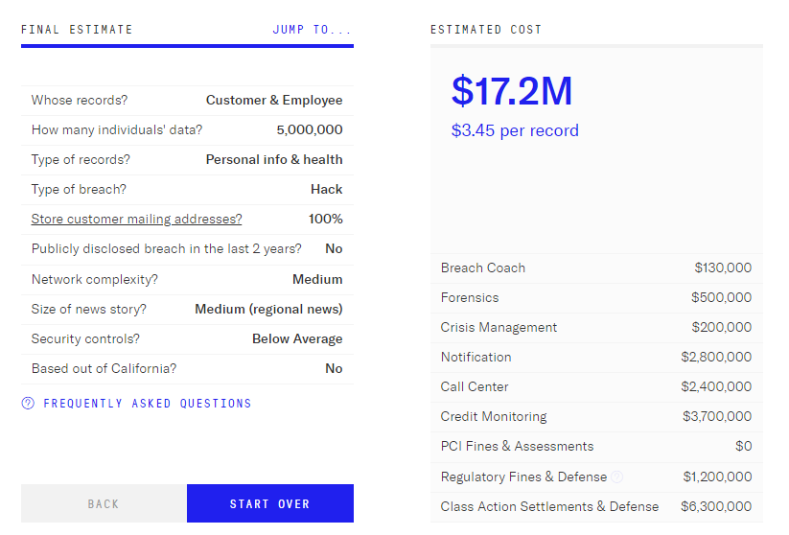
Financial Analysis
Average cost of data breach: USD 4.35 million
IBM's 2022 Data Report: 550 organizations, 17 regions (March 2021 – March 2022)
USA is costliest country with USD 9.44 million
ASEAN's average: USD 2.87 million (12th place)
AirAsia's At-Bay estimate: USD 17.2 million

Slide 8

Detection and Prevention
The CISA has the following recommendations:
Maintaining offline backups of data.
Creating and exercising an incident response plan.
Training employees to identifying phishing attacks.
Updating software to the latest version helps patch vulnerabilities that threat actors can exploit.
Ex: Accellion FTA software deployed several patches following the first detected breach.
This includes ensuring that any software isn’t at its end-of-life.

Slide 9
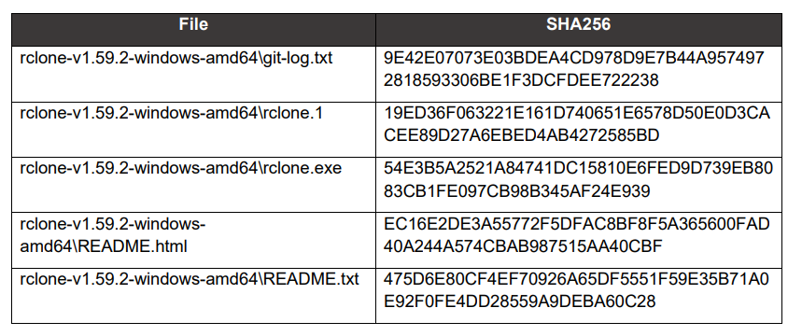
Detection and Prevention
Cyberattacks can be detected by indicators of compromise (IoC).
The CISA released indicators of compromise connected to Daixin attacks.
Helps prevent or mitigate attacks early.
IoCs related to Daixin team attacks, available in a CISA/FBI cybersecurity advisory.

Slide 10
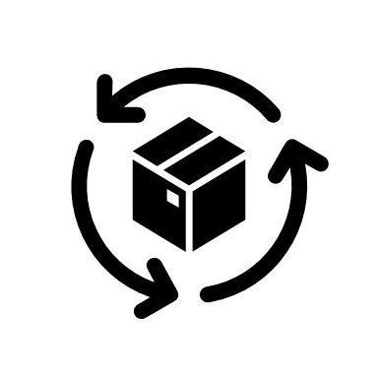
Countermeasures and solutions
Zero Trust approach:
Patch Management:
Regular vulnerability assessments:
Employee training :
Implement multi-factor authentication (MFA):
Data encryption:
Third-party risk management
Incident response planning:

Slide 11

Thank you
Adam MacDougall,
Thomas Matejek
Madhu Nepal
Mehmet Ozmen
Chris Panczak
Chandra Rawat
Shavaughn Robinson
This Photo by Unknown author is licensed under CC BY-NC.

