Slide 1






Cannacoin
Cryptocurrency for the cannabis community, worldwide. Since 2014
October 2021
OCTOBER 2021
Pass it on...
INFO@CANNACOIN.ORG

Slide 2

Who are we?
We're just like you...
We get it. We are a strong and talented team of cannabis proponents and tech professionals with years of combined experience in cryptocurrency and the cannabis industry under our belts. We all wanted something better and we saw a future in cryptocurrency.
Let's face it, handling all that cash is an extremely risky effort plus banks are a hassle for cannabis businesses. The world is changing. The idea behind our project is that, simply put, Bitcoin is becoming too valuable to spend on everyday purchases like cannabis and that cryptocurrency, in one form or another, will eventually be ubiquitous.
Cannacoin is smarter, more efficient, and safer than traditional money.
OCTOBER 2021
PITCH DECK

Slide 3

Our Story
Cannacoin was first deployed on March 28, 2014 as a solution to the "cash only" respite set on growers, dispensaries, and consumers alike through federal regulation and as a response to the Global Financial Crisis (GFC) of 2008. It is the evolution of distributed computing and the BitTorrent protocol.
It was the brainchild of the founders of the popular, but now defunct, NWGT.org medical cannabis forum and exchange that initially formed from a simple CL encounter to well over 20,000 members at its peak.
Cannacoin is a new form of electronic money called "cryptocurrency" more specifically an "altcoin" similar to Litecoin and Dogecoin and is geared toward use within the independent, medical, and recreational cannabis community worldwide as a medium of exchange, a unit of account, and a store of value for cannabis and cannabis related goods and services.
2014
DEPLOYED ON MARCH 28
OCTOBER 2021
0.00%
PRE-MINE AND NO ICO
13,140,000
MAX COIN SUPPLY

Slide 4

Our Mission
We want to be your coin of choice for cannabis transactions.
We want to bring Cannacoin to the masses in order to make the world a safer place. We plan to place Cannacoin kiosks in participating cannabis shops to load your phone for purchases with our mobile wallet and pay with our retail POS solution called Cannacoin Pay.
Cannacoin is a simple, efficient, and secure process. It is a seamless experience and much safer than cash. What are you waiting for?
OCTOBER 2021

Slide 5
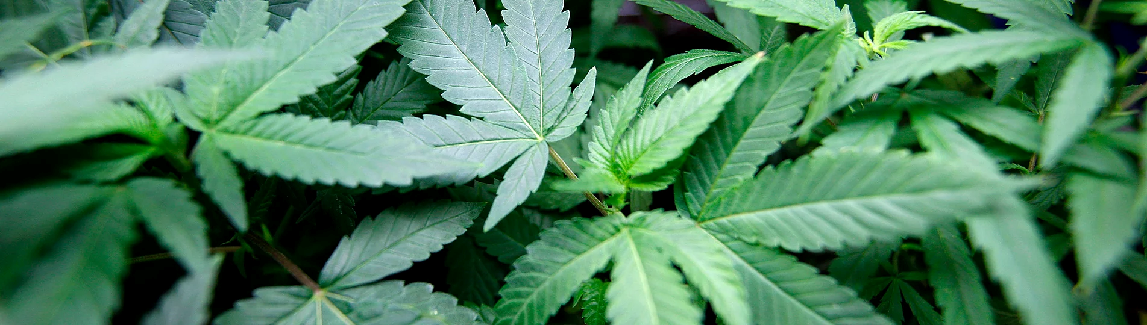

OCTOBER 2021
How does it work?
We utilize Proof of Stake and decentralized blockchain technology to verify and record transactions in real time and ensure the security of the value therein. The amount of Cannacoin you hold determines your network weight which in turn determines your mining power which is used to verify transactions and release freshly minted coins to the network. You then earn new coins based on the amount of coins you already hold. It’s as easy as that.
Available for Windows and Linux. Soon available on Android.
Retail POS solution called Cannacoin Pay
Online exchange and kiosks at participating shops

Slide 6






The Team
It takes a village...
Brent K. aka deusopus
Lead Director and Founder of Grass Haus Enterprises. Member since 2014.
James P. aka CryptoKid
Tom B. aka Crypto Splinter
Administrative Assistant and Junior Member
Assistant Director and Senior Member
OCTOBER 2021
Phillip C. aka GodCloud
Treasurer and Junior Member
In Memory of
Phil C. aka RebPhil
Original Lead Developer and Founding Member of Cannacoin Community Netowork
RIP 2015
PITCH DECK

Slide 7

Recruit Volunteers
Conduct Fund Raising
Write a Whitepaper
Hire a development team
Audit and verify the security of the source code on GitHub
Upgrade and release an updated wallet for Windows, Linux, and Android
Launch a block explorer on https://cannascan.info
PHASE I
ROADMAP
OCTOBER 2021
Secure a legal team
Obtain a payment processor
Hire online risk management team
Hire customer support team
Recruit a sales and marketing team
Launch a standard order book type exchange at https://cannacoin.exchange
PHASE II

Slide 8
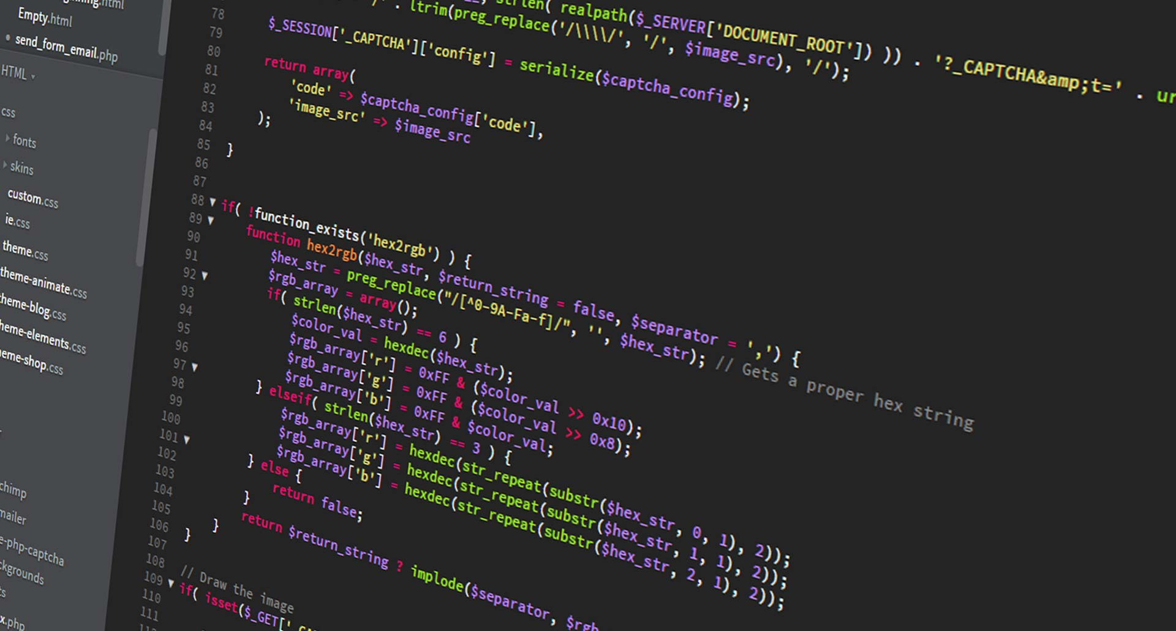
SOURCE CODE
Garbage In, Garbage Out...
The Cannacoin source code is a brilliant work of art made with love by hand for all to enjoy. It is now, and always has been, completely free and open source available for public audit and contribution on GitHub. We have proudly been "Proof of Stake" since December of 2014 for environmental awareness and scalability. Feel free to jump in and browse our codebase and join the more than 200 independent contributors to date.
https://github.com/cannacoin-official
OCTOBER 2021
PITCH DECK
AUGUST 2021

Slide 9
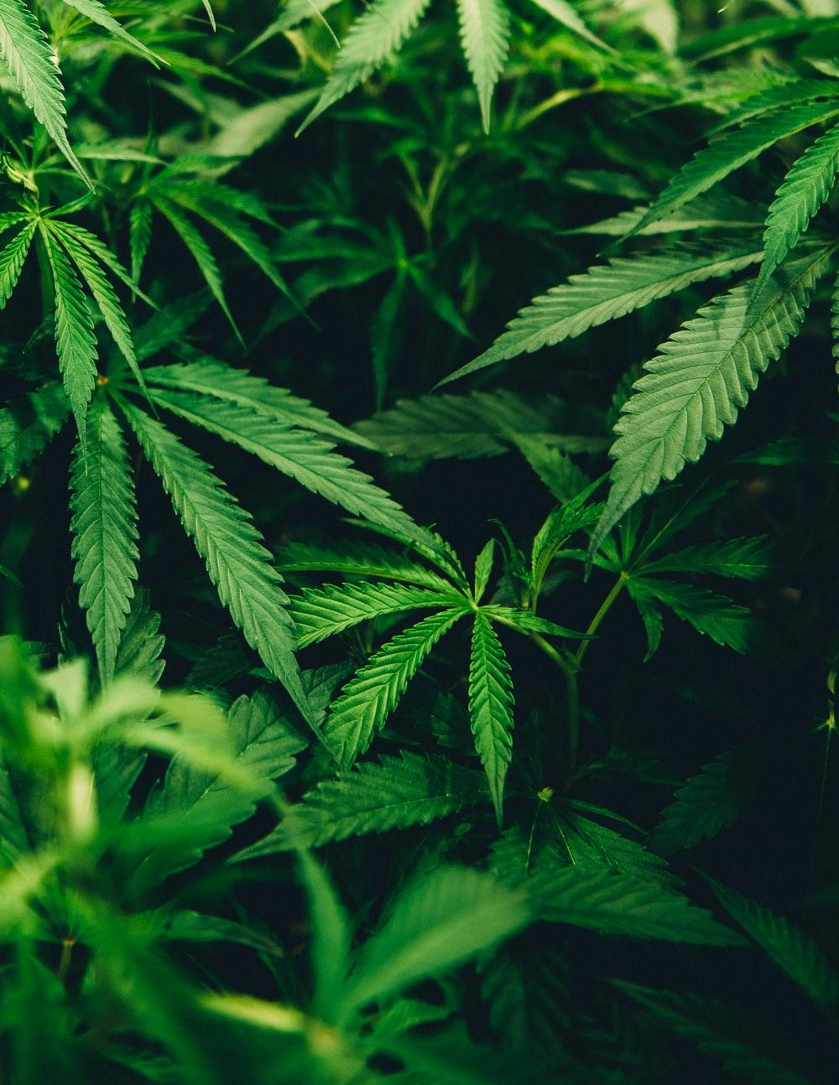
CANNACOIN.ORG
Get connected
Contact us
OCTOBER 2021
INFO@CANNACOIN.ORG
(833) 4-GETCOIN
Cannacoin. Cryptocurrency for the cannabis community worldwide. Since 2014
Trademark pending. All rights reserved. 2014-2021

