Slide 1
DashT – An OpenCPN Plug-In
v2
EngineDJG Dial
for
Engine and Energy Data

Slide 2
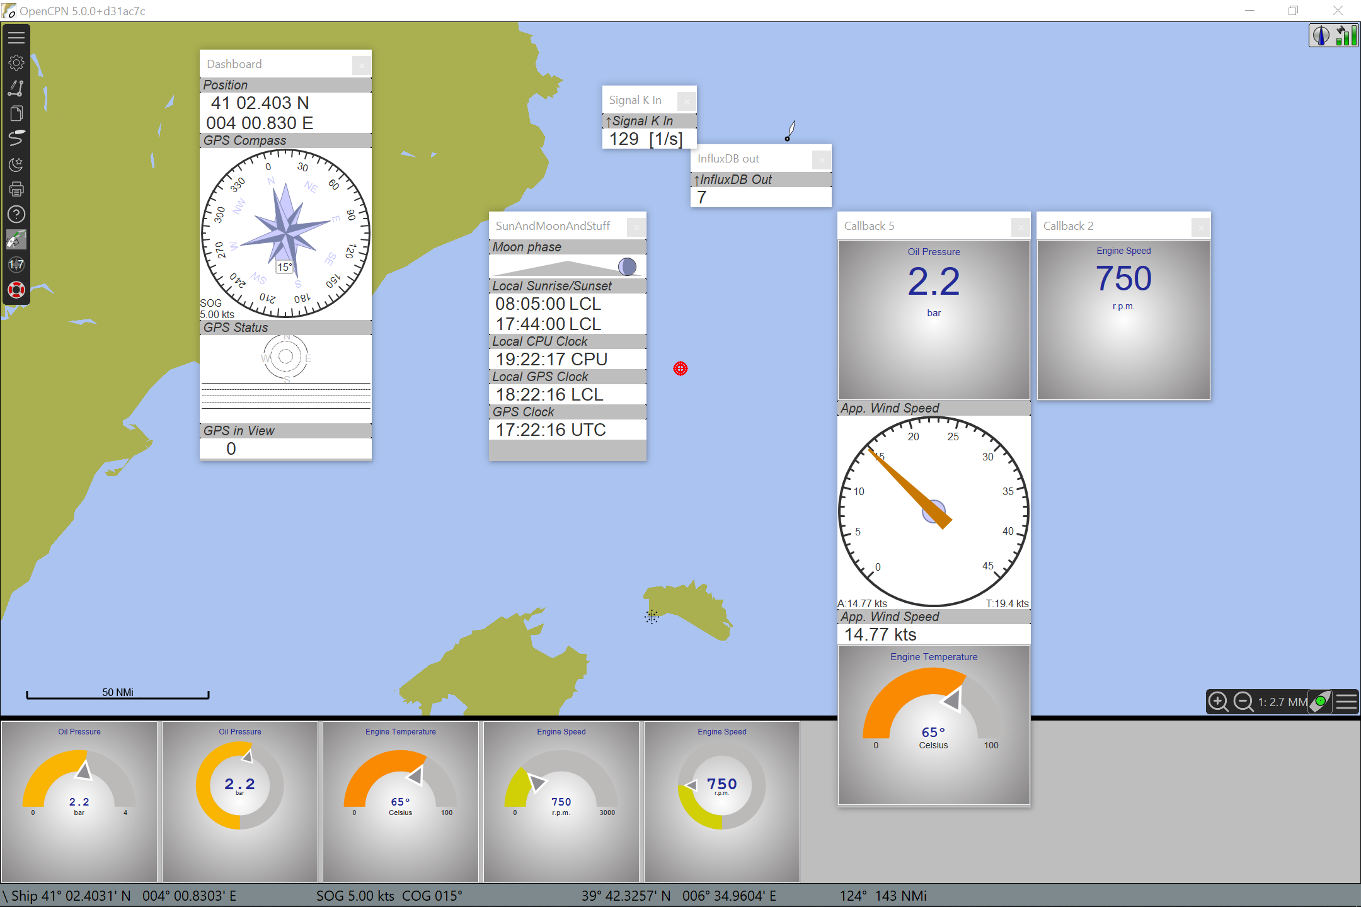
What it is
Modern web techniques embedded in OpenCPN Dashboard
A dedicated instrument for Engine and Energy data in Signal K data format
Gets data from DashT by a subscription
Data obtained from a single Signal K node server interconnection
  Allowing multiplication ad infinitum
  Instrument is not making data connections
  Does not interfere with NMEA-0183 data push
HTML5 and JavaScript based
  Plain text customization files provided
  Loading from a local or from a remote host

Slide 3
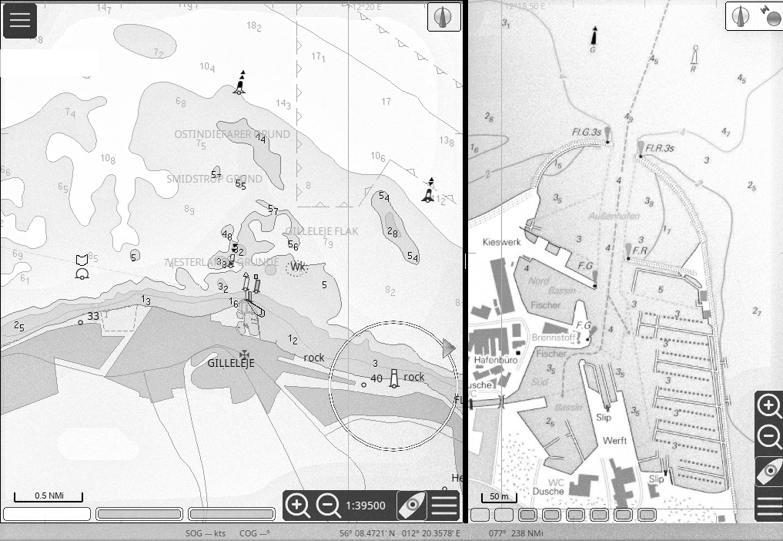
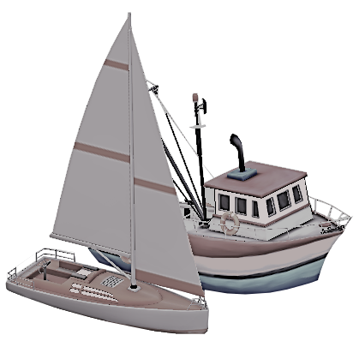
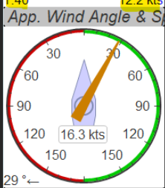
How DashT works without Signal K
OpenCPN
NMEA-0183
NMEA-0183
NMEA-0183
NMEA-2000
Conv.
NMEA-0183
MUX

Slide 4
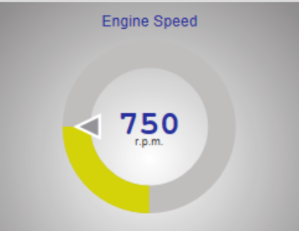
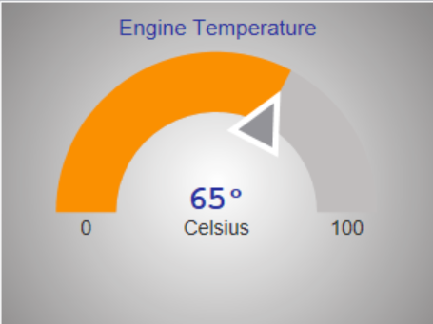
How DashT EngineDJG dials work with Signal K
Streamer
OpenCPN
Delta
NMEA-2000
Adapter
SignalK
server
node
SK
NMEA-0183
MUX

